Slide 1
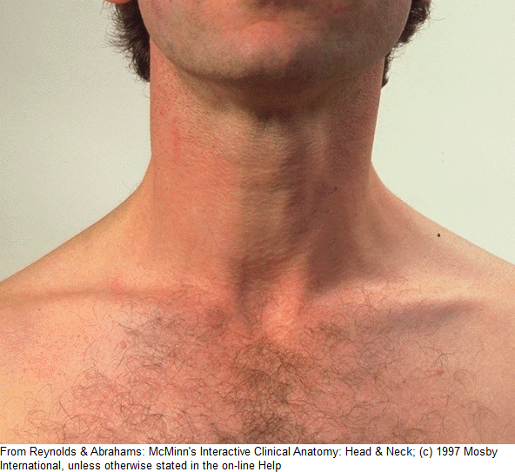
LARYNX Voice Box
Dr. Basil Saeed
Assistant Professor

Slide 2
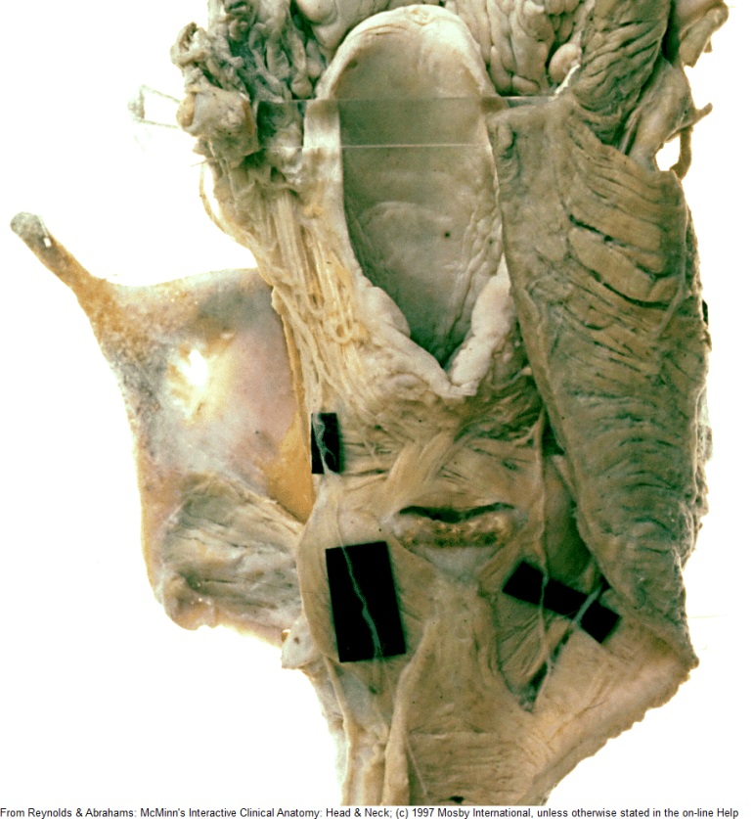
Anatomy
- Situated in the midline of the neck, in front of the laryngopharynx from the level of the 3rd- 6th cervical vertebrae.
It consist of a framework of cartilages, connected by ligaments, lined by a mucous
membrane and moved by
muscles.

Slide 3
Notes:
Location: C4-C6
Upper portion of larynx, which is continuous w/pharynx is almost triangular in shape
Lower portion leading to trachea presents a circular appearance

Slide 4
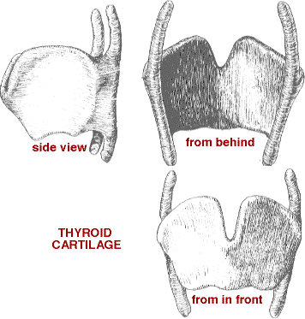
Unpaired Cartilages
Thyroid Cartilage
The largest cartilage.
Makes a prominence
In the front of the
Neck “Adam’s Apple”.
The two alae meet
anteriorly forming an
angle of 90 in males
and 120 in females.

Slide 5
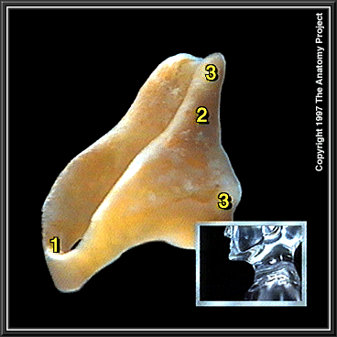
Cricoid Cartilage:
The only complete ring in the respiratory tract. Resembles a signet ring and lies below the thyroid cartilage.
Connected anteriorly with the thyroid cartilage by cricothyroid membrane.

Slide 6
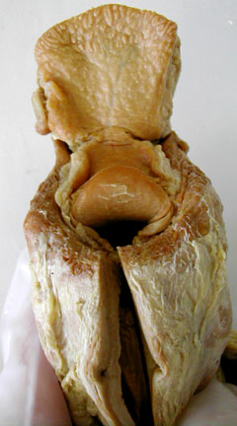
Epiglottis
A leaf-shaped piece of cartilage which is attached both to the base of the tongue and to the upper part of thyroid cartialge.

Slide 7
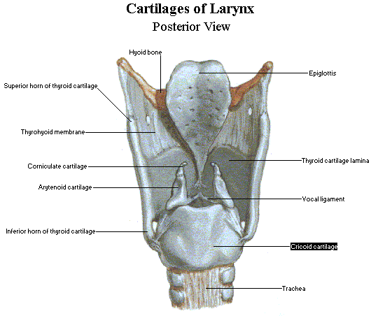
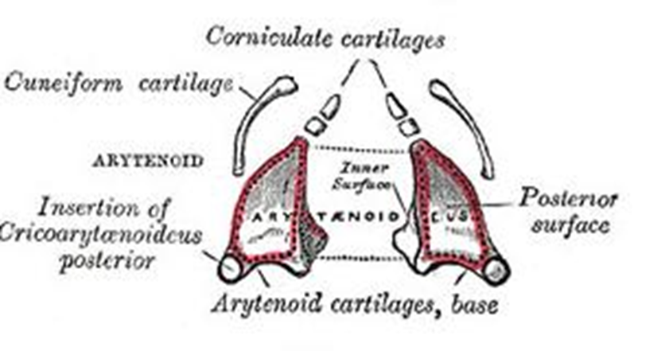
Paired Cartilages
Arytenoid Cartilages:
Pyramidal in shape
The base articulates
with cricoids cartilage.
Anterior projection
((vocal process))
Lateral projection
((muscular process))

Slide 9
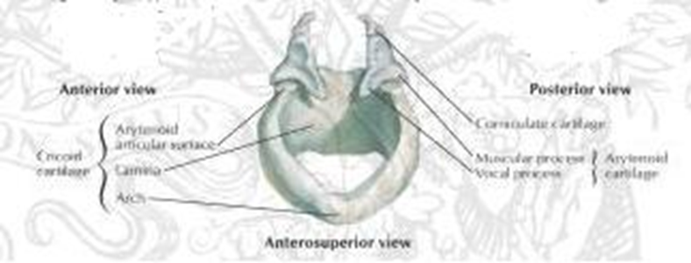
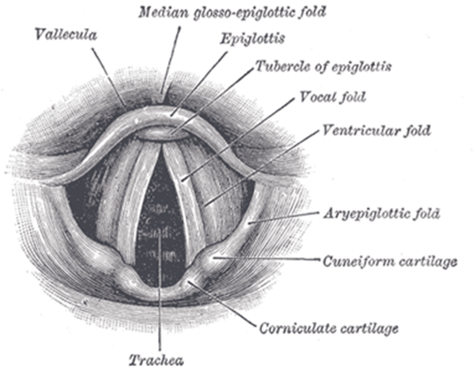
The aryepiglottic folds connect the arytenoids with the base of epiglottis and form the upper edge of the laryngeal inlet.

Slide 11
Laryngeal Muscles
Extrinsic: between the larynx and neighboring structures.
The strap muscles of the neck (sternothyroid and thyrohyoid muscles).
The pharyngeal muscles (stylopharyngeus, palatopharyngeus and inferior constrictor muscles).
Intrinsic
Abductors of the vocal cords: posterior cricoarytenoid.
Adductors of the vocal cords:
1. Lateral cricoarytenoid muscle.
2. Interarytenoid muscle (Transverse arytenoid).
3. Cricothyroid muscle.
4. Thyroarytenoid muscle (vocalis).

Slide 13
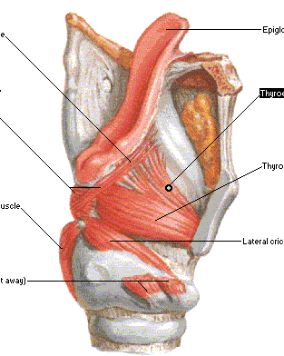

Slide 14
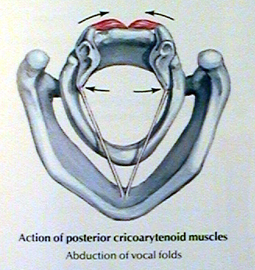
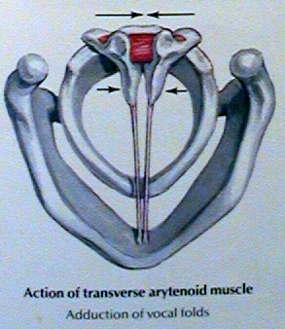

Slide 15
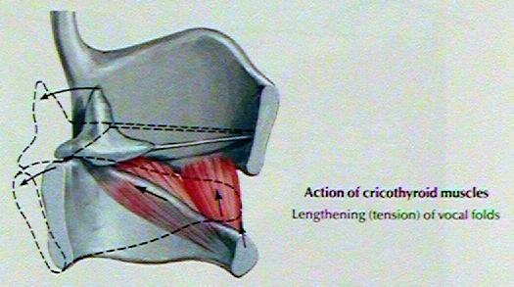
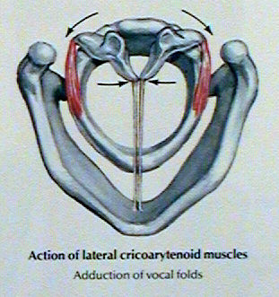
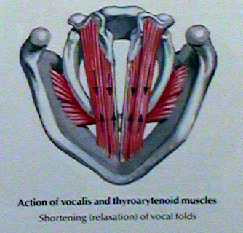

Slide 16
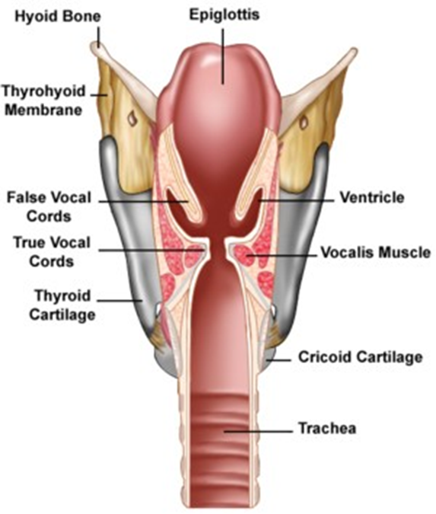
Laryngeal Cavity
The supraglottis from
the inlet to the lower
part of the laryngeal
ventricle
The glottis
comprises the vocal cords
and arytenoids.
The subglottis
below the cords.

Slide 17
The vocal cords are two fold-like structures extending from the thyroid cartilage to the vocal process of the arytenoid cartilage.
The covering epithelium of vocal cords is closely bound to the underlying structure and the blood supply is poor, hence the pearly white appearance.
The epithelium lining the larynx is ciliated columnar type except over the vocal cord where it is stratified squamous type.

Slide 18
Blood Supply
The region above the vocal cord is supplied by the laryngeal branch of the superior thyroid artery.
Below the cords is supplied by the laryngeal branch of the inferior thyroid artery.
Nerve Supply
Sensory: Above the vocal cords is supplied by the internal laryngeal nerve, whereas below the vocal cords, the mucous membrane is supplied by the recurrent laryngeal nerve.
Motor: The recurrent laryngeal nerve,
except the cricothyroid muscle → the external laryngeal nerve.

Slide 19
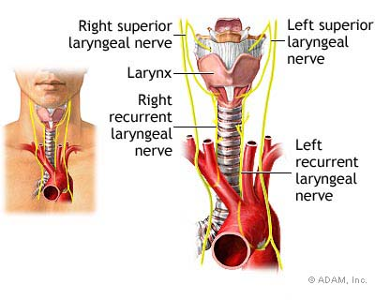

Slide 20
Lymphatic Drainage
The vocal cords have no lympahtic drainage and acts as a watershed dividing the supraglottis from the subglottis. The supraglottis drains to the upper deep cervical chain. Whereas, the subglottis drains to the prelaryngeal, pretracheal and the lower deep cervical chain.

Slide 21
Functions of the Larynx
1. Protection of the lower air passages by:
Approximation of the aryepiglottic folds assisted by the epiglottis.
The apposition of the false cords.
The closure of the vocal cords.
Reflex cessation of respiration.
Cough reflex.
2. Phonation: voice is produced by vibration of the vocal cords and the sound is amplified by the resonating chambers of the mouth, pharynx, nose and chest.
3. Respiration: reflex adjustment of the glottis by abduction during inspiration and adduction during expiration.
4. Fixation of the Chest: when the larynx is closed, the thorarcic cage becomes fixed, permitting, climbing, digging, straining, defecation and micturitiom.

Slide 22
Symptoms of Laryngeal diseases
Disorders of voice
Hoarseness of voice: a rough, husky voice resulting from any abnormality in the vocal cords. There is change of voice from high to low pitch, and may even ends with aphonia.
Causes
* Congenital: laryngeal web.
* Inflammatory: acute and chronic laryngitis.
* Neoplastic: papilloma laryngeal carcinoma.
* Traumatic: external injury and intubation.
* Neurological: Vocal cord palsy (adductor).
* Vocal abuse: Vocal cord nodules and polyps.

Slide 23
Stridor:
Noisy breathing produced by turbulent air flow through a narrowed air passages.
Stridor is a physical sign and not a disease.
Causes
*Congenital: laryngomalacia and subglottic stenosis.
*Trauma: thermal, chemical and surgical.
*Foreign body: larynx or trachea.
*Infective: epiglottitis and croup.
*Neoplastic: papilloma, laryngeal carcinoma.
*Neurological: bilateral vocal cord palsy (abductor).

Slide 24
Cough: dry and irritating cough may reflect laryngitis or a F.B.
Haemoptysis: may be due to infection or neoplastic causes.

Slide 25
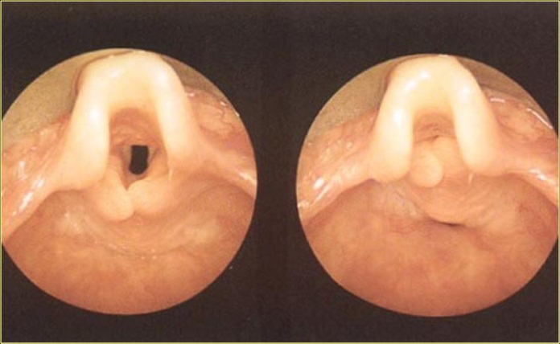
Laryngomalacia
Most common laryngealcongenital abnormality.
It is characterized by excessive flaccidity of supraglottis which is sucked in during inspiration producing stridor.
The condition manifest at birth or soon after and usually disappears by 2 years of age. Its characterized by stridor which is classically inspiratory, worse when the baby is active and relieved by prone position.

Slide 26
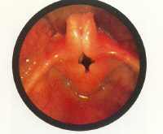
On Exam.
The diagnosis is made at endoscopy with the child breathing spontaneously.
Classical appearance include an omega-shaped epiglottis, short aryepiglottic folds and loose redundant mucosa over the arytenoids.
On inspiration, the cartilages are sucked inwards obstructing the airway.
Treatment
Parental reassurance.
Supraglottoplasty by division of aryepiglottic folds.
Tracheostomy in severe cases.

Slide 27
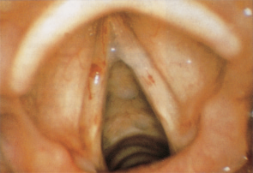
Acute Laryngitis ADULTS
An acute superficial inflammation of the laryngeal mucosa.
Aetiology:
Infection: Its most frequently caused by adeno or influenza viruses but secondary bacterial infection may supervene. Acute laryngitis occurs as part of respiratory tract infection or as an isolated disease.
Trauma: Vocal abuse or endoscopic manipulation.
Irritation: Inhaled fumes, smoking or alcohol abuse.

Slide 28
Clinical Picture
Hoarseness of voice or aphonia, sore throat.
Dry and irritative cough.
Generalized symptoms: malaise and fever.
On examination: Indirect and fibroptic laryngoscopy reveals:
Redness and oedema of the larynx.
The vocal cords is covered with mucous and pus.
Treatment:
Bed rest and vocal rest.
Avoidance of tobacco and irritating agents.
Steam inhalation.
Systemic antibiotics if there is secondary bacterial infection.

