Slide 1
Anxiolytic , Sedative and Hypnotic Drugs
Lecture -2

Slide 2
Benzodiazepines are the most widely used anxiolytic drugs. They have largely replaced barbiturates because:
The benzodiazepines are safer(have a wide therapeutic index) and more effective
Not cause drug – drug interaction(not induce hepatic microsomal enzyme)
Produce tolerance and psychological dependence but physical dependence and withdrawal symptom are less marked

Slide 3
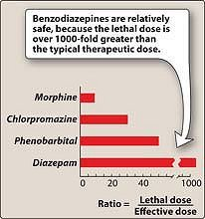

Slide 4
Benzodiazepines are classified according to their duration of action into:
Short – acting : Oxazepam, Triazolam (3-8) hours
Intermediate – acting : Alprazolam, Lorazepam, Temazepam (10-20) hours
Long-acting : Chlordiazepoxide, Diazepam, Flurazepam,

Slide 5
Benzodiazepines
ANXIOLYTIC: Alprazolam, chlordiazepoxide, diazepam, lorazepam
HYPNOTIC: Triazolam, temazepam, flurazepam.

Slide 6
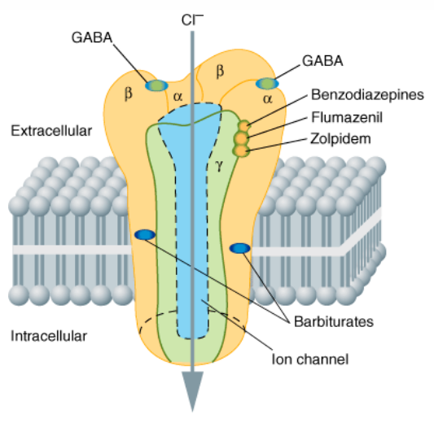

Slide 7
Mechanism of action:
Binding of GABA (the major inhibitory neurotransmitter in the central nervous system) to its receptor triggers an opening of a chloride channel, which leads to an increase in chloride conductance
Benzodiazepines increase the frequency of channel openings produced by GABA. The influx of chloride ions causes hyperpolarization of the cell making it more difficult to depolarize and there for reduces neural excitability

Slide 8
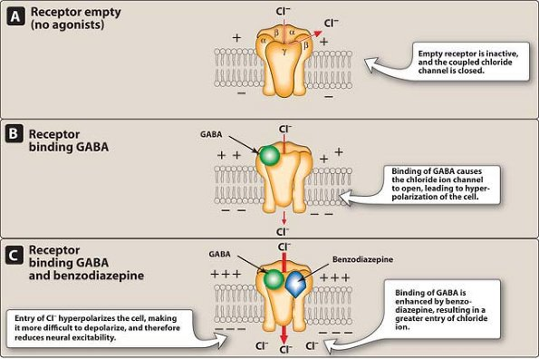

Slide 9
Actions:
The benzodiazepines have neither antipsychotic activity nor analgesic action
Reduction of anxiety: At low doses.

Slide 10
Sedative and hypnotic actions: All of the benzodiazepines used to treat anxiety have some sedative properties, and some can produce hypnosis at higher doses.
Anticonvulsant: some are used to treat epilepsy (status epilepticus) and other seizure disorders.
Muscle relaxant: At high doses, the benzodiazepines relax the spasticity of skeletal muscle

Slide 11
Therapeutic uses:
Anxiety disorders: Benzodiazepines are effective for the treatment of the anxiety. generalized anxiety disorder, specific phobias, such as fear of flying.
The shorter-acting agents are used as premedication for anxiety-provoking and unpleasant procedures, such as endoscopic, bronchoscopic, dental procedures. They cause a form of conscious sedation, allowing the person to be receptive to instructions during these procedures.
.

Slide 12
Muscular disorders: Diazepam is useful in the treatment of skeletal muscle spasms, multiple sclerosis and cerebral palsy
Midazolam is used for the induction of anesthesia

Slide 13
Seizures:
Diazepam and lorazepam are the drugs of choice in terminating grand mal epileptic seizures and status epilepticus.
Clonazepam is occasionally used in the treatment of certain types of epilepsy
chlordiazepoxide, diazepam, and oxazepam are useful in the acute treatment of alcohol withdrawal

Slide 14
Sleep disorders :
Flurazepam: has a long-acting effect and causes no rebound insomnia.
Temazepam: This drug is useful in patients who experience frequent wakening. the peak sedative effect occurs 1 to 3 hours after an oral dose; and should be given 1 to 2 hours before bedtime.
Triazolam: short duration of action and, therefore, is used to induce sleep in patients with recurring insomnia.

Slide 15
Pharmacokinetics
lipophilic,
rapidly and completely absorbed after oral administration
distribute throughout the body .
The half-lives of the benzodiazepines are very important clinically, because the duration of action may determine the therapeutic usefulness, The longer-acting agents form active metabolites with long half-lives. However, with some benzodiazepines, the clinical durations of action do not always correlate with actual half-lives.

Slide 16
Most benzodiazepines, including chlordiazepoxide and diazepam, are metabolized by the hepatic microsomal system to compounds that are also active.
The benzodiazepines are excreted in the urine as glucuronides or oxidized metabolites.

Slide 17
All the benzodiazepines cross the placental barrier and may depress the CNS of the newborn if given before birth.
Nursing infants may also become exposed to the drugs in breast milk

Slide 18
Adverse effects
Drowsiness and confusion.
Psychological and physical dependence on benzodiazepines can develop if high doses of the drugs are given over a prolonged period
withdrawal symptoms, including confusion, anxiety, insomnia, tension, and rarely, seizures.
A short elimination half-life(rapidly eleminated, such as triazolam, induce more abrupt severe withdrawal reactions than drugs that are slowly eliminated, such as flurazepam

Slide 19
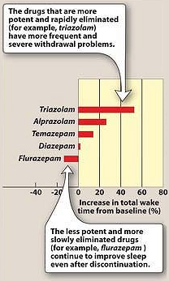

Slide 20
Precautions:
In treating patients with liver disease.
In patients with acute narrow-angle glaucoma.
Alcohol and other CNS depressants enhance the sedative-hypnotic effects of the benzodiazepines.

Slide 21
Benzodiazepine Antagonist
Flumazenil (is a GABA-receptor antagonist) that can rapidly reverse the effects of benzodiazepines(competitively occupies a GABA-receptor without causing a functional change in CL channel) .
for intravenous administration only.
rapid Onset of action
short duration, with a half-life of about 1 hour.
Frequent administration may be necessary to maintain reversal of a long-acting benzodiazepine

Slide 22
Side effects:
1.Dizziness, nausea, vomiting, and agitation
2.withdrawal in dependent patients
3. seizures
If a benzodiazepine is used to control seizure activity
If the patient ingests tricyclic antidepressants

Slide 23
Other anxiolytic drugs: buspirone, hydroxyzine

Slide 24
Buspirone
Is useful in the treatment of generalized anxiety disorder
Has efficacy comparable to that of the benzodiazepines.
Mode of action differs from that of the benzodiazepines because:
The actions of buspirone appear to be mediated by

Slide 25
Serotonin (5-HT_{1A}) receptors, buspirone displays some affinity for DA₂ dopamine receptors and 5-HT_{2A} serotonin receptors
Undergoes metabolism by CYP3A4; thus, its half-life is shortened if taken with rifampin(an inducer of the enzyme)
Lengthened if taken with erythromycin(an inhibitor of the enzyme)

Slide 26
Adverse effects: Headaches, dizziness, nervousness
Disadvantage: Buspirone has the slow onset of action

Slide 27
Hydroxyzine: is an antihistamine with antiemetic activity. It has a low tendency for habituation and, thus, is useful for patients with anxiety who have a history of drug abuse. It is also often used for sedation prior to dental procedures or surgery. Drowsiness is a possible adverse effect

Slide 28
Antidepressants: many antidepressants have proven efficacy in managing the long-term symptoms of chronic anxiety disorders and should be considered as first-line agents, especially in patients with concerns for addiction or dependence or a history of addiction or dependence to other substances.
The SSRIs, TCAs, venlafaxine, duloxetine and MAOIs all have potential usefulness in treating anxiety
y

Slide 29
Other Hypnotic Agents
Zolpidem
Is not a benzodiazepine in structure, but it acts on a subset of the benzodiazepine receptor family, BZ₁.
Zolpidem has no anticonvulsant or muscle-relaxing properties

Slide 30
It shows few withdrawal effects, and minimal rebound insomnia, and little or no tolerance occurs with prolonged use.
Zolpidem is rapidly absorbed from the gastrointestinal tract, and it has a rapid onset of action and short elimination half-life (about 2 to 3 hours).

Slide 31
Zolpidem undergoes hepatic oxidation by the cytochrome P450 system to inactive products.
Drugs such as rifampin, which induce this enzyme system, shorten the half-life of zolpidem,
Drugs that inhibit the CYP3A4 isoenzyme may increase the half-life this drug.

Slide 32
Adverse effects of zolpidem include nightmares, agitation, headache, gastrointestinal upset, dizziness, and daytime drowsiness.

Slide 33
Ramelteon: is a selective agonist at the MT₁ and MT₂ subtypes of melatonin receptors
Stimulation of MT₁ and MT₂ receptors by melatonin the hypothalamus is able to induce and promote sleep

Slide 34
Ramelteon is indicated for the treatment of insomnia in which falling asleep (increased sleep latency)
The potential for abuse of ramelteon is minimal, and no evidence of dependence or withdrawal effects has been observed. Therefore, ramelteon can be administered long-term.
.

Slide 35
Adverse effects of ramelteon include dizziness, fatigue .
Ramelteon may also increase prolactin levels.

Slide 36
Chloral hydrate
The drug is an effective sedative and hypnotic
Induces sleep in about 30 minutes and the duration of sleep is about 6 hours.
Chloral hydrate is irritating to the gastrointestinal tract
It also produces an unusual, unpleasant taste sensation.
It synergizes with ethanol.

Slide 37
Antihistamines: diphenhydramine
They are effective in treating mild types of insomnia.
They have numerous undesirable side effects (such as anticholinergic effects) that make them less useful than the benzodiazepines.

