Slide 1
Antiepileptic drugs ((Anticonvulsant

Slide 2
Epilepsy
The term epilepsy refers to a group of disorders characterized by excessive excitability of neurons within the CNS.
This abnormal activity can produce a variety of symptoms, ranging from brief periods of unconsciousness to violent convulsions.

Slide 3
Seizures are initiated by synchronous, high-frequency discharge from a group of hyperexcitable neurons, called a focus.
Seizures result when discharge from a focus spreads to other brain areas, thereby recruiting normal neurons to discharge abnormally along with focus.

Slide 4
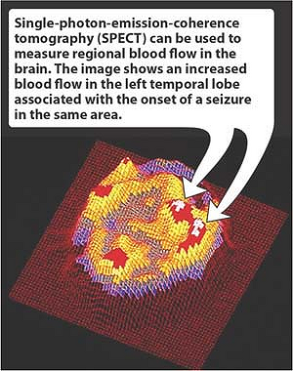

Slide 5
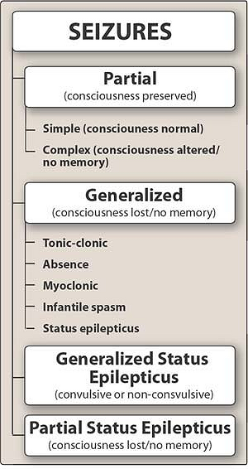

Slide 6
Antiepileptic Drugs:
1. Phenytoin
2. Carbamazepine
3. Phenobarbital
4.Valproic acid
5. Benzodiazepines: diazepam, lorazepam clonazepam.
6. Ethosuximide.

Slide 7
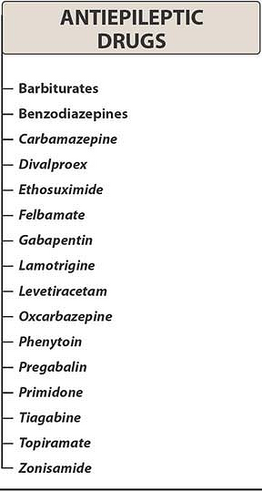

Slide 8
Phenytoin:
At the concentrations achieved clinically, phenytoin causes selective inhibition of sodium channels.
As a result, entry of sodium into neurons is inhibited, and hence action potentials are suppressed.

Slide 9
Therapeutic uses:
Epilepsy. Phenytoin can be used to treat all major forms of epilepsy except absence seizures.
Cardiac Dysrrhythmias. Phenytoin is active against certain types of dysrrhythmias. Phenytoin is a second choice drug after lidocaine for treating digoxin-induced dysrrhythmias.

Slide 10
Adverse Effects:
Effects on the CNS. Sedation, Nystagmus, ataxia, diplopia and cognitive impairment
Gingival hyperplasia.
Skin rash.
Other adverse effects
a. Hirsutism
b. Interference with vitamin D metabolism may cause rickets and osteomalacia.
c. Interference with vitamin K metabolism can lower prothrombin levels, thereby causing bleeding tendencies in newborns.

Slide 11
Pregnancy:
Phenytoin should be used during pregnancy only if the benefits of seizure control outweigh the risk to the fetus.

Slide 13
Plasma level
Levels below 10 µg/ml are too low to control seizure; at levels above 20 µg/ml, signs of toxicity begin to appear. (Narrow therapeutic range).
When treatment with phenytoin is discontinued, dosage should be reduced gradually. Abrupt withdrawal may precipitate seizures

Slide 14
Carbamazepine
Carbamazepine (Tegretol) is a mainstay of epilepsy therapy.
The drug is active against partial seizures and tonic clonic and other types of seizures but not absence seizures.

Slide 15
Mechanism of action:
The mechanism of action of carbamazepine appears to be the same as that of phenytoin.

Slide 16
Therapeutic uses:
1. Epilepsy.
2. Bipolar disorder (manic-depressive illness).
3. Trigeminal neuralgia. Neuralgia is a severe, stabbing pain that occurs along the course of a nerve. Carbamazepine can reduce neuralgia associated with the trigeminal nerves.

Slide 17
Adverse effects:
1. CNS effects. Nystagmus, blurred vision, diplopia, ataxia, vertigo and headace.
2. Hematologic effects. bone marrow suppression leading to leukopenia, anemia and thrombocytopenia. Fatal aplastic anemia
3. Hyponatremia.
4. Dermatologic effects.

Slide 18
Pregnancy:
Carbamazepine may be teratogenic.
In humans, the drug is associated with an increased risk of neural tube defect.

Slide 19
Valproic acid (Depakene)
Valproic acid appears to act by 3 mechanisms:
1. The drug shares the same mechanism as
phenytoin and carbamazepine.
2. The drug suppresses calcium influx through calcium channels.
3. Augment the inhibitory influence of GABA by inhibiting its metabolism

Slide 20
Clinical uses:
1.Broad spectrum antiepileptic agent
2. Bipolar disorder
3. Migrain

Slide 21
Adverse effects:
1.GIT effects.
2. Hepatotoxicity.
3. Other adverse effects.
a. skin rashes.
b. Weight gain.
C. Hair loss
d. Blood dyscrasias: leukopenia, thrombocytopenia, anemia

Slide 22
Gabapentin:
Gabapentin is an analog of GABA. However, it does not act at GABA receptors nor enhance GABA actions, nor is it converted to GABA.
Its precise mechanism of action is not known. .

Slide 23
It is approved as adjunct therapy for partial seizures and for treatment of postherpetic neuralgia.
Good choice due to limited or no reported pharmacokinetic drug interactions

Slide 24
Status epilepticus:
Continuous series of tonic clonic seizures that lasts for at least 20 to 30 minutes.
An IV benzodiazepine, either lorazepam or diazepam, is used initially.
Once seizures have been stopped, phenytoin or phenobarbitone is given for long-term suppression.

