Slide 1
Immunosuppressive Therapy
Lecture No. 3/2014; General Medicine
Prof. Dr. Zainalabideen A. Abdulla,
MRCPI, DTM&H., Ph.D, FRCPath.

Slide 2
Objectives of the lecture
1. To define what is the immune suppression and immunocompromised status.
2. To know the indications of immunosuppressive agents
3. To study from clinical point of view the different immunosuppressive agents
4. To understand the basis and indications of immunotherapy

Slide 4
Immunosuppressive Therapy
Immunosuppression involves an act that reduces the activation of the immune system. Deliberately induced immunosuppression is used for:
1. Hypersensitivity disorders
2. Autoimmune diseases
3. Solid organ transplantation including GvHD

Slide 5
Immunocompromised
Immunocompromised individual is the person who is undergoing
- immunosuppression (deliberate)
- or whose immune system is weak for reasons (non-deliberate) such as:
chemotherapy,
radiation,
HIV
lupus.

Slide 6
Types of immunosuppressive drugs/agents
There are several groups of immunosuppressive drugs/agents including:
1. Glucocorticosteroids
2. Antiproliferative drugs
3. Calcineurine inhibitors
4. Biological agents

Slide 7
Glucocorticosteroids
Glucocorticosteroid drugs such as cortisone, hydrocortisone, prednisone, and prednisolone are the most commonly used steroids as an immunosuppressive medication. They have also potent anti-inflammatory effects.
I. The immunosuppressive effects on the immune system are more prominent on the cellular immunity than on antibody production according to the following mechanisms (See Figure 1):

Slide 8
Figure 1: Immunosuppressive action of glucocorticosteroid drugs

Slide 9
Cont./… Immunosuppressive effects of Glucocorticosteroids
On T-cells:
Decreased numbers of peripheral blood lymphocytes (lymphopenia) and in lymphoid tissues in particular CD4 T cells due to apoptosis in the bone marrow (sequestration) and inhibition of activation and proliferation due to blockade of cytokines production mainly IL-2 and INF-gamma by interfering with their gene expression.
On Neutrophils:
Increased numbers in the peripheral blood due to interference with their migration (chemotaxis) to tissues (demargination).
On monocytes/macrophages:
Decreased numbers of monocytes in the blood, and inhibition of the proinflammatory cytokines production (IL-1, IL-6, and TNF-alpha), antigen presentation, and bactericidal activity.
On B cells: Decrease antibody production in primary immune response and no effect on memory cells (secondary immune response).
II. The anti-inflammatory effect is through the inhibition of phosphlipase A2 and cyclo-oxygenase enzymes of arachidonic acid metabolites (inflammatory mediators).

Slide 10
Clinical uses of glucocoticosteroids The clinical uses are mentioned above; with special attention to allergic diseases, in combination with other immunosuppressive agents to prevent solid transplants rejection, including bone marrow transplantation to prevent GvHD, high doses of I.V. methylprednisolone are used to treat acute rejection episodes, and for treatment of different autoimmune diseases.
Side effects some of which are serious in nature (see Figure 2), so the doses should be minimized as much as possible and tapered gradually before stop after prolonged use to avoid adrenal insufficiency.

Slide 11
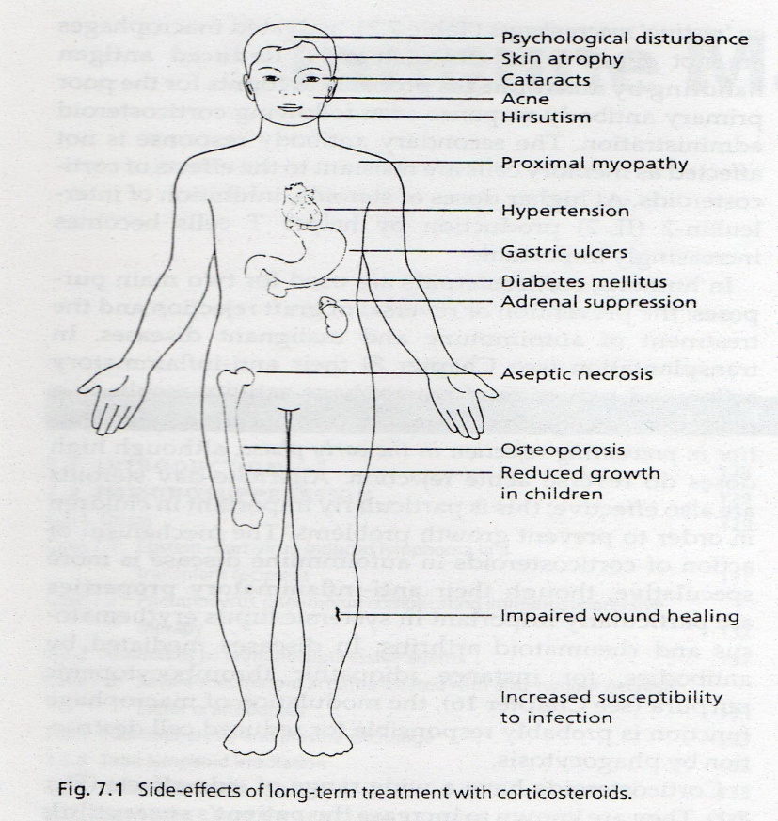

Slide 12
Antiproliferative drugs (cytotoxic and
anti- metabolites)
The anti-proliferative drugs affect the cell division of actively dividing cells including immune cells and cancer cells. They are used primarily for cancer chemotherapy, but also useful as immunosuppressive agents. The major side effects of these agents are myelo-suppression (bone marrow suppression/ leucopenia), infection and hepatotoxicity. The commonly used agents for immune suppression are:

Slide 13
Cont./…Anti-proliferative drugs
1. Azathioprine
It is a purine analogue that inhibits purine synthesis consequently blocking DNA synthesis after it is metabolized in the liver to an active drug form which is 6-mercaptopurine (6MP). It is used to prevent graft rejection and treatment of many autoimmune diseases.
2. Mycophenolate mofitil (MMF
It is also a purine analogue which has a similar action to azathioprine but more powerful with less myelotoxicity. Cont./….

Slide 14
Cont/… Anti-prokiferative drugs
3. Cyclophosphamide
It is an alkylating agent that inhibits DNA synthesis. It is used in the treatment of many autoimmune diseases such as SLE and vasculitis (e.g. Wegener’s granulomatosis). It may cause haemorrhagic cystitis.
4. Methotrexate (MTX)
It is a folic acid antagonist and blocks both DNA and RNA synthesis. It is commonly used in the treatment of rheumatoid arthritis and sometimes in the treatment of psoriasis.

Slide 15
Calcineurin inhibitors & proliferation signal inhibitors
Calcineurin inhibitor (Cyclosporin and Tacrolimus) inhibit IL-2 production that leads to inhibition of T lymphocytes activation and proliferation.
1. Cyclosporine: It is a fungal derived peptide which is used to prevent graft rejection. Its main side effects are increased susceptibility to infections, nephrotoxicity (problem ), hypertension, hirsutism and gingival hypertrophy (Figure 4).
2. Tacrolimus: It is more potent than cyclosporine, but is diabetogenic and less likely to cause hirsutism (hypertrichosis).

Slide 16
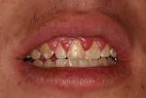

Slide 17
Proliferation signal inhibitors (Sirolimus) Sirolimus acts on T-cells at the level of post-activation events in the nucleus. Its major advantage over calcineurin inhibitors is that it is not nephrotoxic.

Slide 18
Biological agents
These agents (mainly polyclonal or chimeric/ monoclonal antibodies) target antigens on the lymphocytes or cytokines and cytokine receptors.
1. Polyclonal antibodies: Antithymocyte globulin (ATG) is a horse antibody that can deplete the long-lived peripheral T lymphocytes. It is used in the treatment of acute rejection episodes and GvHD in combination with other immunosuppressive agents. As well as in the treatment of aplastic anaemia. The main side effects are serum sickness-like reaction.
2. Chimeric/ monoclonal antibodies (MAb): The most important examples are (see Figure 3 about rheumatoid arthritis as a clinical example):

Slide 19
Cont./… Biological agents
Anti-TNF-alpha blockers: MAb: Infliximab (Remicade), adalimumab, and certolizumab; OR circulating receptor fusion protein: Etanercept (Enbrel); for RA, Crohn’s disease
Anti-CD80/CD28 (costimulatory pair): Abatacept; for RA
Anti-IL-1: Anakinra; for RA
Anti-IL-6: Tocilizumab; for RA
Anti-IL-2/receptor (CD25): Basilizumab, Daclizumab; for prevention of acute transplant rejection
Anti-B cells (CD20): Rituximab; for NHL, RA, multiple sclerosis
Anti-CD3: Muromonab; for graft rejection
Anti-IgE: Omalizumab; for asthma
Anti-CD11a (LFA-1/ICAM-1): Efalizumab; for Psoriasis

Slide 20
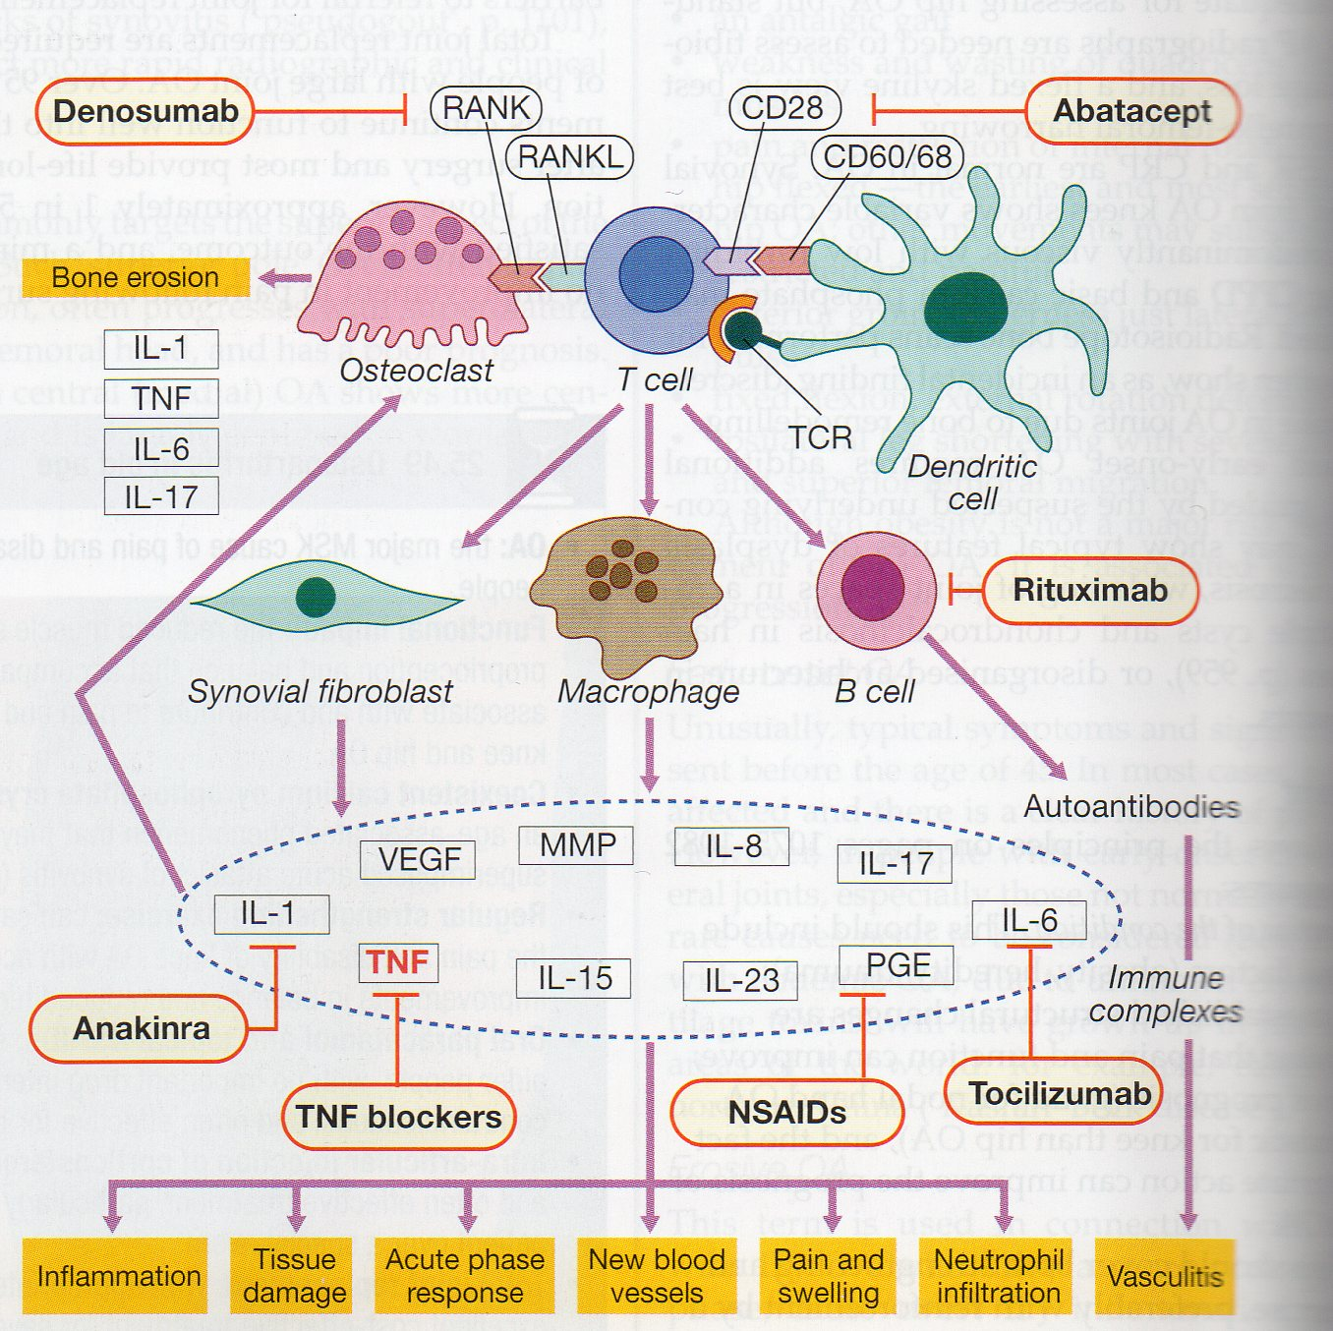

Slide 21
Immunotherapy
Immunotherapy is a new term used instead hypo/desensitization. Its mechanism of action is poorly understood, but the following mechanisms could explain it:
1. Induction the formation of IgG blocking antibodies in the extracellular fluid that can catch the allergens before reaching the basophiles/mast cells.
2. Induction of some changes in the T-cell regulatory mechanism
3. Induction of tolerance (state of a specific unresponsiveness)

Slide 22
The immunotherapy is done by:
Subcutaneous injections of the sensitizing allergen once or twice weekly in increasing doses pattern, until a maintenance dose is reached based on the clinical improvement showed by the patient.

Slide 23
Indications for immunotherapy
1. Severe allergic rhinitis poorly responding to drug therapy and in whom allergen avoidance is not possible
2. Allergic asthma not responding to drug therapy; this rather less certain indication for immunotherapy
3. IgE-mediated allergy to drugs such as penicillin, or insulin. A short course of immunotherapy can be prescribed.
4. Anaphylaxis to insect venom; it is an effective therapy to prevent the development of systemic anaphylaxis to insect venom (e.g. bees, wasp).

Slide 24
Summary of the lecture
1. Immunosuppression reduces the activation of the immune system;
Immunocompromised whose immune system is weak
2. Groups of immunosuppressive agents are: Glucocorticosteroids, Antiproliferative drugs, Calcineurine inhibitors, and Biological agents
3. Glucocorticosteroids: Act on T-, B- Macrophages, and Neutrophils
4. Antiproliferative drugs: affect the cell division of actively dividing cells
5. Calcineurin inhibitors: affect IL-2 production that leads to inhibition of T lymphocytes
6. Biological agents: (polyclonal or chimeric/ monoclonal antibodies) target antigens on the lymphocytes or cytokines and cytokine receptors. A clinical application is given about rheumatoid arthritis
7. Immunotherapy induces the formation of IgG blocking antibodies , changes in the T-cell regulatory mechanism , and tolerance. It is indicated for management of severe allergic rhinitis, allergic asthma, IgE-mediated allergy to drugs, and anaphylaxis to insect venom

