Slide 1
Pleural Disease

Slide 2
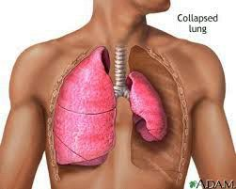
Pneumothorax
Classification
Spontaneous
PSP
SSP
Acquired
Blunt trauma
Penetrating trauma
Barotrauma
Iatragenic injury

Slide 3
Pathophysiology

Slide 4
Primary Spontaneous Pneumothorax (PSP)
Young men (teens – mid 20s)
Tall and thin
Families
Smokers
Secondary Spontaneous Pneumothorax (SSP)
Older people (45 – 64 years)
Pre-existing lung disease
Higher incidence of respiratory failure
Higher mortality rate

Slide 5
Clinical presentation
1. Asymptomatic
2. Symptomatic
a. Pain (PSP)
b. Dyspnea (SSP)
c. Orthopnea, hemoptysis, cough

Slide 6
On examination
Inspection: Dyspnea ± cyanosis
Decrease or absence chest wall movement
Palpation: Apex shifted to the other side
Trachea shifted to the other side
Decreased chest wall expansion
Decreased or absent tactile vocal fremitus
Percussion: Hyper-resonance (tympanic)
Auscultation: Decrease or absent breath sounds

Slide 7
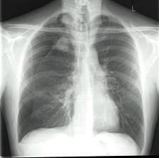
CXR:
closed Pneumothorax

Slide 8
Tension Pnenmothorax

Slide 9
What is the difference??

Slide 14
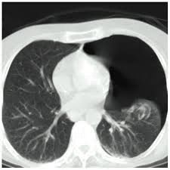
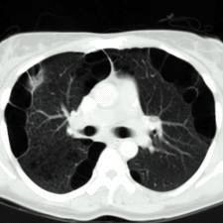
CT scan
Bronchoscopy
Pneumothorax
Emphysema

Slide 15
Complications
Pleural effusion
Hemothorax due to torn pleural adhesions
Empyema
Trapped lung (fibrothorax) due to failure of re-expansion
Tension pneumothorax

Slide 16
Treatment
Observation
Pleurocenthesis or thoracocenthesis
Chest tube thoracostomy
Surgery
Massive air leak
Persistent air leak
Recurrent pneumothorax
Bilateral pneumothorax
Previous pneumonectomy
Occupational hazard
Pleurodesis

Slide 17
Malignant pleural effusion
Causes
lung cancer
pleural malignancy
mediastinal LN malignancy
Treatment of pleural effusion→physician or oncologist
When to reffer to a surgeon →recurrent &/or a suspicion of being a malignant effusion
Why reffer →biopsy + prevent reccurence of effusion

Slide 18
Biopsy:
Cytology of pleural effusion
Abram's needle
CT or U/S guided biopsy
VATS biopsy
Open biopsy
Prevent recurrence
Repeated thoracocenthesis
Chemical pleurodesis
Surgical pleurodesis/pleurectomy
Pleuro-peritoneal shunt (Denver's shunt)

Slide 19
Denver’s Shunt

Slide 20
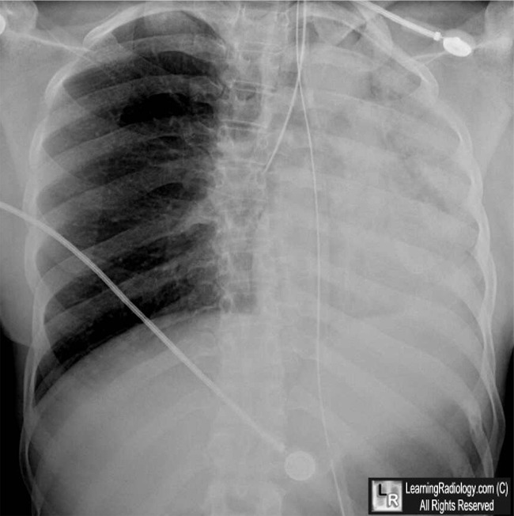
What is the difference??
Massive effusion
Whole lung atelectasis

Slide 21
Empyema
Causes:
Complication of pulmonary infection
Following chest trauma
Extrapulmonary spread
Complication of pneumothorax
Non sterile aspiration of pleural fluid

Slide 22
Pathogenesis
1. Acute or exudative phase
Thin pus, Thin pleura, Expandable lungs
Antibiotics and drainage
2. Transitional or fibrinopurulent phase
Pus thicker, fibrin deposition, lung less expandable
Antibiotics and drainage
3. Chronic or organization phase
Thick pus, thick pleura with fibrous coat, non expandable lungs
Surgery (decortication)

Slide 23
Clinical presentation
fever, maliase, anorexia, weight loss
pleuretic chest pain
dyspnea, cough, purulent sputum
O/E: signs of infection + signs of pleural effusion
Investigations:
CXR
Thoracocenthesis
CT scan

Slide 24
CXR:

Slide 26
Treatment
Objectives:
Control infection
Drain purulent material
Restore lung function
Treatment line
Chest tube thoracostomy + physiotherapy
Decortication / pleurectomy
Open drainage e.g., Eloesser's flap

Slide 27
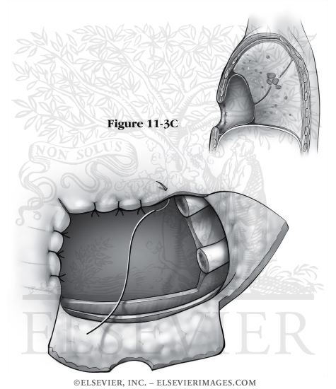
Decortication
Eloesser’s flap

Slide 28
Chylothorax
Etiology:
Disruption or tear in the thoracic duct during its coarse in the chest.
Trauma including penetrating, blunt or iatrogenic injury
Neoplasm with invasion of the thoracic duct
Infection

Slide 29
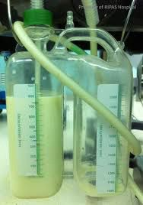
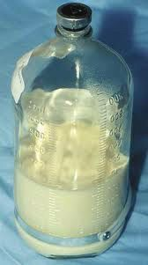
Clinical presentation
Dyspnea, orthopnea, and cough
Malnutrition
Dehydration
Decreased immunity
Investigations:
1. Pleural fluid analysis: odorless milky white appearance with a creamy layer on standing.
2. Lymphangiography

Slide 30
Treatment
1. Conservative treatment
a. Chest tube drainage
b. Correct dehydration
c. Correct electrolyte imbalance
d. Nutritional support by TPN or fat free oral diet
2. Surgical repair or ligation of thoracic duct
3. Denver's shunt (pleuro-peritoneal shunt)

Slide 31
Pleural malignancy
Primary pleural tumors are rare
The most common primary tumor malignant mesothelioma (usually as a consequence of asbestos exposure).
Poor prognosis
Respiratory failure or symptoms of invasion of nearby organ.
CXR: lung surrounded by thick irregular pleura with multiple nodules with extension to nearby structures.
Curative treatment is surgery (extrapleural pneumonectomy).
Both radiotherapy and chemotherapy are weakly effective.

Slide 32
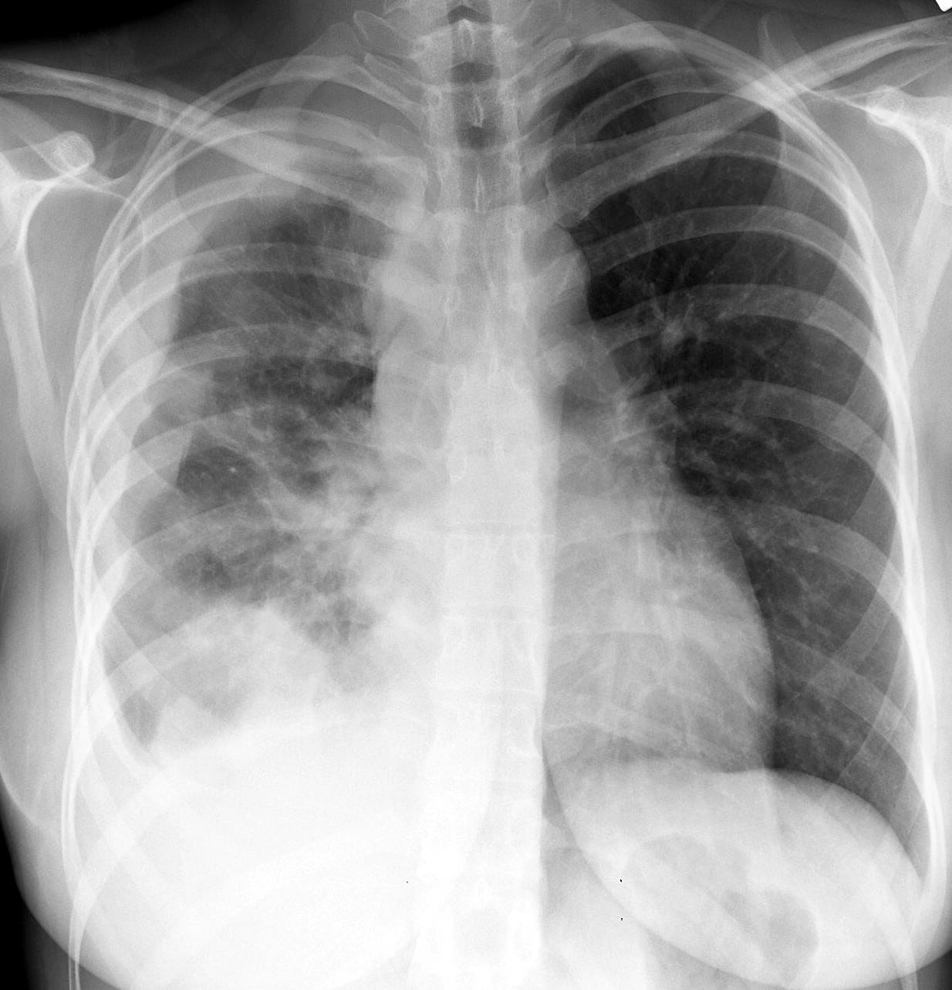

Slide 34
Thank You

