Slide 1
Entamoeba histolytica

Slide 2
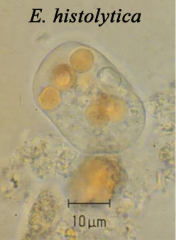
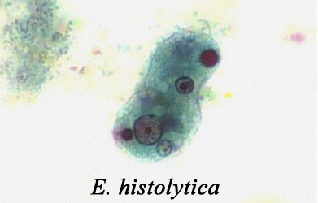

Slide 3
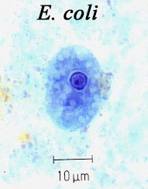
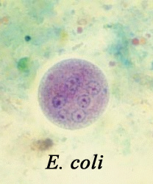
Notes:
Many other amebas and flagellates inhabit the human intestine, mostly harmless. Regardless, they should be recognized by anyone diagnosing fecal samples. Illustrations are through the courtesy of Chiang Mai University, Thailand: dept/parasite/image.htm.

Slide 4
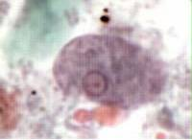
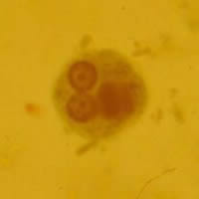
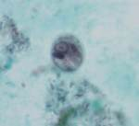
Morphology
Different form of E. histolytica;
1- trophozoite
2- precyst
3- cyst(1, 2, 4 nuclei)

Slide 5
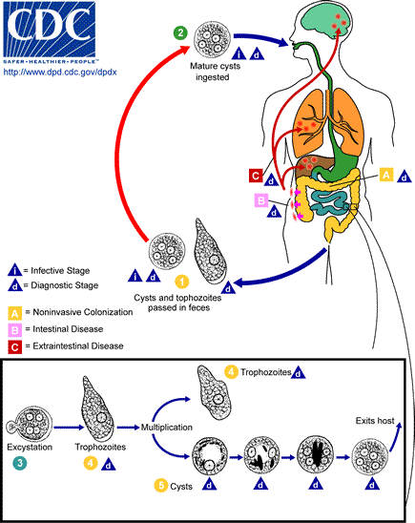
Life cycle
Life cycle

Slide 6
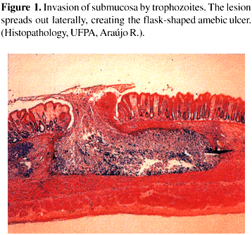

Slide 7
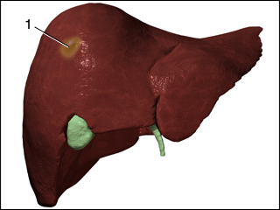
Pyogenic- Liver Abscess

Slide 8
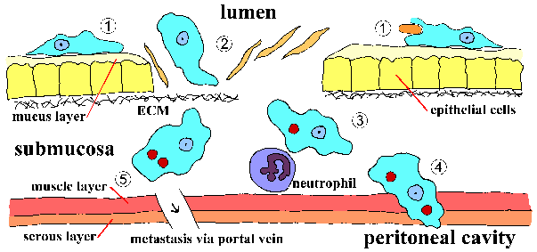

Slide 9
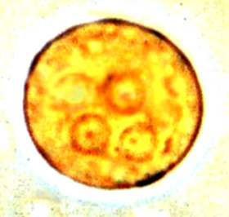
Laboratory diagnosis. An iodine-stained cyst of the pathogen Entamoeba hystolytica with 4 nuclei is illustrated. The harmless commensal Entamoeba coli has larger cyts with 8 nuclei. Furthermore, recall that E. histolytica has a lookalike E. dispars that is harmless.

Slide 10
Transmission
1-driect contact of person to person( fecal-oral)
2- Veneral transmission among homosexual males( oral-anal
3- Food or drink contaminated with feces containing the E.his. cyst
4- Use of human feces (night soil) for soil fertilizer
5- contamination of foodstuffs by flies, and possibly cockroaches

Slide 11
ulcers with raised borders
little inflammation between lesions

Slide 12
Diagnosis
Paraclinical Diagnosis:
Sigmoidoscopic examination:
precence of a grossly normal mucosa between the ulcers serves to differentiate amebic from bacillary dysentery,( the entire mucosa being involvoed in bacillary dysentery).
Hepatomegally
C.B.C. : leukocytosis in Amebic dys. rises above 12000 per microliter, but counts may reach 16000 to 20000 per microliter.

Slide 13
Treatment
Intestinal Amebiasis:
*Asymptomatic amebiasis(cyst passer): Diloxanide furoate ( furamide)
500 mg 3 times daily / 10 days
*Symptomatic amebiasis ( troph. & cyst): - Iodoquinol , 650 mg 3 times daily/ 20 days or Metronidazole (Flagyl) , 750 mg 3 times daily/ 10 days
*Amebic colitis: Chloroquine, 250 mg 2 times daily
* Acute amebic dysentery: Emetine hydrochloride, 1mg/kg daily IM or SC

Slide 14
Treatment
Extraintestinal Amebiasis:
*Amebic liver abscess, ameboma:
Metronidazole, as above plus dehydroemetine / 10 days or Metronidazole or dehydroemetine as above plus Chloroquine , 500 mg 2 times daily / 2 days,…..

Slide 15
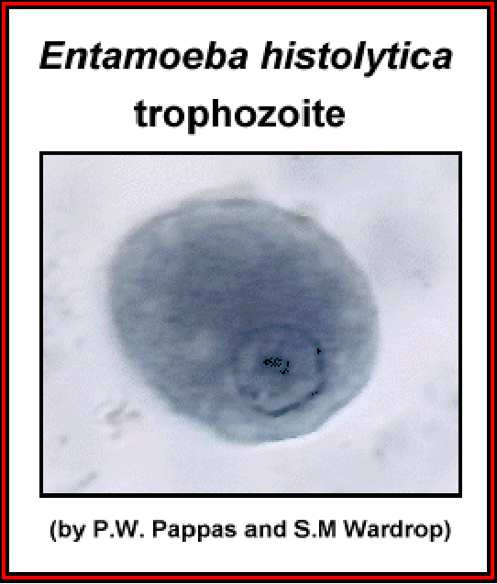

Slide 16
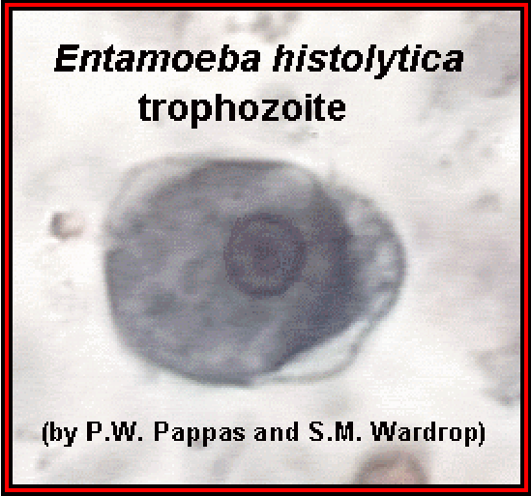

Slide 17
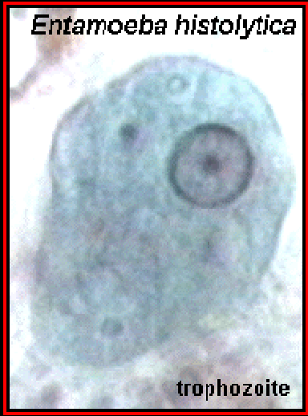

Slide 18
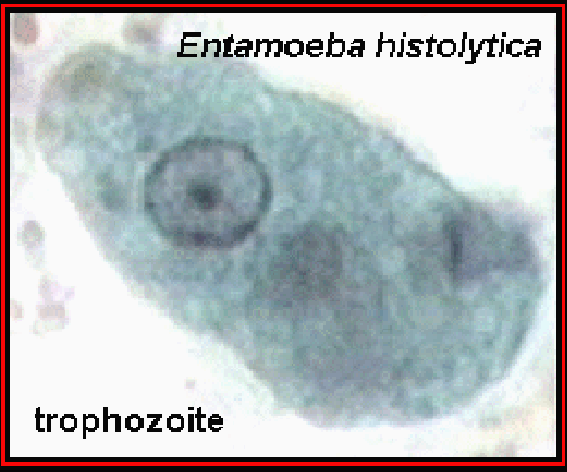

Slide 19
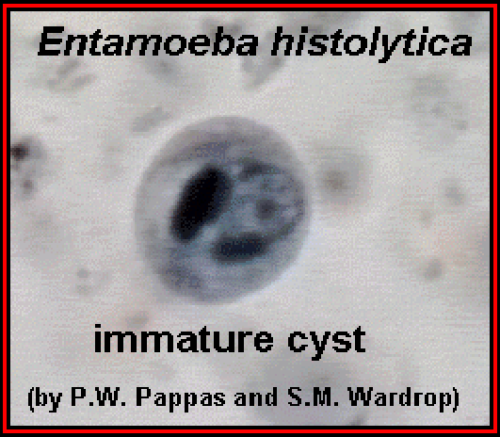

Slide 20
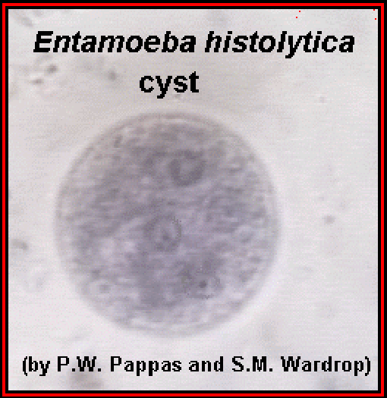

Slide 21
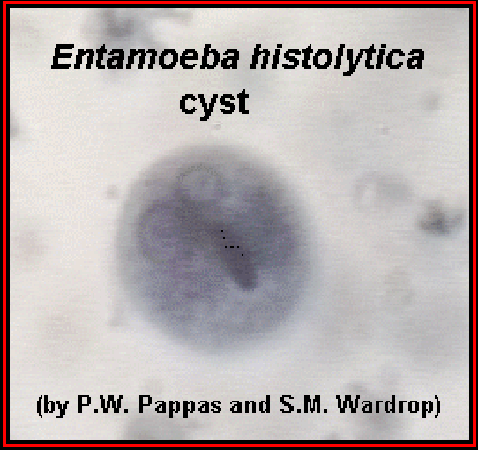

Slide 22
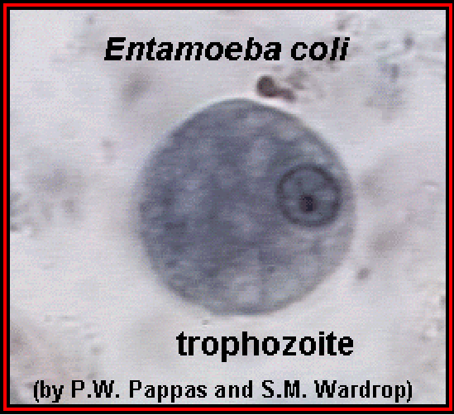

Slide 23
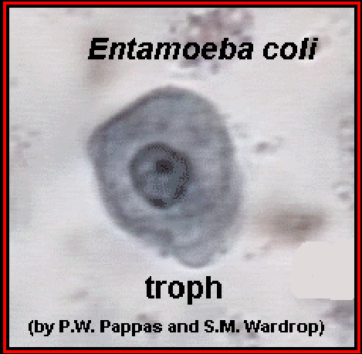

Slide 24
