Slide 1
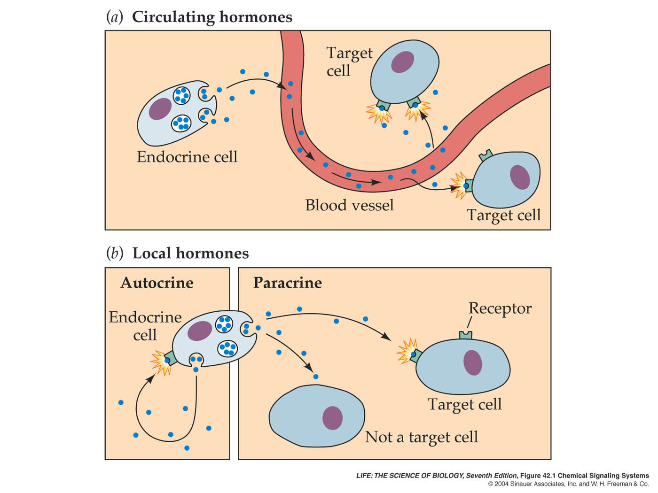

Slide 2
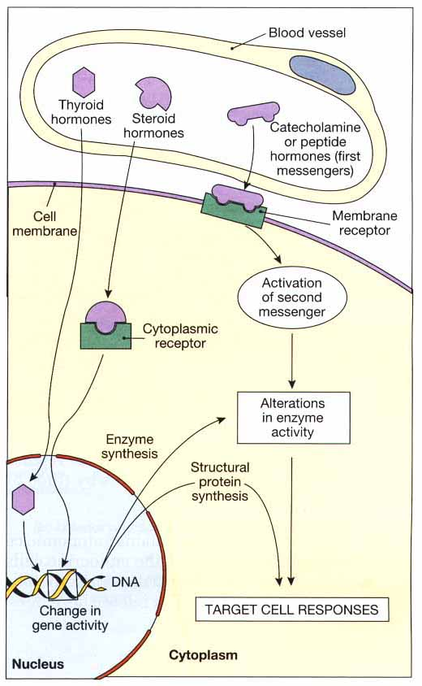
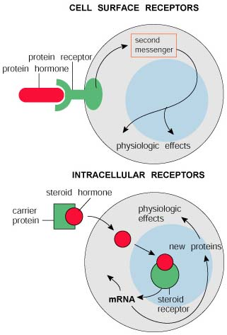

Slide 3
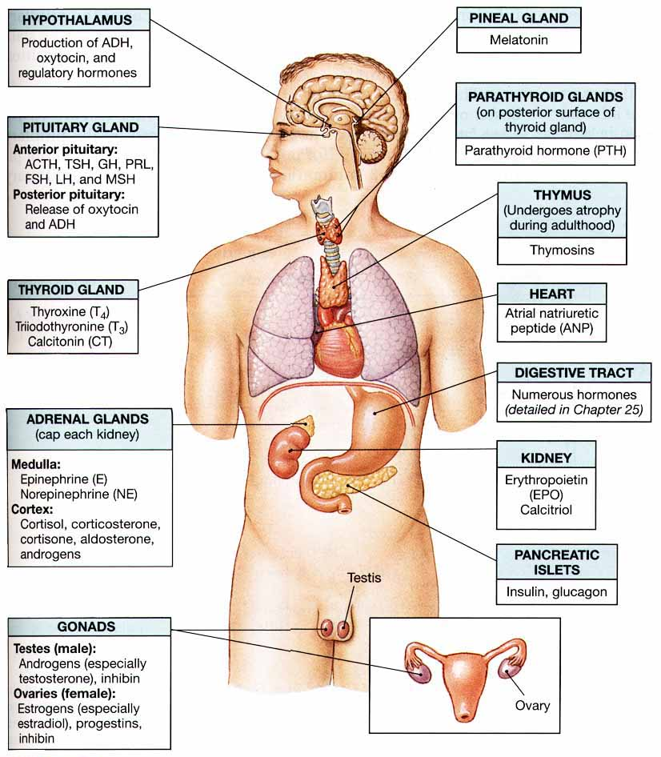

Slide 4
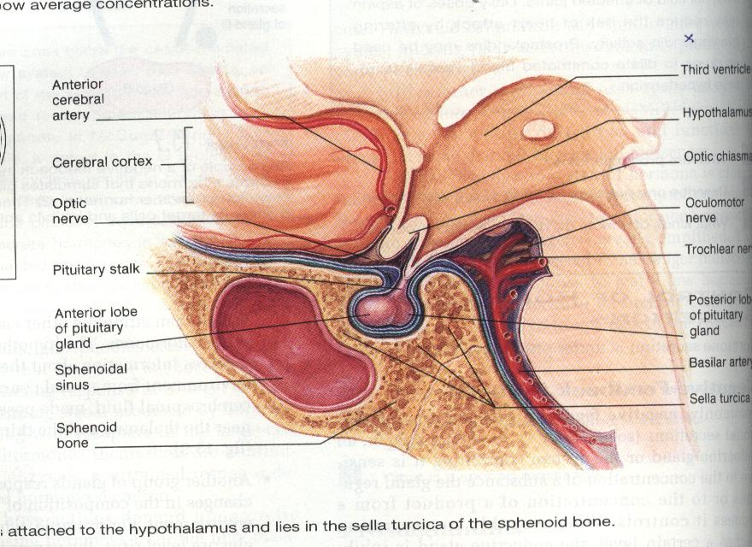
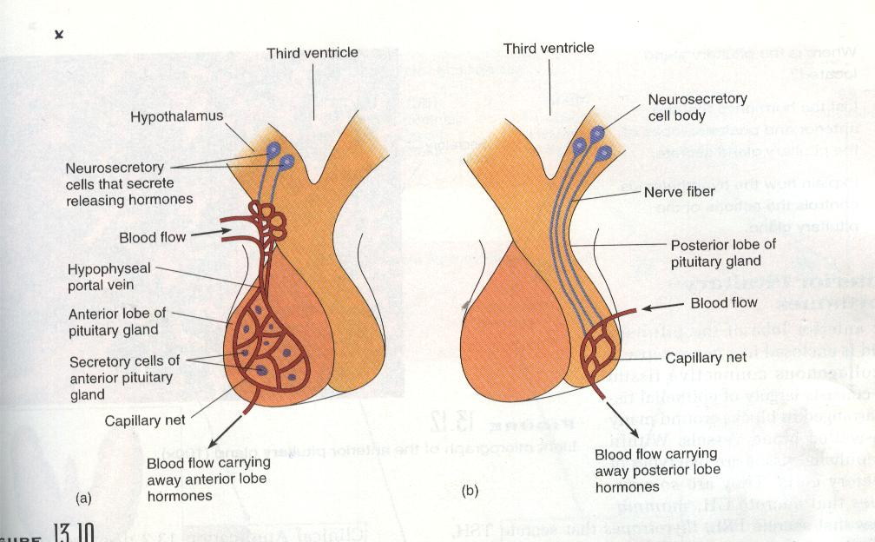

Slide 5
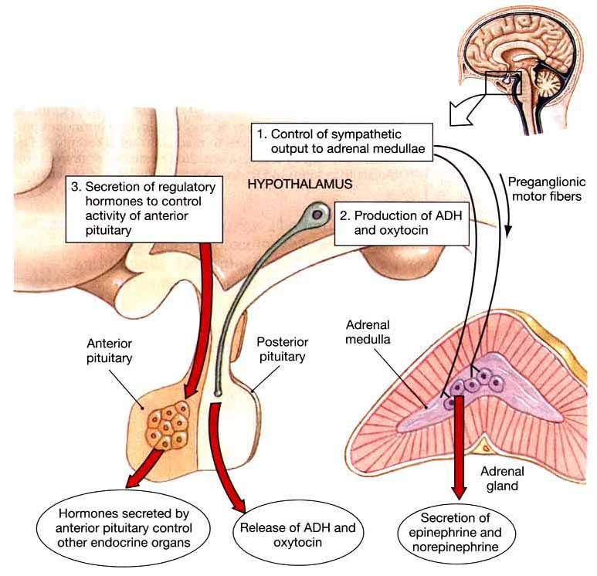

Slide 6
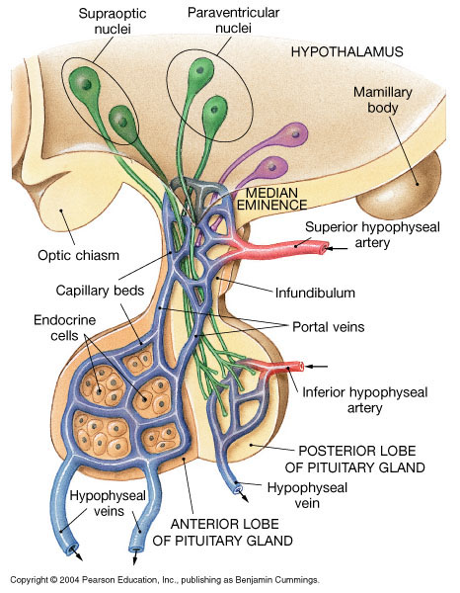
Hypophyseal portal system
All blood entering the portal system will reach the intended target cells before returning to the general circulation

Slide 7
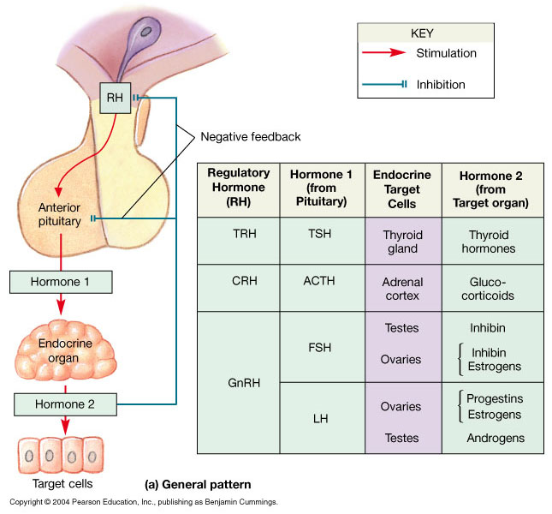
Figure 18.8 Feedback control of Endocrine Secretion
Figure 18.8a

Slide 8
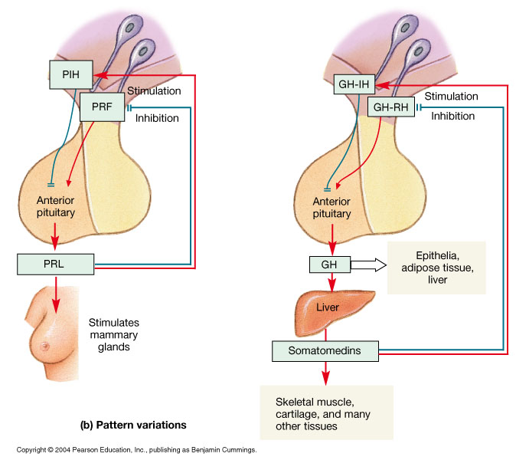
Figure 18.8 Feedback control of Endocrine Secretion
Figure 18.8b

Slide 9
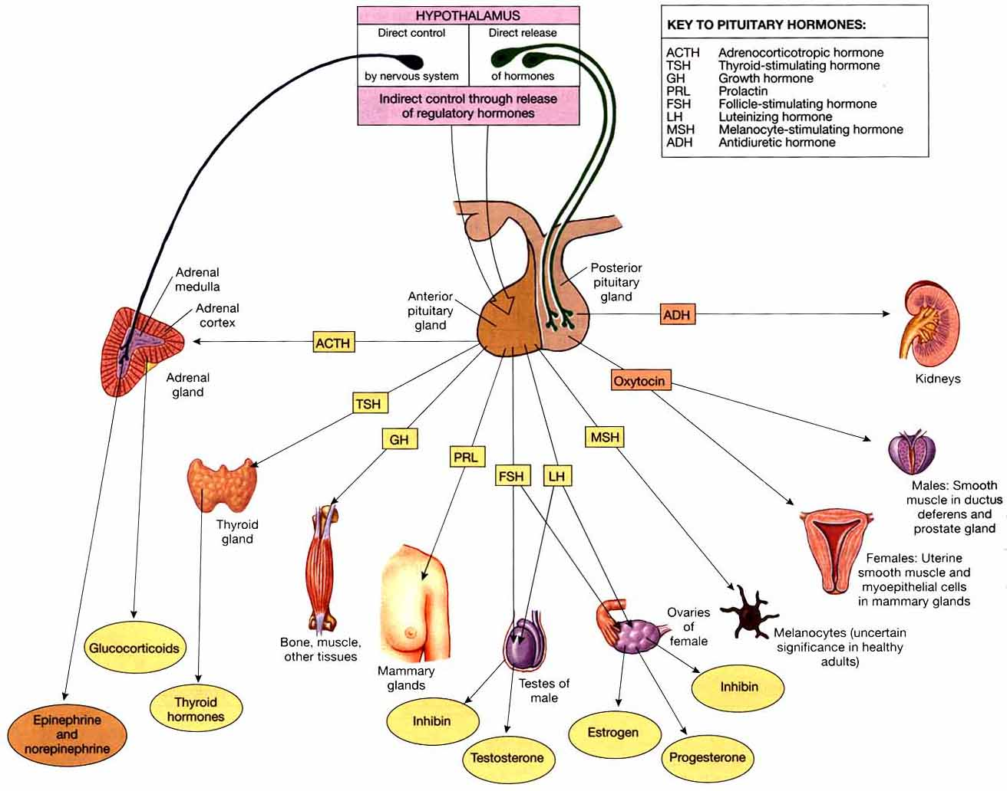

Slide 11
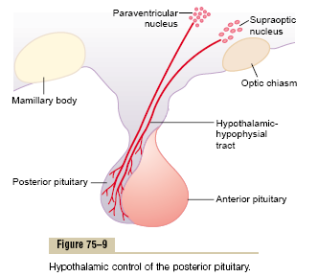
The Posterior Pituitary Gland
  Its also called the neurohypophysis or pars nervosa, contains the axones of some hypothalamic neurons. Neurons within the supraoptic & paraventricular nuclei manufacture :
  Antidiuretic hormone (ADH) also called vasopressin
  - Oxytocin

Slide 12
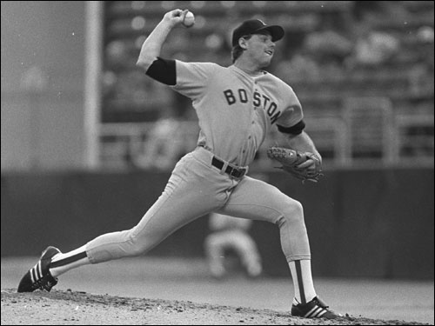
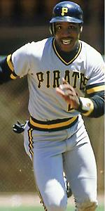
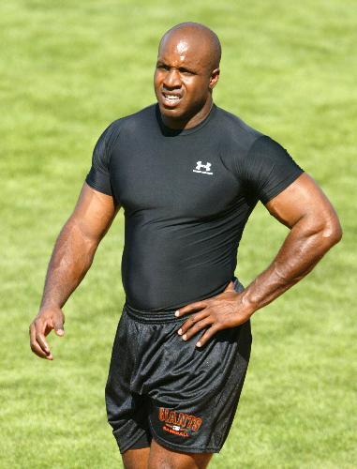
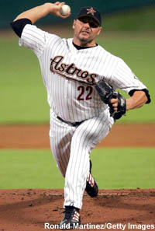
Growth Hormone Action

Slide 13
Growth Hormone Action
Exercise, stress, sleep, low glucose
(+)

Slide 14
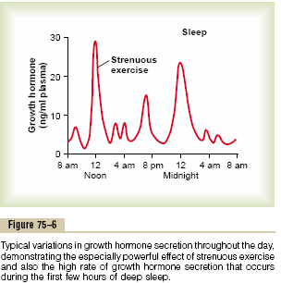

Slide 15
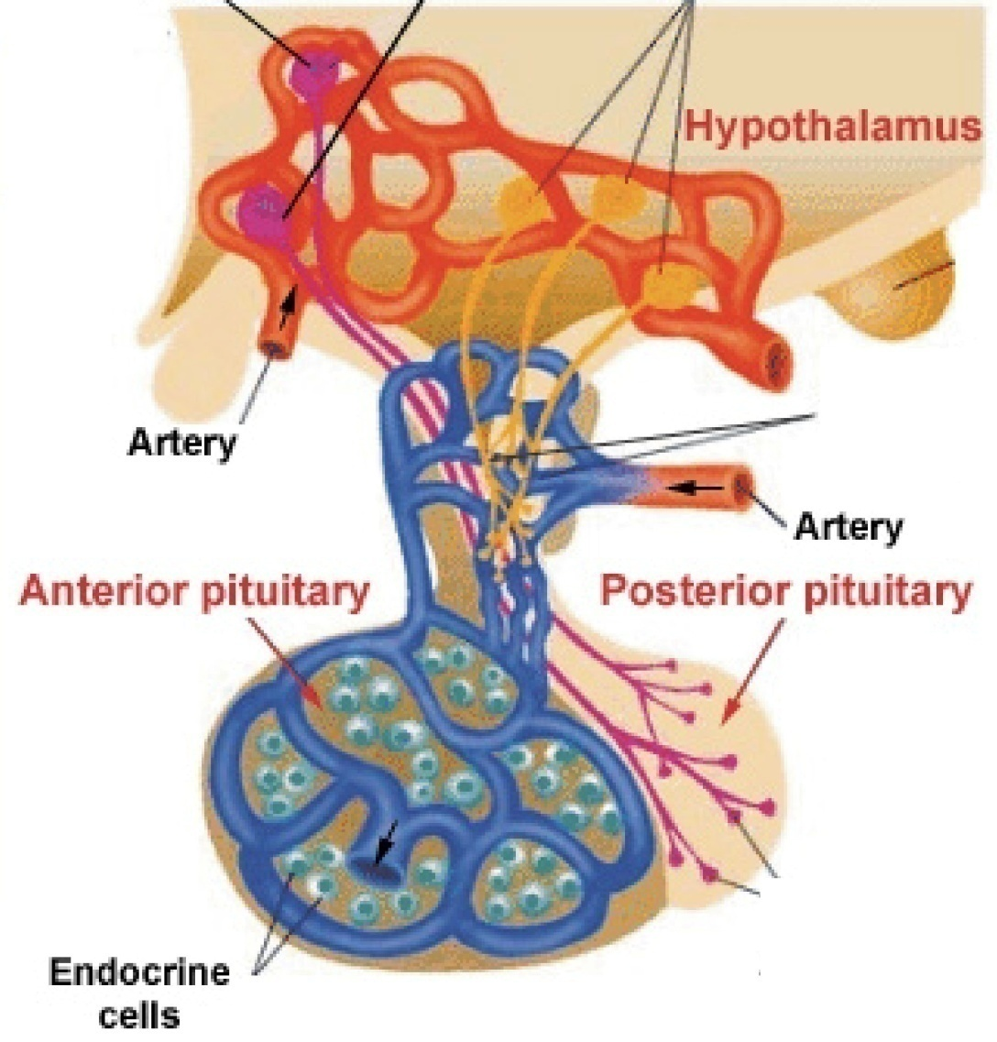
GH Insensitivity (Laron dwarfism)
Ghrelin GHRH Somatostatin
Somatomedin (IGF-1)
GH

Slide 16


Gigantism
  Over-secretion of growth hormone prior to puberty.
  Excessive growth of long bones
  Treatment: drug therapy to inhibit GH release

Slide 17
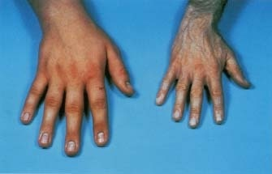
Acromegaly
  Over-secretion of growth hormone during adulthood
  usually from tumor
  Enlargement of the extremities and/or face
  Treatment: drug therapy to inhibit GH release

Slide 18
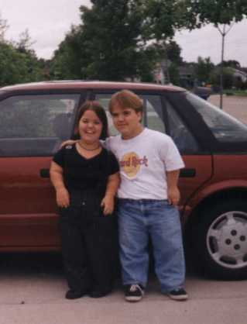
Dwarfism
Under-production of growth hormone during childhood
Long bone growth is decreased
Body is proportioned and intelligence is normal
Treatment: early diagnosis & injections of GH for 5 or more yrs.

Slide 19
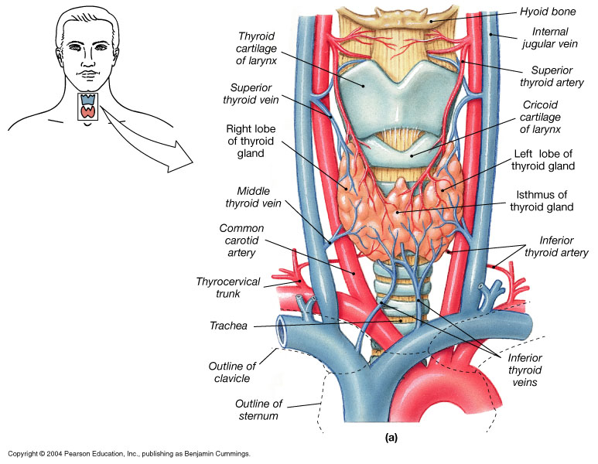
The Thyroid Gland
Lies near the thyroid cartilage of the larynx
Two lobes connected by an isthmus

Slide 20
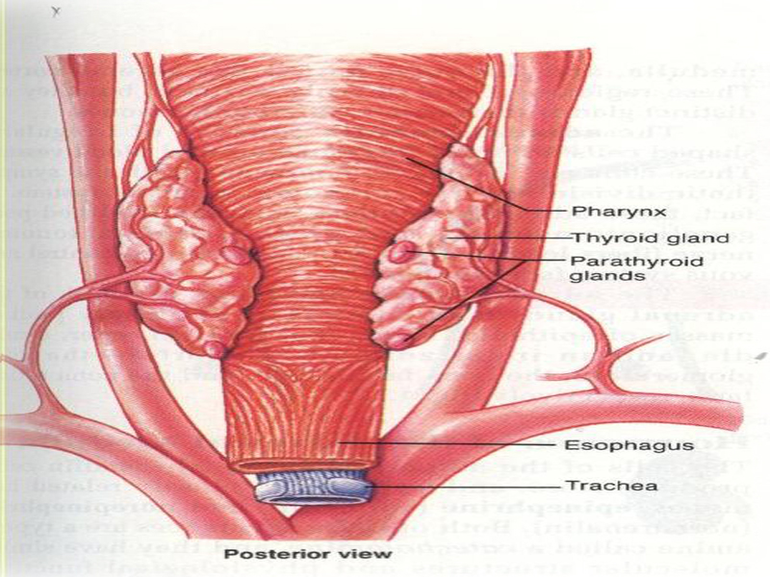

Slide 21
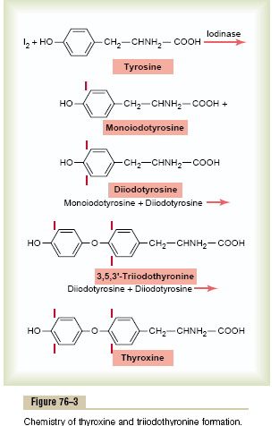

Slide 22
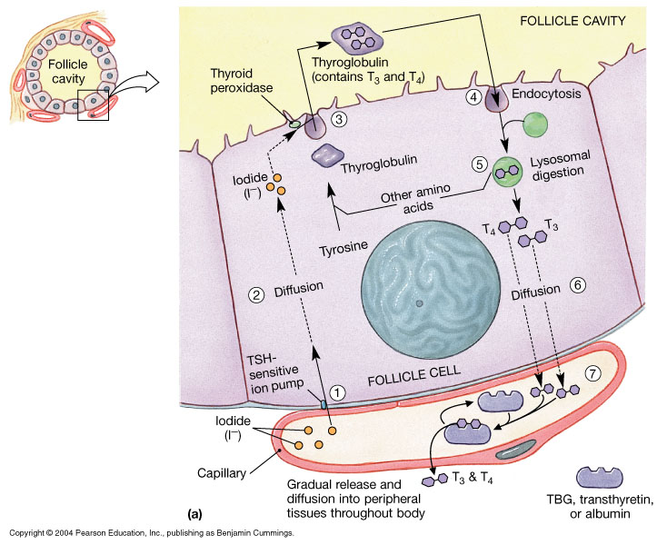
Figure 18.12 The Thyroid Follicles
Figure 18.12a

Slide 23
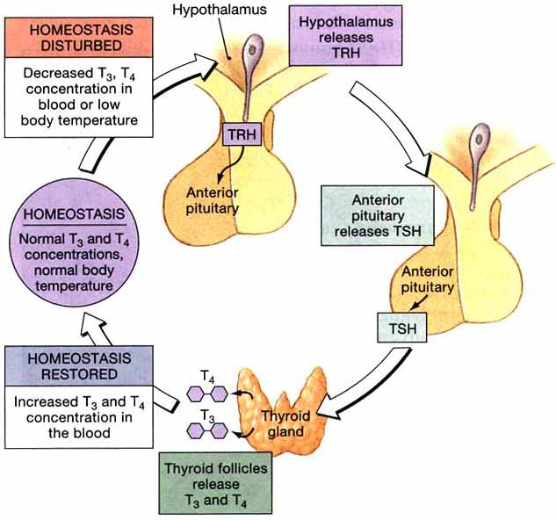

Slide 25
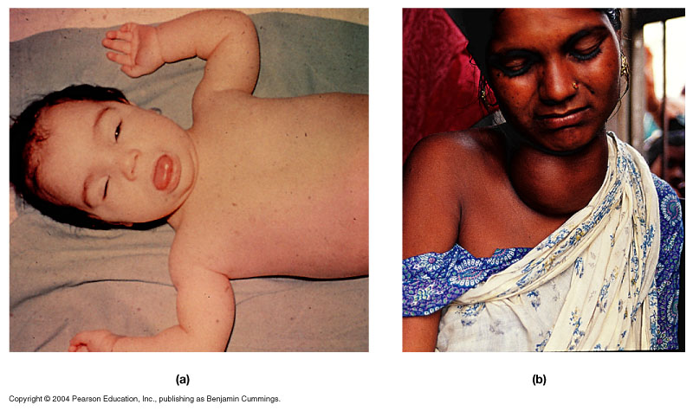
Thyroid Disorders
Figure 18.13

Slide 26
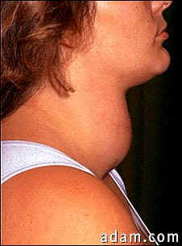
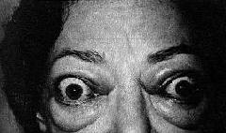
Grave’s disease
Severe form of hyperthyroidism
More common in women
Symptoms: strained and tense facial expression, exophthalmia, goiter, nervous irritability
goiter
exophthalmos

Slide 27
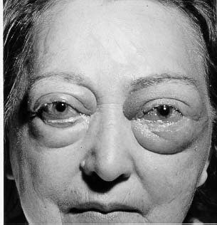
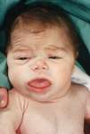
Problems with the Thyroid Gland
Hypothyroidism in infant(cretinism) hyperthyroidism

Slide 28
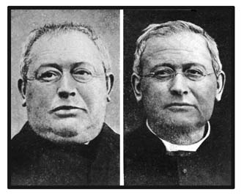
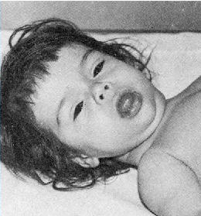
Myxedema
Cretinism
Face becomes swollen, weight increases and memory begins to fail
Treatment is daily thyroid hormone
Follow-up tests to measure TSH blood levels are important
Develops early in infancy or childhood
Lack of mental/physical growth resulting in mental retardation and malformation
Sexual development and physical growth does not reach beyond 7-8 year old children
Normal development cannot be completely restored w/ tx.

Slide 29
The calcium in the plasma is present in three forms :
1. About 41%( 1nmol / L) of calcium is combined with the plasma proteins .
2. About 9% ( 0.2 nmol / L) is combined with an ionic substances ( citrate & phosphate ) .
3. 50 % is ionized .
Plasma Ca ion concentration is 2.4meq/ L

Slide 30
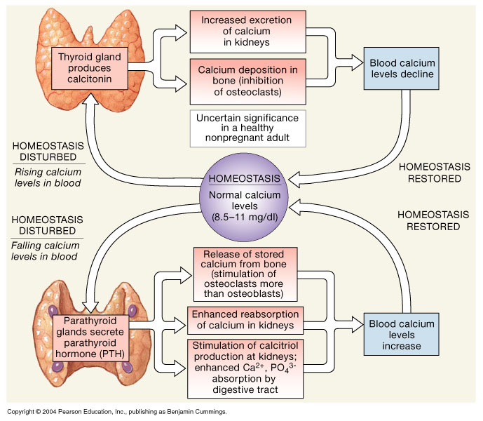
The Homeostatic Regulation of Calcium Ion Concentrations
Figure 18.15

Slide 31
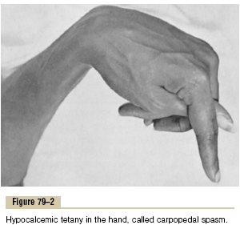
this pic. Shows carpopedal spasm .
Tetany occurs when the blood concentration of Ca falls from 9.4 mg / dl to about 6 mg / dl , which is only 35% below normal & is usually lethal at about 4 mg / dl .

Slide 33
Vitamin D
Vitamin D3 ( cholecalciferol ) is found in the skin .
This is activated &converted to 25-hydroxycholecalciferol in the liver & this has a negative feedback effect on the conversion reactions .

Slide 34
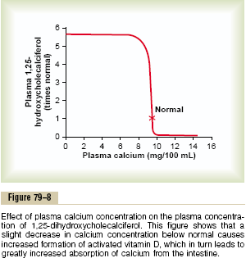
25-hydroxycholecalciferol in the proximal tubules of the kidneys is converted to 1, 25-dihydroxycholecalciferol .this is the most active form of vitamin D .this conversion requires PTH .
This demonstrates that plasma concentration of 1, 25-dihydroxycholecalciferol is inversely affected by the concentration of calcium in the plasma.

Slide 35
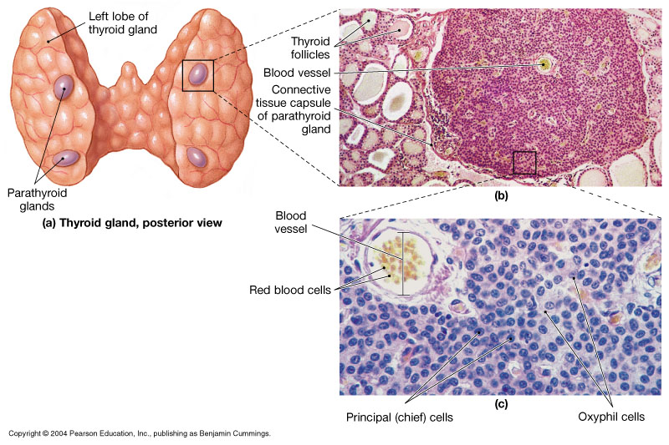
Figure 18.14 The Parathyroid Glands
Figure 18.14

Slide 36
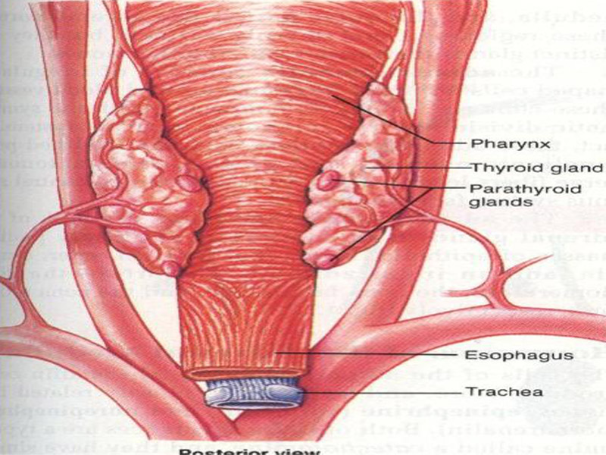
Parathyroid hormone
Normally there are 4 parathyroid glands in humans , they are located immediately behind the thyroid gland and behind each of the upper &each of the lower poles of the thyroid.
The parathyroid gland contains mainly chief cells which secret PTH .PTH is a polypeptide with 84 amino acids .

Slide 37
Effect of PTH on calcium & phosphate concentration in ECF
1. PTH increases calcium &phosphate absorption from the bone .
2. It decrease the excretion of the calcium by the kidney .
3. It increases renal phosphate excretion .

Slide 38
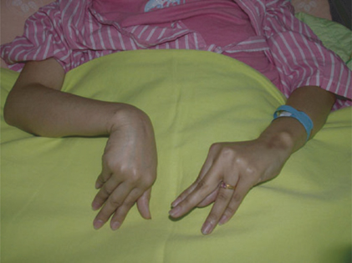
Disease of Parathyroid
Hypoparathyroidism
  Under-activity of parathyroid gland causing a low level of calcium in blood
  Tetany, hyperirritability of nervous system, twitching
  Death can occur if the larynx and respiratory muscles are involved.
Hyperparathyroidism
  Over-activity of parathyroid resulting in increased calcium in the blood
  Leads of kidney stones, GI disturbances
  Bones become weak, deformed and fracture easily because calcium is drawn from the bone

Slide 39
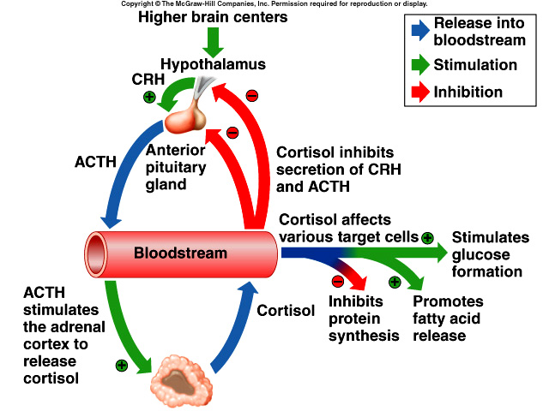

Slide 40
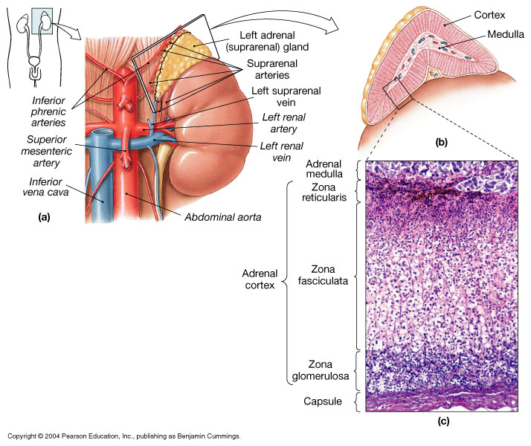
The Adrenal Gland
Figure 18.16

Slide 41
Synthesis and secretion of the adrenocortical hormones
The adrenal cortex has 3 distinct layers .

Slide 42
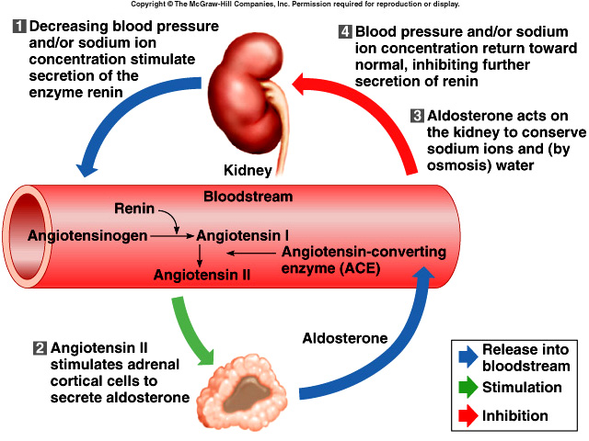

Slide 43
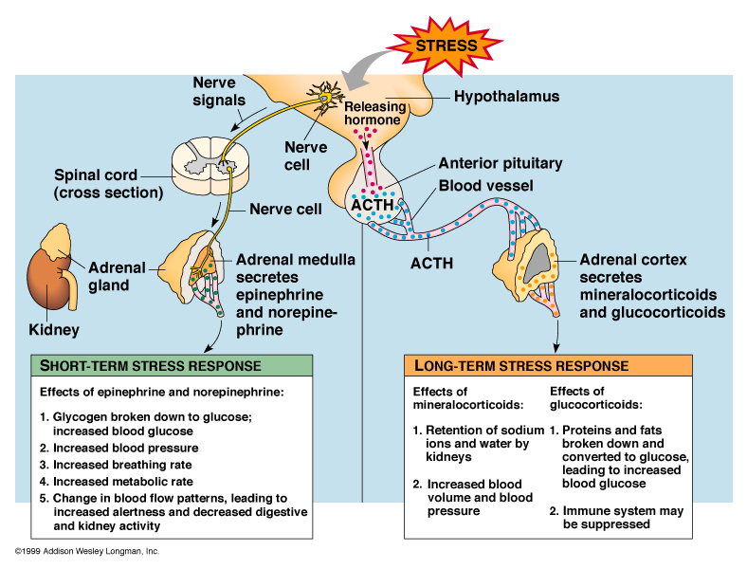

Slide 44
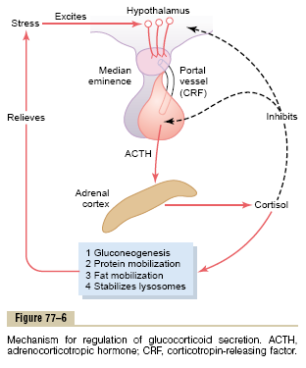
Regulation of cortisol secretion by ACTH from the anterior pituitary
ACTH is a large polypeptide , has 39 amino acids .it is controlled by Corticotropin –releasing factor ( CRF) from the hypothalamus .

Slide 45
ACTH act on adrenocortical cells to produce steroids ,
Stress stimuli activate the entire control system to cause rapid release of cortisol & the cortisol in turn initiates a series of metabolic effects .there is direct feedback of the cortisol to both the hypothalamus & the anterior pituitary to decrease the concentration of cortisol in plasma .
The secretory rate of CRF, ACTH & cortisol are high in early morning but low in the late evening .

Slide 47
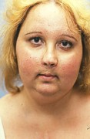
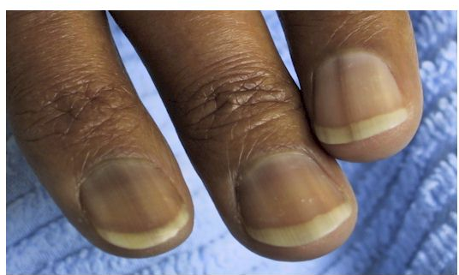
Disease of Adrenal glands
Addison’s disease
  Decreased function of adrenal cortex
  Excessive pigmentation, low blood pressure when standing, muscular weakness/fatigue, diarrhea, wt. loss, vomiting
  Tx. Replace
  hormone
Cushing’s syndrome
  Hypersecretion of glucocorticoids
  Causes hyperglycemia, hypertension, poor wound healing, bruising, “moon” face and obesity

Slide 48
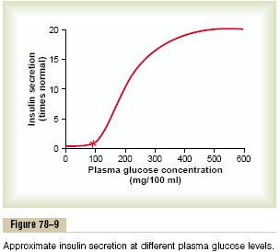
Summary of Blood Glucose Regulation
In normal person , the blood glucose concentration between 80 -90 mg / dl in the fasting person .
This concentration increases to 120-140 mg / dl during the first hour after meal , but the feedback system of glucose return the glucose concentration rapidly to the control level .
Conversely , in starvation , the gluconeogenesis function of the liver provides glucose to F.B.S.

Slide 49
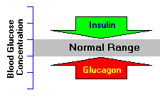
Glucagon
Glucagon has a major role in maintaining normal concentrations of glucose in blood, and is often described as having the opposite effect of insulin. That is, glucagon has the effect of increasing blood glucose levels.
Glucagon is a linear peptide of 29 amino acids. Glucagon is synthesized as proglucagon and proteolytically processed to yield glucagon within alpha cells of the pancreatic islets.

Slide 50
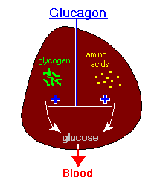
Effect of glucagon on glucose metabolism
The major effects of glucagon on glucose metabolism are:-
Breakdown of liver glycogen ( glycogenolysis ).
Increased gluconeogenesis in the liver .
Both of these effects enhance the availability of glucose to the other organs of the body .

Slide 51
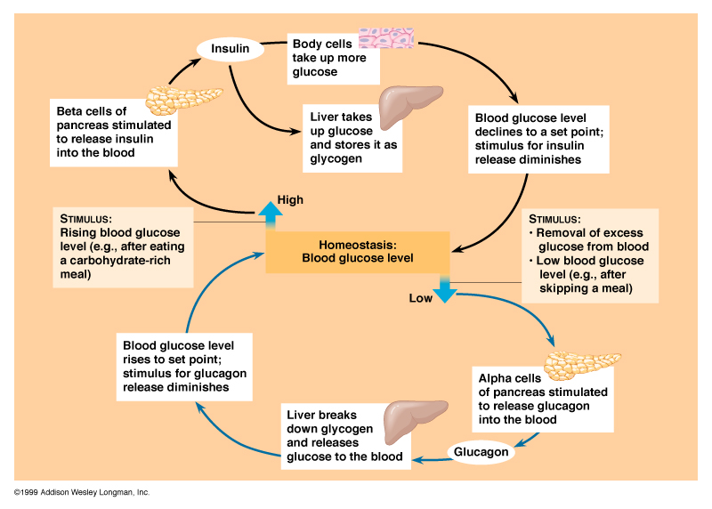

Slide 52
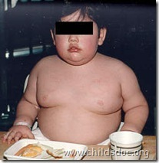
Ghrelin
Disrupted ghrelin circadian rythmn in obese
Promotes lung growth and development in the fetus
Prader-Willi Syndrome characterized by high fasting levels
Can be severely affected by gastric bypass surgery
Obestatin is a converse hormone generated by differential splicing of ghrelin precursor
Anti-obesity vaccine?

