Slide 1
Parasitic Skin Diseases
By
Dr. Salam Altemimi

Slide 2
Leishmaniasis
Leishmania are flagellate protozoans.
The pathogenic one present in Iraq is Leishmania tropica.
The protozoan is transferred by sandflies (Phlebotomus).
The average incubation period is 2–4 weeks.

Slide 3
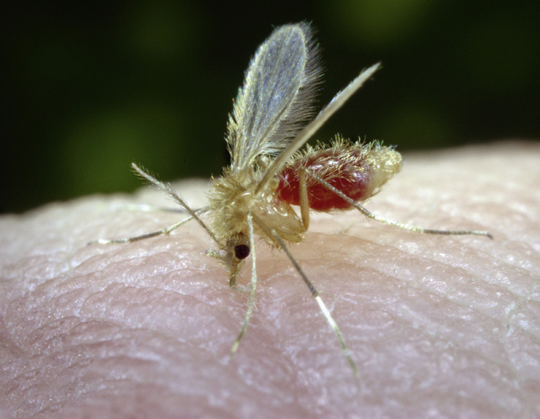
Blood-sucking Phlebotomus papatasi sandfly, it is one third the size of a mosquito. Sandflies are most active from dusk to dawn.

Slide 4
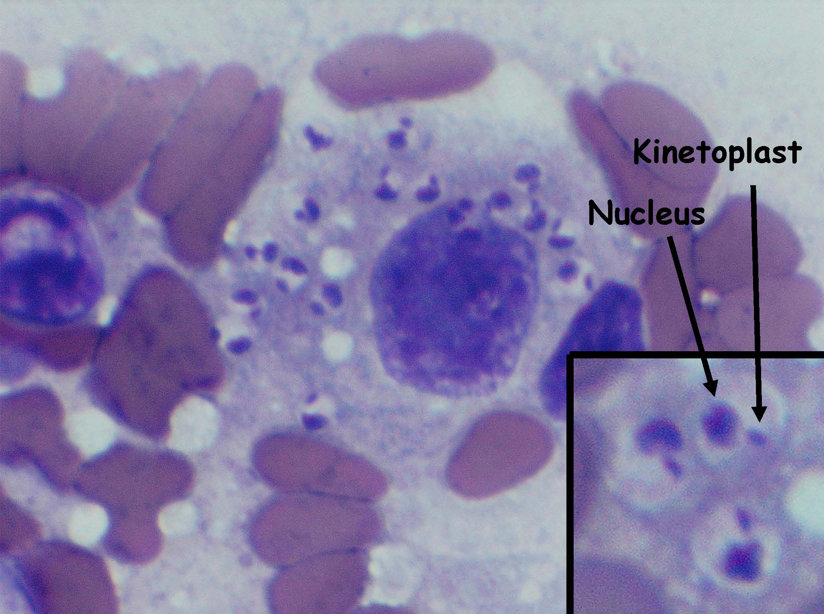
Leishmania: Amastigotes in a macrophage at 1000X, Inset shows the cell membrane and points out the nucleus and kinetoplast.

Slide 5
Acute cutaneous leishmaniasis
Following the bite, a papule develops, then rapidly enlarges and breaks down in the center. The ulcer usually has a rolled border (volcano sign) and it is asymptomatic unless secondarily infected.

Slide 6
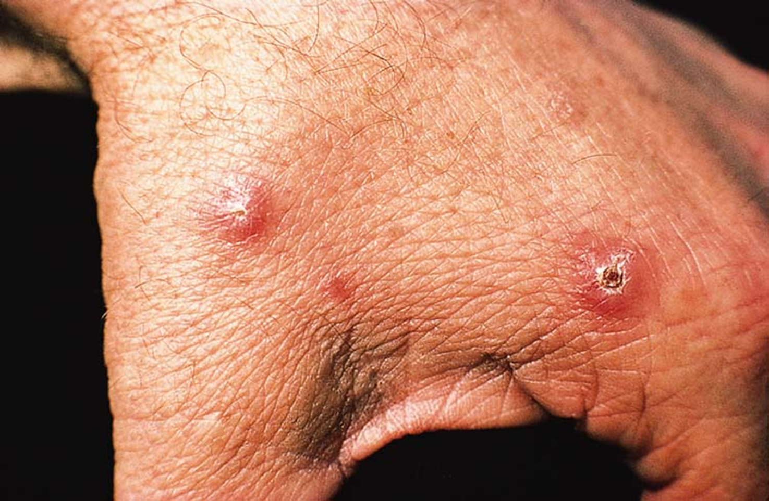
Cutaneous leishmaniasis due to Leishmania major: asymptomatic early papules, one of which is starting to show central crusting.

Slide 7
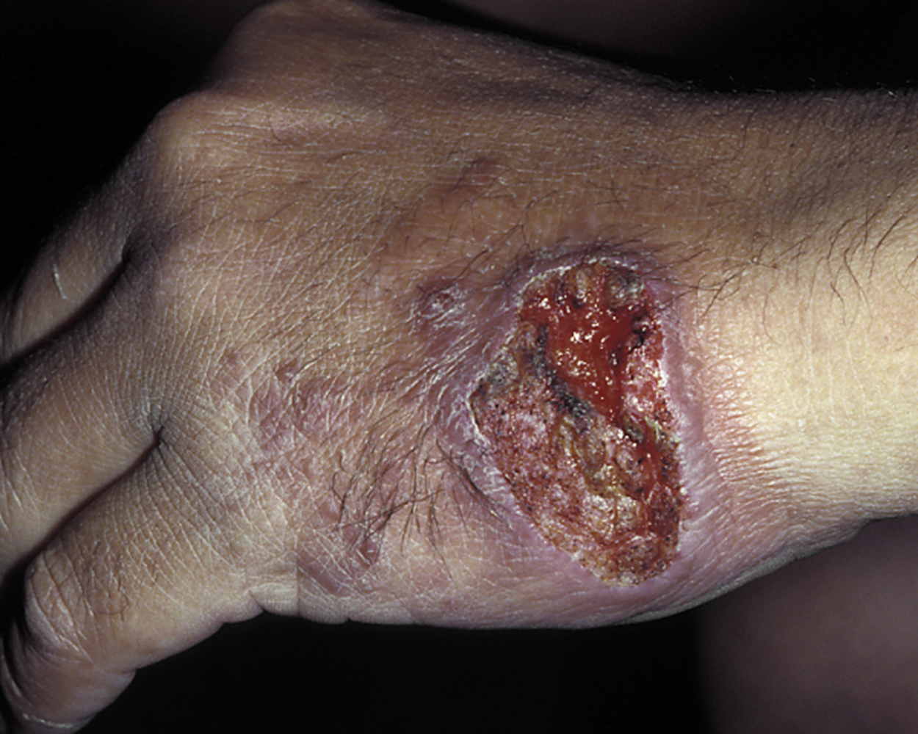
Cutaneous leishmaniasis. A red papule eventually ulcerates and forms raised edges with surrounding dusky red skin.

Slide 8
Treatment
Standard treatment is intralesional injection of sodium stibogluconate (Pentostam) diluted 1:3 with a local anesthetic; 1–2 times weekly for 2–4 weeks.

Slide 9
Pediculosis
Lice (Pediculus spp.) are blood-sucking, wingless, ectoparasitic insects.
Pediculosis capitis (Head lice) is infestation with Pediculus humanus capitis.
Lice live on the scalp and suck blood there. They firmly attach their eggs (nits) to the hair shaft just at the skin surface.
Malathion 0.5% lotion is most effective. Applied twice, 7–14 days apart. Their application is for 30 minutes and rinsed.

Slide 10
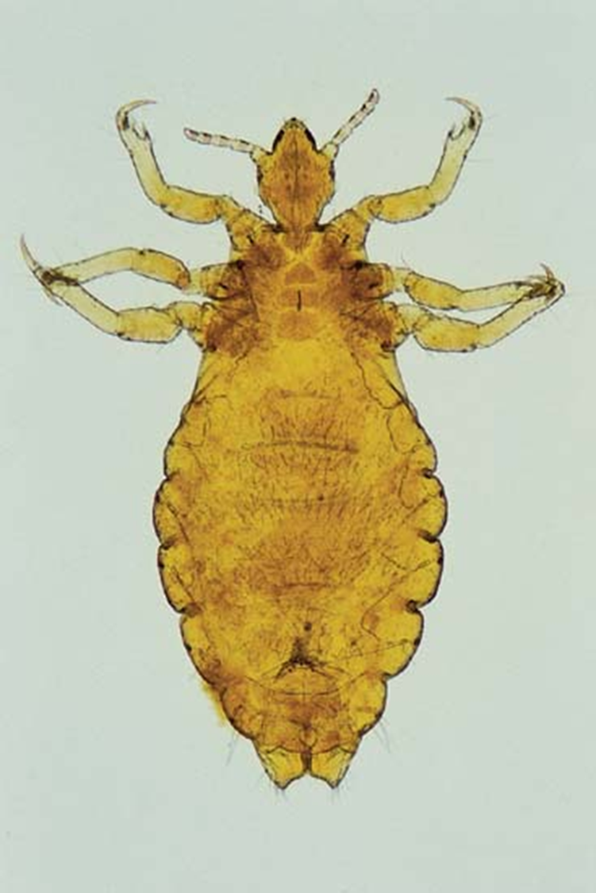
Head louse (Pediculus humanus var. capitis) Body louse (Pediculus humanus var. corporis) It is less than 2 mm, flat, wingless insect with three pairs of legs located on the anterior part of the body directly behind the head. The legs terminate in sharp claws. Body louse is the largest in size.

Slide 11
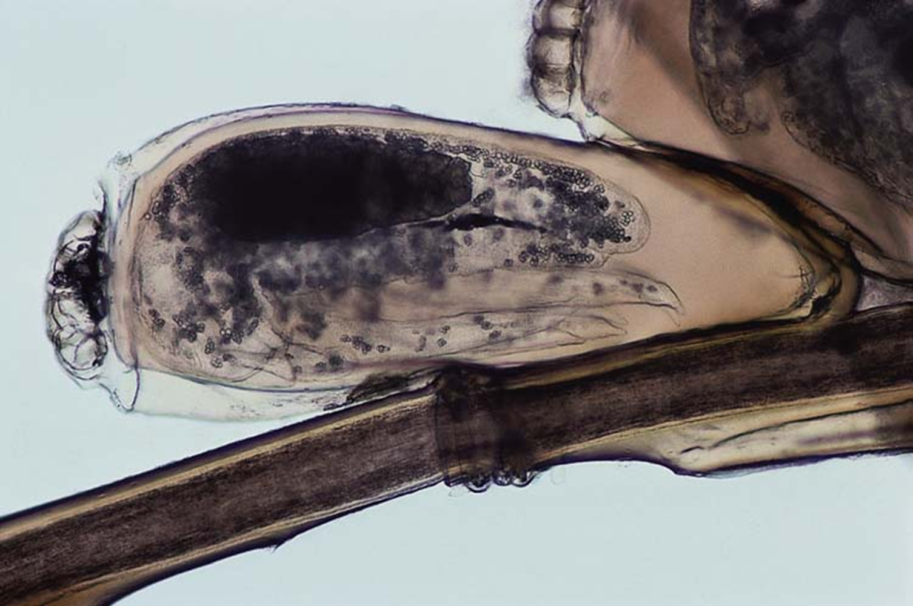
Head louse eggs (nits) cemented to a hair shaft.

Slide 12
Pediculosis corporis (Body lice).
Infestation with Pediculus humanus corporis.
Pediculosis corporis is primarily a disease of the unwashed.
The lice feed on the body, but live in the clothing and tend to lay their eggs along the seams.
Look for the lice and nits on the clothing, not on the skin.
Treatment: Disinfection of clothing and bedding (boiling, hot ironing, fumigation). Attempt to change living conditions.

Slide 13
Pediculosis pubis (Pubic lice).
Infestation with Phthirus pubis. Usually transmitted by sexual contacts.
Moving lice on their pubic hairs.
Nits usually on pubic hair, but occasionally elsewhere (axillary or body hairs; eyelashes, eyebrows).
Treatment: Permethrin cream or shampoo applied for 30 minutes; repeat in 1 week.

Slide 14
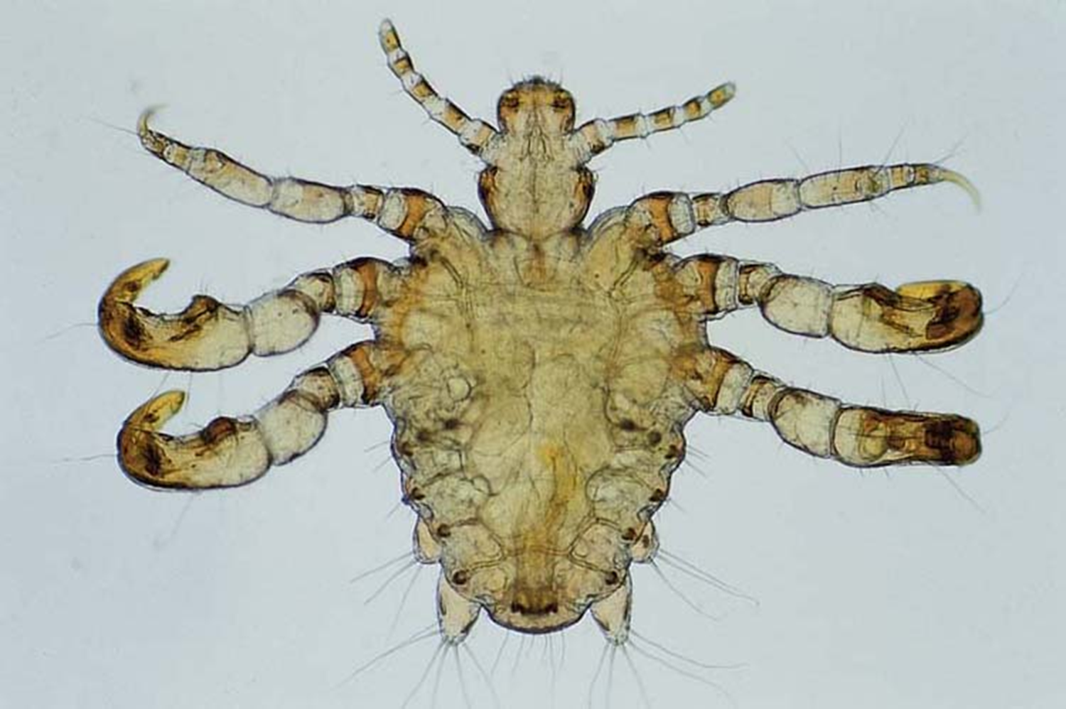
Crab or pubic louse (Phthirus pubis) with a short, oval body and prominent claws resembling sea crabs.

Slide 15
Scabies
Intensely pruritic infestation with the mite Sarcoptes scabiei.
It lives only on humans.
Transmission is by close personal contact.
Female mites burrow in the epidermis just below the stratum corneum, depositing eggs and feces as they move along.

Slide 16
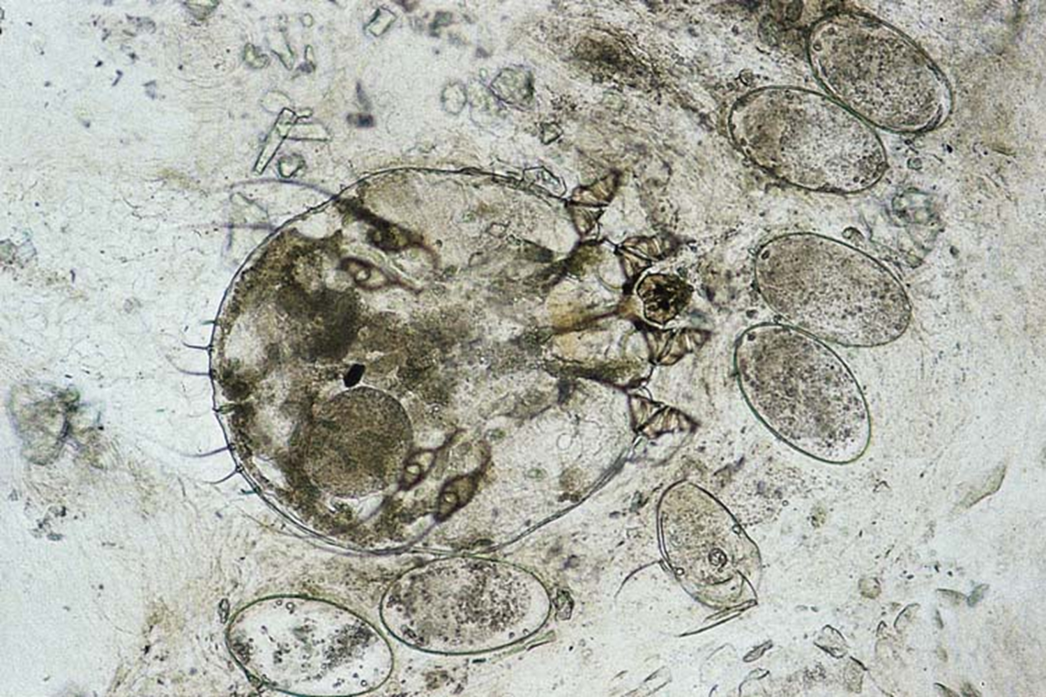
Sarcoptes scabiei: The scabies mite. Female with eggs. Ovoid body, flattened dorsoventrally; four pairs of legs, the anterior 2 pairs tipped with suckers.

Slide 17
Burrows: Fine slightly raised, sometimes erythematous, irregular lines with a terminal swelling where the female mite can be found. Typical sites include interdigital spaces, sides of the hands and feet, flexural surface of the wrist, anterior axillary line, penis, nipples.
Intense pruritus usually worst at night.
Dermatitis: Immune reaction (type IV) to mites leads to both pruritus and diffuse exanthem. Typical sites are thighs, buttocks, trunk.

Slide 18
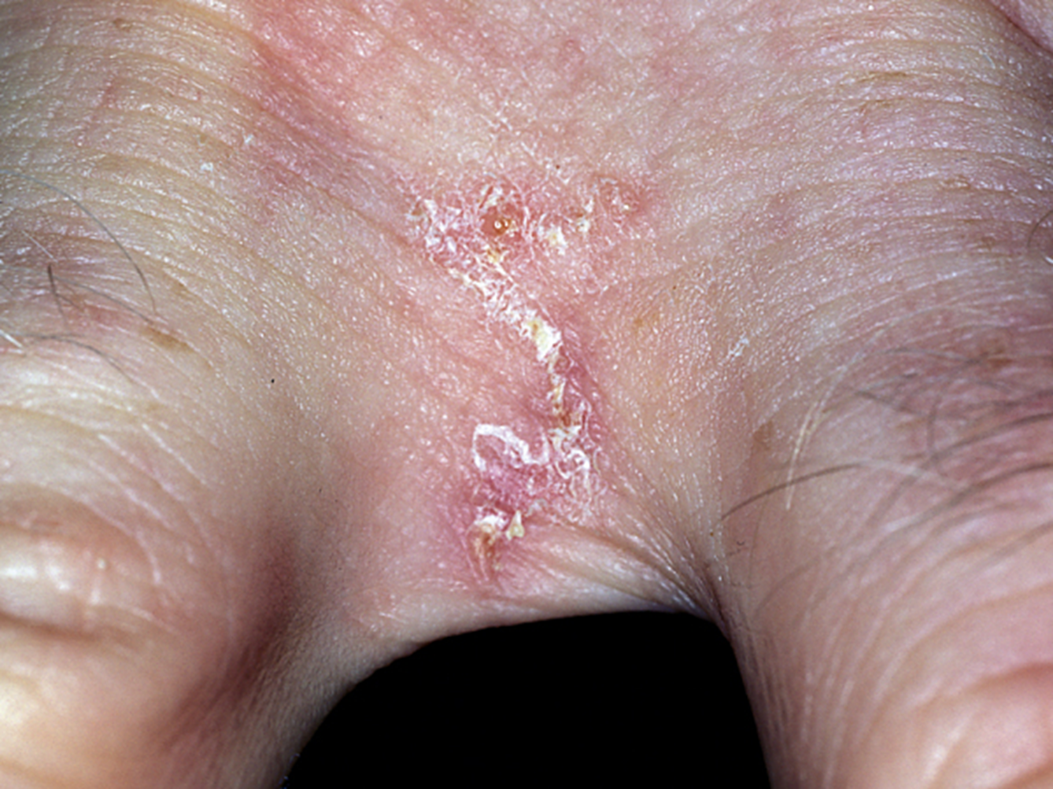
Scabies: Burrows appear as curved tracks and are most often found in the finger webs and on the wrists.

Slide 19
Treatment: Permethrin 5% cream is the agent of choice. Apply at night, wash in morning; repeat after 1 week.
Bedding and clothing should be washed in hot cycle of washing machine.

