Slide 1
Internal iliac artery
From snell
Ruqaya falah

Slide 2
Int.iliac artery :-
It enters the pelvis …on upper margin of greater sciatic foramen it is divided into :-
A)ant.branch.
B)post.branch.
Supply :-
1)pelvic viscera.
2)pelvic walls.
3)perineum.
4)buttocks.

Slide 3
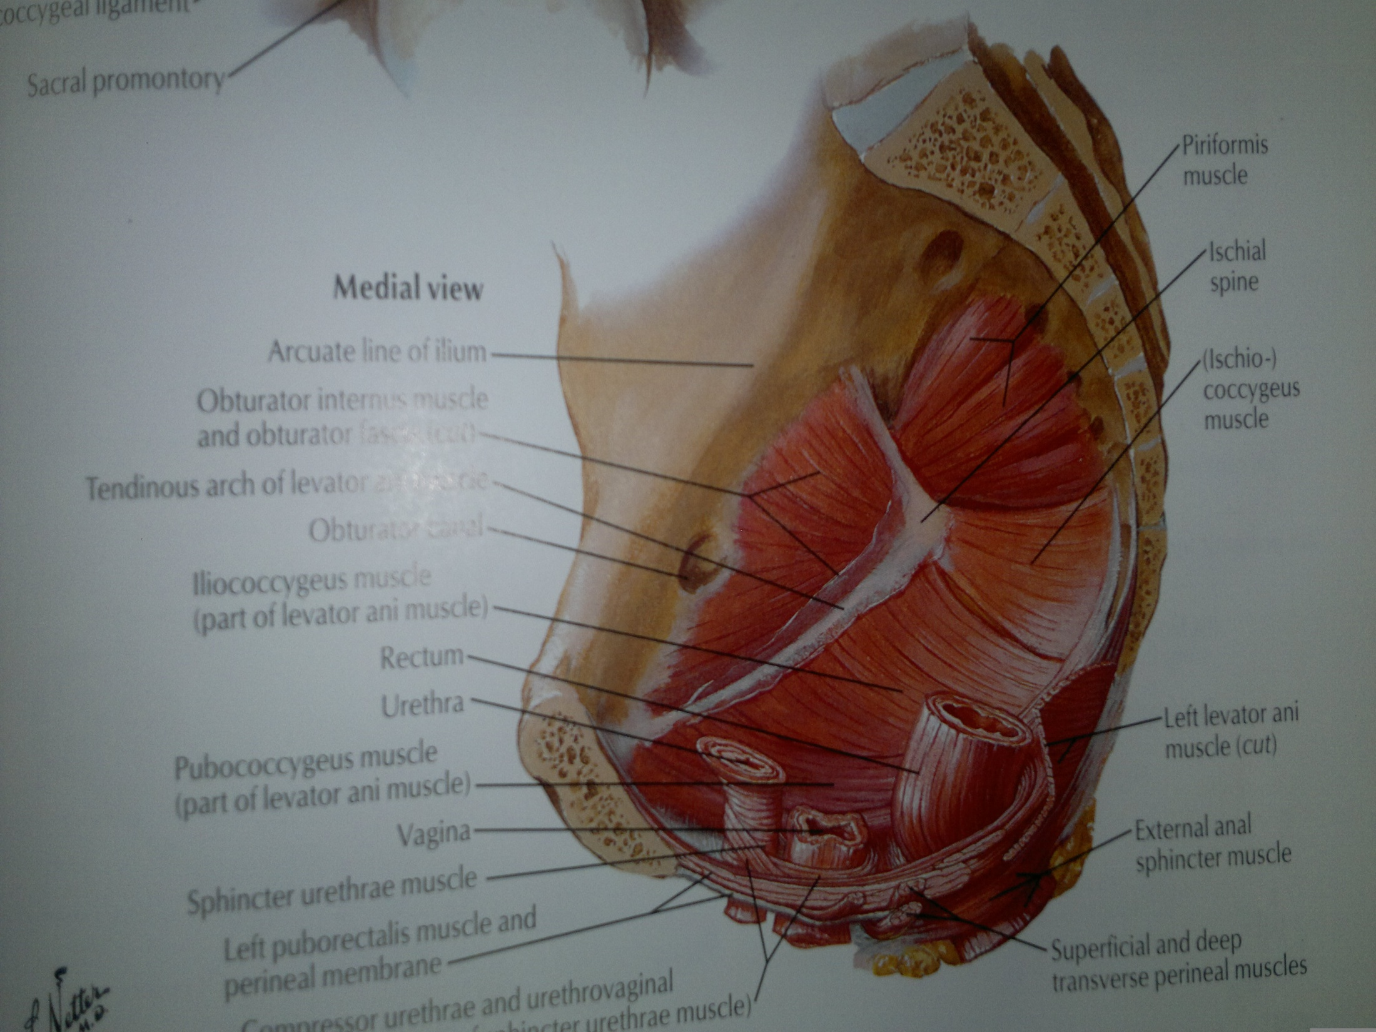

Slide 4
Ant .division branches:-
1)umbilical artery:-gives the sup.vesical artery :-to upper portion of bladder.
2)obturator artery:-leaves the pelvis within the obturator canal…note that it doesn’t supply any structure in pelvis but passes to supply adductors of thigh med.
3)inf.vesical artery :-supplies prostate,seminal vesicle & base of bladder also gives artery to vas deferns.
4)int.pudendal artery:-leaves the pelvis through the greater aciatic foramen …below the piriformis to enter the gluteal region..it enters the perineum through lesser sciatic foramen..then the artery passes in the pudendal canal with pudendal nerve.supplies:-the musculature of anal canal…skin & muscles of perineum.

Slide 5
5)vaginal artery:-this takes the place of inf.vesical artery in male .
Supplies:-vagina & base of bladder.
6)uterine artery (from book)
7)inf.gluteal artery:-this leaves the pelvis through greater sciatic foramen below piriformis muscle…it passes between the 1st & 2nd or 2nd & 3rd sacral nerves.
8)middle rectal artery:-this arises with inf.vesical artery …supply the lower rectum anastmoses with sup & inf rectal arteries.

Slide 6
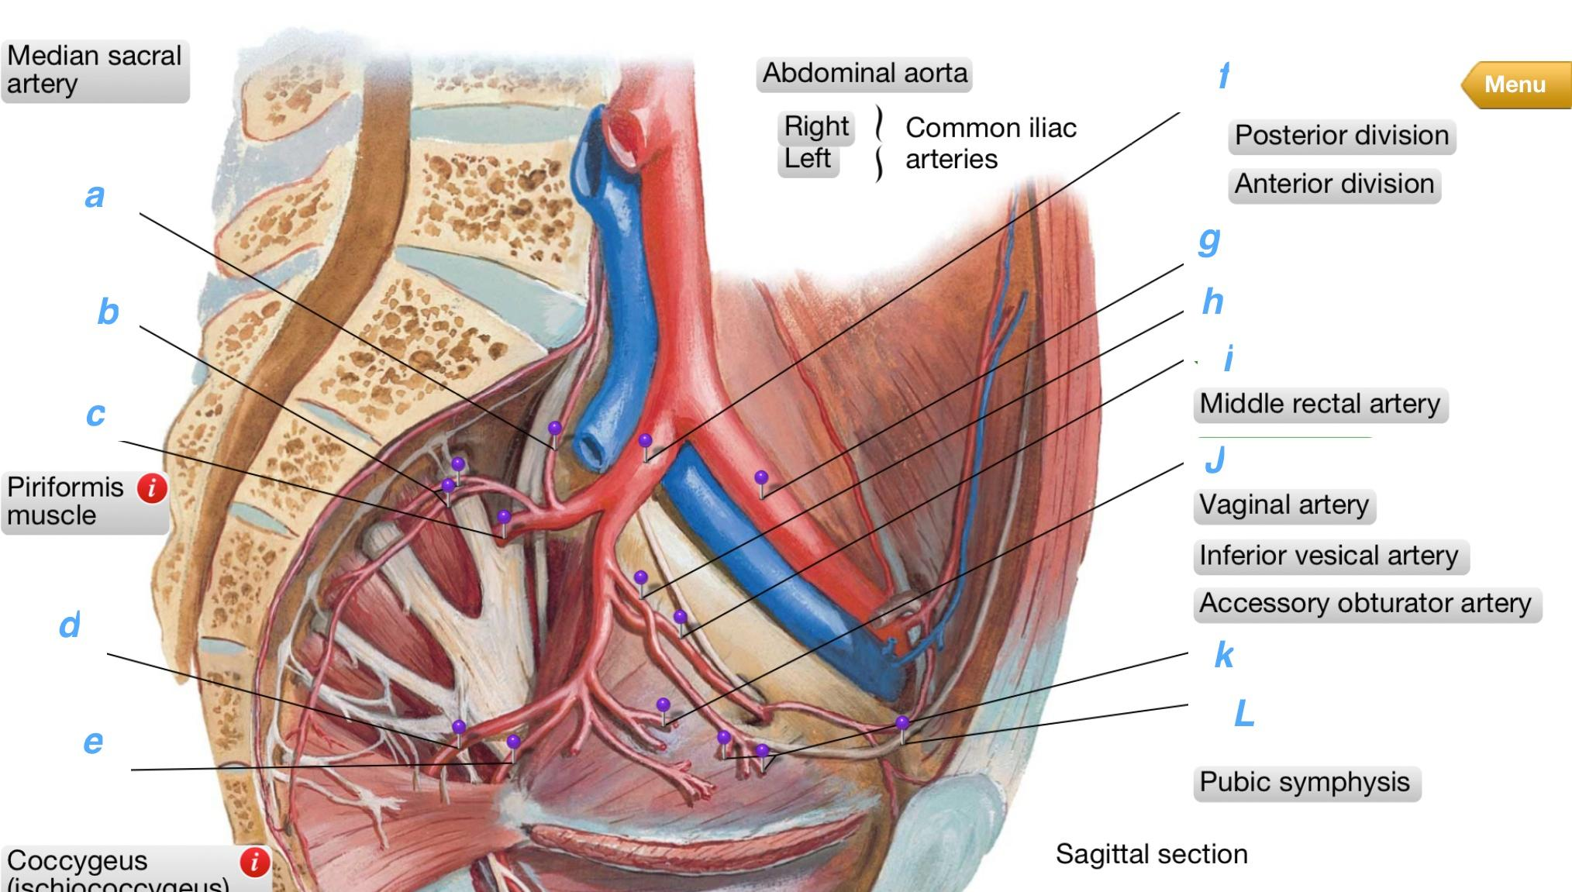

Slide 7
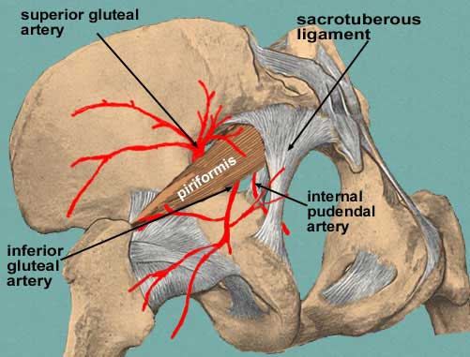

Slide 8
Post.division:-
1)sup.gluteal artery:-leaves the pelvis through greater asciatic foramen …supply gluteal region.
2)iliolumbar artery:-this ascends to ex.iliac vessels..iliacus..psoas.
3)lateral sacral arteries:-passes infront of sacral plexus.to neighboring structures.

Slide 9
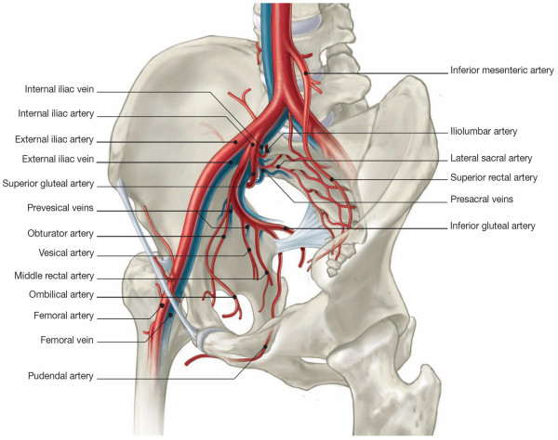
Passes to iliacus,,,psoas,,,ex.iliac vessels.
Infront of sacral plexus

