Slide 1
Surgical removal of impacted lower 3rd molar

Slide 2
Before the surgical procedure the following should be done
1- proper clinical and radiographic evaluation of the condition.
2-classification of the impacted tooth to evaluate the difficulty of the surgical procedure .
3- selection of the proper time for surgical removal.
4- explain the condition and its complication to the patient
5 – select type of anesthesia

Slide 3
Evaluation of the difficulty of the impacted lower third molar removal
1- the orientation of the tooth ( distinction between vertical and distoangular impaction )
2- the depth of the tooth
3- the relation of the impacted tooth to the external oblique ridge and to the internal oblique ridge
4 –root shape like bulbous root or thin spindly roots.
5 – bone density (texture of the investing bone)
6-relation to the inferior dental canal .

Slide 4
Relation to the inferior alveolar canal
If the canal is below the apex it is not at risk . If it at the apex it may be damaged by mesially applied elevation which forces the apex down if bone removal has been in adequate .
The root apex may be grooved by the neurovascular bundle , splitting the tooth longitudinally with an osteotome may also concuss the nerve and produce neuropraxia .

Slide 6
If the nerve is above the level of the apex , it is usually buccal to the root unless the crown is lingually inclined so that the root lies buccaly, a buccaly placed nerve is at risk from buccal bone removal or from buccal movement of the forceps .
If the upper and lower cortical plate of the canal is also missing as the canal crosses the tooth this will mean grooving or perforation of the root .

Slide 7
Another feature which suggest either deep grooving or perforation of the root is when the canal is looped upwards by the tooth . The implication is that the neurovascular bundle has been pulled upwards at that point as the tooth has attempted to erupt .

Slide 8
7 – patient age
8 – degree of mouth opening
9- general buildup of the patient .
10 –type of impaction like soft tissue impaction , bony impaction , tooth to tooth impaction..

Slide 9
11- crown size
12- follicular size
13 – depth of bone between the tooth and the lower border of the mandible .

Slide 10
Selection the time for surgical procedure
Early removal
1- the impaction should be documented
2 –ball in a socket syndrome
Late removal increase difficulty due to long root and dense bone.
The best time for removal when only 2/3 of the root had completed .(15 -25 years of age ) because : roots are generally straight and not curved , bone is softer and more pliant ,the inferior alveolar nerve is more distant from the root apices , and healing is more rapid.

Slide 12
Patient with impacted tooth who wait until symptoms occur before seeking removal have greater morbidity associated with their surgery .early intervention in the surgical removal of impacted 3rd molars will benefit most patients .

Slide 13
The patient
The condition should be explained to the patient in a simple easy way directing his attention to possible complication that may arise from leaving the tooth in position .

Slide 14
Choice the type of anesthesia
Local anesthesia or general anesthesia
The indications for G.A may include :
1 – procedures lasting more than 45 minutes .
2 – uncooperative patient
3 - very apprehensive patient
4- level C impacted lower 8
5- class 3 impacted lower 8 .
6 – multiple impacted teeth removal

Slide 15
The surgical procedure for extraction of impacted lower third molar

Slide 16
1-elevation of an adequate mucoperiosteal flap
There are 3 types of mucoperiosteal flap design for removal of impacted lower third molar :
1- envelop flap : used for soft tissue impaction that need no bone removal. No vertical incision
2- standard flap indicated in all cases of impacted lower third molar . The vertical releasing incision lie distal to the second molar.
3- modified standard flap indicated for impacted tooth that completely covered by bone .the vertical releasing incision lie mesial to the second molar

Slide 17
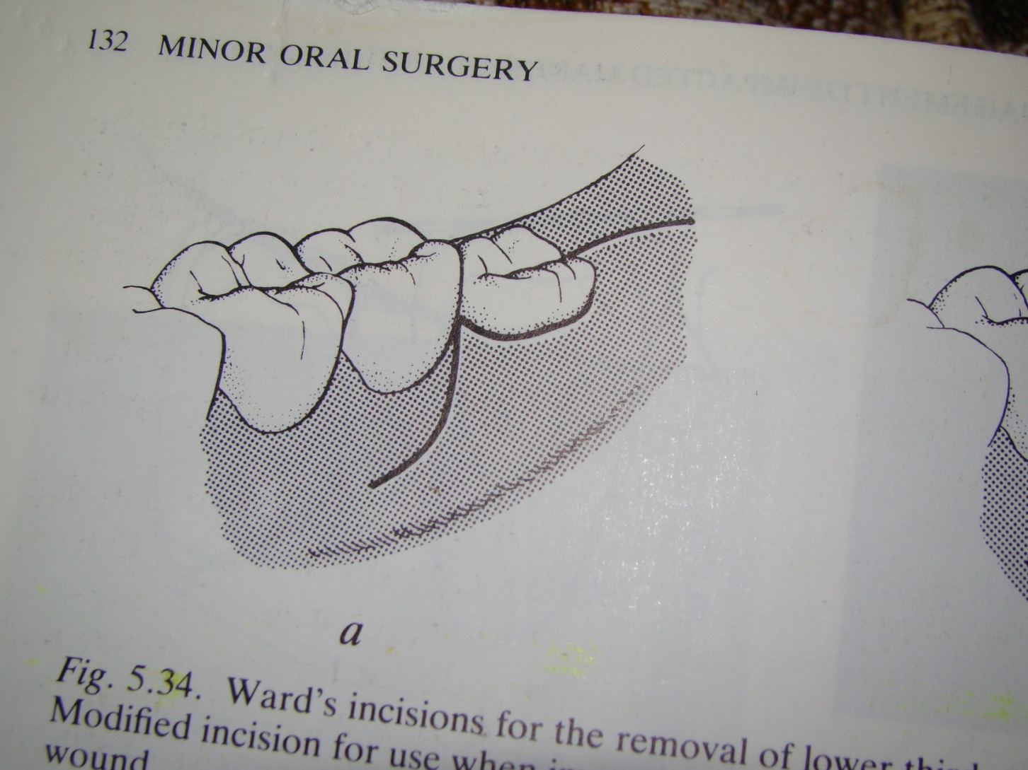
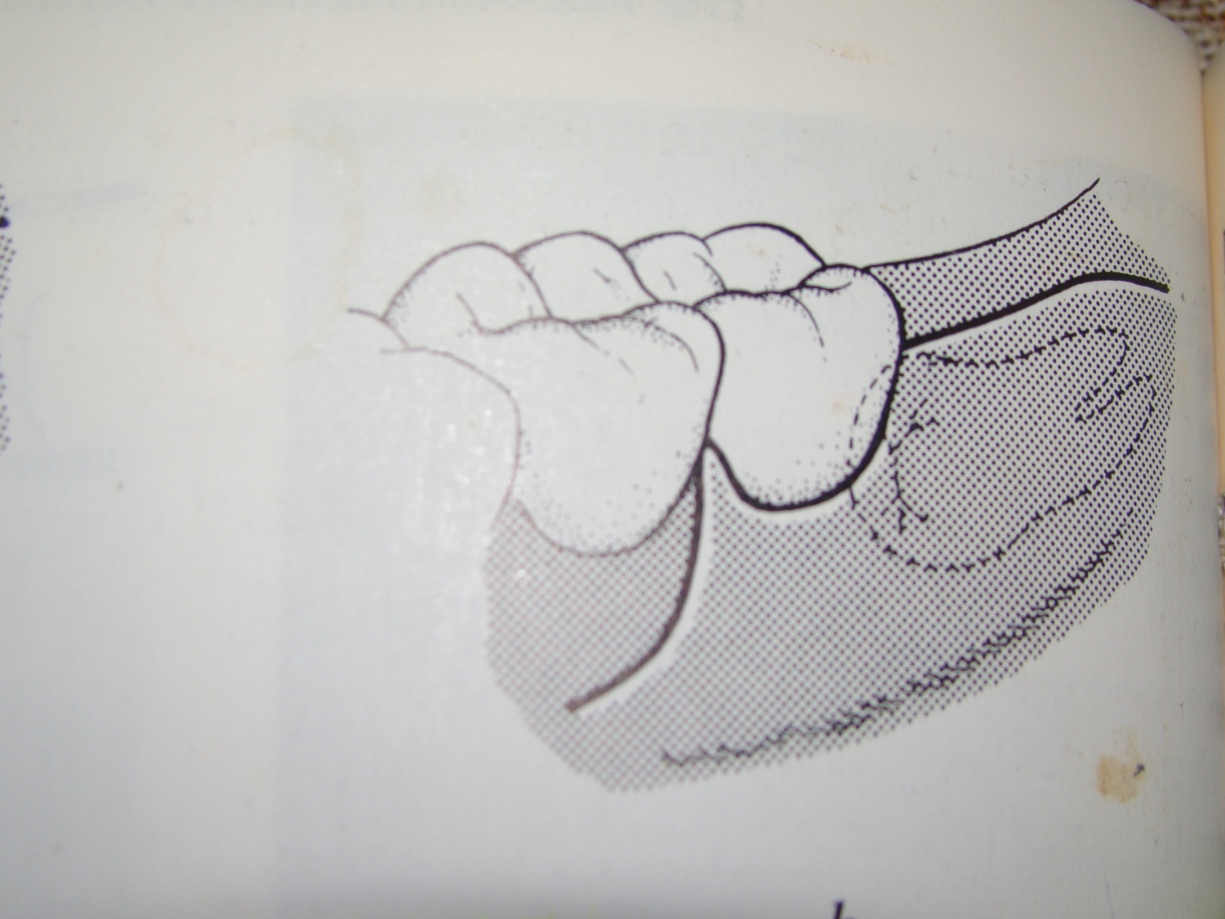

Slide 18
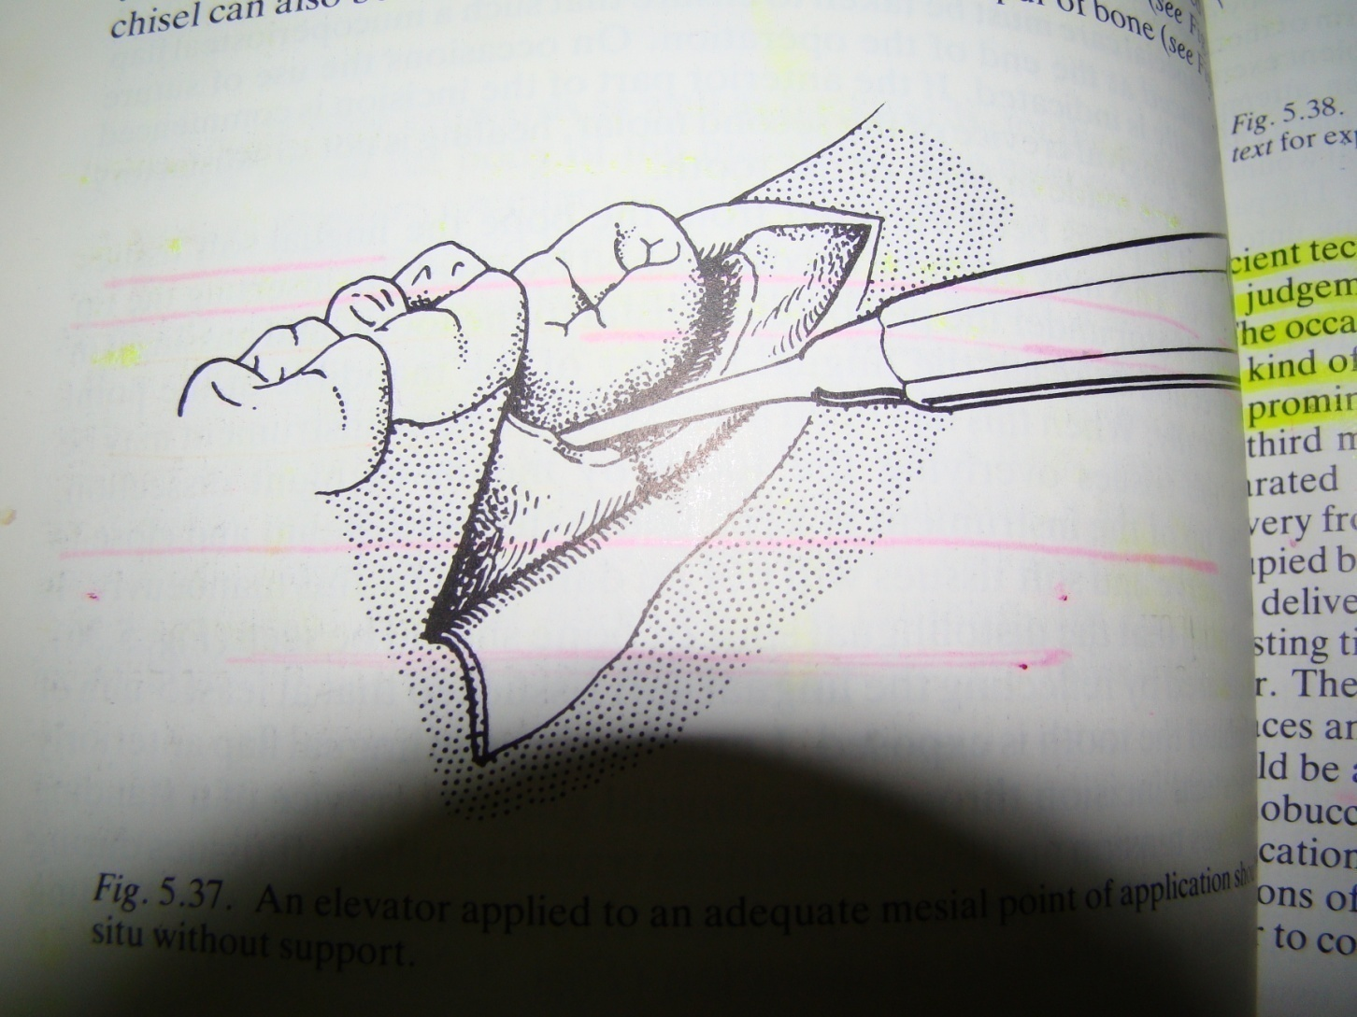

Slide 19
Bone removal
Purpose of bone removal :
1- exposure of the impacted tooth
2- removal of bone in the path of removal
3-exposure of a point for elevator application( at the cemento enamel junction )

Slide 20
Types of bone removal
Guttering with surgical bur or Postage stamp method with surgical bur . Irrigation with cold saline , chlorhexidine or distilled water(20 degree centigrade) .irreversible bone cell necrosis occur at 56 degree centigrade.
Chisel and hammer
Piezoelectric surgery.
Laser surgery.

Slide 21
Removal of surrounding bone
After adequate flap retraction , bone removal is then performed . A high torque handpiece with a special surgical attachment that will not blow air into the surgical field must be used .
A trough should be cut between the crown and the lateral buccal alveolar bone exposing the entire crown to the cementoenamel junction .

Slide 22
A constant stream of water irrigation must accompany the drilling to avoid overheating the bone as well as improving visibility by removing the cut bone and tooth debris .

Slide 24
Piezoelectric bone surgery known simply as piezosurgery is a new technique of bone removal ( osteomy and osteoplasty ) which require the use of micro vibrations of ultrasonic frequency scalpel . the vibration is amplified and transferred into a drill which when rapidly applied with slight pressure up on the bony tissues , results in cavitations phenomena , with a mechanical cutting effect exclusively on mineralized tissue .

Slide 25
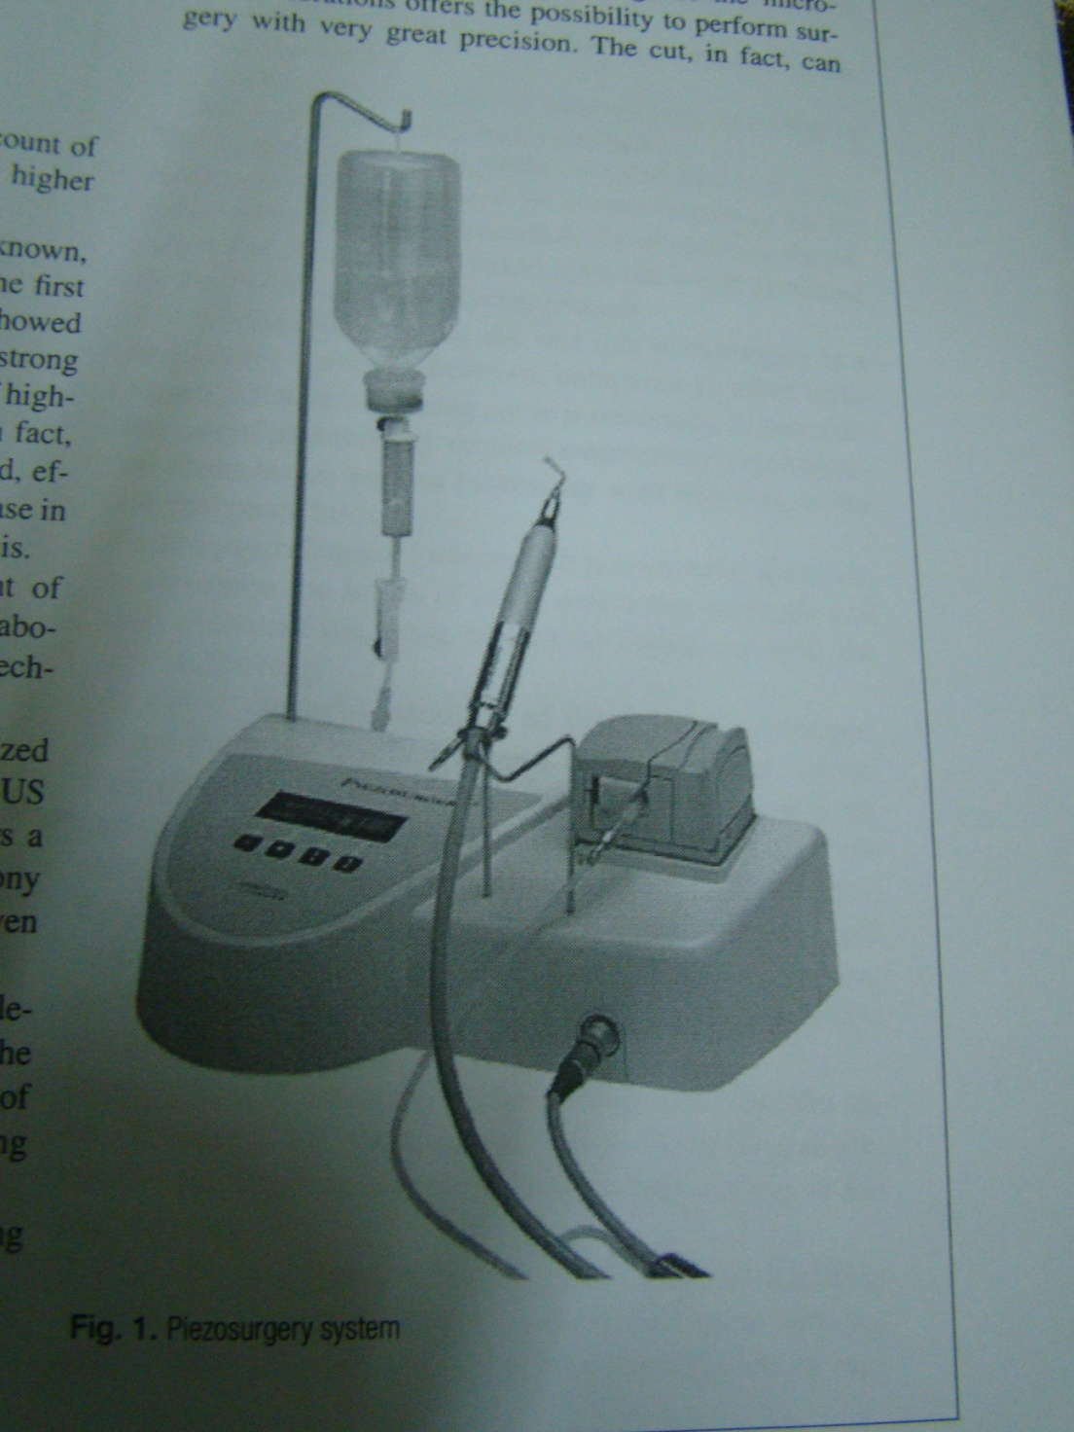
Piezo electric surgery :the advantage of using this technology is that piezoelectric surgery dose not cut soft tissues , so damage to the soft tissue is less likely to occur .

Slide 26
Tooth delivery
1- whole tooth delivery without tooth division . Total delivery by application of force using elevator , mesial or buccal elevator application.
2- tooth division : division is indicated to reduce resistance , create space or remove interlocked cusps of the tooth

Slide 27
Tooth division/ 3 types
1- decapitation : division of the crown of the tooth at cervical margin level. It is indicated in horizontally impacted mandibular 3rd molar .
2 – longitudinal tooth division : indicated when the impacted tooth has a widely divergent straight roots or when one root is straight and the other is curved( different path of removal )

Slide 28
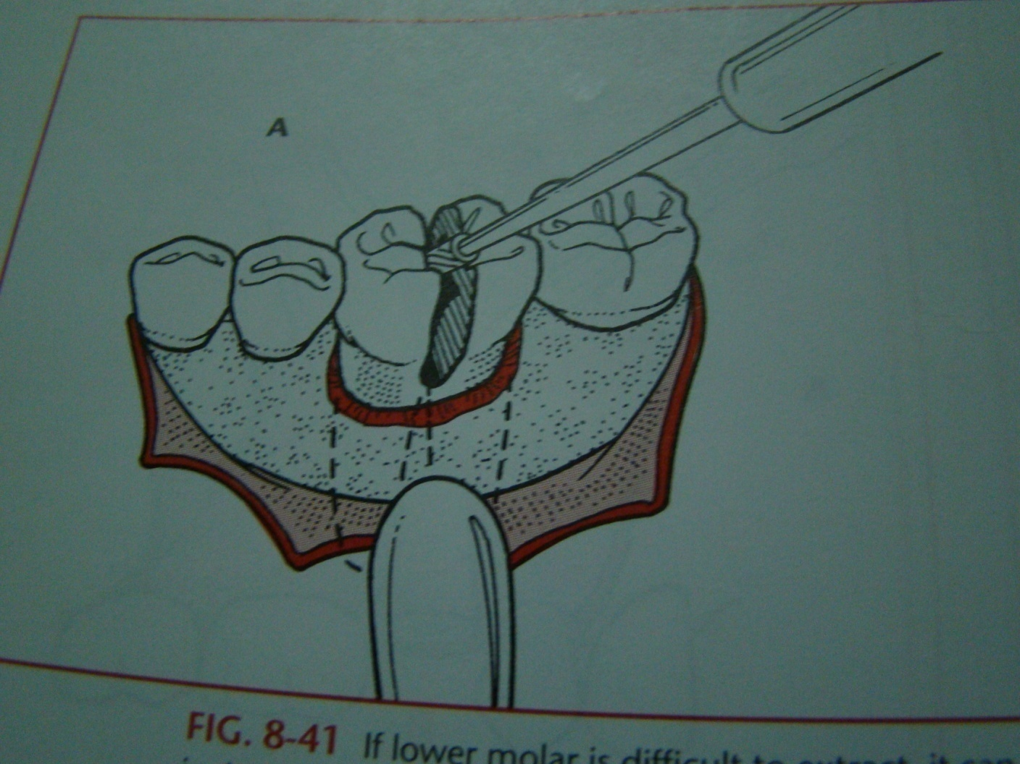
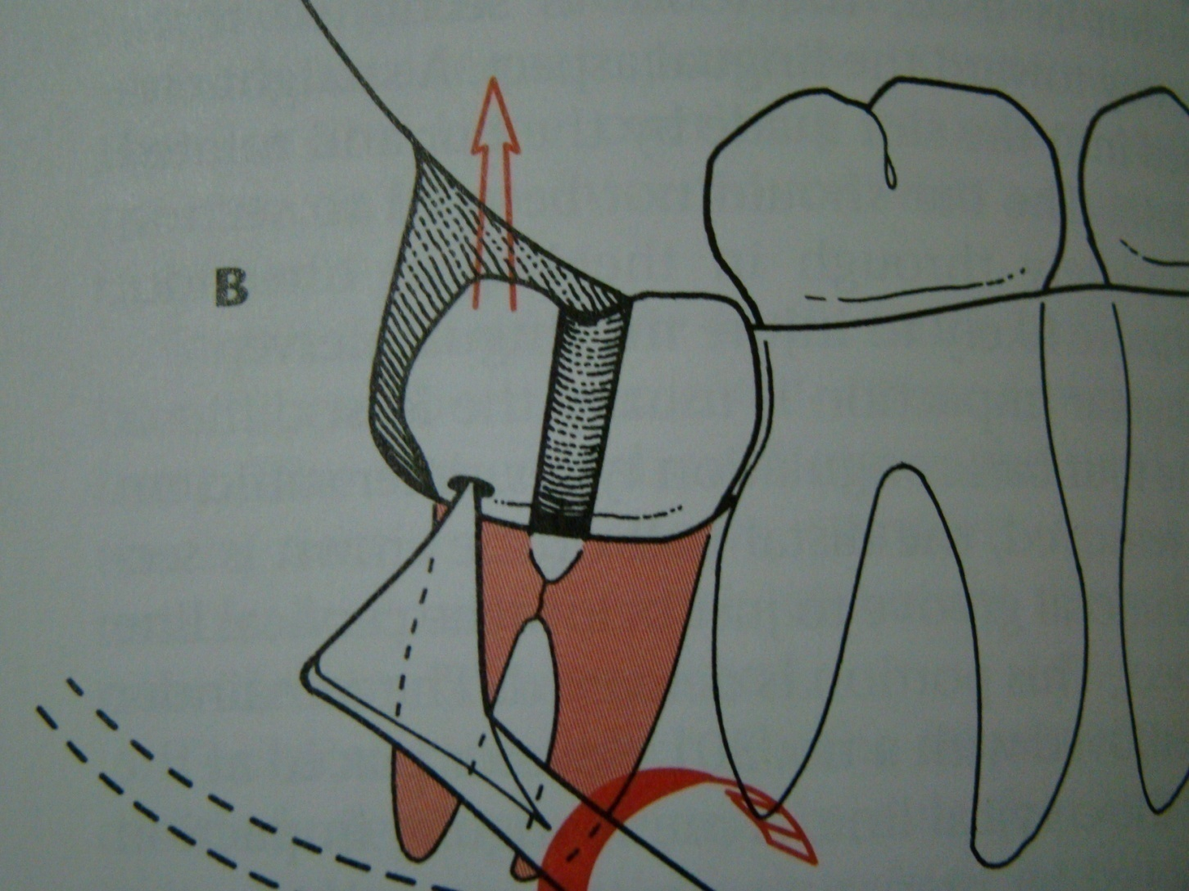
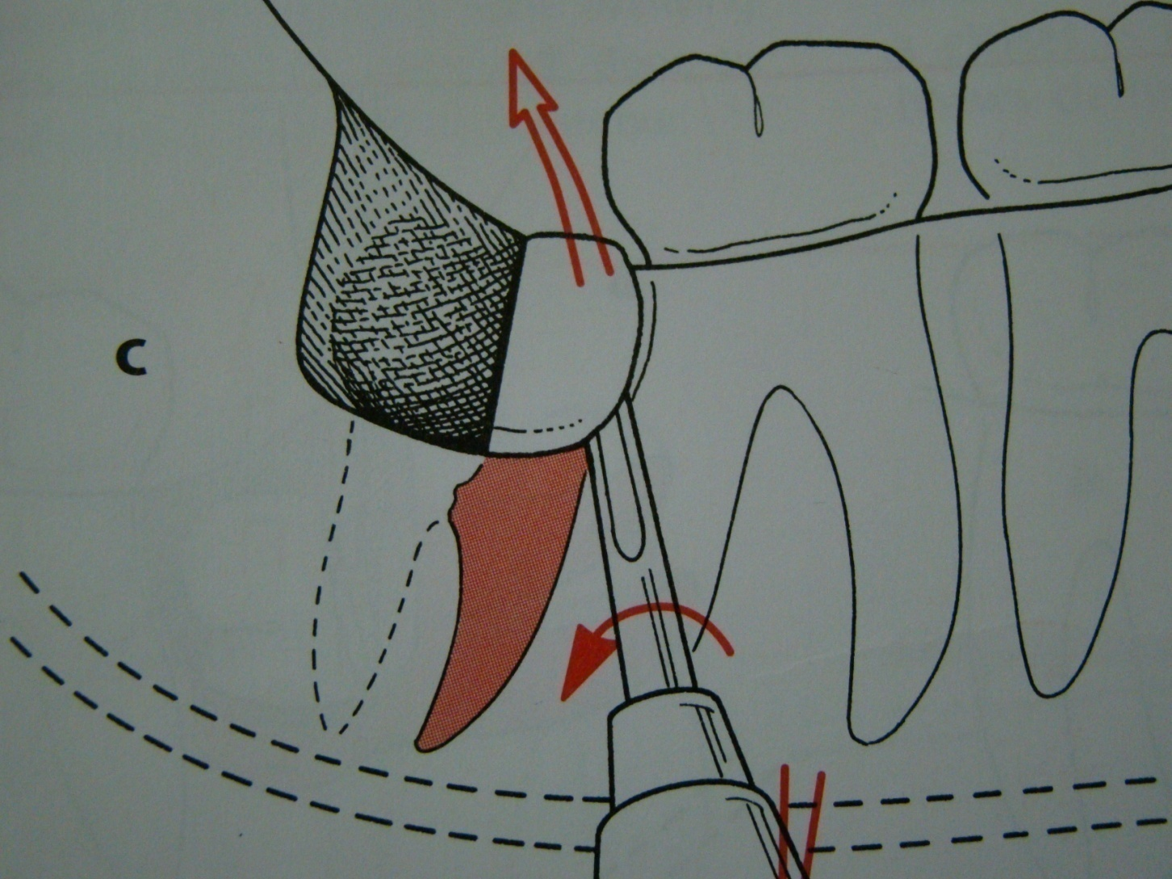

Slide 29
3- division of the interlocking cusp: indicated for mesioangular impaction ,
removal of the interlocking segment of the tooth ,usually located under the distal surface of the second molar

Slide 30
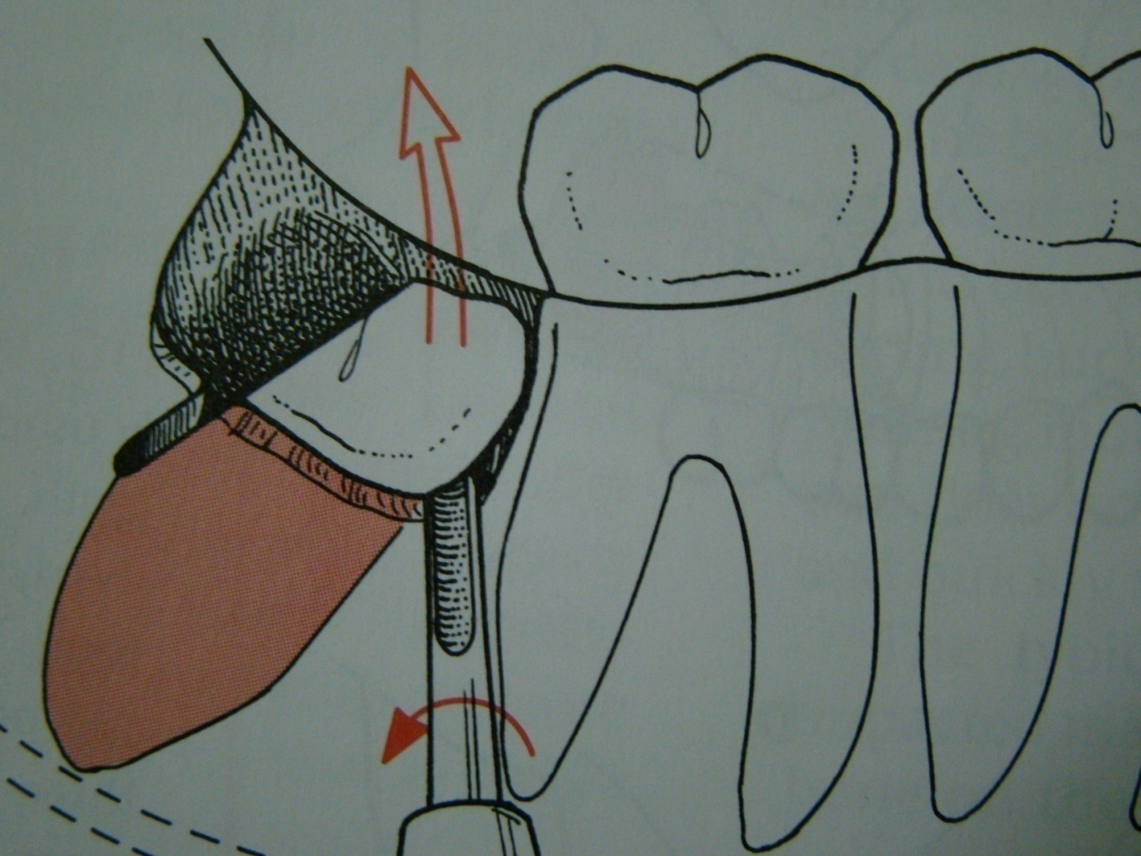

Slide 31
Toilet of the socket or preparation for wound closure
After removal of the tooth from its socket the wound is gently irrigated with sterile normal saline solution and inspected for :
1- Any remnant of the residual tooth sac ( tooth follicle) is removed .
2- Remnants of tooth structure or fragment of bone debris is gently removed.

Slide 32
3- small fragment of detached bone .
4- sharp edges of interseptal or alveolar bone
is trimmed and smoothed .
then final irrigation and wound now is ready for closure
Inadequate debridement is a primary cause of post operative pain and infection .

Slide 33
Closure of the wound
Well designed and properly reflected flap can be easily repositioned into its place ,using 000 black silk suture .

Slide 34
The flap should not be closed watertight with multiple sutures but rather closed with 2 or 3 stitches to allow for some limited opening and drainage .

Slide 35
Post operative care
1- a pressure pack is held in place for 1 hour. Usually use wet gauze or wet cotton .
2- post operative instruction is given to the patient :
a/ cold packs at the angle of the mandible in case of lower 8 for 20 minutes 5 times daily but do not freeze the skin .

Slide 36
B / proper antibiotic therapy
c / maintaining good oral hygiene including mouth washes and teeth brushing
D / soft diet
E /Do not smoke for 24 hour
3- appointment for check up after 2 days .
4 – appointment for suture removal after 5-7 days

Slide 37
Complications associated with surgical removal of impacted teeth
Complication during the surgery :
1 – laceration of the flap due to ;
A / improper incision design.
B / improper elevation of the flap and improper retraction , this lead to delayed healing .
2 – fracture of the jaw at the angle of the mandible due to improper use of elevators with uncontrolled force.

Slide 38
3 – fracture of the tuberosity : this occur with erupted rather than unerupted tooth due to improper use of the force .
4 - injury to inferior alveolar canal occur in deeply seated vertical impaction
5- damage to the nasal floor
6- involvement of the maxillary sinus

Slide 39
7- pushing the maxillary tooth into the maxillary sinus .
8 - pushing the maxillary third molar into the pterygopalatine fossa
9- pushing of the mandibular third molar into the pterygomandibular space or into the submandibular space.
10 - aspiration or swallowing of the impacted tooth .

Slide 40
Post operative complication
1 – post operative pain which is greatly reduced when preemptive analgesia like tramadol injection used .
2- post operative swelling or edema which is greatly reduced when preoperative decadron (dexamethasone 8 mg ) injection used .
3 - Post operative infection which is greatly reduced when preoperative antibiotic like ampiclox 500 mg injection used .

Slide 41
4 - Post operative bleeding which is greatly reduced if complete homeostasis is secured before suturing .
5- trismus
6- osteomyelitis
7- pain at the TMJ
8 - pain with swallowing (dysphagia) due to edema of the pharynx or hematoma formation

Slide 42
Thank you

