Slide 1
Practical Medical Microbiology
Culture Media Preparation

Slide 2
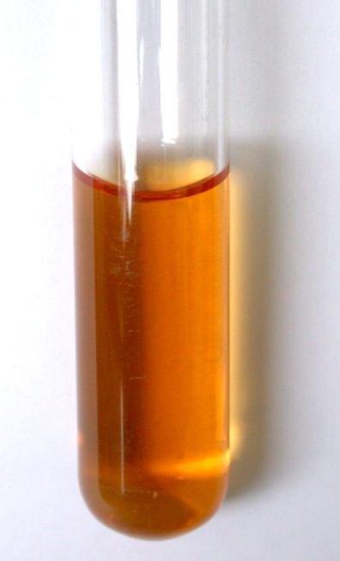
Bacteria have to be grown (cultured) for them to be identified.
By appropriate procedures they have to be grown separately (isolated) on culture media and obtained as pure for study.
Broth Media :Liquid medium – diffuse growth
Solid medium (Agar Media)
discrete colonies.
20/10/2015

Slide 3
TYPES OF CULTURE MEDIA
BASED ON THE AGAR CONCENTRATION (Consistency): 1. Solid media – 2% agar. 2. Liquid media – broth media absence of agar. 3. Semi solid media – 0.2-0.5% agar

Slide 4
BASIC NUTRITIONAL REQUIREMENTS
WATER.
CARBON SOURCE.
NITROGEN SOURCE.
INORGANIC SALTS. Phosphates. Sulfates. Sodium. Potassium. Magnesium. Iron. Manganese. Calcium.
BACTERIAL VITAMINS. Thiamine riboflavin nicotinic acid pyridoxine folic acid vitamine B_{12.}

Slide 5
GASEOUS REQUIREMENTS
OXYGEN Obligate aerobes Facultative anaerobes. Microaerophillic. Obligate anaerobes.
CARBONDIOXIDE: Capnophillic.

Slide 6
TEMPERATURE
Psychrophillic – bacteria that grows at lower temeperature – below 20ºC.
Mesophillic – bacteria that grows at 25ºC-40ºC. optimum temp range - 37ºC.
Thermophillic – bacteria that grows at high temperatures - 55ºC-80ºC.

Slide 7
CULTURE MEDIA BASIC INGREDIENTS
PROTEIN SOURCE – peptone (a complex mixture of partially digested proteins). - special brands – Neopeptone & proteose peptone - digest broths can also be used. - meat extract (Lab Lemco).
MINERAL SALT – sodium chloride.
WATER- source of hydrogen and oxygen.

Slide 8
Agar
Used for preparing solid medium
Obtained from seaweeds.
No nutritive value
Not affected by the growth of the bacteria.
Melts at 98ºC & sets at 42ºC
2% agar is employed in solid medium

Slide 9
Types of culture media
Based on their consistency
a) solid medium
b) liquid medium
c) semi solid medium
Based on the constituents/ ingredients
a) simple medium
b) complex medium
c) synthetic or defined medium
d) Special media

Slide 10
Special media
Enriched media
Enriched with Blood,serum,extrapeptones,egg& vitamins
Used for: cultivation of all fastidious organisms,
(haemophilus influenza&Streptococcus spp.)
Examples: Blood agar &chocolate agar
Enrichment media
Contains substances that stimulates the desired bacteria or has inhibitory substances that inhibits the growth of unwanted bacteria.
Or otherwise promotes the growth of a particular organism and prevent the growth of normal competitors.
Differential media”:
are specialized media that allow identification of organisms based on their growth
and appearance on the media
Selective media
are specialized media that allows the growth of one type or certain types of bacteria ,fungi , while inhibiting the growth of other organism

Slide 11
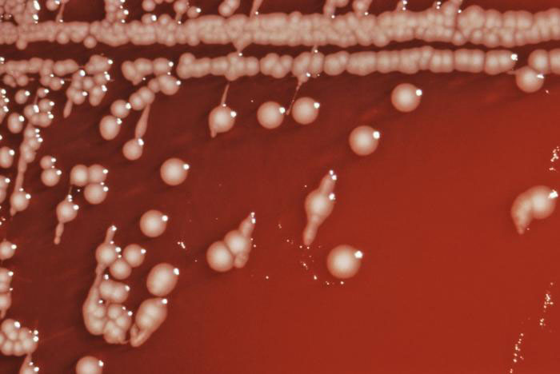
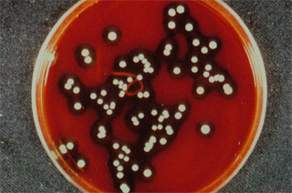
Enriched media
Such as blood agar

Slide 12
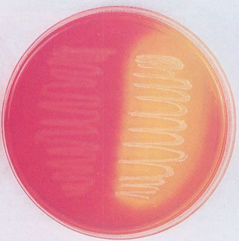
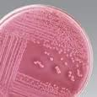
Differential media
which is differential for mannitol
fermentation
Like Staphylococcus aureus change
the color of agar from pink to yellow
Mannitol salt agar
Differential media
MacConkey agar
which is differential for lactose fermentation Ex: E.coli
From non lactose fermenters
Ex: salmonella,shigella
MacConkey agar

Slide 13
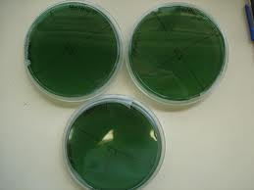
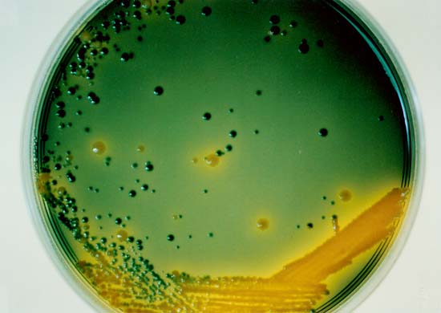
Selective media
Thiosulphate citrate bile salt sucrose (TCBS) which is selective for Vibrio cholerae
MacConkey agar which is selective for Enterobacteriaceae
TCBS agar

Slide 14
Culture Media
Chemically defined media: Exact chemical composition is known
Complex media: Extracts and digests of yeasts, meat, or plants
Nutrient broth
Nutrient agar

Slide 15
SYNTHETIC & SEMISYNTHETIC MEDIUM
SYNTHETIC OR DEFINED MEDIUM: Prepared from pure chemical substances and the exact composition of the medium is known. Used for various special studies such as metabolic requirements. EXAMPLE: Dubo’s medium
SEMISYNTHETIC OR SEMIDEFINED MEDIUM: Composition is approximately known.

Slide 16
COMPLEX MEDIUM
Exact chemical composition of ingredients of culture medium is not known.
Widely used for the cultivation of bacteria for diagnostic purposes.

Slide 18
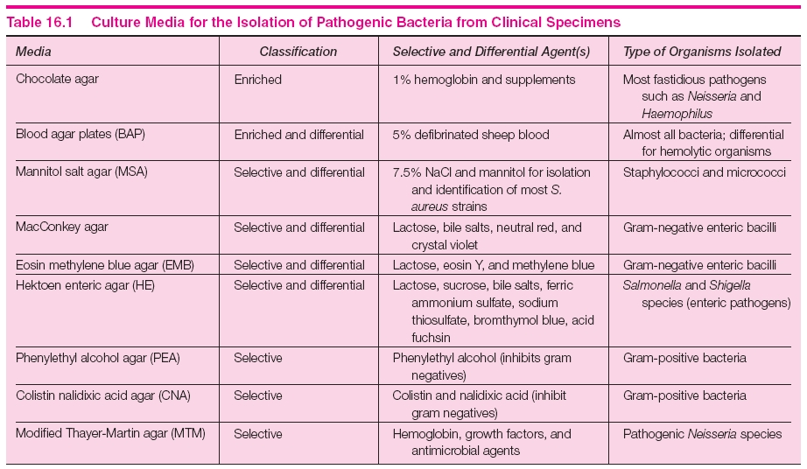
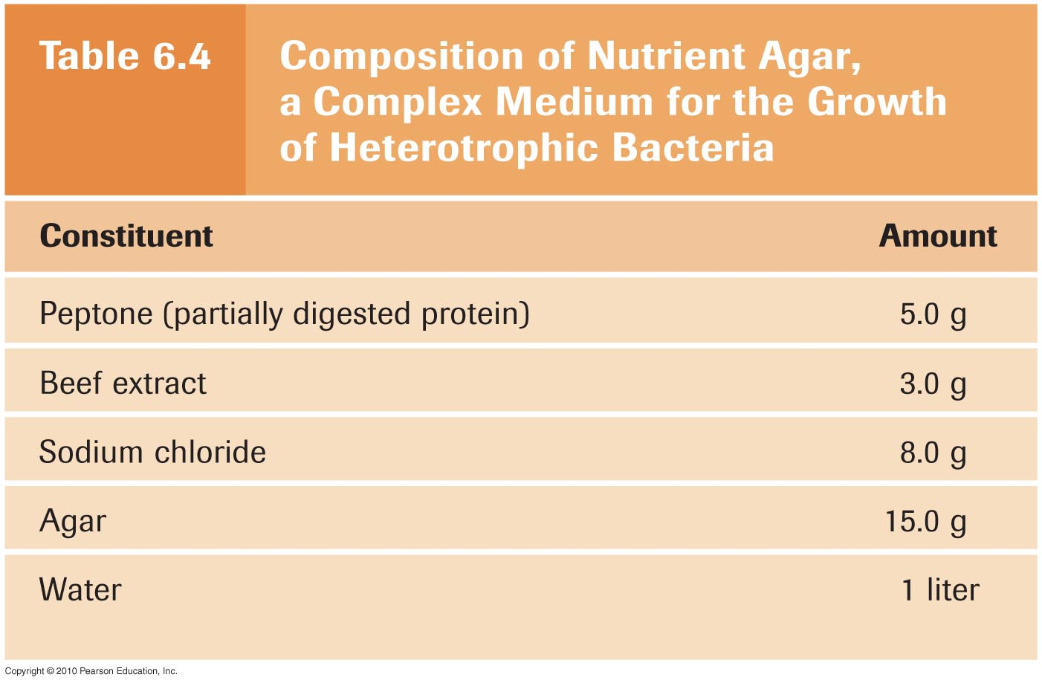

Slide 19
Solid media – contains 2% agar
Colony morphology, pigmentation, hemolysis can be appreciated.
Eg: Nutrient agar, Blood agar
Liquid media(Broth media) – no agar.
For inoculum preparation, Blood culture, for the isolation of pathogens from a mixture.
Eg: Nutrient broth
Semi solid medium – 0.5% agar.
Eg: Motility medium

Slide 20
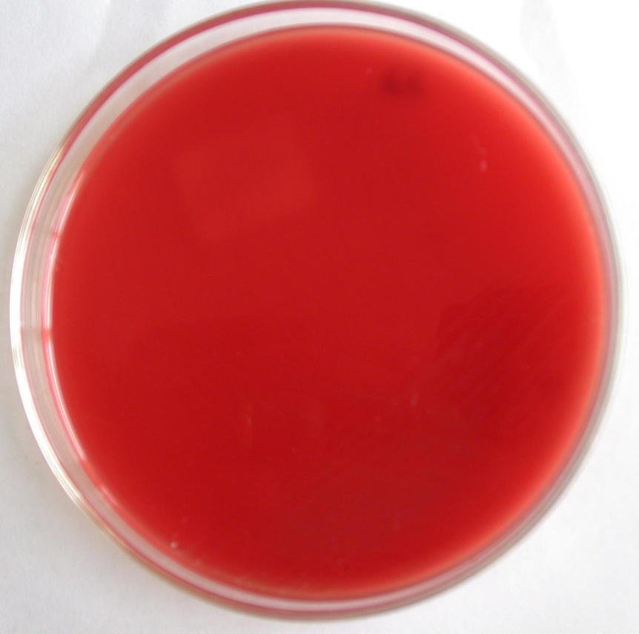
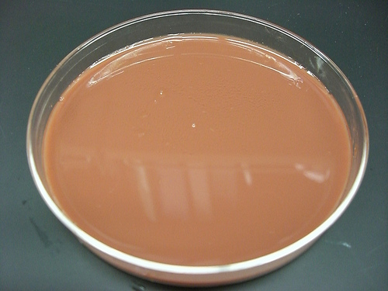
Blood agar
Chocolate agar

Slide 21
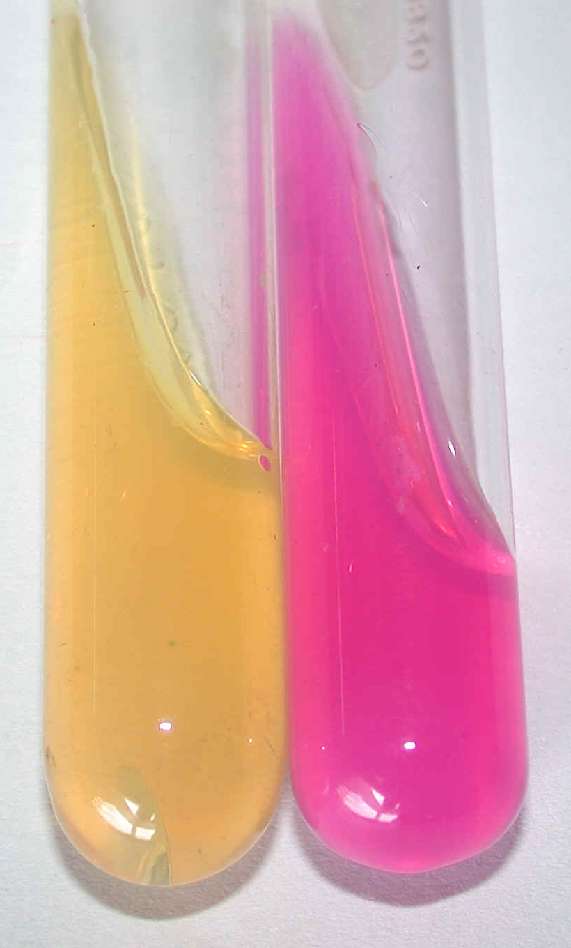
Urease medium
Notes:
Mac Conkey’s medium

Slide 22
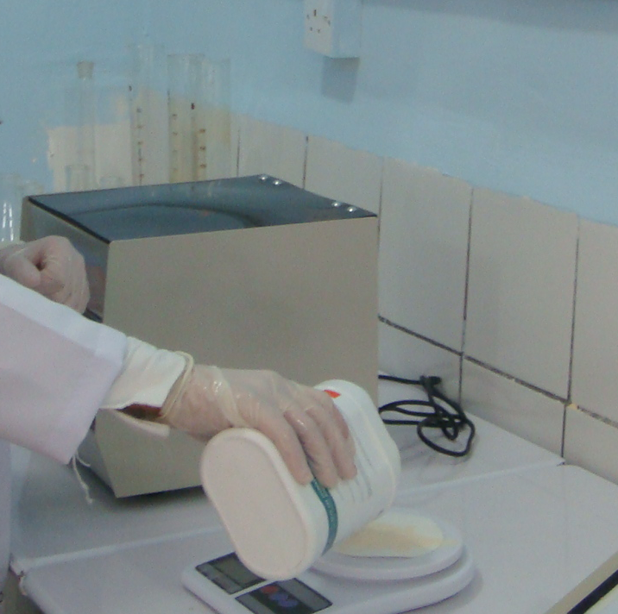
STEP 1:
Correct amount of Dehydrated medium is weighed on balance.

Slide 23
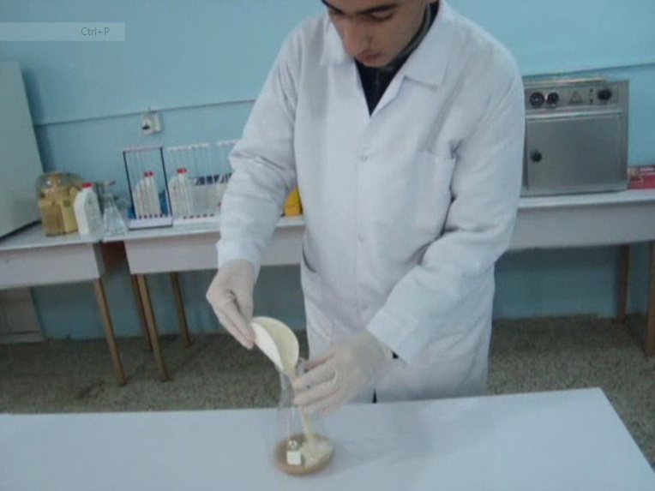
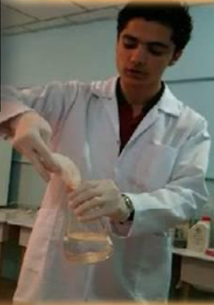
STEP 2:
Dehydrated medium is dissolved in
a measured amount of
distilled water.

Slide 24
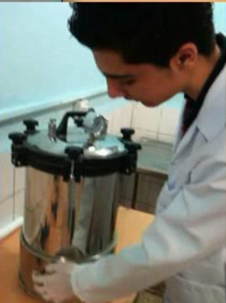
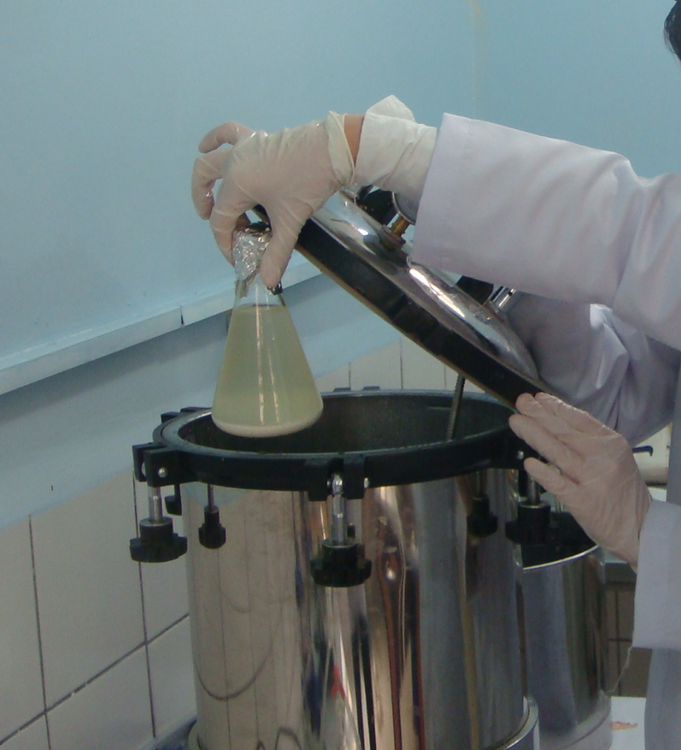
STEP 3:
Tubes and conical of media are sterilized in an autoclave for 15 to 20 minutes at 15 psi steam pressure or (1 bar).

Slide 25
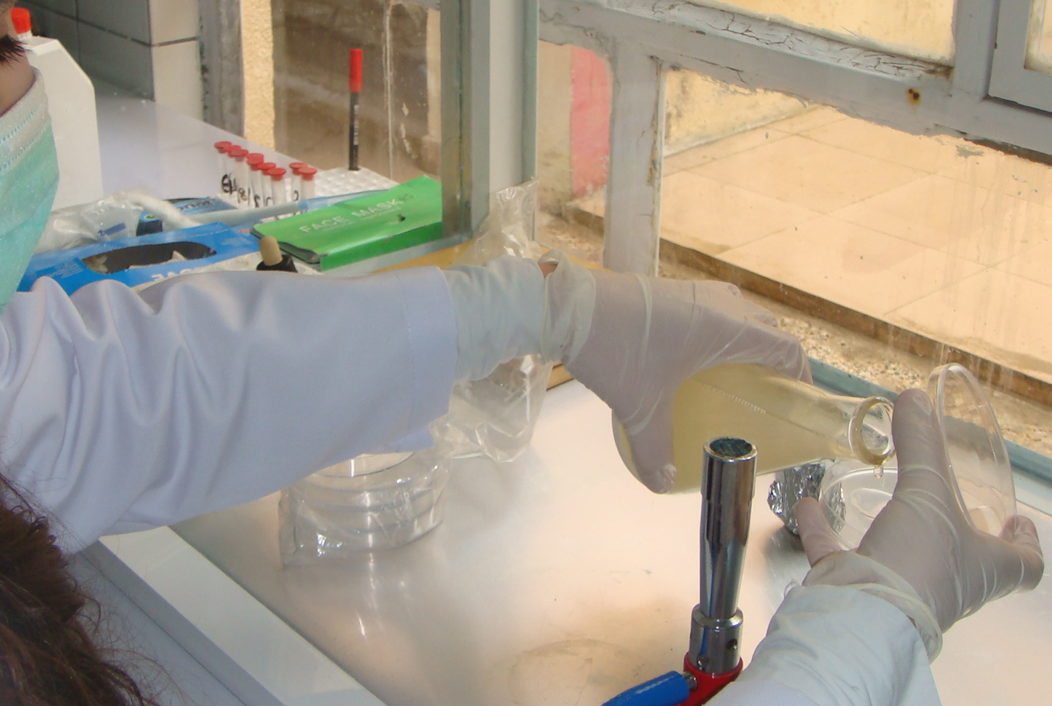
STEP 4:
After sterilization of media .Pour the media agar into the petri dish bottom

