Slide 1
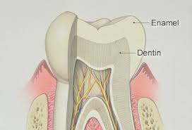
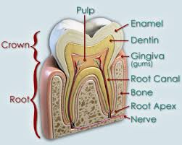
ENAMEL
For 2nd grade
Dr. Huda Y. K.

Slide 2
LECTURE CONTENTS
Definition of enamel.
Composition of enamel.
Structure of enamel.
Properties of enamel.
Function of the enamel.

Slide 5
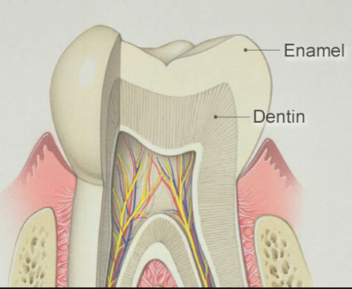
ENAMEL
Tooth enamel is the hardest and most highly mineralized substance of the body which covers the crown of the tooth.
Enamel formation, amelogenesis, is accomplished by cells called ameloblasts. These cells originate from the embryonic germ layer known as ectoderm.
One of the main goals in operative dentistry is preservation of enamel.

Slide 7
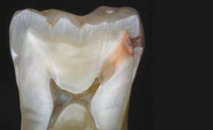
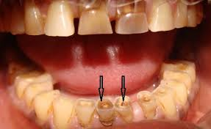
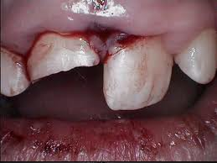
Although enamel can serve lifelong, but it is more susceptible to :
Caries
Attrition (physical forces)
Fracture

Slide 8
One of the interesting features of enamel is that it cannot repair itself.
So, loss in enamel surface can be compensated only by restorative treatment.

Slide 9
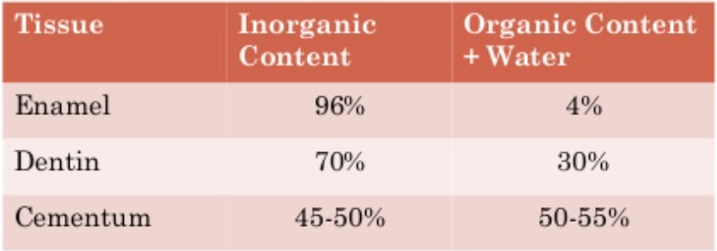
Chemical Composition and Structure Of Enamel
The Inorganic content of mature enamel amounts to 96% by weight; the remainder is organic material (protein, lipid) and water.

Slide 10
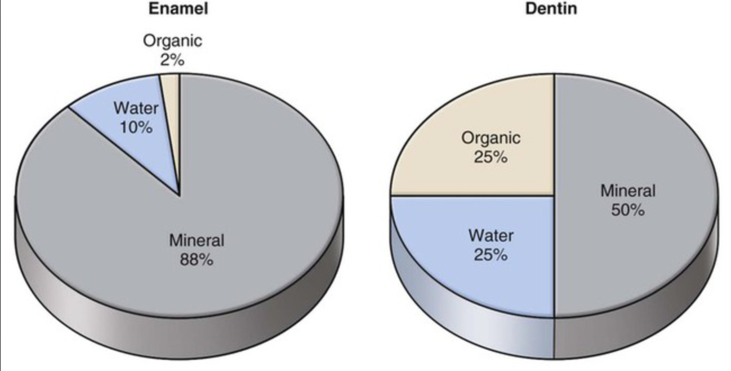
On the basis of volume around 88% is mineral,10% is water, and 2% is organic material (protein, lipid).

Slide 11
Owing to its hardness, enamel is difficult to cut for histological examinations used to study its structure.
Therefore different approaches have been considered to describe its nature.
One way to do this is at the crystalline level.

Slide 12
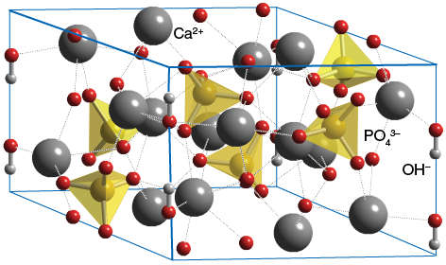
In material science, a crystal is a solid substance in which the atoms, molecules, or ions are arranged in an orderly repeating pattern extending in all three dimensions.

Slide 13
The crystals made by the ameloblasts consist of calcium phosphate
The smallest repeating entity of the crystals in enamel has in its purest form, the formula Ca₅(PO₄)₃(OH) , which is termed hydroxyapatite (HAP).

Slide 14
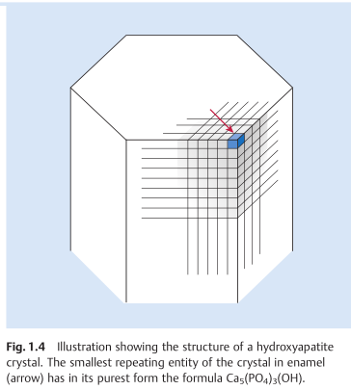
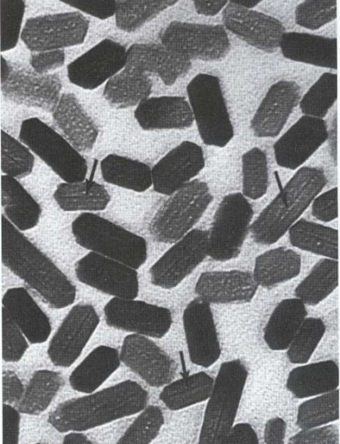
The crystals are approximately hexagonal in cross-section, with a diameter 40nm.

Slide 15
At the chemical level, several substitutions of the ions in HAP can and do occur (resulting in impure forms of HAP) for example:
Substitution with fluoride giving fluoride hydroxyapatite (FHAP);
Substitution with carbonate, carbonate-modified hydroxyapatite (CHAP)
Substitution with magnesium, magnesium-modified hydroxyapatite (MHAP).

Slide 16
More commonly, the OH − ions are only partially replaced by fluoride, and FHAP is formed. These crystals have a lower solubility than HAP, which again has lower solubility than CHAP.
These chemical conditions have great influence on the caries process

Slide 17
Structure
The individual crystals are arranged in rods (or prisms) extending from the enamel–dentin junction to the surface, with an average diameter of about 4–5µm.

Slide 18
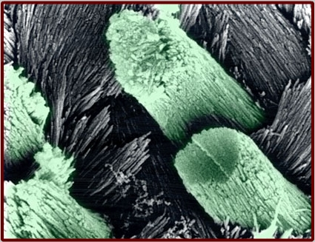
Each rod formed of about 300 unit crystal length and 40 units wide and 20 unit thick in three dimensional hexagon.
In transverse sections, enamel rods appear as hexagonal and occasionally round or oval. Rods may also resemble fish scales.

Slide 19
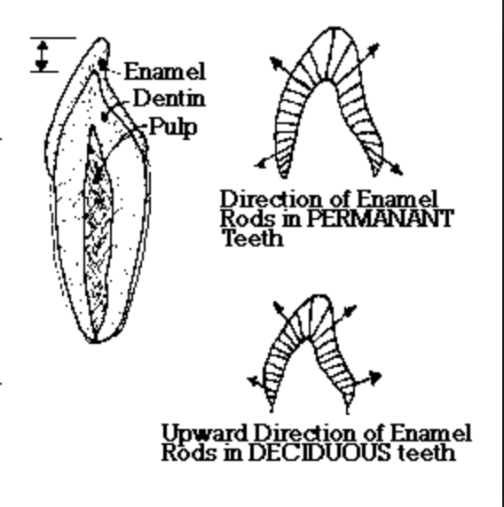
The diameter of rods increases from DEJ towards the outer surface of enamel in a ratio of 1:2.
Enamel rods are arranged in such planes so as to resist the maximum masticatory forces.

Slide 20
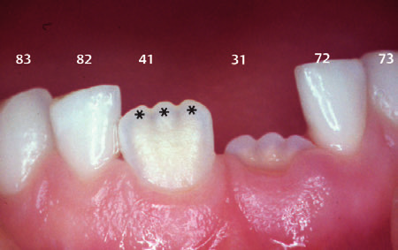
Due to this uniform structure of the enamel with tightly packed crystals, light penetrates through the enamel and is reflected or absorbed in the dentin.
Well mineralized, permanent enamel is translucent, and it is the underlying dentin which, eventually, gives the tooth its color.

Slide 21
Rods are oriented at perpendicular to the DEJ.
Towards the incisal edge these become increasingly oblique and are almost vertical at the cusp tips.

Slide 22
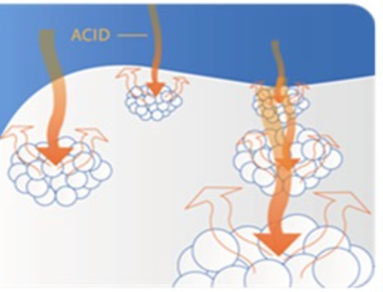
Enamel is soluble when exposed to an acid medium, but the dissolution is not uniform.
Solubility of enamel increases from the enamel surface to the DEJ.
Notes:
Fluoride concentration decreases toward the DEJ

Slide 23
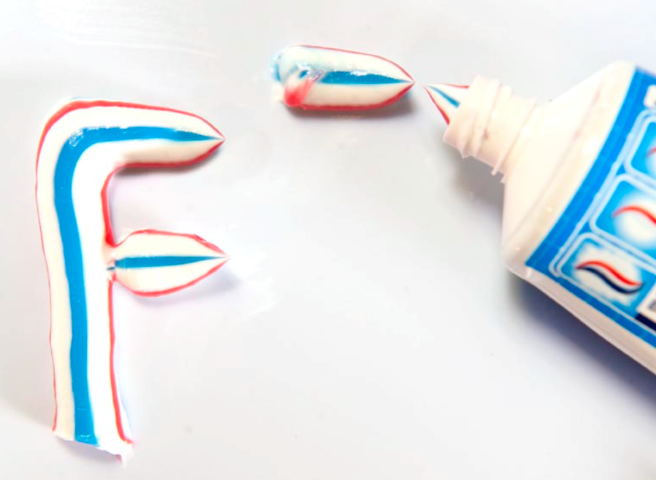
When fluorides are present during enamel formation or are topically applied to the enamel surface, the solubility of surface enamel is decreased.
Fluoride concentration decreases toward the DEJ

Slide 25
STRUCTURE PRESENT IN ENAMEL
GNARLED ENAMEL.
BANDS OF HUNTER-SCHEGER
ENAMEL TUFT
ENAMEL LAMELLAE
ENAMEL SPINDLE
STRIAE OF RETZIUS

Slide 26
1.Gnarled Enamel
There are group of irregular enamel that is more resistant to cleavage called Gnarled enamel present mostly in cervical, incisal and occlusal portion.
This consists of bundles of enamel rods which interwine in an irregular manner with other group of rods, finally taking a twisted and irregular path towards the tooth surface.

Slide 27
2.Bands of Hunter-Schreger
Hunter-Schreger bands usually occur because of alteration of light reflection(Optical phenomenon) ,due to changes in rod direction.
This results in alternating light and dark zones under the microscope.

Slide 28
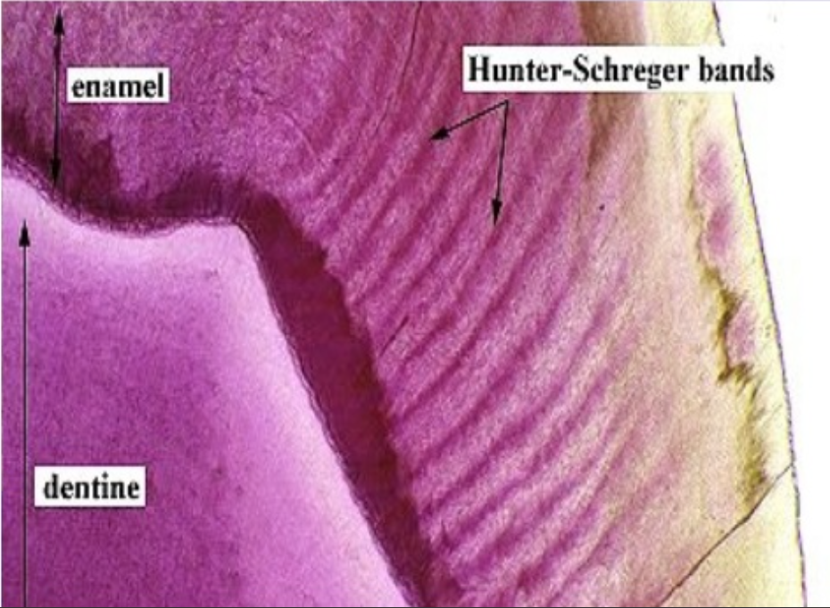
They are mainly found in the inner surface of tooth. these bands are composed of different contents of organic material and varied permeability.
Significance: They are considered to resist and disperse the strong forces.

Slide 29
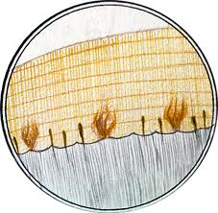
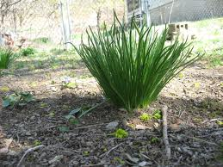
3.Enamel Tufts (Hypomineralized structures)
Enamel tufts are ribbon-like structures which run from dentin to enamel. They are named so because they resemble tufts of grass.

Slide 30
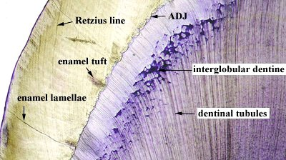
They contain greater concentration of enamel proteins.
Significance: Hypomineralized structure in the enamel, thus it plays role in spread of dental caries.

Slide 31
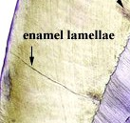
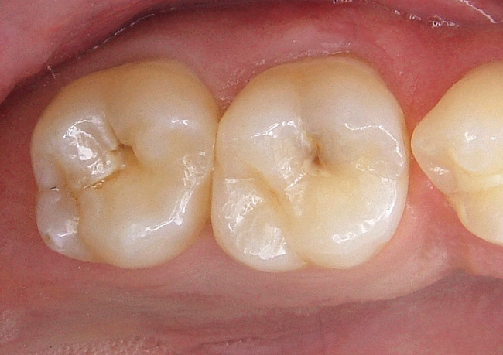
4.Enamel Lamellae
These are leaf like defects present in enamel and may extend to DEJ.
They contains organic substances. Lamellae are commonly found at the base of occlusal pits and fissures.

Slide 32
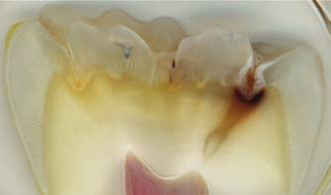
These are caused by “imperfect calcification of enamel tissue”.
Lamella at the base of an occlusal fissure provides an appropriate pathway for bacteria and initiate caries.

Slide 33
ENAMEL LAMELLA

Slide 34
5.Enamel Spindles
Odontoblastic processes sometimes crosses DEJ and their end is thickened.
Spindles serve as pain receptors, that is why, when we cut in the enamel patient complains of pain.

Slide 36
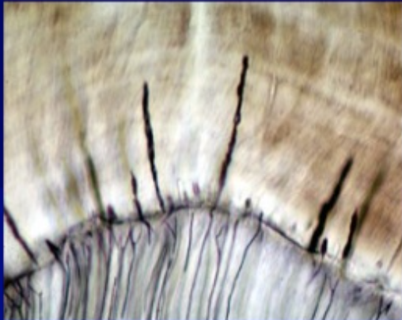
Enamel Spindles

Slide 37
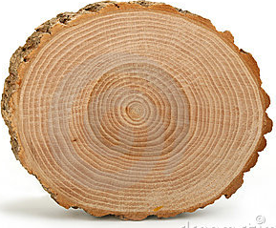
6.Striae of Retzius
They appear as brownish bands in the ground sections and illustrate the incremental pattern of enamel.
These represent the rest periods of ameloblast during enamel formation, therefore also called as growth circles.

Slide 39
Macroscopically/clinically the enamel generally looks smooth and even.

Slide 40
However, at high magnification the surface of enamel is full of developmental defects such as pits, cracks, and fissures as well as normal anatomical features such as Tomes’ process pits corresponding to the head of the ameloblasts.
Thus, there are numbers of surface irregularities on enamel where the microorganism can shelter.

Slide 41
PROPERTIES OF ENAMEL
Thickness
The thickness of enamel varies in different areas of the same tooth and from one type of tooth to another type of tooth.
The average thickness of enamel at the incisal edges of incisors is 2 mm; at the cusp of premolar and molar from 2.3 to 3.0 mm.
Thickness of enamel decreases gradually from cusps or incisal edges to cementoenamel junction.

Slide 44
COLOR

Slide 45
STRENGTH
Enamel has a rigid structure. But it is brittle.
The hardness also decreases from outer surface of the enamel to its inner surface. Also the density of enamel increases from dentino-enamel junction to the outer surface.

Slide 46
When compared, dentin has high compressive strength than the enamel, this acts as a cushion for enamel when masticatory forces are applied on it.
For this reason during tooth preparation, for maximal strength of underlying remaining tooth structure all enamel rods should be supported by healthy dentin base.

Slide 47
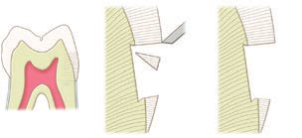

Slide 49
Thank you !

