Slide 1
INTRODUCTION
Dentin is a hard bone-like tissue that is present in the crown as well as in the root of teeth.
In the crown, dentin is covered by enamel and in the root it is covered by cementum

Slide 2
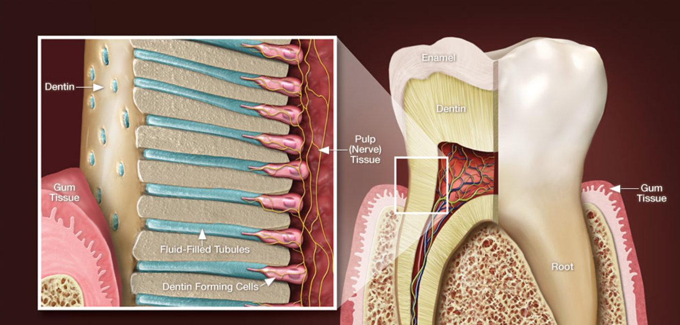
Dentin
Dr. Huda Y. K

Slide 3
INTRODUCTION
Dentin formation, dentinogenesis, is accomplished by cells called odontoblasts.
Because of these odontoblastic cell processes, dentin is considered a living tissue, with the capability of reacting to physiologic and pathologic stimuli.
In contrast to enamel formation, dentin formation continues after tooth eruption and throughout the life of the pulp.
Notes:
Odontoblasts are considered part of pulp and dentin tissues because their cell bodies are in the pulp cavity, but their long, slender cytoplasmic cell processesTomes fibers) extend well (100–200 µm) into the tubules in the mineralized dentin Odontoblastic processes occasionally cross the DEJ into enamel

Slide 4
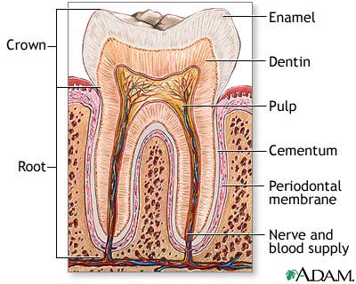

Slide 5
COMPOSITION OF DENTIN
Dentin contains 70% inorganic hydroxyapatite crystals and the rest is 20 % organic substance and 10% water making it more resilient than enamel.
The organic components consist primarily of collagen type 1.

Slide 6
The organic matrix of dentin is collagenous
It provides resiliency to the crown which is necessary to withstand the forces of mastication
The principle inorganic component of dentin is hydroxyapatite crystals
The high mineral content of dentin makes it harder than bone and cementum but softer than enamel

Slide 7
PROPERTIES OF DENTIN
Color
The color of dentin is slightly darker than enamel and is generally light yellowish in young individuals while it becomes darker with age.
On constant exposure to oral fluids and other irritants, the color becomes light brown or black.

Slide 8
Thickness
Dentin thickness is usually more on the cuspal heights and incisal edges and less in the cervical areas of tooth.
It is around 3-3.5 mm on the coronal surface. With advancing age and various irritants, the thickness of secondary and tertiary dentin increases.

Slide 9
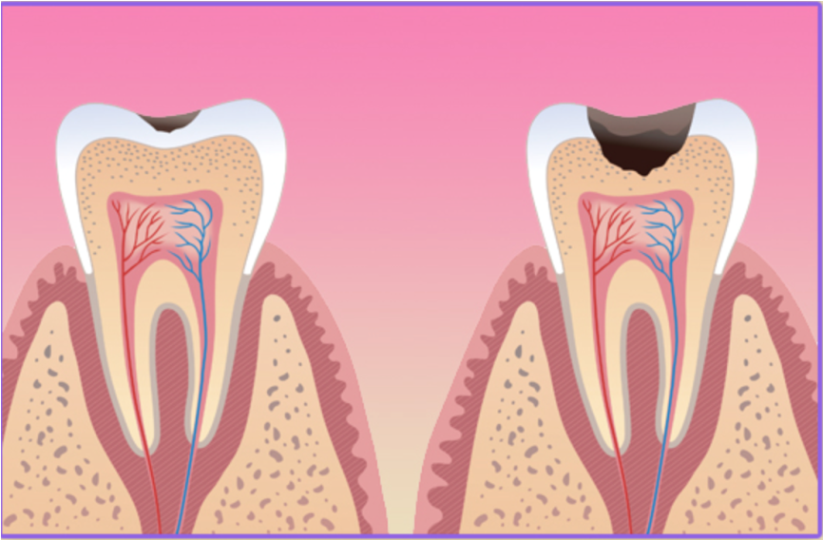
Hardness
The hardness of dentin is one-fifth (1/5) that of enamel. Hardness is not the same in all its thickness. Its hardness at the DEJ is 3 times more than that near the pulp so it is important to keep the depth of preparation near the DEJ.
Hardness of dentin also increases with advancing age due to mineralization.

Slide 10
Types of Dentin :
Dentin
Primary physiologic
dentin
Secondary physiologic
dentin
Tertiary dentin or
reparative dentin or
reactionary dentin or
irregular secondary dentin
Mantle
dentin
Circumpulpal
dentin
Peritubular
dentin
Intertubular
dentin

Slide 11
A. Primary Dentin
The dentin forming the initial shape of the tooth is called primary dentin and is usually completed 3 years after tooth eruption (in the case of permanent teeth).

Slide 12
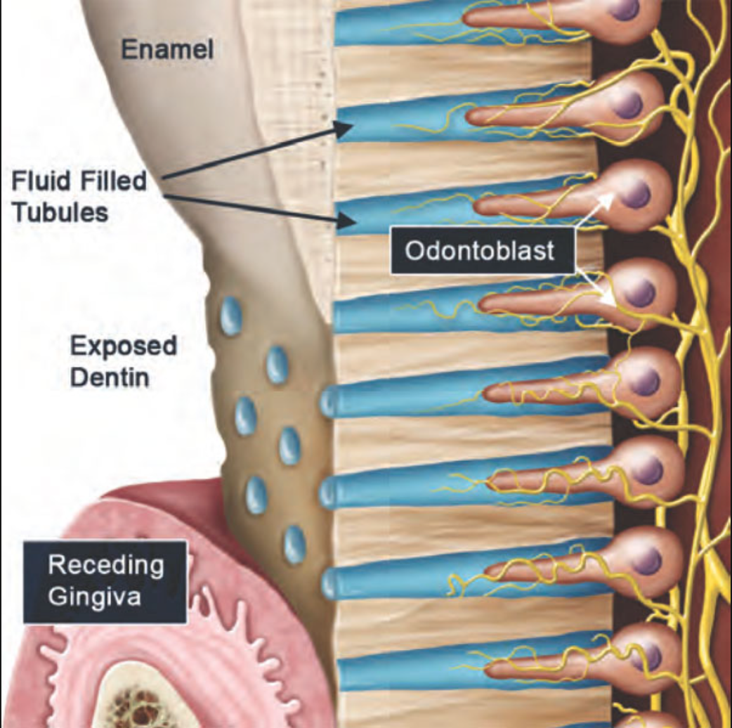
1. Dentinal Tubules
The dentinal tubules are small canals that extend across the entire width of dentin, from the DEJ or DCJ to the pulp.

Slide 13
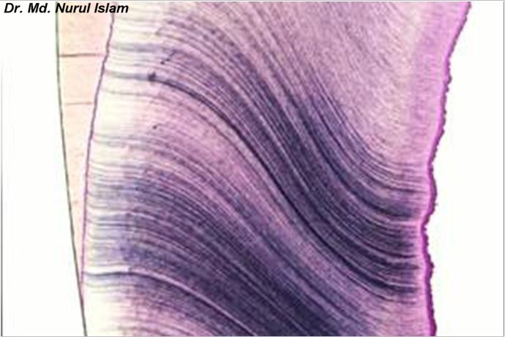
The dentinal tubules follow a gentle “S”-shaped curve in the tooth crown and are straighter in the incisal edges, cusps and root areas.
The ends of the tubules are perpendicular to dentinoenamel and dentino cemental junctions.

Slide 14
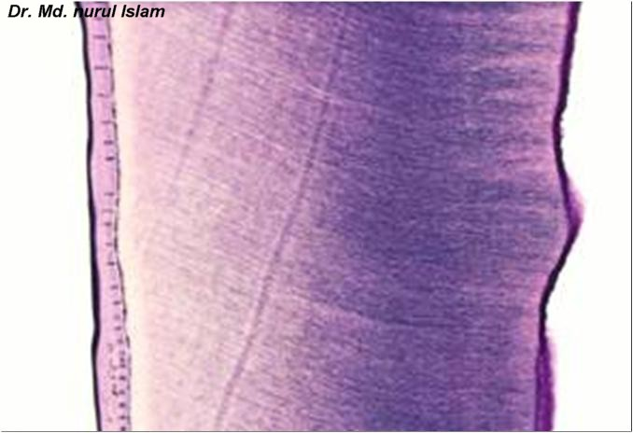
Dentinal Tubules
Coronal dentin
Root dentin

Slide 15
The Dentinal Tubules
The surface area of dentin is much larger at the DEJ or DCJ than it is on the pulp cavity side.
Since the odontoblasts, form dentin while progressing inward toward the pulp, the tubules are forced closer together.

Slide 16
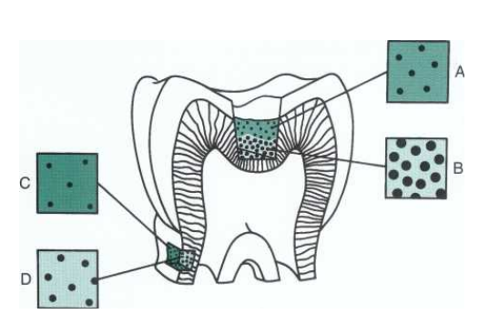
The number of tubules increases from DEJ to pulp. The lumen of the tubules also varies from the DEJ to the pulp surface. In coronal dentin, the average diameter of tubules increases from DEJ to pulp .

Slide 18
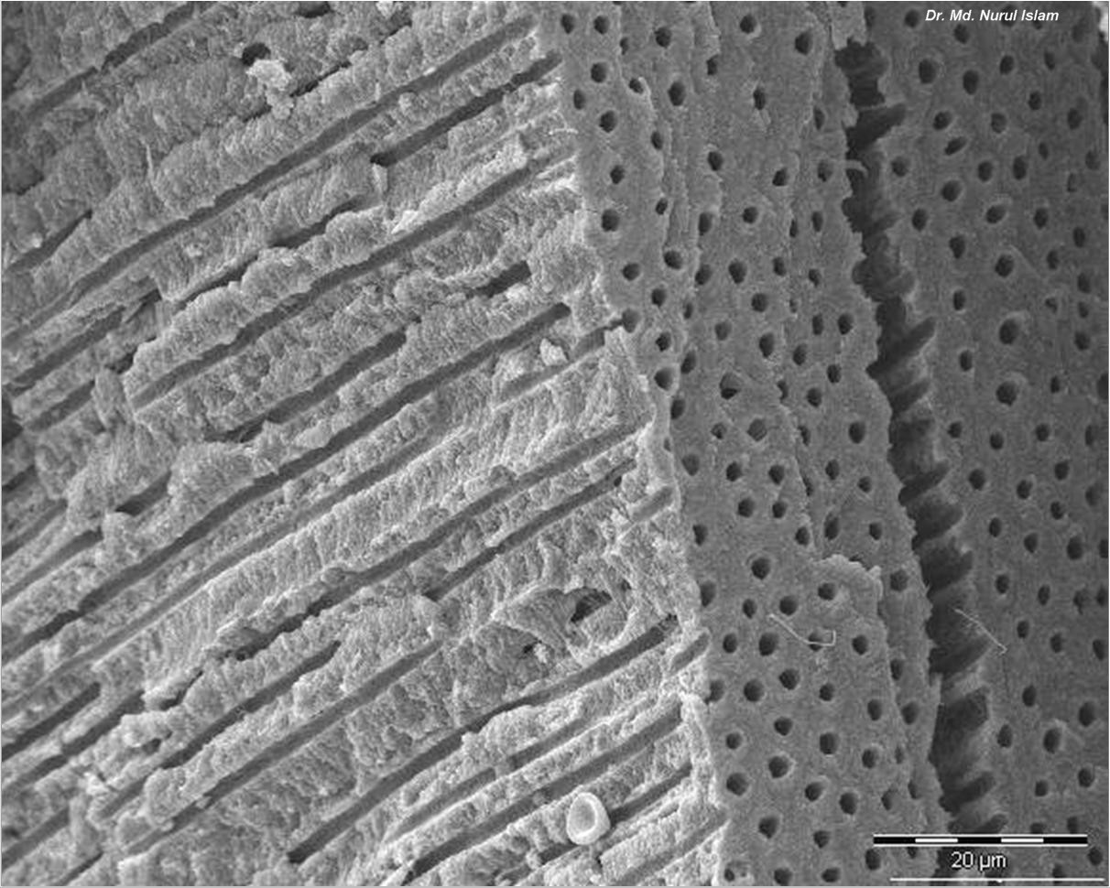
Dentinal tubules

Slide 19
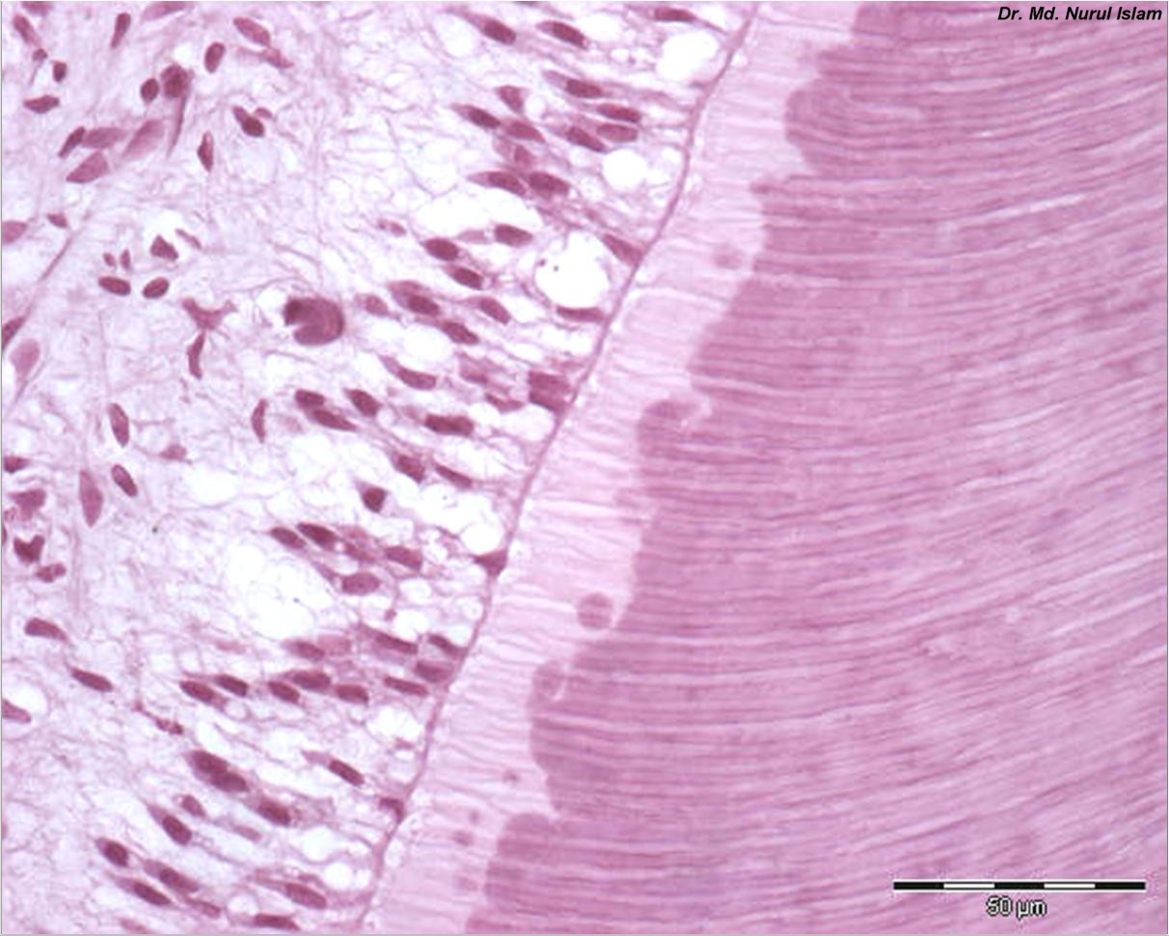
Odontoblast layer
Predentin
Dentinal tubules

Slide 20
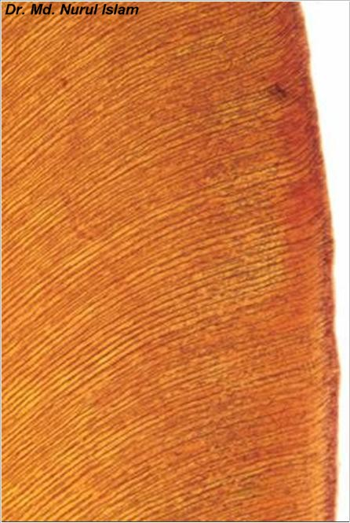
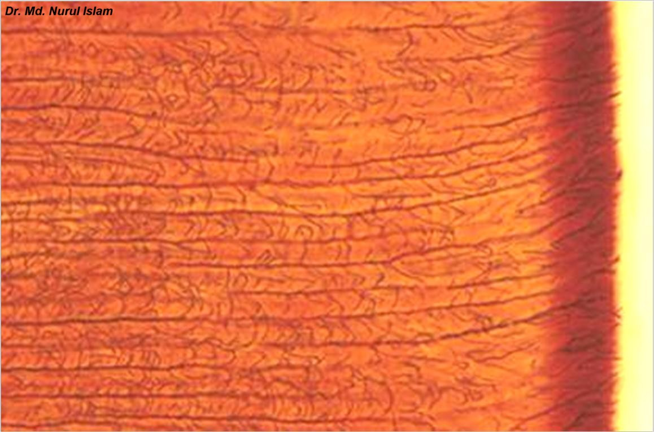
Dentinal
tubules

Slide 21
2.Predentin
This layer of dentin, lie very close to the pulp tissue which is just next to cell bodies of odontoblasts. It is first formed dentin and is not mineralized.
Notes:
The predentin is 10-30 µm unmineralized zone between the mineralized dentin and odontoblasts.

Slide 22
Odontoblasts And Dentinal Tubules
D E J
Mantle D
Odontoblastic process
Peritubular dentin
Circumpulpal D
Intertubular dentin
Predentin
Odontoblasts

Slide 23
3.Peritubular Dentin
This dentinal layer usually lines the dentinal tubules and is more mineralized than intertubular dentin and predentin.
4. Intertubular Dentin
This dentin is present between the tubules which is less mineralized than peritubular dentin. Intertubular dentin determines the elasticity of the dental matrix.

Slide 25
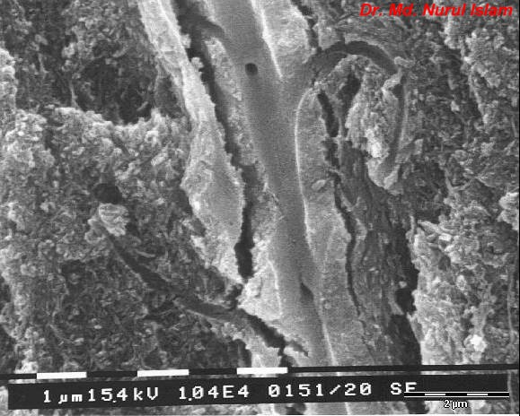
Dentinal tubules
Peritubular dentin
Intertubular dentin

Slide 26
5.Mantle dentin:
At the outermost layer of the primary dentin, just under the enamel, a narrow zone called mantle dentin exists.
It is formed as a result of initial mineralization reaction by newly differentiated odontoblasts.
In other words, it is first formed dentin in the crown underlying the DEJ.

Slide 27
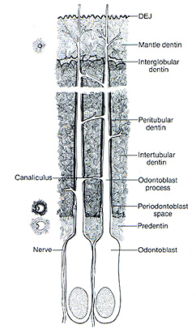

Slide 28
6.Circumpulpal dentin
It forms the remaining primary dentin and is more mineralized than mantle dentin.
This dentin outlines the pulp chamber and therefore, it may be referred to as circumpulpal dentin. It is formed before root completion.

Slide 29
B. Secondary Dentin
Formed after the completion of the apical foramen
Continues to form throughout the life of the tooth
Formed more slowly than primary dentin
Less mineralized than primary dentin

Slide 30
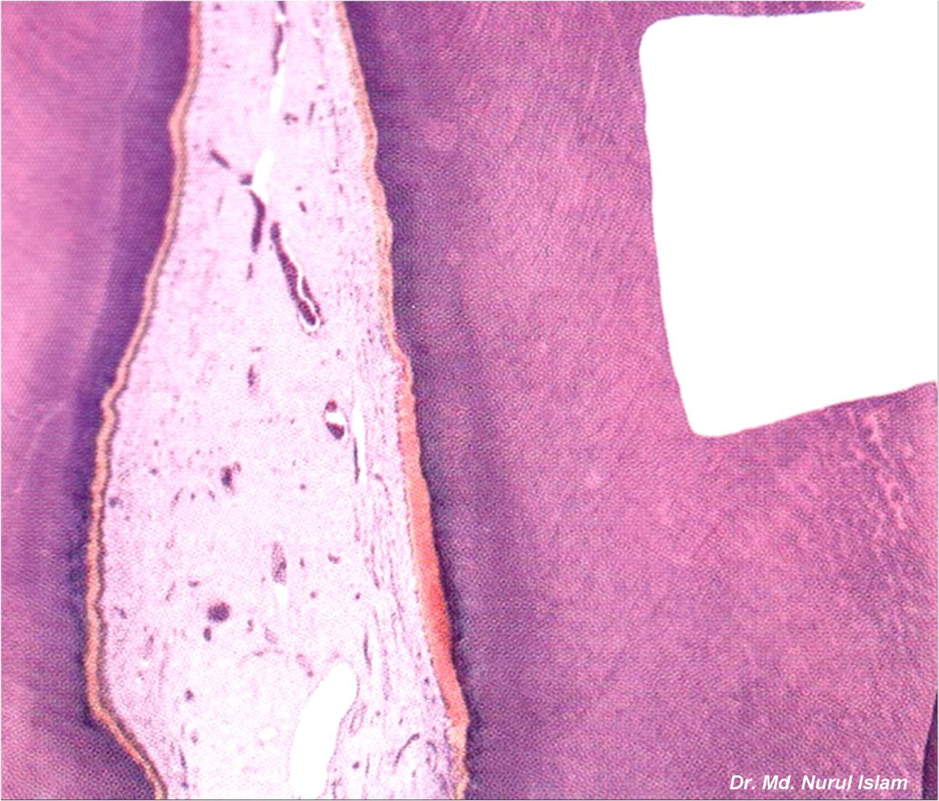
Secondary
physiological
dentin
Primary
physiological
dentin
Tertiary
dentin

Slide 31
C.Tertiary Dentin (Reparative)
Reparative dentin frequently formed as a response to external stimuli such as dental caries, attrition and trauma.
If the injury is severe and causes odontoblast cell death, odontoblast like cells synthesize specific reparative dentin just beneath the site of injury to protect pulp tissue.
The secondary odontoblasts which produce reparative dentin are developed from undifferentiating mesenchymal cells of pulp.

Slide 32
D. Sclerotic Dentin
It occurs due to aging or chronic and mild irritation (such as slowly advancing caries) which causes a change in the composition of the primary dentin.
In sclerotic dentin, peritubular dentin becomes wider due to deposition of calcified materials, which progress from enamel to pulp. This area becomes harder, denser, less sensitive and more protective of pulp against irritations.

Slide 33
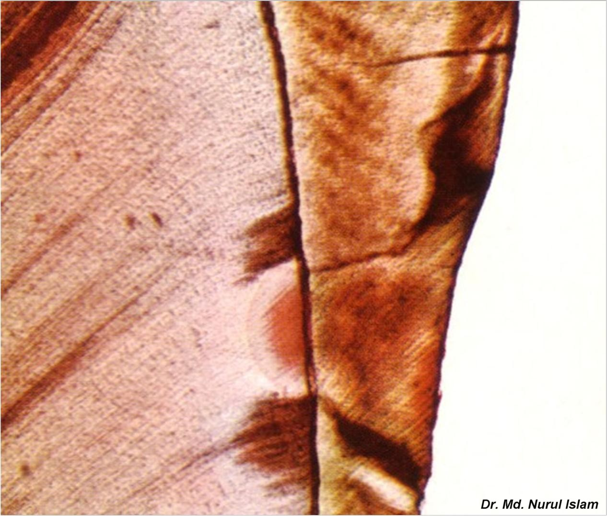
Sclerotic dentin
Dental caries

Slide 36
Cementum

Slide 37
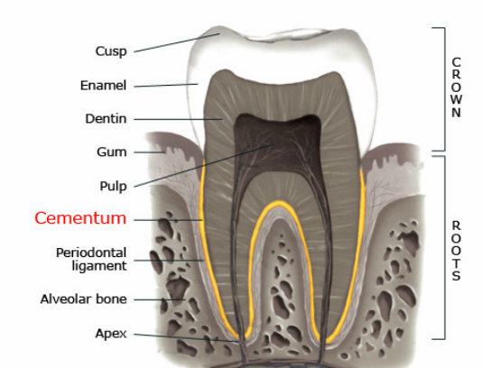
INTRODUCTION
Cementum can be defined as hard, avascular connective tissue that covers the roots of the teeth.
It is light yellow in color and can be differentiated from enamel by its lack of luster and darker hue.
It is very permeable to dyes and chemical agents, from the pulp canal and the external root surface.
Notes:
shining by reflecting light
colour and shade

Slide 38
Composition Of Cementum
Cementum consists of approximately 45 to 50 % inorganic matter and 50 to 55 % organic matter and water by weight.
It is softer than dentin.

Slide 39
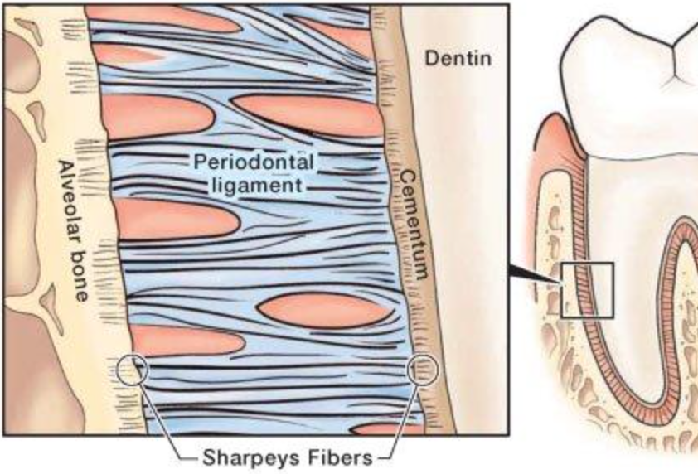
Sharpey’s fibers
which are embedded in cementum and bone, are the principal collagenous fibers of periodontal ligament.

Slide 40
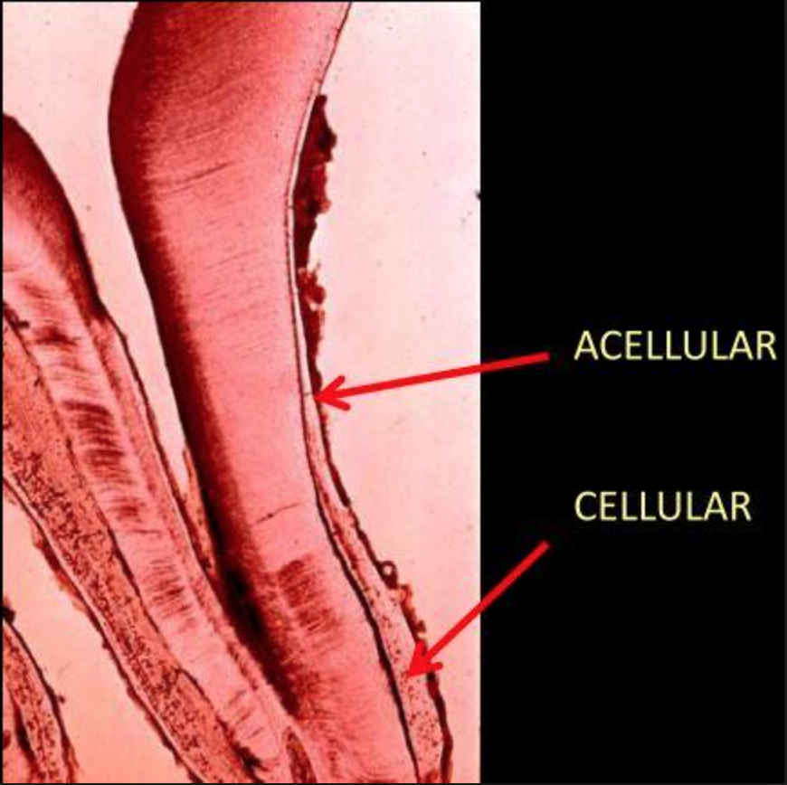
Types
There are two main types of root cementum
Acellular (Primary)
Cellular(Secondary)

Slide 41
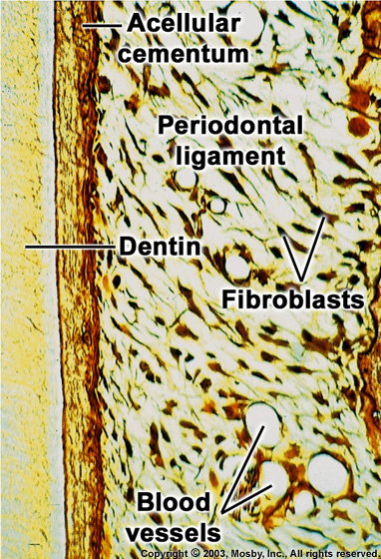
Acellular cementum
Covers the cervical third of the root.
Formed before the tooth reaches the occlusal plane.
As the name indicates, it does not contain cells.
Thickness is in the range of 30-230 μm.
Abundance of sharpey’s fibers.
Main function is anchorage.

Slide 42
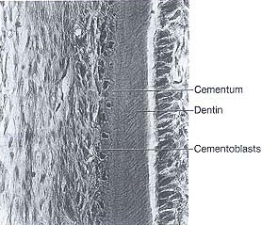
Cellular cementum
Formed after the tooth reaches the occlusal plane.
It contains cells.
Less calcified than acellular cementum.
Sharpey’s fibers are present in lesser number as compared to acellular cementum.
Mainly found in apical third.
Main function is adaptation.

Slide 43
CEMENTODENTINAL JUNCTION CDJ
Smooth in permanent teeth.
Scalloped in deciduous teeth.
Dentin is separated from cementum by a zone known as the intermediate cementum layer.
This layer is predominantly seen in apical two-thirds of roots of molars & premolars.

Slide 45
CEMENTOENAMEL JUNCTION CEJ
In 60% of the teeth, cementum overlaps the cervical end of enamel for a short distance.
In 30% of all teeth, cementum meets the cervical end of enamel in a relatively sharp line.
In 10% of the teeth, enamel & cementum do not meet.

Slide 46
RELATION OF CEMENTUM TO ENAMEL AT THE CEMENTOENAMEL JUNCTION

Slide 47
THANK YOU !

