Slide 1
Hyperbilirubinemia in the Newborn
Dr.Ban Adil
MBCHB,FICSM,MRCPCh

Slide 2
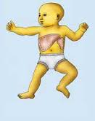
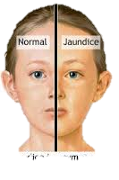
JAUNDICE (ICTERUS).
Def.:Yellow discoloration of the sclera, skin, and mucous membranes
Clinically apparent jaundice in children and adults occurs when the serum concentration of bilirubin reaches 2–3 mg/dL (34–51 μmol/L);
the neonate may not appear icteric until the bilirubin level is >5 mg/dL (85 μmol/L).

Slide 3
Types of jaundice

Slide 5
Types of jaundice
unconjugated, nonpolar, lipid-soluble bilirubin pigment in the skin. This unconjugated bilirubin (designated indirect acting by nature of the Van den Bergh reaction) is an end product of heme-protein catabolism from a series of enzymatic reactions in the reticuloendothelial cells. unconjugated bilirubin are potentially neurotoxic
conjugated bilirubin, the end product from indirect, unconjugated bilirubin that has undergone conjugation in the liver cell microsome by the enzyme uridine diphosphoglucuronic acid (UDP)–glucuronyl transferase to form the polar, water-soluble glucuronide of bilirubin (direct reacting) Even though the conjugated form is not neurotoxic, direct hyperbilirubinemia indicates potentially serious hepatic disorders or systemic illnesses.

Slide 6
Metabolism of bilirubin
Bilirubin is produced by the catabolism of hemoglobin in the reticuloendothelial system.
ring of heme is cleaved by heme oxygenase to form biliverdin
Biliverdin is converted to bilirubin by biliverdin reductase.
One gram of hemoglobin produces 35 mg of bilirubin
Compared with adults, newborns have a twofold to threefold greater rate of bilirubin production (6 to 10 mg/kg/24 hr versus 3 mg/kg/24 hr). This increased production is caused in part by an increased RBC mass (higher hema-tocrit) and a shortened erythrocyte life span of 70 to 90 days compared with the 120-day erythrocyte life span in adults.

Slide 7
Bilirubin produced after hemoglobin catabolism is lipid soluble and unconjugated and reacts as an indirect reagent in the van den Bergh test. Indirect-reacting, unconjugated bilirubin is toxic to the CNS and is insoluble in water, limiting its excretion
Unconjugated bilirubin binds to albumin on specific bilirubin binding sites; 1 g of albumin binds 8.5 mg of bilirubin in a newborn. If the binding sites become saturated or if a competitive compound binds at the site, displacing bound bilirubin, free bilirubin becomes available to enter the CNS. Organic acids such as free fatty acids and drugs such as sulfisoxazole can displace bilirubin from its binding site on albumin.

Slide 8
Hepatic conjugation results in the production of bilirubin diglucuronide, which is water soluble and capable of biliary and renal excretion. The enzyme glucuronosyltransferase represents the rate-limiting step of bilirubin conjugation
Most conjugated bilirubin is excreted through the bile into the small intestine and eliminated in the stool. Some bilirubin may undergo hydrolysis back to the unconjugated fraction by intestinal glucuronidase, however, and may be reabsorbed (enterohepatic recirculation). In addition, bacteria in the neonatal intestine convert bilirubin to urobilinogen and stercobilinogen, which are excreted in urine and stool and usually limit bilirubin reabsorption. Delayed passage of meconium, which contains bilirubin, also may contribute to the enterohepatic recirculation of bilirubin.

Slide 9
HB
globin
heme
iron
biliverdin
Unconjugated bilirubin
albumin
2 Glocoronic acid
UDPGT
Bilirubin diglocoronide
urobilinogen
Reabsorbed to blood
stercobilin
Absorbed back to liver by
E.H circulation

Slide 12
Jaundice and Hyperbilirubinemia in the Newborn
Hyperbilirubinemia is a common and, in most cases, benign problem in neonates. Jaundice is observed during the 1st wk of life in approximately 60% of term infants and 80% of preterm infants.

Slide 13
ETIOLOGY.
Unconjugated hyperbilirubinemia may be caused or increased by any factor that:
increases the load of bilirubin to be metabolized by the liver (hemolytic anemias, polycythemia, shortened red cell life as a result of immaturity or transfused cells, increased enterohepatic circulation, infection);
damages or reduces the activity of the transferase enzyme or other related enzymes (genetic deficiency, hypoxia, infection, thyroid deficiency);
competes for or blocks the transferase enzyme drugs and other substances requiring glucuronic acid conjugation.
leads to an absence or decreased amounts of the enzyme or to reduction of bilirubin uptake by liver cells (genetic defect, and prematurity).

Slide 14
HB
globin
heme
increases the load of bilirubin to be metabolized by the liver (
damages or reduces the activity of the transferase enzyme or other related enzymes
iron
biliverdin
Unconjugated bilirubin
albumin
competes for or blocks the transferase enzyme
leads to an absence or decreased amounts of the enzyme
genetic deficiency, hypoxia, infection, thyroid deficiency
2 Glocoronic acid
UDPGT
hemolytic anemias
polycythemia,
shortened red cell life as a result of immaturity or transfused cells,
increased enterohepatic circulation,
infection
Bilirubin diglocoronide
genetic defect, and prematurity
urobilinogen
Reabsorbed to blood
stercobilin
Absorbed back to liver by
E.H circulation

Slide 15
5.The toxic effects of elevated serum levels of unconjugated bilirubin are increased by factors that reduce the retention of bilirubin in the circulation hypoproteinemia,
6.displacement of bilirubin from its binding sites on albumin by competitive binding of drugs such as sulfisoxazole and moxalactam, acidosis, and
increased free fatty acid concentration secondary to hypoglycemia, starvation, or hypothermia

Slide 16
5. Factors that increase the toxic effects of elevated serum levels of unconjugated bilirubin
HB
globin
heme
displacement of bilirubin from its binding sites on albumin binding of drugs such as sulfisoxazole and moxalactam, acidosis, and increased free fatty acid concentration secondary to hypoglycemia, starvation, or hypothermia
iron
biliverdin
factors that reduce the retention of bilirubin in the circulation
Unconjugated bilirubin
albumin
2 Glocoronic acid
UDPGT
Bilirubin diglocoronide
urobilinogen
Reabsorbed to blood
stercobilin
Absorbed back to liver by
E.H circulation

Slide 17
the permeability of the blood-brain barrier neuronal susceptibility to injury, all of which are adversely influenced by asphyxia, prematurity, hyperosmolality, and infection.
Early and frequent feeding decreases whereas breast-feeding and dehydration increase serum levels of bilirubin
The neonatal production rate of bilirubin is 6–8 mg/kg/24 hr (in contrast to 3–4 mg/kg/24 hr in adults

Slide 18
Delay in passage of meconium, which contains 1 mg bilirubin /dL, may contribute to jaundice by enterohepatic circulation after deconjugation by intestinal glucuronidase (
Drugs such as oxytocin and chemicals used in the nursery such as phenolic detergents may also produce unconjugated hyperbilirubinemia

Slide 19
HB
globin
heme
iron
. Delay in passage of meconium, which contains 1 mg bilirubin/dL, may contribute to jaundice by enterohepatic circulation after deconjugation by intestinal glucuronidase
biliverdin
Unconjugated bilirubin
albumin
2 Glocoronic acid
UDPGT
Bilirubin diglocoronide
urobilinogen
Reabsorbed to blood
stercobilin
Absorbed back to liver by
E.H circulation

Slide 20
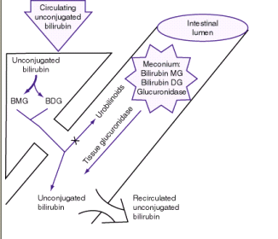

Slide 21
CLINICAL MANIFESTATIONS
Jaundice usually becomes apparent in a cephalocaudal progression starting on the face and progressing to the abdomen and then feet, as serum levels increase

Slide 22
Dermal pressure may reveal the anatomic progression of jaundice face, = 5 mg/dL; mid-abdomen, = 15 mg/dL; soles, = 20 mg/dL , but clinical examination cannot be depended on to estimate serum levels.
11/4/2014 6:37 PM - Screen Clipping

Slide 23
]). Noninvasive techniques for transcutaneous measurement of bilirubin (TcB) that correlate with serum levels may be used to screen infants, but determina tion of serum bilirubin level is indicated in patients with elevated age-specific transcutaneous measurement, progressing jaundice, or risk for either hemolysis or sepsis.

Slide 24
11/4/2014 6:37 PM - Screen Clipping
jaundice from deposition of indirect bilirubin in the skin tends to appear bright yellow or orange,
jaundice of the obstructive type (direct bilirubin) has a greenish or muddy yellow cast.
Although signs of kernicterus rarely appear on the 1st day, affected infants may present with lethargy and poor feeding and, without treatment, can progress to acute bilirubin encephalopathy

Slide 25
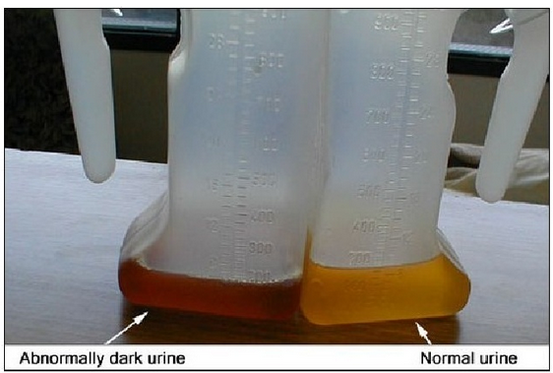

Slide 26
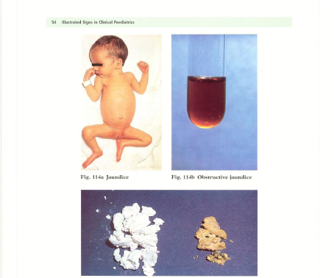

Slide 27
DIFFERENTIAL DIAGNOSIS. Jaundice that is present at birth or appears within the 1st 24 hr of life
erythroblastosis fetalis,
concealed hemorrhage,
sepsis,
congenital infections, including syphilis, cytomegalovirus, rubella, and toxoplasmosis

Slide 28
Jaundice that 1st appears on the 2nd or 3rd day
is
usually physiologic but may represent a more severe form.
Familial non-hemolytic icterus (Crigler-Najjar syndrome)
early-onset breast-feeding jaundice.

Slide 29
. Jaundice appearing after the 3rd day and within the 1st wk:
bacterial sepsis
urinary tract infection;
it may also be due to other infections, notably syphilis, toxoplasmosis, cytomegalovirus, (TORCH)or enterovirus

Slide 30
1st recognized after the 1st wk of life
There is a long differential diagnosis for jaundice :
Including
breast-milk jaundice,
septicemia,
congenital atresia or paucity of the bile ducts, hepatitis,
galactosemia,
hypothyroidism,
CF,
congenital hemolytic anemia crises related to red cell morphology and enzyme deficiencies spherocytosis,G6PD,pyruvate kinase def.(

Slide 31
DIAGNOSIS

Slide 32
Investigations for early jaundice
Serum bilirubin level
FBC and film
Blood group
Maternal blood group
Direct coombs test
Consider G6PD level

Slide 33
The differential diagnosis for persistent jaundice during the 1st mo of life:
cholestasis,
hepatitis
, cytomegalic inclusion disease, syphilis, toxoplasmosis,
familial non-hemolytic icterus,
congenital atresia of the bile ducts,
galactosemia, or
inspissated bile syndrome following hemolytic disease of the newborn.
Rarely, physiologic jaundice may be prolonged for several wk, as in infants with hypothyroidism or pyloric stenosis.

Slide 34
Investigations for prolonged jaundice
Serum bilirubin level
Conjugated fraction of bilirubin
Liver function test (GGT, ALT, AST, Albumin)
Coagulation profile (PT, PTT, INR)
Abdominal ultrasound (gallbladder)
HIDA scan (with follow through)
Thyroid function test (TSH, free T4)
Metabolic screen (urine for reducing substance)
Hepatitis screen (TORCH)
Liver biopsy (bile duct proliferation)
FBC and film
Blood group
Maternal blood group
Direct coombs test
Notes:
DISIDA is radiotracer material.
DISIDA scan is hepatobiliary imaging, utilizing technetium-labeled diisopropyl iminodiacetic acid (DISIDA) nuclear scintiscan.
DISIDA scans are sometimes called nuclear medicine gall bladder or hepatobiliary scans. HIDA, its predecessor, is little used today because DISIDA can image the gall bladder better when liver function is poor. DISIDA scans try to determine if the small tube (cystic duct) which leads to the gall bladder is blocked.
A DISIDA scan is performed to visualize the gall bladder filling and emptying.

Slide 37
Full-term, low-risk, asymptomatic infants may be evaluated by monitoring total serum bilirubin (TSB) levels. Regardless of gestation or time of appearance of jaundice, patients with significant hyperbilirubinemia and those with symptoms or signs require a complete diagnostic evaluation, which includes determination of direct and indirect bilirubin fractions, hemoglobin, reticulocyte count, blood type, Coombs test, and examination of a peripheral blood smear. Indirect hyperbilirubinemia, reticulocytosis, and a smear with evidence of red blood cell destruction suggest hemolysis (

Slide 38
). In the absence of blood group incompatibility, non–immunologically induced hemolysis should be considered.
If direct hyperbilirubinemia is present, hepatitis, congenital bile duct disorders (atresia, paucity, Byler disease), cholestasis, inborn errors of metabolism, CF, and sepsis are diagnostic possibilities. If the reticulocyte count, Coombs test, and direct bilirubin are normal, physiologic or pathologic indirect hyperbilirubinemia may be present (

Slide 39
PHYSIOLOGIC JAUNDICE (ICTERUS NEONATORUM)
Under normal circumstances, the level of indirect-reacting bilirubin in umbilical cord serum is 1–3 mg/dL
rises at a rate of <5 mg/dL/24 hr;
thus, jaundice becomes visible on the 2nd–3rd day,
usually peaking between the 2nd and 4th days at 5–6 mg/dL
and decreasing to below 2 mg/dL between the 5th and 7th days of life

Slide 40
Cause of physiological jaundice
increased bilirubin production resulting from
increased RBC mass,
shortened RBC life span,
hepatic immaturity of glucuronosyltransferase.

Slide 41
Risk factors for elevated indirect hyperbilirubinemia include:
maternal age, race (Chinese, Japanese, Korean, and Native American),
maternal diabetes,
oxytocin induction,
prematurity,
drugs vitamin K₃
polycythemia,
male sex,
trisomy 21,
cutaneous bruising, blood extravasation (cephalohematoma),
breast-feeding,
weight loss (dehydration or caloric deprivation),
delayed bowel movement, and
a family history/sibling who had physiologic jaundice (

Slide 42
Prediction of which neonates are at risk for exaggerated physiologic jaundice can be based on hour-specific bilirubin levels in the 1st 24–72 hr of life ( Fig )
Indirect bilirubin levels in full-term infants decline to adult levels (1 mg/dl) by 10–14 days of life.

Slide 44
In premature infants, the rise in serum bilirubin tends to be the same or somewhat slower but of longer duration than in term infants.
Peak levels of 8–12 mg/dL are not usually reached until the 4th–7th day,
and jaundice is infrequently observed after the 10th day, corresponding to the maturation of mechanisms for bilirubin metabolism and excretion.

Slide 45
Pathological jaundice is suspected if :
it appears in the 1st 24–36 hr of life.
serum bilirubin is rising at a rate faster than 5 mg/dL/24 hr, (
serum bilirubin is >12 mg/dL in full-term infants (especially in the absence of risk factors) or 10–14 mg/dL in preterm infants,
jaundice persists after 10–14 days of life,
direct-reacting bilirubin is >2 mg/dL at any time.

Slide 46
Other factors suggesting a nonphysiologic cause of jaundice are family history of hemolytic disease, pallor, hepatomegaly, splenomegaly, failure of phototherapy to lower bilirubin, vomiting, lethargy, poor feeding, excessive weight loss, apnea, bradycardia, abnormal vital signs (including hypothermia), light-colored stools, dark urine positive for bilirubin, and signs of kernicterus

Slide 47
breast-feeding jaundice
JAUNDICE ASSOCIATED WITH BREAST-FEEDING
occurs in the 1st week of life, in breast-fed infants who normally have higher bilirubin levels than formula-fed infants .
Hyperbilirubinemia (>12 mg/dL) develops in 13% of breast-fed infants in the 1st wk of life
may be due to decreased milk intake with dehydration
and/or reduced caloric intake.
More in primi- mother,C/S

Slide 48
Giving supplements of glucose water to breast-fed infants is associated with higher bilirubin levels,
in part because of reduced intake of the higher caloric density of breast milk.

Slide 49
Frequent breast-feeding(>10/24 hr),
rooming-in with night feeding,
discouraging 5% dextrose or water supplementation,
and ongoing lactation support may reduce the incidence of early breast-feeding jaundice

Slide 50
JAUNDICE ASSOCIATED WITH BREAST-FEEDING.
breast-milk jaundice
Significant elevation in unconjugated bilirubin (breast-milk jaundice) develops in an estimated 2% of breast-fed term infants
after the 7th day of life,
with maximal concentrations as high as 10–30 mg/dL reached during the 2nd–3rd week
If breast-feeding is continued, the bilirubin gradually decreases but may persist for 3–10 wk at lower levels.

Slide 51
If nursing is discontinued, the serum bilirubin level falls rapidly, reaching normal levels within a few days.
With resumption of breast-feeding, bilirubin levels seldom return to previously high levels.
Phototherapy may be of benefit .
Although uncommon, kernicterus can occur in patients with breast-milk jaundice.
The etiology of breast-milk jaundice is not entirely clear, but may be attributed to the presence of glucuronidase in some breast milk.

Slide 52
Kernicterus
Kernicterus: or bilirubin encephalopathy, is a neurologic syndrome resulting from the deposition of unconjugated (indirect) bilirubin in the basal ganglia and brainstem nuclei.

Slide 53
The precise blood level above which indirect-reacting bilirubin or free bilirubin will be toxic for an individual infant is unpredictable.
Kernicterus usually does not develop in term infants when bilirubin levels are less than 20 to 25 mg/dL.
The incidence of kernicterus increases as serum bilirubin levels increase to greater than 25 mg/dL.

Slide 54
Kernicterus may be noted at bilirubin levels less than 20 mg/dL→ in the presence of sepsis, meningitis, hemolysis, asphyxia, hypoxia, hypothermia, hypoglycemia, bilirubin-displacing drugs (sulfa drugs), and prematurity.
Other risks for kernicterus in term infants are hemolysis, jaundice noted within 24 hours of birth, and delayed diagnosis of hyperbilirubinemia.
.

Slide 55
In previously healthy, predominantly breast-fed term infants, kernicterus has developed when bilirubin levels exceed 30 mg/dL.
Onset is usually in the 1st wk of life, but may be delayed to the 2nd–3rd wk
Kernicterus has developed in extremely immature infants weighing less than 1000 g when bilirubin levels are less than 10 mg/dL because of a more permeable blood-brain barrier associated with prematurity.

Slide 56
CLINICAL MANIFESTATIONS
Signs and symptoms of kernicterus usually appear 2–5 days after birth in term infants
and as late as the 7th day in premature infants,
but hyperbilirubinemia may lead to encephalopathy at any time during the neonatal period.
.

Slide 57
The early signs may be subtle and indistinguishable from those of sepsis, asphyxia, hypoglycemia, intracranial hemorrhage, and other acute systemic illnesses in a neonate.
Lethargy, poor feeding, and loss of the Moro reflex are common initial signs.
Subsequently, the infant may appear gravely ill and prostrated, with diminished tendon reflexes and respiratory distress.
Opisthotonos with a bulging fontanel, twitching of the face or limbs, and a shrill high-pitched cry may follow.

Slide 58
Opisthotonos

Slide 59
In advanced cases, convulsions and spasm occur,
with affected infants stiffly extending their arms in an inward rotation with the fists clenched . Rigidity is rare at this late stage.
Infants with severe cases of kernicterus die in the neonatal period.
Spasticity resolves in surviving infants, who may manifest later nerve deafness, choreoathetoid cerebral palsy, mental retardation, enamel dysplasia, and discoloration of teeth as permanent sequelae.

Slide 60
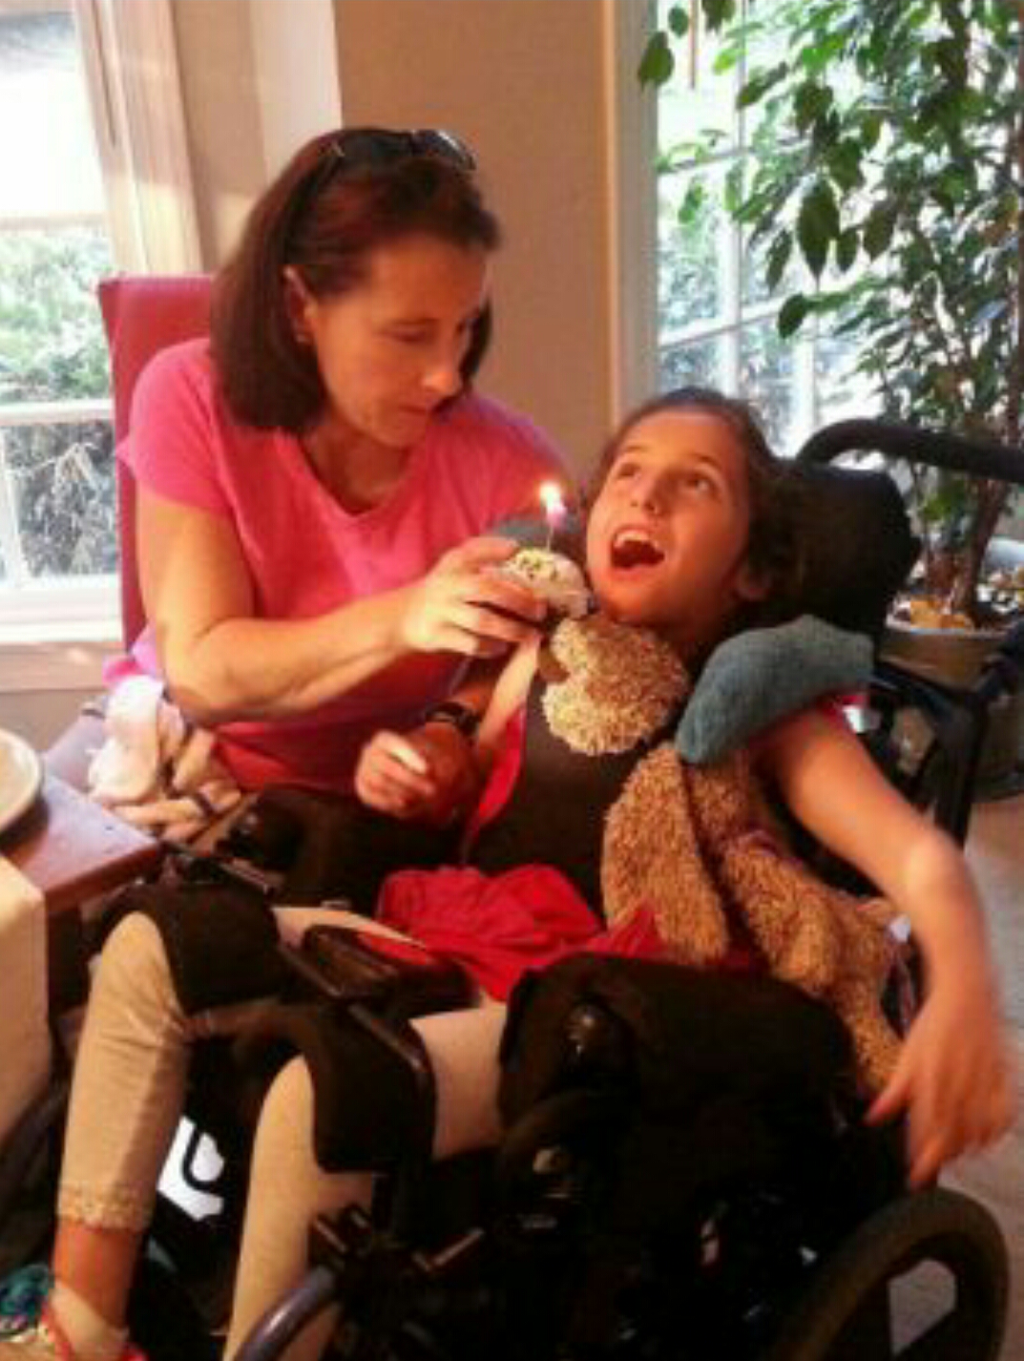

Slide 61
kernicterus
Acute form
Phase 1 1st 1–2 days
Phase 2 middle of 1st wk
Chronic form
First year: hypotonia, active deep tendon reflexes, obligatory tonic neck reflexes, delayed motor skills
poor sucking,
Stupor hypotonia,
seizures
hypertonia of extensor muscles, opisthotonos, retrocollis, fever
Phase 3 after the 1st wk
hypertonia
After 1st yr: movement disorders (choreoathetosis, ballismus, tremor), upward gaze, sensorineural hearing loss

Slide 62
Clinical Features of Kernicterus
ACUTE FORM | Phase 1 (1st 1–2 days): poor sucking, stupor, hypotonia, seizures
 | Phase 2 (middle of 1st wk): hypertonia of extensor muscles, opisthotonos, retrocollis, fever
 | Phase 3 (after the 1st wk): hypertonia
CHRONIC FORM | First year: hypotonia, active deep tendon reflexes, obligatory tonic neck reflexes, delayed motor skills
 | After 1st yr: movement disorders (choreoathetosis, ballismus, tremor), upward gaze, sensorineural hearing

Slide 63
Clinical Features of Kernicterus
ACUTE FORM | Phase 1 (1st 1–2 days): poor sucking, stupor, hypotonia, seizures
 | Phase 2 (middle of 1st wk): hypertonia of extensor muscles, opisthotonos, retrocollis, fever
 | Phase 3 (after the 1st wk): hypertonia
CHRONIC FORM | First year: hypotonia, active deep tendon reflexes, obligatory tonic neck reflexes, delayed motor skills
 | After 1st yr: movement disorders (choreoathetosis, ballismus, tremor), upward gaze, sensorineural hearing loss

Slide 64
Many infants who progress to these severe neurologic signs die; the survivors are usually seriously damaged, but may appear to recover and for 2–3 mo show few abnormalities. Later in the 1st yr of life, opisthotonos, muscle rigidity, irregular movements, and convulsions tend to recur

Slide 65
In the 2nd yr, the opisthotonos and seizures abate, but irregular, involuntary movements, muscle rigidity, or, in some infants, hypotonia increase steadily.
By 3 yr of age, the complete neurologic syndrome is often apparent and consists of bilateral choreoathetosis with involuntary muscle spasms, extrapyramidal signs, seizures, mental deficiency, dysarthric speech, high frequency hearing loss, squinting, and defective upward eye movements. Pyramidal signs, hypotonia, and ataxia occur in a few infants. In mildly affected infants, the syndrome may be characterized only by mild to moderate neuromuscular incoordination, partial deafness, or “minimal brain dysfunction,” occurring singly or in combination; these problems may be inapparent until the child enters school (

Slide 66
Therapy of Indirect Hyperbilirubinemia
Phototherapy
is an effective and safe method for reducing indirect bilirubin levels.
Bilirubin absorbs light maximally in the blue range (420–470 nm).
Broad-spectrum white, blue, and special narrow-spectrum (super) blue lights have been effective in reducing bilirubin levels

Slide 67
Unconjugated bilirubin
(4Z, 15Z configuration)
phototherapy (light 425- to 475-nm)
isomer 4Z, 15E bilirubin
lumirubin
Mode of action of phototherapy
photochemical reaction producing configurational isomer
the reversible, more water-soluble
bypassing the liver's conjugation system
excreted in bile without conjugation.
a more water-soluble structural isomer which does not spontaneously revert to unconjugated native bilirubin (irreversible)
can be excreted in urine.

Slide 68
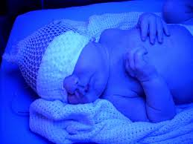
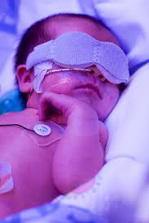
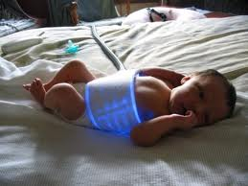
Conventional phototherapy
is applied continuously, and the infant is turned frequently for maximal skin surface area exposure
. It should be discontinued as soon as the indirect bilirubin concentration has reduced to levels considered safe with respect to the infant's age and condition.

Slide 69
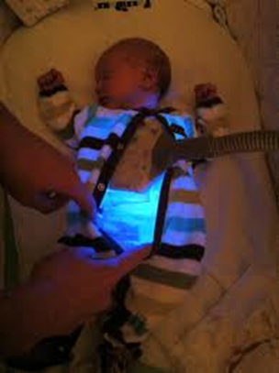
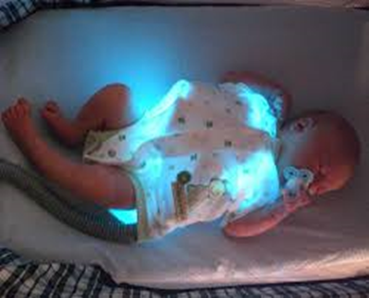
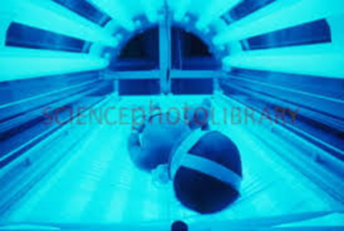
Maximal intensive phototherapy
Such therapy includes “special blue” fluorescent tubes,
placing the lamps within 15–20 cm of the infant,
and placing a fiberoptic phototherapy blanket under the infant's back to increase the exposed surface area.

Slide 70
Because phototherapy may require 6–12 hr to have a measurable effect,
it must be started at bilirubin levels below those indicated for exchange transfusion.
In term infants, phototherapy is begun when indirect bilirubin levels are between 16 and 18 mg/dL.
Phototherapy is initiated in premature infants when bilirubin is at lower levels

Slide 71
Bilirubin in the skin absorbs light energy, causing several photochemical reactions.
One major product from phototherapy is a result of a reversible photo-isomerization reaction converting the toxic native unconjugated 4Z, 15Z-bilirubin into an unconjugated configurational isomer 4Z,15E-bilirubin,
which can then be excreted in bile without conjugation.).

Slide 72
The other major product from phototherapy is lumirubin, which is an irreversible structural isomer converted from native bilirubin and can be excreted by the kidneys in the unconjugated state. Bilirubin absorbs light maximally in the blue range (420–470 nm

Slide 73
Suggested Maximal Indirect Serum Bilirubin Concentrations (mg/dL) in Preterm Infants
BIRTHWEIGHT (g) | UNCOMPLICATED | COMPLICATED[*]
<1,000 | 12–13 | 10–12
1,000–1,250 | 12–14 | 10–12
1,251–1,499 | 14–16 | 12–14
1,500–1,999 | 16–20 | 15–17
2,000–2,500 | 20–22 | 18–20

Slide 74
Phototherapy is usually started at 50–70% of the maximal indirect level.
If values greatly exceed this level, if phototherapy is unsuccessful in reducing the maximal bilirubin level, or if signs of kernicterus are evident, exchange transfusion is indicated.

Slide 75
Serum bilirubin levels and hematocrit should be monitored every 4–8 hr in infants with hemolytic disease or those with bilirubin levels near toxic range for the individual infant.
Others, particularly older infants, may be monitored less frequently.
Serum bilirubin monitoring should continue for at least 24 hr after cessation of phototherapy in patients with hemolytic disease because unexpected rises in bilirubin may occur and require further treatment.

Slide 76
NOTES
Skin color cannot be relied on for evaluating the effectiveness of phototherapy;
the skin of babies exposed to light may appear to be almost without jaundice in the presence of marked hyperbilirubinemia.
Although not necessary for all affected infants, intravenous fluid supplementation added to oral feedings may be beneficial in dehydrated patients or those with high bilirubin levels nearing exchange transfusion.
Dark skin does not reduce the efficacy of phototherapy.

Slide 77
Complications of phototherapy
increased insensible water loss
diarrhea
dehydration
macular-papular red skin rash
lethargy
masking of cyanosis
nasal obstruction by eye pads
potential for retinal damage
Skin bronzing may be noted in infants with direct-reacting hyperbilirubinemia

Slide 78
Exchange transfusion
usually is reserved for infants with dangerously high indirect bilirubin levels who are at risk for kernicterus.
As a rule of thumb, a level of 20 mg/dL for indirect-reacting bilirubin is the "exchange number" for infants with hemolysis who weigh more than 2000 g.
Asymptomatic infants with physiologic or breast milk jaundice may not require exchange transfusion, unless the indirect bilirubin level exceeds 25 mg/dL.

Slide 79
The exchangeable level of indirect bilirubin for other infants may be estimated by calculating
10% of the birth weight in grams
the level in an infant weighing 1500 g would be 15 mg/dL. Infants weighing less than 1000 g usually do not require an exchange transfusion until the bilirubin level exceeds 10 mg/dL.

Slide 80
Small infusions of fresh whole blood crossmatched with that of the mother and infant
are alternated with withdrawals of an equivalent quantity of the infant's blood, which is discarded.
Depending on the size of the infant, aliquots of 5 to 20 mL per cycle are withdrawn and infused,
with the total procedure lasting 45 to 60 minutes.

Slide 81
The total amount of blood exchanged is equal to twice the infant's blood volume, calculated as:
Weight (kg) X 85 ml/kg X 2

Slide 82
This volume should remove 85% of the infant's RBCs (the source of bilirubin), maternal antibodies.
The exchange transfusion usually is performed through an umbilical venous

Slide 83
The level of serum bilirubin immediately after the exchange transfusion declines to levels that are about half of those before the exchange;
levels rebound 6 to 8 hours later as a result of continued hemolysis and redistribution of bilirubin from tissue stores.

Slide 84
Complications of exchange transfusion
 | Graft versus reaction | Related to the blood
Hepatitis B,C ,HIV,CMV..) | infection
Hypoglycemia Hypocalcemia Hypomagnesemia hyperkalemia | Metabolic
 | Anemia/polycythemia
 | Perforation | Related to the catheter
 | Haemorrhage
 | vasospasm
 | Hypo-or hyperthermia | Related to the procedure
 | Volume overload
 | Necrotizing entrerocolitis
 | arrythmia
 | Late anemia | Late complications
persistent icterus with significant elevations in direct and indirect bilirubin in infants with hemolytic disease. The cause is unclear, but the jaundice clears spontaneously within a few weeks or months. | Inspissated bile syndrome
 | Portal vein thrombosis and portal hypertension

Slide 85
Late Complications.
Late anemia
may be hemolytic or hyporegenerative. Treatment with supplemental iron, erythropoietin, or blood transfusion may be indicated.
A mild graft vs host reaction may be manifested as diarrhea, rash, hepatitis, or eosinophilia.
Inspissated bile syndrome refers to the rare occurrence of persistent icterus in association with significant elevations in direct and indirect bilirubin in infants with hemolytic disease. The cause is unclear, but the jaundice clears spontaneously within a few weeks or months.
Portal vein thrombosis and portal hypertension

