Slide 1
CEREBELLAR ATAXIA AND RELATED CONDTIONS

Slide 2
Ataxia
incoordination of muscular activity associated with dysfunction of the cerebellum and its connections.

Slide 3
Equilibrium is the ability to maintain orientation of the body and its parts in relation to external space.
It depends on continuous visual, labyrinthine, and somatosensory (proprioceptive) inputs and their integration in the brainstem and cerebellum.
Disorders of equilibrium present with one or both of two cardinal symptoms:
- vertigo: an illusion of bodily or environmental movement, or
- ataxia: incoordination of limbs or gait.

Slide 4
Anatomy and Physiology
1- cerebellar hemisphere: control the movement of the limbs.
2- vermis:the midline part which control the trunk and proximal muscles.
The cerebellum receives special proprioceptive impulses from the vestibular nuclei ,and also receive signals from the proprioceptors of muscles and tendons in the limbs and are conveyed to the cerebellum in the dorsal spinocerebellar tract (from the lower limbs) and the ventral spinocerebellar tract (upper limbs). The main influence of the spinocerebellum appears to be on posture and muscle tone.

Slide 5
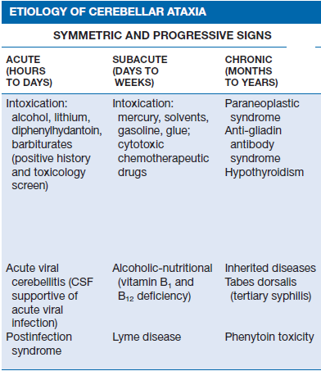

Slide 6
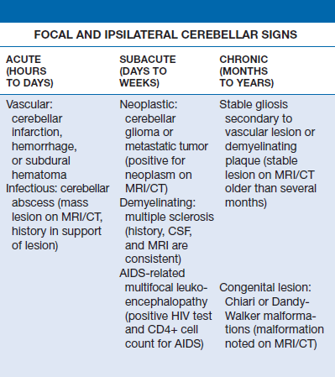

Slide 7
Approach to the Patient to the patient with ataxic disorder
Symptoms and signs of ataxia consist of gait impairment, unclear (“scanning”) speech, visual blurring due to nystagmus, hand incoordination, and tremor with movement. These result from the involvement of the cerebellum and its afferent and efferent pathways, including the spinocerebellar pathways.

Slide 8
A gradual and progressive increase in symptoms with bilateral and symmetric involvement suggests a biochemical, metabolic immune, or toxic etiology. Conversely, focal, unilateral symptoms with headache and impaired level of consciousness accompanied by ipsilateral cranial nerve palsies and contralateral weakness imply a spaceoccupying cerebellar lesion.

Slide 9
Vertiginous ataxia :
True cerebellar ataxia must be distinguished from ataxia associated with vestibular nerve or labyrinthine disease, as the latter results in a disorder of gait associated with a significant degree of dizziness, light-headedness, or the perception of movement , True cerebellar ataxia is devoid of these vertiginous complaints and is clearly an unsteady gait due to imbalance

Slide 10
Sensory Ataxia : ataxia occurs due to lesion in proprioception or dorsal column of spinal cord.
Sensory ataxia can also on occasion simulate the imbalance of cerebellar disease; with sensory ataxia, imbalance dramatically worsens when visual input is removed (Romberg sign).The presence of intention tremor , dysmetri
also called peripheral ataxia or afferent ataxia , this type of ataxia presented also with wide base gait and sometimes with bilateral steppage gait due to peripheral neuropathy , this a , dysnergia, dysdiakokinesia and rebound phenomensa is specific for cerebellar disease.

Slide 11
Causes of sensory ataxia :
Polyneuropathy (heavily myelinated peripheral nerves affection):
1-Autosomal dominant sensory ataxic neuropathy
2-Cisplatin (cis-platinum)
3-Dejerine-Sottas disease (Charcot-Marie Tooth Disease type III)
4-Diabetes
5- Diphtheria
6-Hypothyroidism
7-Immune-mediated neuropathies
8-Isoniazid
9-Paraneoplastic sensory neuronopathy (anti-Hu antibodies)
10-Pyridoxine
11-Refsum disease (CIDP + cerebellar ataxia)
12-Taxol

Slide 12
Myelopathy (posterior column affection):
1- Acute transverse myelitis
2- AIDS (vacuolar myelopathy)
3- Multiple sclerosis
4- Tumor or cord compression
5- Vascular malformations

Slide 13
Polyneuropathy or myelopathy:
1- Friedreich ataxia
2- Neurosyphilis (tabes dorsalis)
3- Vitamin B12 deficiency
4- Vitamin E deficiency
5- Nitric oxide poisioning
6- Copper defeciency.

Slide 14
Autosomal dominant Spinocerebellar Ataxia
Group of heterogeneous inherited disorders characterized by slowly progressive cerebellar ataxia that affects gait early and severely and may eventually confine the patient to bed. They show considerable clinical variability .Most of them begin in adulthood. Atrophy of the cerebellum and sometimes also of the brainstem may be apparent on CT or MRI scans. Definitive diagnosis is by genetic testing. Treatment is symptomatic.

Slide 16
Fridrich Ataxia
the most common of the idiopathic degenerative disorders that produce cerebellar ataxia begins in childhood after age of 4, before age of 25 years, autosomal recessive.
The pathologic findings are localized, for the most part, to the spinal cord and cerebellum & include:
degeneration of the spino-cerebellar tracts, degeneration of posterior columns, degeneration of dorsal roots and dorsal root ganglia so there is associated peripheral neuropathy.

Slide 17
Clinical features:
1-cerebellar symptom:The initial symptom is progressive gait ataxia followed by ataxia of all limbs within 2 years .
2- neuropathy:Knee and ankle tendon reflexes are lost. Joint position and vibration senses are impaired (post. columns involvement + polyneuropathy) in the legs, typically adding a sensory component to the motor component of gait ataxia. Pes cavus (high arch foot) may occur due to loss of interensic muscles of the foot.

Slide 18
3-Spinal cord:Weakness of the legs—and less often the arms—is a later development and may be of the upper or lower motor neuron variety (or both),
Extensor plantar responses (pyramidal tract involvement) + absent ankle jerks (associated neuropathy) .
4-other features:Severe progressive kyphoscoliosis lead to chronic restrictive lung disease. cardiomyopathy result in congestive heart failure and is a major cause of morbidity and death. Other abnormalities include: visual impairment (usually from optic atrophy), nystagmus ,paresthesias, tremor, hearing loss, vertigo,spasticity, leg pains, diabetes mellitus.

Slide 19
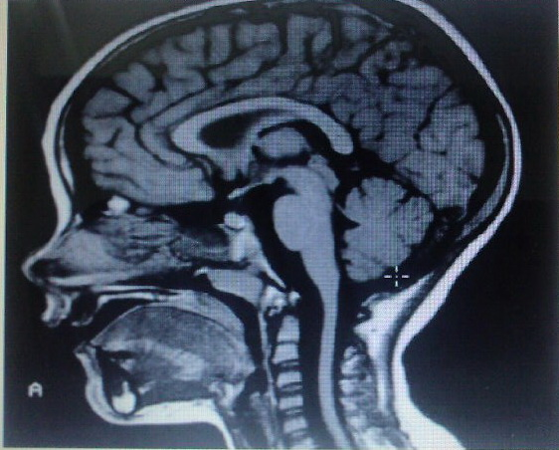

Slide 20
Treatment:
Investigation:
1- MRI brain and spine.
2- CXR.
3-FBS.
4-ECHO.
5- Genetic study.
Treatment:
No specific treatment is available. Just symptomatic.
Note: there is similar condition, mimic Friedriech ataxia, & being due to genetically determined vitamin E deficiency. In this case the patient is heterozygous because disease is inherited as autosomal dominant disorder.

Slide 21
Ataxia telengectasia
Autosomal recessive, progressive pancerebellar degeneration: – characterized by nystagmus, dysarthria, and gait, limb, and trunk ataxia – that begins in infancy.
oculocutaneous telangiectasia: usually appears in the teen years. The bulbar conjunctivae are typically affected first, followed by sun-exposed areas of the skin, including the ears, nose, face, and antecubital and popliteal fossae .
immunologic deficiency: (decreased circulating IgA and IgE) usually becomes evident later in childhood and is manifested by recurrent sinopulmonary infections in more than 80% of patients.Neuropathy: loss of vibration and position sense in the legs, areflexia,

Slide 22
Other features include :
-disorders of voluntary eye movements.
-Mental deficiency (commonly in 2nd decade)
- progeric changes of the skin and hair
- hypogonadism
- insulin resistance

Slide 23
Alcoholic cerebellar degeneration
develop in chronic alcoholics lasting 10 or more years, probably as a result of associated nutritional deficiency. most common in men. usually start between 40 and 60 years.
Degenerative changes are largely restricted to the superior vermis, usually insidious in onset & gradually progressive over weeks to months eventually reaching a stable level of deficit, Gait ataxia is a universal feature, heel-knee-shin test is +ve in about 80%. CT scan or MRI may show cerebellar atrophy. No specific treatment is available. Abstinence from alcohol, combined with adequate nutrition, leads to stabilization in most cases. All patients with this diagnosis should receive thiamine to prevent development of Wernicke encephalopathy.

Slide 24
Any patient with ataxia should send for :
1-Brain MRI
2- CBC and S. B12 LEVEL
3-SPINAL CORD MRI
4-Thyroid function test
5-Celiac Secreen
6-paraneoplastic Ab. Anti Yo & Hu.
7-Liver Function test
8-S. Vit. E LEVEL
9-S. lipid profile for abetaliporotinemia
10 –Toxocology screen
11- Phenytoin and carbimazapin level.

