Slide 1
Neuro Anatomy
أ.د.عبد الجبار الحبيطي

Slide 2
The meninges: -
Three membranes cover the brain & the spinal cord. They are arranged as outer dura, and then arachnoid & inner layer is the pia mater. The cranial dura mater is formed of two layers, an endosteal & Meningeal (the dura of the spinal cord is only one layer). The two layers are firmly fused together, except at certain sites where they separate to enclose between them venous sinuses.
The inner layer of dura is thick, fibrous, tough & strong, being stretched at certain places to form the dural folds (4 in number) they divided the intracranial cavity into a freely communicating compartments, which contain the different parts of the brain. These folds are: -

Slide 3
1-Falx cerebri: -
Is sickle shaped fold occupying the median longitudinal cerebral fissure, between the two cerebral hemispheres, its pointed anterior end attaches to crista galli & internal frontal crest, while its broad posterior extremity fuses with the superior layer of tentorium cerebelli. The flax cerebri has an outer fixed convex border related to the inner aspect of sagittal suture, while its inner border is free & related to corpus callosum (which connects the two cerebral hemisphere) at the bottom of the cerebral fissure.
The flax cerebri enclose three venous sinuses: -
Superior sagittal sinus: - on the fixed outer covex border of flax cerebri.
Inferior sagittal sinus: - on the inner free border of flax cerebri.
Straight (rectus) sinus: - along the line of fusion of posterior extremity of flax cerebri & tentorium cerebelli

Slide 4
2- Tentorium cerebelli: -
Is a tent shaped fold which roofs the posterior cranial fossa & its contents; it separates the superior surface of the cerebellum from inferior surface of the occipital lobe of cerebrum. It has two borders (attached & free). The attached border, extend from the posterior clinoid process, apex of the petrous bone, superior border of petrous bone & along the groove for the transverse sinus on the circumference of the occipital bone on each side. The free border is U shaped & surround the mid brain, it is called the tentorial hiatus (tentorial notch), the two ends of the U cross the fixed part at posterior clinoid process on each side to be affixed at the anterior clinoid process, between the two parts, there is a slit like gap for the passage of occulomotor & trochlear nerves to reach the cavernous sinus on their way to the superior orbital fissure.

Slide 5
Three venous sinuses are enclosed within the tentorium cerebelli includes: -
Rectus (straight) sinus.
Superior petrosal sinus: - on the attached border of petrous bone (superior petrosal sulcus).
Transverse sinus: - lies in the attached border in the groove for transverse sinus on the circumference of occipital bone from inside.

Slide 6
3- Falx cerebelli: -
Is a small sickle-shaped fold attached to the internal occipital crest & fuses to the inferior layer of tentorium cerebelli, it indents the cerebellum from behind between the two cerebellar hemispheres, it encloses the occipital venous sinus.

Slide 7
4- Diaphragma sellae: -
Is a circular fold that roofs the sella turcica (as a diaphragm) where it covers the pituitary gland. It is perforated at its center by the infundibulum (pituitary stalk) which connects the pituitary gland to the hypothalamus. The diaphragma sellae enclose the anterior & posterior intercavernous sinuses.

Slide 8
The dura mater of spinal cord is separated from the wall of the vertebral canal by the epidural (extradural) space & from the arachnoid mater by subdural space. It is attached to the following areas: -
Circumference of foramen magnum.
Bodies of 2nd & 3rd cervical vertebrae.
Back of the coccyx.
Intervertebral foramina (loose attachment).
Posterior longitudinal ligament (loose attachment).
The spinal dura mater is continuous above with the cranial dura mater & ends below at the 2nd sacral vertebra where it forms a sheath around the filum terminale to form dural sac.
It sends sleeves around the roots of the spinal nerves as they approach the intervertebral foramina. The epidural space lies between it & the wall of the vertebral canal. It contain: -
Loose areolar tissue.
Internal vertebral plexus of veins.
Fine arterial branches.

Slide 9
The arachnoid matter:
Is a thin, transparent avascular membrane lies between dura and pia matter. The space between arachnoid and dura is known as subdural space, while the space between it and inner pia is the subarachnoid space.
The arachnoid sends fine finger like projections called arachnoid granulations or velli which project to connect the subarachnoid space with some venous sinuses specially along the course of superior sagittal sinus and forms a rout for passages of some C.S.F to S.S.S.

Slide 10
The pia matter
Is a thin vascular membrane in direct contact and firmly adheres to the surface of the brain and follows into the deepest sulci of the brain it gives:
Tooth like processes along the side of the spinal cord known as ligamentum denticulatum which runs between the root of spinal nerves.
A sleeve covering to the blood vessels entering the brain forming Tella choroidea .
Filum terminale which is a tubular like structure projects from the lower end of the spinal cord and attaches to the back of the coccyx.

Slide 11
Nerves supply of the meninges
Meningeal branches from the ethmoidal nerves to the floor and anterior part of falx cerebri and part of tentorium cerebelli.
Meningeal branch from maxillary division as for e.g Tentorial branch.
Meningeal branch of the mandibular nerve known as nervous spinosum.
Meningeal branches from C1-C3 spinal nerves coming via foramina magnum, hypoglossal and jugular e.g recurrent meningeal.

Slide 12
Blood supply of the meninges
Anterior meningeal branch of anterior ethmoidal A.
Middle and accessory meningeal from maxillary A.
Posterior meningeal from many sources as from occipital, vertebral or ascending pharyngeal A.

Slide 13
The pterion
Is an H- shaped suture on the side of the skull represents the meeting of 4 bones (frontal, parietal, temporal and greater wing of sphenoid)). It is an important clinical area of great surgical importance for the following reasons :
On its inner surface runs the frontal branch of middle meningeal A. thus in any trauma and fracture of the pterion will result in tearing the wall of the artery and the accumulation of clotted blood between the dura and the inner table of the skull bone (periosteum) and known as Extradural or Epidural hematoma.
It is related to the primary motor area of the cerebral cortex ( precentral gyrus ) responsible for the movement of the opposite half of the body except lower limbs and perineum.

Slide 14
Some Terms
Extradural Hematoma ( Epidural ) is due to injury to the middle meningeal A.
Subdural Hematoma is due to injury to a meningeal vein or venous sinuses.
Subarachnoid Hemorrhage is due to rupture intracerebral aneurysm or any cerebral artery in the subarachnoid spaces.

Slide 15
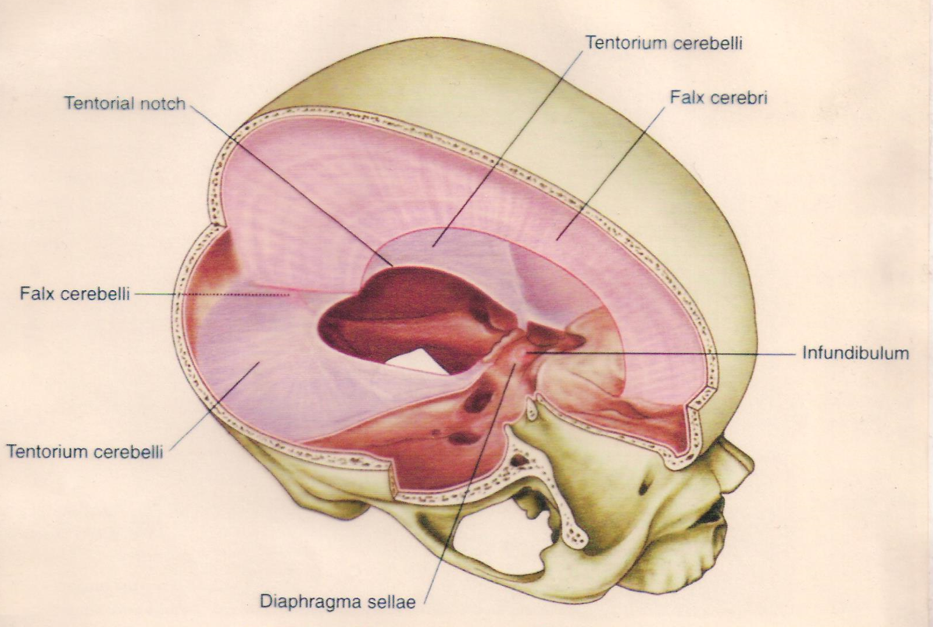

Slide 16
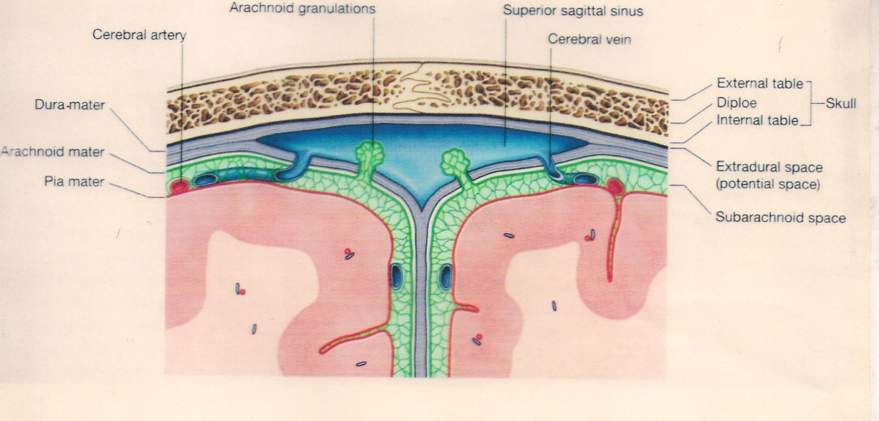

Slide 17
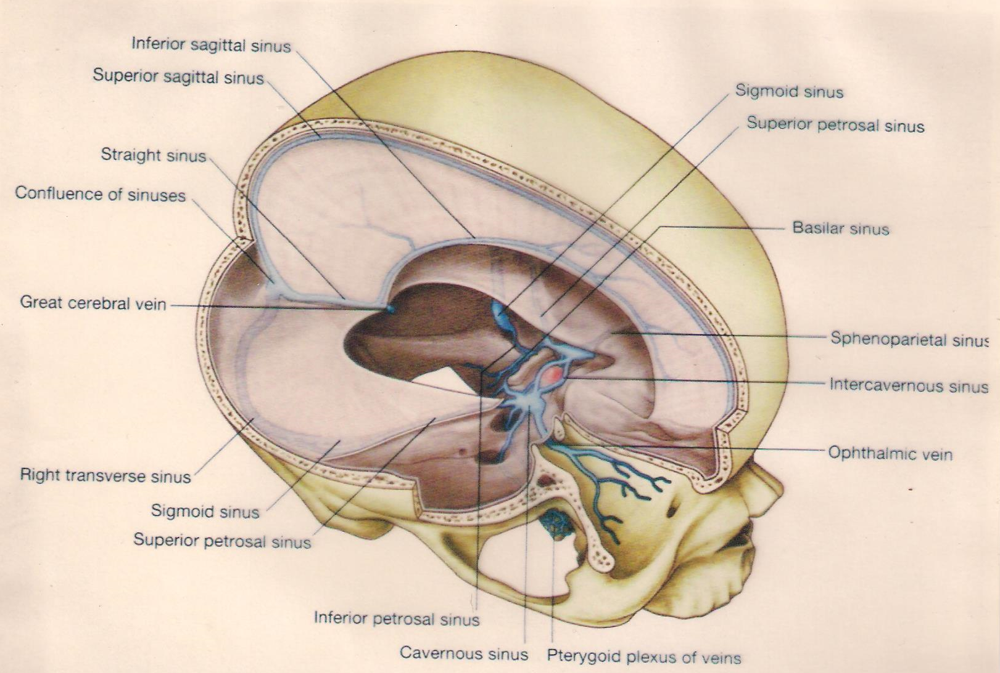

Slide 18
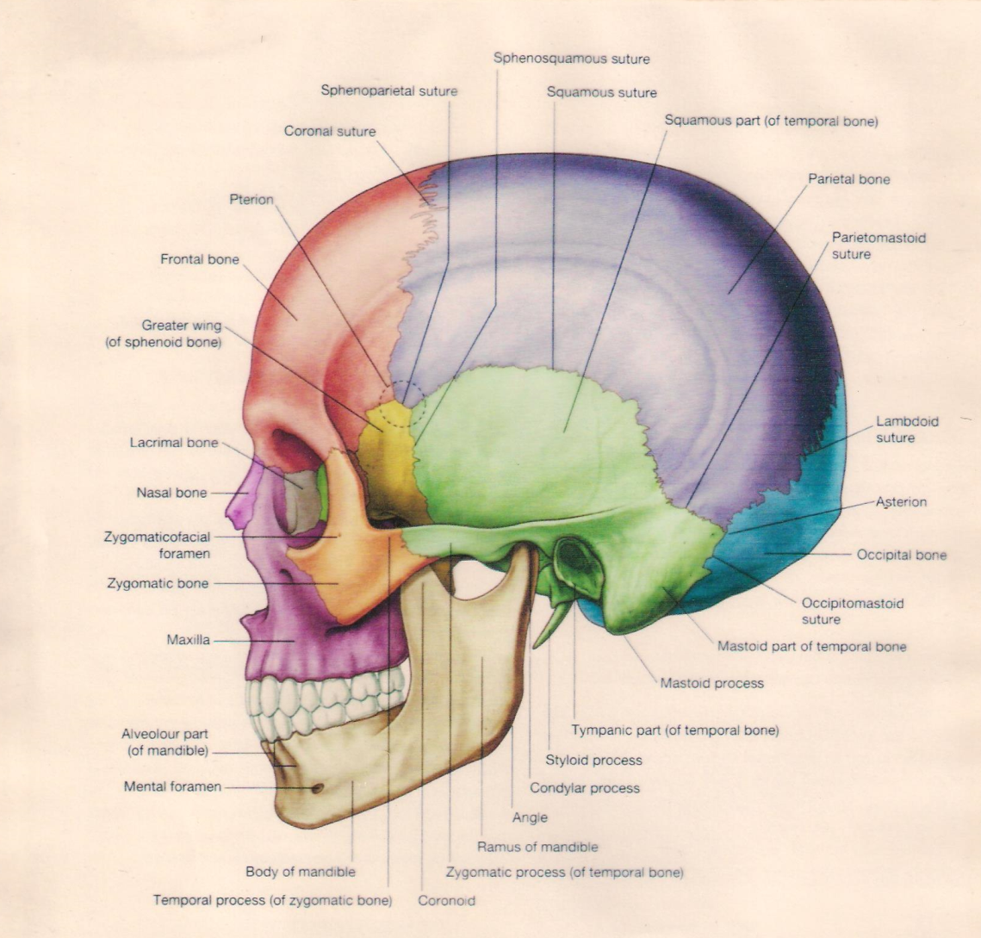

Slide 19
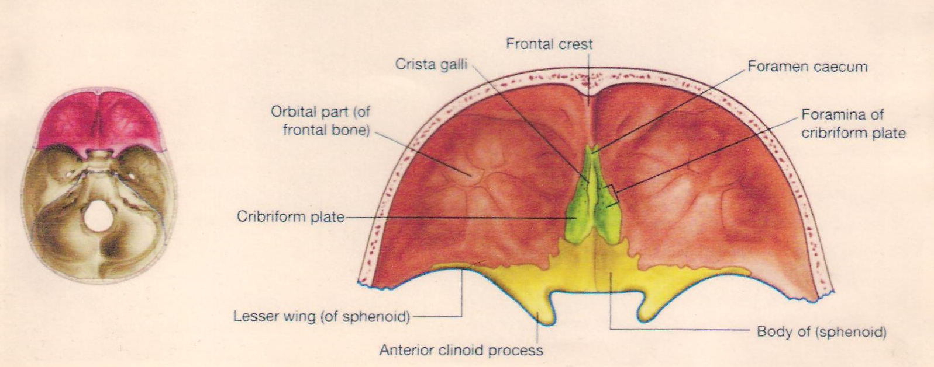

Slide 20
Thank you

