Slide 1
Cell physiology

Slide 3
The cell
The basic living unit of the body .
Each organ is an aggregate of many different cells held together.
The cell membrane
envelops the cell, is a thin, elastic structure .The approximate composition is:
proteins, 55 %
phospholipids, 25 %
cholesterol, 13 %
other lipids, 4 %
carbohydrates, 3 %

Slide 4
The cell membrane lipid
The lipid in the cell membrane is bilayer of phospholipid molecules.
One end of each phospholipid molecule is soluble in water(hydrophilic). The other end is soluble only in fats(hydrophobic.)
The hydrophilic ends then constitute the two surfaces of the complete cell membrane.
The lipid layer is impermeable to the water-soluble substances. Conversely, fat-soluble substances, such as oxygen, carbon dioxide, and alcohol, can penetrate this portion of the membrane

Slide 5
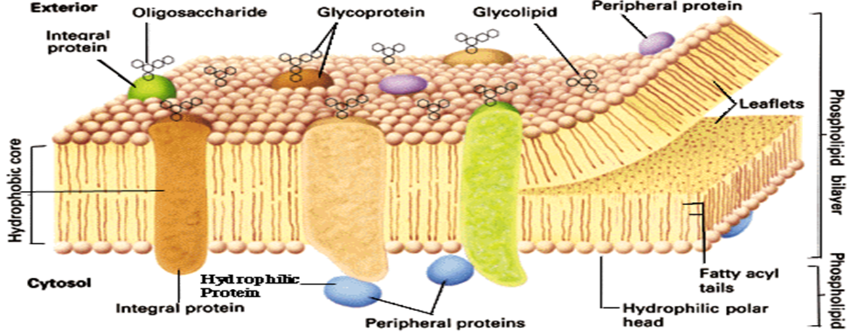

Slide 6
Cell Membrane Proteins
Globular masses floating in the lipid bilayer usually are glycoproteins.
Two types of proteins occur:
Integral proteins that protrude all the way through the membrane, form channels through which water and water-soluble substances can diffuse
Other integral proteins act as carrier proteins for transporting substances.
receptors for hormones .

Slide 7
Peripheral protein molecules are often attached to the integral proteins. function as enzymes.

Slide 8
Membrane Carbohydrates
carbohydrate coat called the glycocalyx have several important functions
1-have a negative electrical charge that repels other negative objects.
2- attaching cells to one another.
3- receptor substances for binding hormones, such as insulin
4- Some enter into immune reactions

Slide 9
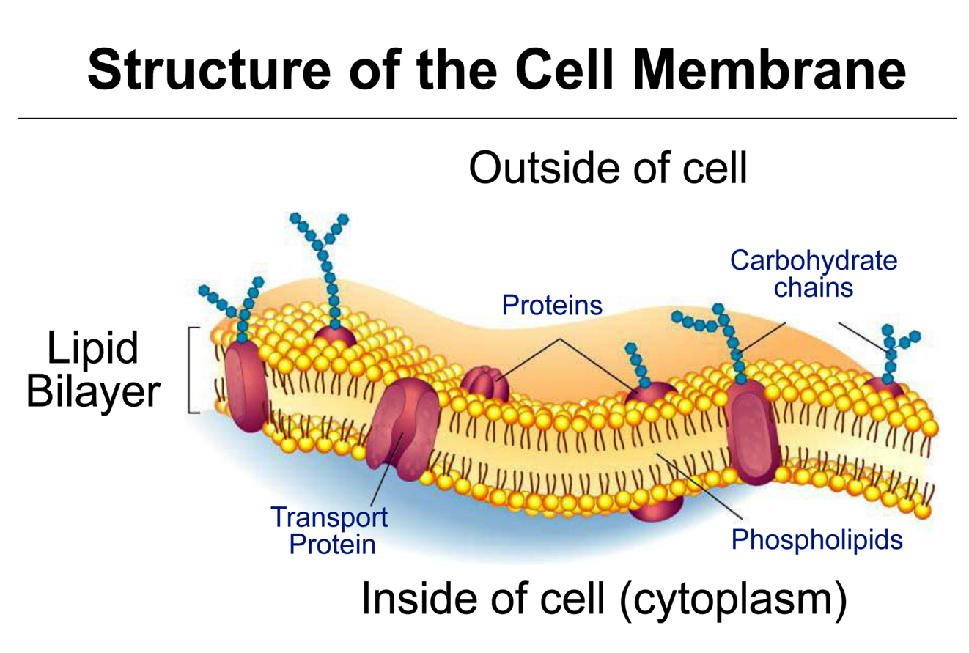

Slide 10
Cytoplasm and Its Organelles
The different substances that make up the cell are collectively called protoplasm
Protoplasm is composed mainly of five basic substances: water, electrolytes,proteins, lipids, and carbohydrates
Water.The principal fluid medium of the cell , which is present in most cells70-80 % 0f the cell mass , except for fat cells.
Ions. The most important ions in the cell are potassium, magnesium, phosphate, sulfate, bicarbonate, and smaller quantities of sodium, chloride, and calcium.

Slide 11
Proteins. 20 % of the cell mass. These can be divided into two types: structural proteins and functional proteins
Structural proteins are present in the cell mainly in the cilia, nerve axons.
The functional proteins are mainly the enzymes of the cell
Lipids. 2% of cell mass the important lipids are phospholipids and cholesterol. The significance of lipids are used to form the cell membrane and intracellular membrane
In the fat cells, lipids often account for as much as 95 %of the cell mass. They represents the storehouse of energy.
Carbohydrates. for nutrition of the cell. 1% of total cell mass ,However, carbohydrate in the form of dissolved glucose is always present in the surrounding extracellular fluid so that it is readily available to the cell.

Slide 12
The cytoplasmic organelles
five important organelles: the endoplasmic reticulum, the Golgi apparatus, mitochondria, lysosomes and peroxisomes.
Endoplasmic Reticulum
network of tubular and flat vesicular structures.
Granular Endoplasmic Reticulum
Has an Attachement of ribosomes. they function to synthesize new protein molecules in the cell
Agranular(or smooth) Endoplasmic Reticulum.
Has no attached ribosomes. functions is lipid synthesis

Slide 13
Golgi Apparatus
functions in association with the endoplasmic reticulum. small “transport vesicles” (also called endoplasmic reticulum vesicles)continually pinch off from the endoplasmic reticulum and fuse with the Golgi apparatus they processed in the Golgi apparatus to form lysosomes, secretory vesicles
Lysosomes
The lysosomes provide an intracellular digestive system it contain hydrolase enzyme that allows the cell to digest
(1) damaged cellular structures
(2) food particles
(3) bacteria.

Slide 14
Mitochondria
called the “powerhouses” of the cell. Without them all cellular functions would cease.
The liberated energy is used to synthesize a “high-energy” substance called adenosine triphosphate (ATP).

Slide 15
Nucleus
the control center of the cell, the nucleus contains large quantities of DNA, which are the genes.

Slide 16
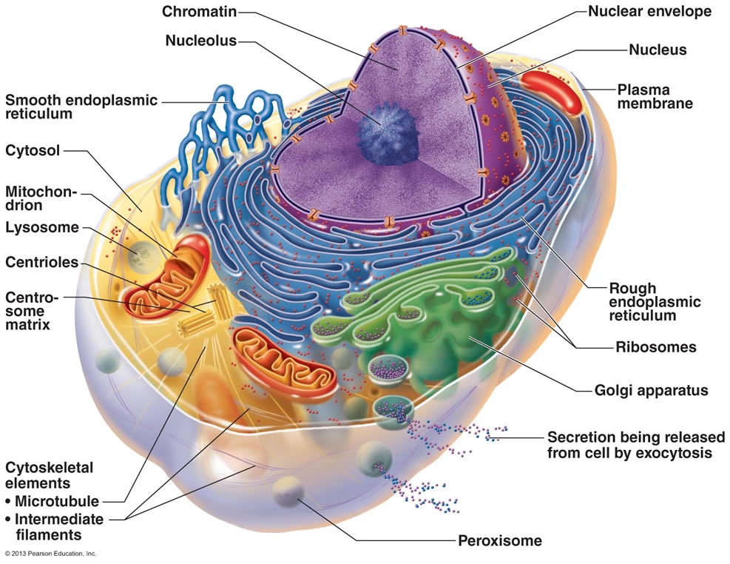

Slide 17
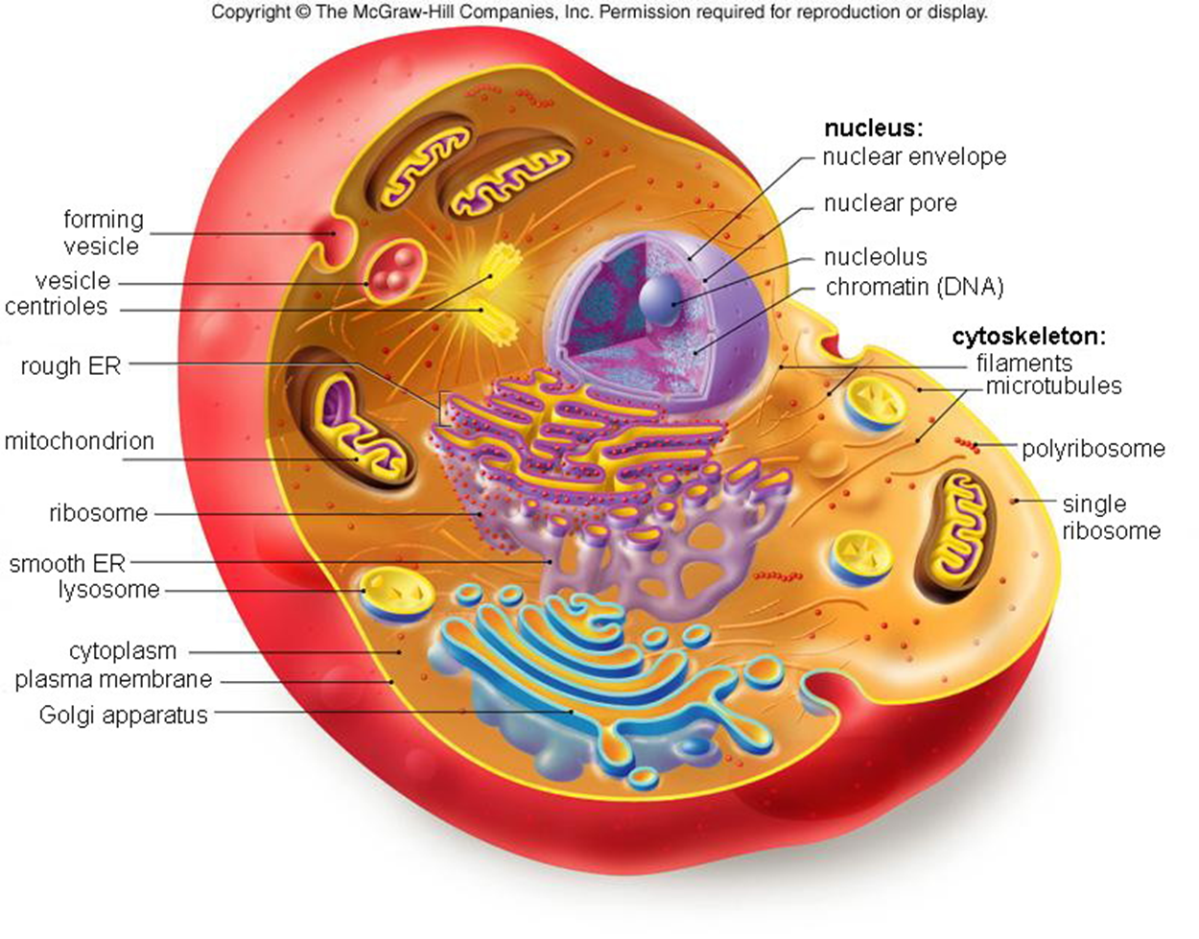

Slide 18
Ingestion by the Cell—Endocytosis
Very large particles enter the cell by endocytosis ,it is a form of active transport .The principal forms of endocytosis are pinocytosis and phagocytosis.

Slide 19
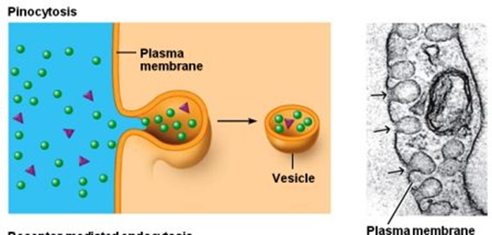
Pinocytosis
Means cell drinking:
is the invagination of the cell membrane to form a pocket, which then pinches off into the cell to form a vesicle filled with a large volume of extracellular fluid and molecules within it .

Slide 21
Phagocytosis
Means cell eating:
The edges of the membrane around the points of attachment evaginate outward to surround the entire particle; to form a closed phagocytic vesicle.
Actin surround the phagocytic vesicle and contract around its outer edge, pinch the vesicle and pushing the vesicle to the interior of the cell
ingestion of large particles, such as bacteria.
Only certain cells have the capability of phagocytosis, like the white blood cells

Slide 22
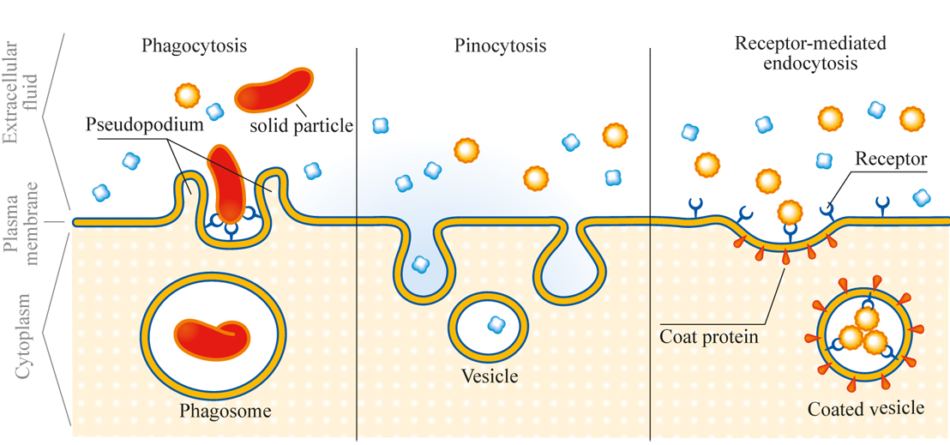

Slide 23
Question: How does a cell get something very large through its membrane?

Slide 24
Digestion of Pinocytotic and Phagocytic Foreign Substances
immediately after a pinocytotic or phagocytic vesicle appears inside a cell, one or more lysosomes become attached to the vesicle and empty their acid hydrolases to the inside of the vesicle, Thus, a digestive vesicle is formed inside the cell cytoplasm.
hydrolases begin hydrolyzing the proteins, carbohydrates, lipids and other substances in the vesicle. The products of digestion are small molecules of amino acids, glucose,phosphates, and so forth that can diffuse through the membrane of the vesicle into the cytoplasm.
What is left of the digestive vesicle, called the residual body represents indigestible substances is excreted through the cell membrane by a process called exocytosis, which is essentially the opposite of endocytosis
-Peroxisomes contain oxidase enzyme

Slide 26
exocytosis
In a highly secretory cell, the vesicles formed by the Golgi apparatus are mainly secretory vesicles containing protein substances that are to be secreted through the surface of the cell membrane.
These secretory vesicles first diffuse to the cell membrane, then fuse with it and empty their substances to the exterior by the mechanism called exocytosis

Slide 27
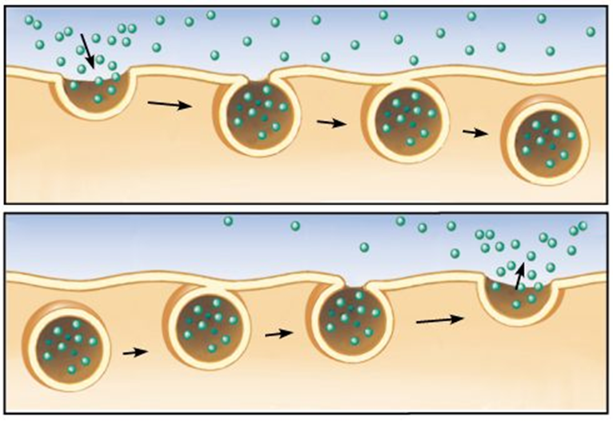
endocytosis
exocytosis

Slide 28
Regression of Tissues and Autolysis of Cells
Tissues of the body often regress to a smaller size, this occurs in the uterus after pregnancy, in muscles during long periods of inactivity.
Lysosomes are responsible for much of this regression

