Slide 1
Neoplasia
Dr. Nadwa S. M.Al-azow

Slide 2
Definition
A neoplasm( new growth) is defined as an
abnormal mass of tissue, whose growth is uncoordinated with and exceeds that of the normal tissues.
The tumor arise from one clone that undergo genetic changes and uncontrolled proliferation

Slide 3
Classification of Tumours
Benign
Malignant
Epithelial
Mesenchymal
Mesenchymal
Epithelial

Slide 4
Benign Epithelial tumors
Tumor arising from covering epithelia called papilloma like squamous papilloma arising from tissue that lined by stratified squamous epithelium like skin, esophagus….
Or glandular epithelia called adenoma like thyroid or breast adenoma….

Slide 5
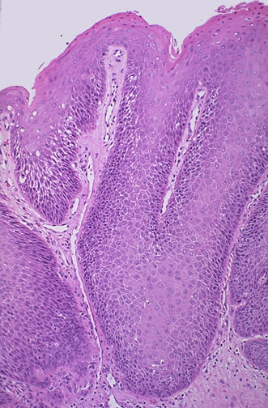
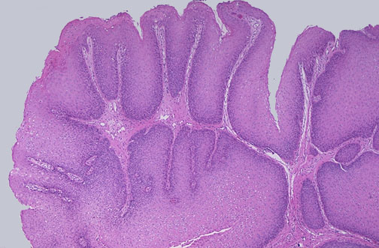

Slide 6
Notes:
Papillary adenoma of colon. Note the fingerlike projections of the tumor.
Iowa Histopathology

Slide 8
Malignant epithelial tumor
Squamouas carcinoma tumor arise from squamous epthelia with features of malignancy
Adenocarcinoma malignant tumor arise from glandular epithelia

Slide 13
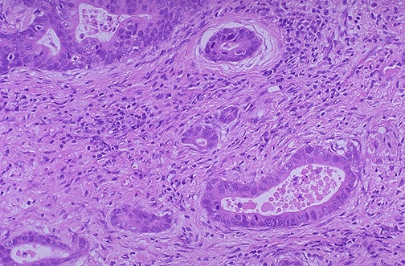
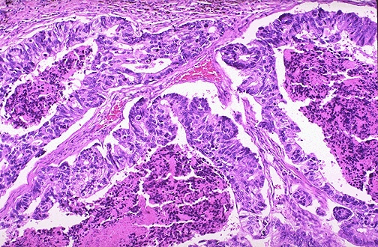
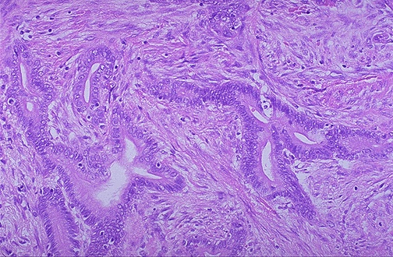

Slide 14
Notes:
Adenocarcinoma of colon arising in a case of ulcerative colitis.
Do you think that most adenocarcinomas arise from tissues or organs that are “glandular” themselves? Ans : YES!

Slide 15
Benign Mesenchymal tumor
The nomenclature of these tumours is straightforward – the name consists of a prefix indicating the type of differentiation,
for example lipo- (fat), chondro- (cartilage), haemangio-(blood vessel), with the suffix -oma denoting a benign tumour.
General features:
Most are slowly growing
encapsulated tumours
composed of the appropriate differentiated tissue

Slide 18
Malignant mesenchymal tumors
These are known as sarcomas . They are
far less common than carcinomas.
Most occur within the deep soft tissue of the limbs and trunk, although some arise within viscera.
Leiomyosarcoma ,liposarcoma , Rhabdomyosarcoma…

Slide 19
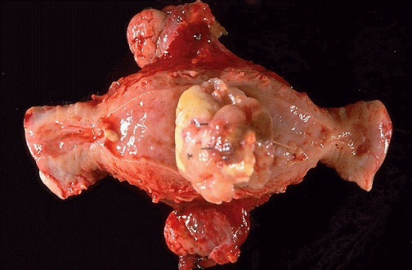
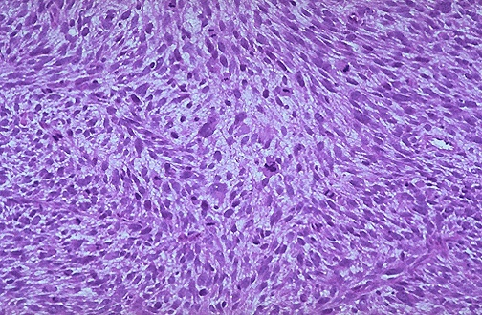

Slide 20
Tumours of Haemopoietic and Lymphoid Tissues
Tumors that arise from stem cells of white blood cells in the bone marrow leukemia
malignant solid tumours of lymphocytic origin, most of which arise in lymph nodes, spleen, thymus or bone marrow Lymphomas

Slide 21
Tumors with mixed differentiation
mixed tumors: e.g. pleomorphic adenoma of salivary gland
Teratoma
tumor comprised of cells from more than one germ layer
arise from totipotent cells (usually gonads)
benign cystic teratoma of ovary is the most common teratoma
Aberrant differentiation (not true neoplasms)
Hamartoma: disorganized mass of tissue whose cell types are indiginous to the site of the lesion, e.g., lung
Choriostoma: ectopic focus of normal tissue (heterotopia), e.g., pancreas,
Misnomers
hepatoma: malignant liver tumor
melanoma: malignant skin tumor
seminoma: malignant testicular tumor
lymphoma: malignant tumor of lymphocytes
Notes:
Misnomers are often REDUNDANT, to try to correct the misnomer.

Slide 23
Differences between benign &malignant tumor

Slide 24
SPREAD OF MALIGNANT TUMOURS
Forms of tumour spread include:
• local spread
• lymphatic spread
• blood (haematogenous spread)
transcoelomic spread
• intraepithelial spread

Slide 25
Local Spread
Malignant cells have the ability to emerge themselves between adjacent normal cells and invade the surrounding tissues ( first loose connective tissue).
For epithelial tumors the first step should break the basement membrane

Slide 27
Lymphatic Spread
This is the principal mode by which carcinomas spread.
The very thin walls of lymphatics are readily penetrated by tumour cell , which is carried along in the lymph to the first lymph node in the lymph node chain

Slide 29
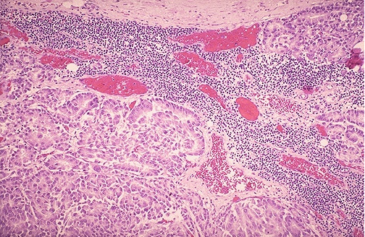

Slide 31
Blood (Haematogenous) Spread
Tumour cells are able to invade thin walled veins and grow along the venous system or embolize into the blood stream.
The site of initial metastasis (first-pass organ)
depends on the venous drainage of the location of the
tumour.

Slide 32
Lung , liver and brain are the main organs of hematogenous spread for cancers.
Blood spread is main way for Sarcoma and later for carcinoma

Slide 35
Transcoelomic Spread
It means spread across body cavities, the
peritoneal, pleural and pericardial spaces.
e.g: Gastric carcinoma can spread in a similar fashion, to involve the peritoneal cavity, often seeding in the ovaries. known as Krukenberg’s tumours

Slide 36
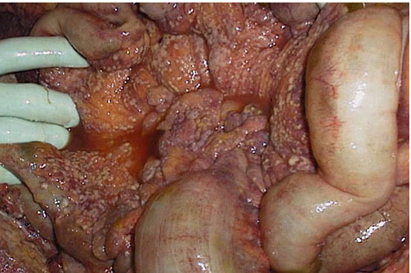

Slide 37
Intraepithelial Spread
This is the process by which tumour cells can infiltrate between the cells of a normal epithelium, without invading the underlying stroma.
It is best seen in Paget’s disease of the nipple in which the cells of ductal carcinoma in situ of breast grow into the nipple skin giving an appearance resembling eczema.

Slide 38
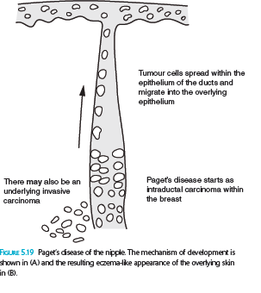

Slide 39
MECHANISMS OF TUMOUR SPREAD
I/ Direct Spread and Invasiveness
Tumour Cell Motility
The cells extrude pseudopodia at the front and attach to stromal proteins
(cytoskeleton)
Invasion of Basement Membrane and Stroma
1.cancer cells have altered integrin molecule expression
2. production of proteolytic enzymes by cancer
Reduction in Cell: Cell Adhesion
(low production of c-cadherin by malignant cells

Slide 40
II/ Angiogenesis
(New blood vessels formation occur normally during tissue healing and chronic inflammation)
In recent years they found it is important step in tumor growth and metastasis , which involve:
proteolytic digestion of basement membrane by plasminogen activators and matrix metalloproteinases
migration of endothelial cells, initially as a solid cord
proliferation of endothelial cells
● organization of the cords of endothelial cells into new blood vessels with lumens.

Slide 41
III / vascular Invasion
The thin walls and poorly formed basement membranes of newly formed blood vessels allow the tumor cells to penetrate.
Once tumour cells are free within the lumen of the blood vessel they are carried into the circulation and lodge in a capillary bed.

Slide 42
IV/ Establishment of a New Colony
This involves cell proliferation and the development of a tumour blood supply by stimulation of angiogenesis as previously described.

Slide 43
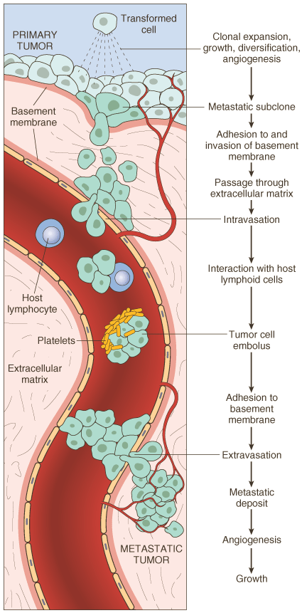
TRANSFORMATION→ GROWTH→ BM INVASION→ ANGIOGENESIS→ INTRAVASATION→ EMBOLIZATION→ ADHESION→ EXTRAVASATION→ METASTATIC GROWTH→etc.
Notes:
Another AWESOME diagram! Most important diagrammatic explanation of malignancy I have ever seen.
Linear→Linear→Linear→Linear→Linear→Linear→Linear→Linear→Linear→Linear→Linear→Linear→

Slide 44
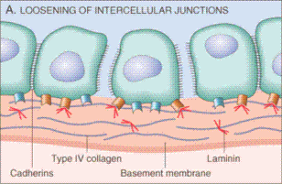
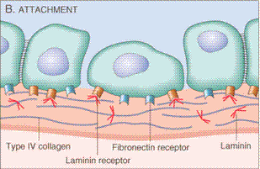
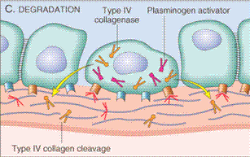
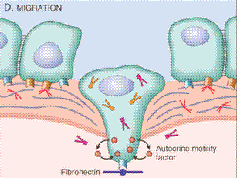
Notes:
Detachment, 2) attachment, 3) degradation, 4) migration
Google hits:
“invasive carcinoma” = 300K
“invading carcinoma” = 3K
“infiltrating carcinoma” = 30K
“infiltrative carcinoma” = 3K

Slide 45
PREMALIGNANT CONDITIONS:
Three main groups of lesions can be regarded as
premalignant:
• malignant change in benign tumors :
EXAMPLE/ colonic adenoma , neurofibroma
•

Slide 46
Intraepithelial malignancy/dysplasia ( carcinoma in situ)
The epithelial cells show the cytological features of malignancy but have not yet developed the ability to invade adjacent normal tissues.
This process has been known as dysplasia, carcinoma in situ and more recently as ‘intraepithelial neoplasia’.

Slide 47
malignancy developing in chronic inflammation :
chronic damage & repair during chronic inflammation may lead to cancer .
Ulcerative colitis colonic cancer
Hashimotos’ thyroiditis lymphoma
Cirrhosis of liver hepatocellular carcinoma

Slide 48
Clinical Effects of Tumors
Benign tumor
Pressure effects due to tumor expansion e.g/
pitutatry adenoma may cause hypopitutarisim
Distortion of uterine cavity in leiomyoma
Effect of substances produced by tumor cells
e.g/thyroid adenoma leads to hyperthroididism
Painless palpable lump (feeling of discomfort

Slide 49
Non –metastatic
Effects Effects of Malignant tumors Metastatic effects
Inappropriate secretion of hormones
Direct effects

Slide 50
Direct Effects
Pain due to compress the adjacent structures such as nerves by the mass of malignant tumor .
Haemorrhage from an ulcerated carcinoma may be acute or chronic, thus leading to iron deficiency anaemia
Narrowing (stenosis) or complete obstruction of
a hollow viscus

Slide 51
Metastatic Effects
Metastases can cause similar mass effects to primary tumours, but because they are usually multiple
the consequences tend to be more severe

Slide 52
Non-metastatic Effects
Patients with advanced cancer are often wasted (cachectic) with weight loss, anorexia and
Immunosuppression
abnormalities of coagulation, for example thrombophlebitis migrans
neurological disorders, for example neuropathy, cerebellar
Degeneration
These effects due to secretion of cytokines like interlukin 1(IL-1) & tumor necrosis TNFα

Slide 53
Inappropriate Hormone Production
Many tumours produce hormones not normally produced by their tissue of origin.

Slide 54
Paraneoplastic Syndromes
These occur in about 10% of persons with malignant disease
They are related to secretion of hormone or hormone like substances which are produced by certain malignant tumors , they are important for the following resons:
They may represent the earliest manifestation of an occult neoplasm.
In affected patients they may represent significant clinical problems and may even be lethal.
They may mimic metastatic disease

Slide 55
Causal mechanism | Underlying cancer | Clinical syndromes
ACTH or ACTH-like substance | Small-cell carcinoma of lung | Cushing Syndrome
 | Pancreatic carcinoma
 | Neural tumors
Parathyroid hormone–related protein (PTHRP), TGF-α, TNF, IL-1 | Squamous cell carcinoma | Hypercalcaemia
 | Breast cancer
 | Renal carcinoma
 | Adult T-cell leukemia /lymphoma

Slide 56
Causal mechanism | Underlying carcinoma | Clinical Syndromes
Insulin or insulin-like substance | Ovarian carcinoma | hypoglycaemia
 | Fibrosarcoma
 | Other mesenchymal sarcomas
Erythropoietin | Gastric carcinoma
 | Renal carcinoma | polycythemia
 | Cerebellar hemangioma
 | Hepatocellular carcinoma

Slide 57
TUMOUR STAGING AND GRADING
Methods are used to asses the aggressiveness of malignant tumors and the spread of them
necessary for prognosis of the malignant tumor and choice the proper treatment

Slide 58
Grading of malignant tumors
Grading of a cancer is based on the degree of differentiation of the tumor cells & the resemblance of cancer cells to tissue of origin.
The main parameters that look for :
mitotic activity
nuclear pleomorphism
degree of differentiation
extent of necrosis

Slide 59
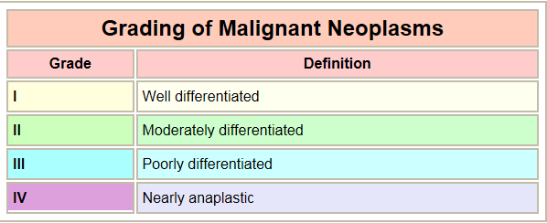
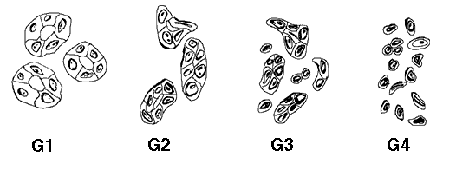

Slide 60
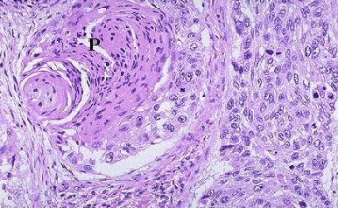
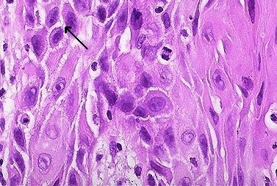
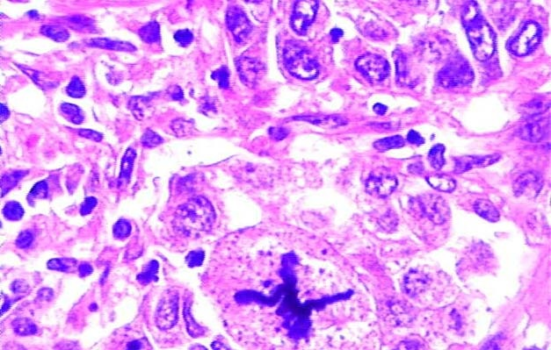
WELL?
(pearls)
MODERATE?
(intercellular bridges)
POOR?
(WTF!?!)
GRADING for Squamous Cell Carcinoma
Notes:
60

Slide 61
Anaplasia :
lack of differentiation of malignant cells
The features of anaplasia
Pleomorphism : different of size and shape in both cells and nucleus
Abnormal nuclear morphology : the nuclear-to-cytoplasm ratio may approach 1 : 1 instead of the normal 1 : 4 or 1 : 6.
Mitoses : not only increase in the proliferative rate but atypical, bizarre mitotic figures
Tumor Giant cell formation : possessing only a single huge polymorphic nucleus and others having two or more large, hyperchromatic nuclei

Slide 62
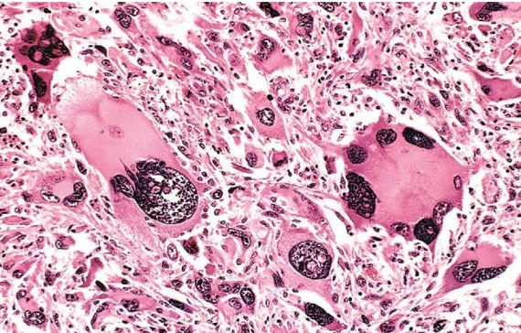

Slide 63
The staging of cancers
is based on the size of the primary lesion, its extent of spread to regional lymph nodes, and the presence or absence of blood-borne metastases.
The main staging system have used is TNM staging
T for primary tumor (T1-T4 ) T0 is referred to carcinoma in situ
N for regional lymph node involvement (N1-N3)
M for metastases (M0-M1)

Slide 64
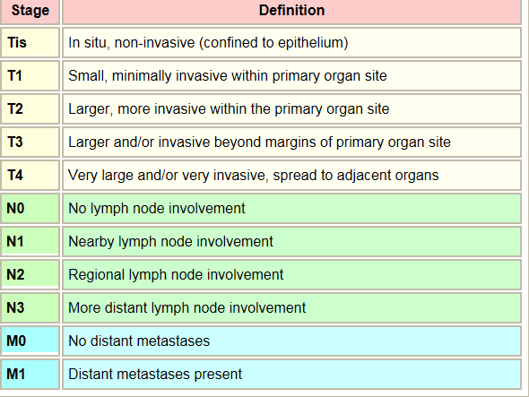

Slide 65
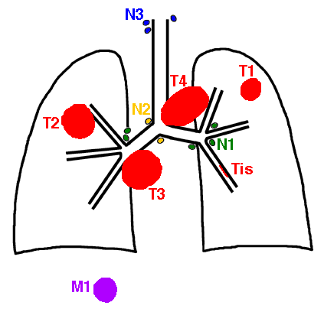

Slide 66
PATHOLOGICAL DIAGNOSIS OF TUMORS
Although clinical, radiological and biochemical findings all contribute towards the diagnosis of a tumour,
the final diagnosis is made in almost all cases by microscopic examination

Slide 67
Biopsies for Histopathological Assessment
Excisional Biopsy
Is used for small tumors
The entire lesion is removed &examined
Incisional Biopsy
Needle Biopsy
Cytology
For large tumor , wedge sections will be removed & examined microscopically
deep-seated ones under radiological control, can be sampled by needle biopsy in which a thin core of tissue is removed
Examination of individual tumor cells in body fluid or by using needle aspiration (breast lump ,thyroid)

Slide 68
Additional techniques :
Some of tumors are undifferentiated and very difficult to reach the diagnosis by H&E stain
So we need additional techniques to reach final diagnosis and give the proper treatment.
Electron microscope
Immunohistochemical stains : special technique which is depended on antigen –antibody reaction .(using antibodies to cell constituents)
In-situ hybridization have been used to detect gene expression as a way of determining tumor type

Slide 69
Tumor Markers
These substances are produced by tumor cells, are
detectable in the blood, and are of value in diagnosis and in monitoring progress following treatment.

Slide 70
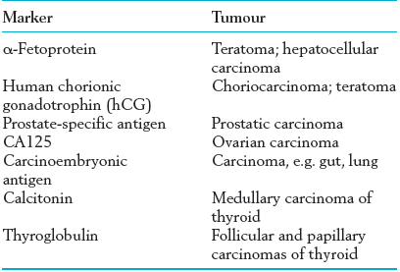

Slide 71
Causes of Neoplasia
The origin for many neoplasms is obscure. However, there are several theories of origin:
Oncogenic viruses
HPV in Squamous cell carcinoma of cervix
Epestein virus in Burkitt’s lymphoma
Chemicals
aniline dyes and bladder cancer
Aflatoxine & hepatocellular carcinoma
cigarette smoke and lung cancer
Hepatitis B virus in hepatocellular carcioma
Radiation
UV light= skin cancer
Ionizing radiation =thyroid, lung,colon and Breast cancer
Hereditary causes
Defect in chromosomes as Retinoblastoma defect in chromosome 13

Slide 72
Causes of Neoplasia : cont.
Also they are found the incidence of cancers are increased in older persons
racial predilections (American women have breast cancer more often than Japanese women; Japanese men have stomach cancer far more often than American men).

Slide 73
Carcinogenesis is a multistep process :
Initiators
Initiation that lead to irreversible DNA damage(lethal damage)
Example : Alkylating agent like cycophosphamide
Promotors
Lead to proliferation of abnormal (mutagenic cells) but they there appears to be a "dose-threshold" concentration of promoter below which neoplasia will not occur
like hormone therapy estrogen(diethylstilbesterol)

Slide 74
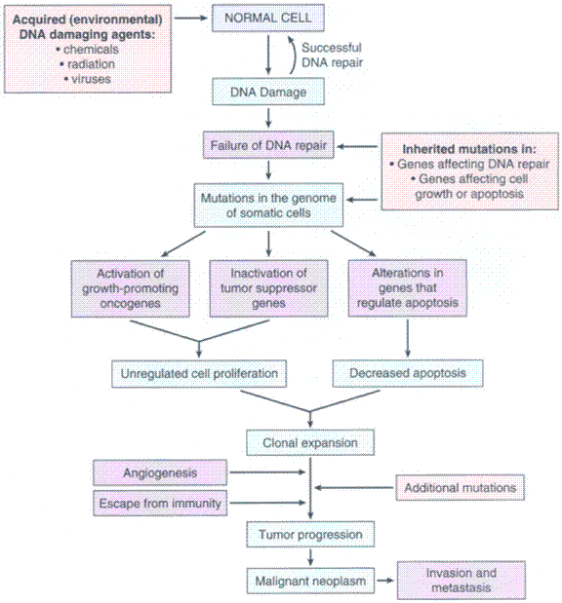
Notes:
understanding the development of malignancy in a logical way!

Slide 75
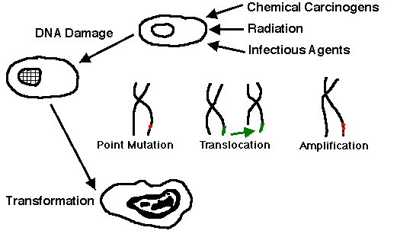

Slide 76
MOLECULAR BASIS of CANCER
Four classes of normal regulatory genes
PROTO-oncogenes ((gene responsible for cell growth)
Tumor suppressor genes
DNA repair genes
Apoptosis genes
Notes:
.

Slide 77
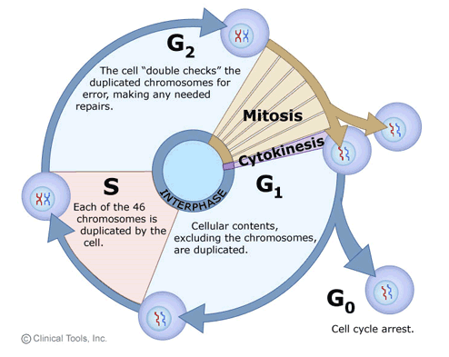

Slide 78
Defect (over expression) in proto-oncogene (growth factors) leads to uncontrolled cell proliferations )
e.g / RAS overexpression in many human cancer
Loss of tumor supprresor genes (P53)
Limitation of apoptotic genes (BCL2)
Defects in DNA repair genes

Slide 79
TRANSFORMATION & PROGRESSION
Self-sufficiency in growth signals
Insensitivity to growth-inhibiting signals
Evasion of apoptosis
Defects in DNA repair: “Spell checker”
Limitless replicative potential: Telomerase
Angiogenesis
Invasive ability
Metastatic ability
Notes:
The various aspects of “malignant transformation”. Just like cancer itself is a progression of increasingly disturbing processes, so is malignant transformation. These are not necessarily exactly linear events, but close.
Look at these as being factors in growth regulation.

Slide 80
HOST DEFENSES
IMMUNE SURVEILLENCE CONCEPT
CD8+ T-Cells
NK cells
MACROPHAGES
ANTIBODIES

Slide 81
How do tumor cells escape immune surveillance?
Mutation, like microbes
↓ MHC molecules on tumor cell surface
Immunosuppressive agents
Antigen masking
Apoptosis of cytotoxic T-Cells (CD8), i.e., the tumor cell KILLS the T-cell!
Notes:
T cells require two signals to become fully activated. A first signal, which is antigen-specific, is provided through the T cell receptor which interacts with peptide-MHC molecules on the membrane of antigen presenting cells (APC). A second signal, the CO-STIMULATORY signal, is antigen nonspecific and is provided by the interaction between co-stimulatory molecules expressed on the membrane of APC and the T cell.

