Slide 1
White blood cells count
University of Ishik
Faculty of dentistry
Practical Medical Physiology
2th stage
Abdulqadir Kh.Hamad
M.Sc. Medical Biology
Abdulqadir.bio@raparinuni.org

Slide 2
White blood cells or leukocytes are cells of the immune system which defend the body against both infectious disease and foreign materials.
Whenever a infectious agent enters the body the white blood cells have a variety of ways by which they can attack. Some will produce protective antibodies that will overpower the pathogen. Others will surround and engulf the pathogen.
Several different and diverse types of leukocytes exist, but they are all produced and derived from a multipotent cell in the bone marrow known as a hematopoietic stem cell.

Slide 3
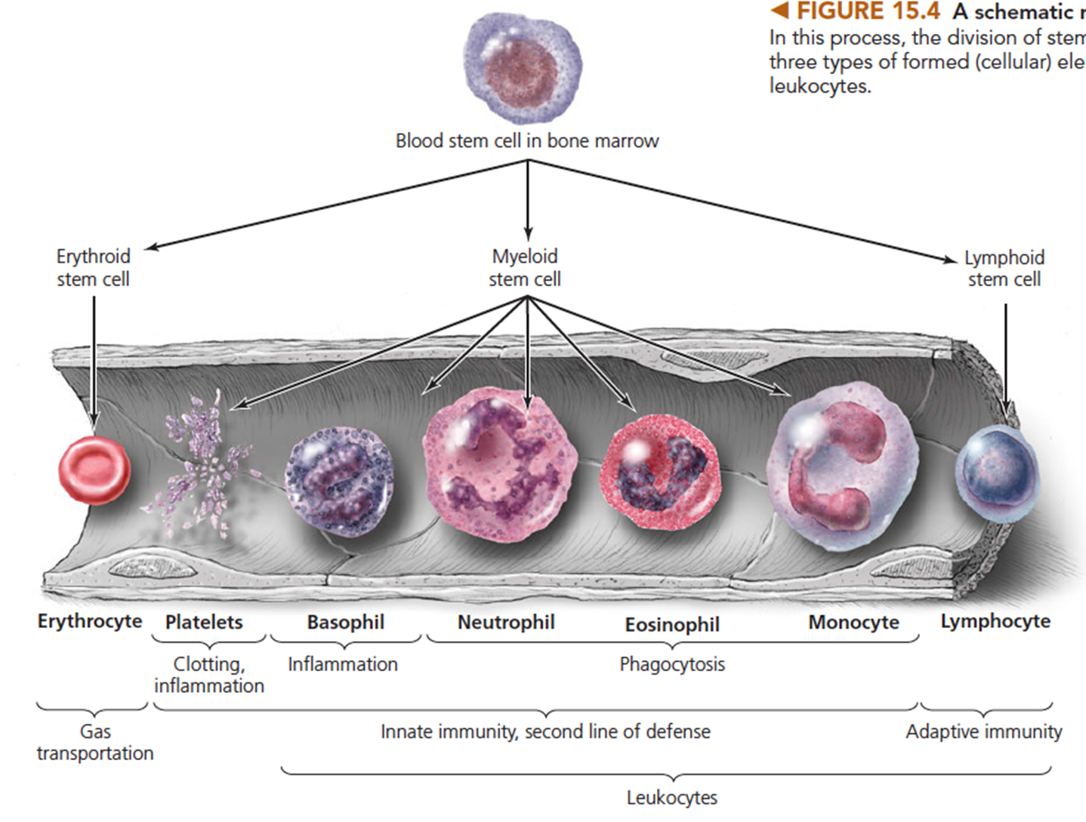

Slide 4
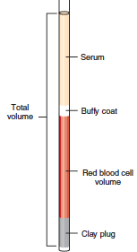
White Blood Cells (Leukocytes)
Leukocytes are found throughout the body, including the blood, tissues and lymphatic system.
The name "White Blood Cell" derives from the fact that after centrifugation of a blood sample, the white cells are found in the Buffy coat, a thin layer of nucleated cells between the sedimented red blood cells and the blood plasma, which is typically white in color. The scientific term leukocyte directly reflects this description, derived from Greek leuko - white, and cyte - cell.

Slide 5
White Blood Cells (Leukocytes)
White blood cell count (WBC) is the total number of leukocytes in a volume of blood, expressed as thousands/µl.
Total WBC count can be done by manual methods or by automated cell counters.
Normal Values
White blood cell count
Adult: 4500–10,500/mm3 or 4.5–10.5 x 10³/μl
Child 6–12 years: 4500–13,500/mm3 or 4.5–13.5 x 10³/μl
Child 2–6 years: 5000–15,500/mm3 or 5.0–15.5 x 10³/μl
Child < 2 weeks: 5000–21,000/mm3 or 5.0–21.0 x 10³/μl

Slide 6
Leukocytosis is a condition characterized by an elevated number of white cells in the blood. Such as in case :
appendicitis, bacterial infections, burns, cholera
Leukopenia is a condition characterized by a decreased number of white cells in the blood such as in case :
acquired immune deficiency syndrome (AIDS), anemia.

Slide 7
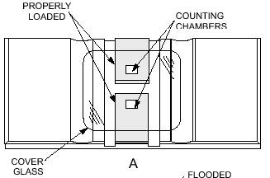
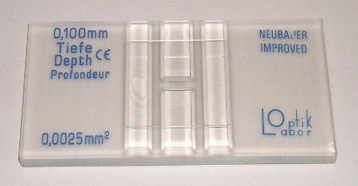
Hemocytometer
Its composed of a thick glass slide and a cover slide.
In the center of the slide, there is an H- shaped groove
The surface of the chamber contains two counting ruled areas
The distance between the bottom of the coverslip and the surface of the counting area of the chamber is 0.1 mm

Slide 8
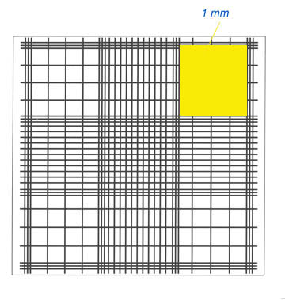
Hemocytometer
The whole counting area is divided into 9 big squares.
Each square is 1mm
long and 1mm wide.
The four corner
squares are used
for WBC counting.
W
W
W
W

Slide 9
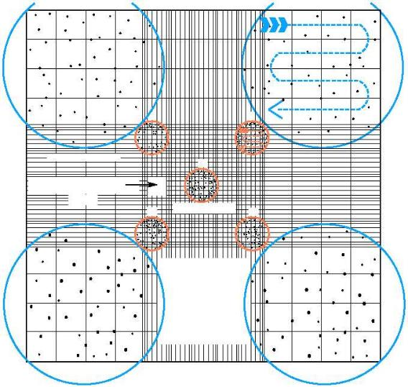
Hemocytometer

Slide 10
Procedure
Collect blood sample
Put 0.38 ml of WBC Diluting Fluid in to test tube
Add 0.02 ml of blood to the solution by Micropipette or Hb pipette. let for 2 minute to allow RBC to hemolyze
Mount the cover slide on the chamber after moistening the 2 raised edge.
Aspirate the diluted blood with a non-heparinized capillary tube
Carefully charge hemacytometer with diluted blood by gently touching sides of coverslip to expel contents until chamber is properly filled.
Notes:
Turks' solution which is formed of:
Glacial acetic acid 3 ml
Crystal violet 1 ml
100 ml distilled water.

Slide 11
Procedure
8. Under 10 x magnifications, leukocytes are counted in all 4 corner large squares of counting chamber.
9. Count cells starting in the upper left. Move to the upper right corner square.
Notes:
Turks' solution which is formed of:
Glacial acetic acid 3 ml
Crystal violet 1 ml
100 ml distilled water.

Slide 12
Calculations
Depth= 0.1 mm
Correction for dilution:
Dilution 1:20
Dilution factor 20
Correction of volume:
Volume of 1small square = 1x1x0.1= 0.1mm³
Volume of 4 large squares = 4x0.1= 0.4 mm³ or μL

Slide 13
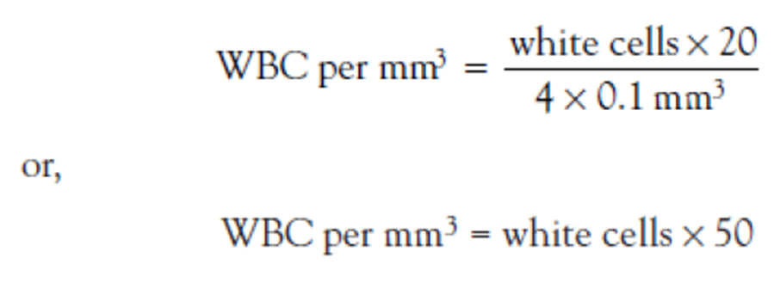
Calculations

Slide 14
Reference
Chernecky & Berger: Laboratory Tests and Diagnostic Procedures, 5th ed.
http://www.mtg-de.com/products/ivf-icsi/disposables-and-small-devices/sperm-counting-chambers.html
http://www.inflammation.ndo.co.uk/Cell%20Culture/3iii%20Methods/Microscopy%20&%20Counting/Cellmicros1.html
http://www.theapprofessor.org/image-blood.html

