Slide 1
The muscles of Upper limb

Slide 2
Introduction

Slide 3
Shapes of Muscles

Slide 4
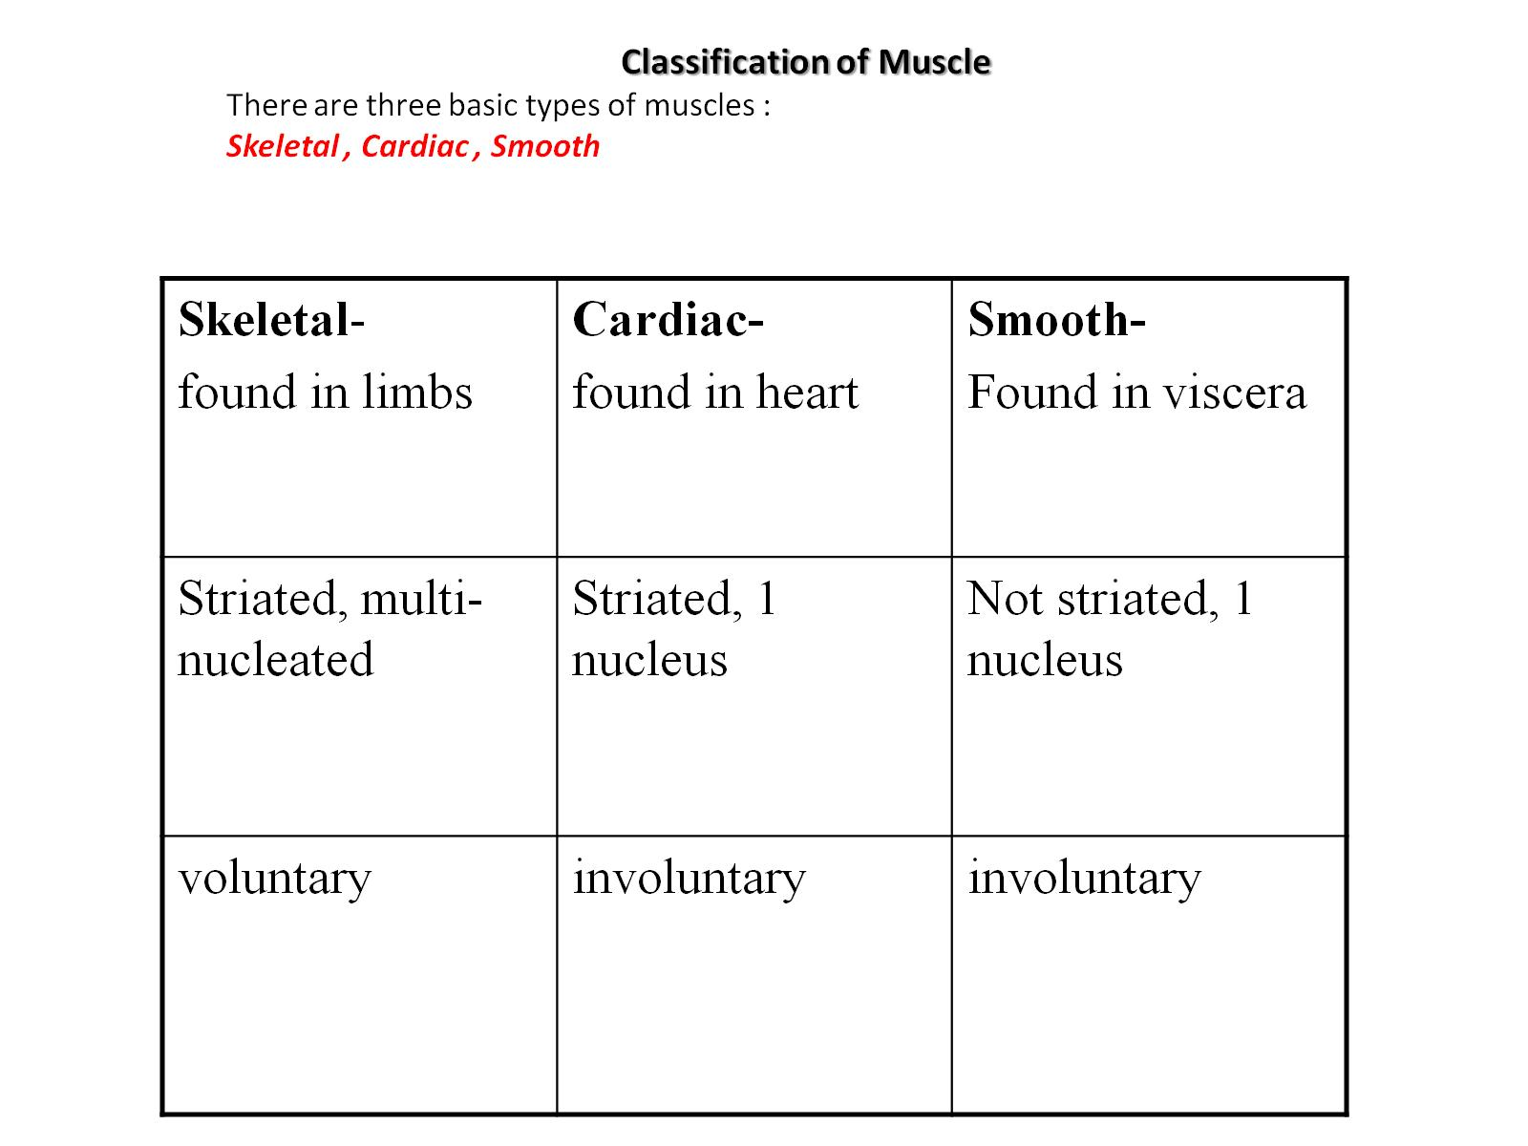
Classification of Muscle There are three basic types of muscles : Skeletal , Cardiac , Smooth

Slide 11
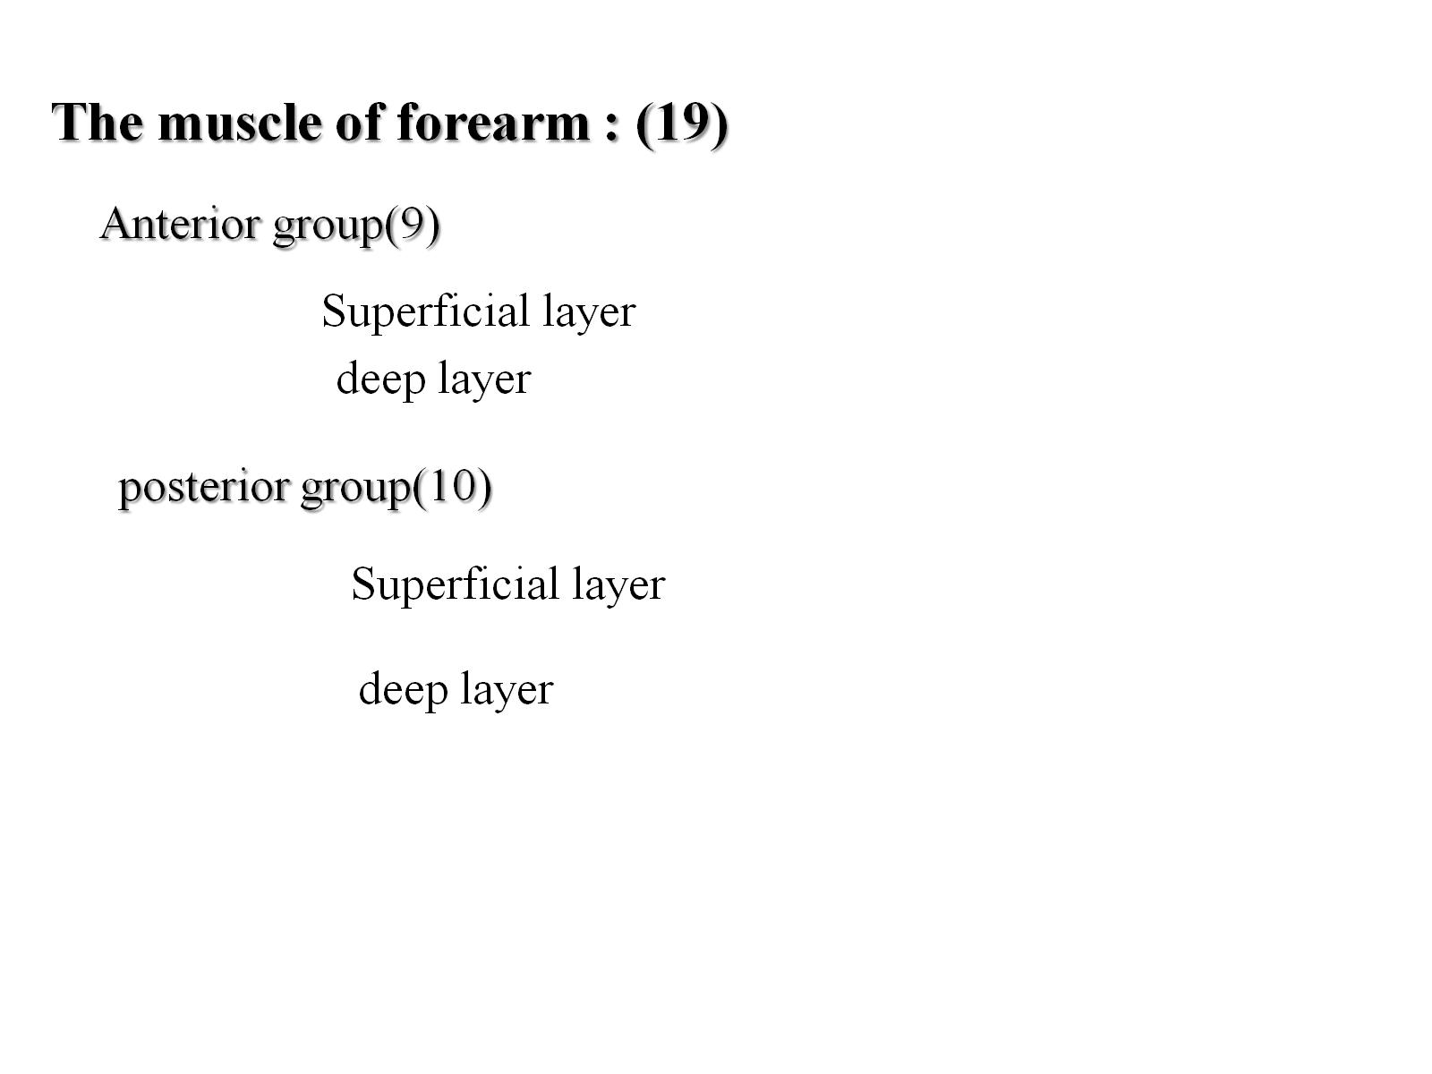

Slide 12
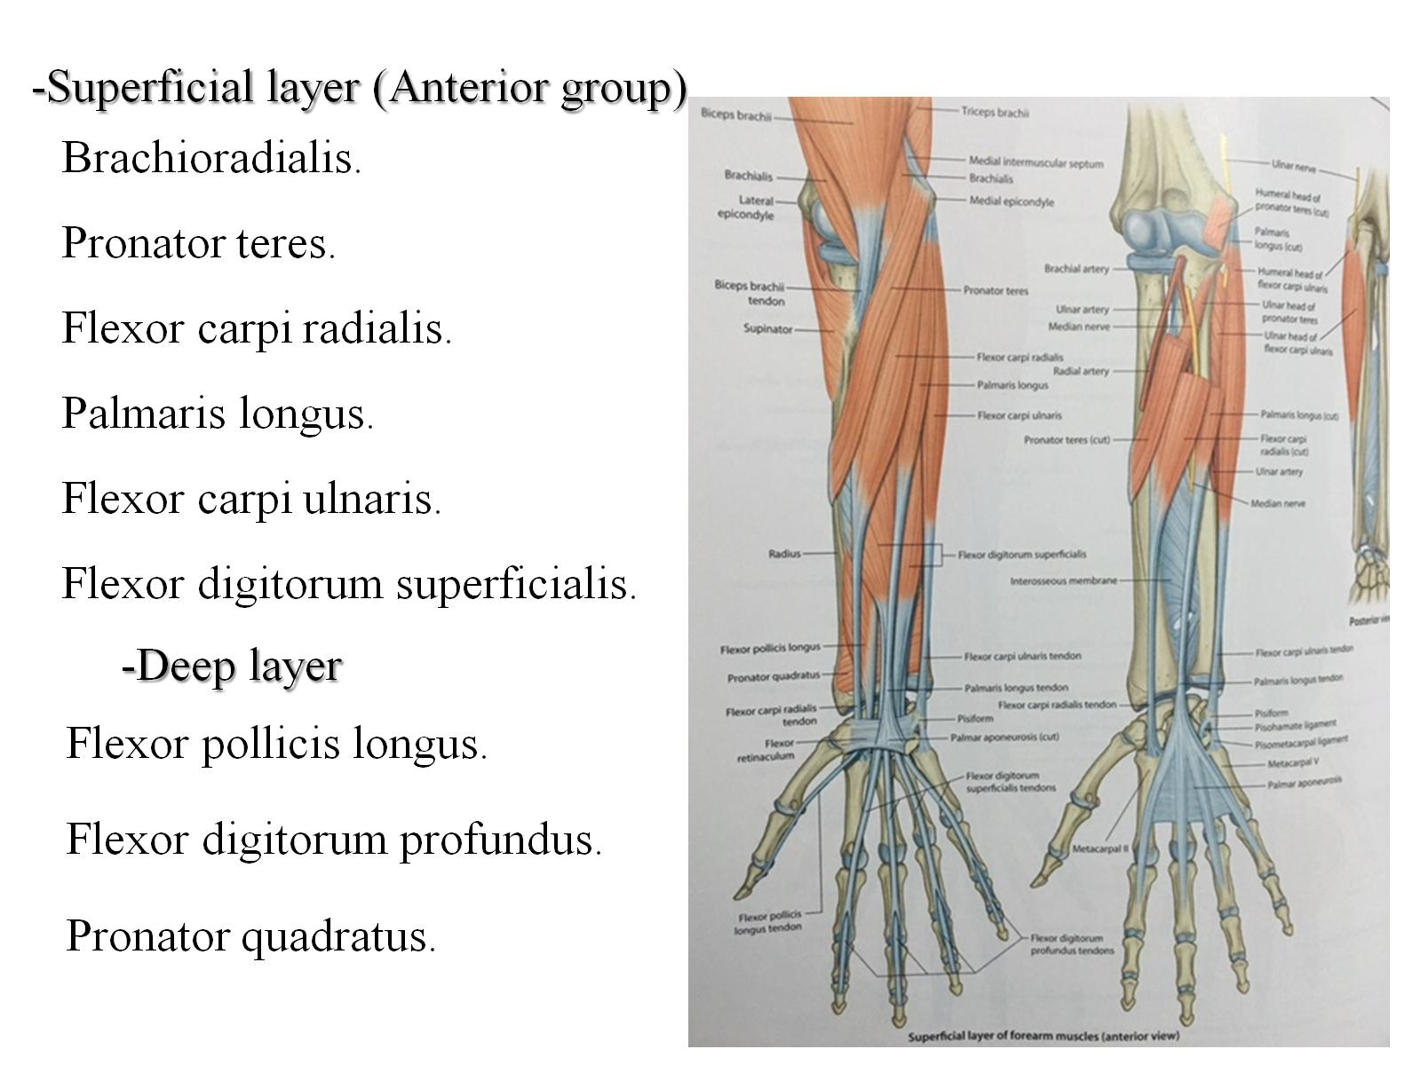

Slide 15
How are Muscles Attached to Bone?

Slide 16
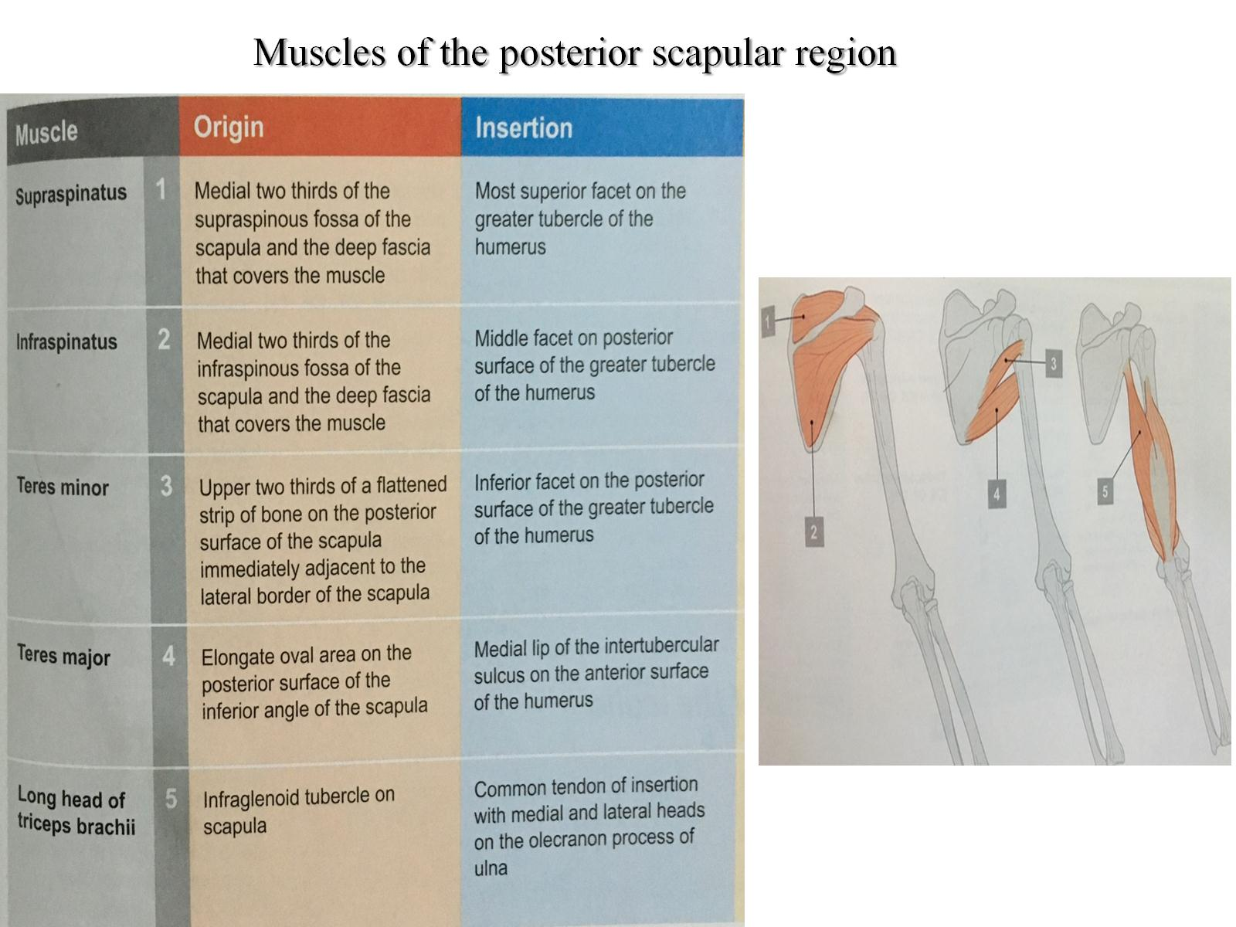
Muscles of the posterior scapular region

Slide 17
Muscles of the anterior wall of the axilla

Slide 18
Muscles of the lateral and posterior wall of the axilla

Slide 19
Muscles having parts that pass trough the axilla

Slide 20
Muscles of the anterior compartment of the arm :

Slide 21
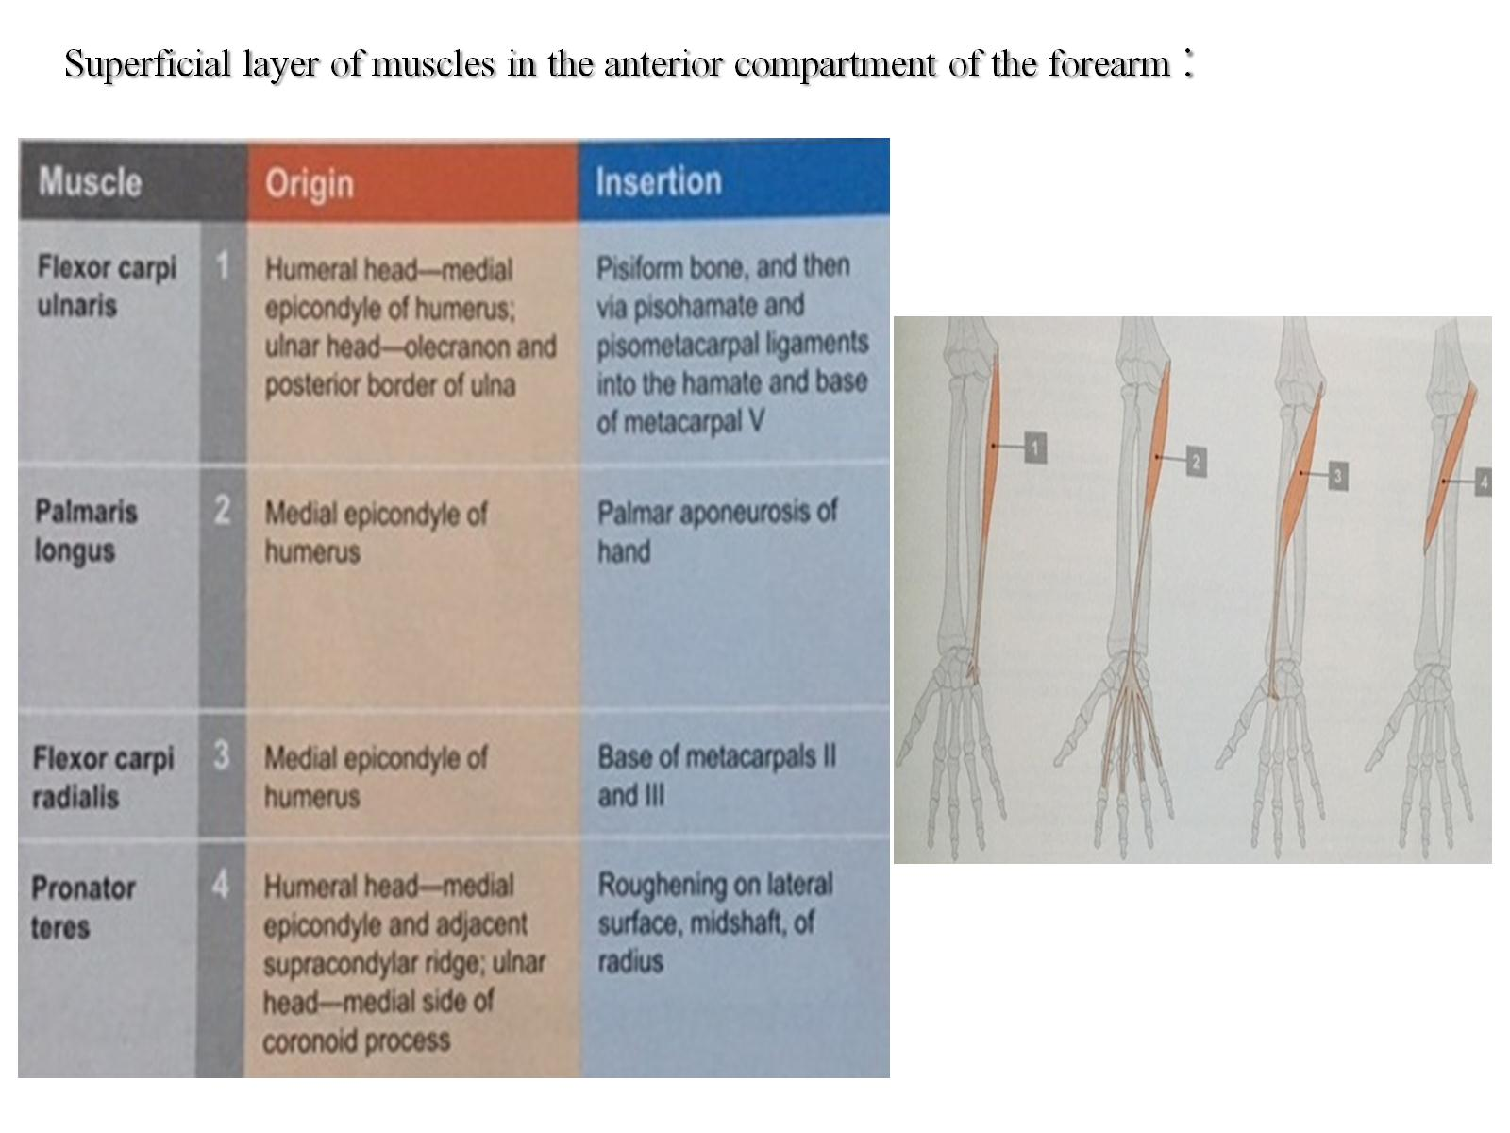
:Superficial layer of muscles in the anterior compartment of the forearm

Slide 22
: intermediate layer of muscles in the anterior compartment of the forearm

Slide 23
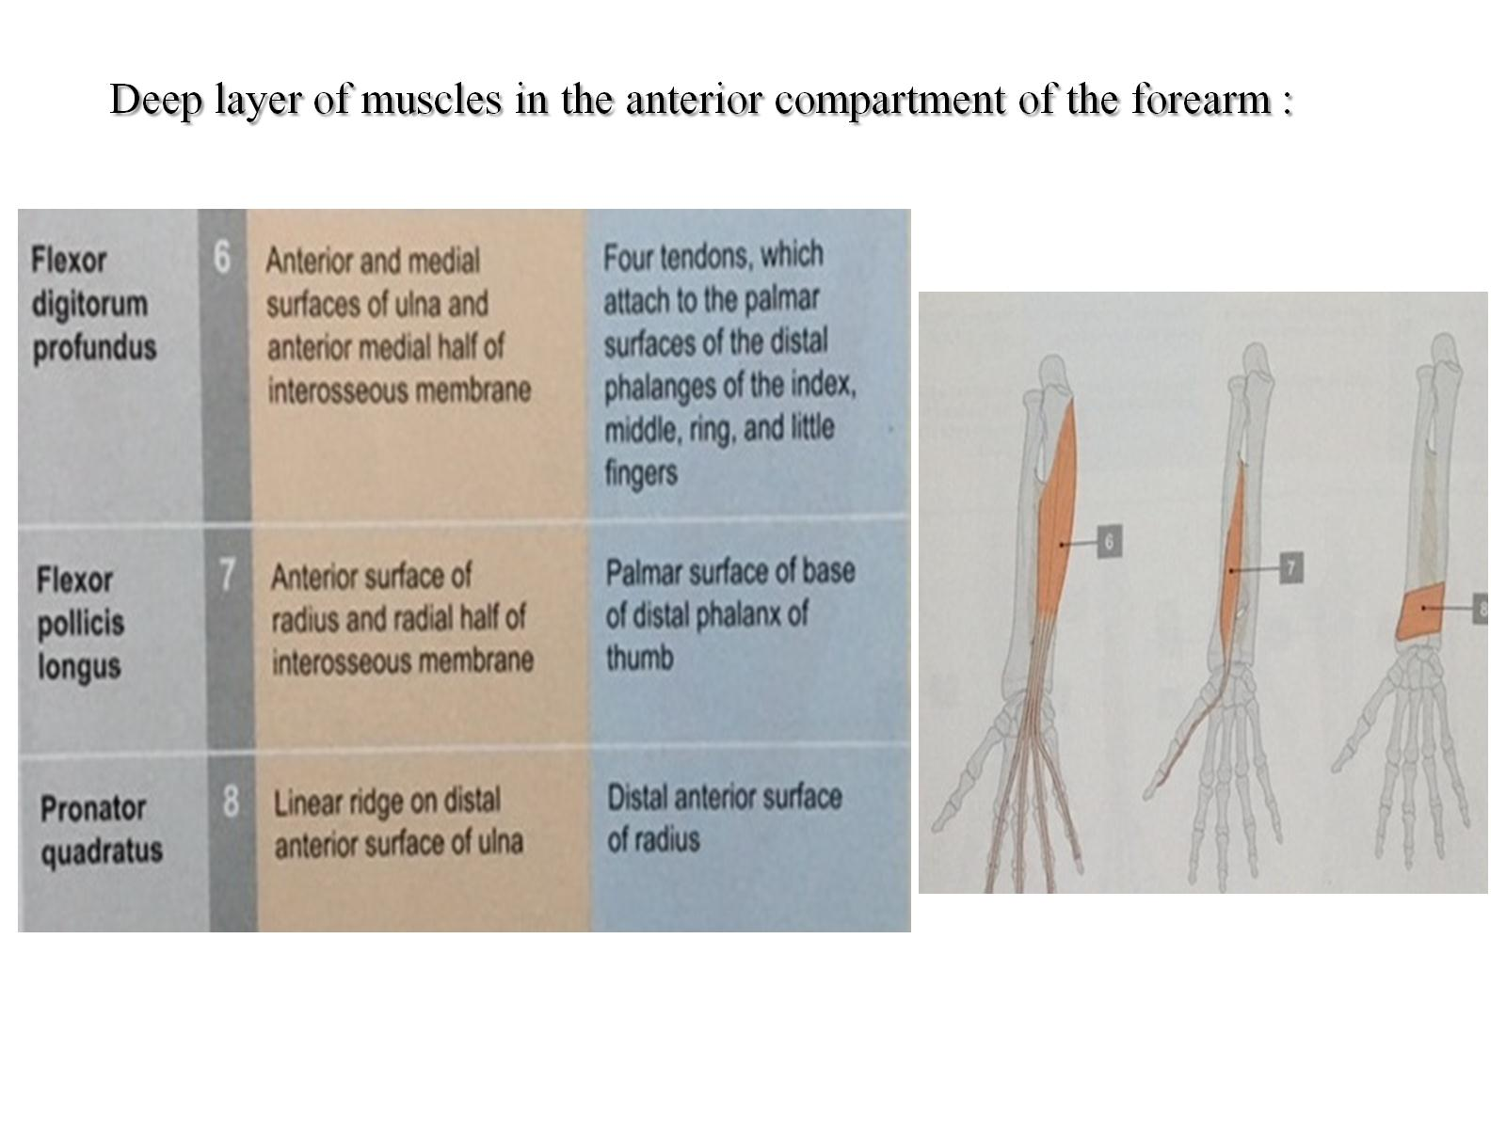
Deep layer of muscles in the anterior compartment of the forearm :

Slide 24
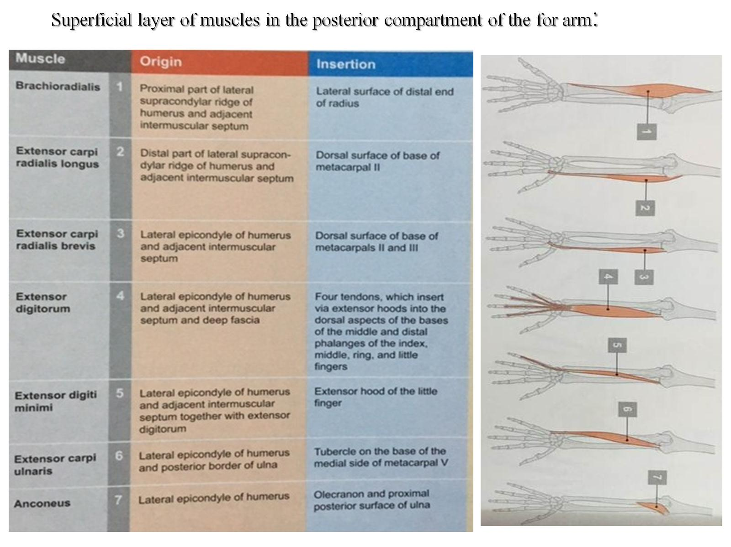
:Superficial layer of muscles in the posterior compartment of the for arm

Slide 25
Deep layer of muscles in the posterior compartment of the forearm :

Slide 26
Intrinsic muscles of the hand :

Slide 27
