Slide 1
Narcotic Analgesics
Department of Pharmacology
Mohammed Q. Mal-Allah

Slide 2
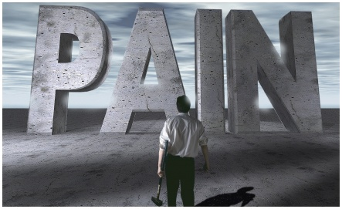

Slide 3
Analgesic: is the drug that relieves pain, they are divided into two types:
Narcotic: which act centrally as Opioids.
Non-narcotic: they act peripherally as Aspirin.

Slide 4
Narcotics: they relieve pain and also cause drowsiness and sedation. The prototype drug is (Morphine) derived from Opium.
Opioids: they are natural or synthetic compounds that produce morphine-like action. They act on the CNS causing drowsiness and sedation.
Opiates: this term refers to drugs as morphine or codeine that are obtained from the juice of the opium poppy (they are natural).

Slide 5
1.Ligands
(1)endogenous:
endorphins from pituitary
β-endorphin
dynorphin
enkephalins from brain
M-enkephalin
L-enkephalin
(2)exogenous: drugs

Slide 6
Opioid Receptors:
The major effects of opioids are mediated by 4 families of receptors which are: µ, Kappa, Delta, and Sigma.
Each of these receptors exhibit different specificity for the drug that they bind.
Opioid drugs may be agonist to a receptor or antagonist or partial agonist or mixed agonist-antagonist

Slide 7
【action mechanism】
ligands
opioid receptors
Gi
inhibiting adenylate cyclase
increasing potassium ion efflux or reducing calcium ion influx
impeding neuronal firing and
transmitter release

Slide 9
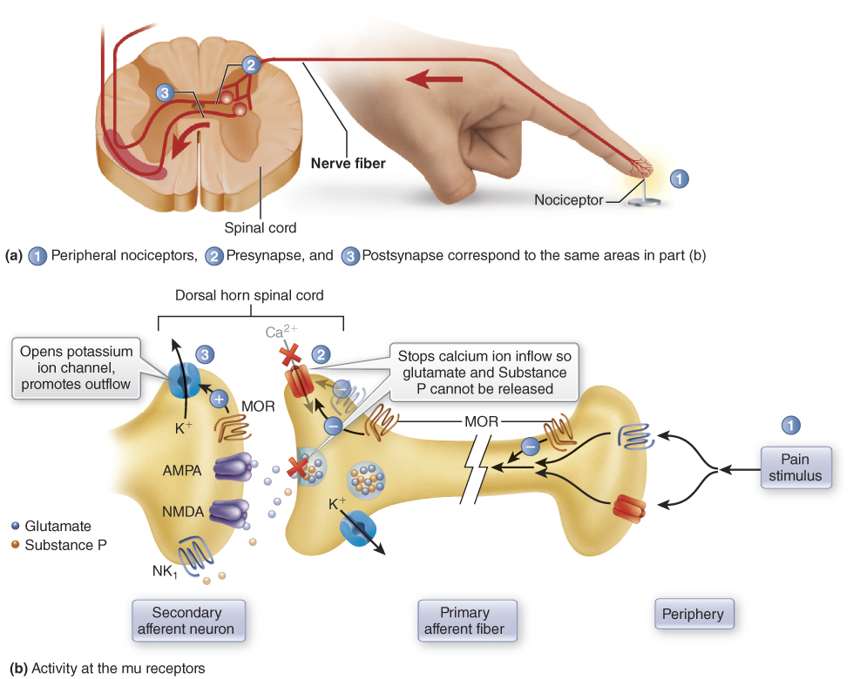

Slide 10
At the Supra Spinal level:
Opioids either directly inhibit these neurons or on the other hand neurons that send processes to the spinal cord and inhibit pain
Opioids inhibit the inhibitory (GABAnergic) inter-neuron; the pain inhibitory neuron will be indirectly excited by opioids
opioids concurrently act on both spinal and supra spinal sites and interaction at these two sites tend to increase the overall analgesic efficacy

Slide 12
Distribution of opioid receptors
1. Brain stem: respiration, cough, nausea, vomiting, Maintenance of blood pressure, pupil diameter, and control the stomach secretions.
2. Medial thalamus: deep pain that is poorly localized and emotionally influenced.
3. Spinal Cord: receiving and integration of incoming sensory information.

Slide 13
4. Limbic System: (emotional reaction to pain).
5. Hypothalamus: neuroendocrine secretions.
6. The Periphery: they bind to peripheral sensory nerve plexuses and their terminals. They inhibit Ca⁺ dependent release of excitatory pro inflammatory substances (substance P) from these nerve-endings which may contribute to the anti­-inflammatory and analgesic effect of opioids.
7. The Immune Cells: the function is not well-defined.

Slide 14
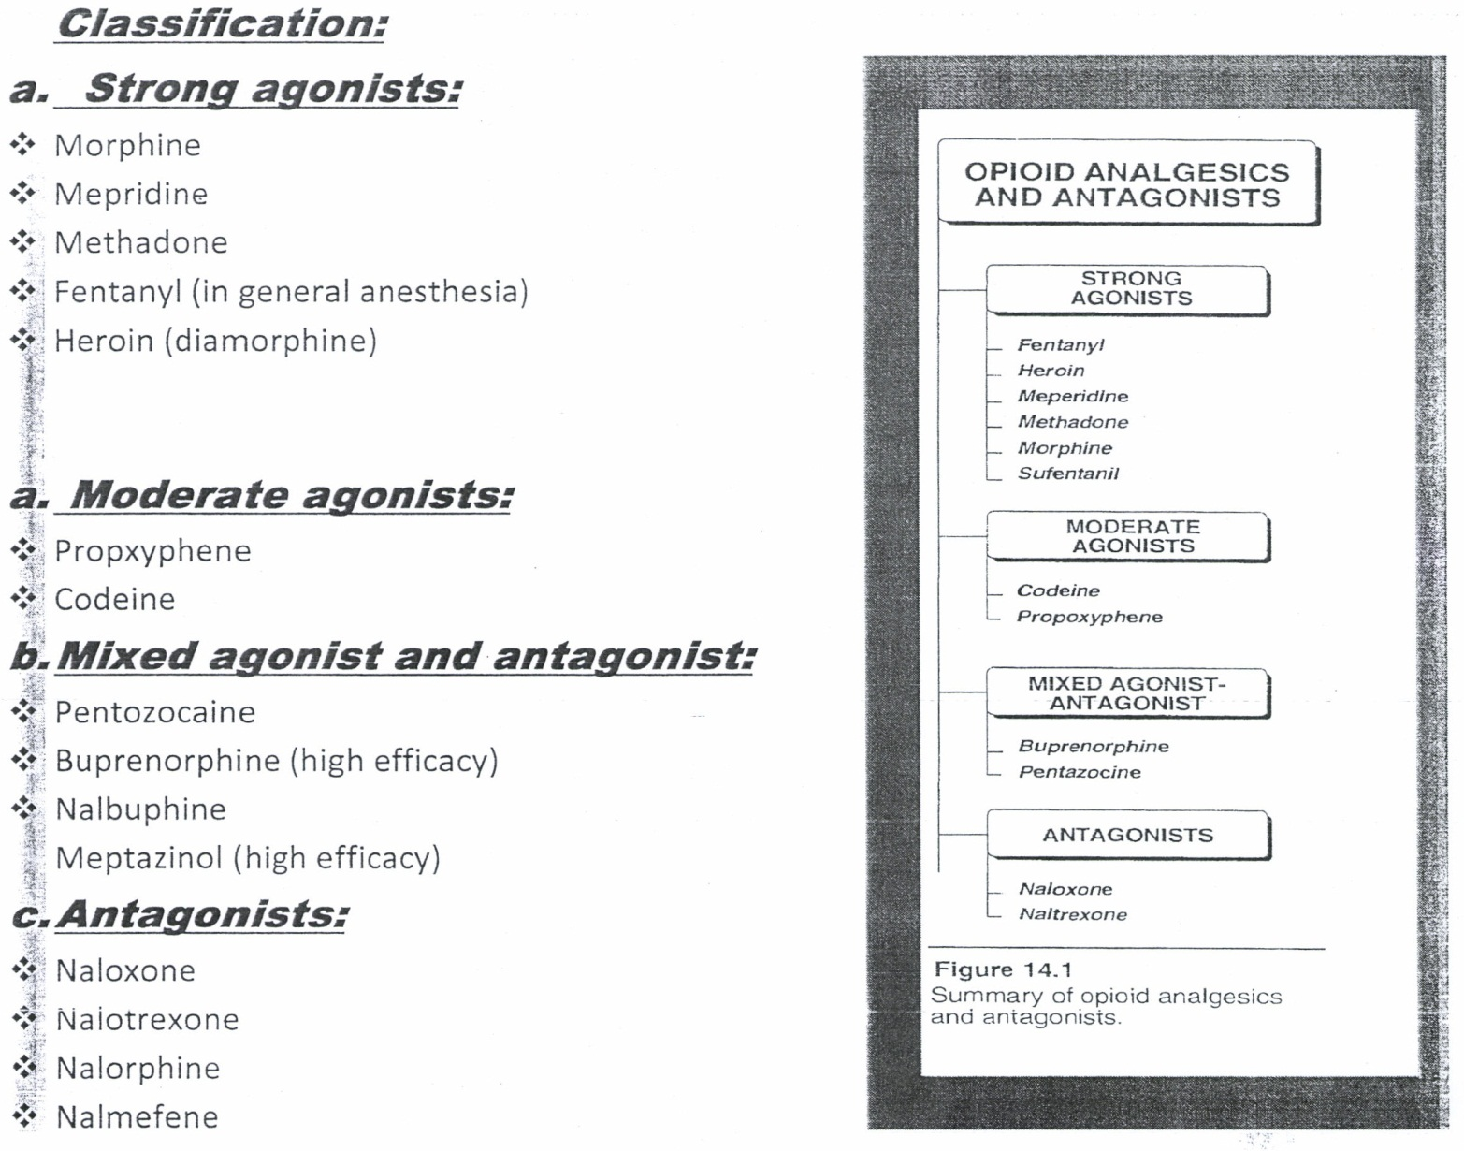

Slide 15
morphine
CNS :
Depressant actions:
Analgesia: - Spinal and supraspinal level .
- Alter brain perception to pain .
- Chronic dull pain, colic and acute sharp pain .
- Relieving anxiety and stress accompanied with severe pain

Slide 16
Drowsiness and mental clouding :
hypnotic and tranquilizer effect.
Respiratory effect:
- decrease the rate and depth
- CO₂ narcosis
- respiratory arrest
* morphine is dangerous in patients with chronic obstructive pulmonary disease, and asthma, in which it will also increase the viscosity of bronchial secretions in addition to bronchospasm due to histamine release.

Slide 17
Inhibition of cough center: cough suppression
Increase the intracranial pressure: due to CO2 retention, dilation of cerebral vessels, and increase the CSF pressure, therefore --> morphine is contraindicated in patients with severe head injury.
Polysynaptic refluxes : in sc inhibited
Hormonal decrease : in GnRH, CRH - decreases LH and FSH, and also decrease ACTH - decrease in Bendorphine and cortisol

Slide 18
Stimulatory actions:
Miosis: Pin point pupil
Stimulates 3rd nerve nucleus
There is only little tolerance to this effect (even addicts show pin point pupil)
Important diagnostic feature of coma because most other causes of coma cause dilation of the pupil

Slide 19
Emesis: direct stimulation of CTZ
Monosynaptic spinal cord refluxes trunkal rigidity and myoclonus in man
Rarely, excitation in some animals as cats and horses.
Release of ADH, prolactin, and GH by diminished dopaminergic inhibition

Slide 20
Smooth muscles:
GIT:
Small intestine, resting tone is increased with periodic spasms, but the amplitude of segmental non-propulsive contractions is decreased, it causes spasm of sphincters.
Large intestine, it decreases propulsive contractions, peristalsis, and tone is increased. It decreases intestinal secretions.
Stomach, it delays gastric emptying, decreases motility and HCI secretion.
It causes constipation due to increased transient time and it increases viscosity of feces due to increased water absorption.

Slide 21
Central action of these drugs leads to neglection of the urge to defecate and contribute to constipation.
Morphine increases the intrasigmoidal pressure; therefore it is contraindicated in patients with (diverticularis disease).
Pethidine does not produce this high pressure and it can be used if needed.
Morphine endangers the intestinal anastamosis and should not used in intestinal obstruction.

Slide 22
Biliary system:
Spasm of sphincter of oddi --> increases intrabiliary pressure.
Sometimes, biliary colic is worsened by morphine if the dose is enough only to cause increased intrabiliary pressure with only slight analgesia.
This effect can be reversed by naloxone or GTN (glyceryl trinitrate), but it is not effectively reversed by atropine

Slide 23
The bronchi : bronchospasm
Ureter: spasm.
Bladder:
Spasm of the sphincter that leads to retention of urine in patients with benign prostatic hyperplasia.
Uterus:
Labor is prolonged due to slowing of the effective contraction --> prolong child birth.

Slide 24
CVS: central action veno and arteriolo dilation
stimulates the vagal center bradycardia
release of histamine vasodilation; arteriolar dilation hypotension in patients with acute MI.

Slide 25
Acute LVF(acute pulmonary edema)
Mental distress --> by tranquilizer effect.
Cardiac distress --> by decreasing the sympathetic drive
Respiratory distress --> by rendering the respiratory center insensitive to afferent stimuli coming from the conjusted lungs.

Slide 26
Clinical Uses:
Relief of severe pain,
Relief of anxiety in serious and frightening diseases accompanied by pain, e.g. accidents or hemorrhage
Relief of dyspnea in acute left ventricular failure.
Production of euphoria and relief pain of dying.
Premedication for surgery, application in anesthesia
Symptomatic control of non-serious diarrhea e.g. traveler’s diarrhea (codeine, loperamide).
Suppression of cough (morphine-like substance) codeine.
To control acute restlessness (rarely).

Slide 27
Adverse Effects:
Respiratory depression.
Vomiting.
Dysphoria.
Hypotension.
Retention of urine in (BPH).
Pruritis (itching around the nose).

Slide 28
Contraindications
CNS:
Head injury because it increases intracranial pressure.
Acute alcoholism.
Convulsion disorders.
Respiratory system: in asthma and chronic obstructive pulmonary disease (COPO).
GIT:
Diverticulitis.
Pancreatitis.
Biliary infections.
Intestinal anastamosis resection and obstruction.

Slide 29
In severe liver disease (acute or chronic) that leads to toxic effects (encephalopathy).
Avoided during labor.
Patients with adrenal insufficiency and myxedema i.e. hypothyroidism may experience extended effect from opioids.

Slide 30
Morphine interaction:-
Phenothiazine: enhances depressant effect of morphine.
Tricyclic antidepressants.
Sedative hypnotics: they increase eNS depressant & respiratory depression.
MAO inhibitors: result in hyperpyrexia & hypertension.
Amphetamine: in low doses they enhance analgesia.

Slide 31
Tolerance & physical dependence:
Tolerance occurs mainly to the agonist effects which are respiratory depression, analgesia, euphoria & sedative effects, but not to the stimulatory actions as miosis & constipations & convulsions
Cross tolerance between opioids & with other CNS depressants as barbiturates & alcohol
Change in no. of receptors or change in sensitivity.

Slide 32
The abrupt withdrawal of the administration of the opioid would be expected to produce rebound or withdrawal syndrome .
Withdrawal syndrome consists largely from the opposite actions of opioids , also associated with noradrenergic storm.

Slide 33
Treatment of addicts:
Withdraw morphine gradually.
Substitute methadone which produces mild withdrawal syndrome, since it has long t1/2 (48hrs), perhaps supplements with chlorpromazine or benzodiazepine as valium.
Clonidine decreases the severity of withdrawal syndrome by decreasing the effects of noradrenalin hyperactivity. (Clonidine stimulates presynaptic α2 – R --> inhibition of the sympathetic over activity).
* Lofexidine is clonidine analogue that may also aid opioid detoxification.
* Sometimes, we also use atropine or Beta blockers as propranolol that decreases emotional compulsions after stopping opioid.

Slide 34
Morphine Poisoning:
Coma, slow & shallow respiration, pinpoint pupil, circulation is maintained till hypoxia is advanced & cyanosis occurs. The main signs of morphine poisoning are:
Bradypnea.
Patient coma in an unconscious state & pupils are constricted (miosis), while in most other cases of coma the pupil is dilated.

Slide 36
Treatment of morphine poisoning:
Support of respiration & circulation till antagonize the effect of opioids.
We give naloxone I.V. it's a pure opioid antagonist, also it is used as a test (therapeutic test) whether the coma is due morphine or not, by giving naloxone.

Slide 37
Pethidine (demerol, meperidine):
commonly used
less efficacy than morphine
effective in pain beyond reached of codeine.
It is like morphine in causing respiratory depression, euphoria & vomiting.
Structurally, it is not related to morphine, but it shares many properties with morphine including that of being antagonized by naloxone.

Slide 38
 | Morphine | Pethidine
1 | Binding toµ receptor | Binding to Kappa receptors
2 | Suppress cough usefully | Doesn't suppress cough usefully
3 | Cause constipation | Causes less intense & less frequent constipation
4 | Delay labor | Less likely to prolong child-birth so is used in 1st stage of labor
5 | Cause sedation and prolonged analgesia | Little hypnotic effect & analgesic effect are shorter than morphine
6 | No atropine –like effect (miosis) | Atropine like effects: dry mouth, blurred vision & sometimes mydriasis though usually miosis
7 | Profound dependence | Dependence is less marked than morphine
8 | No myoclonus or convulsion s with overdose | Overdose leads to myoclonus & convulsions

Slide 39
Methadone:
It is a synthetic drug structurally related or similar to morphine & acts mainly on µ receptors. The analgesic activity is equal to that of morphine & very effective orally.
Dependence occurs, but is less severe & causes less severe withdrawal syndrome because of long tl/2, therefore the addicts on morphine & heroin are transported to methadone as one step of treatment.

Slide 40
Diamorphine (heroin):
Semi synthetic drug made by acetylation of morphine. It is the most powerful of all dependence producing drugs (very imp.), because it's more lipophilic & enters the CNS readily & causes more euphoria than morphine
Fentanyl: used in anesthesia

Slide 41
Low to moderate efficacy group
Codeine:
its action is 1/10 that of morphine
It is used in cough suppression & for short term systemic control of the acute diarrhea.
Dextropropoxyphene:
In over-dose it causes respiratory depression & arrhythmia because of the quinidine-like action on the heart

Slide 42
Partial agonists (mixed):
Pentazocine: is a partial agonist at Kappa receptors & weak antagonists at µ receptors & delta receptors.
Phenazocine: The main use is in biliary colic because; it causes less spasm of sphincter of Oddi.
Buprenorphine:
also it's used in biliary colic treatment.
Disadvantages: although less likely to cause respiratory depression, but in over­dose this depression is "only partially antagonized" by the action of naloxone.

Slide 43
Meptazinol: It causes no euphoria & no withdrawal syndrome when it is discontinued.
Tramadol: tl/2 is 6hrs. It binds to µ receptors causing analgesia. It inhibits neuronal nor-adrenaline uptake & serotonin release. It is effective orally & as effective as pethidine for post-operative pain & less likely to cause constipation & less addiction & respiratory depression.

Slide 44
Opioid antagonists:
Naloxone:
Pure competitive antagonist at u, Kappa & sigma receptors, but its potency on u receptors is 10 times_greater than on Kappa receptors .
When given I.V., it reverses opioid-induced respiratory depression within 1-2 min & the duration of action is lhr .
Because opioid analgesic acts much longer than this (1hr), repeated I.V. doses of naloxone of “100 mg” are required

Slide 45
Naltrexone:
It is similar to naloxone but longer action (tl/2 is 4hrs)
Duration of action 2-3 days because the active metabolites have t1/2 of 13 hrs. .
Advantage on naloxone that it can be given orally.
Nalorphine:
Antagonist for all effects of morphine & other opioids.
It is partial antagonist(i.e.:- in normal subject it acts as weak agonist, but if given to addict on morphine or other opioids which are stronger, then it acts as antagonists to their effects.
Nalmefene: it is the newest of all these antagonists. It is a derivative of naltrexone but given only I.V. It has a longer t1/2 than naloxone (8-10hrs.).

Slide 46
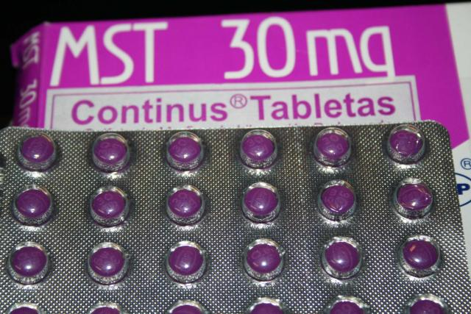
Morphine (MST®)

Slide 47
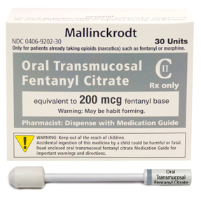
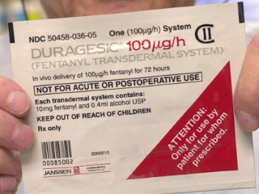
Fentanyl (Duragesic®)

Slide 48
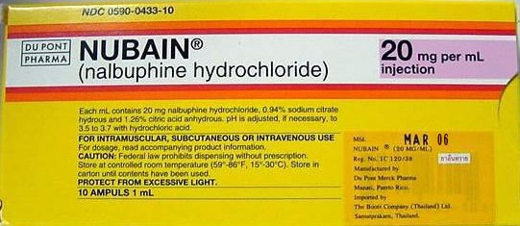
Nalbuphine (Nubain®)

Slide 49
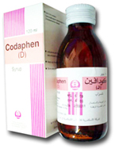
Codeine (Codaphen®)

Slide 50
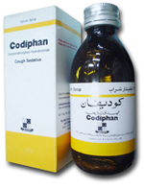
Dextromethorphan (Codiphan®)

Slide 51
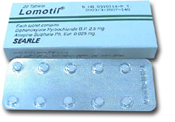
Diphenoxylate (Lomotil®)

Slide 52
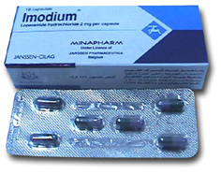
Loperamide (Immodium®)

Slide 53
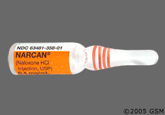
Naloxone (Narcan®)

Slide 54
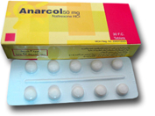
Naltrexone (Anarcol®)

Slide 55
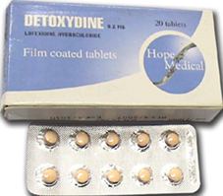
Lofexidine (Detoxydine®)

