Slide 1
Complete denture Impressions
Dr. Salah Kh. Al-Rawi
BDS, MSc. PhD
Dental Science, Prosthodontist, Maxillo-Facial Prostheses

Slide 2
Impression
A complete denture impression is a negative registration of the entire denture bearing, stabilizing, and border seal areas present in the edentulous mouth.
A preliminary impression is an impression made for the purpose of diagnosis or for the construction of a special or custom tray.
A final impression is an impression for making the master casts. The master casts are used in constructing the dentures.

Slide 3
Impression tray
is composed of
Body: The body consists of a floor and flanges.
Handle.

Slide 4
IMPRESSION TRAYS
Parts
1 . Body
2 . Handle
Body
Body
Handle
Handle
DENTULOUS TRAY
EDENTULOUS TRAY
Floor
Flat
Body
Flange
Long
Dentulous Tray
Handle
Straight
Floor
Round
Body
Edentulous Tray
Flange
Short
Handle
L - Shape

Slide 5
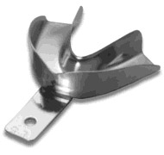
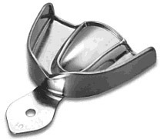
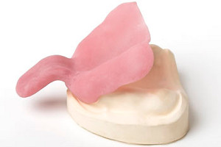
Types of Impression tray
It is a device used to carry & control impression material while making an impression
1-stock tray
The tray we use in the primary impression
2-custom tray
(Special, Individual trays)
The tray we use in the final impression ,and constructed on diagnostic cast

Slide 6
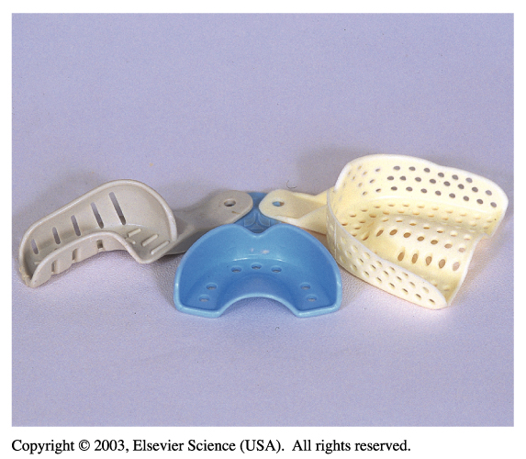
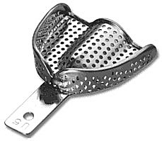
Types of stock trays
Metallic it can be aluminum or stainless steel.
Non metallic:-
Plastic tray which can be sterilized.
Disposable plastic trays.

Slide 7
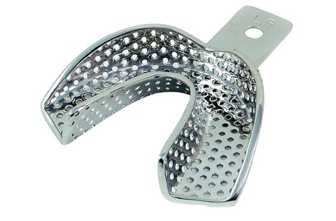
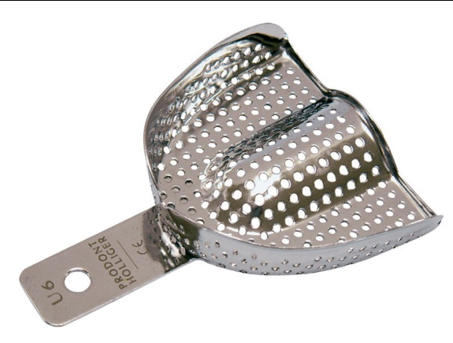
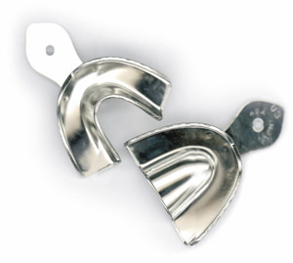
Types of stock trays
1. Perforated trays (used with alginate)
Non perforated or plain trays
(used with impression compound)

Slide 8
Impression materials for complete denture:
Primary impression :
a) impression compound
b) Alginate
Secondary impression :
Rubber base
Zinc oxide Eugenol
plaster of paris

Slide 9
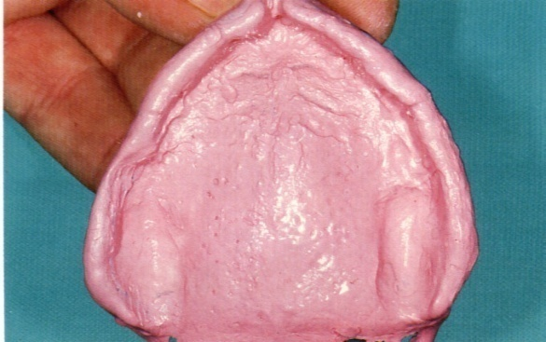
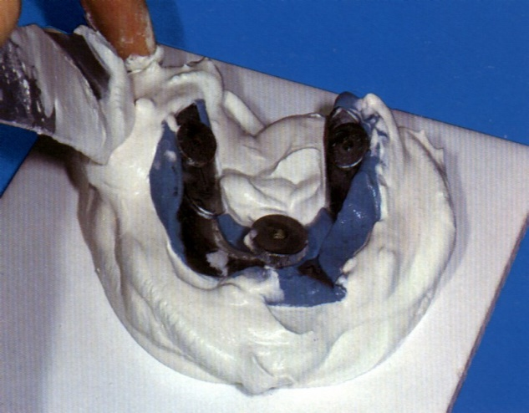
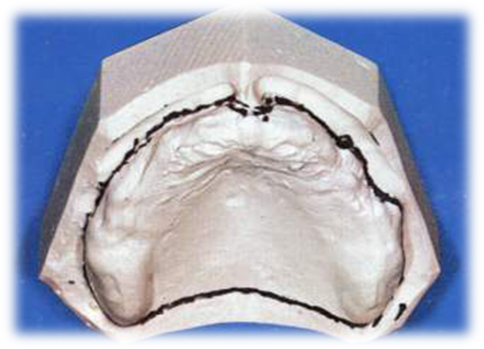
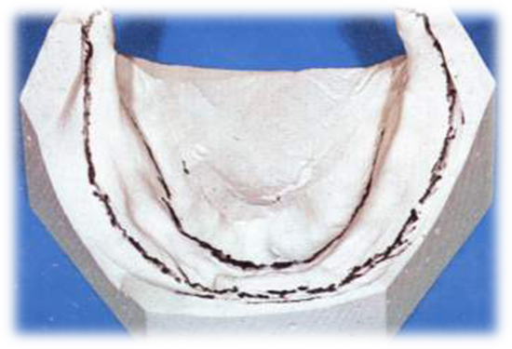
Preliminary Impression
USES
Study cast
As a study cast to study :
1. Ridge shape .
2. Palatal Vault shape .
3. Denture bearing areas .
4. Areas of undercut .
5. Relief areas .
6. Posterior palatal seal area .
7. Sharp bony edges .
8. Depth of the sulcus .
9. Inter-ridge space
10. Inter-ridge relations .

Slide 10
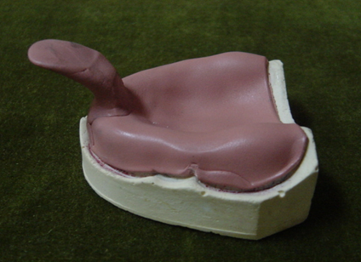
SPECIAL OR INDIVIDUAL TRAYS
Types according to materials fabrication
1- Shellac base plate special tray
2- Acrylic resin custom (special) trays:
a- cold cured
b- heat cured
c- light cured
Both heat and cold cured are used widely now.
It is rigid and light in weight, not wrap in the mouth .
Advantages of Special Trays
1 . Fit more accurately the individual arch of the patient.
2 . Bulk of the impression material is reduced .
4 . More accurate border contour
5 . Less impression material is used .
6. More comfortable to the patient .

Slide 11
Final impression Techniques

Slide 12
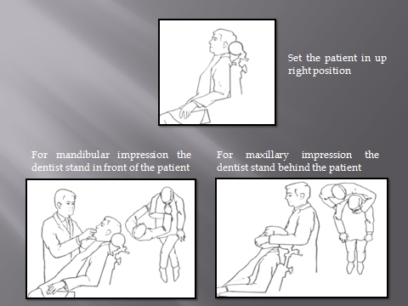

Slide 13
Mucostatic technique
Also referred as open mouth technique.
Record the tissues in there undisplaced position.
dentist exerts pressure.

Slide 14
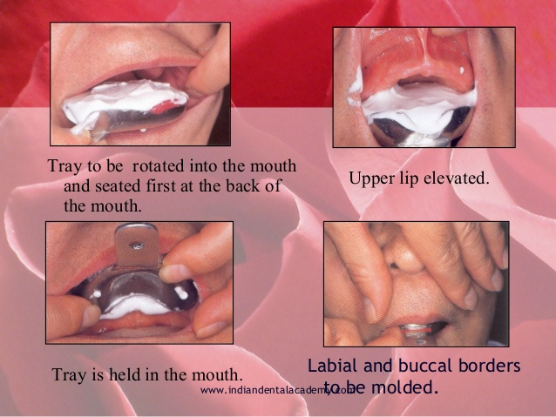

Slide 16
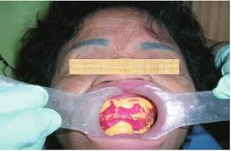
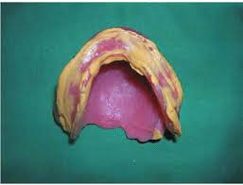

Slide 18
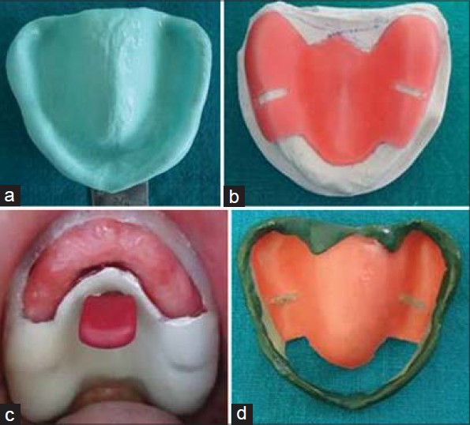

Slide 19
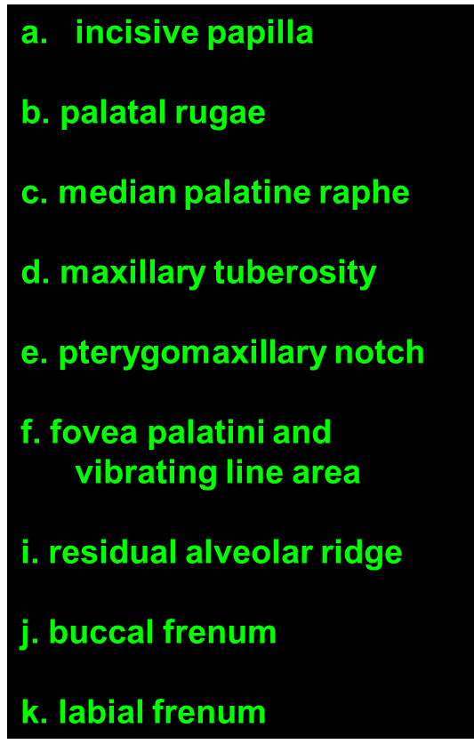
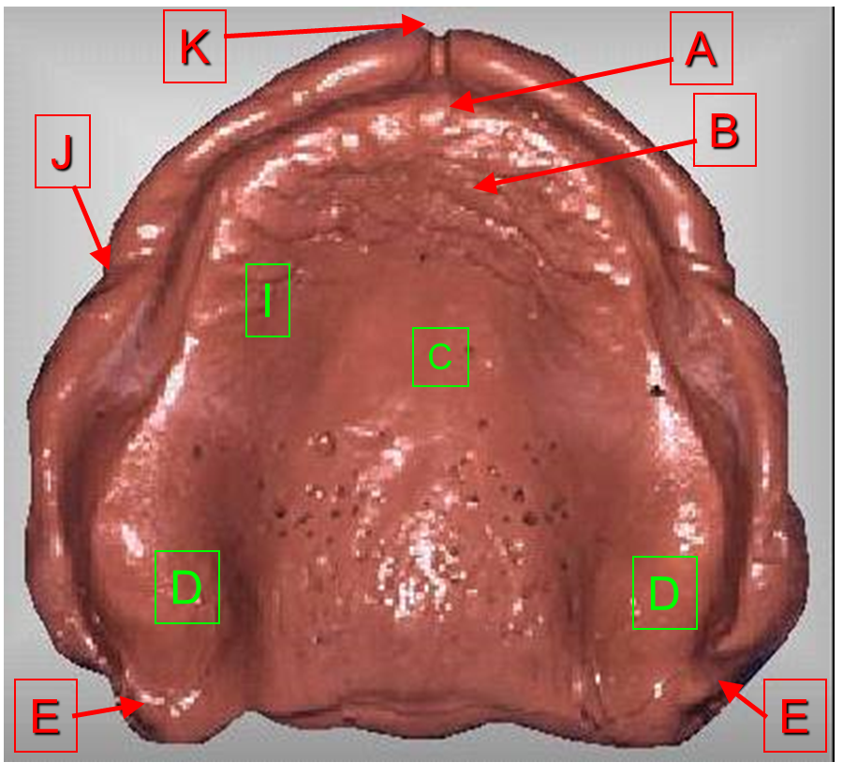
MAXILLARY IMPRESSION

Slide 20
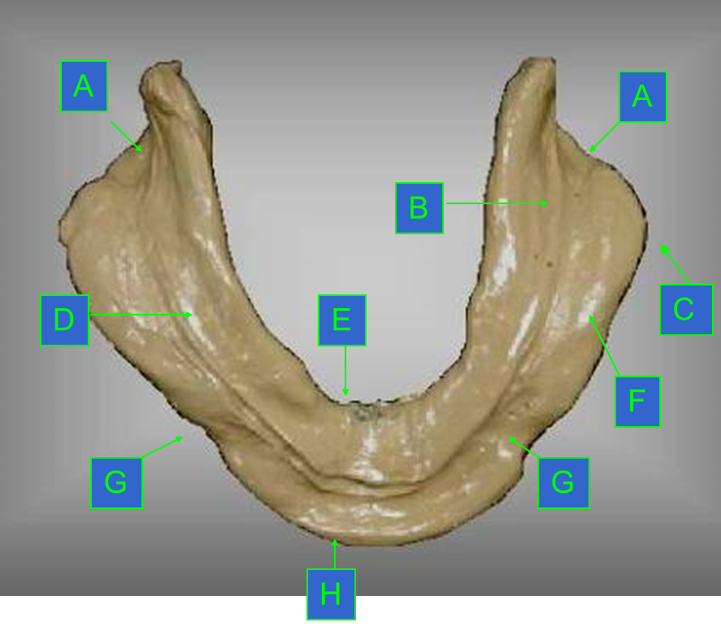
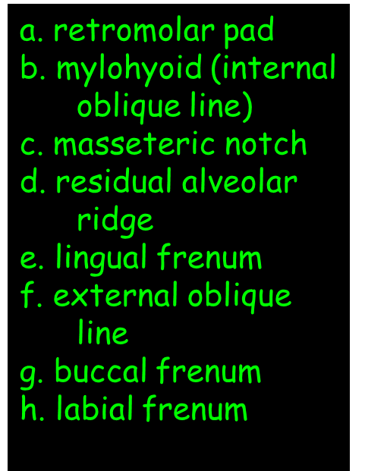
MANDIBULAR IMPRESSION

Slide 24
3- Boxing the impression
An impression is boxed to preserve the borders of the impression so that it will be accurately reproduced in the cast.
ADVANTAGES OF BOXING
1 . The borders of the impression are preserved
2 . The thickness of the base of the cast can be controlled
3 . Permits vibrating the stone material into the impression
4 . Time is conserved
5 . Material are conserved

Slide 25
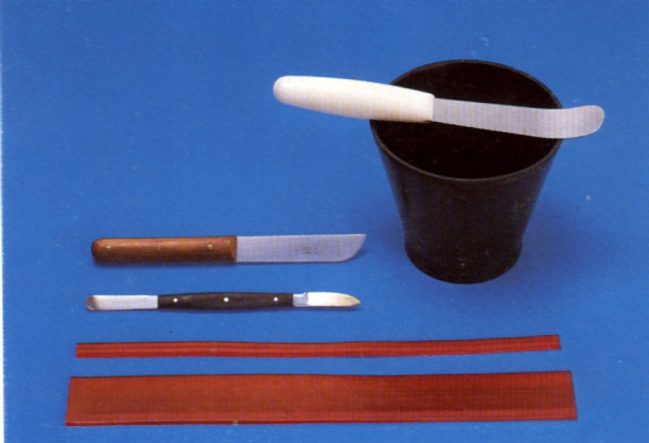
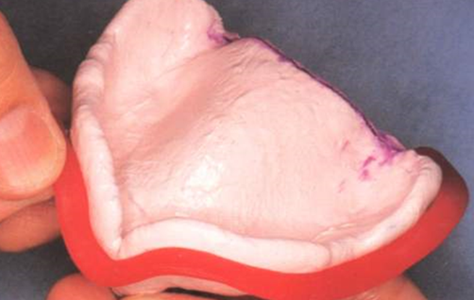
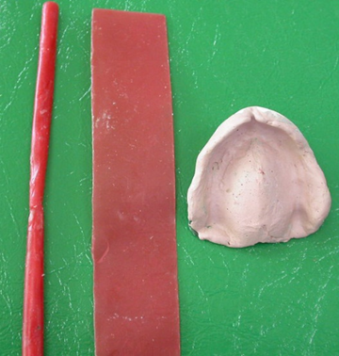
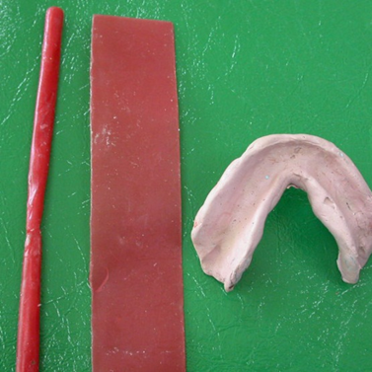

Slide 26
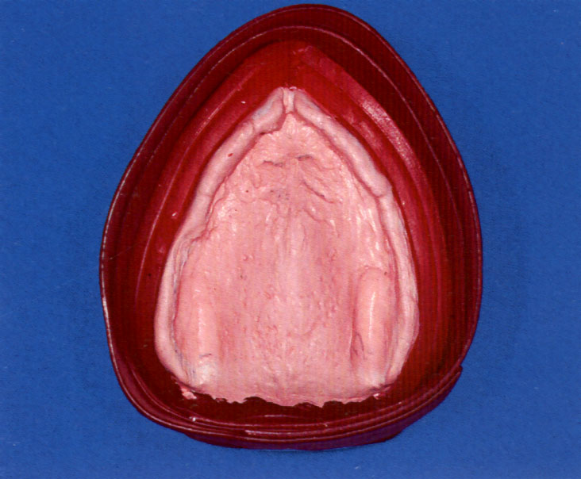
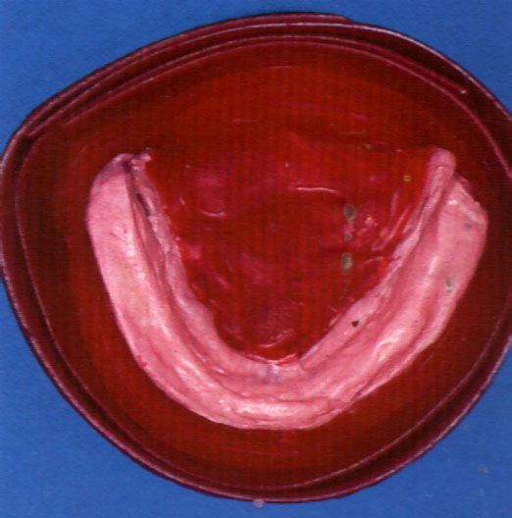

Slide 27
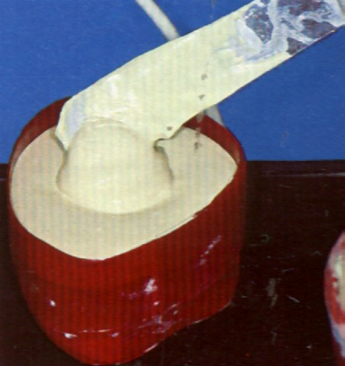
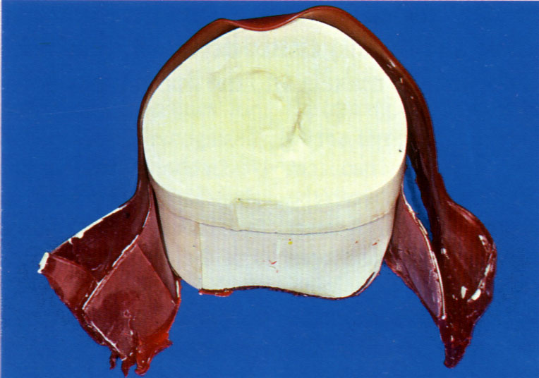
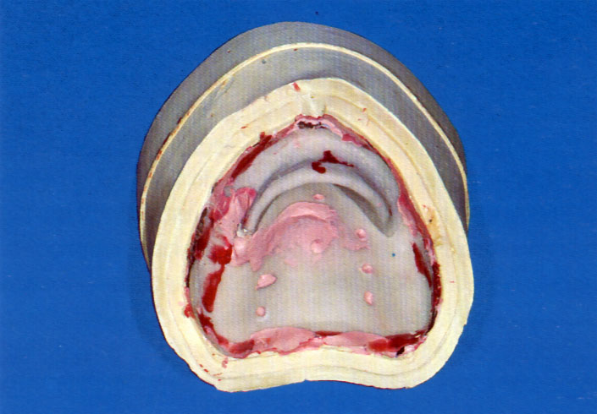

Slide 28
THANK YOU

