Slide 1
General principles
Aside from molecules that are actively transported into the brain, the penetration of toxicants and their metabolites into the nervous system is largely related to their lipid solubility, unionized form.
The blood-brain barrier is incompletely developed at birth and in premature infants
Neurons is highly dependent upon aerobic metabolism.
To meet high energy requirements, the brain utilizes aerobic glycolysis and is extremely sensitive to even brief interruptions in the supply of oxygen or glucose

Slide 2
Toxic Responses of the Nervous System
Efforts to understand the mechanism of action of individual neurotoxic compounds have begun with the identification of the cellular target.
In the NS, this has most often been one of four targets: the neuron, the axon, the myelinating cell, or the neurotransmitter system
neurotoxic compounds may be identified which cause:
- neuronopathies
- axonopathies
- myelinopathies
- neurotransmitter-associated toxicity

Slide 3
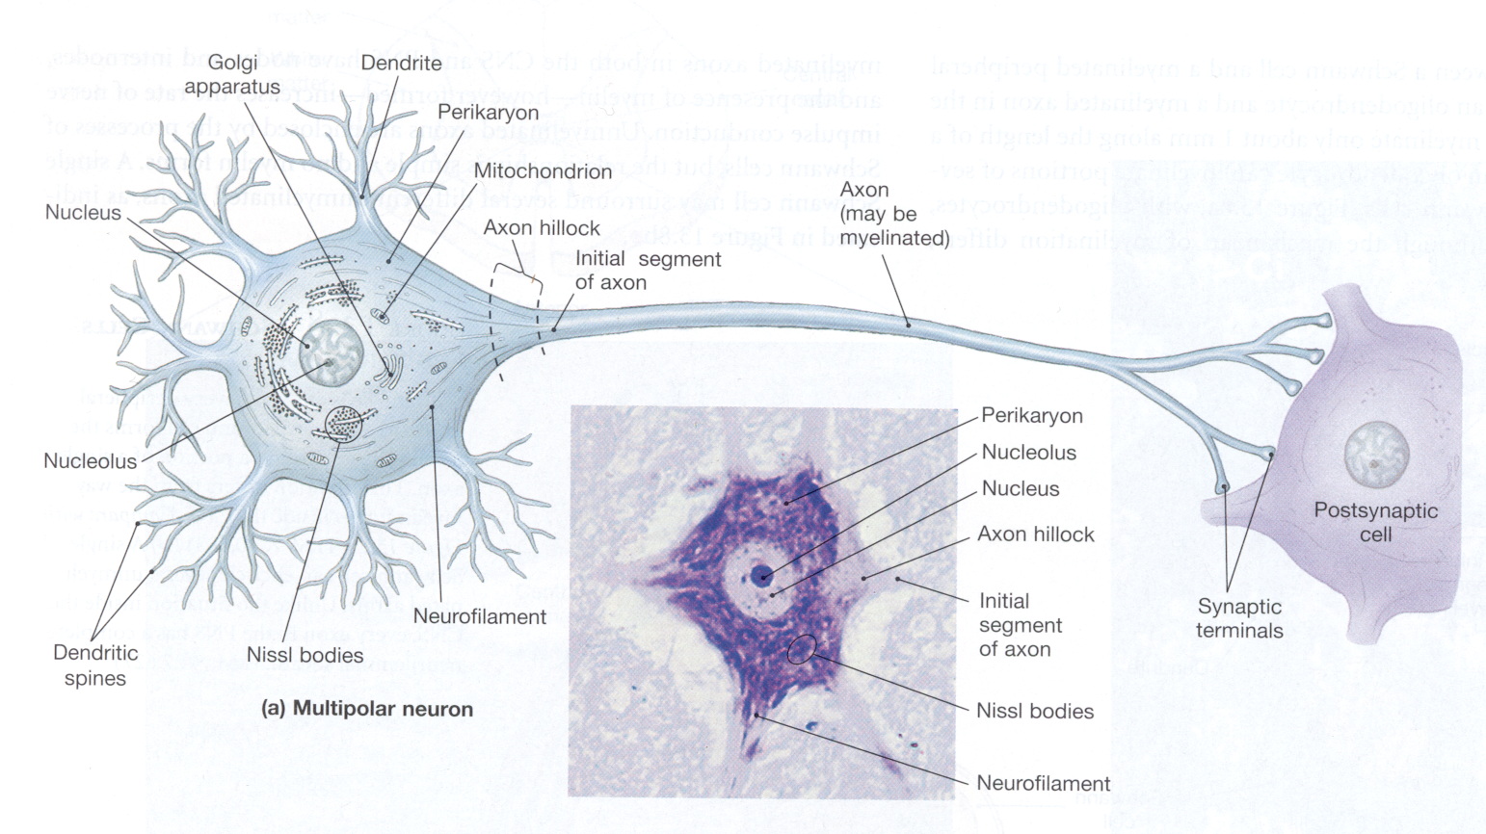
NERVOUS SYSTEM ANATOMY

Slide 4
MANIFESTATIONS OF NEUROTOXICITY
NEURONOPATHIES
Injury or death to neurons
Irreversible loss
Caused by CO, ethanol, carbon tetrachloride, methyl mercury, lead

Slide 5
MANIFESTATIONS OF NEUROTOXICITY
AXONOPATHIES
Primary site of toxicity is axon
Degeneration of axon, surrounding myelin, but cell body remains intact
Irreversible in CNS, but reversible in PNS
Caused by organophosphorous esters

Slide 6
MANIFESTATIONS OF NEUROTOXICITY
MYELINOPATHIES
Demyelination
Remyelination in CNS occurs to a limited extent
Remyelination in PNS done by Schwann cells (reversible)
Caused by amiodarone

Slide 7
MANIFESTATIONS OF NEUROTOXICITY
NEUROTRANSMISSION-ASSOCIATED ANOMALITIES
Interruption of impulse transmission
Blockade of transsynaptic communication
Inhibition of neurotransmitter uptake
Caused by nicotine, amphetamines, cocaine

Slide 8
Neurotransmission-Associated Neurotoxicity
naturally occurring toxins, as well as synthetic chemicals, alter specific mechanisms of intercellular communication.
OP and carbamate pesticides produce their insecticidal actions by inhibiting AChE, the catalytic enzyme that ends the postsynaptic action of acetylcholine.
The resultant cholinergic overstimulation produces signs of acute toxicity ranging from flu-like symptoms to gastrointestinal distress, ataxia, twitching, convulsions, coma, and death.
These effects are not as well-correlated with AChE inhibition as might be expected for all such pesticides, leading to suggestions of additional mechanisms of actions that have since been verified in animal and in vitro studies.

Slide 9
Nicotine
Nicotine Widely available in tobacco products nicotine has diverse pharmacological actions
These toxic effects range from acute poisoning to more chronic effects.
Nicotine exerts its effects by binding to a subset of cholinergic receptors, the nicotinic receptors.
These receptors are located in ganglia, at the neuromuscular junction, and also within the CNS, where the psychoactive and addictive properties most likely reside.
Smoking and “pharmacological” doses of nicotine accelerate heart rate, elevate blood pressure, and constrict blood vessels within the skin.

Slide 10
Acute overdose of nicotine has occurred in children who accidentally ingest tobacco products, in tobacco workers exposed to wet tobacco leaves, and in workers exposed to nicotine-containing pesticides.
In each of these settings, the rapid rise in circulating levels of nicotine leads to excessive stimulation of nicotinic receptors, a process that is followed rapidly by ganglionic paralysis.
Initial nausea, rapid heart rate, and perspiration are followed shortly by marked slowing of heart rate with a fall in blood pressure. Somnolence and confusion may occur, followed by coma; if death results, it is often the result of paralysis of the muscles of respiration.

Slide 11
Cocaine
Cocaine blocks the reuptake of dopamine (DA), norepinephrine, and serotonin at the nerve terminal in the CNS, and also causes release of DA from storage vesicles.
The primary event responsible for the addictive properties and euphoric feeling when intoxicated is a block on the DA reuptake transporter (DAT).
This leads to enhanced DAergic transmission, and can result in a variety of symptoms in the user.
The mechanism of altered neurotransmission has been linked to the DA D1 receptor, as mice lacking this receptor fail to exhibit many of the same characteristic behaviors as wild- type mice.

Slide 12
Adult vs developing fetuses and children
Developing fetuses and children are more vulnerable to neurotoxins
In active growing stage
“blood-brain barrier not completely formed
Metabolic pathways for detoxification are not fully developed
Elderly is also ↑ sensitivity to neurotoxins
↓ compensation ability of nervous system
↓ hepatic and renal functions

Slide 13
Thank you

