Slide 1
Vision
O B J E C T I V ES
describe the accessory structures of the eye and the structural components of the eyeball.
Discuss image formation by describing refraction, accommodation, and constriction of the pupil.
Describe the processing of visual signals in the retina and the neural pathway for vision.
Describe the color vision
Dark adaptation
Types of blindness

Slide 2
Sight or vision is extremely important to human survival.
More than half the sensory receptors in the human body are located in the eyes, and a large part of the cerebral cortex is devoted to processing visual information

Slide 3
The electromagnetic spectrum.
Visible light is the part of the electromagnetic spectrum with wavelengths ranging from about 400 to 700 nm.

Slide 5
Visual system
image formation & phototransduction
Visual pathway: transmission of nerve impulses
Visual cortex: occipital lobe of cerebral cortex
primary visual receiving area: sides of the calcarine fissure visual processing & perception occurs here
Stimulus: Light in the visible portion of the electromagnetic spectrum.
The Sensory organ is the Eye
The eye is regarded as an optical instrument for focusing of images on retina by refraction of light rays.
Refractive power
Cornea: 40 dioptres its fixed
Lens: 20 dioptres its adjustable
Photoreceptors on retina are rods and cones

Slide 6
Refraction of light
when light beam passes through an angulated interface, light rays bend
Biconvex spherical lens---→ convergence
Concave spherical lens-----→ divergence
Accommodation : It’s a Parasympathetic response
When a person looks at a near object, 3 changes occur:
accommodation reflex, convergence of visual axis, pupil constrict
When accommodation relaxed:
Near object (<6 m) diverging rays image falls behind retina
Far object (>6 m) parallel rays ;image falls on retina
Physiology
ciliary muscles contracts, this relaxes the lens ligaments, lens spring into a more onvex shape.
near point of vision recedes throughout life ;slowly at 1st; advancing rapidly with old age; due to increasing hardness of lens SO impaired accommodation and hence receding of near point leading to Presbyopia
Presbyopia ; due to increasing hardness of lens means reading and close vision is difficult :this is corrected by wearing convex lens that diverging rays.

Slide 7
Errors of refraction:
Emmetropia(normal vision):The accommodation is relaxed ;far object, parallel rays – image falls on retina.
1. Hyperopia (farsightedness) short eyes ball/weak lens image from distant objects formed behind retina
accommodation all the time so ciliary muscle overworked lead to eye strain, headache, convergence of visual axes ,squint/strabismus. Its corrected by convex lens.
2.Myopia (nearsightedness) long eye ball the image from distant objects is formed in front of retina, corrected by concave lens.
Astigmatism (Uneven corneal surface) curvatures at various meridians not equal i.e Different focal points so there is distorted image. Corrected by cylinder lens

Slide 9
Photoreceptors
Receptor cells containing excitatory/inhibitory synaptic transmitters
Rods
Photopigments : protein: rhodopsin --→Vitamin A aldehyde --→retinal ----→retinene
Abundant in the peripheral retina ,its Low threshold receptors its sensitive for dim light ie night vision (scotopic vision) its Most sensitive to 505 nm ie Blue-Green .
Cones:
Photopigments: protein: photopsins,Vitamin A aldehyde,retinal, retinene
Abundant in in central retina particularly in fovea centralis (in macula lutea)
Higher threshold receptors for daylight detailed vision (photopic vision) and colour vision
Visual acuity greatest at fovea centralis

Slide 10
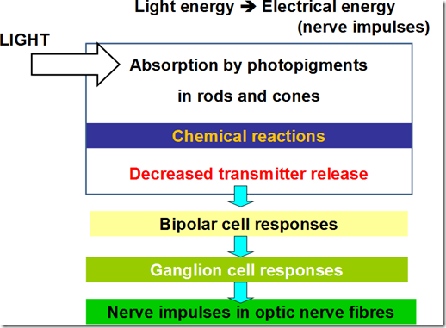
Phototransduction

Slide 11
In the photoreceptors,
In the dark
Na+ channel open Na+ entry Depolarization-→Inhibitory neurotransmitter release
Bipolar cells inhibited
Ganglion cells (axons of optic nerves)-→decrease discharge.
In the light
Activates rhodopsin,decomposition of rhodopsin →cis-retinal bleached → trans-retinal (opsin & retinal) this makes retinal detaches from opsin →activated opsin -→Na+ channels close →Na+ entry decrease-→Hyperpolarization →Decrease inhibitory neurotransmitter release from the rod this leads to removal of inhibition →Bipolar cells excited → stimulate Ganglion cells -→action potential initiated →transmit to the brain → vision occurs.

Slide 12
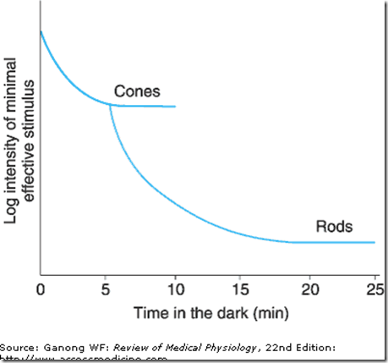
Dark adaptation

Slide 13
If one moves from a brightly lighted room to a dimly lighted room
retina slowly becomes more sensitive to light ; pupil dilate – to capture more light into the retina,
this decline in visual threshold is called dark adaptation.
Dark adaptation depends on:
rate of regeneration of rhodopsin, which depends on vitamina A (retinol).
Vitamin A deficiency: Signs & Symptoms of vit A defeciency: impaired dark adaptation,Nactalopia,
night blindness, Bitot spots,Xerophthalmia, eye drying, eratomalacia, corneal softening Ulceration And Scars.
Pathophysiology; degeneration of rods & cones, degeneration of neural layers of retina ,blindness its most common cause of preventable blindness, treatment should be before receptors are destroyed.

Slide 14
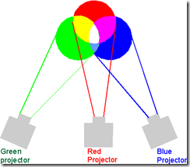
Colour vision
The sensation of any spectral colour can be produced by:
mixture of various proportions of:
Red wavelength,Green wavelength,
and Blue wavelengh.
There are3 types of cones
Red cones; absorb long wavelength,
L cones
Green cones; absorb medium wavelength,
M cones
Blue cones; absorb short wavelength,
S cones
Cones most sensitive to 405 nm (yellow-green)

Slide 15
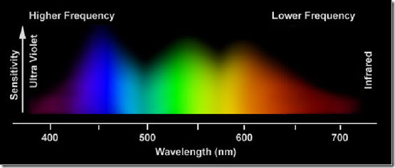
Color blindness
Trichromats (have 3 cone systems -RGB)
Normal trichromats,individuals with normal colour vision
Anomalous trichromats (1 weak cone system)
Protanomaly: red weakness
defective red-sensitive cones
Deuteranomaly:green weakness
defective green-sensitive cones
Tritanomaly:blue weakness
defective blue-sensitive cones
Dichromats (2 cone systems)
Protanopia,red blindness
no red-sensitive cones
Deuteranopia,green blindness
no green-sensitive cones
Tritanopia;blue blindness
no blue-sensitive cones
Monochromats (1 cone system)

Slide 16
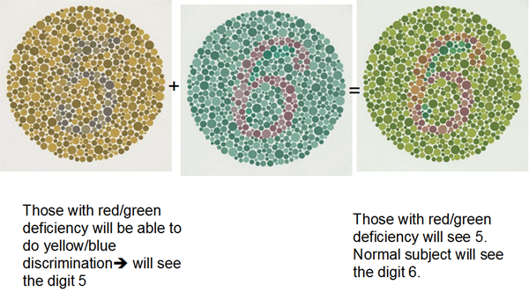
Test for colour vision
Colour matching
Ishihara Pseudoisochromatic plates
Causes of colour blindness: 1. Inherited ,X-linked recessive
2.defective opsins
most frequently: red-green weakness
Lesions of visual cortex concerned with colour vision

Slide 17
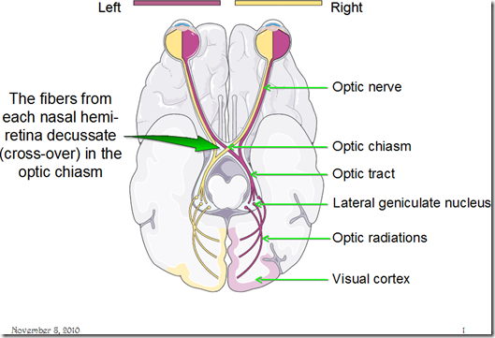
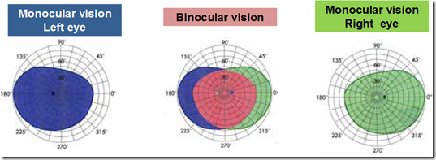
Visual fields & Visual pathways
Fusion of 2 images occurs in the visual cortex
Visual axes of 2 eyes must be properly aligned if not, double vision (diplopia)
Diplopia
2 different images sent to the brain
brain will suppress one of the images
to prevent seeing double
in children (<6 y/o)suppression of one eye’s input to the brain leads to reduced vision in the suppressed eye
Amblyopia
Examination of visual fields
Perimetry

Slide 18
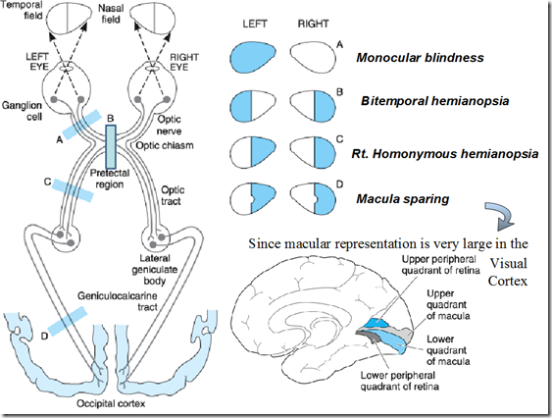
Lesions in visual pathways (Visual field defect)
Anterior pituitary tumours
pressure on optic chiasma from below
eg. visual field defects in gigantism

Slide 19
Visual acuity
Defined in terms of minimum separable
shortest distance by which 2 lines can be separated & still be perceived as 2 lines
Snellen letter charts
designed so that the height of the letters in the smallest line a normal individual can read at 20 ft (6m) subtends a visual angle of 5 minutes
Jaeger’s cards test for near vision (reading)
When visual acuity is markedly reduced
can be quantified in terms of
Count fingers
distance at which the patient can count fingers
Hand movement
discern hand movement
Perceive light
No light perception (NLP)
if an eye is totally blind, examination will reveal NLP

Slide 20
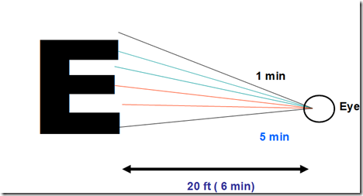

Slide 21
Blindness (Visual impairment)
Transient blindness
may occur on sudden exposure to darkness/bright light
blinding light
light adaptation= 5 minutes
Transient monocular blindness
associated with an increased risk of subsequent stroke
Night blindenss
Colour blindness
Total blindness
Visual field contraction/blindness

