Slide 1
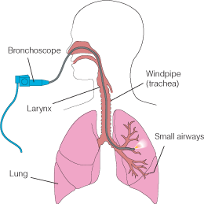
Bronchoscopy
Bronchoscopy Looking into the living lungs (Chevalier Jackson 1928) Today with the major advance in technology View the fine details of the end bronchial anatomy Diagnosis of the disease Treating diseases It is the visualization of the air way using either rigid Bronchoscope (GA) or the flexible (Fiber optic Bronchoscope ) (LA) or both simultaneously .Through which we can remove FB , take BAL , brushing lesions &Trans bronchial Biopsy .

Slide 2
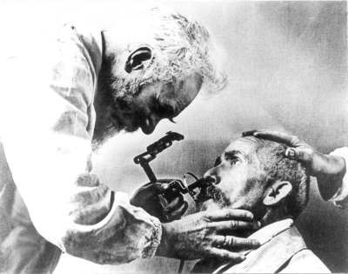
HISTORY
Gustav Killian (The father of bronchoscopy ) , was appointed professor
of ENT at the university of Freiburg in 1892 .
Gustav Killian in 1897 succeeded in removing aspirated pork bone from the bronchus of a 63 –year-old farmer under cocaine anesthesia .He used external light source , a head mirror , esophagoscope and forceps to remove the bone .
He became famous & his clinic attracted patients from far and wide for his expertise in removing different kind of (FB) such as bones ,beans ,buttons ,coins & tin whistle .
Gustav Killian Bronchoscope , external light source

Slide 3
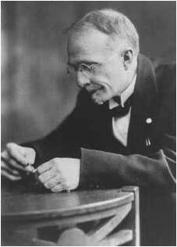
Bronchoscopy rapidly developed into a science (with the creation of a better instruments and techniques ) Chevalier Jackson Founded philadelphia school of bronchoesophagology Jackson‘s monograph first published in 1950
Chevalier Jackson’s Bronchoscope with a small distal bulb & built –in suction tube

Slide 4
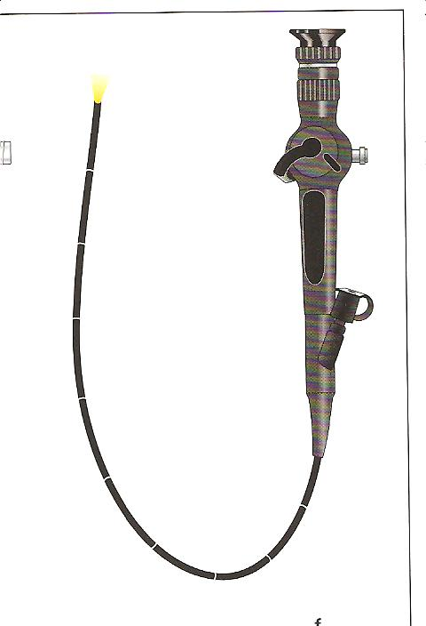
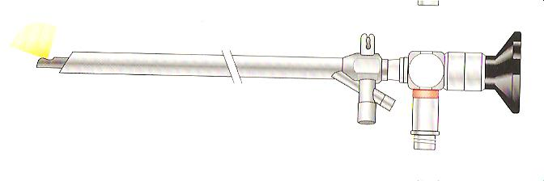
Early in the 1960s Shigeto Ikeda devised a means to replace the small electric bulb with glass fibers capable of transmitting brighter light from an outside source. He presented the first flexible bronchoscope at the 1966 International Congress on Diseases of the Chest in Copenhagen.
H.H.Hopkins English physicist developed the rod-lens optical telescopes which could be used with the rigid bronchoscope

Slide 5
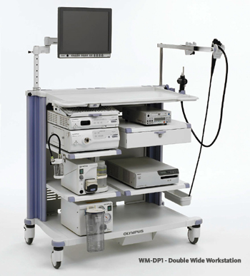
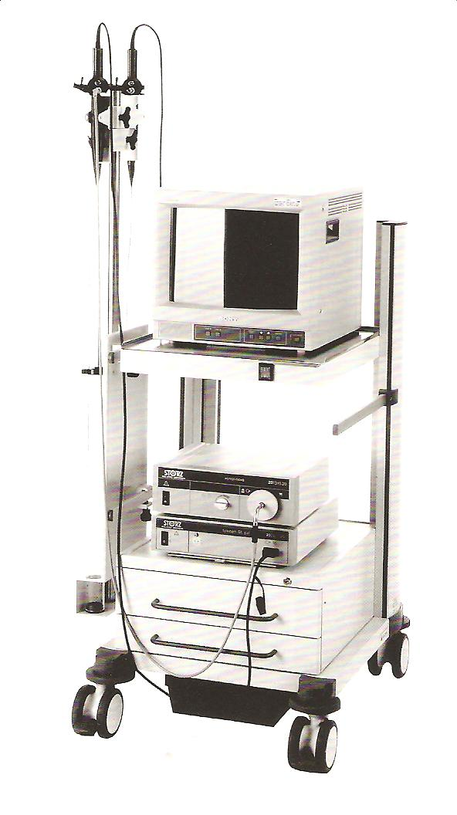
At the end of the 1980s, Asahi Pentax replaced the fiberoptic bundle with a charge-coupled sensor at the tip of the scope. This videobronchoscope allowed the bronchoscopist to look at a monitor screen instead of through the eyepiece of the scope

Slide 6
Rigid Bronchoscopes
Hollow metal tubes , of variables sizes down to ( 3mm -9.5 mm) and variable length (20-40 cm) .These instruments usually have illumination at their tips as well as side holes near the tip to facilitate ventilation .They are always inserted trans orally .General anesthesia is recommended for its introduction .

Slide 7
Indications for Rigid Bronchoscopy
1-Hemoptysis
2-Tracheal stenosis.
3-Foreign body removal .
4-All bronchological interventions such as bougienage , removal of threads & post intervention hemoptysis.
5-Confirmation of cell type in case of previous , non diagnostic fiberoptic bronchoscopy .
6-Laser treatment
7-Removal of tumor
8-Removal of excess fibrin , mucous plug .
9-Bronchography .
10-Autofluorescence and photodynamic diagnosis .
i.e. Diagnostic and Therapeutic

Slide 8
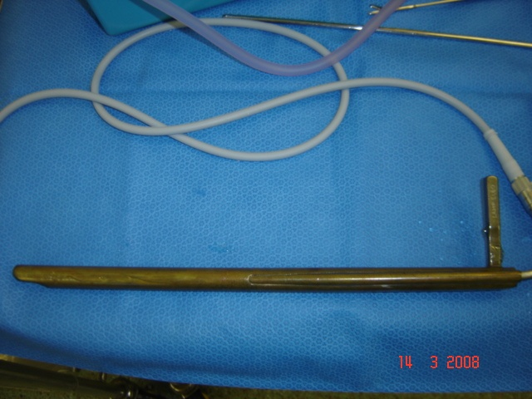
Endoscopey for the museum

Slide 9
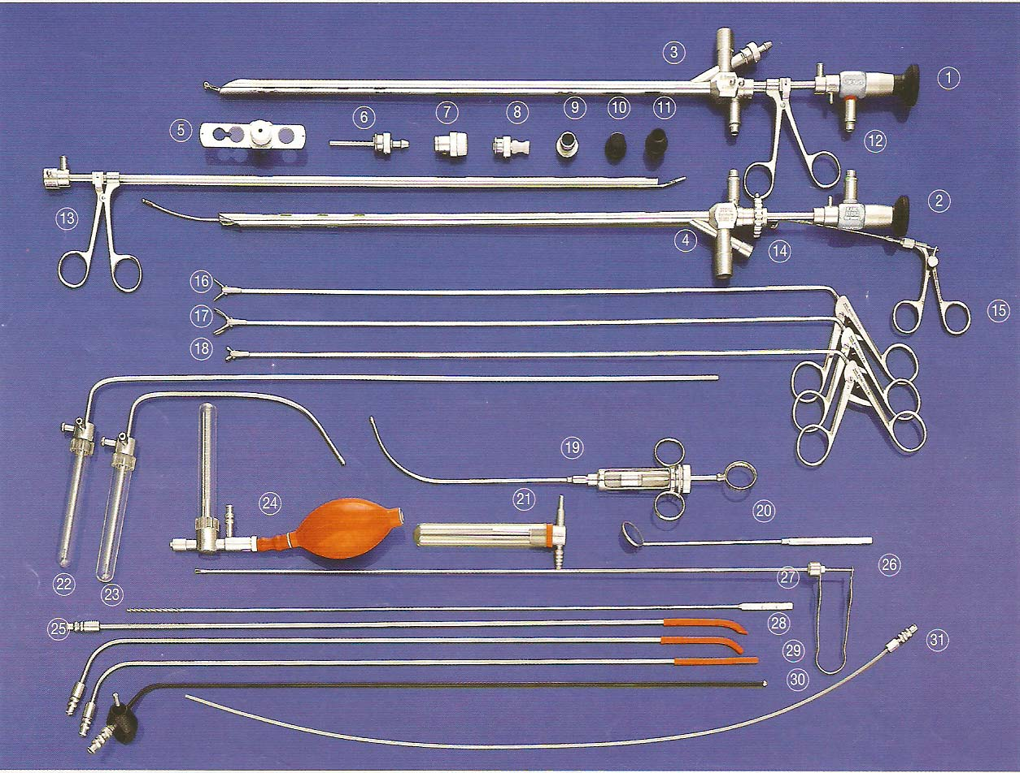
Bronchoscopy ( Adult Set )

Slide 10
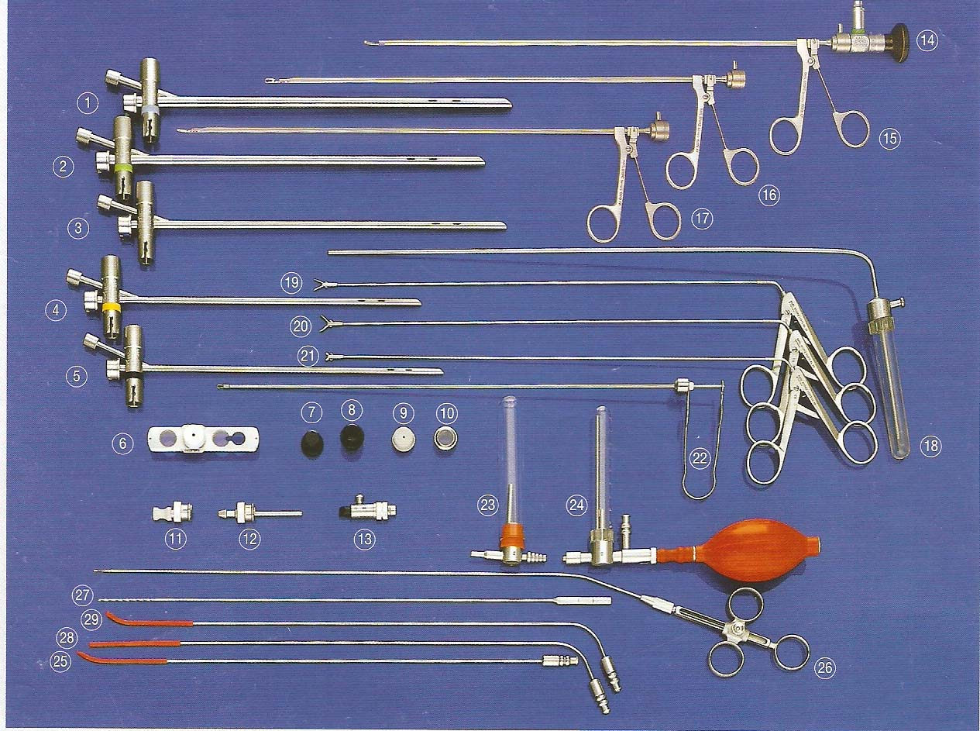
Bronchoscopy (Pediatric Set )

Slide 11
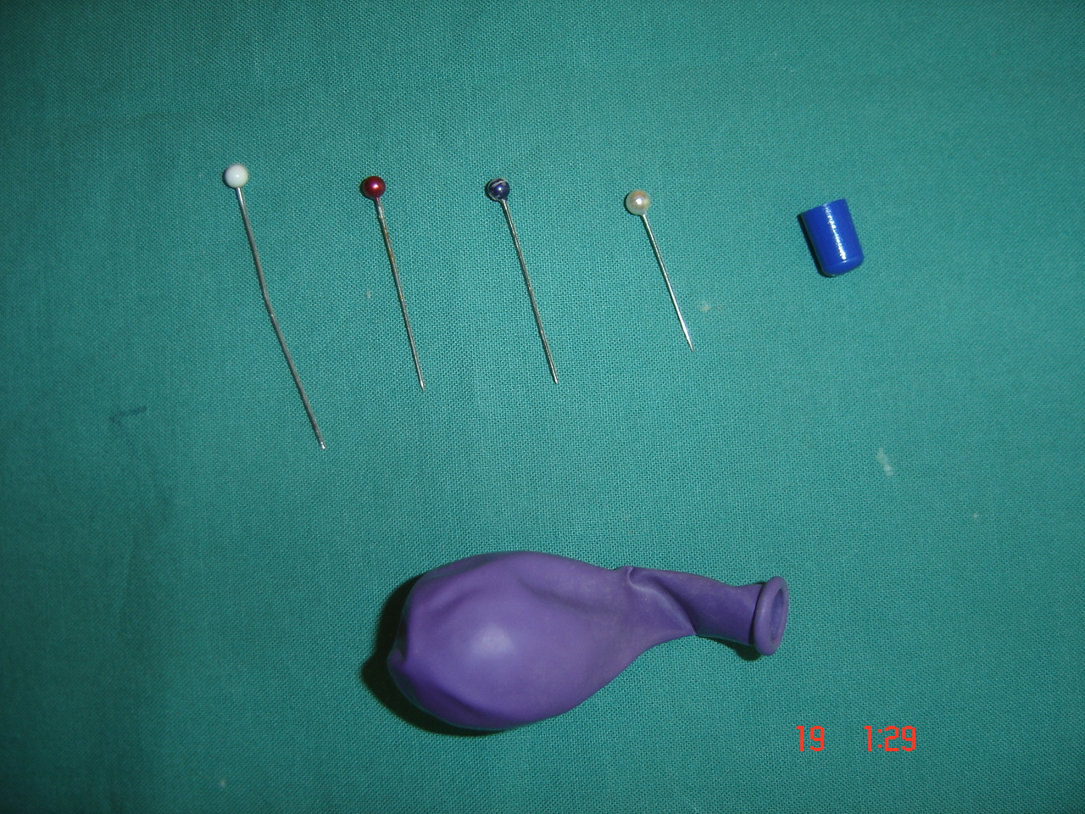

Slide 12
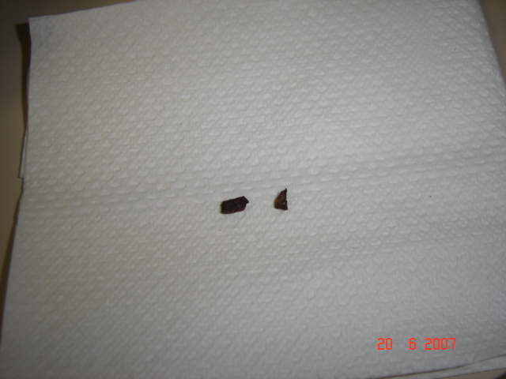
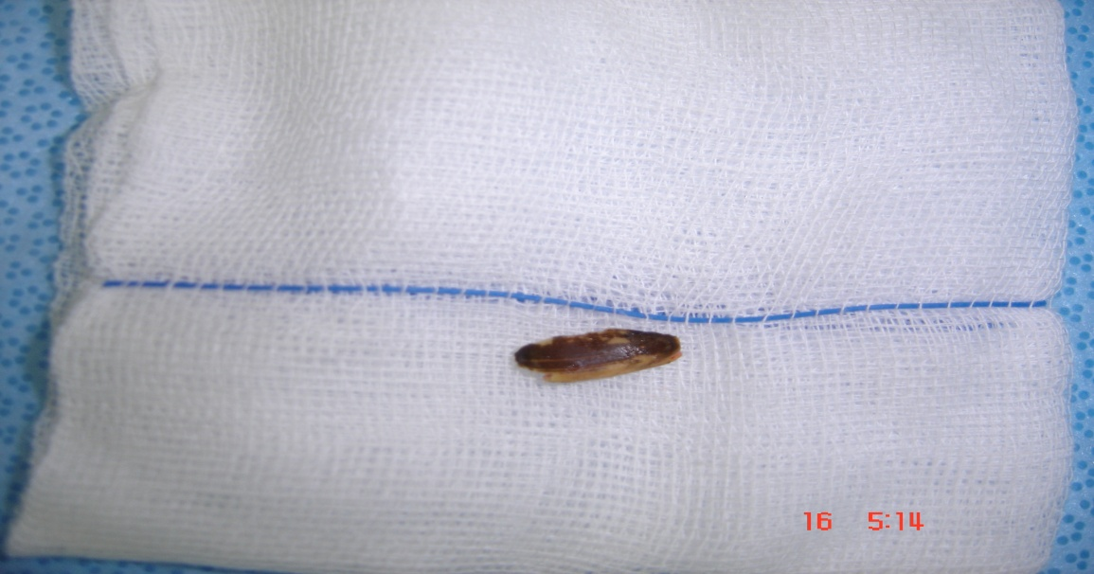
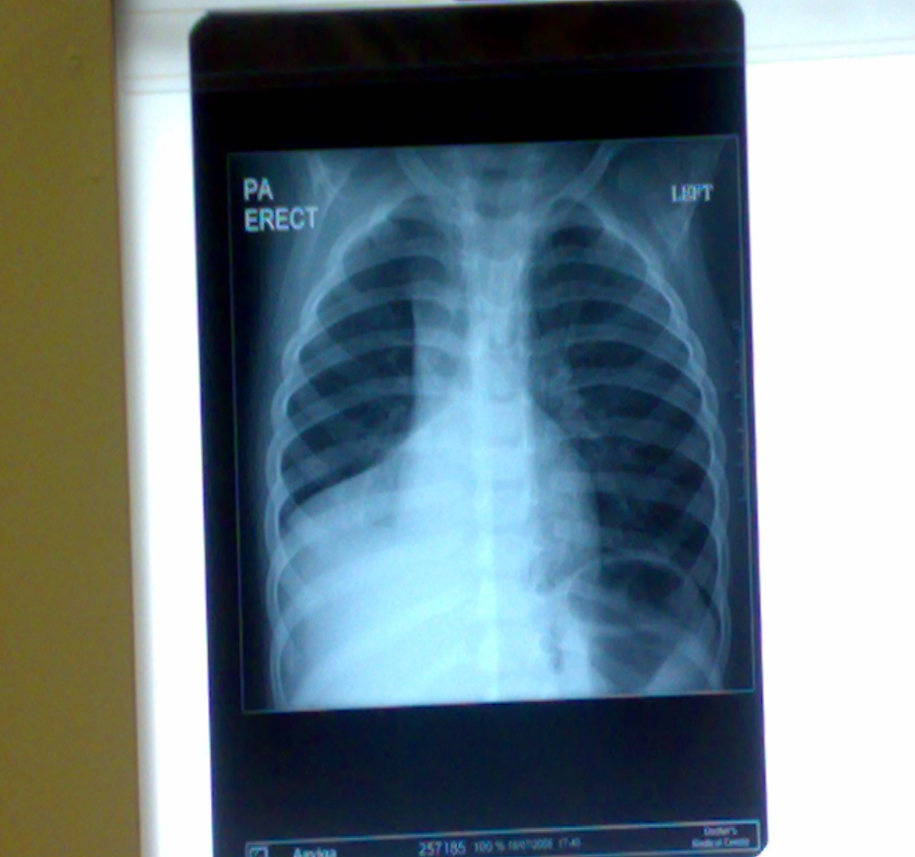
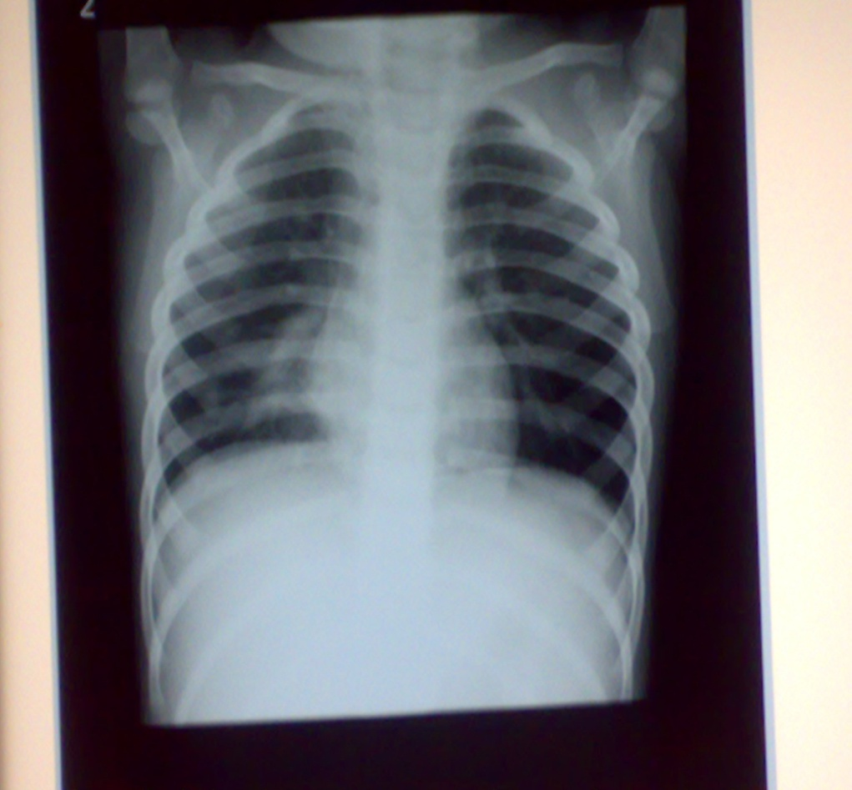

Slide 13
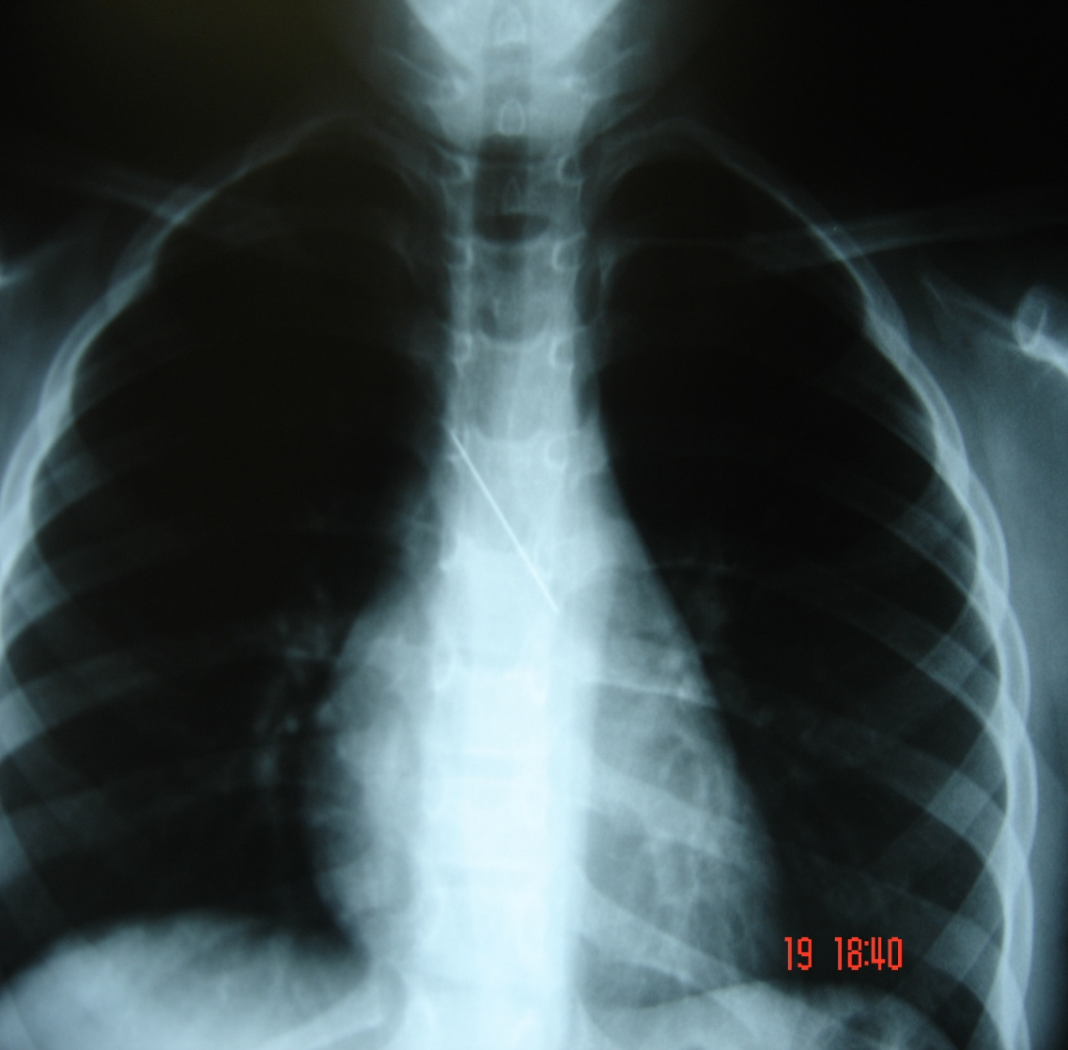
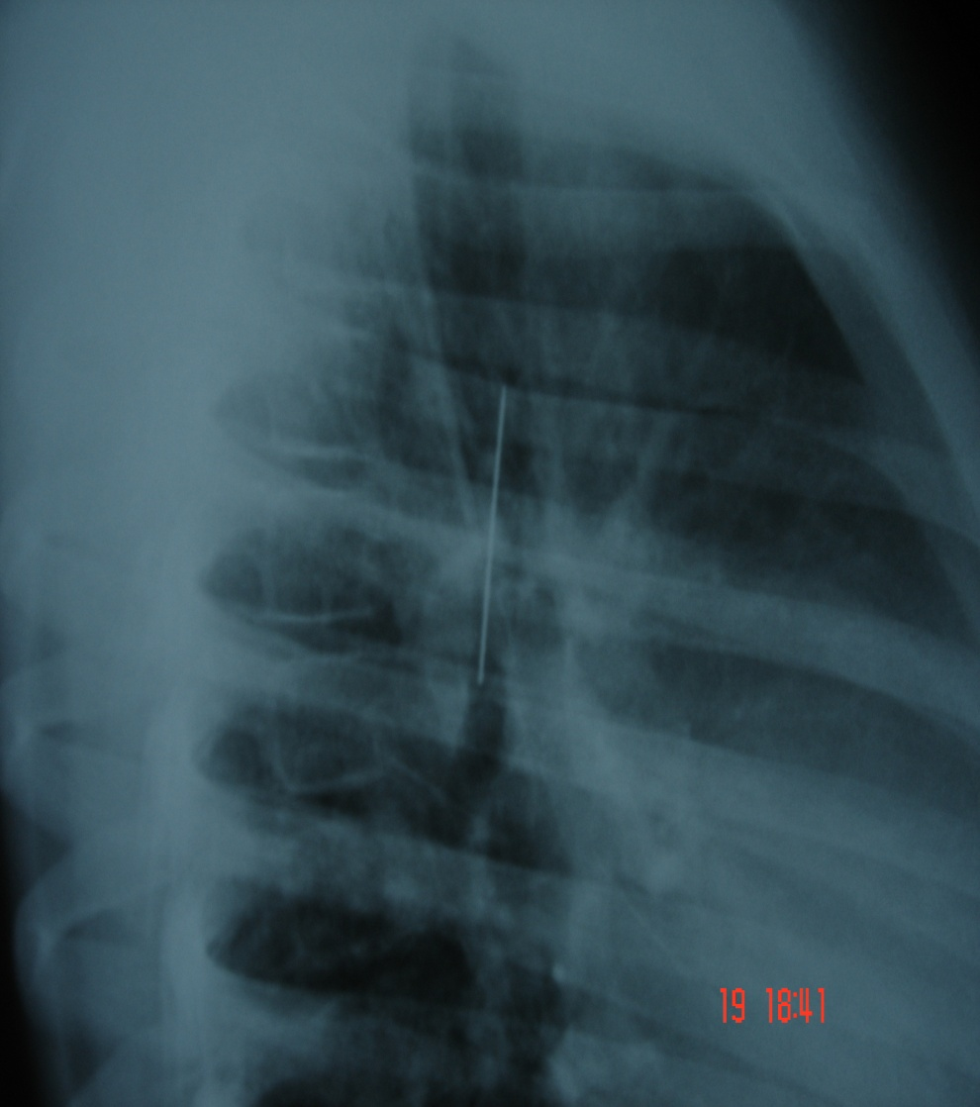
Foreign Body (RMB)

Slide 14
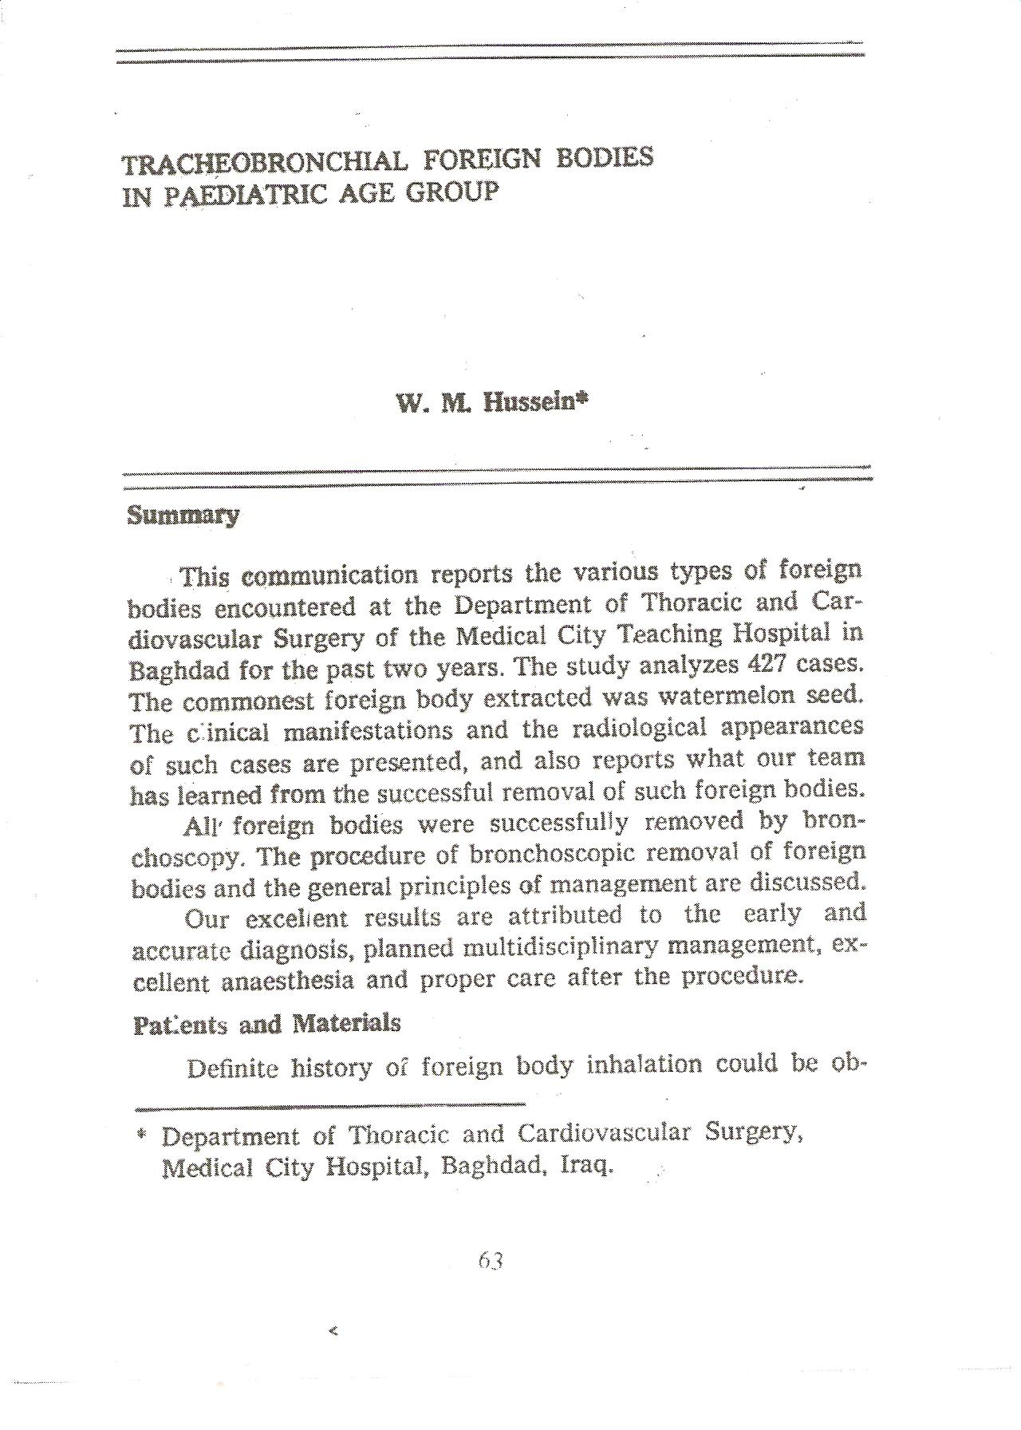
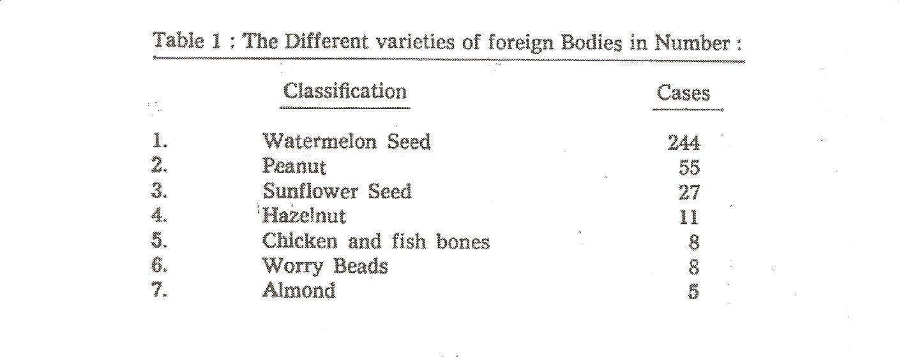
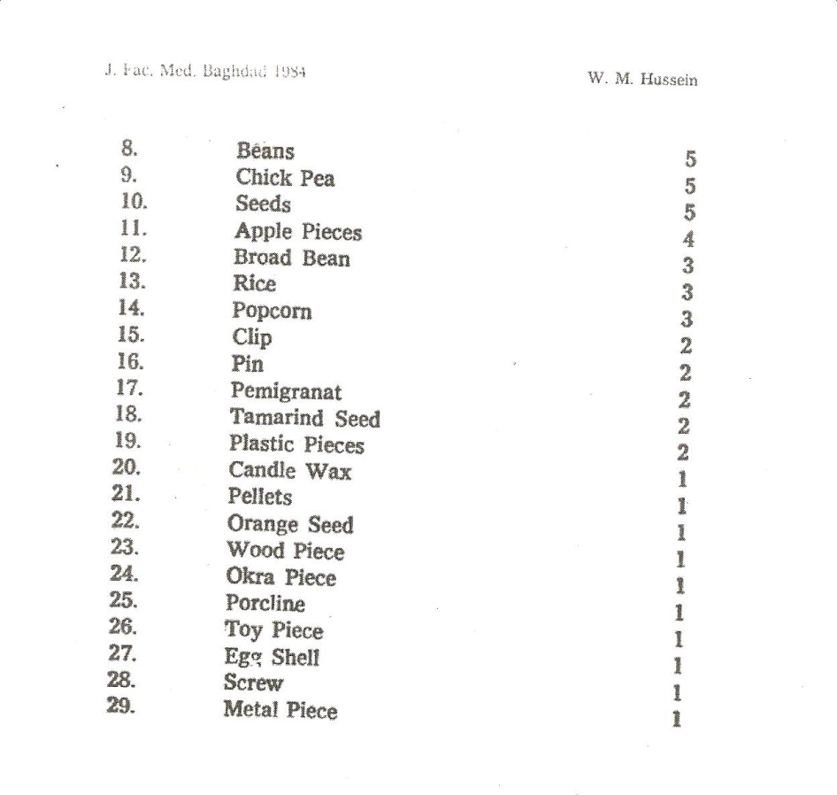

Slide 15
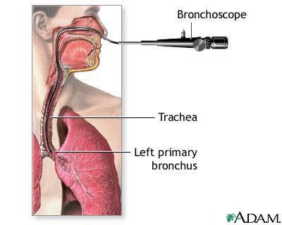
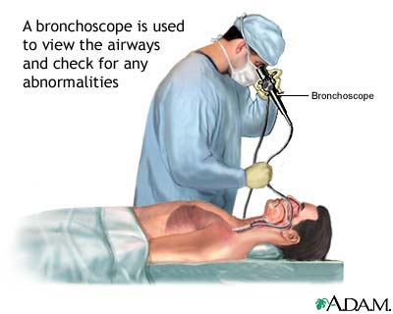
Flexible Bronchoscopy
It consists of Control section , a flexible insertion tube & a bending tip .The control section contains the eye piece ,control lever and a channel for aspiration or for introduction of solution and instruments.

Slide 16
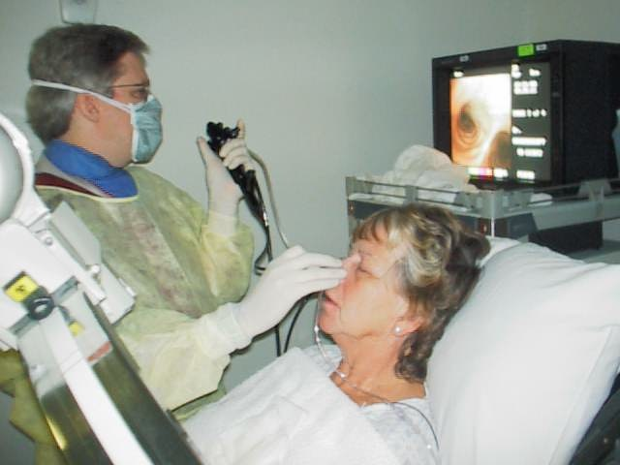
These flexible bronchoscopes have variable outside diameter (1.8 -6 mm) with inner channel ranging from (1.8 -2.6 mm) . Highly maneuverable and can reach areas in the endo bronchial tree not accessible to the rigid bronchoscopes . Can be inserted either transorally or transnasally or through the rigid bronchoscope. We have the Infantile , Pediatric , adult types and the Video –Bronchoscopes

Slide 17
Indications for flexible Bronchoscopy
1-For routine examinations .
2-Treatment of acute respiratory problems in the ICU.
3-Suction under visual control .
4-Use of catheter and brushes for cytology.
5-For obtaining secretions for bacteriological tests.
6-Localization of the bleeding site in case of hemoptysis.
7-Theraputic suction & irrigation .
8-Transbronchial lung biopsy .
9-Selective bronchography .
10-Autofluorescence & photodynamic diagnosis .
Major disadvantage of the flexible Bronchoscope is that it is a closed system that does not provide an airway , and the relatively small inner channel is considered to be incapable of allowing adequate suction when confronted with copious secretions or massive haemoptysis .
It is not so much effective in the removal of foreign bodies .

Slide 18
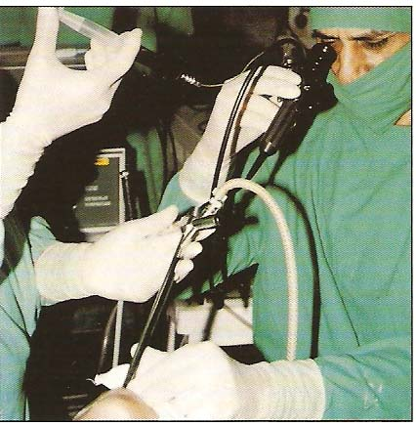
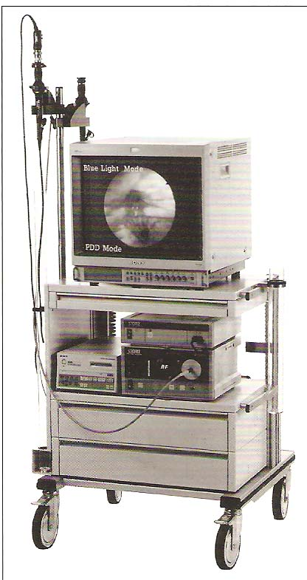
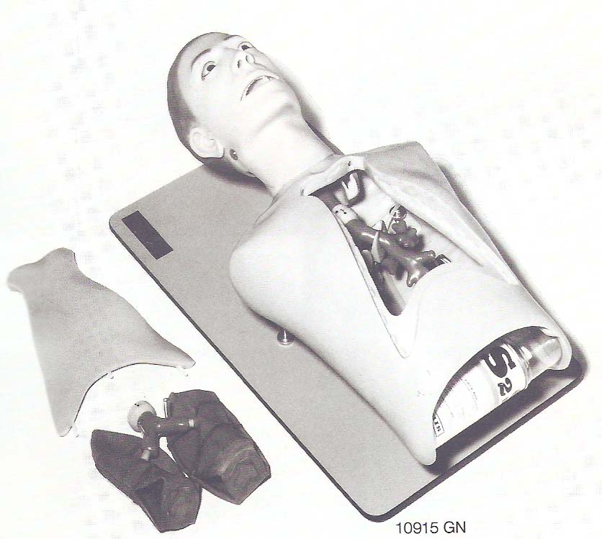
Tracheo-Bronchial Trainer

Slide 19
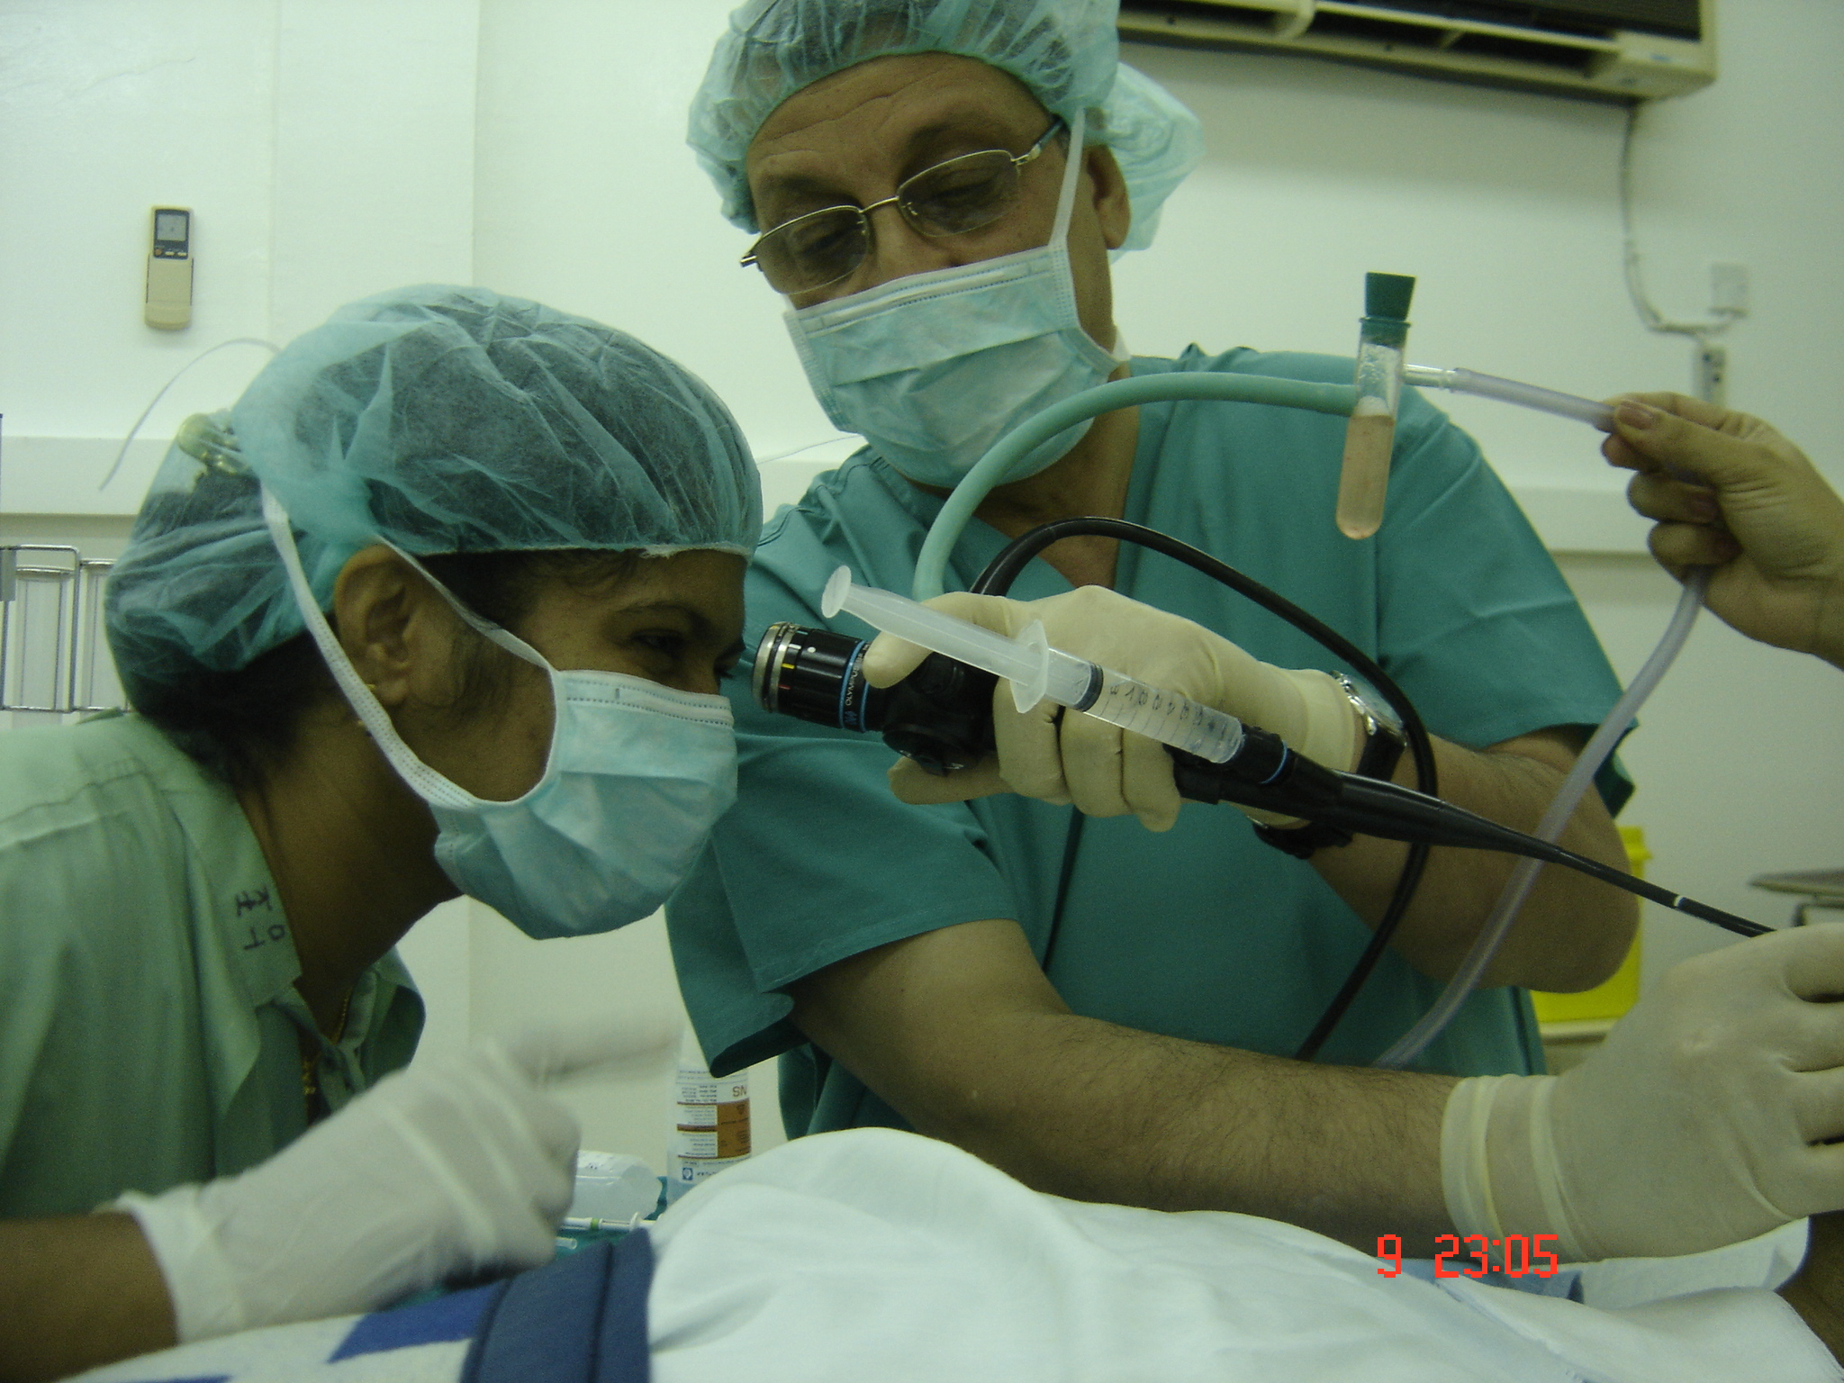
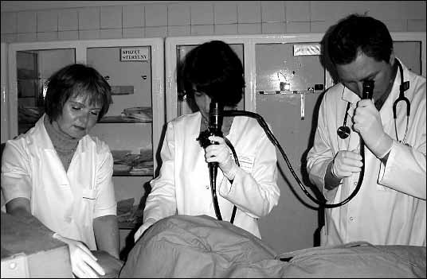
Suction
Lever
Saline for irrigation
Sample collection (BAL)
Lecture scope

Slide 20
Contra indications
Rigid Bronchoscopy Is best avoided in the presence of Cervical spine injury thoracic to prevent hyperextension of the neck & in patient with Aneurysm of the aorta
Flexible Bronchoscopy
Best avoided in patient with Massive Haemoptysis & patients with air way problems
In cases of doubt as to whether bronchoscopy should be done or not , bronchoscopy should always be done ( Jackson’s 1915 statement ) .
In suspected cases of F.B inhalation it is better to have a negative bronchoscopy rather than to miss a F.B inside with all its pathological consequences .

Slide 21
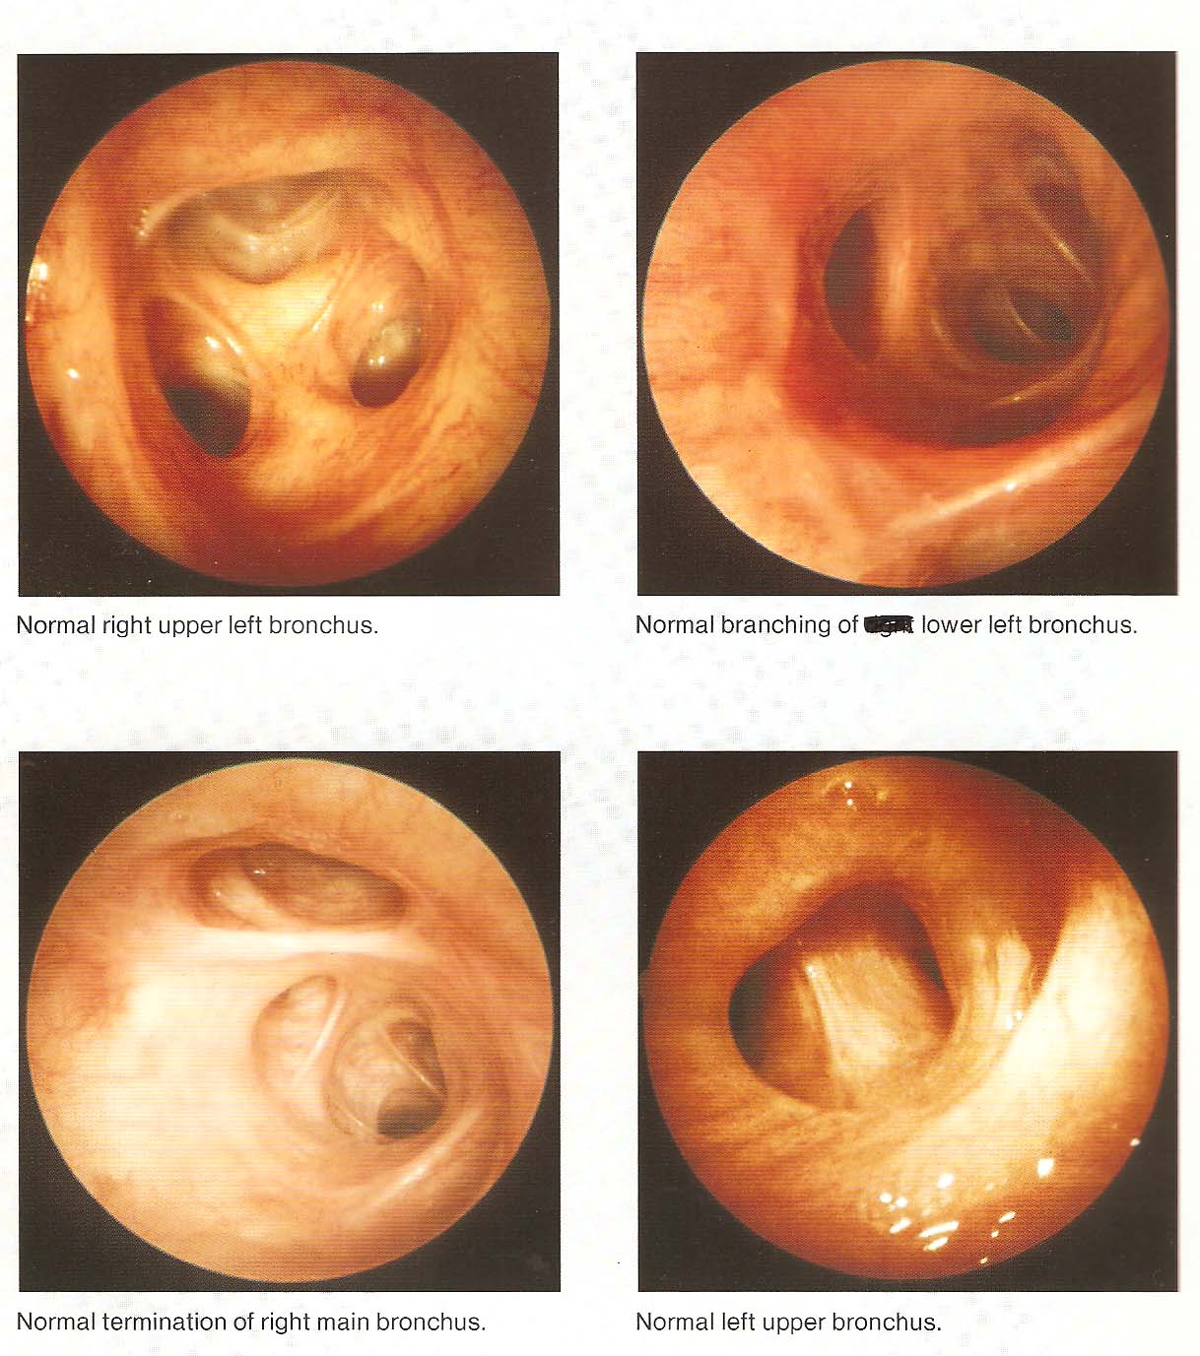
Normal Bronchoscopic Findings

Slide 22
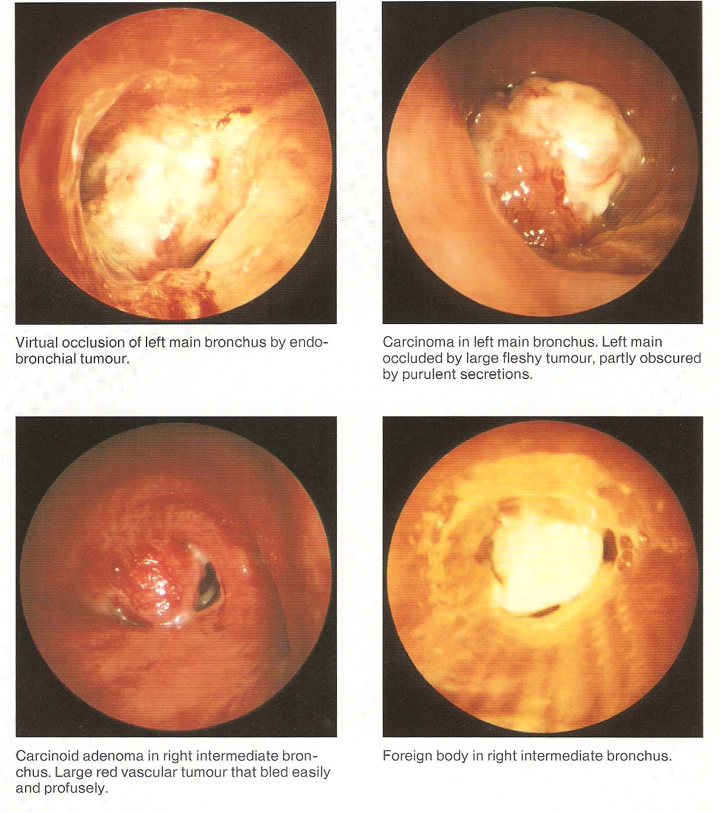
Abnormal Bronchoscopic Findings

Slide 23
COMPLICATIONS
When bronchoscopy performed by properly trained individuals
It is a safe procedure .However a variety of other problems have been reported including
Pneumothorax , bronchospasm , Bronchial perforation (Surgical emphysema & tension pneumothorax ) ,
Subglottic edema , Uncontrolled bleeding , Infections
Arrhythmias rarely ( Cardiopulmonary arrest )
Hypoventilation (Hypoxia& hypercapnia)
Majority related to a biopsy procedure So explorative thoracotomy may be safer than (injudicious biopsy )
Some minor complications
Damage of teeth , Injuries to lips or mouth

Slide 24
Post bronchoscopy care
1-Close monitoring for 2-4 hours after the procedure
2-Eating and drinking is not allowed until the effect of anesthesia have worn off .
3-Some may advise routine CXR after performing a biopsy to check for signs of pneumothorax .
3-Those patients develop complications may need to stay in the hospital for additional time .
4-The patients may have sore throat , hoarseness ,cough or muscle ache .
Fever up to temperature 38 “ c is common after bronchoscopy but usually for only 24 hours .

Slide 25
Advances in Bronchoscopy
1- Brochoscopic Ultra-sound
2-Bronchoscopic stenting (Air way prosthesis )
3-PDD & AF Bronchoscopy .
4-Bronchoscopic Laser therapy .
5-Bronchoscopic Electro Cautery
6-Cryo therapy
7-Brachy therapy
8-Photo therapy

Slide 26
Bronchoscopy need cooperation and mutual understanding Between
1-A well trained endoscopist
2-a qualified staff
3-Expert and well trained anesthetist
Bronchoscopy
is now an integral part of respiratory medicine.
Diagnostic indications include tissue diagnosis, detection and staging of lung malignancy, evaluation of diffuse lung diseases like sarcoidosis and idiopathic interstitial pneumonias, pulmonary inspection of burn patients, identification of organisms infecting the respiratory tract and lungs.
As a therapeutic modality, bronchoscopy is used to place stents to protect airways vulnerable to collapse or occlusion, to remove foreign bodies or masses, to treat early stage endobronchial malignancy.

