Slide 1
Sterilization perminant contraception

Slide 2
Female sterilization
This involves the mechanical blockage of both fallopian tubes to prevent sperm reaching & fertilizing the oocyte.
Bilateral salpingectomy or hysterectomy may be used if there is coexistent gynaecological pathology.

Slide 3
It is most commonly performed by laparascopy under general anesthesia as a day case.
Alternative technique is mini-laparatomy with small suprapubic incision or through the posterior vaginal fornix[colpotomy].
Avariety of methods used for tubal occlusion
Include:
Ligation
Electrocautery
Laser
Falope ring
clips

Slide 4
Female Sterilization Overview
Anatomy
Ampulla
Isthmus
Infundibulum
Fimbria

Slide 5
Methods of female sterilization
Procedure | Timing | Technique
Minilaparotomy | Post Partum Post Abortion Interval | Mechanical Devices (Clips, Rings) Tubal Ligation or Excision
Laparoscopy | Interval Only | Electrocoagulation (Unipolar, Bipolar) Mechanical Devices (Clips, Rings)
Laparotomy | In conjunction with other surgery (Cesarean section, salpingectomy, ovarian cystectomy, etc.) | Mechanical Devices (Clips, Rings) Tubal Ligation or Excision

Slide 6
Informed concent
Discussion with patient must take place and cover the following details:
It must be a voluntary decision
Discussion of other options
Discussion of method of sterilization
Sterilization is permanent
Probability of failure
Discussion about methods of contraception for prevention of STDs
Special consideration for women with mental disabilities

Slide 7
Monopolar coagulation
It is laparascopic procedure
Complications
Bowel Burn
Bleeding
Longer portion of tube is damaged
Failures and ectopic pregnancy

Slide 8
Bipolar coagulation
Laparoscopic
Benefits
Most common method of laparoscopic sterilization
Burn several locations along the tube
Complications
High rate of ectopic pregnancy
Potential for bowel burns
Reversals are potentially more difficult due to the extent of tube damage

Slide 9
Destruction of the Entire Fallopian Tube: “Three Burn” Technique

Slide 10
Falope ring
Mechanical occlusion invented in 1974
Tubal occlusion accomplished by placing a silicone band around the tube
Thicker tubes may be problematic
May not be suited for postpartum
Complications
Increased patient discomfort during recovery – large area of necrosis
Failure Rate: 17.7/1000¹ (1.8%)

Slide 11
Falope Ring/Yoon Band

Slide 12
Filshie Tubal Ligation System
Can be used in minilaparatomy & laparascopy
Used as interval or postpartum srerilization

Slide 13
Methods of Female Sterilization

Slide 14
Pomeroy technique
Incision – suprapubic and subumbilical
Isthmic portion is ligated twice
Segment is then excised
Benefits
Easy technique
Highly effective
Relatively inexpensive)
Tied
Cut
Final result

Slide 15
Parkland technique
Isthmic portion of tube is segmented and ligated at two points
An avascular area in the mesosalpinx is opened
Proximal and distal ligated and segment exiced
Benefits
Good success rates
Few complications
Inexpensive to perform

Slide 16
Irving technique
Bury the proximal tubal stump within the myometrium
Benefits
Used in conjunction with cesarean delivery
Complications
Moderate level of difficulty to perform
Pomeroy and Parkland are quicker
Failure rate: 1/1000¹

Slide 17
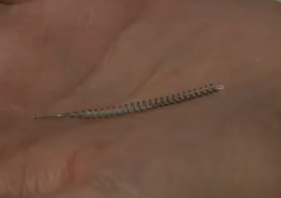
Essure
Essure microinsert sterilization device
Hysteroscopic procedure
Approved in 2002
The coil-like device is inserted under local anesthesia into the fallopian tubes where it is incorporated by tissue
Micro-insert placed into each tube, The device induces a local inflammatory response and, eventually, fibrosis of the intramural tubal lumen. these fibers stimulate in-growth over several weeks

Slide 18
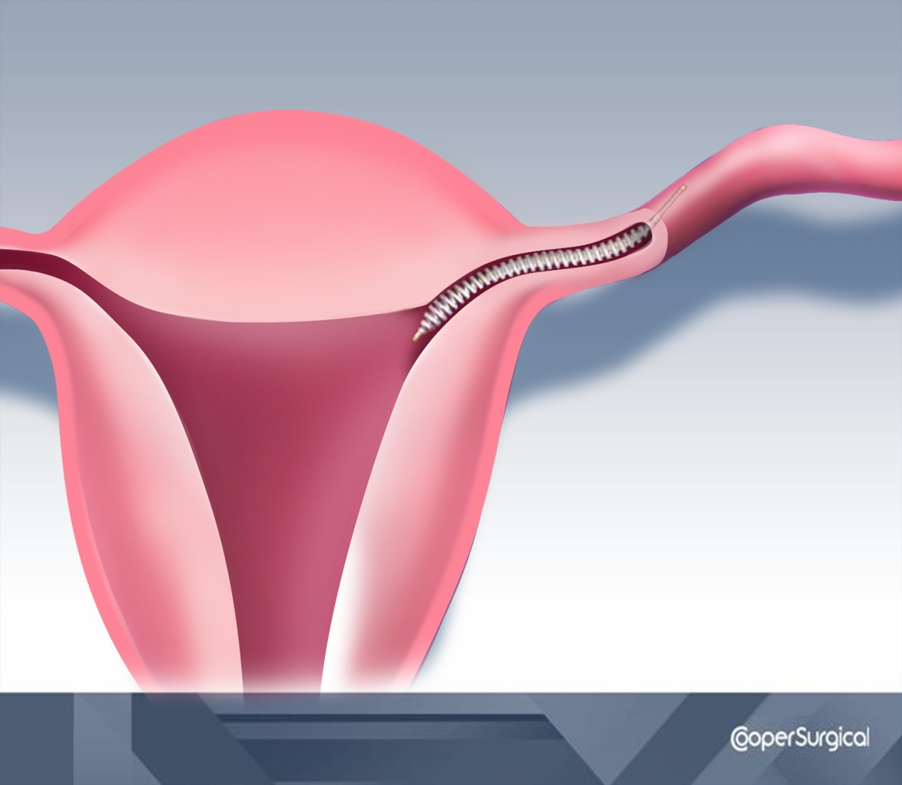
86% Success Rate for 1st time
placements of micro-inserts
The woman is advised to use
contraception for 3 months
until hysterosalpingography
HSG procedure confirms
occlusion of both tubes

Slide 19
complications
-Short term
Anesthetic problems.
Intra-abdominal organ damage.
Gas embolism.
Thromboembolic disease.
Wound infection

Slide 20
Long term-
Women may experience regret post-procedure
Ectopic pregnancy
Failure rate 1-2/1000 operation.
Menstrual disorders
Psychological disorders

Slide 21
Reversibility
All surgical tubal occlusion procedures are considered to be permanent female sterilization methods
success restoration of tubes does not mean always success of pregnancy and carries a significant risk of ectopic pregnancy

Slide 22
Male sterilization(vasectomy)
-Safe and permanent birth control procedure
- Involve division or occlusion of the vas deference on each side to prevent the passage of sperm & seminal fluid from epididymis

Slide 23
Its advatages are-safe, inexpensive,done under local anesthesia& with less complications than
female sterilization.i
Its disadvantages is not effective immediately,
Need 12- 16 weeks to be effective.
The man should have semin analysis till two samples free from sperms.

Slide 25
Vasectomy procedure
Office visit – approximately 1 hour
Local anesthetic to the overlying skin
Clamp the vas through the skin
Incision made
Small segment removed (3 mm)
Cut segments
-Tied
-Cauterized
-Clipped

Slide 26
complications
-Bleeding ,hematoma :
-Infection
-Sperm granuloma at the cut ends of the vas
-antisperm Antibodies development
-Chronic pain:
-Failure as 1 in 1000
-Concerns of testicular and prostate cancer but
Data do not support a risk

Slide 27
reversal
50-70% who had procedure reversed are fertile
Better success the shorter the interval from procedure to reversal
<3 yrs – 76% successful
>15 yrs – 30% successful

