Slide 1
Urology Exam.

Slide 2
What's the Name and clinical use?
Double jj connected to guide wire used to bypass ureteric obst.

Slide 3
What's the Name and clinical use?
Rigid cystoscope for dx and transection of tumor /stone fragmentation by laser or crasher

Slide 4
What's the Name and clinical use?

Slide 5
What's the abnormal finding and the clinical significance?
Hematuria significes a ca pathology especially if over 45 years /also may indicate stone presence

Slide 6
What's the advantage?
Estimation of urine output during surgery By 2 ways cath.
Also to prevent retention of urine

Slide 7
What's this imaging study? What the abnormal finding?
Wilms tumor deviating the kidney ant. Upward
Big should be reduced by chemo then surgery

Slide 8
What's this test?
Transillumination of the testis (hydrocele)

Slide 9
KUB.
Non visualization of the Rt. Kidney either due to early obst. Or type 5 renal injury

Slide 10
What's this imaging study? What the abnormal finding?
Ct enhanced
Big simple renal cyst(non enhancing mass homogenous) treatment is conservative or drainge if symptomatic

Slide 11
What's the Diagnosis?
Hematocele due to trauma treated conservative if small and by drainage if big examine the testis it could be injured also and may need open surgery.
Notice bruises of trauma

Slide 12
كال صعب عوفو مضروبه الكليه Deceleration injury
And kidney not visualized

Slide 13
1- What's the Name of this instruments?
Cystoscope parts

Slide 14
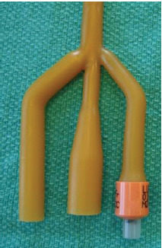
2- What's the difference and clinical use?
3 way caths also called retention caths. They have three lumen:
1-for urine drainage into urine bag.
2-the second for the sterile water that will inflate the balloon.
3-for installation of medication or irrigation of the bladder. اهم شي الي بالاحمر

Slide 15
What's the abnormal finding
KUB
Multiple bilateral renal stones
Staghorn stone needs PCNL

Slide 16
A 55-year-old man with hematuria , What's this study and abnormal finding ?
Ct enhanced
Renal cyst type 4 with calcification and peripheral enhancement needs radical nephrectomy

Slide 17
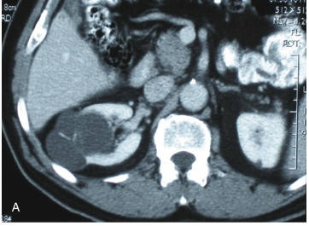
Bosniak's class II renal cysts. A, CT scan shows right renal cyst with thin internal septation.

Slide 18
What's This Study & Abnormal Finding
Retrograde urethrography showing stricture of the bulbar part of urethra.

Slide 19
Blood transfusion

Slide 20
Whats this abnormality?
Hypospidius
Conal and subcoronal

Slide 21
What the differential Diagnosis?
Testicular swelling without skin changes
1-hydrocele
2-hematoma
3-hernia

Slide 22
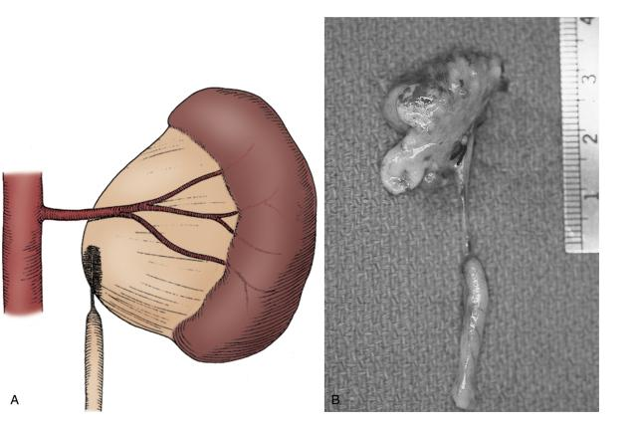
What's Diagnosis?
UPJ obst. Ureteric stricture and dilation of renal pelivs

Slide 23
Can you grade this Reflux?
Grade 5
-Obliteration of papillary impressions(fornices)
-Dilated and torturous ureter

Slide 24
Whats this test ? What's the most important finding to be excluded by this test?
DRE (prostatic enlargement)
-CA prostate
-BPH

Slide 25
65 years old patient with Painless haematuria, Whats the abnormal finding?
Ca. Bladder (tumor or mass)
Stage T3-T4 needs systemic and radical

Slide 26
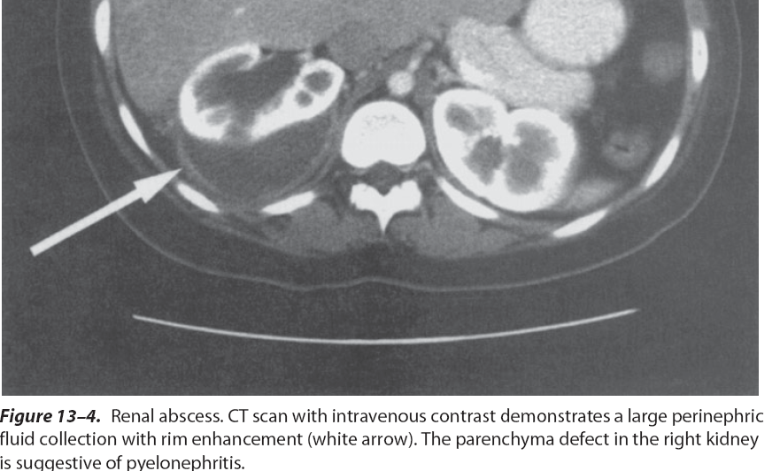
What's the management?
Crescent sign of perinephric abscess complicated from a pyelonephritis
Percutaneous drainage by wide bore for the thick pus

Slide 27
What's management?
Nephrectomy
Stage 5
Completely shuttered kidney
Multiple major laceration with devitalized tissue
Main renal vascular hemorrhage with uncontrolled hemorrhage
Hilar avulsion

Slide 28
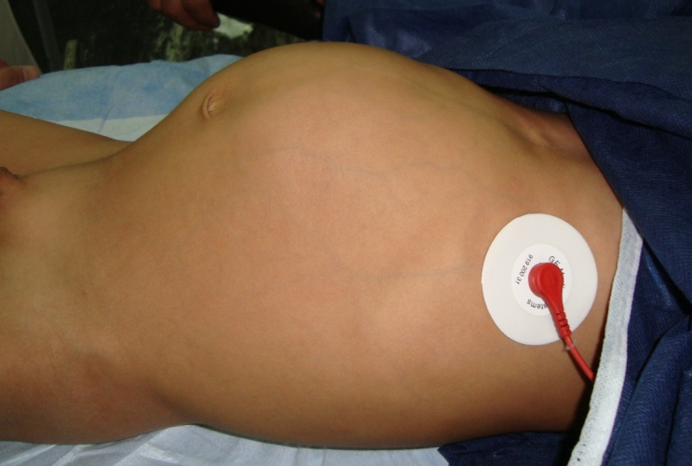
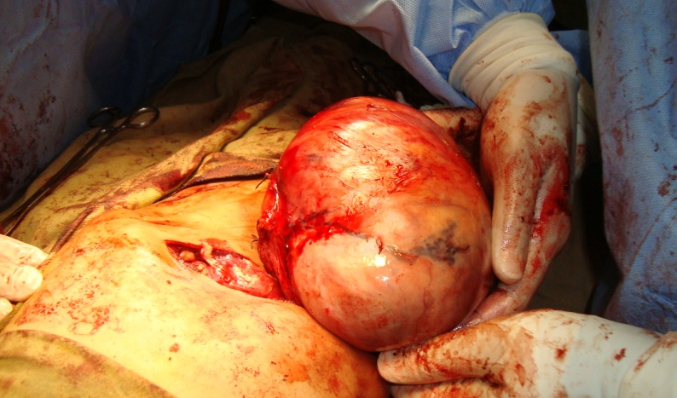
What's most common Cause?
Wilm's tumor

Slide 29
Hydrocele

Slide 30
Cryptochrdism surgery
Orchidopexy

Slide 31
Horseshoe kidney
With hydronephrosis

Slide 32
Different types of scalpel

Slide 33
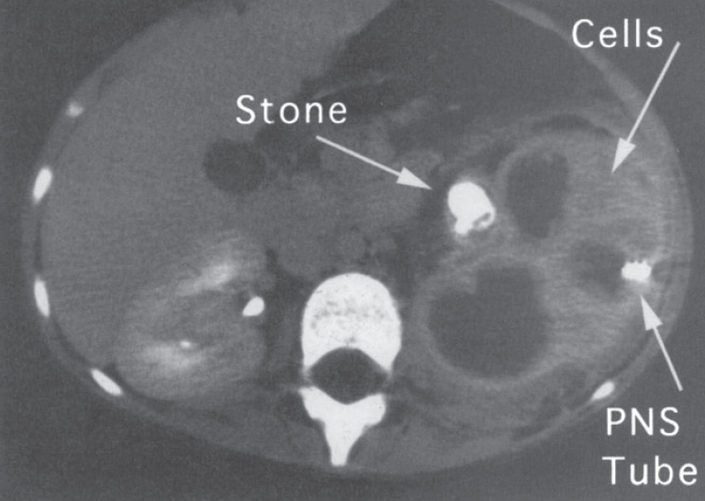

Slide 34
URETEROCELE

Slide 35
Ureteric hydronephrosis ??

Slide 36
Micropenis and microtestis

Slide 37
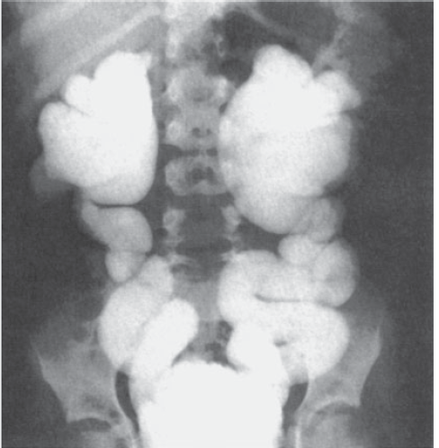
VUR/VCUG

Slide 38
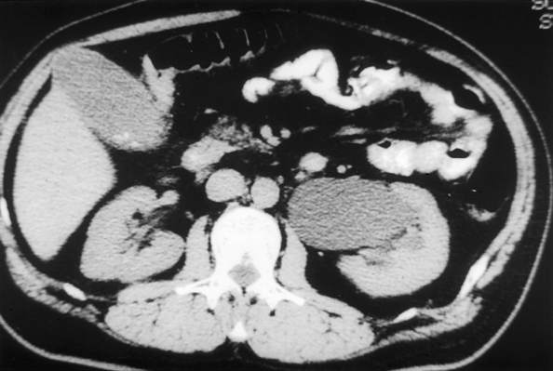
Ct scan
PUJ obst.

Slide 39
Post. Urethral valve with leaflets

Slide 40
Bladder exstrophy

Slide 41
Bladder diverticulum (in acquired outlet obst.)
US ???

Slide 42
Isolated penile chordee

Slide 43
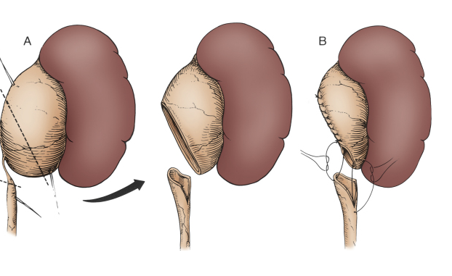
Surgical Technique of treating PUJ
Spatulation

Slide 44
What's abnormal finding?
Ct enhanced
Rt renal mass (RCC enhanced) needs radical nephrectomy

Slide 45
What this?

Slide 46
What's the imaging modality? What's the Diagnosis?
-KUB -JJ and kidney stone

Slide 47
What's the imaging modality? What's the Diagnosis?
Native Ct
right kidney stone

Slide 48
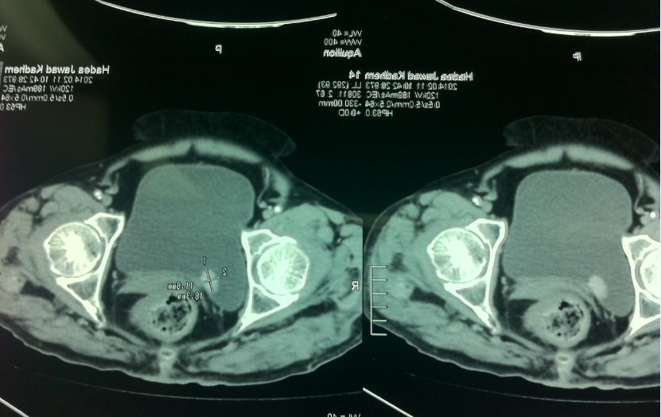
History of Hematuria bladder tumor (stageTa-T1)

Slide 49
What's the imaging study &Diagnosis? KUB : Rt. stone and lt. staghorn

Slide 50
What's the Diagnosis Rt. undescended testis with scrotal hemi hypoplasia

Slide 51
What's the imaging study &Diagnosis VUR grade 5 voiding cystourethrogram

Slide 52
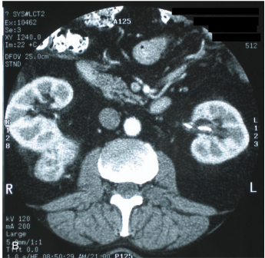
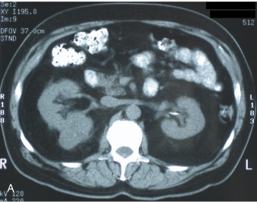
What's the imaging modality What's the diagnosis CT with and without contrast >>> Rt. kidney cancer(RCC)

Slide 53
What's the imaging modality? What's the Diagnosis? Ct >> مادري كنسر لو ولمز تيومر !

Slide 54
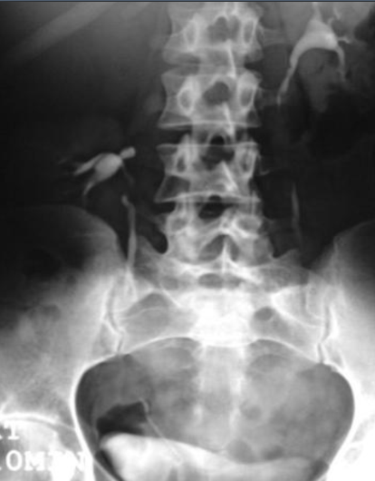
What's the imaging modality What's the diagnosis? Ectopic kidney IVU

Slide 55
What's This Procedure? PCN= percutaneous nephrostomy for staghorn and kidney stone

Slide 56
? What's the Diagnosis forigenier gangrene

Slide 57
What's this study and DX? IVU>>> normal IVU

Slide 58
Ca Prostate bone scan

Slide 59
What's this surgical procedure hydrocelectomy

Slide 60
Doppler study of scrotal Swelling

Slide 61
What's this procedure? Intruretral lithotripsy

Slide 62
Slide IVU ureter obst lead to calyceal dilatation

Slide 63
What's the imaging modality? What's the Diagnosis? Us >>> bladder mass

Slide 64
Ureter dilatation in left

Slide 65
What's the imaging modality? What's the Diagnosis? Us >>> stone with acoustic shadow in renal pelvis

Slide 66
What's the imaging modality? What's the Diagnosis? Ct >>> left kidney tumor

Slide 67
What's the Diagnosis? hypospadia

Slide 68
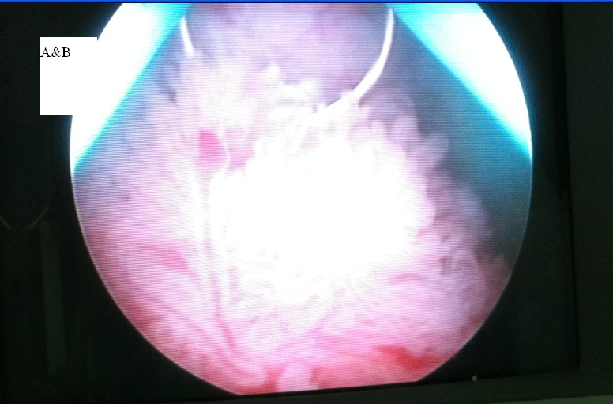
Slide NO.3 : 60 years old male presented with history of intermittent painless haematuria. What's: The Cystoscopic Findings bladder tumor

Slide 69
What's the Diagnosis ماعرف !يمكن بولي سستك

Slide 70
What's the imaging modality? What's the Diagnosis? Left kidney tumor

Slide 71
What's This Procedure? PCN

Slide 72
What's this surgical incision? ماعرف !

Slide 73
What's the imaging modality? What's the Diagnosis? Urethral stenosis with retrograde urethrography

Slide 74
What's the imaging modality? What's the Diagnosis? CT >>> lt kidney tumor

Slide 75
What's this Procedure? Rigid cystoscope

Slide 76
What's the imaging modality? What's the Diagnosis? Nephrostography refulx grade 5

Slide 77
Undescended testis
Neuropathic distended bladder
Study >>> retrograde cystourethrography

Slide 78
KUB show stone and calcification
Ct show bladder carcinoma stage 4

Slide 79
Hydrocele evacuation

