Slide 1
Dyslipidemia PHCL 442
Hadeel Al-Kofide

Slide 2
Topics to be covered today
Lipid metabolism
What is dyslipidemia?
Classification of dyslipidemia
Secondary causes of lipoprotein abnormalities
Rationale for treating dyslipidemia
Diagnosis
Risk assessment
Setting your Goals
Treatment modalities
Therapeutic life style changes
Drug therapy
Summary of the effect of drugs on lipid profile
Which agent to use for which patient?
Patient counseling

Slide 3
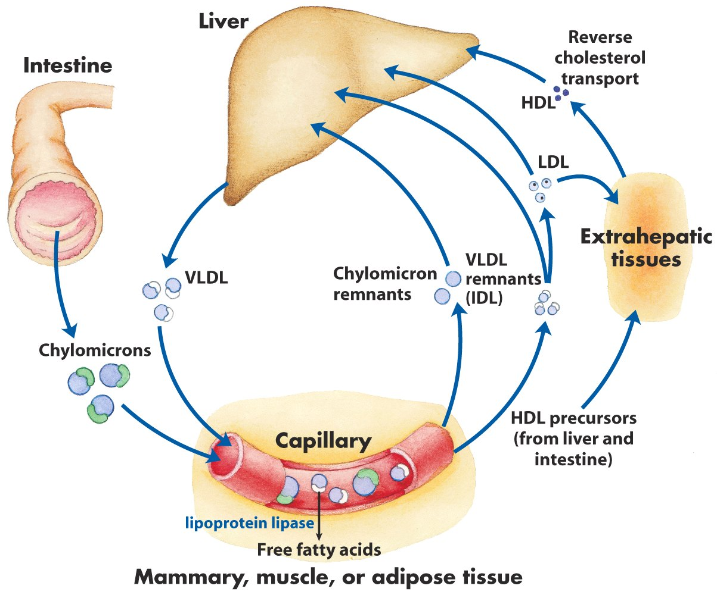
Lipid Metabolism
Cholesterol synthesis
Lipoproteins:
VLDL
LDL
HDL
Chylomicrons
Apolipoproteins
LDL receptor

Slide 4
What is Dyslipidemia?
Dyslipidemias are disorders of lipoprotein metabolism
Including lipoprotein overproduction & deficiency
They may manifest as one or more of the following: Elevated total cholesterol, low-density lipoprotein cholesterol (LDL), & triglyceride levels or as decreased high-density lipoprotein cholesterol (HDL) level

Slide 5
Classification of Dyslipidemia

Slide 6
Fredrickson Classification
Type | Elevated particles | Associated clinical disorders | Serum TC | Serum TG
I | Chylomicrons | Lipoprotein lipase deficiency, apolipoprotein C-II deficiency | ↔ | ↑↑
IIa | LDL | Familial hypercholesterolemia, polygenic hypercholeterolemia, nephrosis, hypothyroidism, familial combined hyperlipidemia | ↑↑ | ↔
IIb | LDL, VLDL | Familial combined hyperlipidemia | ↑↑ | ↑

Slide 7
Fredrickson Classification
Type | Elevated particles | Associated clinical disorders | Serum TC | Serum TG
III | IDL | Dysbetalipoproteinemia | ↑ | ↑
IV | VLDL | Familial hypertriglyceridemia, familial combined hyperlipidemia, sporadic hypertriglyceridemia, diabetes | ↔↑ | ↑↑
V | Chylomicrons, VLDL | Diabetes | ↑ | ↑↑

Slide 8
Secondary Causes of Lipoprotein Abnormalities
Hypercholesterolemia
Hypothyroidism; Obstructive liver disease; Nephrotic syndrome; Drugs: progestogens, cyclosporine, thiazides
Hypertriglyceridemia
Obesity, DM, Pregnancy, CRF, Alcohol, Stress, Sepsis, Acute hepatitis, SLE, Drugs: estrogen, β-blockers, steroids, acid resins, thiazides
Low HDL
Type-2 DM, Rheumatoid arthritis, Malnutrition, Obesity, Cigarette smoking, Beta blockers

Slide 9
Rationale for Treating Dyslipidemia
Pathogenesis of atherosclerosis
Epidemiological studies
Clinical trials
LDL cholesterol as a primary target of therapy

Slide 10
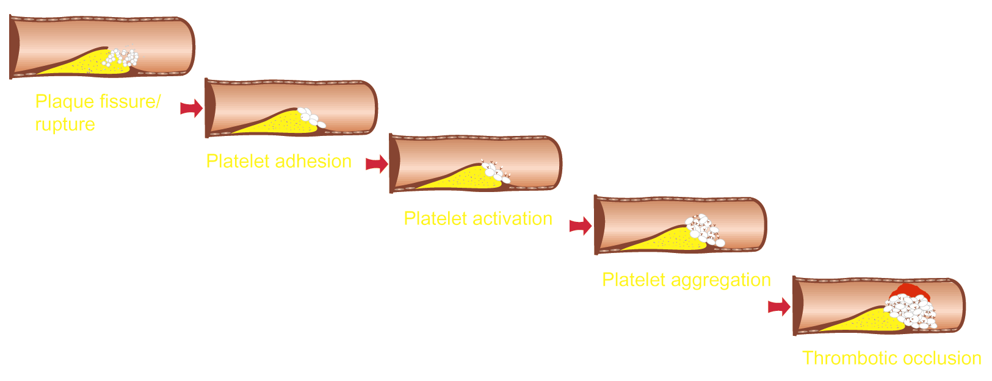
Pathogenesis of Atherosclerosis
Rationale for Treating Dyslipidemia

Slide 11
Epidemiological Studies
Rationale for Treating Dyslipidemia
For every 1% increase in cholesterol level there is 1-2% increase in the incidence of CHD
There is a gender difference in relation to age: male at higher risk in 50-60s while female in 60s-70s
CHD cause death in female more than all cancer combined

Slide 12
Clinical Trials
Rationale for Treating Dyslipidemia
Trial | Intervention | Initial LDL | Change in LDL | CHD event reduction
CHD & CHD risk equivalent
4S | Simvastatin | 188-117 | ↓ 35% | ↓ 34%
LIPID | Pravastatin | 150-112 | ↓ 25% | ↓ 24%
CARE | Pravastatin | 139-98 | ↓ 32% | ↓ 24%
Post-CABG | Lovastatin/Resin | 136-98 | ↓ 39% | ↓ 24%

Slide 13
Clinical Trials
Rationale for Treating Dyslipidemia
Trial | Intervention | Initial LDL | Change in LDL | CHD event reduction
Acute coronary syndrome patients
MIRACL | Atorvastatin | 124-72 | ↓ 42% | ↓ 26%
AVERT | Atorvastatin | 145-77 | ↓ 42% | ↓ 36%

Slide 14
Clinical Trials
Rationale for Treating Dyslipidemia
Trial | Intervention | Initial LDL | Change in LDL | CHD event reduction
Patients without evidence of CHD
LRC-CPPT | Resin | 205-175 | ↓ 15% | ↓ 19%
WOSCOPS | Pravastatin | 192-142 | ↓ 26% | ↓ 31%
Tex/AFCAPS | Lovastatin | 150-115 | ↓ 25% | ↓ 40%
ASCOT | Atorvastatin | 132-85 | ↓ 31% | ↓ 50%

Slide 15
LDL as a Primary Target of Therapy
Rationale for Treating Dyslipidemia
Epidemiological studies supported that the increase in LDL is associated with increase in CHD
Studies showed that it is the most abundant & clearly evident atherogenic lipoprotein
The ultimate proof was in in clinical trials

Slide 16
Diagnosis

Slide 17
Classification of Lipid Levels
Diagnosis
Total cholesterol mg/dl |  | LDL cholesterol mg/dl
< 200 | Desirable | < 100 | Optimal
200-239 | Border line high | 100-129 | Near optima/Above optimal
≥ 240 | High | 130-159 | Borderline high
 |  | 160-189 | High
 |  | ≥ 190 | Very high
NCEP ATP III Classification of Blood Lipids

Slide 18
Classification of Lipid Levels
Diagnosis
Triglycerides mg/dl |  | HDL cholesterol mg/dl
< 150 | Normal | < 40 | Low
150-199 | Border line high
200-400 | High | ≥ 60 | High
≥ 500 | Very high
NCEP ATP III Classification of Blood Lipids

Slide 19
How to Calculate LDL Cholesterol?
Diagnosis
HDL & TGs are measured directly in the lab
LDL can be calculated using a specific equation
If TG is > 400 mg/dl then this formula is not accurate & LDL must be measured directly in the lab
LDL-C = Total Cholesterol – (HDL-C + TG/5)

Slide 20
Risk Assessment

Slide 21
Non Lipid Risk Factors for CHD
Risk Assessment
Modifiable Risk Factors | Non Modifiable Risk Factors
Hypertension | Age
Cigarette smoking | Male
Thrombogenic/ hemostatic state | Family history of premature CHD
Diabetes
Obesity
Physical inactivity
Atherogenic Diet

Slide 22
How to Assess Risk?
Risk Assessment
Why is it important?
The decision on how aggressive to treat depends on the assessment of global CHD risk
How?

Slide 23
How to Assess Risk?
Risk Assessment
Assess risk factors:
CHD or CHD risk equivalent (regardless of number of risk factors) using NCEP ATP III definition of CHD & CHD risk equivalent
≥ 2 risk factors with no CHD & no CHD risk equivalent using NECP ATP III major risk factors that modify LDL goals
If ≥ 2 risk factors & no CHD or CHD risk equivalent:
Assess global CHD risk by Framingham Point Score

Slide 24
CHD & CHD Risk Equivalent
Risk Assessment
Clinical CHD | Carotid artery disease | Peripheral arterial disease | Abnormal aortic aneurysm | DM
Myocardial ischemia (angina) | Stroke history | Claudication | Present | Present
Myocardial infarction | Transient ischemic attack history | ABI > 0.9
Coronary angiography &/or stent replacement | Carotid stenosis > 50%
CABG
Prior unstable angina
Any of these present?
Yes -------------------------------------------- CHD or CHD risk equivalent
No ----- See if the patient has major risk factors that modify LDL goals
NCEP ATP III Definition of CHD & CHD Risk Equivalent

Slide 25
Major Risk Factors That Modify LDL Goals
Risk Assessment
Positive risk factors (↑ risk) | Negative risk factors (↓ risk)
Age: Male ≥ 45 yr Female ≥ 55 yr | High HDL (≥ 60 mg/dl)
Family history of premature CHD (definite MI or sudden death before 55 yr in father or other male first degree relative OR before 65 yr in mother or other female relative)
Current cigarette smoking
Hypertension (≥ 140/90 mm Hg or on antihypertensive drugs)
Low HDL (< 40 mg/dl)
Check if your patient has ≥ 2 risk factors
NCEP ATP III Major Risk Factors That Modify LDL Goals

Slide 26
Framingham Point Score
Risk Assessment
When to use it?
If the patient has CHD or CHD risk equivalent
≥ 2 risk factors & no CHD or CHD risk equivalent
< 2 risk factors
NO
Yes
NO

Slide 27
Framingham Point Score
Risk Assessment
It defines the 10 year risk of developing CHD
Framingham Point Score Male
Framingham Point Score Female

Slide 28
So… How to Assess?!
Risk Assessment
Your patient must fall in one of 3 categories:
If the patient has CHD or CHD risk equivalent
≥ 2 risk factors & no CHD or CHD risk equivalent
< 2 risk factors
No need to use Framingham score because these patients already have ≥ 20% risk of CHD in 10 years without any calculation
Use to Framingham score to assess their 10 year risk
No need to use Framingham score because they already have low risk for CHD

Slide 29
Now Chose your Goals of Therapy

Slide 30
LDL Goals & Cut Points for TLC & Drug Therapy
Risk Category | LDL Goal | LDL at which to initiate TLC | LDL at which to consider drug therapy
CHD or CHD risk equivalent (10 yr risk > 20%) | < 100 | ≥ 100 | ≥ 130 (100-129, drug is optional)
≥ 2 risk factors (10 yr risk ≤ 20%) | < 130 | ≥ 130 | With 10 yr risk 10-20% ≥ 130 With 10 yr risk ≤ 10% ≥ 160
< 2 risk factors | < 160 | ≥ 160 | 190 (160-189, drug therapy is optional)
TLC = Therapeutic Life Style Changes

Slide 31
Treatment Modalities

Slide 32
Treatment Modalities
Therapeutic Life Style Changes (TLC)
Drug Therapy

Slide 33
Therapeutic Life Style Changes
Nutrient | Recommended intake
Total fat | 25-35% of total calories
Saturated fate | < 7% of total calories
Polyunsaturated fat | Up to 10% of total calories
Monounsaturated fat | Up to 20% of total calories
Carbohydrates | 50-60% of total calories
Fiber | 20-30 g/day
Cholesterol | < 200 mg/day
Protein | 15% of total calories

Slide 34
Therapeutic Life Style Changes
When restricting saturated fat by < 10% of calories blood cholesterol reduces by 3-14%
Response to diet is variable
Patients who adhere to a low fat diet also response to a lower doses of lipid-lowering drugs

Slide 35
Therapeutic Life Style Changes
Other life style changes include:
Weight reduction specially in overweight patients (reduce 10% in the first 6 months)
Increase physical activity
Smoking cessation

Slide 36
Drug Therapy for Dyslipidemia
Bile acid resins
Ezetimibe
Niacin
Statins
Fibric acid derivatives
Fish oil
Postmenopausal drug therapy

Slide 37
Bile Acid Resins
Drug Therapy
Bile acid sequestrants: cholestyramine, colestipol, colesevelam
Available as powder & tablet
Reduces LDL by 15-18%
Advantage: a strong safety record (not absorbed from GI so lack of systemic toxicity)
Disadvantages: unpleasant granulated texture of powder old resins
New resins (colesvelam) less GI side effects, present as tablet but large

Slide 38
Bile Acid Resins
Drug Therapy
Mechanism of action:
They bind bile acids in the intestine through anion exchange; this reduces the enterohepatic recirculation of bile acids, which releases feedback regulation on conversion of cholesterol to bile acids in the liver
The resulting decrease in hepatocyte cholesterol content enhances LDL-receptor expression, which in turn lowers serum LDL-cholesterol concentrations

Slide 39
Bile Acid Resins
Drug Therapy
Adverse effects:
GI: constipation, bloating, epigastric fullness, nausea & flatulence (specially with old ones)
Increase TGs (old resins)
To overcome GI s.e: mix resin powder in noncarbonated pulpy juice, swallow it without engulfing air (use straw) & maintain adequate intake of fluid & fiber in diet

Slide 40
Bile Acid Resins
Drug Therapy
Drug interactions:
GI binding can reduce absorption of anionic drugs (warfarin, thyroxin, digitoxin, beta-blockers & thiazide diuretics)
Can reduce this drug interactions by administration 1 hour before or 4 hours after the resin
Colesevelam have higher specificity to binding to bile acid so less drug interactions

Slide 41
Ezetimibe
Drug Therapy
Cholesterol absorption inhibitor
New agent, came to the market at 2003
It reduces LDL by 18-22%
Little effect on TG or HDL
LDL effect enhanced when adding a statin by 10-20%
It has the advantage of minimum systemic absorption

Slide 42
Ezetimibe
Drug Therapy
Mechanism of action:
It interferes with the active absorption of cholesterol from the intestininal lumen into the enterocyte
About 50% less cholesterol is transported from intestine to the liver, leading to reduction in hepatic cholesterol stores & increase in the clearance of cholesterol from the blood

Slide 43
Ezetimibe
Drug Therapy
Adverse effects:
Diahhrea, arthralgia, cough & fatigue

Slide 44
Niacin
Drug Therapy
Water soluble B vitamin that improves all lipids
Has been used for a long time
Comes in 3 forms:
Immediate release crystalline form: Causes flushing
Sustained release: less flushing but maximum dose 2 gm to prevent liver toxicity
Extended release: New drug, Niaspan is extended release formula better than other forms due to less side effects

Slide 45
Niacin
Drug Therapy
Decreases LDL by 15-25%
Decreases TGs by 30-40%
Increases HDL by 20-30%
The strongest in increasing HDL
Also useful in hypertriglyceridemia

Slide 46
Niacin
Drug Therapy
Mechanism of action:
Inhibit the mobilization of free fatty acids from peripheral adipose tissue to the liver which reduces synthesis & secretion of VLDL particles by the liver
Because LDL is a product of VLDL degradation reducing VLDL will reduce LDL

Slide 47
Niacin
Drug Therapy
Adverse effects:
Flushing & headache: with immediate release, can be reduced by giving aspirin
Increase blood glucose by 10-20%
Hepatotoxicity: sustained release formulation, defined as 3 times the upper limit of liver enzymes & could be associated with symptoms as fatigue, anorexia, malaise & nausea
Niasepam: is the best, less flushing but more GI effects like nausea, dyspepsia & activation of peptic ulcer, can reduce these side effect if given with food. Less hepatic toxicity in doses ≤ 2gm/day

Slide 48
Statins
Drug Therapy
HMG-CoA reductase inhibitors
Most potent cholesterol lowering drugs
6 different agents:
Rosuvastatin
Atorvastatin
Simvastatin
Lovastatin
Pravastatin
Fluvastatin
They are all powerful in decreasing LDL levels but some have greater effect on LDL than others

Slide 49
Statins
Drug Therapy
Agent | Dose (mg) | LDL lowering (↓)
Atorvastatin | 10 | 39%
 | 20 | 43%
 | 40 | 50%
 | 80 | 60%
Rosuvastatin | 10 | 46%
 | 20 | 52%
 | 40 | 55%
 | 5 | 26%
Simvastatin | 10 | 30%
 | 20 | 38%
 | 40 | 41%
 | 80 | 47%
↑ dose
↑ LDL lowering effect

Slide 50
Statins
Drug Therapy
Mechanism of actions:
Statins act by inhibiting the enzyme HMG-CoA reductase, the enzyme controlling the first committed step of cholesterol synthesis in the liver
Reducing hepatocellular cholesterol promotes an up-regulation of LDL receptors & increases LDL clearance
They reduce TGs by reducing secretion of VLDL particles & increase clearance of VLDL

Slide 51
Statins
Drug Therapy
Adverse effects:
Headache
Myalgias (with no CPK changes)
GI symptoms: dyspepsia, constipations & abdominal pain
These adverse effects reduced with continued therapy

Slide 52
Statins
Drug Therapy
Adverse effects:
Hepatotoxicity:
Increases liver enzymes 3 times the upper normal limit in 1-1.5% of patients in a dose dependent manner
Levels may return to normal whether DC or if still on therapy
Rechallenge, how?

Slide 53
Statins
Drug Therapy
Adverse effects:
Muscle toxicity (myositis):
Increases CPK > 10 times upper normal limit with the presence of muscle aches, soreness or weakness (myalgia)
Happens in 0.1-1% of patients in a dose dependent manner
Does not require routine monitoring but if symptoms occur check CPK
Once occur, DC then after symptoms subside start with a different statin
Rarely causes rhabdomyolysis

Slide 54
Statins
Drug Therapy
Drug interactions:
With gemfibrozil increase risk of rhabdomyolysis
Increase muscular toxicity with drugs that compete or inhibit CYP450 3A4 system (cyclosporine, erythromycin, calcium blockers, niacin, ketoconazole)
What to do when using these drugs?
Lovastatin & rosuvastatin may prolong bleeding time with warfarin

Slide 55
Statins
Drug Therapy
Contraindications:
Active liver disease
Patient pregnant or planning to get pregnant

Slide 56
Fibric Acid Derivatives
Drug Therapy
Fibrates: gemfibrozil & fenofibrate
Agent of choice in hypertriglyceridemia
Decrease TG by 20-50%
Increase HDL by 10-15%
Decreases LDL by 10-25%
In patients with combined hyperlipidemia gemfibrozil may increase LDL, while fenofibrate may not increase but has lower effect in LDL reduction (around 10% only)

Slide 57
Fibric Acid Derivatives
Drug Therapy
Mechanism of action:
Increases activity of Peroxisome proliferator-activated receptor-alpha (PPARα), a receptor which is involved in metabolism of carbohydrates & fats, as well as adipose tissue differentiation
This increases synthesis of lipoprotein lipase therefore increasing clearance of triglycerides

Slide 58
Fibric Acid Derivatives
Drug Therapy
Adverse effects:
GI symptoms like nausea, dyspepsia & abdominal pain
Myositis & rhabdomyolysis: more common with gemfibrozil specially combination with statins
Gallstones

Slide 59
Fish Oils
Drug Therapy
It contains polyunsaturated (omega-3) fatty acids
It lowers TG levels by 30-60%
Little value in LDL reduction
Supplemental fish oils have been demonstrated by clinical trials to reduce CHD events
Most useful in patients with hypertriglyceridemia not adequately controlled by drugs (niacin & fibrates)

Slide 60
Postmenopausal Drug Therapy
Drug Therapy
Postmenopausal women have increased risk of CHD
Estrogen is known to improve lipid & liporprotein profile
Due to high incidence of side effects (Thromboembolism, breast cancer) they are not recommended for treatment of dyslipidemia in postmenopausal women
These women are candidate for previous modalities for lowering lipid level

Slide 61
Summary of the Effect of Drugs on Lipid Profile
Drug | LDL | HDL | TG
Resin | ↓ 15-30% | ± 3% | ↑ 3-10%
Ezitimibe | ↓ 18-22% | ↑ 0-2% | ↓ 0-5%
Niacin | ↓ 15-30% | ↑ 20-35% | ↓ 30-60%
Statin | ↓ 25-60% | ↑ 5-15% | ↓ 10-45%
Fibrates | ± 10-25% | ↑ 10-30% | ↓ 30-60%

Slide 62
What Agent(s) for What Patient?

Slide 63
Drugs of Choice for Dyslipidemia
According to clinical trials & guidelines Statins are the most effective treatment for high LDL levels
Elevated LDL cholesterol value:
Drug of choice: Statin
Alternative therapy: Niacin, resins or ezetimibe
Combination: statin + niacin; statin + ezetimibe; or statin + resin
If patients can not tolerate statins, or used statin but with no effect (rare)
If patients did not achieve goal of LDL with maximum statin dose

Slide 64
Drugs of Choice for Dyslipidemia
It decreases LDL & TG but require higher doses for TG
Elevated LDL & TG values:
Drug of choice: Statin
Combination: statin + niacin; statin + ezetimibe; or statin + resin
For many patients with mixed hyperlipidemia can use a moderate dose of statin (to avoid side effects of higher doses) with combination of either niacin, resin, ezetimibe or fibrates

Slide 65
Drugs of Choice for Dyslipidemia
Normal LDL value but Low HDL:
Drug of choice: Niacin or fibrates
If patient have normal LDL OR patient within LDL goal on statin therapy but still HDL high add niacin or fibrates

Slide 66
Drugs of Choice for Dyslipidemia
Elevated TGs value:
Drug of choice: Fibrates & niacin
Can add fish oil
If only TG level is high

Slide 67
Patient Instructions & Counseling
Statins
Usually administered in the evening because most hepatic cholesterol production occurs during the night
Atorvastatin may be given any time of the day because of its longer half-life
You may take this medicine with or without food

Slide 68
Patient Instructions & Counseling
Bile acid resisn:
Cholestyramin: take it with the largest meal
Titrate dose slowly to avoid GI side effect
The powder cannot be used in dry form. It can be mixed with water, fruit juice, milk, & with food such as thin soup or with milk in breakfast cereal until completely dissolved. The patient must drink this mixture right away
Counsel patient to rinse the glass with liquid to ensure ingestion of all resin
Increase fluid intake
Dose other drugs 1 hour before or 4 hours after resin

Slide 69
Patient Instructions & Counseling
Fibrates:
Gemfibrozil should be taken twice daily 30 minutes before meals
Fenofibrate can be taken with food once daily
Monitor muscle toxicity, especially when used with statins

Slide 70
Thank you

