Slide 1

Neonatal Examination
Done By :
Jaafar Sedqi
Aya Nazar
Dima Amir
Raheeq Abdul Hadi
Supervision
Dr.Numan

Slide 2
The Newborn Examination

Slide 3
Learning Objectives
    Classification of newborn
    Estimate the gestational age
    Understand Apgar score
    Assess vital signs
    General Examination
    Physical examination
    Neurological examination

Slide 4
Classification of newborn
  Classification by Gestational Age
  Preterm <37 wks
Full term 37-42
Postterm >42 Wks
Classification By Birth Weight
Low Birth Weight < 2500 g
Very Low birth weight < 1500 g
Extreme low birth weight < 1000 g

Slide 5
Classification
Classification By Weight Percentiles
    AGA 10th-90th percentile for GA
    SGA < 10th percentile for GA
    LGA >90th percentile for GA

Slide 6
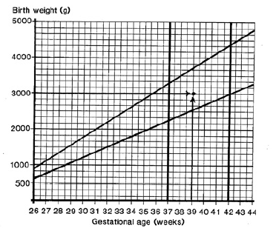
Weight for Gestational Age Chart
Acta Paediatr Scand Suppl 1985; 31: 180.

Slide 7
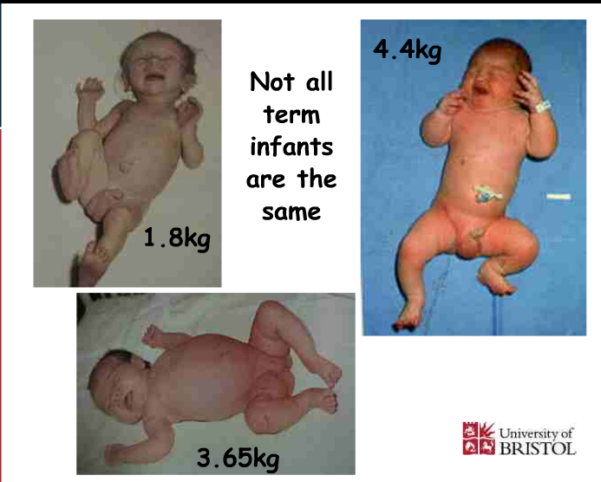

Slide 8
Estimation of
gestational age

Slide 9
Gestational Age Assessment
Obstetricians
- LMP
- Ultrasound
New Ballard score

Slide 10
Gestational Age Assessment
New Ballard Score
- Performed within 12-24 hours
- Neuromuscular maturity (6)
- Physical maturity (6)
Ballard JL, et al. J Pediatrics; 1991: 119 (3)

Slide 11
Ballard Score
External Characteristics
      Edema
      Skin texture, color, and opacity
      Lanugo
      Plantar creases
      Nipples and breasts
      Ear form and firmness
      Genitals
Neuromuscular Score
      Posture
      Square Window
      Arm recoil
      Popliteal angle
      Scarf sign
      Heel to ear

Slide 12
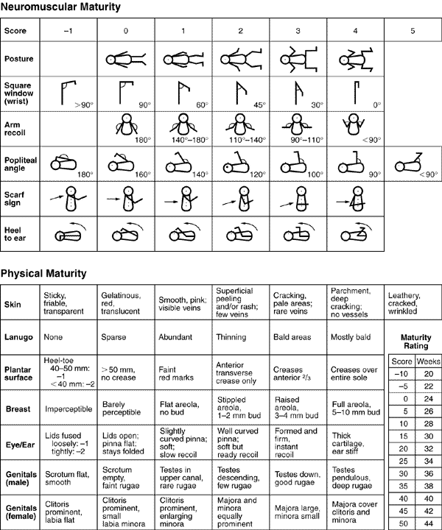
New Ballard Score
Ballard JL, et al. J Pediatrics; 1991: 119 (3)

Slide 13
Small for Gestational Age
0
Symmetric
  HC, length, weight all <10 percentile
  33% of SGA infants
  Cause: Infection, chromosomal abnormalities, inborn errors of metabolism, smoking, drugs
Asymmetric
  Weight <10 percentile, HC and length normal
  55% of SGA infants
  Cause: Uteroplacental insufficiency, Chronic hypertension or disease, Preeclampsia, Hemoglobinopathies, altitude, Placental infarcts or chronic abruption
Combined
  Symmetric or asymmetric
  12% of SGA infants
  Cause: Smoking, drugs, Placental infarcts or chronic abruption, velamentous insertion, circumvallate placenta, multiple gestation

Slide 14
Large for Gestational Age
0
Etiologies
  Infants of diabetic mothers
  Beckwith-Wiedemann Syndrome
    characterized by macroglossia, visceromegaly, macrosomia, umbilical hernia or omphalocele, and neonatal hypoglycemia
  Hydrops fetalis
  Large mother

Slide 15
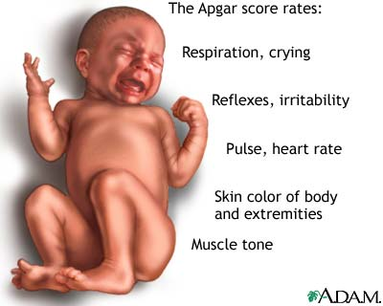
APGAR Score
0
Score | 0 | 1 | 2
Heart Rate | Absent | <100bpm | >100bpm
Respiratory effort | Absent, irregular | Slow, crying | Good
Muscle tone | Limp | Some flexion of extremities | Active motion
Reflex irritability (nose suction) | No response | Grimace | Cough or sneeze
Color | Blue, pale | Acrocyanosis | Completely pink

Slide 16
Apgar Score
Assess the physical condition of newborns after delivery at 1,5 m and every 5 m.until its value is > 7
A value > 7 indicate the baby’s condition is good to excellent
A value less than 4 necessitate continued resuscitation
Apgar score is a good predictor of survival but using it to predict long-term outcome is inappropriate

Slide 17
Vital signs
Temperature
Heart rate
Respiratory rate
Blood pressure
Capillary refill time

Slide 18
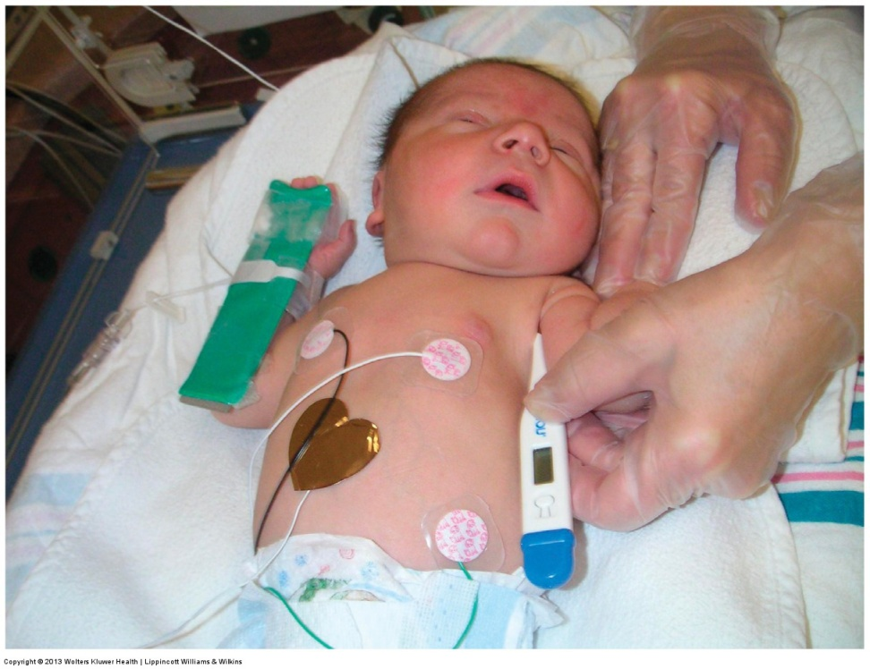
1.Temperature
Temperature should be taken axillary
The normal temperature for infant is 36.5- 37-5⁰C.
Axillary temp.is 0.5-1 0c lower than rectal

Slide 19
2- Heart rate
It should be obtained by auscultation and counted for a full minute
Normal heart rate is 120-160 beat /m.
If the infant is tachycardic (heart rate >170 BPM), make sure the infant is not crying or moving vigorously

Slide 20
3. Respiratory rate
Normal respiratory rate is 40 –60/minute
Respiratory rate should be obtained by observation for one full minute
Newborns have periodic rather than regular breathing

Slide 21
4. Blood pressure
It is not measured routinely
Normal blood pressure varies with gestational and postnatal ages

Slide 22
5. Capillary refill time
Normally < 3 seconds over the trunk
May be as long as 4 seconds on extremities
Delayed capillary refill time indicates poor perfusion

Slide 23

GENERAL EXAMINATION

Slide 24
Skin
General description:
At birth;
Color: bright red,
Texture: soft and has good elasticity.
Edema is seen around eye, face, and scrotum or labia.
Cyanosis of hands & feet (acrocyanosis)

Slide 25
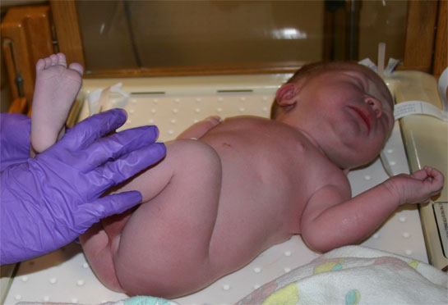
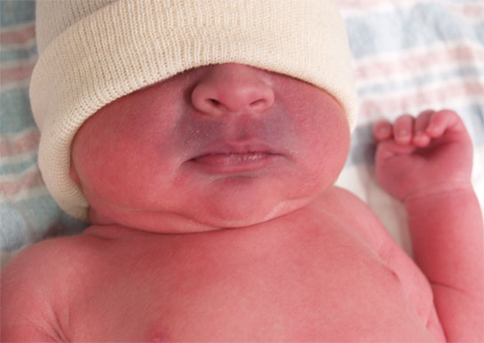
General description of the skin

Slide 26
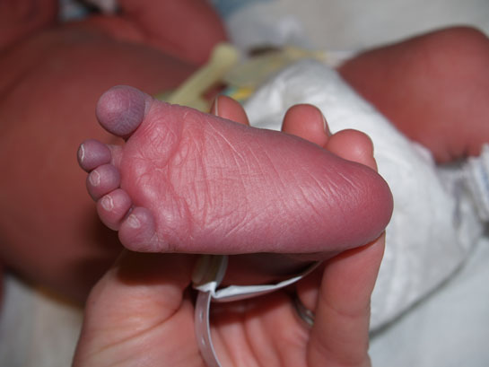
Acrocyanosis

Slide 27
1.Vernix Caseosa
Soft yellowish cream layer that may thickly cover the skin of the newborn, or it may be found only in the body creases and between the labia.
The debate of wash it off or to keep it.

Slide 28
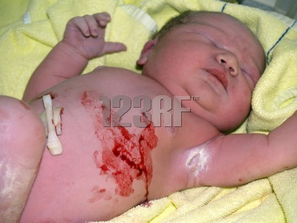
Vernix Caseosa

Slide 29
2. Lanugo hair
Distribution
- The more premature baby is, the heavier the presence of lanugo is.
- It disappears during the first weeks of life

Slide 30
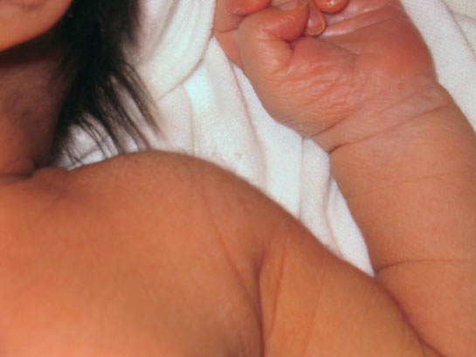
Lanugo hair

Slide 31
3. Mongolian spots
Black coloration on the lower back, buttocks, anterior trunk, & around the wrist or ankle.
They are not bruise marks or a sign of mental retardation, they usually disappear during preschool years without any treatment.

Slide 32
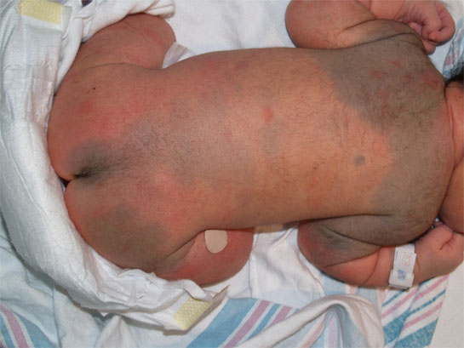
Mongolian spots

Slide 33
4. Desquamation
Peeling of the skin over the areas of bony prominence that occurs within 2-4 weeks of life because of pressure and erosion of sheets.

Slide 34
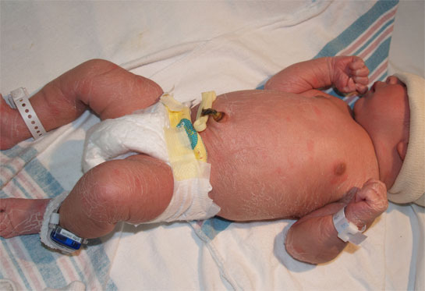
Desquamation

Slide 35
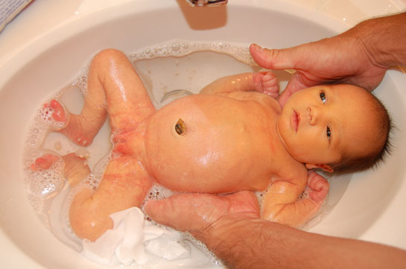
5. Physiological Jaundice

Slide 36
6. Milia
Small white or yellow pinpoint spots.
Common on the nose, forehead, & chin of the newborn infants due to accumulations of secretions from the sweat & sebaceous glands that have not yet drain normally.
They will disappear within 1-2 weeks, they should not expressed.

Slide 37
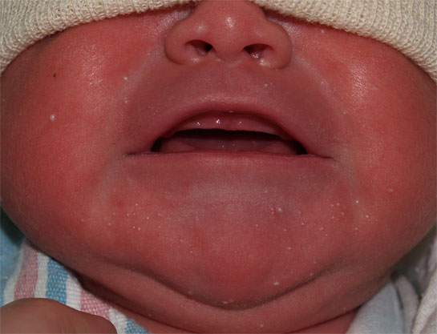
Milia

Slide 38
7. Head
The Anterior fontanel: is diamond in shape, located at the junction of 2 parietal & frontal bones. It is 2-3 cm in width & 3-4 cm in length. It closes between 12-18 months of age.
The posterior fontanel: is triangular in shape, located between the parietal &

Slide 39
occipital bones. It closes by the 2nd month of age
Fontanels should be flat, soft, & firm. It bulge when the baby cries or if there is increased in ICP. Two conditions may appear in the head:
Caput succedaneum & Cephlhemtoma

Slide 40
Caput succedaneum
An edematous swelling on the presenting portion of the scalp of an infant during birth, caused by the pressure of the presenting part against the dilating cervix. The effusion overlies the periosteum with poorly defined margins.

Slide 41
Caput succedaneum
Caput succedaneum extends across the midline and over suture lines. Caput succedaneum does not usually cause complications and usually resolves over the first few days. Management consists of observation only.

Slide 42
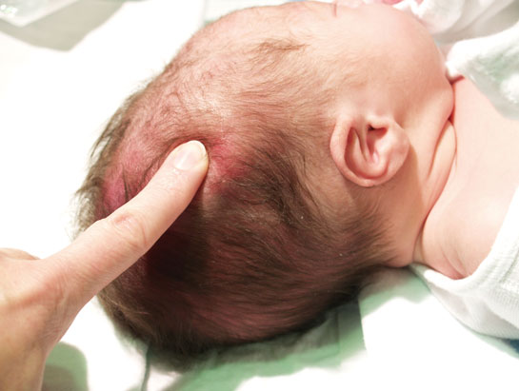
Caput succedaneum

Slide 43
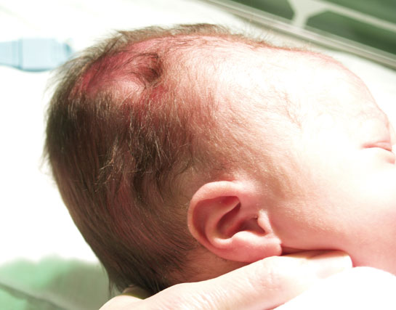
Caput succedaneum

Slide 44
Cephalhematoma
Cephalhematoma is a subperiosteal collection of blood secondary to rupture of blood vessels between the skull and the periosteum, in which bleeding is limited by suture lines (never cross the suture lines).

Slide 45
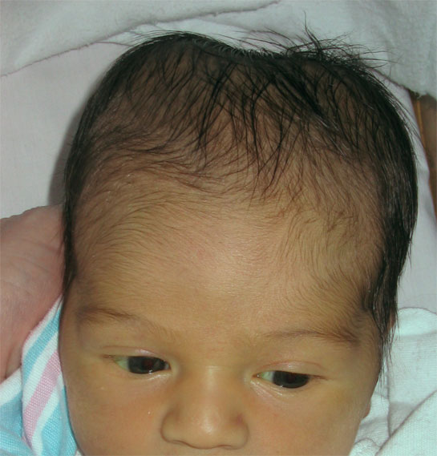
Cephalhematoma

Slide 46
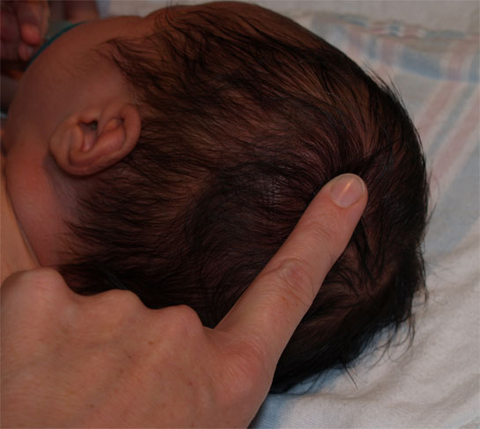
Cephalhematoma

Slide 47
Anterior and posterior fontanelle
Large anterior fontanelle is seen in
hypothyroidism,osteogenesisimperfecta,hydrocephalus
Small ant.fontanelle in microcephaly and craniostenosis
Bulging ant. fontanelle in menigitis and hydrocephalus Intracranial hemorrhage
Depressed ant.fontanelle in dehydration
Large post.fontanelle :suspicious of hypothyroidism

Slide 48
8. Eyes
Usually edematous eye lids
- Gray in color. True color is not determined until the age of 3-6 months.
- Pupil: React to light
- Absence of tears
- Blinking reflex is present in response to touch
- Can not follow an object (Rudimentary fixation on objects).

Slide 49
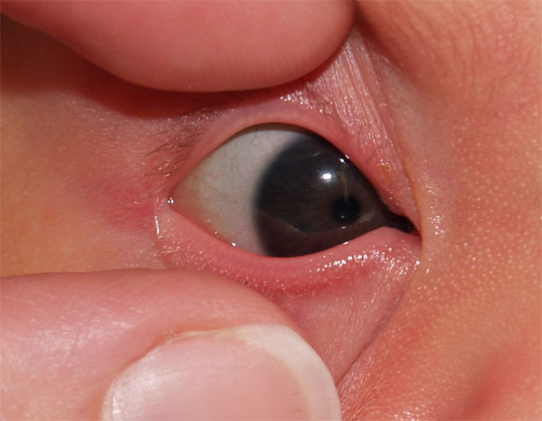
Normal Eye

Slide 50
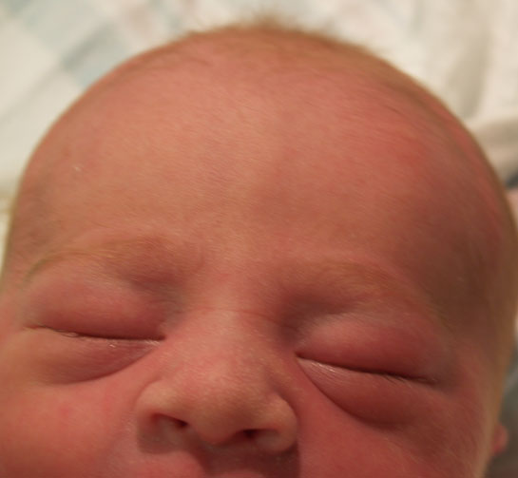
Eyelid Edema

Slide 51
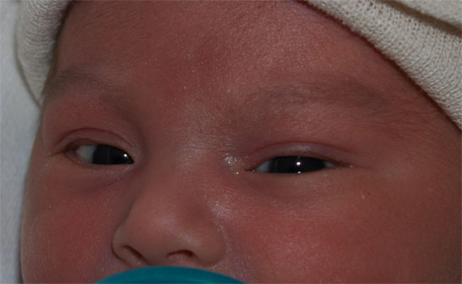
Dysconjugate Eye Movements

Slide 52
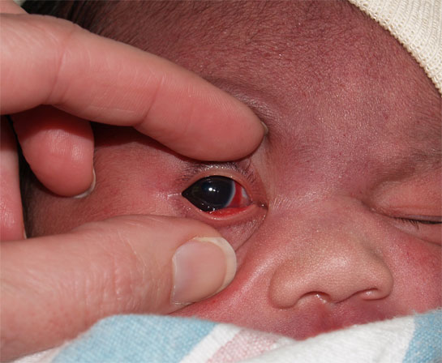
Subconjunctival Hemorrhage

Slide 53
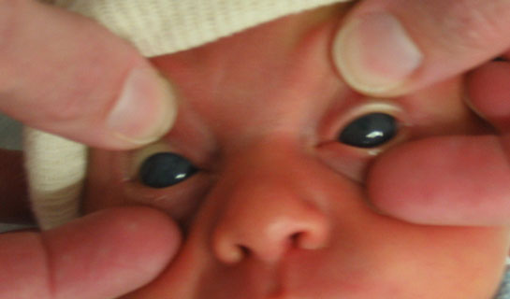
Congenital Glaucoma

Slide 54
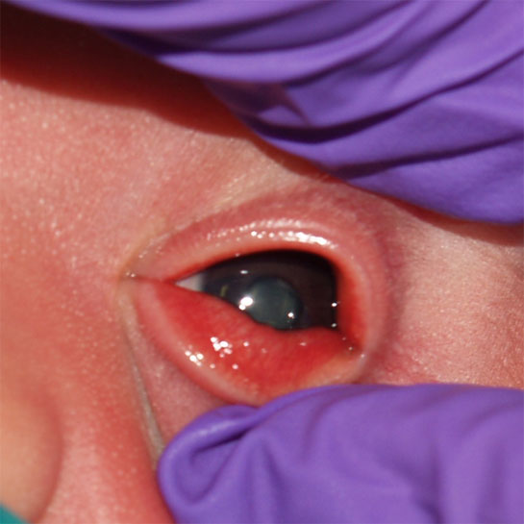
Congenital Cataracts

Slide 55
9. Ears
Position: In the normal newborn the top of the ear should be parallel to the outer and inner canthus
of the eye
Startle Reflex:
Pinna flexible, cartilage present.

Slide 56
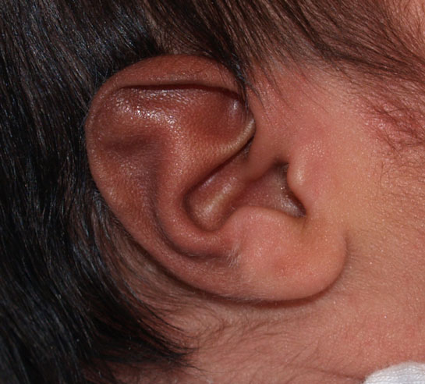
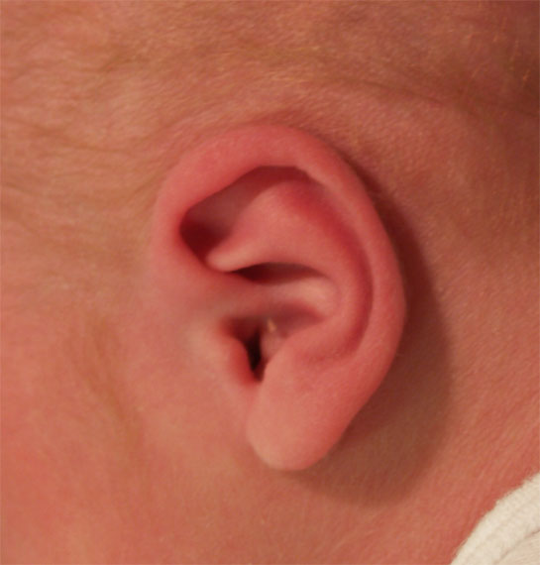
Normal Ears

Slide 57
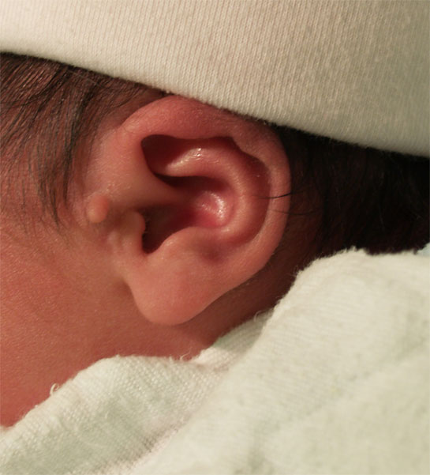
Ear Tag

Slide 58
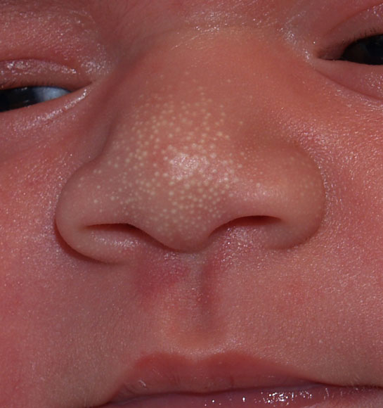
10. Nose
Nasal Patency (stethoscope).
Nasal discharge – thin white mucous
Normal Nose

Slide 59
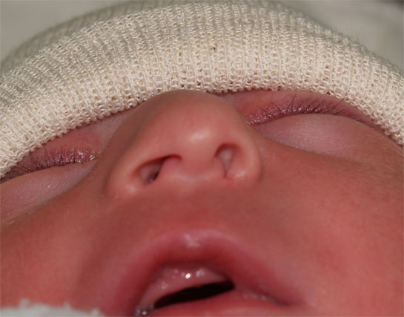
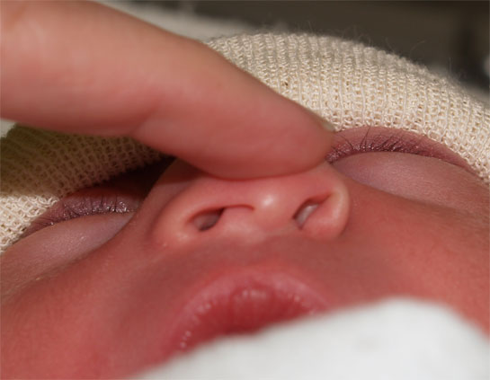
Dislocated Nasal Septum

Slide 60
11. Mouth & Throat
- Intact, high arched palate.
- Sucking reflex – strong and coordinated
- Rooting reflex
- Gag reflex
- Minimal salivation

Slide 61
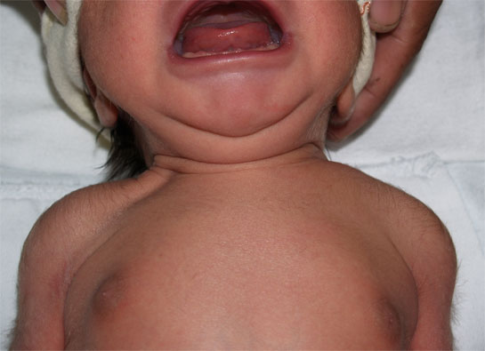
12. Neck
Short, thick, usually surrounded by skin folds.

Slide 62
Cysts: Thyroglossal cyst
Cystic hygroma
Masses: Sternomastoid tumor
Thyroid
Webbing

Slide 63
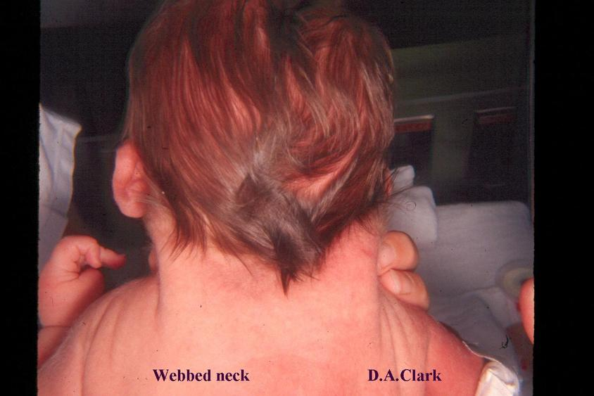
Webbed Neck

Slide 64
System assessment of the neonates:
1. Gastrointestinal System:
Mouth should be examined for abnormalities such as cleft lip and/or cleft palate.
Epstein pearls are brittle, white, shine spots near the center of the hard palate. They mark the fusion of the 2 hollows of the palate. If any; it will disappear in time.

Slide 65
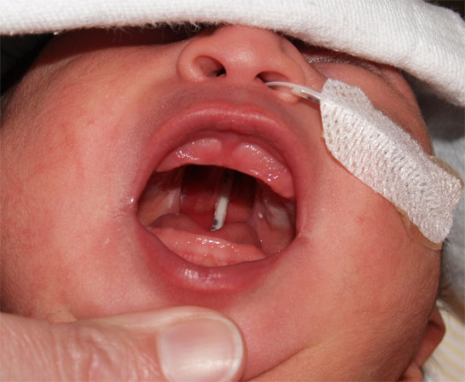
Cleft Palate

Slide 66
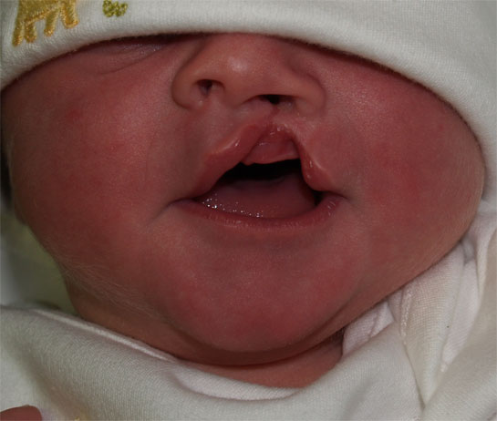
Cleft Lip

Slide 67
Cheeks Have a chubby appearance due to development of fatty sucking pads that help to create negative pressure inside the mouth which facilitates sucking.

Slide 68
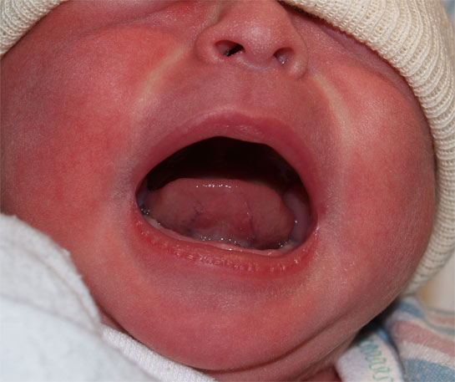
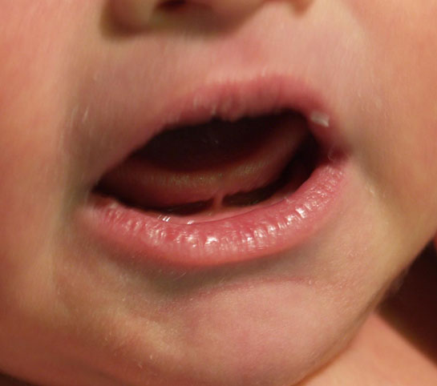
Normal Tongue Ankyloglossia

Slide 69
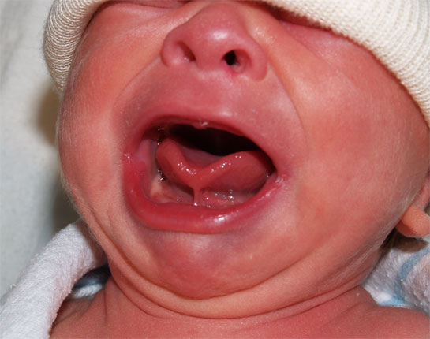
Ankyloglossia

Slide 70
Gum: May appear with a quite irregular edge.
Sometimes the back of gums contain whitish deciduous teeth that are semi-formed, but not erupted

Slide 71
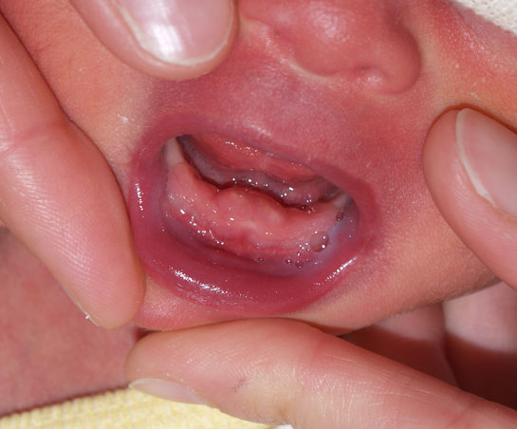
Irregular edges with Natal Teeth

Slide 72
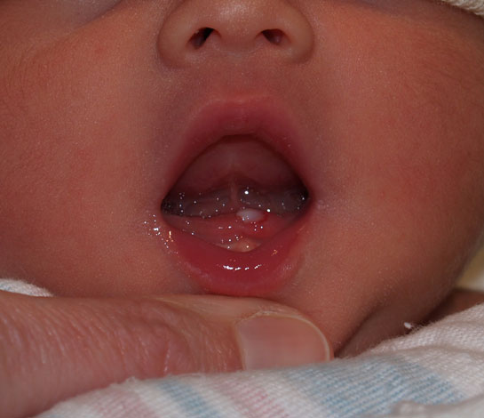
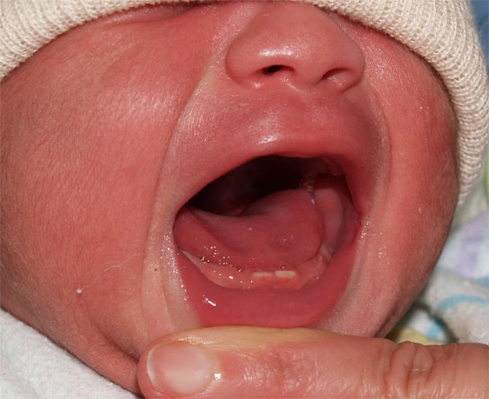
Natal Tooth

Slide 73
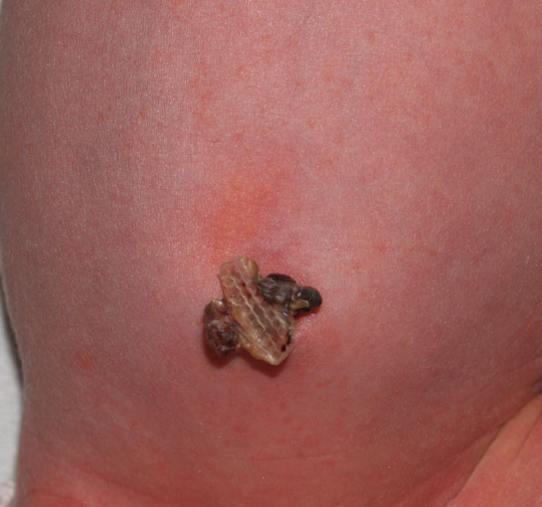
13. Abdomen
Cylindrical in Shape

Slide 74
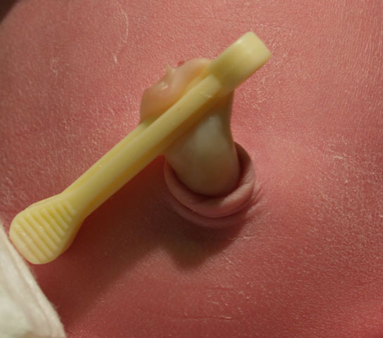
Normal Umbilical Cord
Bluish white at birth with 2 arteries & one vein.

Slide 75
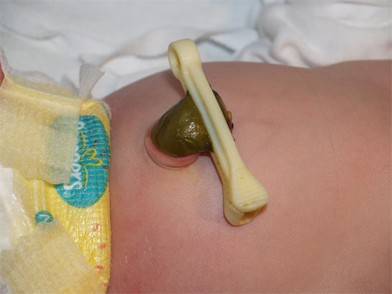
Meconium Stained Umbilical Cord

Slide 76
14. Circulatory system
Heart:
Apex- lies between 4th & 5th intercostal space, lateral to left sternal border.

Slide 77
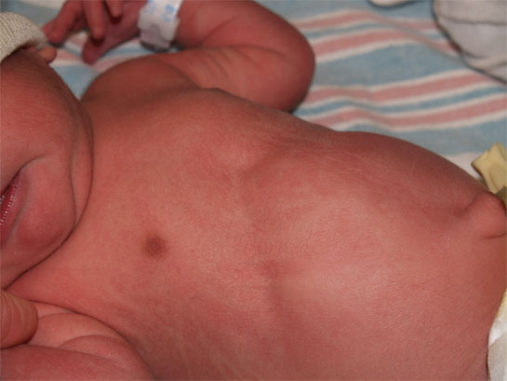
15. Respiratory system
Slight substernal retraction evident during inspiration

Slide 78
15. Respiratory system Cont.
Respiratory is chiefly abdominal
Cough reflex is absent at birth, present by 1-2 days postnatal.
Possible signs of RDS are:
- Cyanosis other than hands & feet.
- Flaring of nostrils.
- Expiratory grunt-heard with or without stethoscope.

Slide 79
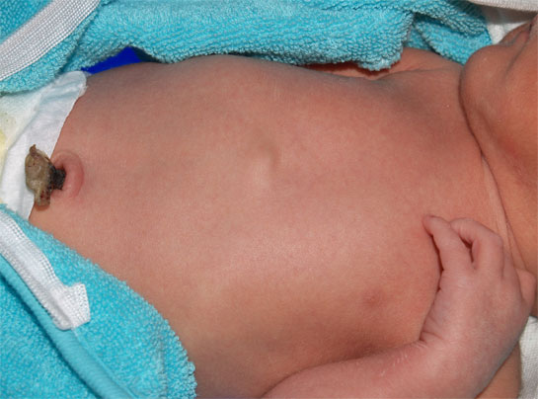
Respiratory system Cont.
Xiphesternal process evident

Slide 80
Muskloskletal
Fractures
Dislocations
Polydactyly
Syndactyly
Deformities

Slide 81
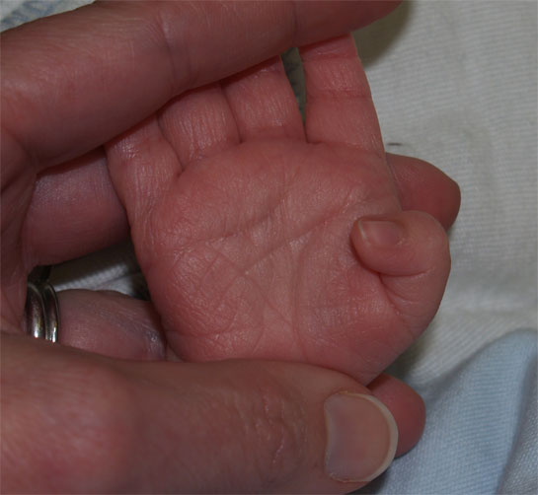
Extremities
Nail beds pink

Slide 82
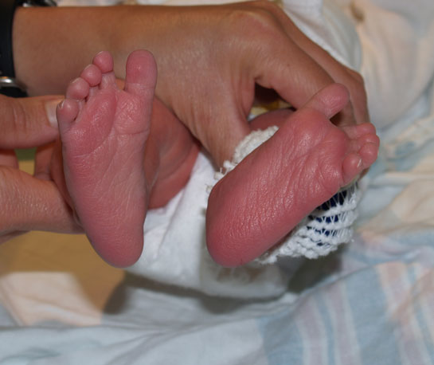
Extremities
Creases on anterior two thirds of sole.

Slide 83
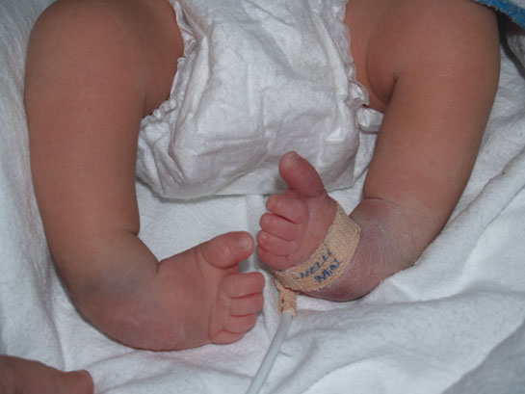
Common feet abnormalities
Club Feet

Slide 84
Physical exam

Slide 85
Physical examination
1st examination in delivery room or as soon as possible after delivery
2nd and more detailed examination after 24 h of life
Discharge examination with 24 h of discharge from hospital

Slide 86
1- Measurements
There are three components for growth measurements in neonates
  Weight
  Length
  Head circumference
All should be plotted on standardized growth curves for the infant’s gestational age

Slide 87
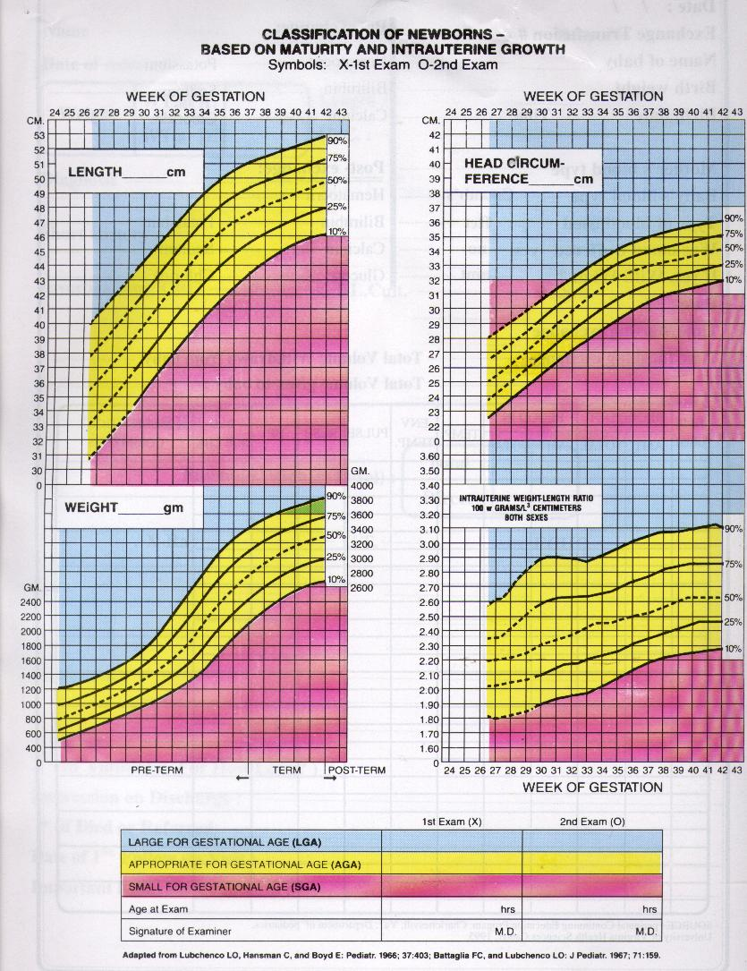

Slide 88
1- Weight
Weight of F.T infants at birth is 2.6– 3.8kg.
Babies less than 2.5 kg are considered low birth weight.
Babies loose 5 – 10% of their birth weight in the first few days after birth and regain their birth weight by 7 – 10 days.
Weight gain varies between 15-20 gm/day.

Slide 89
2. Length
Crown to heel length should be obtained on admission and weekly
Acceptable newborn length ranges from 48-52 cm at birth

Slide 90
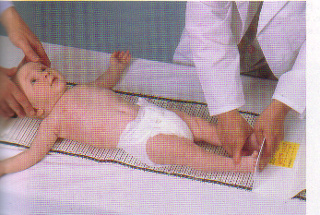
2. Length

Slide 91
3. Head Circumference
Head circumference should be measured on admission and weekly
Using the measuring paper tape around the most prominent part of the occipital bone and the frontal bone
Acceptable head circumference at birth in term newborn is 33-38 cm

Slide 92

3. Head Circumference

Slide 93
Neurological exam

Slide 94

Muscle tone
Connvulsions
Neonatal reflexes
Moro
Grasp
Tonic Neck
Stepping and Placing
Rooting &Suckling

Slide 95


Posture
  Term infants normal posture is hips abducted and partially flexed, with knees flexed.
  Arms are abducted and flexed at the elbow.
  Fists are often clenched, with the fingers covering the thumb
Tone
  To test, support the infant with one hand under the chest. Neck extensors should be able to hold head in line for 3 seconds
  There should be no more than 10% head lag when moving from supine to sitting positions.

Slide 96

Hypotonia

Slide 97


Slide 98
Neonatal reflexes
Also known as developmental, primary,or primitive reflexes.
They consist of autonomic behaviors that do not require higher level brain functioning
They can provide information about integrity of
C.N.S. Their absence indicate C.N.S depression
They are often protective and disappear as higher level motor functions emerge.

Slide 99
Moro Reflex
Onset: 28-32 weeks GA
Disappearance:4- 6 months
It is the most important reflex in neonatal period

Slide 100

Moro reflex
Stimulus : when baby in supine position elevate his head by your hand then allow head to drop suddenly
:Response
Extension of the back
Extension and abduction of the UL
Flexion and adduction of the UL with open fingers
Crying

Slide 101

Significance of Moro
Bilateral absence:
CNS depression by narcotics or anesthesia
Brain anoxia and kernicterus
Very Premature baby
Asymmetric response:
Erbs palsy , fracture clavicle or humerus
Persistence beyond 6th month:
CNS damage

Slide 102


Slide 103
Suckling Reflex
When a finger or nipple is placed in the mouth, the normal infant will start to suck vigorously
Appears at 32 w & disappears by 3 – 4 m

Slide 104

Suckling Reflex

Slide 105
Rooting Reflex
Well-established: 32-34 weeks GA
Disappears: 3-4 months
Elicited by the examiner stroking the upper lip or corner of the infant’s mouth
The infant’s head turns toward the stimulus and opens its mouth

Slide 106

Rooting Reflex

Slide 107
Rooting reflex

Slide 108
Palmar grasp
Well-established: 36 weeks GA
Disappears: 4 months
Elicited by the examiner placing her finger on the palmar surface of the infant’s hand and the infant’s hand grasps the finger
Attempts to remove the finger result in the infant tightening the grasp

Slide 109


Grasp reflex
Technique: put the examiner finger in the baby palm with slight rubbing .
Response: the infant grasp the finger firmly
Significance:
Absent CNS depression
Persist CNS damage

Slide 110
Stepping Reflex
Onset: 35-36 weeks GA
Disappearance: 6 weeks
Elicited by touching the top of the infant’s foot to the edge of a table while the infant is held upright.
The infant makes movements that resemble stepping

Slide 111

Stepping :
Hold baby in upright position then lower him till his sole touch table → stepping movement start.

Slide 113

Placing :
When dorsum of the baby foot touches the under surface of the table → flexion then extension to place or put his foot on the table

Slide 114

Placing Reflex

Slide 115
Placing reflex

Slide 116
Tonic neck (Fencing posture)
Evident at 4 weeks PGA
Disappearance: 7 months
Elicited by rotating the infant’s head from midline to one side
The infant should respond by extending the arm on the side to which the head is turned and flexing the opposite arm
Appearance at birth or persistence beyond 9m indicate cerebral palsy

Slide 117

Tonic neck (Fencing posture)

Slide 118

Thank You

