Slide 1
Liver
&
Biliary Tract Disease

Slide 2
Functional Anatomy
&
Physiology

Slide 3
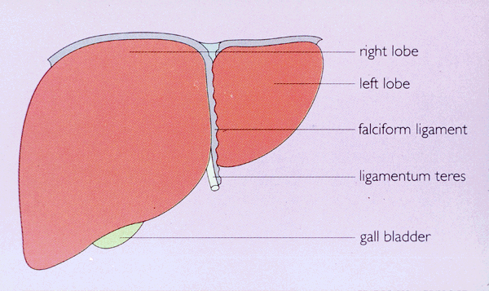
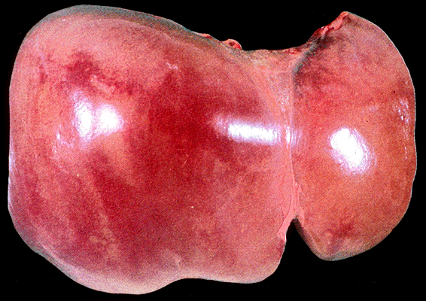

Slide 4
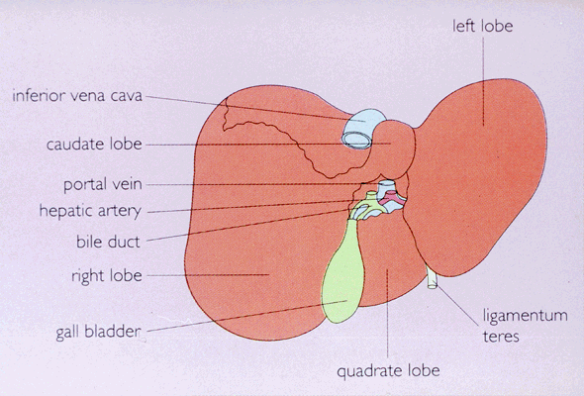
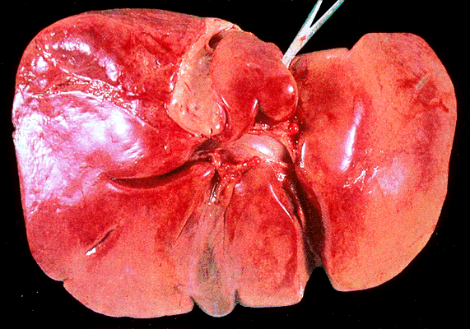

Slide 5
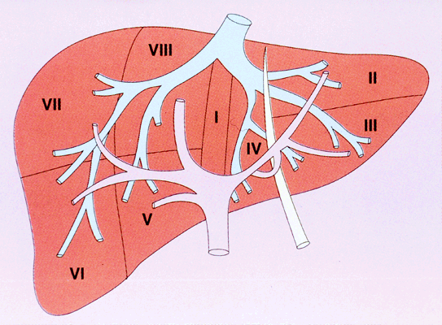
Diagram showing liver segments together with portal and hepatic venous system

Slide 6
Schematic representation of the liver

Slide 7
Hepatic acinus (functional unit of the liver)

Slide 8
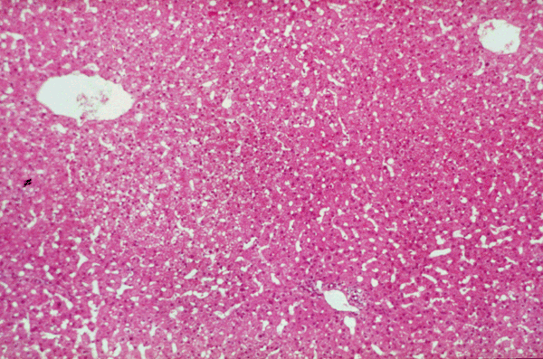
Normal adult liver section showing the radiating plates of liver cells between the portal tracts & central veins

Slide 9
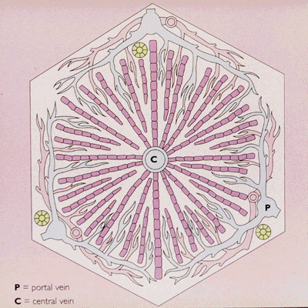
Acinus

Slide 10
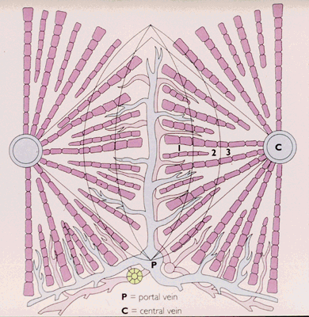

Slide 11
Important liver functions

Slide 12
Function of non-parenchymal liver cells

Slide 13
MAJOR HEPATIC FUNCTIONS
Metabolism:
Following a meal, more than half the glucose absorbed is taken up by the liver and stored as glycogen or converted to glycerol and fatty acids, thus avoiding marked hyperglycaemia.
excess amino acids are catabolised to urea.
during fasting the liver releases glucose, derived either from the breakdown of glycogen or from gluconeogenesis using amino acids released from extrahepatic tissues such as muscle.
the liver plays a central role in lipid metabolism,
The liver plays a central role in the metabolism of bilirubin, bile salts, drugs and alcohol.

Slide 14
Some vitamins, such as A, D and B12, are stored by the liver in large amounts, while others, such as vitamin K and folate, are stored in smaller concentrations and disappear rapidly if dietary intake is deficient.
Vitamin K is essential for the hepatic synthesis of coagulation factors II, VII, IX and X .
The liver stores minerals such as iron, in ferritin and haemosiderin, and copper.

Slide 15
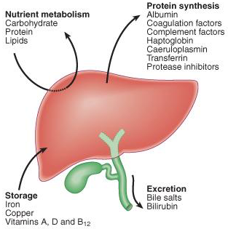

Slide 16
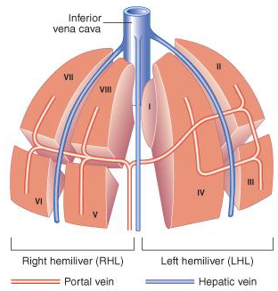
The liver is one of the heaviest organs in the body, weighing 1.2-1.5 kg.
It is divided into right and left hemilivers based on the hepatic blood supply.
The right and left hemilivers are further divided into a total of eight segments in accordance with subdivisions of the hepatic and portal veins.
The segments each have their own hepatic artery branch and biliary tree.

Slide 17
Functions of the Liver
processing of dietary amino acids, carbohydrates, lipids and vitamins
removal of microbes and toxins in splanchnic blood
synthesis of plasma proteins
detoxification and excretion into bile of endogenous waste products & pollutant xenobiotics

Slide 18
