Slide 1
Fixed partial Denture
Dr. Ahmed jawad al-ashaw

Slide 2
Summery
Definitions
Functions
Components of FPD
Types of FPD
Indications
Contra-indications
Advantages
Disadvantages

Slide 3
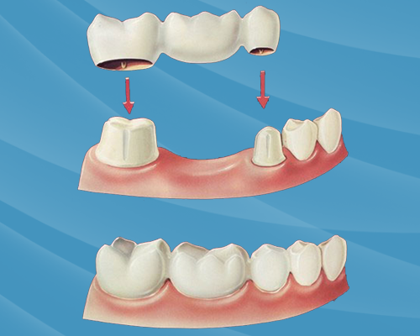
Defenition
FIXED PARTIAL DENTURE :
A partial denture that is luted or otherwise securely retained to natural teeth, tooth roots and/or dental implant abutments that provide the primary support to the prosthesis

Slide 4
FUNCTIONS OF FIXED PARTIAL DENTURE
Provide proper occlusal function.
Maintain arch integrity/tooth position.
Maintain occlusal relationships.
Protect and preserve the remaining structures.
Restore esthetics

Slide 5
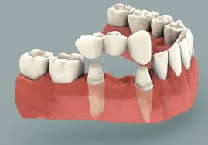
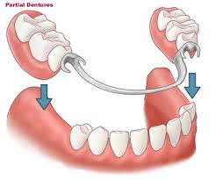
Difference between fixed and removable P.T
Both bridges and partial dentures replace missing teeth.
A bridge is permanently attached to abutment teeth or in some cases implants.
A partial denture is attached by clasps to the teeth and is easily removed by the patient.
Patients are usually more satisfied with bridges than with partial dentures.

Slide 6
Components of Fpd

Slide 7
1- Abutment
It is the selected remaining tooth or teeth where a crown or a bridge is attached

Slide 8
2- retainer
It is the artificial crown or crowns used to attach the bridge to the abutment tooth/teeth.

Slide 9
2- retainer
Retainers in fixed partial dentures can be broadly classified based on tooth coverage:
Full veneer crowns.
Partial veneer crowns.
Conservative (minimal preparation) retainers.

Slide 10
2- retainer
Based on the material being used
All metal retainers.
Metal ceramic retainers.
All ceramic retainers.
All acrylic retainers.

Slide 11
3. pontic
Artificial crown used to restore the missing tooth or teeth in the arch.

Slide 12
4- connector
Serves to connect retainer on one side to the other retainer on the other side of the bridge as well as unites all the other parts of the bridge

Slide 13
Types of FPD
Fixed fixed partial denture
Fixed movable partial denture
Cantilever
Spring cantilever

Slide 14
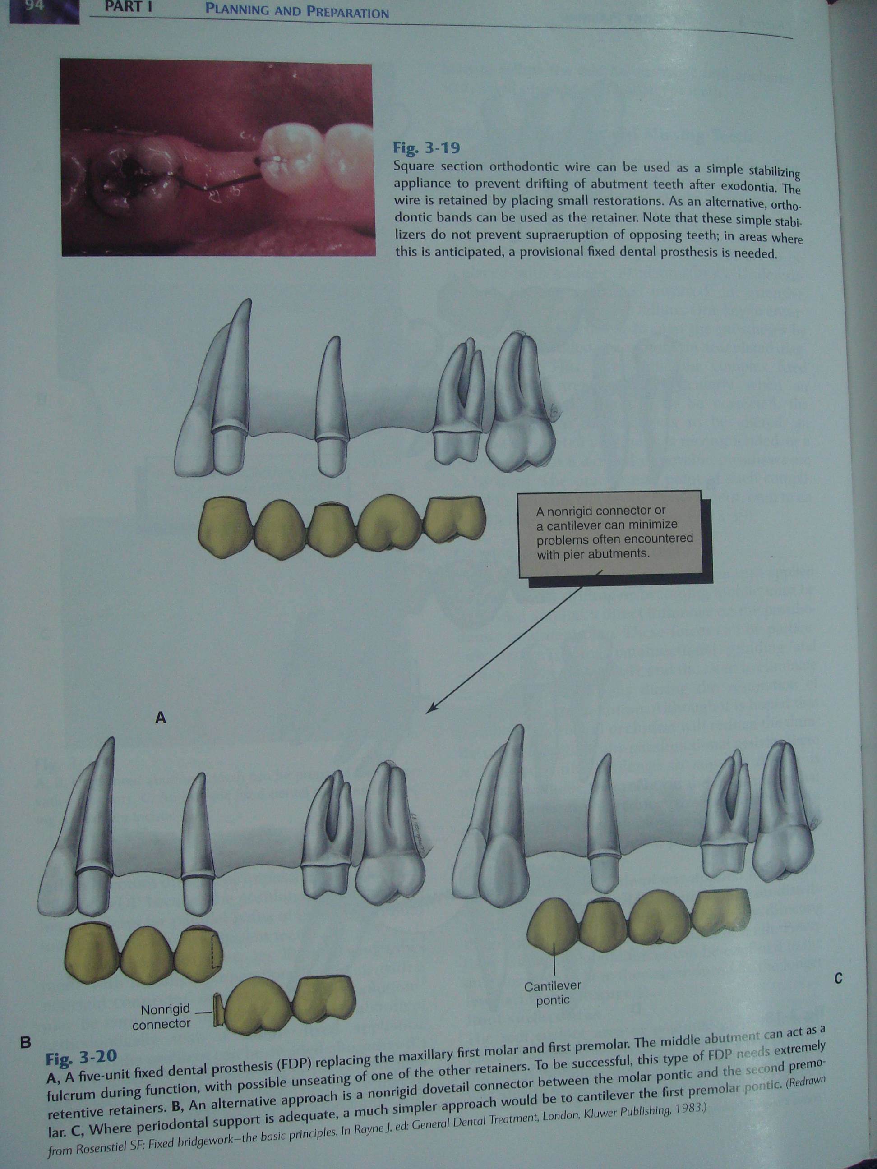
Fixed fixed partial denture
Permits no individual or independent movements of its parts and is also known as STATIONARY FIXED BRIDGE

Slide 15
Fixed movable partial dentur
One which allows some individual or separate movements of some of its parts and is also known as LIMITED STATIONARY or BROKEN STRESS BRIDGE

Slide 16
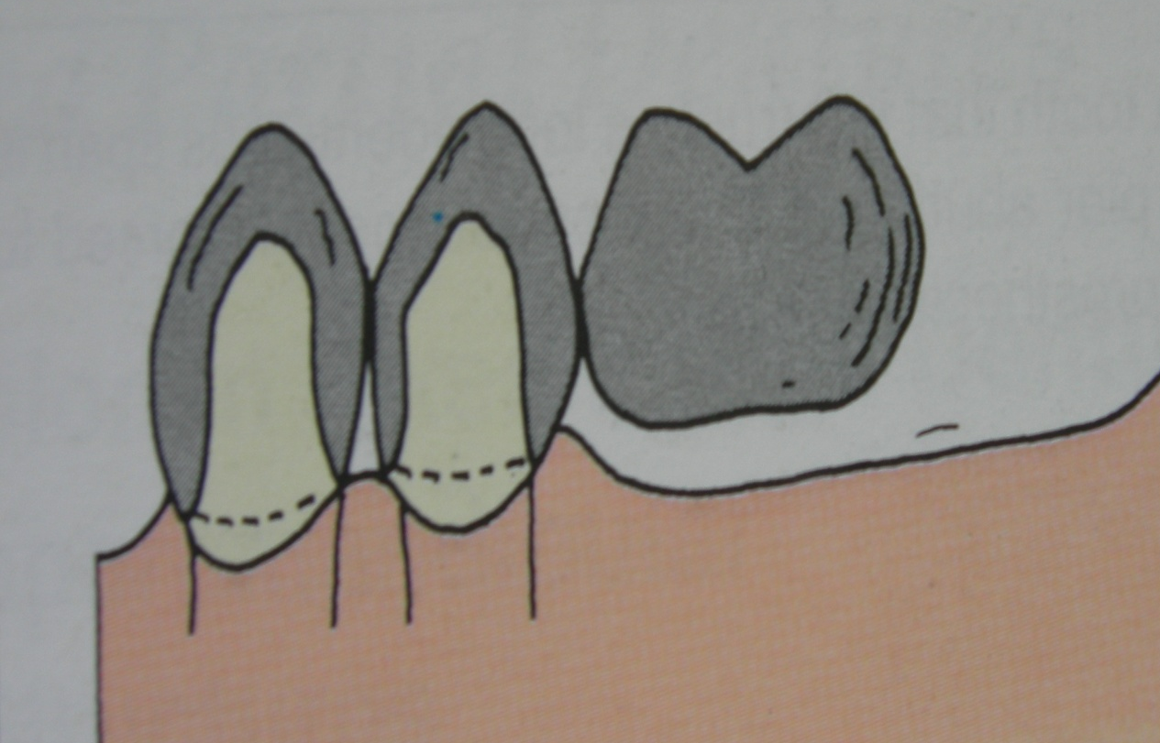
Cantilever
One which has one or more abutments at one end of the bridge while the other end is unsupported

Slide 17
Spring cantilever
This is a special cantilever bridge exclusively designed for replacing maxillary incisors but these dentures can support only a single pontic. Support is obtained from posterior abutments.

Slide 18
Indications of Fpd
Short span edentulous arches.
Presence of sound teeth that can offer sufficient support adjacent to the edentulous space.
Some cases with ridge resorption where a removable partial denture cannot be stable or retentive.
Patient’s preference
Mentally compromised and physically handicapped patients who cannot maintain the removable prosthesis.

Slide 19
Contra-indications of fpd
• Large amount of bone loss as in trauma.
• Very young patients where teeth have large pulp chambers.
• Presence of periodontally compromised abutments.
• Long span edentulous spaces.
• Bilateral edentulous spaces, which require cross arch stabilization.

Slide 20
Contra-indications of fpd
Congenitally malformed teeth, which do not have adequate tooth structure to offer support.
Mentally sensitive patients who cannot cooperate with invasive treatment procedures.
Medically compromised patients (e.g. Leukemia, hypertension).
Very old patients.
Distal extension denture bases as in class i and ii cases.

Slide 21
Advantages of FPD
Improved aesthetics – for many people with teeth missing in the front part of the mouth, appearance is an important consideration.
Ability to eat – some feel that eating with removable partial dentures is troublesome especially if food gets trapped in between the denture and the ridge.
Improve speech – the upper front teeth are the most important in modifying speech and a dental bridge feels more secure compared to a removable partial denture.

Slide 22
Advantages of FPD
Occlusal or bite stability – if the bite stability is lost, teeth movement can distort the current bite and may lead to malocclusion.
Space maintenance – if the missing teeth can be replaced before tooth movements occur and when tooth movement is likely, this may well be justified for replacement.
Periodontal splinting – following the successful treatment of advanced gum disease, it may be necessary to splint uncomfortably mobile teeth.

Slide 23
Disadvantages of FPD
Damage to tooth and pulp – in preparing teeth as bridge attachments, it may be necessary to remove certain amount of healthy tooth tissue. Whenever a tooth is prepared, there is a danger to the pulp, even if proper precautions are followed.
Secondary tooth decay due to faulty design of dental bridge or poor oral hygiene.

Slide 24
Disadvantages of FPD
Failures of bridges – no matter how good the dental bridge was made, there is always an element of risk.
Increase plaque accumulation that can lead to gum disease if oral hygiene is not kept clean.
More expensive than removable partial denture

