Slide 1
Histology
Second stage ( 2016-2017 )
Lab. 1
Respiratory System Practical Slides

Slide 2
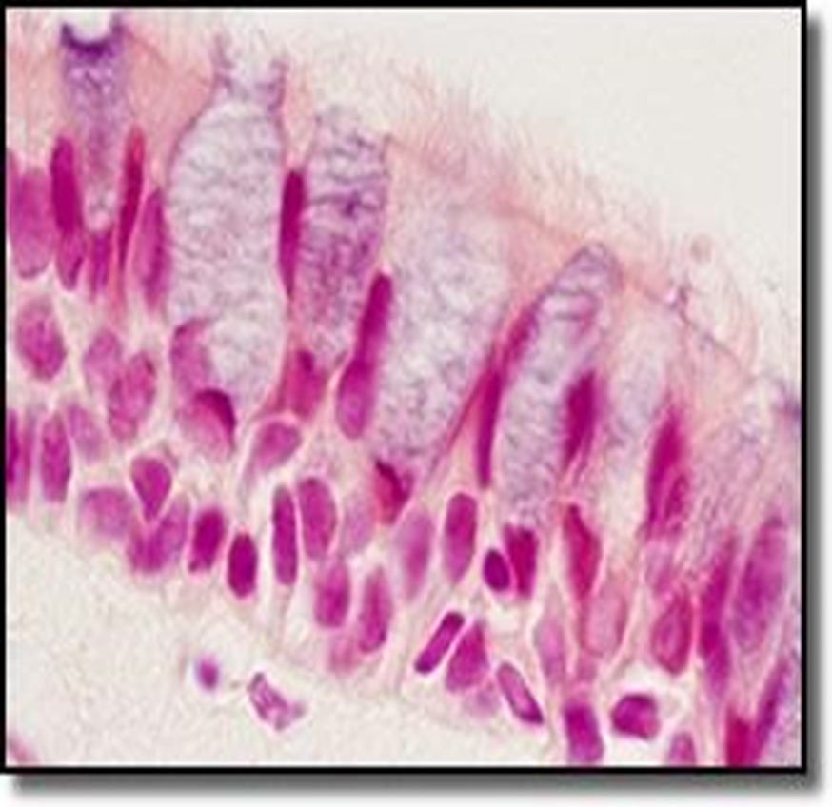
Pseudo stratified columnar ciliated epithelium with goblet cells
The question about this slide : What kind of epithelium is found here in the upper part of this photomicrograph?

Slide 3
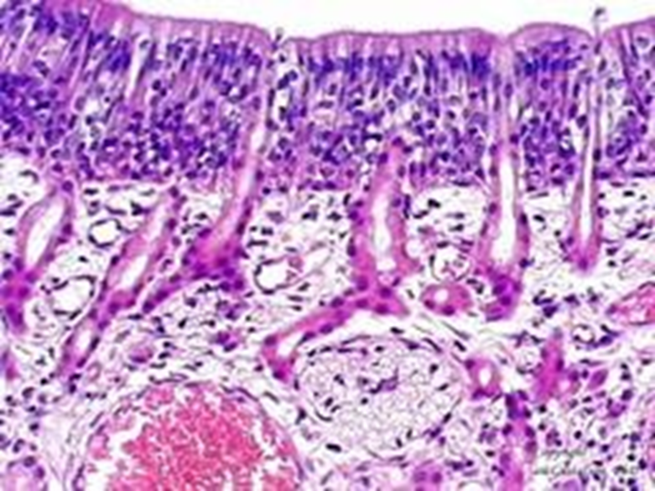
Olfactory Epithelium with Bowmen's gland and olfactory nerve fibers
The question about this slide : What kind of epithelium is found here in the upper part of this photomicrograph

Slide 4
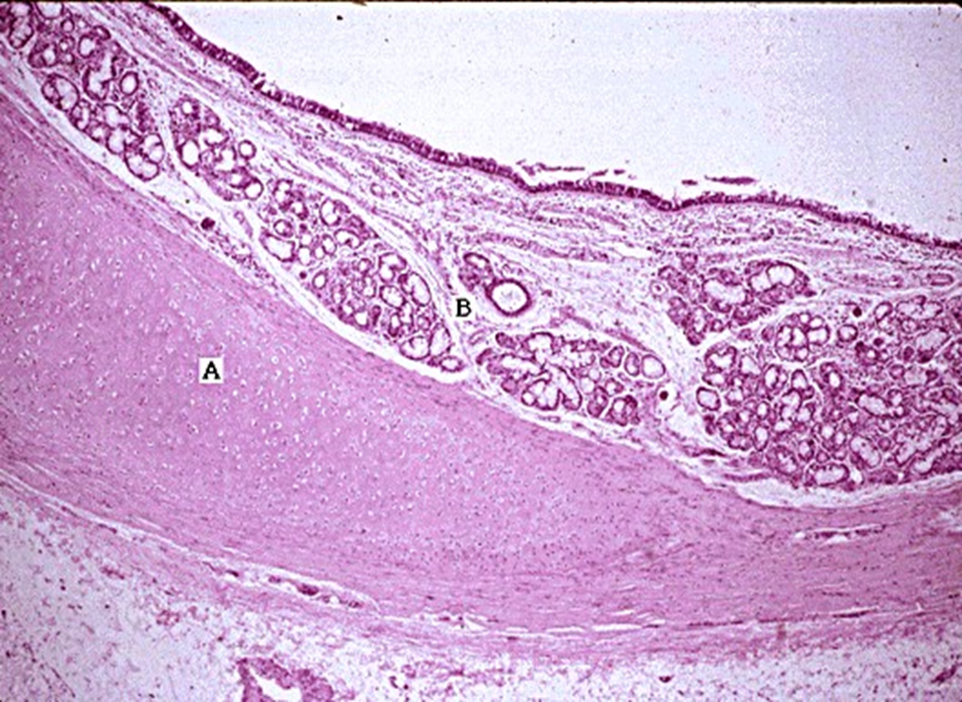
This slide is actually of the trachea , A is hyaline cartilage and ,B are mixed glands.
The question about this slide : Name the tissue indicated by A and the structures indicated by B.? What is this slide of ?

Slide 5
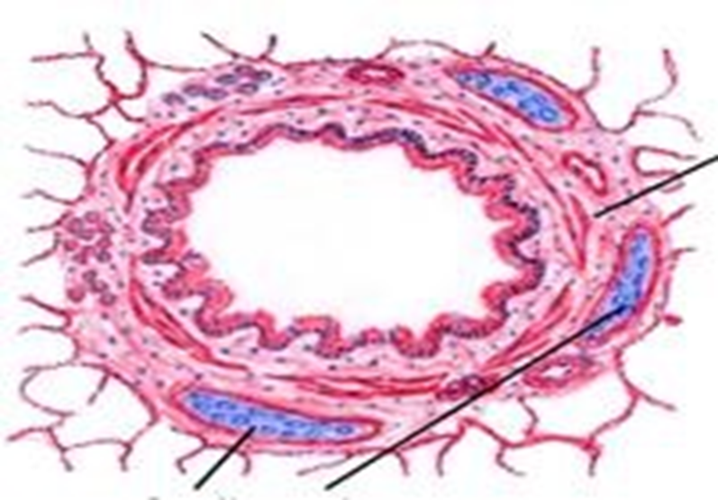
Bronchus
The question about this slide : What is this slide of ?

Slide 6
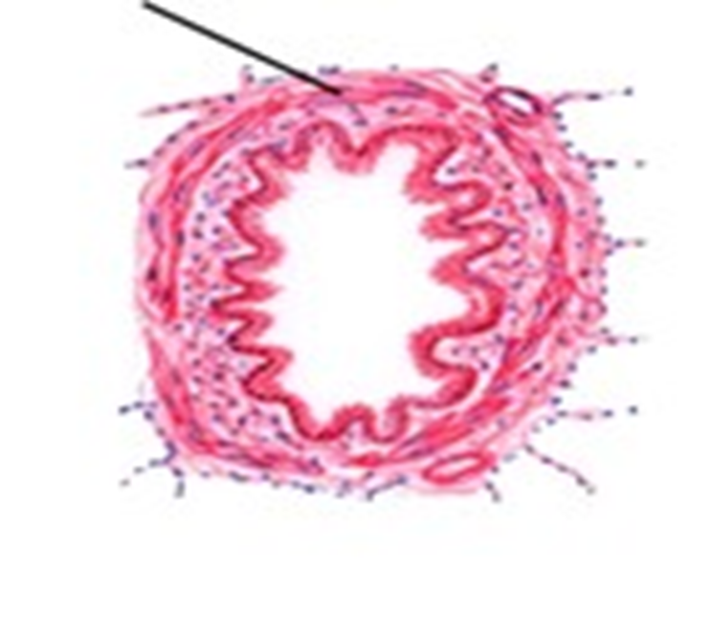
Bronchiole
The question about this slide : What is this slide of ?

Slide 7
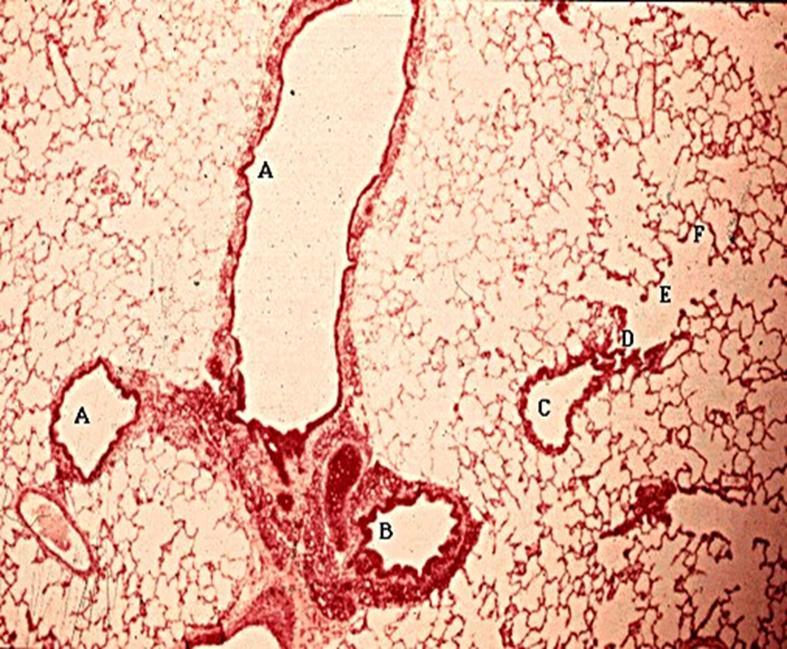
The lung
The question about this slide : Name the indicated structures and you may as well name the organ too
A bronchioles ( note the absence of cartilage in their wall)
B is a bronchus ( with a plate of cartilage in their upper left hand corner of its wall )
C is a terminal bronchiole branching into D the respiratory bronchial (which can be distinguish by the alveoli interrupting its wall)
E are alveolar duct

Slide 8
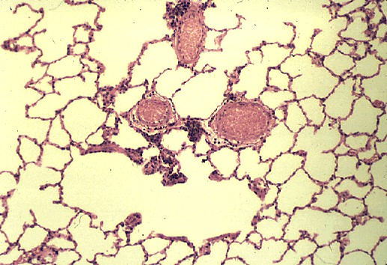
These are the alveoli
The question about this slide : What structures are shown here?

