Slide 1
Skull Applied Anatomy

Slide 2
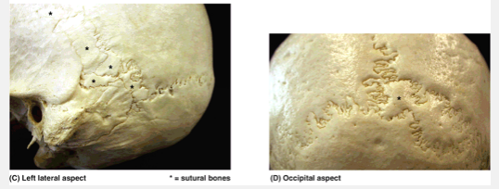
Sutural bones

Slide 3
Mandibular age-related resorption

Slide 4
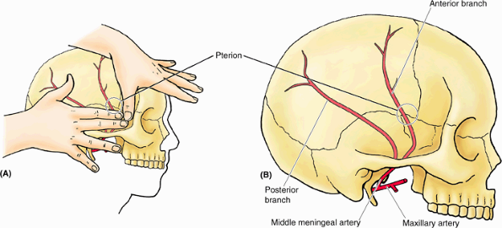
Pterion

Slide 5
Infant Skull: Fontanelles

Slide 7
Premature suture closure
A: Scaphocephaly
B: Plagiocephaly
C: Oxycephaly

Slide 8
Teething

Slide 9
Facial bones fractures

Slide 11
Raccoon eyes

