Slide 1
2nd type of Basic tissues
Connective Tissue (Co.T)

Slide 2
Co. T Facts
They are the most abundant and widely distributed tissue type in the body.
Connective tissues run the gamut for vascularity.
Some tissues are avascular (Cartilage), some are poorly vascularized (dense Co. T) and some have rich blood supplies (bone).

Slide 3
Co. T. Facts
Co. T. can be rigid (bone), flexible (adipose), or fluid (blood).
Unlike the tightly packed Epithelial tissues, living cells in Co.T are separated by a non-living extra-cellular matrix [ECM](Ground Substance and Fibers).
Due to the matrix, Co.T are able to bear weight, withstand tension, and endure abuses that no other tissues could tolerate.

Slide 4
Function of Co.T
Many specific functions. Its major functions include
Binding and support
Protection
Insulation
Transportation of substances

Slide 5
Components of Co.T
Connective Tissues are made of three main components:
Ground Substance (Matrix)
Fibers
Cells

Slide 6
Co.T Facts – Ground Substance
The ground substance is the unstructured material between cells that contains the fibers.
The ground substance holds large amounts of fluid and serves as a medium through which nutrients and other substances can diffuse between blood vessels and the cells.

Slide 7
Ground Substance
Ground Substance

Slide 8
Co.T, Fibers
There are 3 types of fibers prevalent in Co.T
A). Collagen fibers – are wide and wavy in appearance and generally stain pink. 79% of the protein in the body is collagen.
B). Elastic fibers – are thin flexible fibers made of protein elastin, that generally stain black.
C). Reticular fibers – are actually thin collagen fibers. They have a spider web appearance and appear black under stain.

Slide 9
Fiber Types
Elastic Fiber
Collagen Fiber
Reticular Fibers

Slide 10
Co.T, The Cells
Each major type of Co. T has its own fundamental cell type in both immature and mature forms.

Slide 11
The following types of connective tissue are covered in this activity:
Loose (areolar) connective tissue (delicate thin layers between
tissues; present in all mucous membranes)
2. Adipose tissue (fat)
3. Dense connective tissue (tendons/ligaments)
4. Hyaline cartilage (nose/ends of long bones/ribs)
5. Elastic cartilage (outer ear/epiglottis)
6. Fibrocartilage (between vertebrae/knee joints/pubic joint)
7. Bone (skeletal system)
8 Blood (bloodstream)

Slide 12
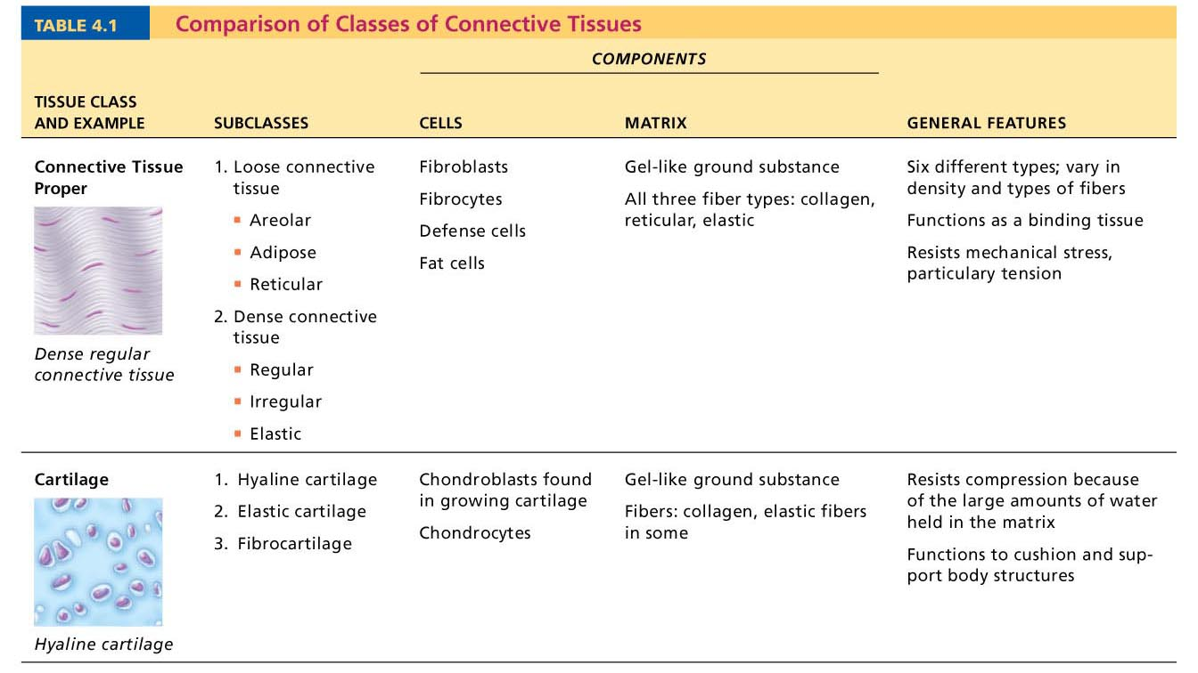
Table 4.1 Comparison of Classes of Connective Tissues (1 of 2)

Slide 13
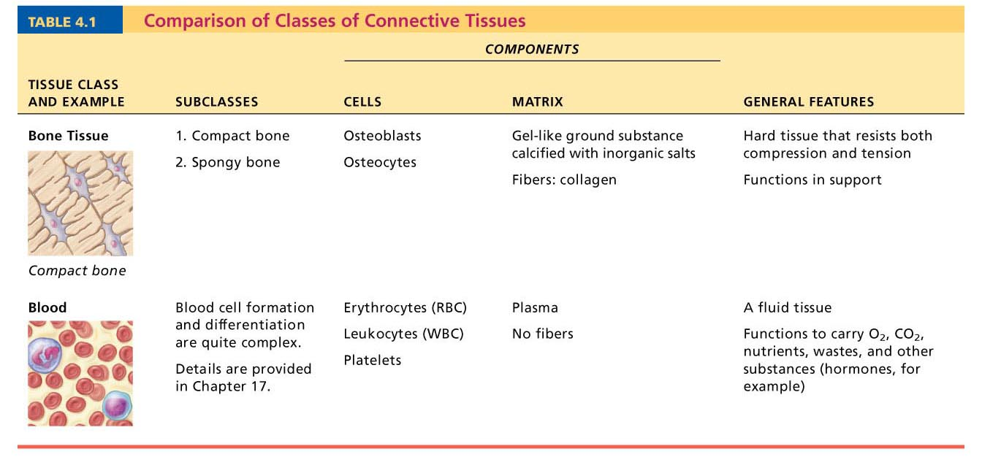
Table 4.1 Comparison of Classes of Connective Tissues (2 of 2)

Slide 14
Figure 4.8a Connective tissues.
(a) Connective tissue proper: loose connective tissue, areolar
Description: Gel-like matrix with all
three fiber types; cells: fibroblasts,
macrophages, mast cells, and some
white blood cells.
Elastic
fibers
Function: Wraps and cushions
organs; its macrophages phagocytize
bacteria; plays important role in
inflammation; holds and conveys
tissue fluid.
Collagen
fibers
Location: Widely distributed under
epithelia of body, e.g., forms lamina
propria of mucous membranes;
packages organs; surrounds
capillaries.
Fibroblast
nuclei
Epithelium
Photomicrograph: Areolar connective tissue, a
soft packaging tissue of the body (300x).
Lamina
propria

Slide 15
Figure 4.7 Areolar connective tissue: A prototype (model) connective tissue.
Cell types
Extracellular
matrix
Ground substance
Macrophage
Fibers
• Collagen fiber
• Elastic fiber
• Reticular fiber
Fibroblast
Lymphocyte
Fat cell
Capillary
Mast cell
Neutrophil

Slide 16
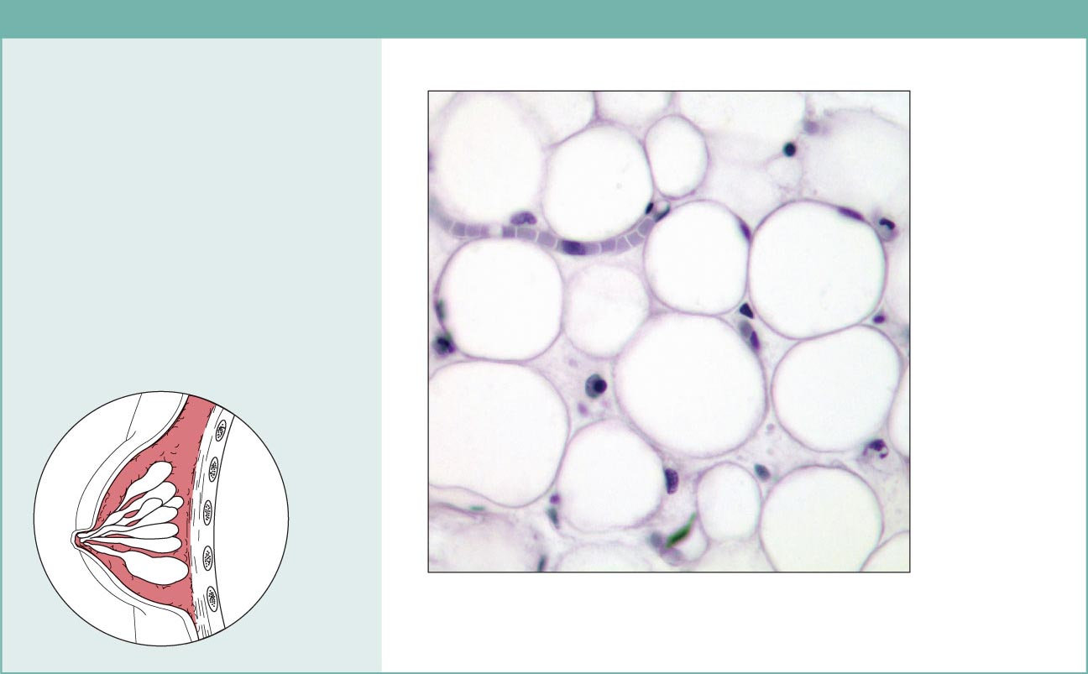
Figure 4.8b Connective tissues.
(b) Connective tissue proper: loose connective tissue, adipose
Description: Matrix as in areolar,
but very sparse; closely packed
adipocytes, or fat cells, have
nucleus pushed to the side by large
fat droplet.
Function: Provides reserve food
fuel; insulates against heat loss;
supports and protects organs.
Nucleus of
fat cell
Location: Under skin in the
hypodermis; around kidneys and
eyeballs; within abdomen; in breasts.
Adipose
tissue
Vacuole
containing
fat droplet
Photomicrograph: Adipose tissue from the
subcutaneous layer under the skin (350x).
Mammary
glands

Slide 17
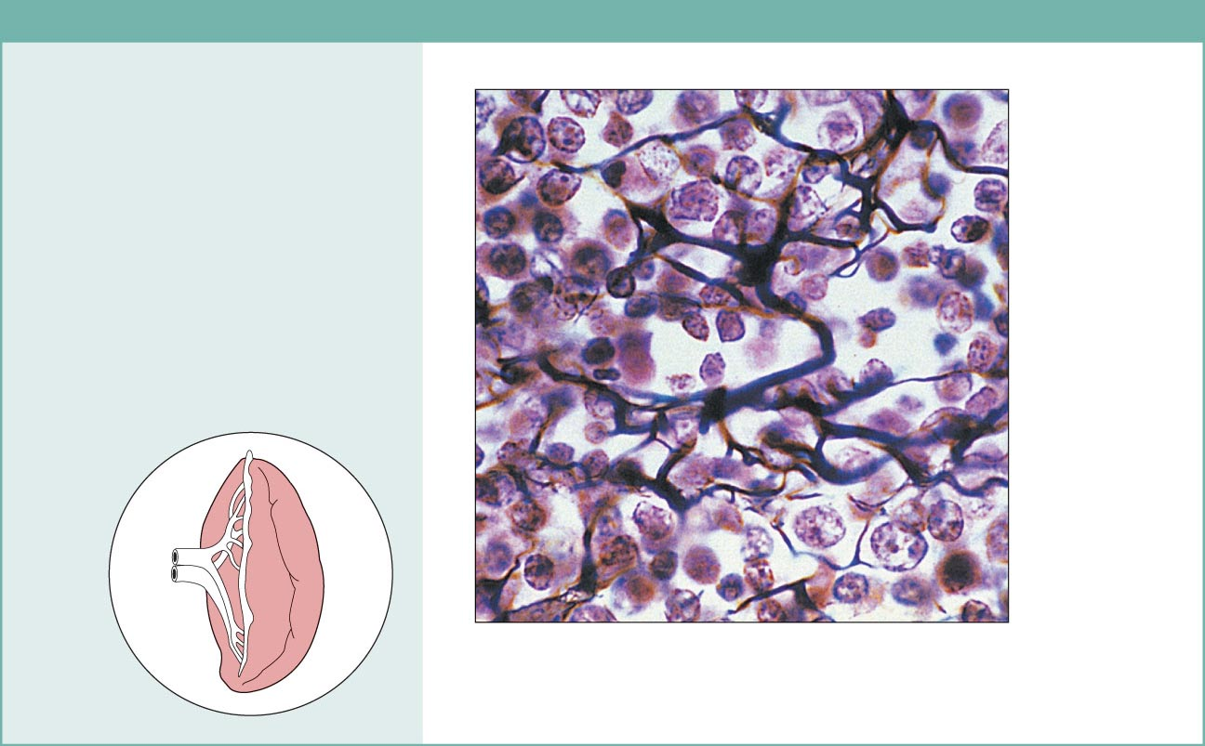
Figure 4.8c Connective tissues.
(c) Connective tissue proper: loose connective tissue, reticular
Description: Network of reticular
fibers in a typical loose ground
substance; reticular cells lie on the
network.
Function: Fibers form a soft internal
skeleton (stroma) that supports other
cell types including white blood cells,
mast cells, and macrophages.
White blood
cell
(lymphocyte)
Location: Lymphoid organs (lymph
nodes, bone marrow, and spleen).
Reticular
fibers
Spleen
Photomicrograph: Dark-staining network of reticular
connective tissue fibers forming the internal skeleton
of the spleen (350x).

Slide 18
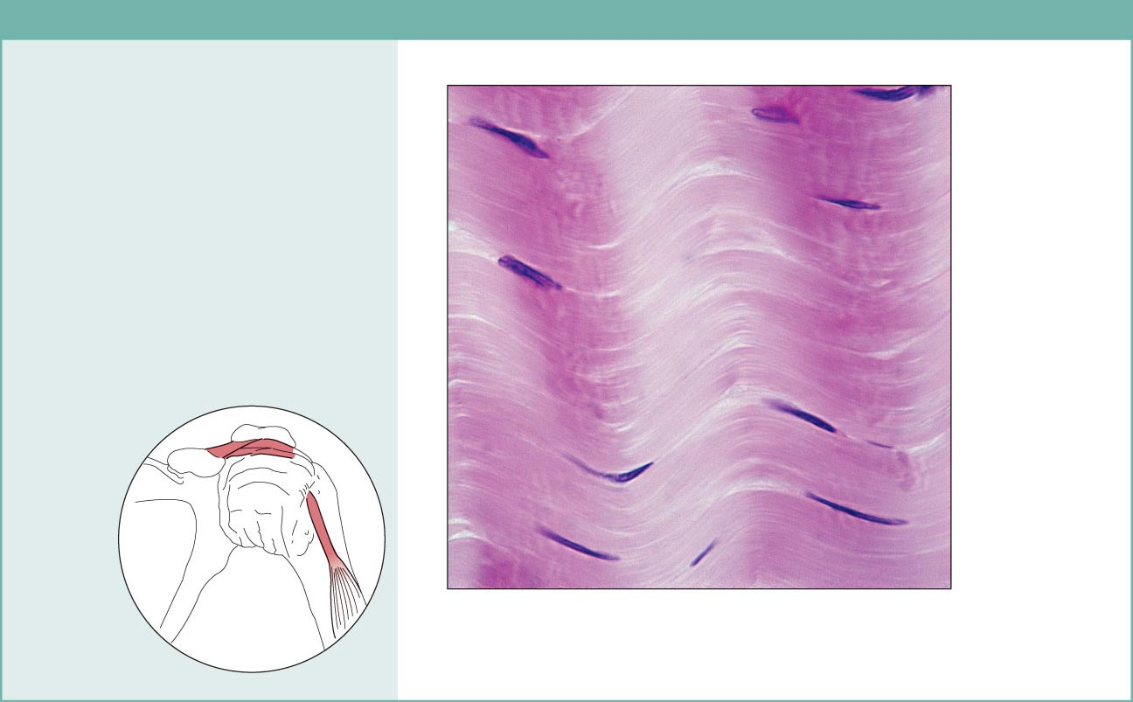
Figure 4.8d Connective tissues.
(d) Connective tissue proper: dense connective tissue, dense regular
Description: Primarily parallel
collagen fibers; a few elastic fibers;
major cell type is the fibroblast.
Collagen
fibers
Function: Attaches muscles to
bones or to muscles; attaches bones
to bones; withstands great tensile
stress when pulling force is applied
in one direction.
Location: Tendons, most
ligaments, aponeuroses.
Nuclei of
fibroblasts
Shoulder
joint
Ligament
Photomicrograph: Dense regular connective
tissue from a tendon (500x).
Tendon

Slide 19
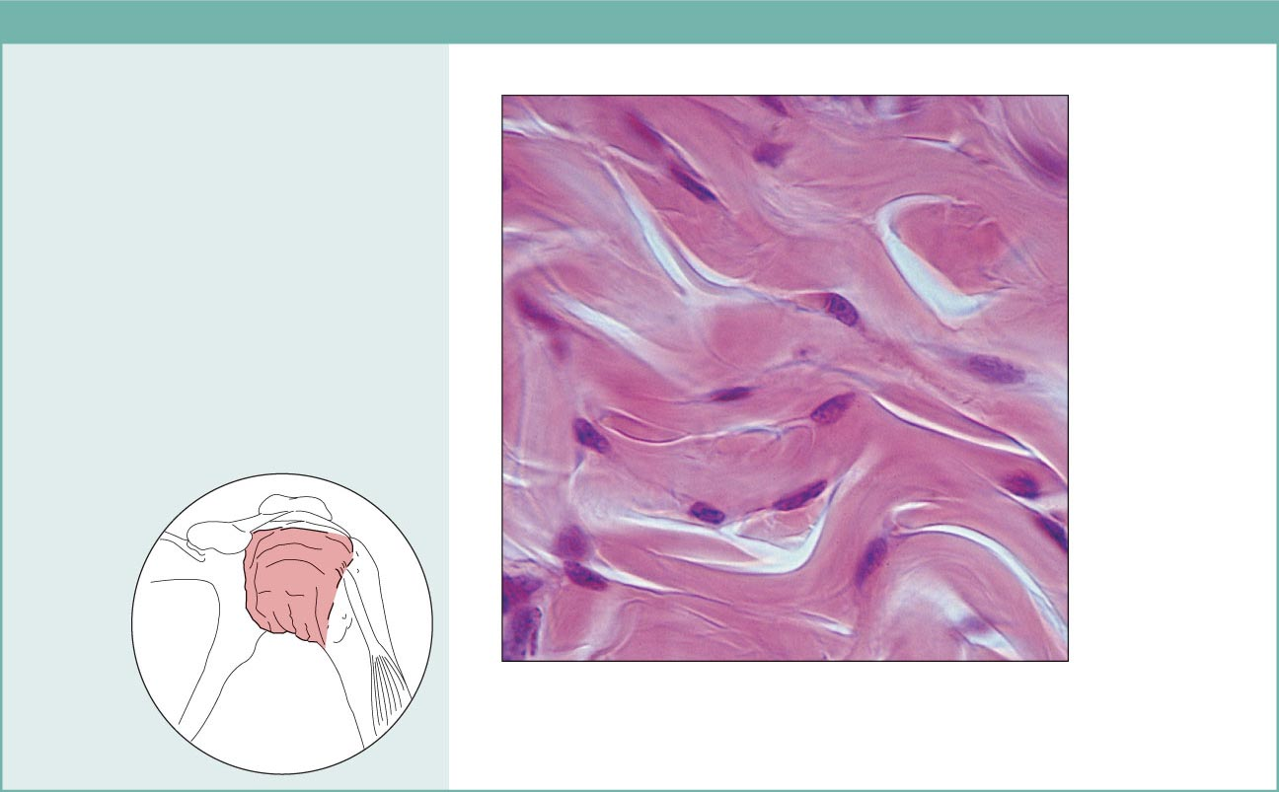
Figure 4.8e Connective tissues.
(e) Connective tissue proper: dense connective tissue, dense irregular
Description: Primarily
irregularly arranged collagen
fibers; some elastic fibers;
major cell type is the fibroblast.
Nuclei of
fibroblasts
Function: Able to withstand
tension exerted in many
directions; provides structural
strength.
Location: Fibrous capsules of
organs and of joints; dermis of
the skin; submucosa of
digestive tract.
Collagen
fibers
Fibrous
joint
capsule
Photomicrograph: Dense irregular
connective tissue from the dermis of the
skin (400x).

Slide 20
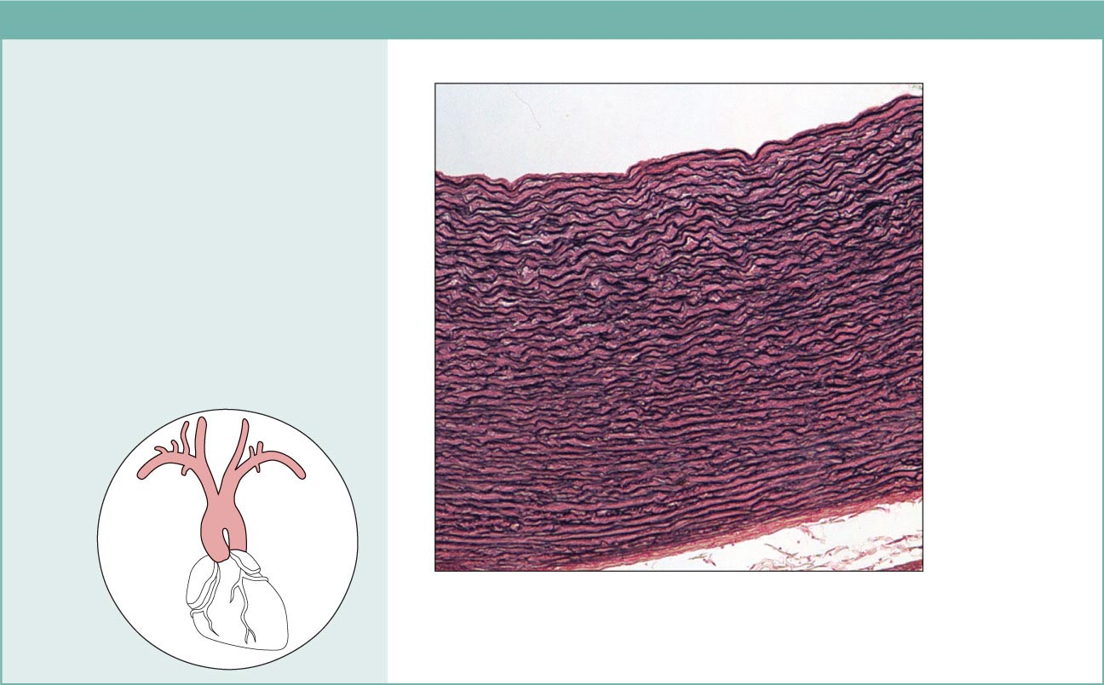
Figure 4.8f Connective tissues.
(f) Connective tissue proper: dense connective tissue, elastic
Description: Dense regular
connective tissue containing a high
proportion of elastic fibers.
Function: Allows recoil of tissue
following stretching; maintains
pulsatile flow of blood through
arteries; aids passive recoil of lungs
following inspiration.
Location: Walls of large arteries;
within certain ligaments associated
with the vertebral column; within the
walls of the bronchial tubes.
Elastic fibers
Aorta
Heart
Photomicrograph: Elastic connective tissue in
the wall of the aorta (250x).

Slide 21
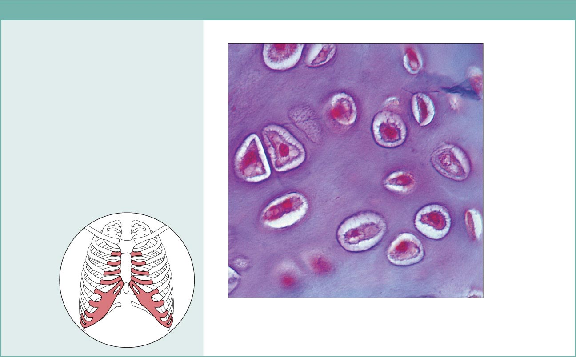
Figure 4.8g Connective tissues.
(g) Cartilage: hyaline
Description: Amorphous but firm
matrix; collagen fibers form an
imperceptible network; chondroblasts
produce the matrix and when mature
(chondrocytes) lie in lacunae.
Function: Supports and reinforces;
has resilient cushioning properties;
resists compressive stress.
Location: Forms most of the
embryonic skeleton; covers the ends
of long bones in joint cavities; forms
costal cartilages of the ribs; cartilages
of the nose, trachea, and larynx.
Chondrocyte
in lacuna
Matrix
Costal
cartilages
Photomicrograph: Hyaline cartilage from the
trachea (750x).

Slide 22
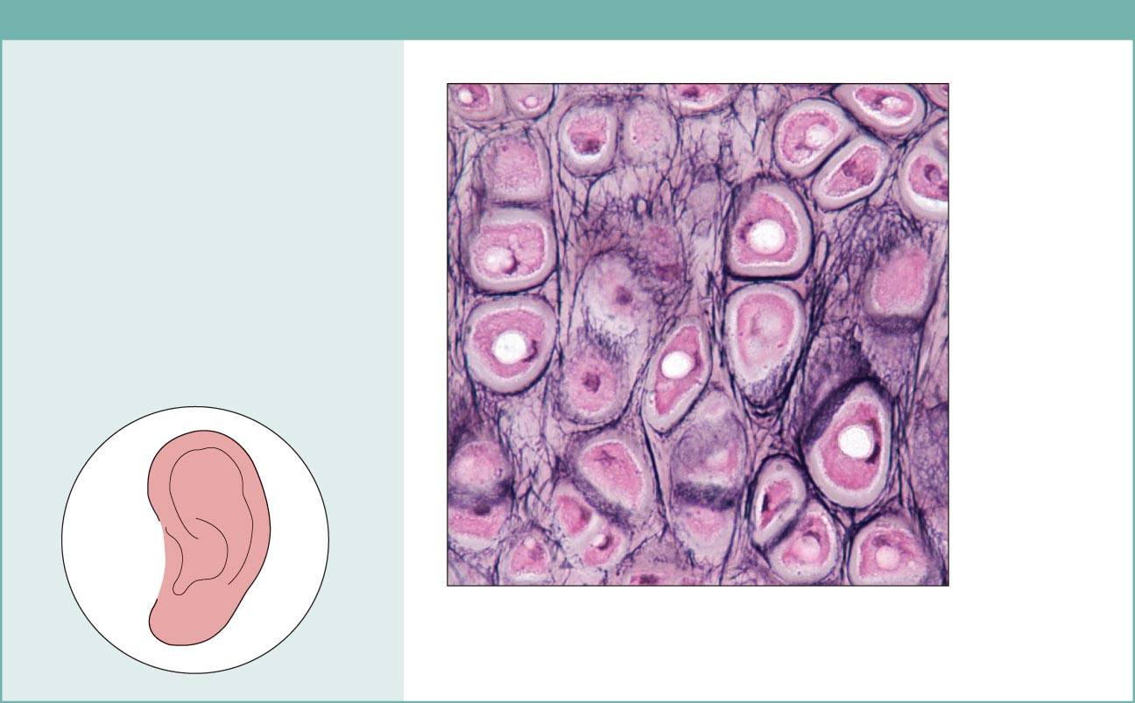
Figure 4.8h Connective tissues.
(h) Cartilage: elastic
Description: Similar to hyaline
cartilage, but more elastic fibers
in matrix.
Function: Maintains the shape
of a structure while allowing
great flexibility.
Chondrocyte
in lacuna
Location: Supports the external
ear (pinna); epiglottis.
Matrix
Photomicrograph: Elastic cartilage from
the human ear pinna; forms the flexible
skeleton of the ear (800x).

Slide 23
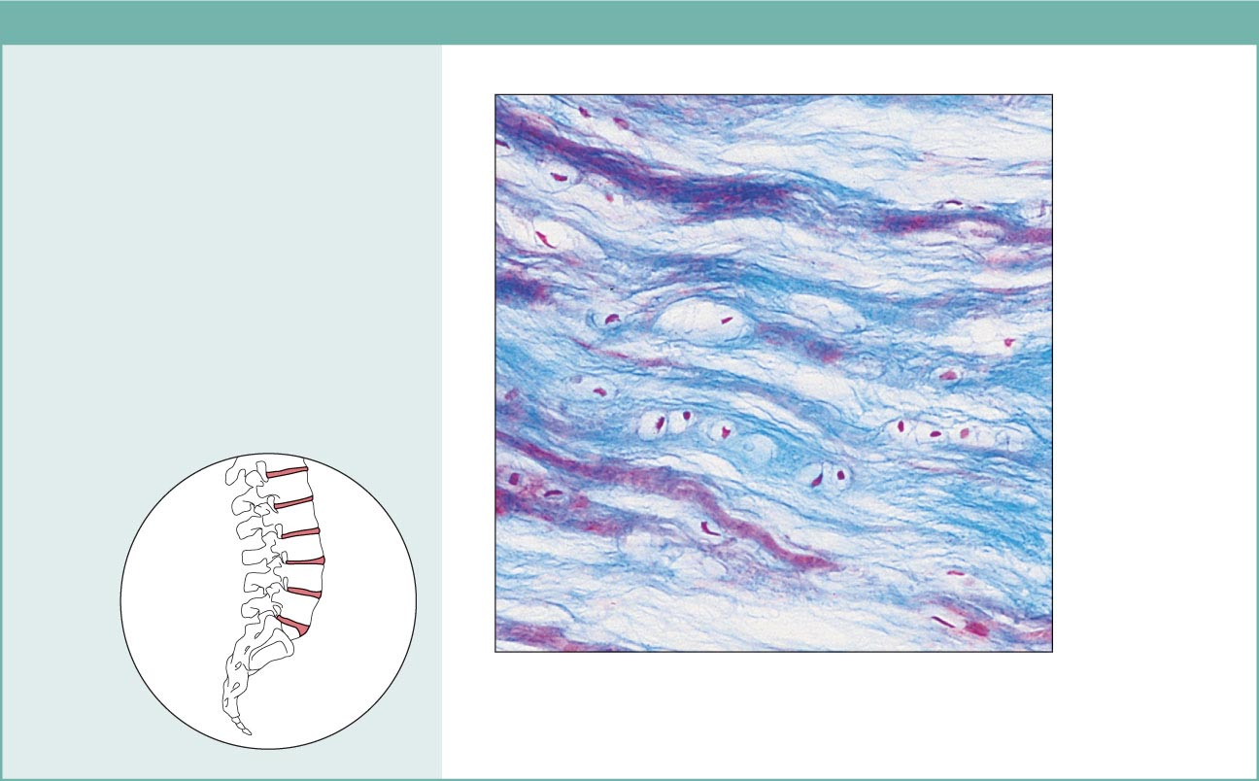
Figure 4.8i Connective tissues.
(i) Cartilage: fibrocartilage
Description: Matrix similar to
but less firm than that in hyaline
cartilage; thick collagen fibers
predominate.
Function: Tensile strength
with the ability to absorb
compressive shock.
Location: Intervertebral discs;
pubic symphysis; discs of knee
joint.
Chondrocytes
in lacunae
Intervertebral
discs
Collagen
fiber
Photomicrograph: Fibrocartilage of an
intervertebral disc (125x). Special staining
produced the blue color seen.

Slide 24
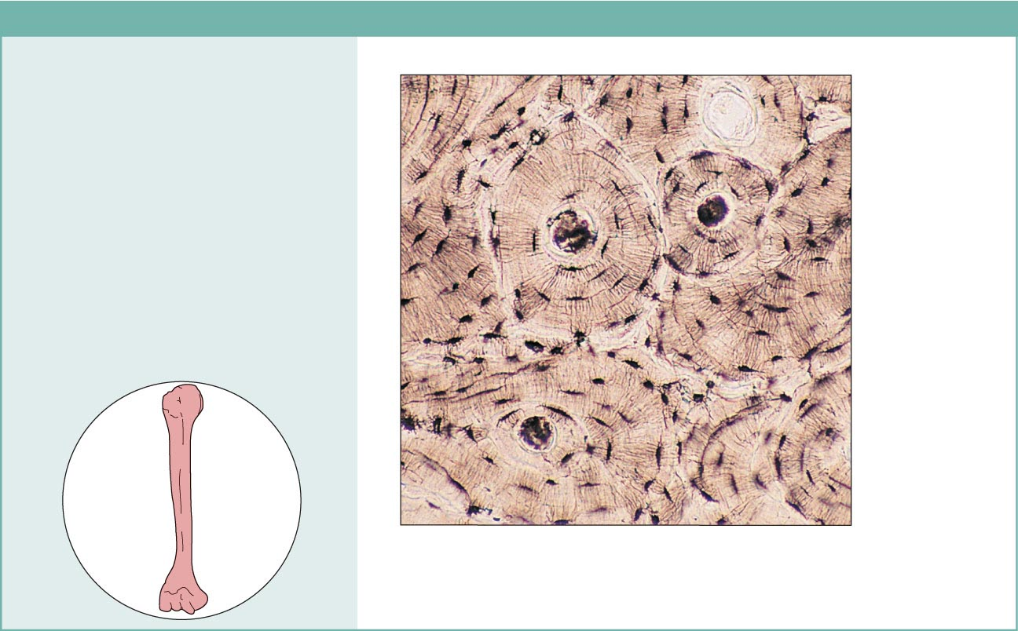
Figure 4.8j Connective tissues.
(j) Others: bone (osseous tissue)
Description: Hard, calcified
matrix containing many collagen
fibers; osteocytes lie in lacunae.
Very well vascularized.
Function: Bone supports and
protects (by enclosing);
provides levers for the muscles
to act on; stores calcium and
other minerals and fat; marrow
inside bones is the site for blood
cell formation (hematopoiesis).
Central
canal
Lacunae
Lamella
Location: Bones
Photomicrograph: Cross-sectional view
of bone (125x).

