Slide 1
Types of Retainers
Dr. Ahmed Jawad

Slide 2
Requirements of retainer
Biocompatable
Withstand the masticatory forces
Restore the anatomy of the tooth
Pulp consideration

Slide 3
Requirements of retainer
Strong enough to resist deformation under functional stress
Esthetically acceptable
Maintain oral hygiene

Slide 4
Criteria for selection of retainers
Degree of retention required
Surface area of the abutment
Periodontal condition
Effective root surface area
Crown root ratio
Condition of the abutment teeth
Preservation of tooth structure
Relation with the opposing teeth
Material used for bridge construction
Alignment of teeth

Slide 5
1- Degree of retention required
It represent the most important criterion,
The factors that affect retention are:
Length of the span:
Longer the span the greater the stress on the retainers, so the components of the bridge must be stronger
Type of the bridge:
Stronger retainers are required for fixed-fixed bridge than fixed-movable bridge to withstand the stress on the cementing media

Slide 6
1- Degree of retention required
Strength of the bite:
It varies according to age sex and muscular development of the patient.
Heavier bite requires stronger and thicker metal to prevent failure of retainers
Tooth or teeth to be replaced
Size and position of pontic have a direct effect on type of retainer, for example: replacement of molar impart great stress to abutment than lower central.

Slide 7
1- Degree of retention required
Articulation:
Errors in articulation affect the selection and the design of the retainer.
Correction of any supra erupted tooth opposing pontic area is done prior to construction of a bridge
Habits of the patient:
Bruxism patient should be given thicker and stronger retainer than normal because of their excessive clenching

Slide 8
Criteria for selection of retainers
2- Surface area of the abutment tooth, the surface area of lower molar is greater than that of a canine so the use of molar as abutment will increase the retention.
3- Periodontal condition: in cases of gingival recession the finish line should be placed supragingivally to minimize gingival irritation, but this will reduce the surface area of the abutment tooth and decrease the retention.

Slide 9
Criteria for selection of retainers
4- Effective root surface area: single rooted teeth have less effective root surface area than multirooted teeth, also periodontally diseased teeth have a compromised root surface area.
5- Crown root ratio: this depends on the degree of eruption of the tooth and on the degree of gum recession.

Slide 10
Criteria for selection of retainers
6- Condition of the abutment: partial veneers crowns are indicated for non carious abutments, while full veneer crowns used for large carious abutments. Endodontically treated teeth requires post and core.
7- Preservation of tooth structure:
Partial > full veneer > all ceramic

Slide 11
Criteria for selection of retainers
8- Relation with the opposing teeth.
9- Material used for bridge construction.
10- Aligment of teeth.

Slide 12
Classification of retainers
Extra coronal
full coverage
Intra coronal
Inlay
Radicular retainers
partial coverage
onlay
complete metal
metal fused to seramic
3/4 crown
reverse 3/4 crown
7/8 crown
resin bonded retainers
all ceramic zirconia bridge

Slide 13
Extra-coronal retainers
Full coverage restorations
These are restorations used to restore the all surfaces of the clinical crown. And are classified according to the material used in their construction, as:
1. Metal crowns
2. Non-metal crowns
3. Combination of both of the two above.

Slide 14
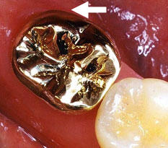
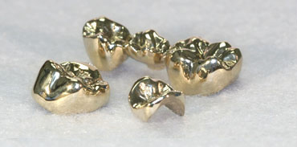
Metal crown
It is an artificial metallic restoration used to cover all the surfaces of the clinical crown.
It is made only from metal, e.G. Gold.

Slide 15
Metal crowns
Indications
1. As single crown or as a bridge (retainer for FPD).
2. Only for posterior teeth (where there is a sever occlusal stress).
3. In patient with high caries index.
4. For an endodontically treated tooth.
5. For malalignment tooth/or teeth.
6. For teeth with a short occluso-gingival height.
7. For a badly broken clinical crown.
8. In a long span bridge.

Slide 16
Metal crowns
Contraindications
1. In case of anterior teeth, for esthetic reasons.
2. In a situation where another conservative preparation can be use (e.G. Partial coverage).
3. When less than maximum resistance and retention is needed.
4. When caries extend gingivally, as that the finish line cannot be made.
5. In case of uncontrolled caries.

Slide 17
Metal crowns
Advantages
1. Great resistance form.
2. Great retention.
3. High strength.
4. Good protection for a tooth to be restored.
5. Can modify occlusion in case of overeruption.
6. Can modify tooth contour in case of open contact or in
buccal or lingual contour in a tooth used as a retainer for FPD.
7. Ideal restorations for teeth with developmental defects.

Slide 18
Metal crowns
Disadvantages
1. Bad esthetics (especially for anterior
teeth).
2. Pulp vitality can not be detected.
3. Incipient caries can not be detected.
4. Extensive amount of tooth reduction.

Slide 19
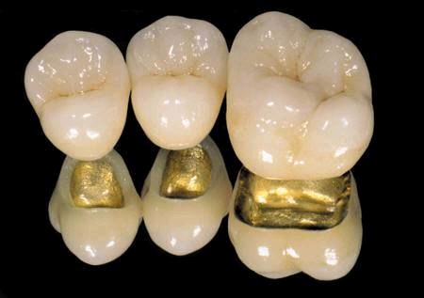
Combined crowns
Known as :
- Porcelain Fused to Metal
crowns (PFM), or
- Metal ceramic crowns.

Slide 20
Metal ceramic crowns
Indications
1. On teeth require esthetic.
2. In case of extensive tooth destruction as a result of caries, trauma, or existing previous restorations.
3. When there is a repeated failure of PJC.
4. When superior retention and resistance is needed.
5. In case of an endodontically treated tooth.
6. To recontour axial surfaces or correct minor malinclinations of teeth.

Slide 21
Metal ceramic crowns
Contraindications
1. In patient with active caries or untreated periodontal disease.
2. In young patient with large pulp chamber because of the high risk of pulp exposure.
3. Where a more conservative restoration can be made.

Slide 22
Metal ceramic crowns
Advantages
1. Have the strength of cast metal crowns with the esthetic of the all ceramic crowns
2. Have good retention.
3. Permit easy correction of the axial walls.

Slide 23
Metal ceramic crowns
Disadvantages
1. Their preparation requires more tooth reduction to provide sufficient space for the restorative materials.
2. Their facial margins for anterior teeth, is often placed subgingivally which increase the risk for periodontal disease.
3. The laboratory casts are expensive.
4. A frequent problem is the difficulty of accurate shade selection.

Slide 24
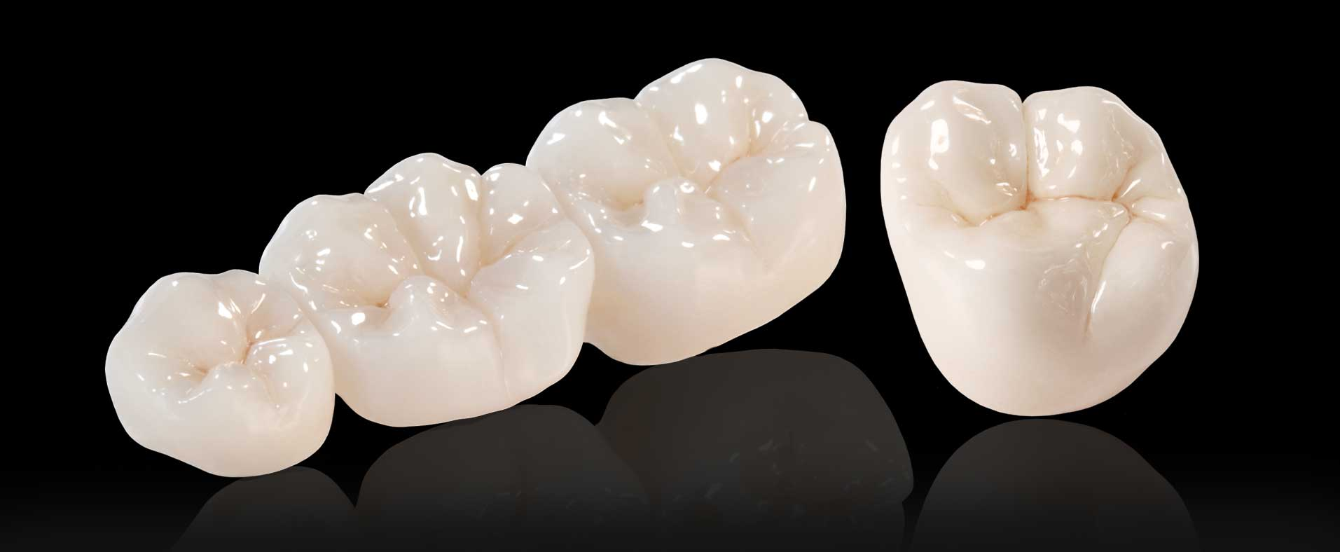
All ceramic zirconia bridge

Slide 25
Zirconia crown
Indications
1. For anterior teeth (especially incisors).
2. For severely discolored anterior teeth.
3. Over an existing post and core substructure.
Zirconia crown
Contraindications
1. Parafunctional habits
2. In case of tooth with short clinical crown (no
enough tooth structure to support the porcelain).
3. In case of edge to edge or overbite occlusion.
4. Reduced inter-occlusal space

Slide 26
Zirconia crown
Advantages
1. Have the best cosmetic effect of all dental restorations.
2. High strength
3. biocompatable
4. excellent insulation
Zirconia crown
Disadvantage
1. Expensive as it requires CAD/CAM system
2. Bond between the ceramic veneer and the zirconia framework is the weakest component of the layered structure.

Slide 27
Partial coverage crown
E.g. ¾ crown

Slide 28
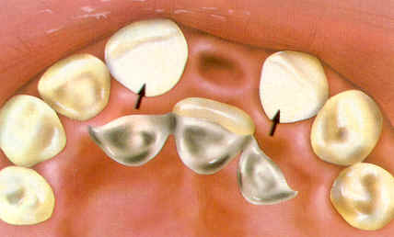
Resin bonded bridge

Slide 29
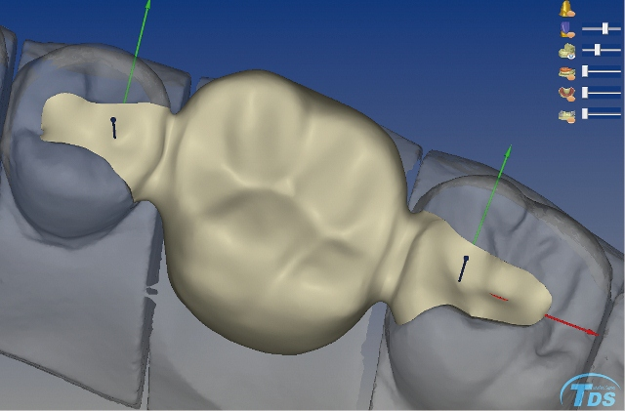
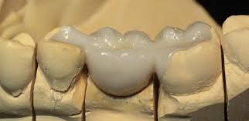
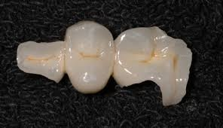
Intra coronal retainers
Inlay and onlay

