Slide 1
جراحة فم \ خامس اسنان
د.وفاء م(7)
28-11-2016
Dr. Wafaa Khalil

Slide 2
Anatomy of TMJ
Temporomandibular Joint
consists of mandible suspended from temporal bone via ligaments and muscules, including stylomandibular and sphenomandibular ligaments
a true synovial joint capable of gliding, hinging, sliding and slight rotation
mandible and temporal bone separated by meniscus (disc)

Slide 3
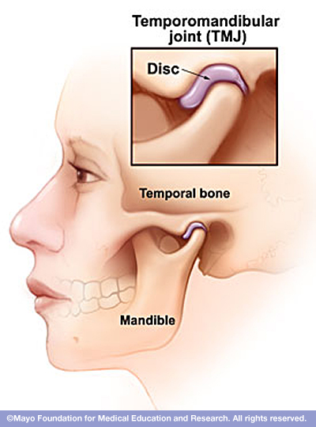
Anatomy of TMJ
Condylar process of mandible articulates with glenoid fossa of temporal bone
anterior: anterior eminance of TMJ
posterior: EAC
lateral: zygomatic arch
medial: styloid process

Slide 4
Anatomy of TMJ
Condylar process, continued
lined by fibrous tissues, primarily hyaline cartilage
this is the primary growth center of the mandible
damage leads to facial maldevelopment, including both the mandible and the maxilla
Coronoid process
insertion for portions of temporalis and masseter

Slide 5
Anatomy of TMJ
Meniscus (disc)
synovial fluid above and below disc
“shock absorber”
internal derangement in 50% of all people
anteriorly and medially most common
jaw “pops”
held in place by medial and lateral capsular ligaments and retrodisc pad

Slide 7
Disease of TMJ
Developmental
Inflammatory / infectious condition
Degenerative / autoimmune
Cystic lesion
Traumatic injury
Neoplasm
Miscellaneous

Slide 8
Disease of TMJ
Developmental Disturbances
Condylar agenesis
the absence of all or portions of condylar process, coronoid process, ramus or mandible
other first and second arch anomalies seen
early treatment maximizes condylar growth
a costocondral graft may help with facial development

Slide 9
Disease of TMJ
Hypoplasia
Unilateral, Bilateral
Example “first arch syndrome” , Hemifacial microsomia ( 1st & 2nd arch syndrome or otomandibular dysostosis), Treacher Collins Syndrome (mandibulofacial dysostosis)
usually developmental secondary to trauma or infection
most common facial deformity is shortening of mandible
jaw deviates towards affected side
Flatness of the face on the unaffected side. (The side to which the ramus is short causes muscles to appear fuller; the muscles on the unaffected side are stretched so that side appears flatter.) Mandibular deviation causes malocclusion
Treatment for child: costochondral graft
Treatment for adult: shorten normal side or lengthen involved side

Slide 10
Disease of TMJ
Hyperplasia
Hemifacial hyper atrophy
an idiopathic, progressive overgrowth of mandible
deviation of jaw away from affected side
presents in 2nd decade
Treat by condylectomy

Slide 11
Disease of TMJ
Infection
( specific, non specific infection)
Acute, chronic
Viral, bacterial, fungal
Origin
Ear
Direct injury
Systemic spread

Slide 12
Disease of TMJ
Degenerative / autoimmune
- Joint Disorders are the second most common cause of temporomandibular pain after myofacial pain dysfunction syndrom
- Include internal derangements, degenerative joint disease, traumatic arthritis, ankylosis

Slide 13
Disease of TMJ
Joint Disorders, Continued
Cardinal features are jaw popping (clicking) and pain
50% of the population has a jaw pop, which usually occurs with opening (between 10-20 mm)
may elicit a history of “lock” jaw

Slide 14
Joint Disorders, Continued
Internal Derangement
the most common joint disorder
involves the abnormal repositioning of the disc
disc location is usually anteromedial
four types of derangements (see other screen)

Slide 15
Joint Disorders, Continued
Type IA
popping over the joint without associated pain (50% of normal subjects)
Type IB
popping over the joint with pain
due to chronic streching of capsular ligaments and tendons

Slide 16
Joint Disorders, Continued
Type II
similar to type IB, but a history of “lock jaw” can be elicited
closed lock vs open lock
Type III
a persistent lock, usually closed
No click

Slide 17
Rx of Internal Derangements
Type I and II
similar to myofascial disorders: NSAIDs, anxiolytics/relaxers, “oral” hygiene and appliances if necessary for four weeks
progression of symptoms may require surgical intervention
main goal is lysis of adhesion and repositioning of disc
open vs arthroscopic

Slide 18
Rx of Internal Derangements
Type III
usually requires general anesthesia to mobilize jaw
agressive medical and physical therapy is initiated, including a bite appliance
if no improvement after 3 weeks, surgery is indicated to lyse adhesions and/or reposition disc

Slide 19
Disease of TMJ
Traumatic injury to the joint
Traumatic arthritis
Acute subluxation
Chronic subluxation
Dislocation
Acute, chronic
Anterior, posterior, medial , lateral
Tearing of the disk

Slide 20
Disease of TMJ
Traumatic injury to the joint, continued
Damage to the condyle
# condyle
Infection
Still’s disease (Systemic-Onset Juvenile Rheumatoid Arthritis) is a disorder characterized by inflammation with high fever spikes, fatigue, salmon-colored rash and/or arthritis. Though there have been several theories regarding the cause(s) of Still's disease, the cause is not yet known. Many symptoms of Still's disease are often treatable with anti-inflammatory drugs)
Ankylosis of the Temporomandibular join

Slide 21
Traumatic Injuries
Fractures of the condyle and subcondyle are common
unilateral fracture involves deviation of jaw towards affected side with or without open bite
Treat: Maxillo-mandibular fixation (MMF) with early mobilization
bilateral fracture usually has anterior open bite
often requires open reduction with internal fixation (ORIF) of one side with MMF

Slide 22
Traumatic Injuries
Dislocation of the TMJ
Acute dislocation
new onset Type III derangement, surgery of the mouth
treatment is reduction under anesthesia manually (downward,backward,upward)
Chronic dislocation
usually secondary to abnormally lax tendons
Rx: sclerosing agents like (alcohol, sodium tetradecyl sulfate,...ect.) capsulorraphy, myotomy of lateral pterygoid

Slide 23
Disease of TMJ
Limitation of Mouth opening
Extra capsular causes
# zygoma
Coronoid bone hyperplasia ( enlargement)
Scar tissue due to burn of the skin of the face
Neurogenic causes
Myogenic causes ( scar tissue in the muscles of mastication, myositis ossificans due to injury)
Psychogenic causes (hysterical condition)
Submucous fibrosis
Inferior Dental block
Haematoma
Low grade infection
Wisdom tooth removal (oedema , swelling and trismus)
Tetanus
Intra capsular causes
Ankylosis of the TMJ either: Fibrous Ankylosis
Bonny ankylosis

Slide 24
Ankylosis of the TMJ
Defn: the obliteration of the joint space with abnormal bony morphology
etiologies include prolonged MMF, infection, trauma.
False ankylosis: an extracapsular condition from an abnormally large coronoid process, zygomatic arch or scar tissue

Slide 25
Ankylosis of the TMJ, Continued
Treatment
Child: a costochondral graft to help establish a growth plate
Adult: prosthetic replacement
the new joint should be established at highest point on ramus for maximal mandibular height
an interpositional material is needed to prevent fusion

Slide 26
Arthritis of the TMJ
The most frequent pathologic change of the TMJ
Most are asymptomatic
Rheumatoid arthritis
usually seen in other joints prior to TMJ
when present, both joints usually affected
early radiographic changes include joint space narrowing without bony changes

Slide 27
Arthritis of the TMJ, Continued
late radiographic changes may involve complete obliteration of space with bony involvement and even ankylosis
end stage disease results in anterior open bite
Juvenile RA may progress to destruction of the growth plate, requiring costochondral graft
Treatment
NSAIDs, penicillamine, gold
Surgery limited to severe JRA and ankylosis

Slide 28
Arthritis of the TMJ, Continued
Degenerative Arthritis
“wear and tear” of the joints
most asymptomatic
Primary Degenerative arthritis
“wear and tear” - usually in older people
asymptomatic or mild symptoms
Secondary Degenerative arthritis
due to trauma, infection and bruxism
symptoms severe
radiographic findings include osteophytes an derosion of the condylar surface

Slide 29
Arthritis of the TMJ, Continued
Treatment is initially similar to myofascial disorders, including NSAIDs, benzos and “oral” hygiene. Bite appliance may be necessary
After 3-6 months, surgery is considered
lysis of adhesions, osteophyte removal
condylar shave. Resorption of the condyle is a known complication

Slide 30
Myofascial Pain Dysfunction Disorders
Muscular Disorders (Myofascial Pain Disorders) are the most common cause of TMJ pain
It refers to a group of muscle disorders characterized by diffuse facial pain and limited mouth opening.
the cause of MPD is often multifactorial. Biologic, behavioral, environmental, social,emotional.
More in female

Slide 31
Myofascial Pain Dysfunction Disorders
Signs and symptoms
unilateral dull, aching pain worse with use (gum, candy, bruxism)
Associated with sleep disturbances, otalgia, headache, burning tongue and cervical pain.
Tooth clenching or grinding and bruxism,
Limited and painful mouth opening.
- Sore teeth and frequently complain of jaw tiredness and fatigue when eating.
- Tenderness to palpation of the masticatory and
cervical muscles,

Slide 32
Myofascial Pain Dysfunction Disorders
Treatment: most patients with MPD will improve with conservative treatment. TMJ surgery
will not resolve and will usually make it worse.
The patient should be educated and reassured that the pain usually resolves with simple treatment and that a more serious condition does not exist
Soft diet
“oral” hygiene: no gum chewing, candy chewing, jaw clenching
Bed rest, NSAIDs, muscle massage and physical therapy
heat, muscle relaxants (benzos)
Bite appliance (splint)
psychological evaluation

Slide 33
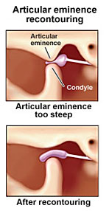
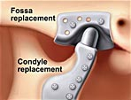
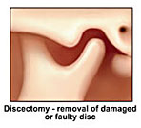
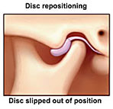
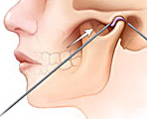
Disease of the TemporoMandibular Joint (TMJ)
Osteophyte
Pannus formation
Arthrocentesis (is the irrigation of the joint) for painful limited opening. TMJ arthroscopy is performed to lysis and lavage for the management of patients with painful limited mouth opening.
Arthroplasty refers to all types of open surgery for TMJ, including disk repositioning, discectomy, and joint replacement
Disk repositioning is used when the protective cartilage disk has slipped out of place inside the TMJ
A discectomy is performed when the disk providing padding and protection to the TMJ has deteriorated or become damaged
TMJ replacement

Slide 34
Disease of TMJ
Benign tumors and lesion
Osteoma
Osteochondroma
Chondroma
Chondroblastoma
Giant cell granuloma
Giant cell tumor
Neurofibroma
Hemangioma
Arteriovenous malformation
Synovial chondromatosis
Osteochondrosis dissecans
Ganglion cyst

Slide 35
Surgical approaches to TMJ
Pre auricular approach
Endaural approach
Post auricular approach
Submandibular (Risdon’s ) approach
Post ramal ( Hind’s ) approach
Parotidectomy type of incision with temporal extension
Hemicoronal approach
Coronal or bicoronal approach

Slide 36
Preauricular approach
Endaural approach

Slide 37
Submandibular approach
Post ramal approach

Slide 38
Post auricular approach
Parotidectomy type of incision with temporal extension

