Slide 1
GENITOURINARY TUBERCULOSIS
accounts for 30% to 40% of all extrapulmonary TB.
In developed countries, urogenital tuberculosis occurs in 2% to 10% of cases of pulmonary tuberculosis, while in developing countries it occurs in as many as 15% to 20% of cases.

Slide 6
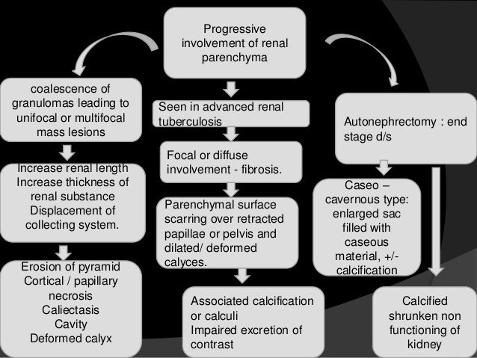

Slide 9
WORK UP
Urinalysis and Culture.
Mantoux Test.
PCR.
Radiography and Endoscopy:
Plain Radiograph
Intravenous Urography (IVU)
Computed Tomography
Ultrasonography

Slide 10
WORK UP
Retrograde Pyelogram and Antegrade Pyelogram.
Cystoscopy and Ureteroscopy

Slide 11
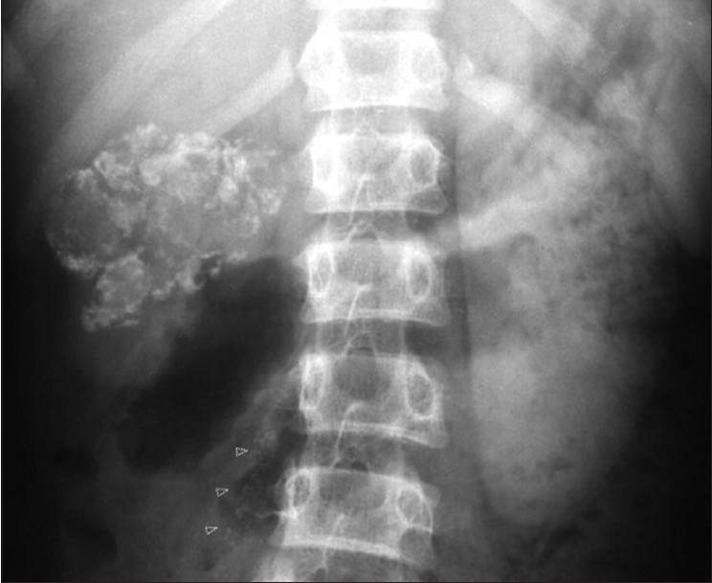

Slide 12
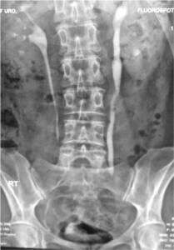

Slide 13
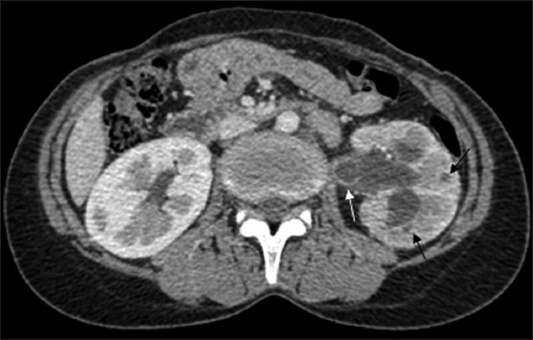

Slide 14
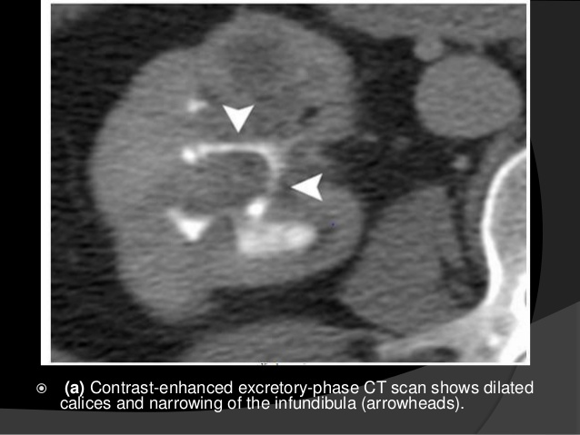

Slide 15
Treatment
Antituberculous Drugs.
Surgical Therapy:
Nephrectomy
Ureteropelvic and Ureteral Surgery
Bladder Surgery
epididymectomy

Slide 16
INDICATIONS OF NEPHRECTOMY
1-dest kid.despite Rx.
2- coexist malig.
3-HTN.
4-calcified non funct. Kid.

Slide 17
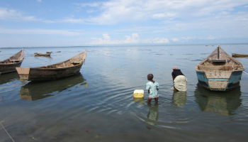
URINARY BILHAR.
S. mansoni
S. japonicum
S. haematobium
n Southwest Asia, the disease is found
in Southern Yemen, Yemen, Saudi Arabia, Lebanon, Syria, Turkey,
Iraq, and Iran
Notes:
n Southwest Asia, the disease is found
in Southern Yemen, Yemen, Saudi Arabia, Lebanon, Syria, Turkey,
Iraq, and Iran

Slide 18
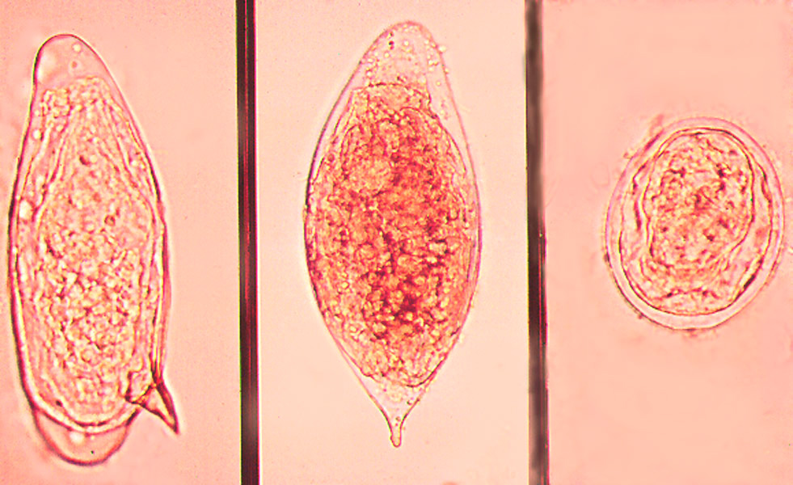

Slide 19
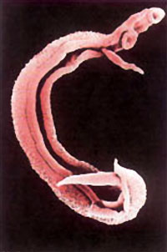

Slide 20
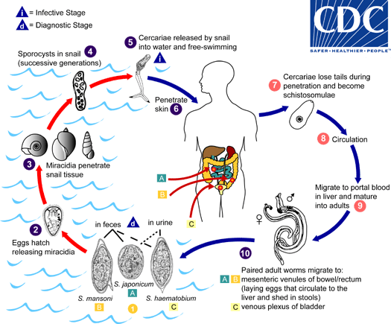

Slide 21
Clinical Manifestations
fever, lymphadenopathy, splenomegaly, eosinophilia, urticaria, and othemanifestations of a serum sickness–like disease.
3 to 9 weeks after infection.
Chronic Schistosomiasis
Hematuria
Pain
Irritative voiding symptoms
Incontinence
anemia

Slide 23
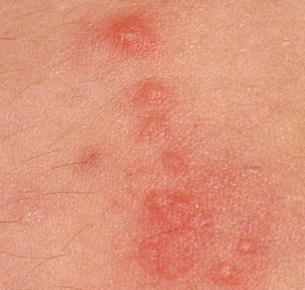

Slide 24
DIAGNOSIS
Eggs in urine
Serological tests AB
IVU
CT
cystoscope

Slide 25
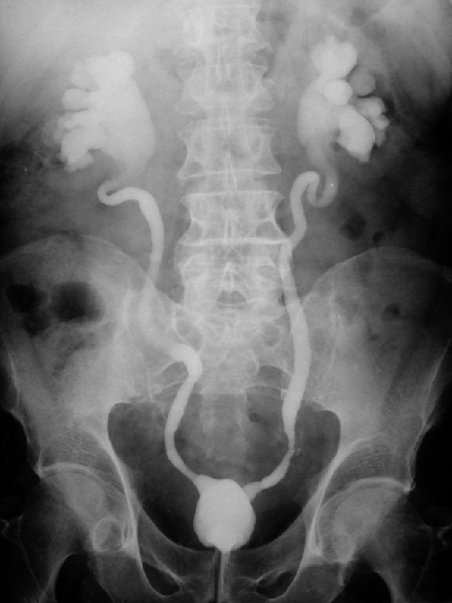

Slide 26
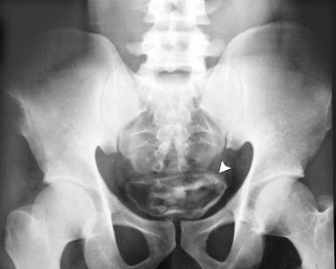

Slide 27
TREATMENT
Medical Management.
Praziquantel is the drug of choice for all schistosoma species
Surgical Management.
COMPLICATIONS
Infection
Malignancy
stones

Slide 28
Hydatid Disease
renal hydatids occur in only about 2% of cases
The hydatid is the larval form of Echinococcus granulosus,whose definitive host is the dog, and whose principal intermediate host is the sheep.

Slide 29
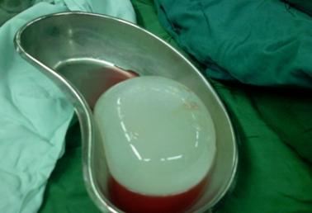
presentation
Asymp.
Flankpain
Backache
Palpable loin mass

Slide 30
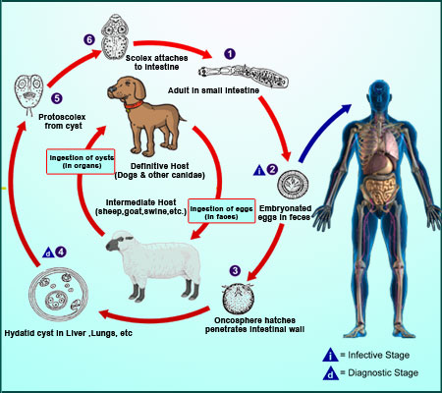

Slide 31
diagnosis
Serology
Plain X-ray
U/S
CT
Rx
Nephrectomy
Albendazol pre-op.

Slide 32
