Slide 1

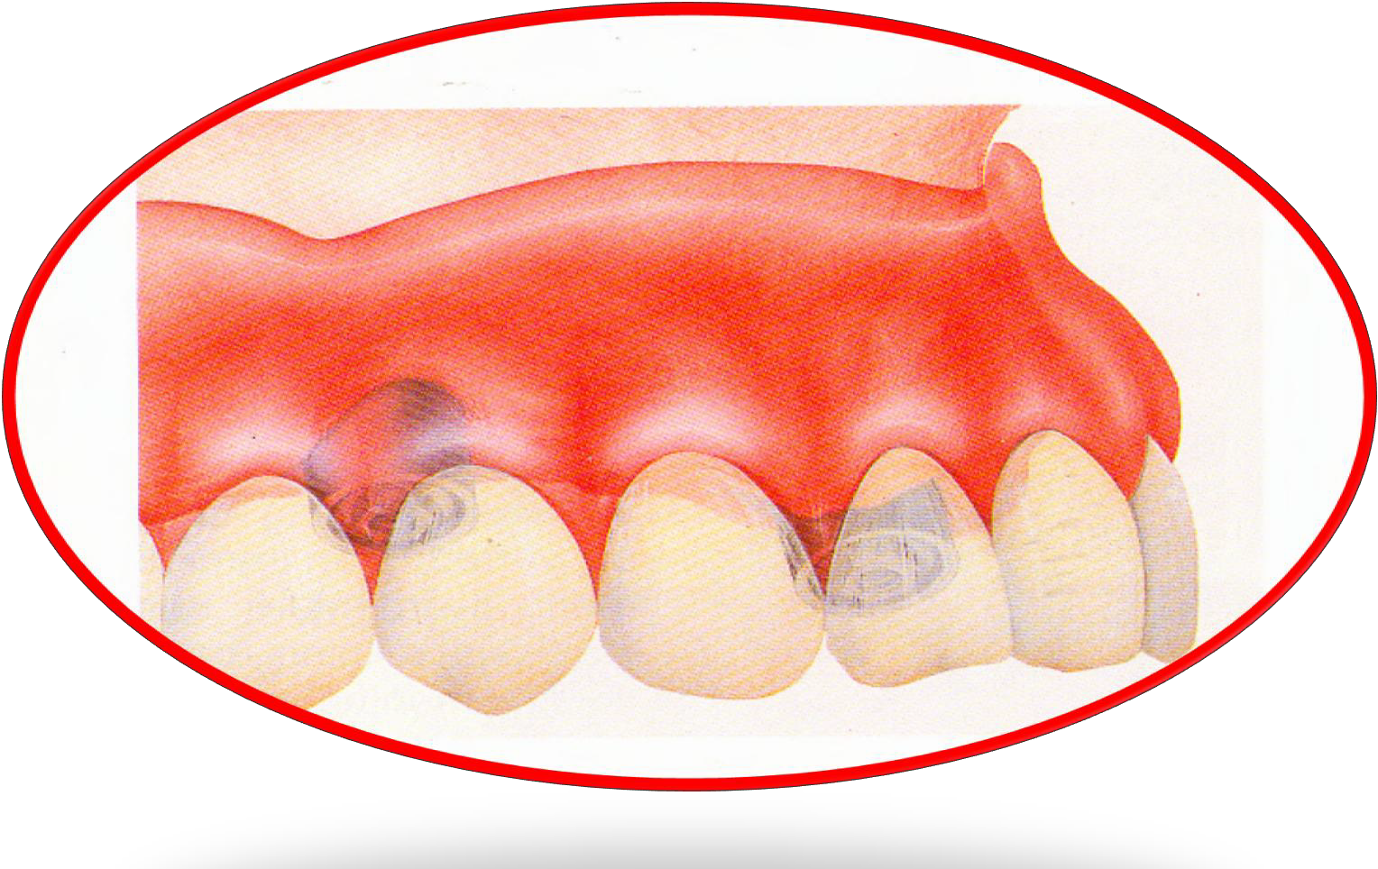








صناعة اسنان \ خامس
د. زينة م4
1-12-2016
By
Dr. Monia MN Kandil

Slide 2
Definition of Overdentures
Any removable dental prosthesis that
completely or partially covers and rests on one or more remaining natural teeth, the roots of natural teeth, and/or dental implants; is called
overlay denture, overlay (superimposed)
prosthesis .
(Glossary of prosthodontic terms, 2005)

Slide 3


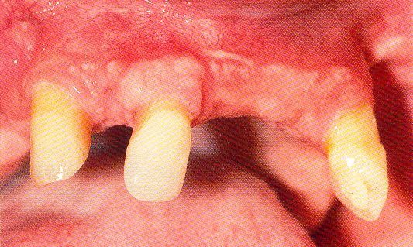
◻ 1) Few remaining teeth or teeth with an unfavourable distribution in the arch which precludes treatment with a removable P.D.

Slide 4
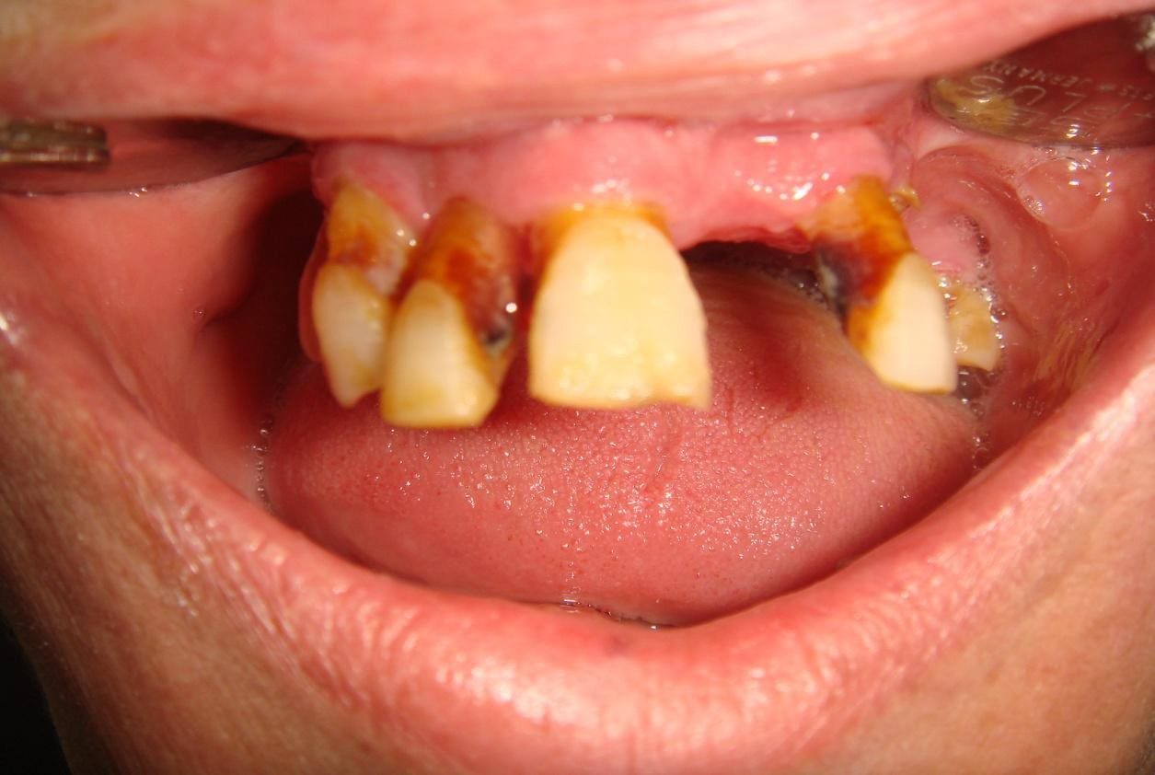
◻ 2) Severe loss of periodontal attachment in a patient who cannot afford a fixed partial denture

Slide 5
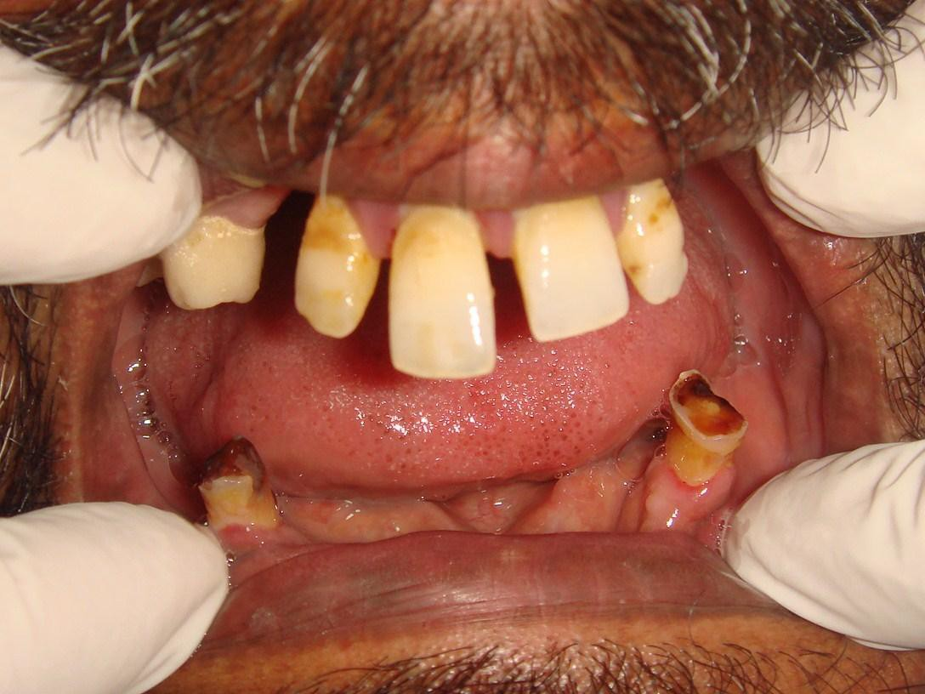
◻ 3) Complicated functional and aesthetic conditions due to tooth migration which make restoration with a removable or fixed partial denture difficult.

Slide 6
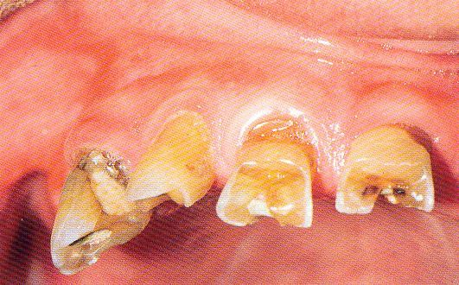
◻ 4) Significant tooth loss due to attrition.

Slide 7

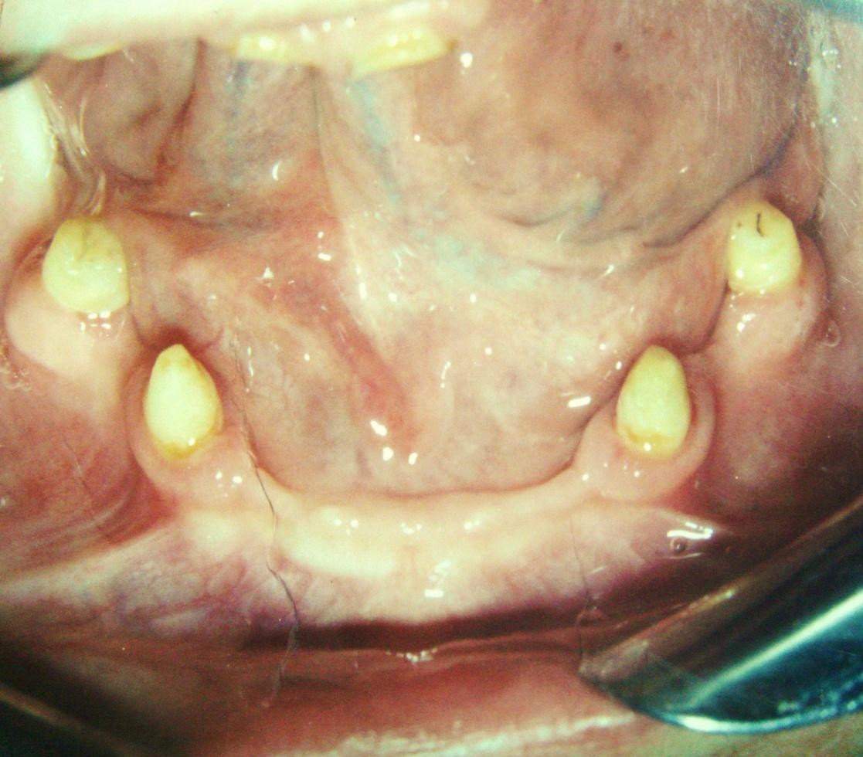
◻ 5) Congenital absence of teeth i.e. Partial anodontia.

Slide 8


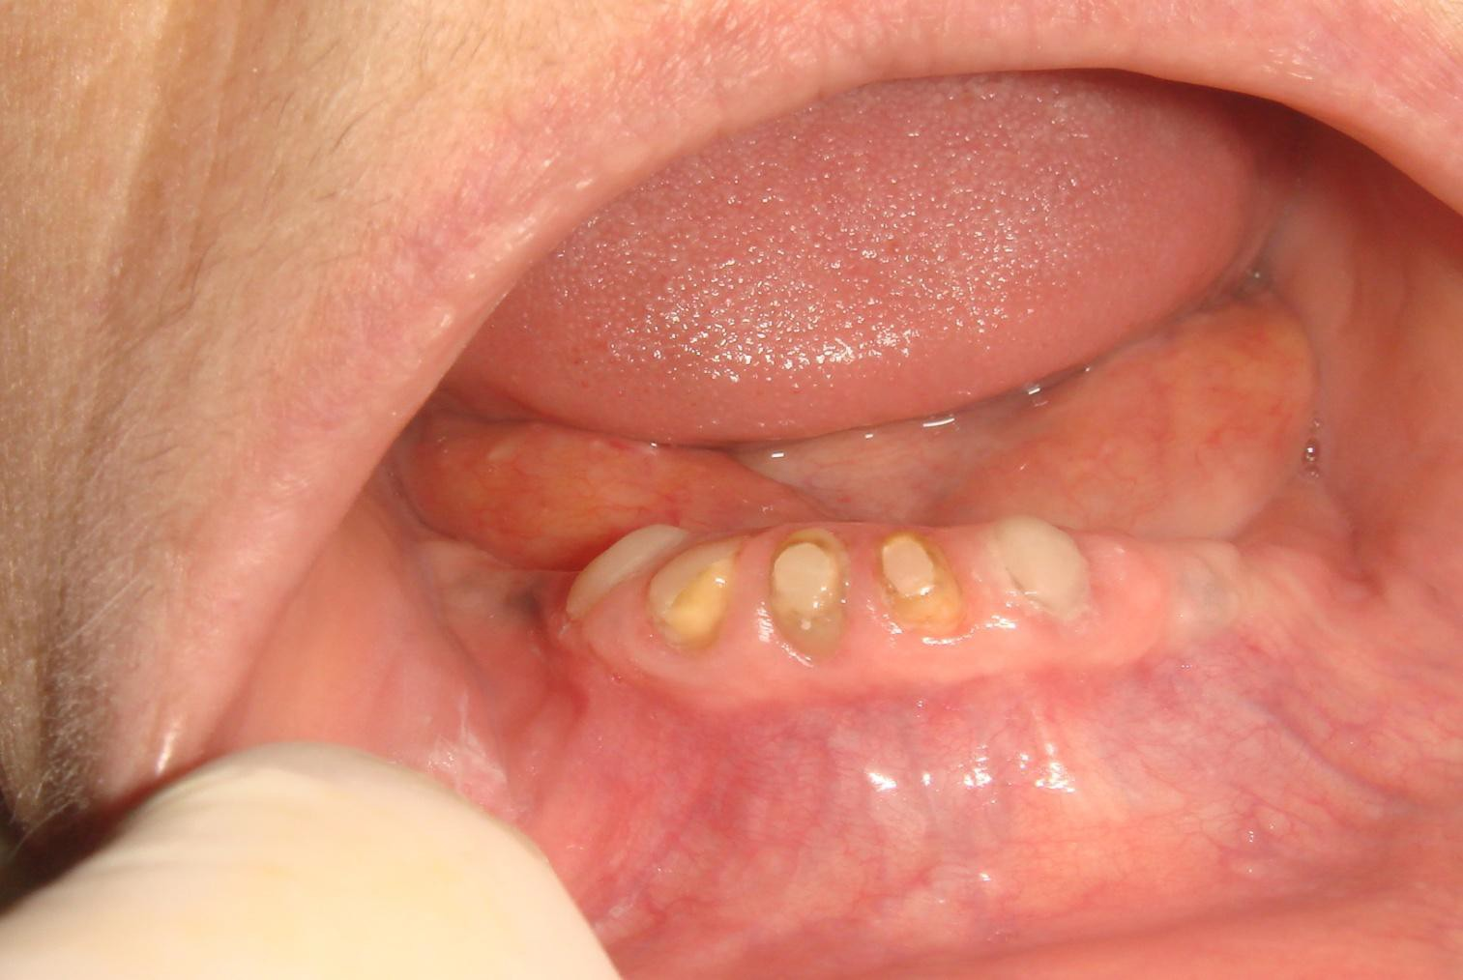
◻ 1) Preservation of the alveolar ridge.

Slide 9

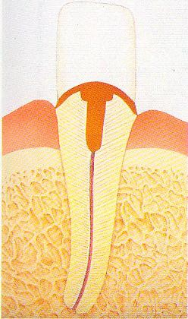
◻ 2) Enhanced retention of the tooth in the jaw
(reduced C/R ratio)

Slide 10
◻ 3) Enhancement and maintenance of denture
stability .
◻ 4) Maintenance of the patient’s neuromuscular control and prevention of masticatory muscle atrophy .
◻ 5) Mental and functional comfort of the patient
◻ 6) Enhanced retention of the denture.

Slide 11


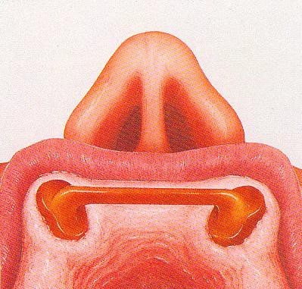
◻ 1) Overdentures are occasionally bulkier than
conventional dentures.

Slide 12

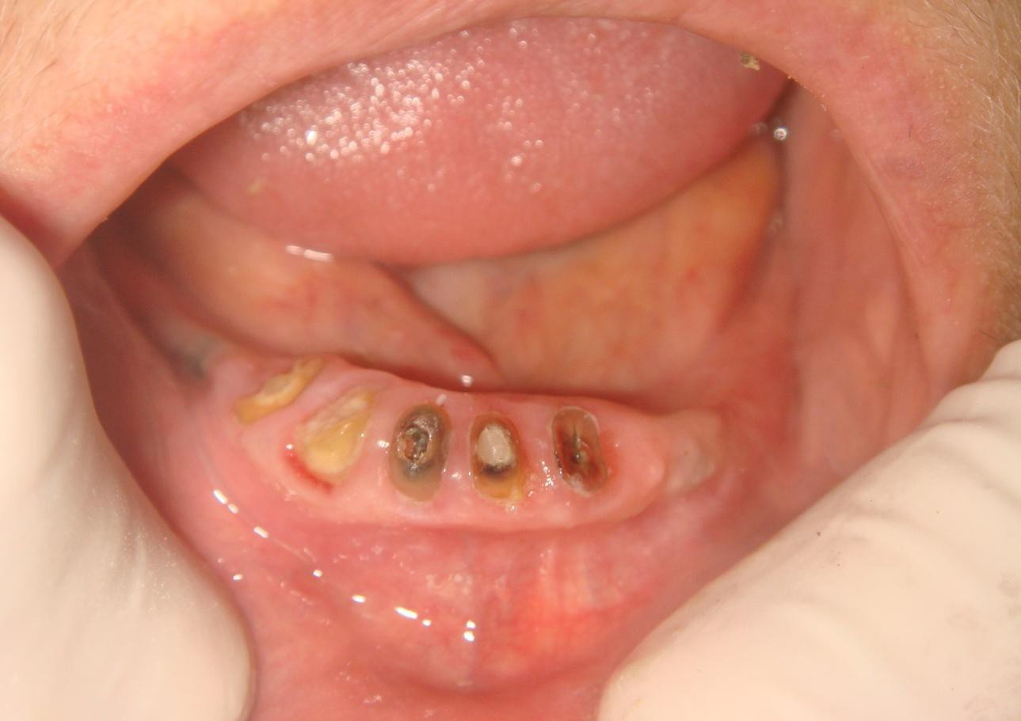
◻ 2) Susceptibility of the abutment teeth to caries periapical disease , periodontal disease and vertical root fractures.

Slide 13
◻ 3) Increased demand for
the patient’s
motivation towards oral hygiene.
◻ 4) More time consuming chair-side , more recall visits and higher cost.
◻ 5) The patient applies more load on the overdenture which is inherently weaker due to the space occupied by the root(s).

Slide 14


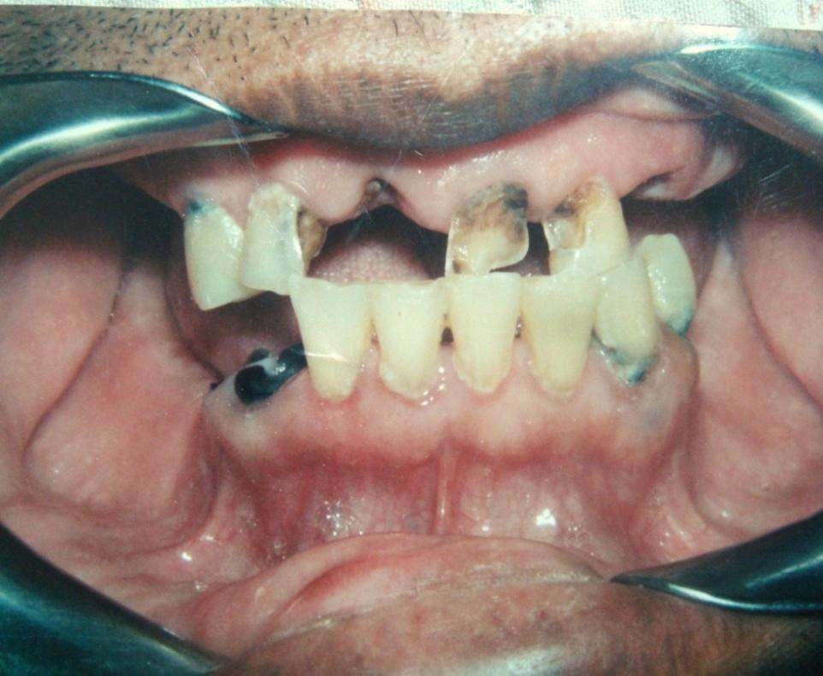
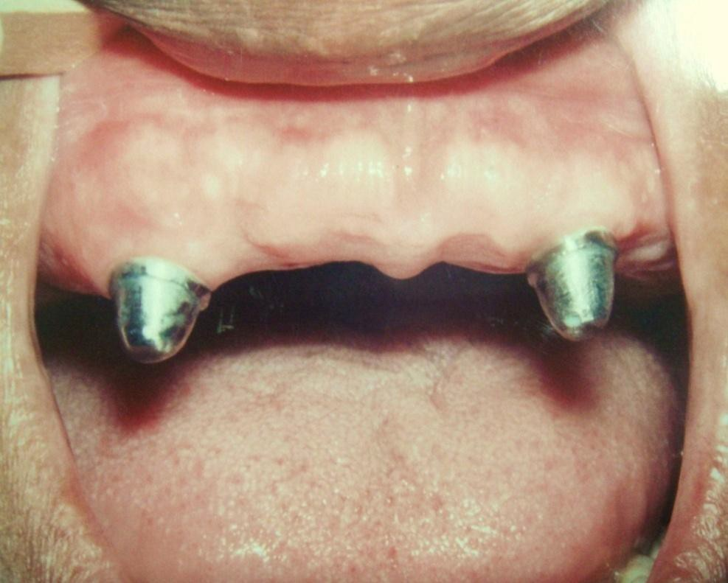

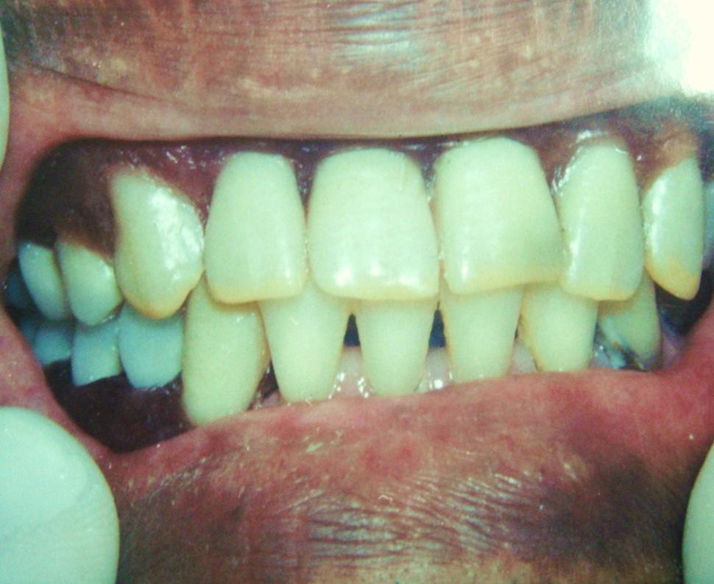

Slide 15
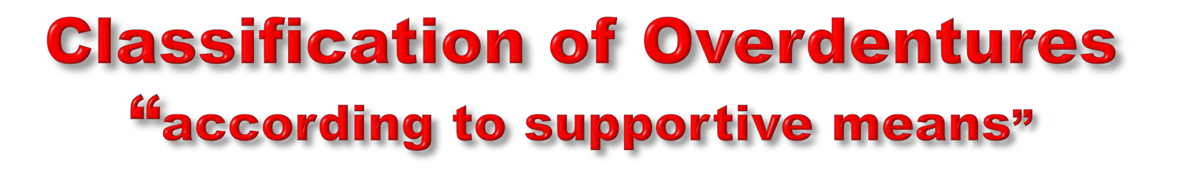
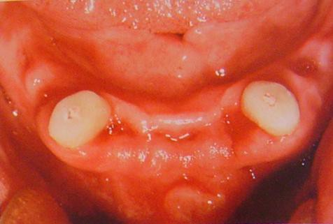
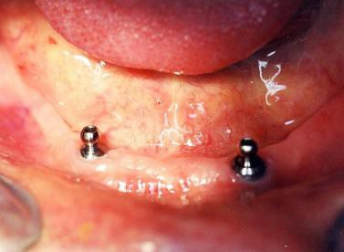
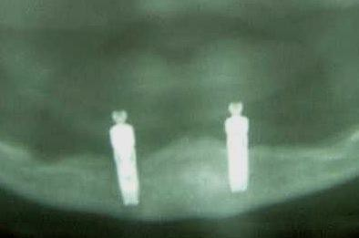
Implant supported
Tooth supported

Slide 16



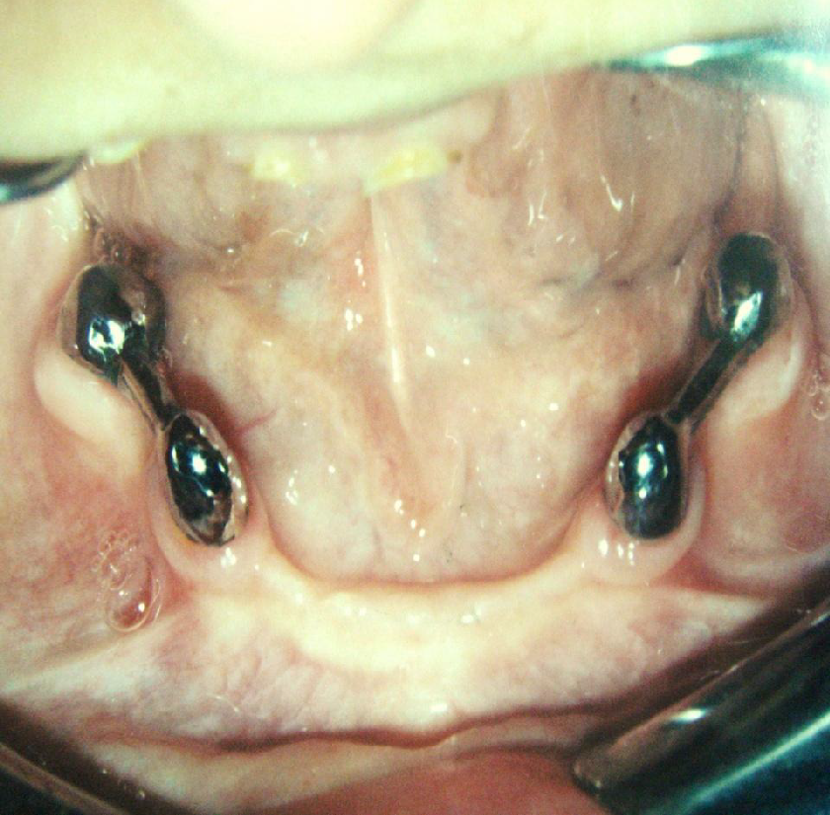
1) Tooth supported overdentures.

Slide 17


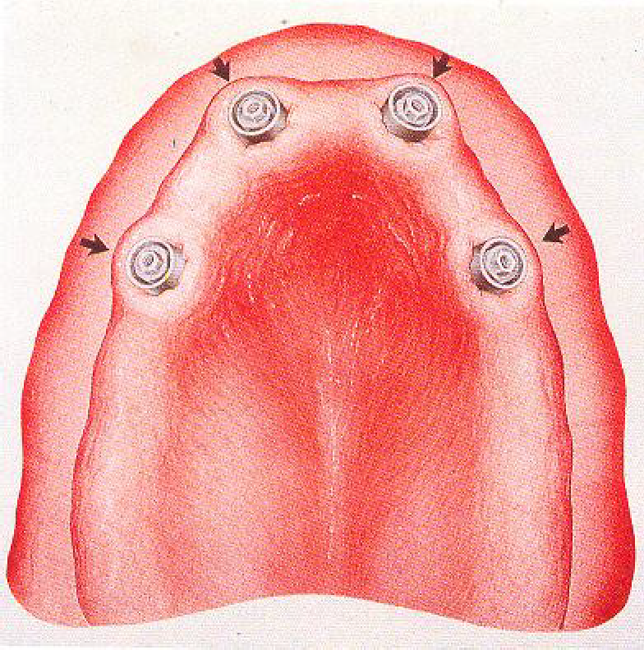
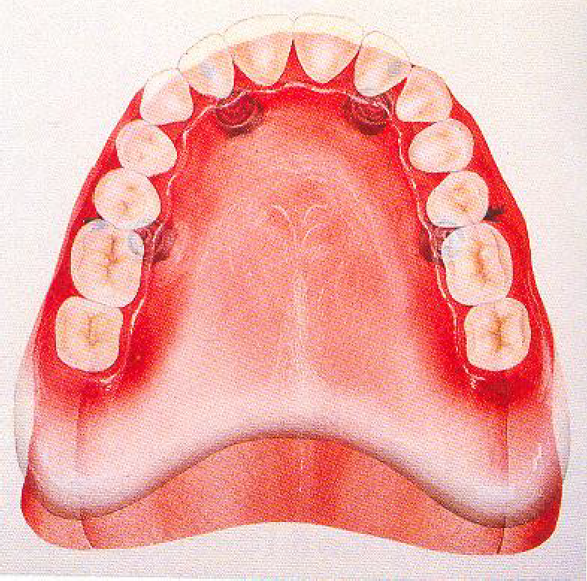
2) Implant supported overdentures.

Slide 18

“According to design and technique of
abutment preparation”
1- Simple tooth reduction of vital abutment. 2- Tooth reduction and cast coping of
vital
abutment / thimble or dome- shaped.
Endodontic therapy and amalgam plug.
Endodontic therapy with post and coping.
Endodontic therapy with cast coping and attachments.
Telescopic Overdenture.

Slide 19
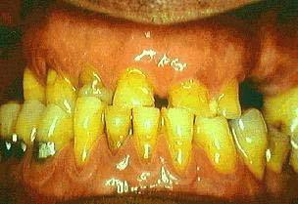
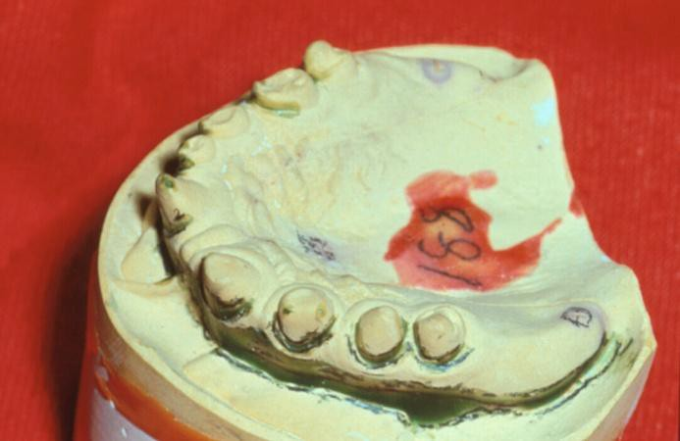
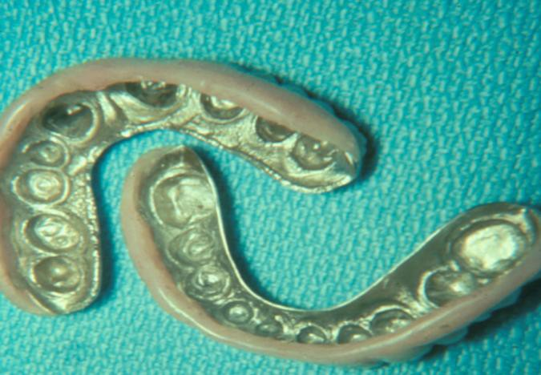
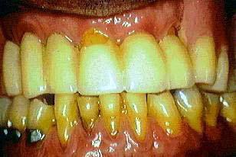
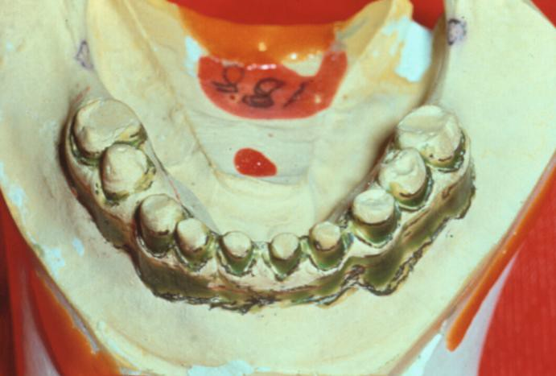
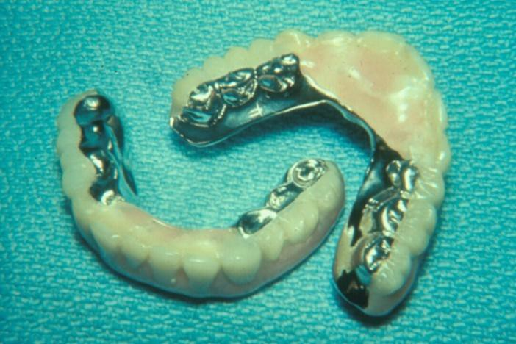
1- Simple tooth modification of vital abutment.

Slide 20
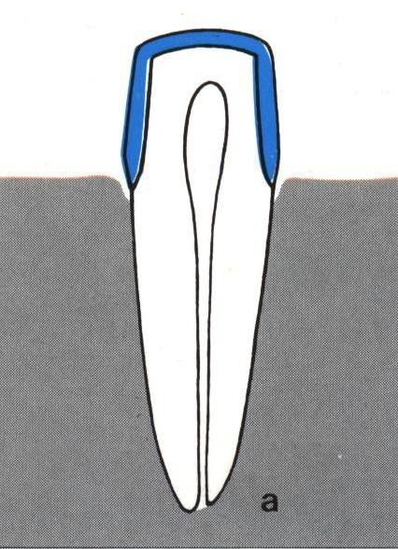
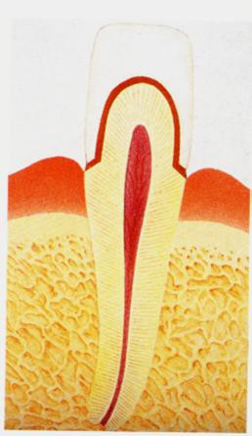
2- Tooth reduction and cast coping of vital abutment
A- Thimble-shaped
coping

Slide 21
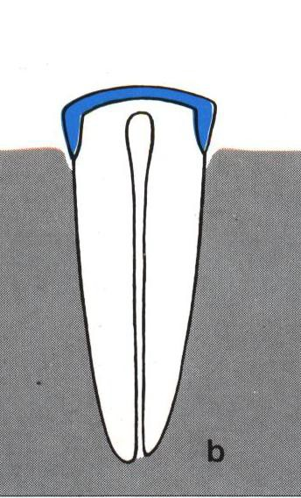
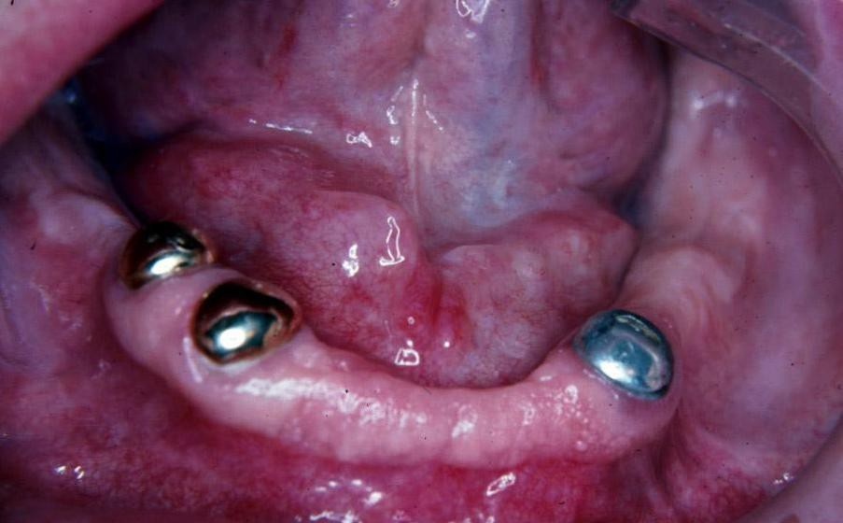
2- Tooth reduction and cast coping of vital abutment
B- Tooth reduction
and cast coping

Slide 22
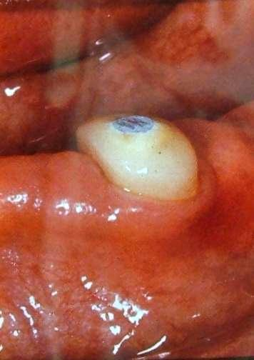
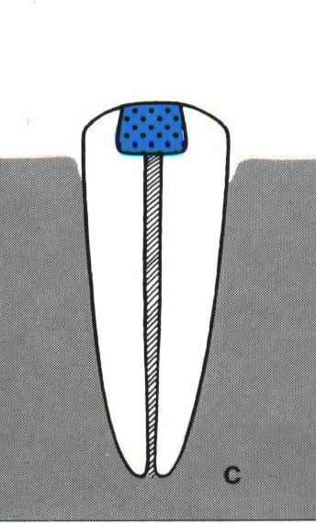
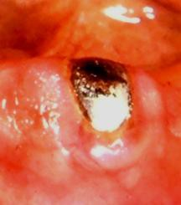
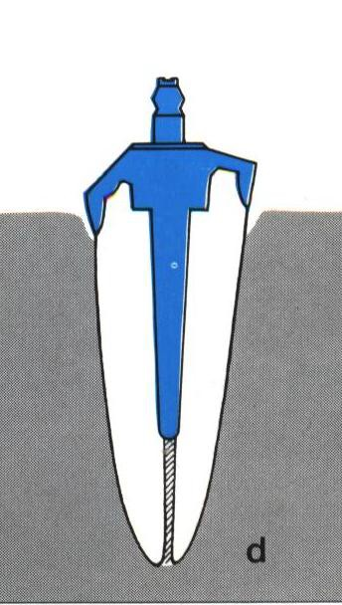
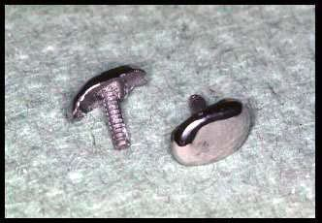
.Endodontic therapy and amalgam plug
.Endodontic therapy with post and cast coping

Slide 23
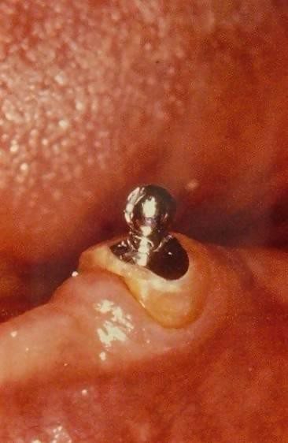
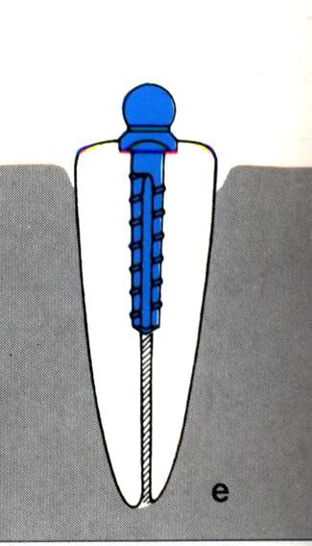
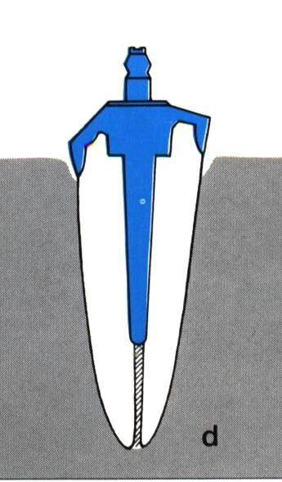
5- Endodontic therapy with cast
coping and attachments

Slide 24
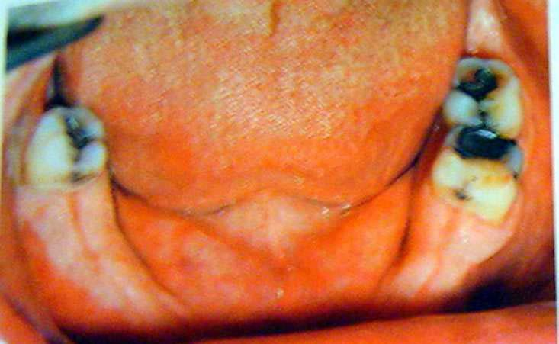
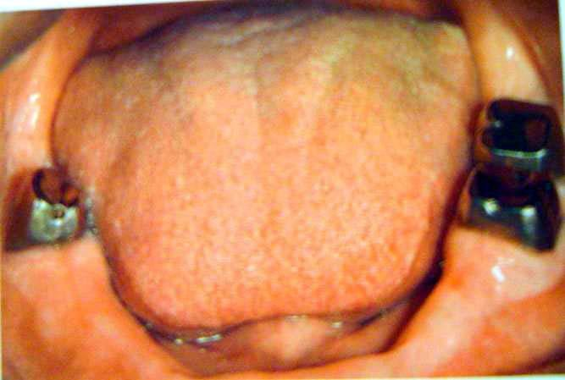
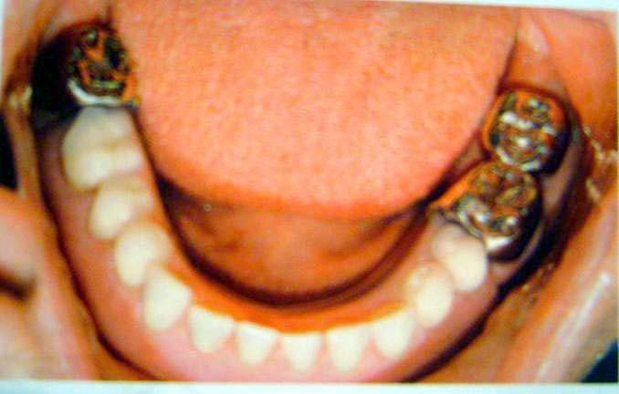
6- Telescopic overdenture

Slide 25
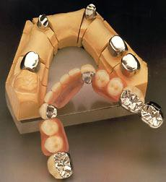
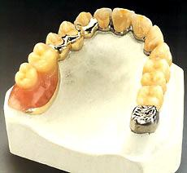
Gold or metallic cast Copings and telescopic crowns are a method of improving overdenture retention. These
may be conical crowns (semi- parallel wall) with a friction adaptation at the marginal area of the abutment, or Milled crowns for larger areas and parallel surfaces.
Friction retention is more commonly used in exclusively tooth-supported overdentures
that are not supported by soft
tissue.

Slide 26

Immediate
Overdentures
Definitive Overdentures
Transitional
Overdentures

Slide 27

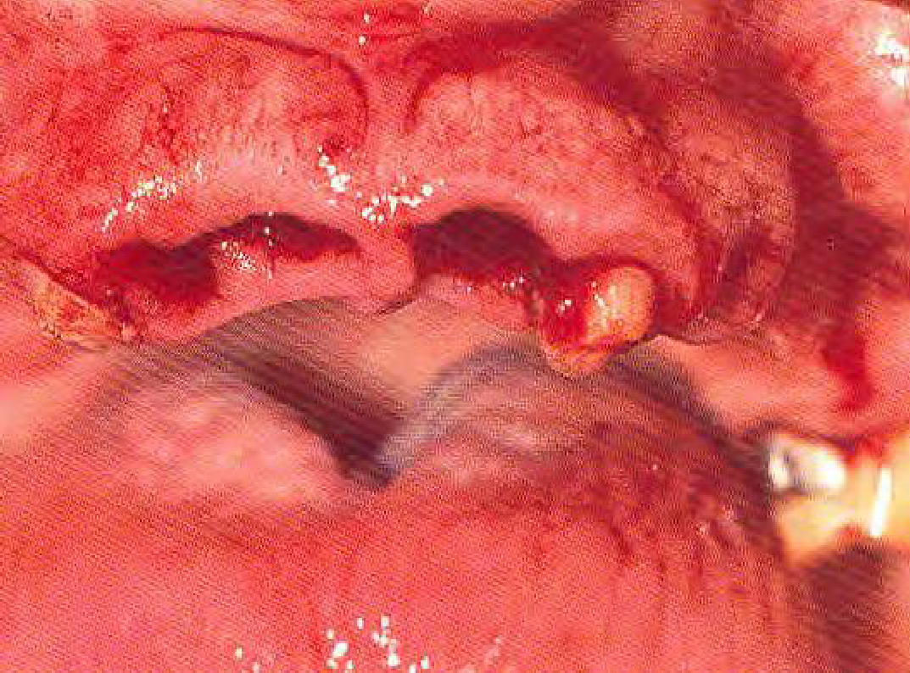
1) Immediate overdenture.

Slide 28
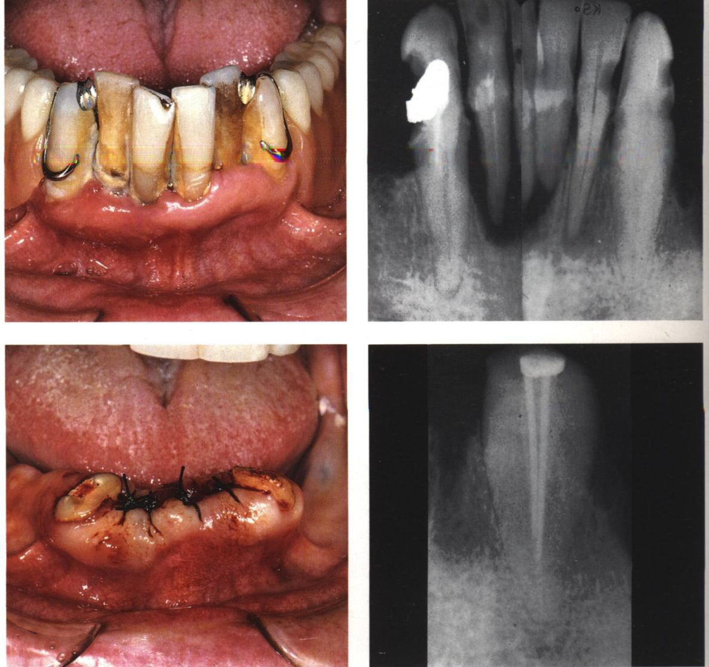
Immediate Overdenture
It’s constructed prior to the preparation of abutment teeth and inserted after the preparation.
When the processed denture is fitted, it is relined with cold cured acrylic in the areas around the abutment teeth to make it fit as well as possible.

Slide 29
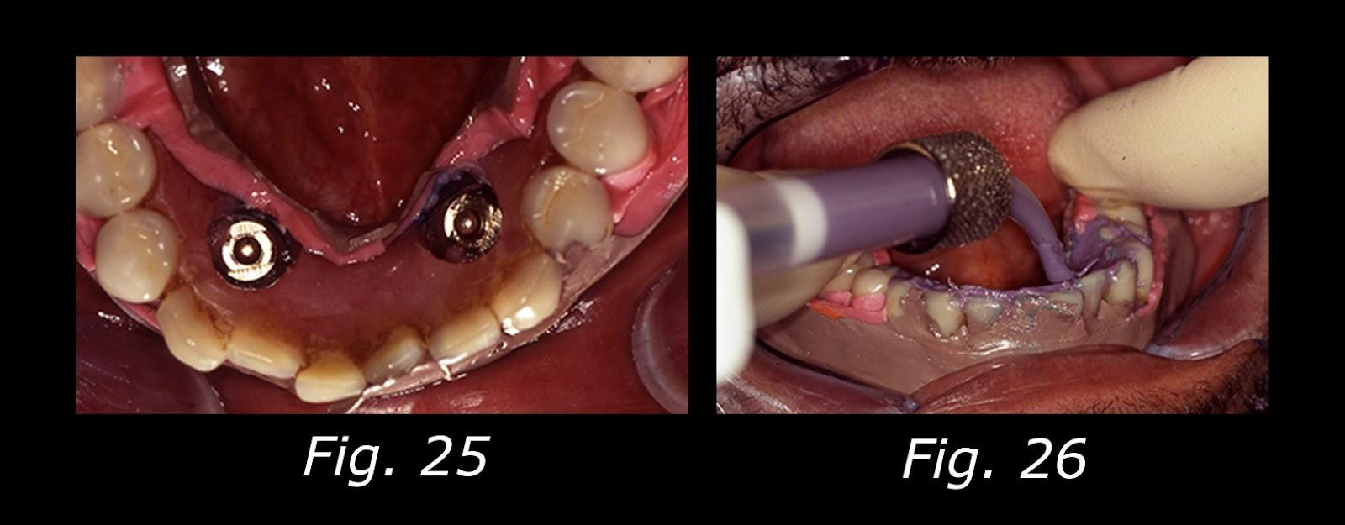
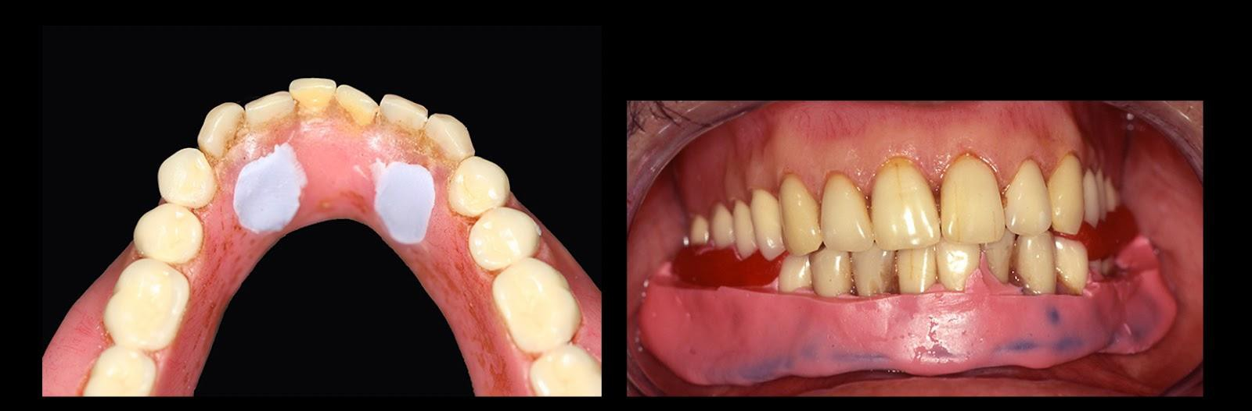
2) Transitional Overdentures

Slide 30
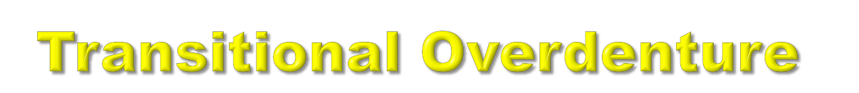
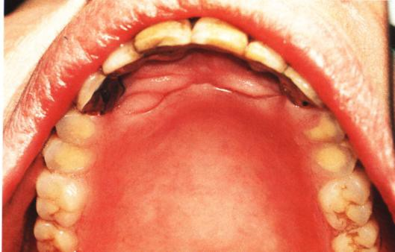
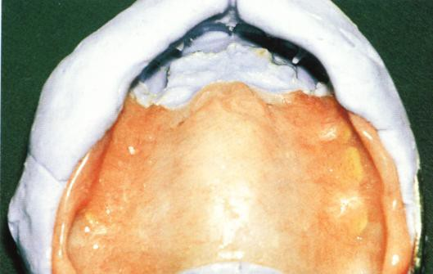

Obtaining by Converting an already existing RPD to an O.D.

Slide 31


3) Definitive overdenture.

Slide 32




Partial overdenture
Complete overdenture

Slide 33

Simple overdentures.
Attachment retained overdentures.

Slide 34




1) Simple overdenture.
a) without copings.
b) with copings.

Slide 35
Attachment retained overdenture.
a) stud attachment
b) bar attachment
c) magnet attachment
d) telescopic attachment

Slide 36


Attachment retained overdenture.
a) stud attachments

Slide 37


Attachment retained overdenture.
b) bar attachment

Slide 38


Attachment retained overdenture.
c) magnet attachment

Slide 39

Attachment retained overdenture.
d) telescopic attachment

Slide 40

◻ 1) Medical history.
◻ 2) Dental history.
◻ 3) Patient’s oral hygiene and anticipated cooperation and motivation.
◻ 4) Examination and proper abutment selection.

Slide 41





1) Bilateral distribution (avoid unilateral and diagonal).
2) Natural teeth or
implants as antagonists.

Slide 42




◻ 3) Endodontic treatment
possible.
◻ 4) min. 5mm periodontal
attachment
◻ min. 3mm attached gingiva.
◻ min. 2-3mm abutment height.
◻ no bony undercuts interfere
with the insertion.

Slide 43




◻ 5) sufficient space between the abutment
and the opposing.

Slide 44






















































1) Long (6-8mm):
heavily tapered facially.
less tapered lingually.
gingival 1/3 approximately parallel.
a heavy shoulder at the gingival margin , if a secondary metal coping will be placed.
teeth are usually vital.
◻
◻
◻
◻

Slide 45



Slide 46
2) Medium (4-6mm):
◻ a) usually conical with greater taper on all surfaces.
◻ b)usually used with a bar.
◻ c) tooth may or may not be vital.

Slide 47





Slide 48
3) Medium short (2-4mm):
◻ a) proximal walls should be parallel for max. frictional fit
◻ b) adjacent abutments better to be splinted
◻ c) tooth is non vital
◻ d) used when a favourable C/R ratio
is needed

Slide 49



Slide 50
4) Short (1-2mm):
◻ a) conform to the curvature of the alveolar ridge (Dum-shape).
◻ b) very low profile.
◻ c) indicated for max. favourable C/R
ratio.
◻ d) can be used with the stud
attachment.

Slide 51

May be with or without amalgam plug.

Slide 52


























5) Submerged root:
Abutment reduced to level below gingival margin, so need extra retentive attachment (intracoronally).

Slide 53








Slide 54




RCF .... if needed

Slide 55




Slide 56



If planned…

Slide 57



Slide 58



Slide 59
Centric & vertical relation registrations.
Arrangements of the artificial teeth, according to aesthetic & functional (occlusal) considerations.
Try in the unfinished denture.
Deliver the prosthesis, after patient constructed conversation.

Slide 60




Slide 61


Slide 62



Nearly same steps mentioned with the tooth supported OD, except the step of tooth reduction.
If using an attachment with the implant, the direct pick up procedure for the female part within the denture base is favourable.

Slide 63
















































Same as conventional overdenture, except:
◻ Choose the retaining clasp (simplest design): Light-guage wrought wire clasp is the best choice to allow easy release of direct retainer if occ. load to be applied on the distal extension base.
◻ Continue as conv. RPD (mouth prep., imp. making, fitting of the framework).
◻ Altered cast impression tech. by rubber base if
there is undercut in the POD abutment.

Slide 64




