Slide 1
The Head and Neck The Neck

Slide 2
The Neck
The neck is the region of the body that lies between the lower margin of the mandible above and the suprasternal notch and the upper border of the clavicle below.

Slide 3
Skin
The natural lines of cleavage of the skin are constant and run almost horizontally around the neck.
This is important clinically because an incision along a cleavage line will heal as a narrow scar, whereas one that crosses the lines will heal as a wide scar.

Slide 4
Cutaneous Nerves of Neck
Cutaneous Nerves
The skin overlying the trapezius muscle and that on the back of the scalp as high as the vertex, is supplied segmentally by the posterior rami of cervical nerves 2-5.
The skin of the front and sides of the neck is supplied by the anterior rami of the cervical nerves 2-4 through branches of the cervical plexus
Greater occipital n. (posterior ramus of C2)
Lesser occipital n. (C2) hooks around the accessory nerve and ascends along the posterior border of the sternocleidomastoid muscle to supply the skin over the lateral part of the occipital region and the medial surface of the auricle.
Greater auricular n. (C2 & 3) ascends across the sternocleidomastoid muscle and divides into branches that supply the skin over the angle of the mandible, the parotid gland, and on both surfaces of the auricle.
Transvers cutaneous n. (C2 & 3) emerges from behind the middle of the posterior border of the sternocleidomastoid muscle. It passes forward and divides into branches that supply the skin on the anterior and lateral surfaces of the neck, from the body of the mandible to the sternum.
Supraclavicular n. (C3 & 4) emerge from beneath the posterior border of the sternocleidomastoid muscle and descend across the side of the neck. They pass onto the chest wall and shoulder region, down to the level of the second rib. They divide into the medial, intermediate, and lateral supraclavicular nerves.

Slide 5
Fascia of the neck
Superficial Fascia
The superficial fascia of the neck forms a thin layer that encloses the platysma muscle.
Also embedded in it are the cutaneous nerves, the superficial veins, and the superficial lymph nodes.

Slide 6
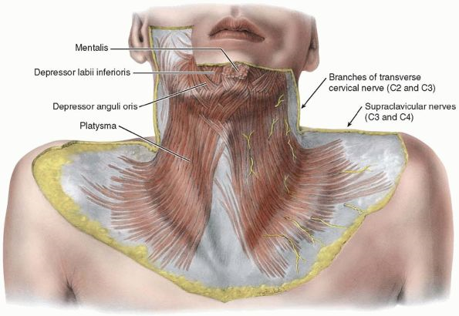
The Platysma Muscle
The platysma muscle is a thin muscular sheet embedded in the superficial fascia.
Origin:
It originates from the deep fascia that covers the upper part of the pectoralis major and deltoid muscles.
Insertion:
It passes upward into the neck and is inserted into the lower margin of the body of the mandible.
Nerve Supply:
Its nerve supply is the cervical branch of the facial nerve.
Action:
It depresses the mandible and also draws down the lower lip and the angle of the mouth.

Slide 7
Superficial veins
external jugular vein
The external jugular vein begins just behind the angle of the mandible by the union of the posterior auricular vein and the posterior division of the retromandibular vein.
It descends obliquely across the sternocleidomastoid muscle and, just above the clavicle in the posterior triangle, pierces the deep fascia and drains into the subclavian vein.
Tributaries
Posterior auricular vein
Posterior division of retromandibular vein.
Posterior external jugular vein: This is a small vein that drains the posterior part of the scalp and neck and joins the external jugular vein about halfway along its course.
Transverse cervical vein.
Suprascapular vein.
Anterior jugular vein: This vein begins just below the chin, by the union of several small veins. It runs down the neck close to midline. Just above the suprasternal notch, the veins of the two sides are unite by a transverse trunk called jugular arch. The vein turns sharply laterally and passes deep to the sternocleidomastoid muscle to drain into the external jugular vein.

Slide 8
Superficial Lymph Nodes
The superficial cervical lymph nodes lie along the external jugular vein superficial to the sternocleidomastoid muscle.
They receive lymph vessels from the occipital and mastoid lymph nodes and drains into the deep cervical lymph nodes.
Deep Fascia
The deep cervical fascia consists of areolar tissue that supports the muscles, vessels, and viscera of the neck.
In certain areas it is condensed to form well-defined fibrous sheets called the investing layer, the prevertebral layer, and pretracheal layer.
It is also condensed around the carotid vessels to form the carotid sheath.
the subclavian artery together with the brachial plexus of nerves, carries with them a sheath of fascia the axillary sheath, derived from the prevertebral layer of the deep cervical fascia.
Investing Layer
The investing layer is a thick layer that encircles the neck.
It splits to enclose the trapezius and the sternocleidomastoid muscles.

Slide 9
The Layers of Deep Cervical Fascia
Prevertebral layer.
lies in front of the vertebral column, prevertebral muscles, cervical brachial plexuses.
Laterally covering postvertebral muscle on floor of post. triangle and blends with cervical fascia.
Superiorly attached to base of the skull and inferiorly it blends with the anterior longitudinal ligament.
Pretracheal layer.
superiorly attached to hyoid bone and the oblique line of thyroid cartilage.
surrounds the thyroid gland and binds it to the larynx.
encloses the parathyroid glands and invests the infrahyoid muscles.
Carotid sheath.
Laterally encloses internal jugular vein.
Medially common and internal carotid arteries.
Posteriorly vagus nerve.
Axillary sheath.
As the subclavian artery and the brachial plexus emerge in the interval between the scalenus anterior and the scalenus medius muscles, they carry with them a sheath of the fascia, which extends into the axilla and is called the axillary sheath.

Slide 10
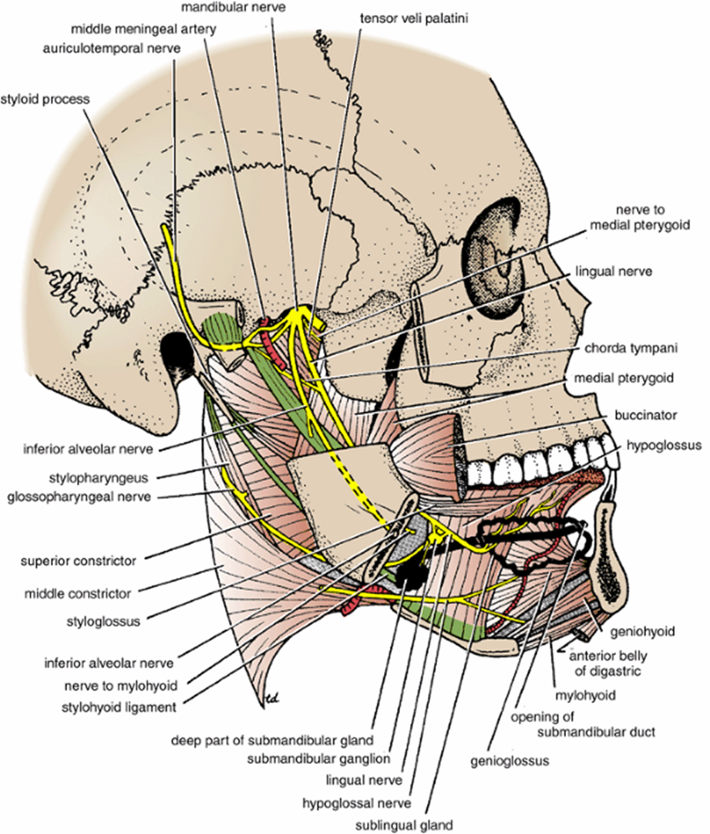
Cervical Ligaments
Stylohyoid ligament: Connects the styloid process to the lesser cornu of the hyoid bone
Stylomandibular ligament: Connects the styloid process to the angle of the mandible.
Sphenomandibular ligament: Connects the spine of the sphenoid bone to the lingula of the mandible
Pterygomandibular ligament: Connects the hamular process of the medial pterygoid plate to the posterior end of the mylohyoid line of the mandible. It gives attachment to the superior constrictor and the buccinator muscles.

Slide 11
Posterior Triangle
Posterior Triangle
The posterior triangle is bounded posteriorly by the trapezius muscle, anteriorly by the sternocleidomastoid, and inferiorly by the clavicle.
The triangle is covered by skin, superficial fascia, platysma, and the investing layer of deep fascia.
Running across the triangle in this covering are the supraclavicular nerves.
The muscular floor of the triangle is covered by the prevertebral layer of the deep fascia.
It is formed from above downward by the semispinalis capitis, splenius capitis, levator scapulae, and scalenus medius.
A small part of the scalenus anterior may be present, but it is usually overlapped and hidden by the sternocleidomastoid muscle
The inferior belly of the omohyoid subdivides the posterior triangle into a large occipital triangle above and a small supraclavicular triangle below.

Slide 12
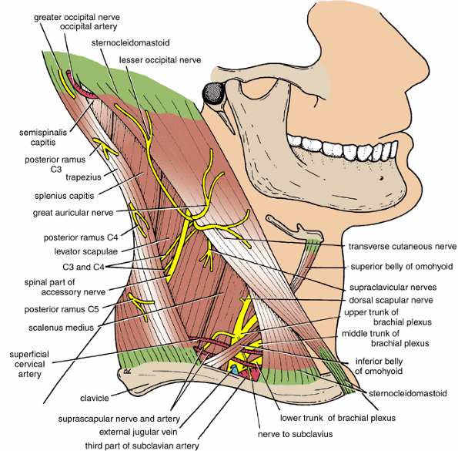
Superficial cervical artery
Content of the Posterior Triangle
The superficial cervical artery is a branch of the thyrocervical trunk, which is a branch of the first part of the subclavian artery.
It runs across the lower part of the posterior triangle and disappear deep to the trapezius muscle.
Suprascapular artery
The suprascapular artery is also a branch of the thyrocervical trunk.
It runs across the lower part of the posterior triangle and follows the suprascapular nerve into the supraspinous fossa and takes part in the arterial anastomosis around the scapula
Occipital artery
The occipital artery is a branch of the external carotid artery. It enters the posterior triangle at its apex, appearing between the sternocleidomastoid and the trapezius muscles.
The artery then ascend in a tortuous course over the back of the scalp, accompanied by the greater occipital nerve.

Slide 13
Brachial Plexus
Brachial plexus
The brachial plexus is formed from the anterior rami of the fifth, sixth, seventh, and eighth cervical nerves and from the first thoracic nerve.
The plexus is divided into the roots, the trunks, the divisions, and the cords.
The roots of the brachial plexus
enter the posterior triangle of the neck through the interval between the scalenus anterior and scaleneus medius muscles.
Together with the subclavian artery, the plexus acquires a sheath, the axillary sheath.
The trunks of the brachial plexus are formed as follows:
The fifth and sixth cervical root quickly unites to form the upper trunk of the plexus.
The seventh cervical root continues as the middle trunk of the plexus.
The eighth cervical and the first thoracic roots unite to form the lower trunk of the plexus.
The divisions of the of the brachial plexus
are formed by each trunk dividing into anterior and posterior branches.
The cords of the brachial plexus are formed as follows:
The lateral cord is formed by the union of the anterior divisions of the of the upper and middle trunks.
The posterior cord is formed by the union of the posterior divisions of the upper, middle, and lower trunk.
The medial cord is formed from the anterior division of the lower trunk.
The cords of the plexus leave the posterior triangle by descending behind the clavicle and entering the axilla.

Slide 14
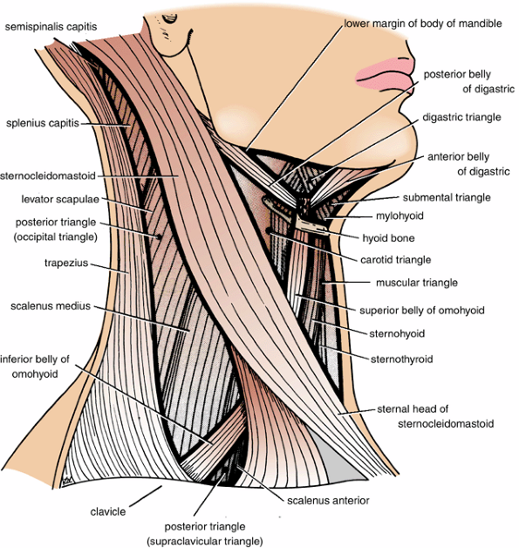
The omohyoid muscle has an inferior belly, an intermediate tendon, and a superior belly.
Origin and insertion: the inferior belly arises from the upper margin of the scapula and the suprascapular ligament.
The inferior belly is a narrow, flat muscle that passes upward and forward across the lower part of the posterior triangle of the neck.
It passes deep to the sternocleidomastoid muscle and ends in the intermediate tendon.
The intermediate tendon is held in position by a loop of deep fascia that slings the tendon to the clavicle and the first rib.
The superior belly ascends almost vertically in the anterior triangle of the neck and is inserted into the lower border of the body of the hyoid bone.
Nerve supply: ansa cervicalis (C1, 2, and 3).
Action: It depresses the hyoid bone.
Omohyoid

Slide 15
Anterior Triangle of Neck
Anterior Triangle of the Neck
The anterior triangle of the neck is bounded anteriorly by the midline of the neck, posteriorly by the anterior border of the sternocleidomastoid, and superiorly by the lower margin of the mandible.
The triangle is covered by the skin, superficial fascia, platysma, and the investing layer of the deep fascia.
Running across the triangle are the cervical branch of the facial nerve and the transverse cutaneous nerve.
The anterior triangle can be subdivided into smaller triangles by the anterior and posterior bellies of the digastric muscle and the superior belly of the omohyoid muscle.
These triangles are called the submental, digastric (or submandibular), carotid, and muscular triangles.

Slide 16
Digastric muscle
The digastric muscle has a posterior belly, an intermediate tendon, and an anterior belly.
Origin and insertion:
The posterior belly arises from the medial surface of the mastoid process of the temporal bone. Passes downward and forward and ends in the intermediate tendon.
The intermediate tendon pierces the stylohyoid insertion and binds to the junction of the body and greater cornu of the hyoid bone.
The anterior belly runs forward and medially and is attached to the lower border of the body of the mandible.
Nerve supply:
The posterior belly of the muscle is innervated by facial nerve and the anterior belly by branch from the mandibular division of the trigeminal.
Action:
Depresses the mandible or elevates the hyoid.
Stylohyoid Muscle
The stylohyoid muscle is a small slip that passes along the upper border of the posterior belly of the digastric muscle.
Origin: From the styloid process of the temporal.
Insertion:
The muscle passes downward and forward and is inserted to the junction of the body and great cornu of the hyoid bone.
It is pierced near its insertion by the intermediate tendon of the digastric muscle.
Nerve supply: Facial nerve
Action: Elevates the hyoid bone.

Slide 17
Submental Triangle:
The submental triangle lies below the chin and is bounded anteriorly by the midline of the neck, laterally by the anterior belly of the digastric, inferiorly by the body of the hyoid bone.
The floor of the triangle is formed by the mylohyoid muscle.
It contains the submental lymph nodes.
Digastric Triangle
The digastric triangle lies below the body of the mandible.
It is bounded anteriorly by the anterior belly of the digastric and posteriorly by the posterior belly of the digastric and the stylohyoid muscle.
It is bounded above by the lower border of the body of the mandible.
The floor of the triangle is formed by the mylohyoid and hyoglossus muscles.
The anterior part of the triangle contains the submandibular salivary gland with the facial artery and the facial vein and submandibular lymph node superficial to it.
In the posterior part of the triangle lies the carotid sheath, with the carotid arteries, internal jugular vein, and vagus. The lower part of the parotid gland projects into the triangle.

Slide 18
Carotid Triangle
The carotid triangle lies behind the hyoid bone.
It is bounded superiorly by the posterior belly of the digastric, inferiorly by the superior belly of the omohyoid, and posteriorly by the anterior border of the sternocleidomastoid muscle.
Its floor is formed by portions of the thyrohyoid, hyoglossus, and inferior constrictor muscle of the pharynx.
The triangle contains the carotid sheath, with the common carotid artery dividing within the triangle into internal and external carotid arteries, internal jugular vein and its tributaries.
Muscular Triangle
The muscular triangle lies below the hyoid bone.
It is bounded anteriorly by the midline of the neck, superiorly by the superior belly of the omohyoid, and inferiorly by the anterior border of the sternocleidomastoid muscle.
Its floor is formed by the sternohyoid and sternothyroid muscle.
Beneath the floor lie the thyroid gland, the larynx, the trachea, and the esophagus.

Slide 19
Infrahyoid Muscles
The sternohyoid, omohyoid, sternothyroid, and thyrohyoid are thin, straplike muscles that are collectively known as the infrahyoid muscles.
Together with the suprahyoid muscles they stabilize the hyoid bone to provide a base for the movements of the tongue.
They also participate in the movements of the larynx in swallowing.
Sternohyoid
Origin: From the posterior surface of the manubrium sterni.
Insertion: The muscle runs upward and is inserted into the lower border of the body of the hyoid bone.
Nerve Supply: Ana cervicalis (C1, 2 and 3)
Action: Depresses the hyoid bone.
Sternothyroid
Origin: From the posterior surface of the manubrium sterni.
Insertion: The muscle runs upward deep to the sternohyoid, covering the lateral lobe of the thyroid gland. It is inserted into the oblique line of the lamina of the thyroid cartilage.
Nerve Supply: Ansa cervicalis (C1, 2 and 3).
Action: Depresses the larynx.
Thyrohyoid
Origin: From the oblique line of the lamina of the thyroid cartilage.
Insertion: The muscle runs upward over the thyrohyoid membrane and is inserted in the lower border of the body of the hyoid bone.
Nerve Supply: The first cervical nerve via a branch of the hyoglossal nerve.
Action: Depresses the hyoid bone or elevates the larynx.

Slide 20
Main Arteries of the Neck
The right common carotid artery arises from the brachiocephalic artery behind the right sternoclavicular joint.
The left artery arises from the arch of the aorta in the superior mediastinum.
The common carotid artery runs upward through the neck, from the sternoclavicular joint to the thyroid cartilage, where it divides into the external and internal carotid arteries.
The common carotid artery is embedded in the carotid sheath throughout its course and closely related to the internal jugular vein and vagus nerve.
Carotid sinus
At its point of division, the terminal part of the common carotid artery or the beginning of the internal carotid artery shows a localized dilation, called the carotid sinus.
The carotid sinus serves as a reflex pressoreceptors mechanism: a rise in blood pressure causes a slowing of the heart rate and vasodilatation of the arterioles.
carotid body
The carotid body is a small structure that lies posterior to the point of bifurcation of the common carotid artery.
It is innervated by the glossopharyngeal nerve and is a chemoreceptor, being sensitive to excess carbon dioxide and reduced oxygen tension in the blood.
Such a stimuli reflexly produces a rise in blood pressure and heart rate and an increase in respiratory movements.

Slide 21
Common Carotid artery
External carotid artery
The external carotid artery is one of the terminal branches of the common carotid artery. It supplies structure in the neck, face, scalp; it also supplies the tongue and maxilla. The branches of the external carotid artery are as follows:
Ascending pharyngeal artery ascends on the lateral wall of the pharynx and gives branches to the pharynx, tonsils, soft palate and auditory tube.
Lingual artery arises at the level of the hyoid bone and passes forward deep to hyoglossus in the substance of the tongue and then to its tip.
Facial artery arises just above the lingual artery and In the neck the artery supplies the tonsils, soft palate and submandibular gland, and on the face it supply the upper and lower lips and the facial musculature.
Occipital artery arises opposite the facial artery and passes backward along the lower border of the posterior belly of the digastric and medial to the mastoid process. It runs upward over the back of the skull and reaches the vertex. The artery supplies the upper part of the neck and the back of the scalp.
Posterior auricular artery passes backward along the upper border of the posterior belly of the digastric, and on to the lateral aspect of the scalp. It supplies the auricle and the adjacent scalp.
Superficial temporal artery is formed behind the neck of the mandible in the parotid gland and ascend over the lateral aspect of the scalp, where it divides into anterior and posterior branches. It supplies the face (by its facial branches), the auricle and the scalp.
Maxillary artery arises behind the neck of the mandible in the parotid gland it passes forwards through the infratemporal fossa and enters the pterygopalatine fossa where it divides into its terminal branches.
Superior thyroid artery. Descends to the upper pole of the thyroid gland with the external laryngeal nerve. It gives off the superior laryngeal branch which pierces the thyrohyoid membrane with the internal laryngeal nerve.

Slide 22
Internal Carotid Artery
The internal carotid artery is one of the terminal branches of the common carotid artery.
It supplies the brain, the eyes, the forehead, and part of the nose.
The artery begins at the level of the upper border of the thyroid cartilage and ascends in the neck to the base of the skull.
It enters the cranial cavity through the carotid canal in the petrous part of the temporal bone.
It lies embedded in the carotid sheath with the internal jugular vein and vagus nerve.
The internal carotid artery gives no branches in the neck.

Slide 23
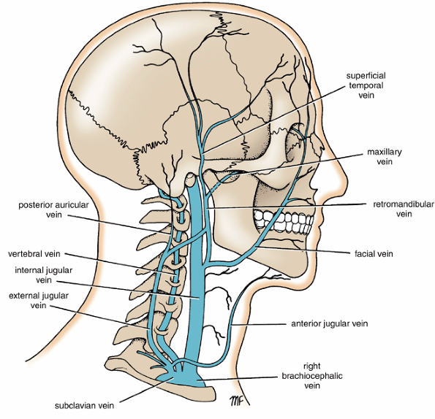
Main Veins of the Neck
The main veins of the neck that lie superficial to the deep fascia of the neck , namely, the external and anterior jugular veins, were described previously.
Internal Jugular Vein
The internal jugular vein receives blood from the brain, face, and neck.
It begins at the jugular foramen in the skull as a continuation of the sigmoid sinus.
It descends through the neck in the carotid sheath and unites with the subclavian vein behind the medial end of the clavicle to form the brachiocephalic vein.
The vein has a dilatation at its upper end called the superior bulb and another dilatation near its termination called the inferior bulb.
Directly above the inferior bulb is a bicuspid valve.
The tributaries of the internal jugular vein are the inferior petrosal sinus, facial, pharyngeal, lingual, superior thyroid, middle thyroid, and occipital veins.

Slide 24
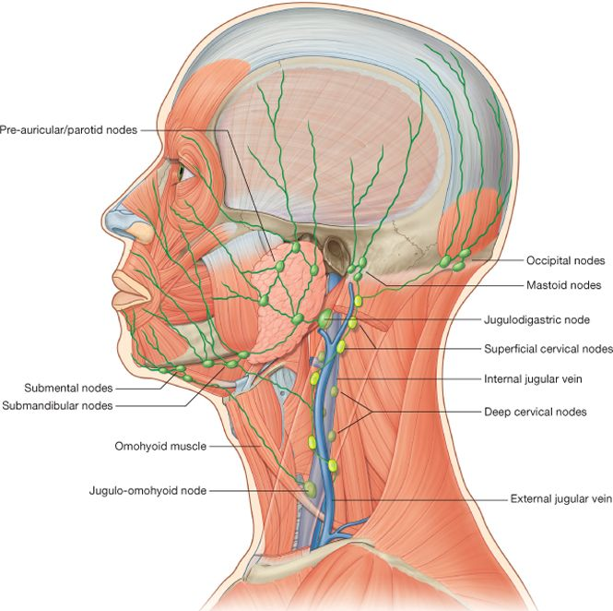
Main Lymph Nodes of the Neck
Deep Cervical Lymph Nodes
The deep cervical lymph nodes form a chain along the anterolateral surface of the internal jugular vein.
They are embedded in the carotid sheath and receive afferent lymph vessels from neighboring structures and from all other groups of lymph nodes in the head and neck.
The efferent lymph vessels from the nodes join to form the jugular lymph trunk.
This vessel drains into the thoracic duct, the right lymph duct, or the subclavian lymph trunk, or it may drain independently into the brachiocephalic vein.

Slide 25
Main Nerves of the Neck
Vagus Nerve (Tenth cranial nerve)
The vagus nerve is composed of both motor and sensory fibers.
It originates in the medulla oblongata and leaves the skull through the middle of the jugular foramen in accompany with the ninth and eleventh cranial nerves.
The vagus nerve posses two sensory ganglia: a superior ganglion, which situated on the nerve within the jugular foramen, and an inferior ganglion, which lies just below the foramen.
The cranial part of the accessory nerve joins the vagus nerve below the inferior ganglion.
The vagus nerve passes vertically down the neck within the carotid sheath.
At the root of the neck the nerve accompanies the common carotid artery and lies anterior to the first part of the subclavian artery.

Slide 26
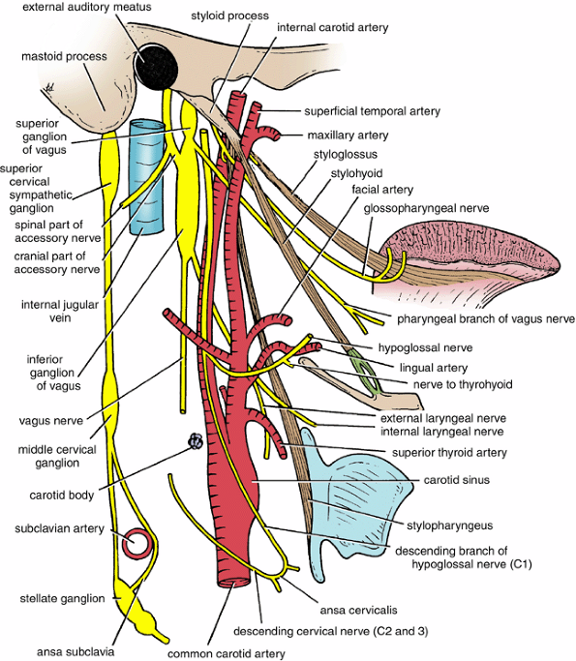
The meningeal branch
The auricular branch supplies the medial surface of the auricle, the floor of the external auditory meatus, and the adjacent part of the tympanic membrane.
The pharyngeal branch contains motor fibers from the cranial part of the accessory nerve. It passes forward between the internal and external carotid arteries to reach the pharyngeal wall. It joins branches from the glossopharyngeal nerve and the sympathetic trunk to form the pharyngeal plexus. It supplies all the muscles of the pharynx except the stylopharyngeus (glossopharyngeal nerve) and all the muscles of the soft palate except the tensor veli palatine (mandibular division )
The superior laryngeal nerve runs downward and medially behind the internal carotid artery. It divides into internal and external laryngeal nerves. The internal laryngeal nerve pierces the thyrohyoid membrane, along with the superior laryngeal artery. It is a sensory nerve that supplies the floor of the piriform recess and the mucous membrane of the larynx down as far as the vocal fold. The external laryngeal nerve is a fine nerve that descends in a company with the superior thyroid artery. It supplies the cricothyroid muscle of the larynx.
Two or three cardiac branches arise from the vagus as it descends through the neck. End in the cardiac plexus in the thorax.
The right recurrent laryngeal nerve arises from the vagus as it crosses the first part of the subclavian artery. It hooks backward and upward behind the artery and ascends in the groove between the trachea and the esophagus. It passes with inferior thyroid artery. It supplies all the muscles of the larynx except the cricothyroid (external laryngeal Abranch). The nerve also supplies the mucous membrane below the vocal cord and the mucous membrane of the upper part of the trachea.
The left recurrent laryngeal nerve arises from the vagus as it crosses the arch of the aorta in the thorax. It hooks around the arch behind the ligamentum arteriosum and ascend between the trachea and the esophagus.
Branches of the Vagus Nerve in the Neck

Slide 27
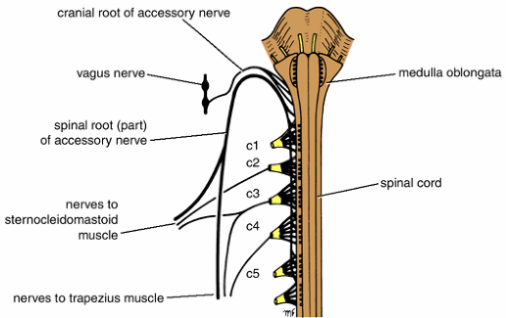
The accessory nerve is composed of motor fibers. It is formed by the union of cranial and spinal roots.
The cranial root is smaller and arises in the medulla oblongata.
The spinal roots arise from the upper five cervical segments of the spinal cord.
The spinal roots unite to form a trunk that ascends in the vertebral canal to enter the skull through the foramen magnum.
Both the cranial and spinal roots come together and pass through the middle of the jugular foramen.
The cranial root now separates from the spinal root and joins the vagus at its inferior ganglion. It is distributed mainly in the pharyngeal and recurrent laryngeal branches of the vagus nerve.
The spinal root runs downward and laterally and crosses the internal jugular vein. It then enters the deep surface of the sternocleidomastoid muscle, which it supplies. Finally it reaches the trapezius muscle and supplies it.
Accessory Nerve (Eleventh Cranial Nerve)

Slide 28
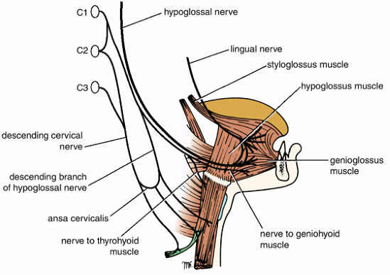
The Hypoglossal Nerve (Twelfth Cranial Nerve)
The hypoglossal nerve is the motor nerve to the tongue muscles.
It arises in the medulla oblongata and leaves the skull through the hypoglossal canal in the occipital bone.
The nerve adheres briefly to the lateral surface of the vagus, and descends with it to the deep surface of the posterior belly of the digastric.
Here it curves anteriorly on the root of the occipital artery, and enters the anterior triangle of the neck lateral to the external carotid artery
Branches
The meningeal branch supplies the meninges in the posterior cranial fossa.
The descending branch, which is composed of C1 fibers, arises from the hypoglossal nerve as it curves forward below the posterior belly of the digastric. It is joined by the descending cervical nerve (C2 and 3) from the cervical plexus to form a loop called ansa cervicalis. Branches from the loop supply the omohyoid, sternohyoid, and sternothyroid muscles.
The nerve to the thyrohyoid, which is composed of C1 fibers, descends to supply the thyrohyoid muscle.
The muscular branches to all the intrinsic and extrinsic muscles of the tongue except the palatoglossus.

Slide 29
Cervical Part of the Sympathetic Trunk
The cervical part of the sympathetic trunk extends upward to the base of the skull and below to the neck of the first rib, where it becomes continuous with the thoracic part of the sympathetic trunk.
It lies directly behind the internal and common carotid arteries in the deep fascia.
The sympathetic trunk possesses three ganglia: the superior, middle, and the inferior cervical ganglia.

Slide 30
superior cervical ganglion
The is the largest and lies between the internal carotid artery and the longus capitis, opposite the second and the third cervical vertebrae. It gives off the following branches.
Communicating branches (cranial nerves branches) to the ninth, tenth, and twelfth cranial nerves.
Gray rami communicantes pass to anterior rami of the upper four cervical nerves.
Internal carotid nerve passes on to the internal carotid artery. It divides into branches around the artery to form the internal carotid plexus.
Pharyngeal branches pass medially to the pharyngeal plexus.
Superior cardiac branch, which descends in the neck and ends in the cardiac plexus in the thorax.

Slide 31
middle cervical ganglion
The middle cervical ganglion lies at the level of the cricoid cartilage. Its branches are:
Gray rami communicantes to the anterior rami of the fifth and sixth cervical nerves.
Thyroid branches, which pass along the inferior thyroid artery to the thyroid gland.
The middle cardiac branch, which descends in the neck and ends in the cardiac plexus in the thorax.
inferior cervical ganglion
The in most people fused with the first thoracic ganglion to form the stellate ganglion.
It lies in the interval between the transverse process of the seventh cervical vertebra and the neck of the first rib. The branches are:
Gray rami communicantes to the anterior rami of the seventh and eighth cervical nerves.
Arterial branches to the subclavian and vertebral arteries.
Inferior cardiac branch, which descends to join the cardiac plexus in the thorax.

Slide 32
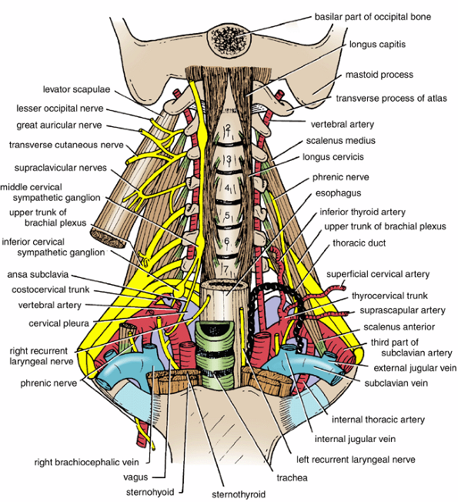
The cervical plexus is formed by the anterior rami of the first four cervical nerves.
The plexus lies on the scalenus medius and is covered anteriorly by the scalenus anterior, the prevertebral fascia, and the internal jugular vein.
Branches
Cutaneous branches:
Lesser occipital nerve
The great auricular nerve
Transverse cutaneous nerve.
The supraclavicular nerve.
Muscular branches supply the prevertebral muscles (longus capitis, longus colli, rectus capitis anterior, rectus capitis lateralis, and scalenus medius), sternocleidomastoid, trapezius, and levator scapulae.
Communications with the hypoglossal nerve, a branch from the C1 joins the hypoglossal nerve. Some of these C1 fibers later leave the hypoglossal as the descending branch, which unites with the descending cervical nerve (C2 and 3), to form the ansa cervicalis. The first, second, and third cervical nerve fibers within the ansa cervicalis supply the omohyoid, sternohyoid, and sternothyroid muscles. Other C1 fibers within the hypoglossal nerve leave it as the nerve to the thyrohyoid and geniohyoid.
Phrenic nerve (C3, 4 & 5, mainly 4). Descends through the neck and thorax to supply the diaphram
The posterior rami of the cervical nerves supply the regions on each side of the midline posteriorly. The largest nerve, the greater occipital nerve, arises from C2 and supplies much of the back of the scalp.
Cervical Plexus

Slide 33
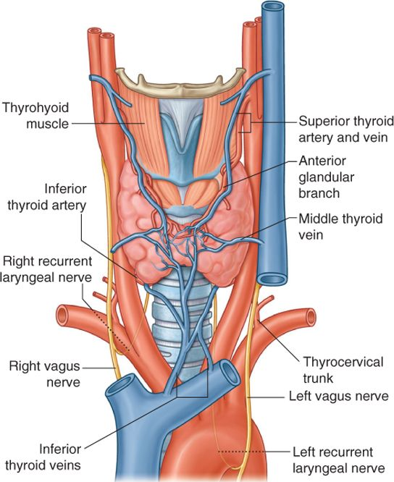
Thyroid Gland
The Viscera of the Neck
The thyroid gland consists of right and left lobes connected by a narrow isthmus.
It is a vascular organ surrounded by a sheath derived from the pretracheal layer of deep fascia.
The sheath attaches the gland to the larynx and the trachea.
Each lobe is pear shaped, with its apex being directed upward as far as the oblique line on the lamina of the thyroid cartilage; its base lies below at the level of the fourth or fifth tracheal ring.
The isthmus extends across the midline in front of the second, third, and fourth tracheal rings.
A pyramidal lobe is often present, and it projects upward from the isthmus, usually to the left of the midline.
A fibrous or muscular band frequently connects the pyramidal lobe to the hyoid bone; if it is muscular, it is referred to as the levator glandulae thyroideae.

Slide 34
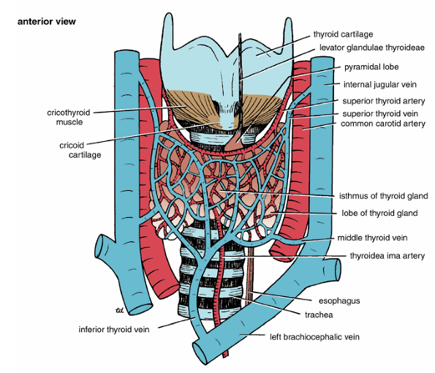
Relations of the Lobes
Anterolaterally: The sternothyroid, the superior belly of the omohyoid, the sternohyoid, and the anterior border of the sternocleidomastoid
Posterolaterally: The carotid sheath with the common carotid artery, the internal jugular vein, and the vagus nerve
Medially: The larynx, the trachea, the pharynx, and the esophagus.
Associated with these structures are the cricothyroid muscle and its nerve supply, the external laryngeal nerve.
In the groove between the esophagus and the trachea is the recurrent laryngeal nerve.
The rounded posterior border of each lobe is related posteriorly to the superior and inferior parathyroid glands and the anastomosis between the superior and inferior thyroid arteries.
Relations of the Isthmus
Anteriorly: The sternothyroids, sternohyoids, anterior jugular veins, fascia, and skin
Posteriorly: The second, third, and fourth rings of the trachea
The terminal branches of the superior thyroid arteries anastomose along its upper border.

Slide 35
arteries
Blood Supply
The arteries to the thyroid gland are the superior thyroid artery, the inferior thyroid artery, and sometimes the thyroidea ima.
The arteries anastomose profusely with one another over the surface of the gland.
The superior thyroid artery, a branch of the external carotid artery, descends to the upper pole of each lobe, accompanied by the external laryngeal nerve.
The inferior thyroid artery, a branch of the thyrocervical trunk, ascends behind the gland to the level of the cricoid cartilage. It then turns medially and downward to reach the posterior border of the gland.
The thyroidea ima, if present, may arise from the brachiocephalic artery or the arch of the aorta. It ascends in front of the trachea to the isthmus.
veins
The veins from the thyroid gland are the superior thyroid, which drains into the internal jugular vein; the middle thyroid, which drains into the internal jugular vein; and the inferior thyroid vein, which drains into the left brachiocephalic vein in the thorax.

Slide 36
Lymph Drainage
The lymph from the thyroid gland drains mainly laterally into the deep cervical lymph nodes.
A few lymph vessels descend to the paratracheal nodes.
Nerve Supply
Superior, middle, and inferior cervical sympathetic ganglia
Functions of the Thyroid Gland
The thyroid hormones, thyroxine and triiodothyronine, increase the metabolic activity of most cells in the body.
The parafollicular cells produce the hormone thyrocalcitonin, which lowers the level of blood calcium.

Slide 37
Parathyroid Gland
The parathyroid glands are ovoid bodies measuring about 6 mm long in their greatest diameter.
They are four in number and are closely related to the posterior border of the thyroid gland, lying within its fascial capsule.
The two superior parathyroid glands are the more constant in position and lie at the level of the middle of the posterior border of the thyroid gland.
The two inferior parathyroid glands usually lie close to the inferior poles of the thyroid gland.
They may lie within the fascial sheath, embedded in the thyroid substance, or outside the fascial sheath.
Sometimes they are found some distance caudal to the thyroid gland, in association with the inferior thyroid veins, or they may even reside in the superior mediastinum in the thorax.

Slide 38
Blood Supply
The arterial supply to the parathyroid glands is from the superior and inferior thyroid arteries.
The venous drainage is into the superior, middle, and inferior thyroid veins.
Lymph Drainage
Deep cervical and paratracheal lymph nodes
Nerve Supply
Superior or middle cervical sympathetic ganglia
Functions of the Parathyroid Glands
The chief cells produce the parathyroid hormone, which stimulates osteoclastic activity in bones, thus mobilizing the bone calcium and increasing the calcium levels in the blood.
The parathyroid hormone also stimulates the absorption of dietary calcium from the small intestine and the reabsorption of calcium in the proximal convoluted tubules of the kidney.
It also strongly diminishes the reabsorption of phosphate in the proximal convoluted tubules of the kidney.
The secretion of the parathyroid hormone is controlled by the calcium levels in the blood.

Slide 39
Trachea
The trachea is a mobile cartilaginous and membranous tube.
It commences at the lower border of the cricoid cartilage of the larynx and extends downward in the midline of the neck.
In the thorax it ends by dividing into two main bronchi at the level of the disc between the fourth and fifth thoracic vertebrae.
relations
The trachea is related anteriorly to the skin, the fascia, the isthmus of the thyroid gland, and the inferior thyroid vein.
It is overlapped by the sternothyroids and sternohyoids.
The trachea is related posteriorly to the right and left recurrent laryngeal nerves, the esophagus, and the vertebral column.
It is also related posteriorly to the lobes of the thyroid gland (down as far as the 5th or 6th ring) and the carotid sheath.
Blood, Nerve and Lymph Supply
The blood supply of the neck is derived mainly from the inferior thyroid arteries.
The nerve supply is from the vagi, the recurrent laryngeal nerves, and the sympathetic trunk.
The lymph vessels drain into the pretracheal and paratracheal lymph nodes.

Slide 40
Esophagus
The esophagus is a muscular tube about 25cm long.
Extending from the pharynx to the stomach.
It begins at the level of the cricoid cartilage, opposite to the body of the sixth cervical vertebra.
It commences in the midline, but as it descends through the neck, it inclines to the left side and it further course is described in the thorax.
relations
The esophagus is related anteriorly to the trachea, the recurrent laryngeal nerves.
Posteriorly it is related to the prevertebral layer of deep cervical fascia, the longus colli, and the vertebral column.
Laterally on each side lie the lobe of the thyroid gland and the carotid sheath.
Blood, Nerve and Lymph Supply
The arteries of the esophagus in the neck are derived from the inferior thyroid arteries.
The veins drain into the inferior thyroid veins.
The nerves are derived from the recurrent laryngeal nerves and from the sympathetic trunks.
The lymph vessels drain into the deep cervical lymph nodes

Slide 41
The Root of the Neck
The root of the neck can be defined as the area of the neck immediately above the inlet of the thorax.

Slide 42
Scalenus Anterior
The scalenus anterior muscle is deeply placed and descends almost vertically from the vertebral column to the first rib.
Origin: from the transverse processes of the third, fourth, fifth, and sixth cervical vertebra.
Insertion: The fibers pass downward and laterally to be inserted into the scalene tubercle of the first rib.
Nerve supply: From the anterior rami of the fourth, fifth, and sixth cervical nerves.
Action: It assists in elevating the first rib.

Slide 43
Scalenus Medius
Origin from the transverse process of the atlas and the transverse processes of the next five cervical vertebrae.
Insertion: The muscle passes downward and laterally and is inserted into the upper surface of the first rib. The muscle lies behind the root of the brachial plexus and behind the subclavian artery.
Nerve supply: branches from the anterior rami of the lower cervical nerves.
Action: it assists in elevating the first rib.
Scalenus Posterior
The Scalenus posterior muscle may be absent or blended with the Scalenus medius.
It is originated from the transverse processes of the lower cervical vertebrae and is inserted into the outer surface of the second rib.
It supplies by branches from the anterior rami of the lower cervical nerves. Its action elevates the second rib.

Slide 44
Subclavian Artery
The right subclavian artery arises from the brachiocephalic artery, behind the right sternoclavicular joint.
It passes upward and laterally as a gentle curve behind the Scalenus anterior muscle, and at the outer border of the first rib it becomes the axillary artery.
The left subclavian artery arises from the arch of the aorta, behind the left common carotid artery.
It ascends to the root of the neck and then arches laterally in a manner similar to that of the right subclavian artery.
The subclavian artery is divided into three parts by the presence of the Scalenus anterior muscle.

Slide 45
first part of the subclavian artery
The first part of the subclavian artery extends from its origin to the medial border of the scalenus anterior.
Branches
Vertebral artery
The vertebral artery arises from the subclavian artery and ascends in the neck between the longus colli and the scalenus anterior muscle.
It enters the transverse foramen of the sixth cervical vertebra. It then ascends through foramina in the transverse processes of the upper six cervical vertebrae. Passes from the transverse process of the atlas, the artery pierces the dura mater and enters the vertebral canal.
The vertebral artery then ascends into the skull through the foramen magnum to supply the brain.
The branches of the vertebral artery in the neck are spinal and muscular branches. The spinal branches enter the vertebral canal through the intervertebral foramina.

Slide 46
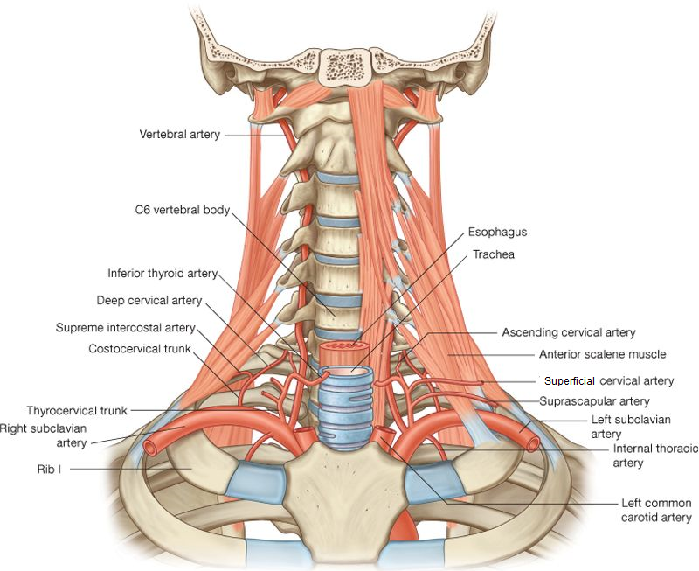
Thyrocervical Trunk
The thyrocevical trunk is a wide, short trunk that arises from the front of the first part of the subclavian artery.
It gives off three branches: (1) the inferior thyroid, (2) superficial cervical, and (3) suprascapular arteries.
The inferior thyroid artery ascends along the medial border of the scalenus anterior to the level of the cricoids cartilage. It then turns medially and downward reaches the posterior border of the thyroid gland and is closely related to the recurrent laryngeal nerve.
The superficial cervical and suprascapular arteries pass laterally across the scalenus anterior muscle to enter the posterior triangle of the neck.
Internal Thoracic Artery
The internal thoracic artery arises from the lower border of the first part of the subclavian artery.
It enters the thorax by descending behind the first costal cartilage..
first part of the subclavian artery

Slide 47
Second part of the subclavian artery
The second part of the subclavian artery lies behind the scalenus anterior muscle and gives off the costocervical trunk.
Then the trunk divides into the superior intercostals (gives rise to the posterior intercostals arteries of the first and second intercostals space), and deep cervical arteries (passes backward to supply the muscles of the back and the neck).
Third part of the subclavian artery
The third part of the subclavian artery extends from the lateral border of the scalenus anterior to the outer border of the first rib.
Here, it becomes the axillary artery. Together with the brachial plexus of nerves, it carries with it a sheath of fascia the axillary sheath, derived from the prevertebral layer of the deep cervical fascia.
The third part of the subclavian artery usually has no branches, occasionally the superficial cervical or suprascapular artery or both arise from the third part of the subclavian artery

Slide 48
Thoracic Duct
The thoracic duct begins in the abdomen at the upper end of the cisterna chyli.
It enters the thorax through the aortic opening in the diaphragm and ascends through the mediastinum.
Then it passes upward along the left margin of the esophagus.
On reaching the medial border of the scalenus anterior, it turns downward and drains into the beginning of the left brachiocephalic vein.
It may end in the terminal part of the subclavian or internal jugular veins.
At the root of the neck the thoracic duct receives the left jugular, subclavian, and brachiomediastinal trunks.
The thoracic duct thus conveys to the blood all lymph from the lower limbs, pelvic cavity, abdominal cavity, left side of the thorax, and left side of head, neck, and left arm.

Slide 49
Lymph Drainage of the Head and Neck
The lymph nodes in the head and neck are made up of several regional groups and a terminal group.

Slide 50
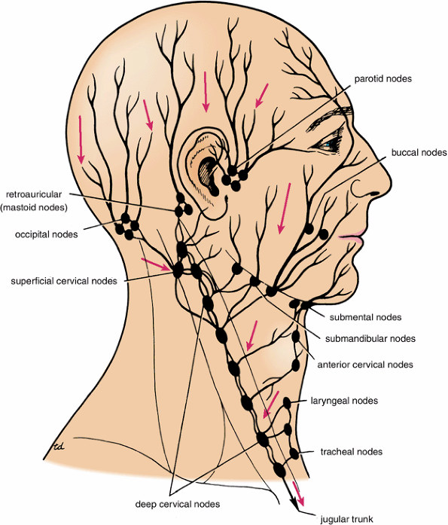
Occipital lymph nodes
Regional Lymph Nodes of Head and Neck
The are situated over the occipital bone at the apex of the posterior triangle of the neck.
They receive the lymph from the back of the scalp.
The efferent lymph vessels drain into the deep cervical lymph nodes.
Retroauricular (mastoid) lymph nodes
The retroauricular (mastoid) lymph nodes are situated over the lateral surface of the mastoid process of the temporal bone.
They receive lymph from a strip of scalp above the auricle and from the posterior wall of the external auditory meatus.
The efferent lymph vessels drain into the deep cervical lymph nodes.
Parotid lymph nodes
The are situated on or within the parotid salivary gland.
They receive lymph from a strip of the scalp above the parotid salivary gland, from the lateral surface of the auricle and the anterior wall of the external auditory meatus, and from the lateral parts of the eyelids.
The nodes that are deeply placed in the parotid salivary gland also receive lymph from the middle ear.
The efferent lymph vessels drain into the deep cervical lymph nodes.

Slide 51
Buccal (facial) lymph
The buccal (facial) lymph nodes are situated over the buccinator muscle, close to the facial vein.
They lie along the course of the lymph vessels that ultimately drain into the submandibular nodes.
Submandibular lymph nodes
The submandibular lymph nodes are situated on the superficial surface of the submandibular salivary gland, beneath the investing layer of the deep cervical fascia.
They can be palpated just below the lower border of the body of the mandible.
They receive lymph from a wide area, including the front of the scalp, the nose and adjacent cheek, the upper and lower lips (except the center part), the maxillary, frontal and ethmoidal air sinuses, the upper and lower teeth (except the lower incisors), the anterior two-thirds of the tongue (except the tip), the floor of the mouth and vestibule, and the gums.
The efferent lymph vessels drain into the deep cervical lymph nodes.
Submental lymph nodes
The are situated in the submental triangles between the anterior bellies of the digastric muscles.
They receive lymph from the tip of the tongue, the floor of the mouth beneath the tip of the tongue, the incisor teeth and the associated gums, the central part of the lower lip, and the skin over the chin.
The efferent lymph vessels drain into the submandibular and deep cervical lymph nodes.

Slide 52
anterior cervical lymph nodes
The anterior cervical lymph nodes are situated along the course of the anterior jugular veins.
They receive lymph from the skin and superficial tissue of the front of the neck.
The efferent lymph vessels drain into the deep cervical lymph nodes.
superficial cervical lymph nodes
The superficial cervical lymph nodes are situated along the course of the external jugular vein.
They receive the lymph from the skin over of the jaw, the skin over the apex of the parotid salivary gland, and the lobe of the ear.
The efferent lymph vessels drain into the deep cervical lymph nodes.
retropharyngeal lymph nodes
The retropharyngeal lymph nodes are situated in the retropharyngeal space, in the interval between the pharyngeal wall and the prevertebral fascia.
They receive lymph from the nasal part of the pharynx, the auditory tube, and the upper part of the cervical vertebral column.
The efferent lymph vessels drain into the deep cervical lymph nodes.

Slide 53
laryngeal lymph nodes
The laryngeal lymph nodes are situated in front of the larynx on the cricothyroid ligament.
One or two small nodes may be found in front of the thyrohyoid membrane.
They receive lymph from the adjacent structures, and their efferent vessels drain into the deep cervical lymph nodes.
tracheal lymph nodes
The tracheal lymph nodes are situated lateral to the trachea (paratracheal nodes) and in front of the trachea (pretracheal nodes).
They receive lymph from the neighboring structures, including the thyroid gland.
The efferent lymph vessels drain into the deep cervical lymph nodes.
All the efferent lymph vessels from the above lymph nods eventually drain into the deep cervical lymph nodes.

Slide 54
deep cervical lymph nodes
The deep cervical lymph nodes form a chain along the course of the internal jugular vein from the skull to the root of the neck.
They are embedded in the fascia of the carotid sheath and the tunica adventitia of the internal jugular vein.
Two of the node are often referred to clinically and are called the jugulo-digastric node and the jugulo-omohyoid node.
Terminal Lymph Node of Head and Neck
jugulo-digastric node
The jugulo-digastric node lies just below the posterior belly of the digastric muscle and is located just below and behind the angle of the mandible.
It is concerned with the lymph drainage of the tonsil and the tongue.
jugulo-omohyoid node
The jugulo-omohyoid node is related to the intermediate tendon of the omohyoid muscle and is associated mainly with the drainage of the tongue.
The deep cervical lymph nodes receive lymph from neighboring structures and from all the other regional lymph nodes in the head and neck.
The efferent lymph vessels join to from the Jugular lymph trunk.
This vessel drains into the thoracic duct or the right lymph duct.
Alternatively, it may drain into the subclavian lymph trunk or independently into the brachiocephalic vein.

