Slide 1
RHEUMATOID ARTHRITIS
Dr.Fakhir Yousif

Slide 2
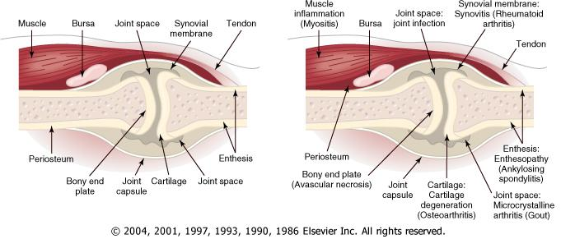
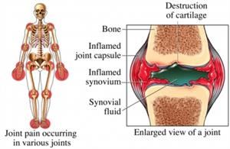

Slide 3
Definition
Rheumatoid Arthritis
chronic systemic inflammatory disorder affected synovium
bone, cartilage, ligaments with extra-articular manifestations

Slide 4
RA is a chronic disease that leads to joint damage within the first 2 years, causes marked functional limitation and a 30% loss of work within the first 5 years, and shortens life by 5 to 7 years.

Slide 5
Rheumatoid factor (RF), an immunoglobulin M (IgM) auto-antibody against the Fc portion of an IgG molecule first described by Waaler in 1940, is the main serologic marker, found in 75% to 80% of patients

Slide 6
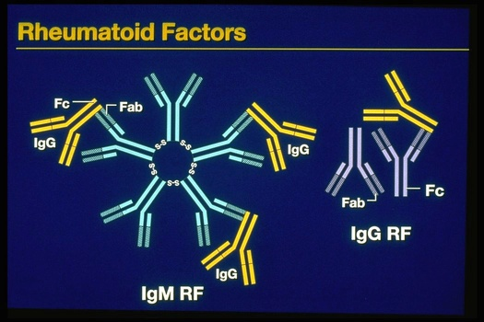

Slide 7
Epidemiology
RA occurs throughout the world and in all ethnic groups. The prevalence is lowest in black Africans and Chinese, and highest in the Pima Indians of Arizona. In Caucasians it is around 1.0-1.5% with a female:male ratio of 3:1. Before the age of 45, the female:male ratio is 6:1. Prevalence increases with age, with 5% of women and 2% of men over 55 years being affected.

Slide 8
Etiology
Genetic factors in RA are important in defining disease susceptibility and severity.
Family studies have demonstrated an increased risk for disease in siblings of persons affected with RA. Concordance has been found to be 12% to 15%

Slide 9
in monozygotic and 4% in dizygotic twins, strong evidence for a major influence of genetic factors in disease causation .

Slide 10
Enviromental
viruses (e.g., parvovirus B19, Epstein-Barr virus), Mycoplasma, and other bacteria (e.g., streptococci).
Possible auto-antigens include type 2 collagen proteoglycan, chondrocyte antigens, heat shock proteins .

Slide 11
11
Urbanization
has a major impact on incidence & severity of R.A.
cigarete smoking

Slide 12
Histopathology
. In the early months of RA, edema, angiogenesis, hyperplasia of synovial lining, and inflammatory infiltrate are already present. Once the disease enters a more chronic phase, massive hyperplasia, mainly of type A synovial cells, and subintimal mononuclear cell infiltration

Slide 13
The synovium of RA assumes the appearance of a reactive lymph node because of the extensive infiltration by plasma cells, macrophages, and lymphocytes in the form of large lymphoid follicles.

Slide 14
One characteristic feature of RA is the invasion of and damage to cartilage, bone, and tendons by an infiltrating inflammatory synovial tissue mass called the pannus

Slide 15
Clinical Characteristics of Rheumatoid Arthritis

Slide 16
Diagnosis of RA is made with four or more of the following
Morning stiffness (> 1 hour
Arthritis of three or more joint areas
Arthritis of hand joints
Symmetrical arthritis
Rheumatoid nodules
Seropositive - Rheumatoid factor OR Anti-CCP (citrullinated C peptide)
Radiological changes
Duration of 6 weeks or more

Slide 17
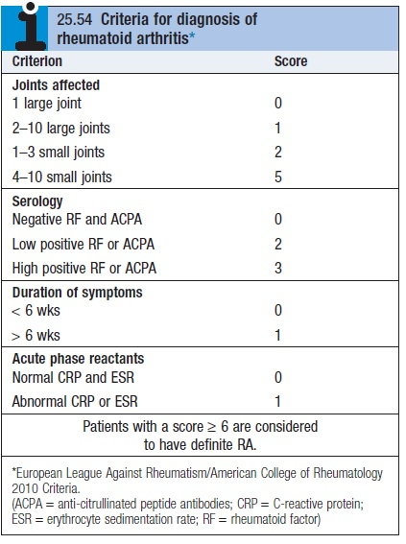

Slide 18
Joints Affected :
  Typically involves elbows, wrists, MCP, and PIP joints
  1st & 2nd cervical vertebrae frequently involved
Unaffected joints :
  Thoracolumbar spine, DIPs & SI joints

Slide 19
Rheumatoid Arthritis: PIP Swelling
Swelling is confined to the area of the joint capsule
Synovial thickening feels like a firm sponge
19

Slide 20
Rheumatoid HAND
An across-the-room diagnosis
Prominent ulnar deviation in the right hand
MCP and PIP swelling in both hands
MCP sublaxation
Synovitis of left wrist
20

Slide 21
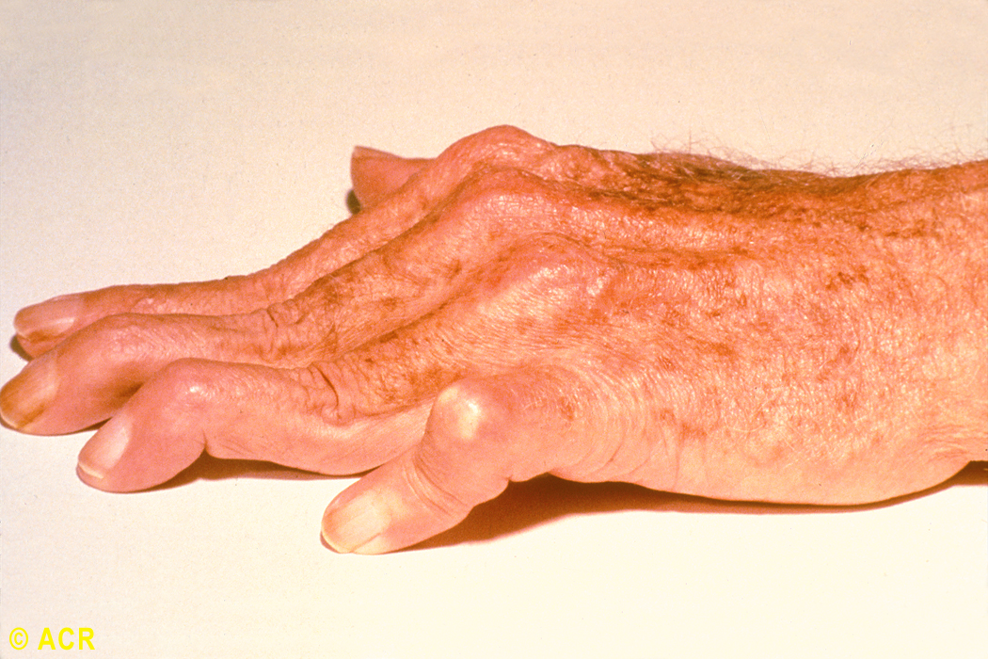
Rheumatoid arthritis: swan-neck and boutonnière deformity, hand
21

Slide 22
Nonreducible flexion at the PIP joint with concomitant hyperextension of the DIP joint of the finger (boutonniere deformity, occurs as a consequence of synovitis with stretching of, or rupture of, the PIP joint through the central extensor tendon with concomitant volar displacement of the lateral bands.

Slide 23
Hyperextension at the PIP joint with flexion of the DIP joint (swan-neck deformity, may be initiated by disruption of the extensor tendon at the DIP joint with secondary shortening of the central extensor tendon and hyperextension of the PIP joint,

Slide 24
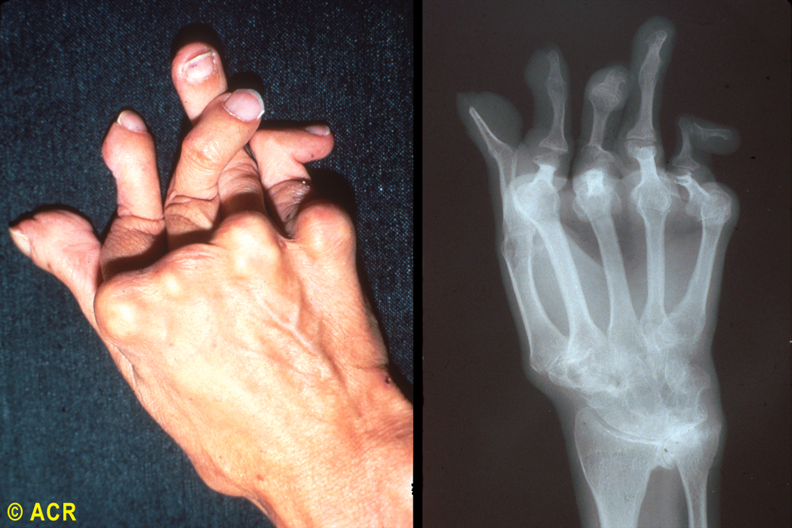
Rheumatoid arthritis: arthritis mutilans, hand (clinical and radiograph)
24

Slide 25
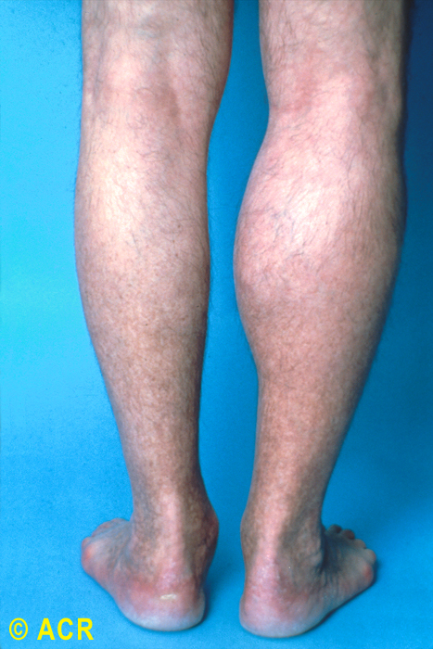
Rheumatoid arthritis: ruptured right popliteal cyst
25

Slide 27
EXTRA-ARTICULAR MANIFESTATIONS OF RHEUMATOID DISEASE

Slide 28
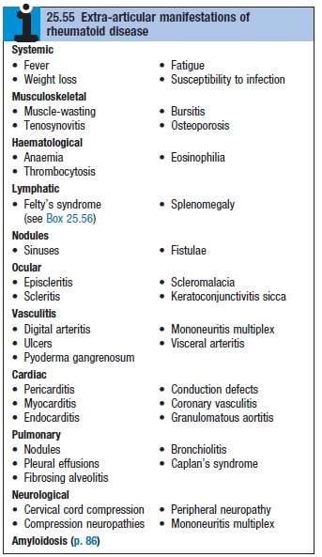

Slide 29
Haematological
Anaemia
Thrombocytosis
Eosinophilia

Slide 30
Lymphatic
Splenomegaly
Felty's syndrome

Slide 31
Ocular
Eapiscleritis
Scleritis
Scleromalacia
Keratoconjunctivitis sicca

Slide 32
Vasculitis
Digital arteritis
Ulcers
Pyoderma gangrenosum
Mononeuritis multiplex
Visceral arteritis

Slide 33
Cardiac
Pericarditis
Myocarditis
Endocarditis
Conduction defects
Coronary vasculitis
Granulomatous aortitis

Slide 34
Pulmonary
Nodules
Pleural effusions
Fibrosing alveolitis
Bronchiolitis
Caplan's syndrome

Slide 35
Neurological
Cervical cord compression
Compression neuropathies
Peripheral neuropathy
Mononeuritis multiplex

Slide 36
Cutaneous features
Subcutaneous rheumatoid nodules occur almost exclusively in seropositive patients, usually at sites of pressure or friction such as the extensor surfaces of the forearm, sacrum, Achilles tendon and toes

Slide 37
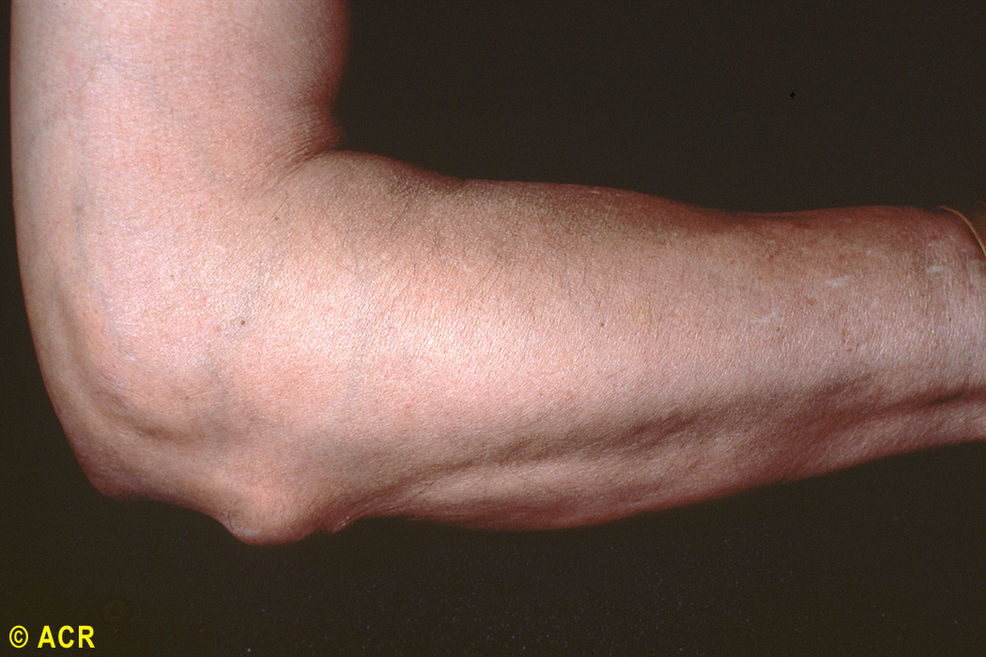
Rheumatoid arthritis: subcutaneous nodule, olecranon
37

Slide 38
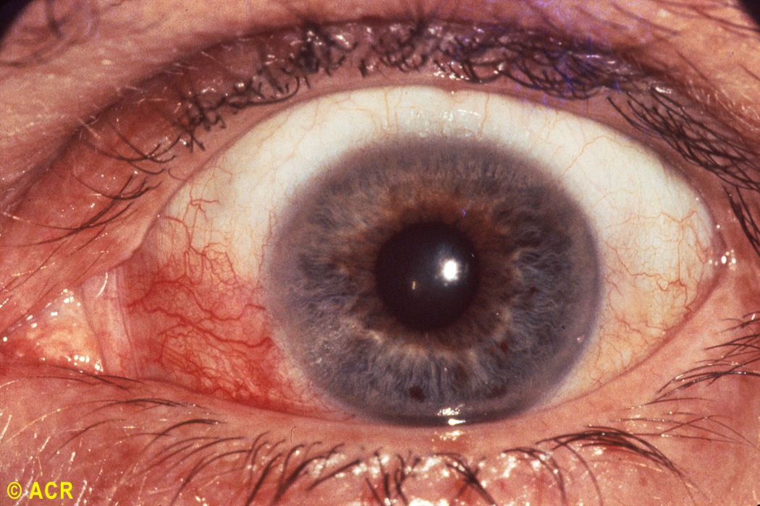
Rheumatoid arthritis: episcleritis
38

Slide 39
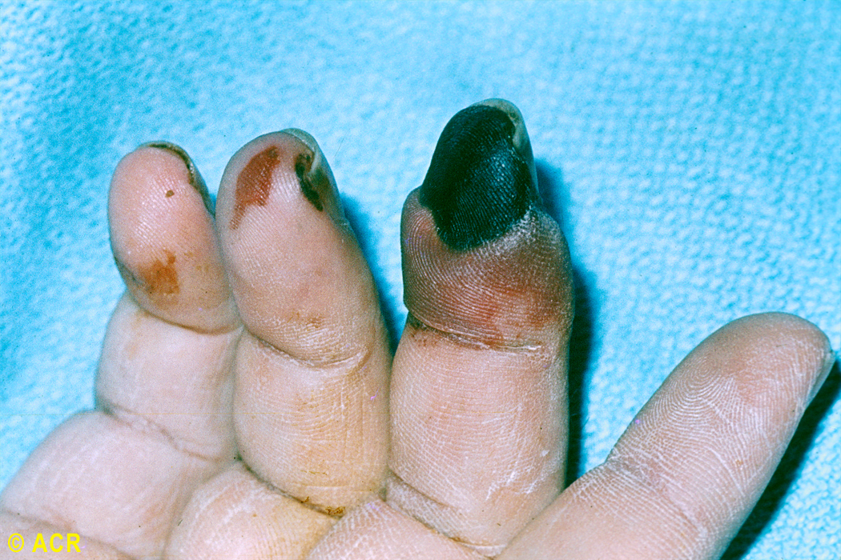
Rheumatoid arthritis: vasculitis and gangrene, fingers
39

Slide 40
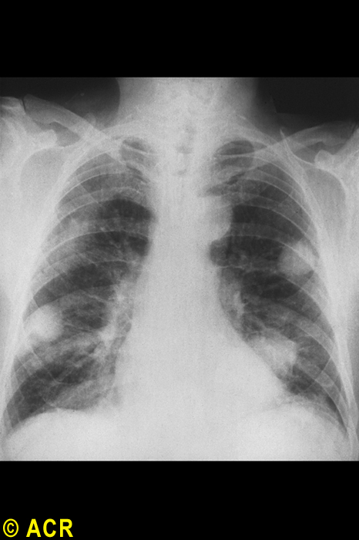
Rheumatoid arthritis: pulmonary nodules
40

Slide 41
Laboratory Tests
Raised inflammatory markers . Reasonable correlation with clinical activity
Mild anemia & thrombocytosis
S. Rheumatoid factor (Agglutination method). Positive in near 70-80% cases (western countries). Not specific
Anti-CCP (citrulline – containing proteins) antibodies. Similar sensitivity to RF but more specific (up to 95%)
41

Slide 42
Examination of joint fluid
the most helpful laboratory procedure. The fluid is inflammatory, with more than 10,000 white blood cells and a predominance of polymorphonuclear leukocytes, typically 80% or more. Rheumatoid factor, an IgM antibody directed to IgG, is found in 80 to 90% of patients with RA...

Slide 43
. XR-Findings
43
Peri articular osteopenia
Marginal erosions (at least months of persistent activity)
Joint space narrowing (cartilage loss)
Ankylosis (wrists)
Deformities

Slide 44
Joint damage progression in R.A. hand
A. Soft-tissue swelling, no erosions
B. Thinning of the cortex on the radial side and minimal joint space narrowing
C. Marginal erosion at the radial side of the metacarpal head with joint space narrowing
44

Slide 45
Prognosis
45
The following factors at presentation are associated with a poor prognosis: higher baseline disability
female gender
involvement of MTP joints
positive rheumatoid factor
disease duration of over 3 months.

