Slide 1
NEURO ANATOMY
Lec.2
أ.د.عبد الجبار الحبيطي

Slide 2
Venous sinuses: -
These are venous spaces present either between the outer & inner layers of the dura mater or within the meningeal layer only (i.e related to folds of the dura). They receive the venous blood from the brain, meninges & diploi veins of skull bones & drain them eventually in to the bulb of the internal jugular veins. They possess no valves they include singled & paired sinuses.

Slide 3
Paired sinuses include: -
Spheno parietal: - related to the lesser wing of sphenoid.
Cavernous sinus: - on either side of body of sphenoid, extending from medial end of S.O.F to the apex of the petrous bone.
Superior petrosal sinus (S.P.S): - on the upper border of petrous bone.
Inferior petrosal sinus (I.P.S): - runs on the petro occipital sulcus.
Transverse sinus: - runs transversely from internal occipital protuberance in a groove within the circumference of the occipital bone.
Sigmoid sinus (S- shaped): - starts at the base of the petrous temporal bone, as a continuity of the transverse sinus.

Slide 4
Singled sinuses include: -
Superior sagittal sinus (S.S.S): - on the convex, outer fixed margin of the falx cerebri.
Inferior sagittal sinus (I.S.S): - on the inner, free border of falx cerebri.
Straight (rectus) sinus: - at the line of fusion of broad posterior end of falx cerebri with the superior layer of tentorium cerebelli.
Occipital sinus: - in the attached margin of falx cerebelli at the internal occipital crest. It communicates with the internal vertebral venous plexus (in the vertebral canal) & also communicates with the confluence of sinuses at the internal occipital protuberance.
Confluence of venous sinuses.
Basilar venous plexus.

Slide 5
The cavernous sinus: -
It contains the following structures: -
Within the lumen: -
  Internal carotid artery.
ii. Internal carotid sympathetic plexus.
iii. Abducent nerve.
On the wall of the cavernous sinus: -
  Occulomotor nerve.
  Trochlear nerve.
  Ophthalmic division of trigeminal nerve.
  Maxillary division of trigeminal nerve.

Slide 6
Tributaries of The Cavernous Sinus are :
1-The central of the Retina.
2-Ophthalmic veins .
3-Sphenoparietal venous sinus.
4-Some veins on the inferior surface (Base) of the
Brain.
The Cavernous Sinus is present on either side of the body of the sphenoid extending from the medial end of S.O.F to the apex of the Petrous bone.The 2 Cavernous sinuses are connected together by the
Intercavernous venous sinuses .

Slide 7
Drainage of The Cavernous Sinuses (i.e Terminations):
1-Inferior termination to the pterygoid venous plexus in the infratemporal fossa via the foramen of lacerum or ovale.
2-Posterior terminations:
a-To superior petrosal sinus on the upper surface of the petrous
bone, where it joins the junction between the transverse &
sigmoid sinus.
b-Via the inferior petrosal sinus(runs on the petro-occipital groove)
to go directly to the bulb of the internal jugular vein via jugular
foramen
The 2 inferior petrosal sinuses are connected together via the basilar venous plexus (seen on the basi-occiput).This basilar plexus forms arout Of communication between the 2 I.P.S from one side & with internal vertebral venous plexus via foramen magnum.

Slide 8
The cavernous sinuses are liable to infection from the dangerous triangular area around the mouth via communication of the ophthalmic vein & the angular vein (the beginning of the facial vein).This leads to Cavernous sinus thrombosis which causes a pressure on the cranial
Nerves supplying the extra-occular muscles which becomes in a state of Paralysis (i.e non-functioning).

Slide 9
The relations of the cavernous sinuses are:
a-Medially by the sphenoid arir sinuses & the
pituitary gland.
b-Laterally by the trigeminal ganglion &
Temporal lobe of cerebrum.

Slide 10
The Emissary Veins
Are valveless veins connecting the venous sinuses inside the skull with veins out side the skull .They pass through emissary foramens in the wall or base of the skull .They serves to equalize the blood pressure between the venous sinuses & veins out side the skull as follows:
1-The S.S.S is connected to out side via.
a-Parietal foramen to join s.s.s with occipital v out side the skull.
b-Foramen Caecum also joins s.s.s with veins of the nose.
2-The sigmoid sinus by emissary veins pass through.
a-Mastoid foramen to join it with the occipital veins.
b-Condylar foramen joins it with suboccipital venous plexus.
3-With cavernous sinus via:
a-Foramena ovale & lacaerum to join it with pterygoid venous
plexus.
b-Carotid canal joins it with the pharyngeal venous plexus.
c-Ophthalmic veins may be considered as an emissary veins .

Slide 11
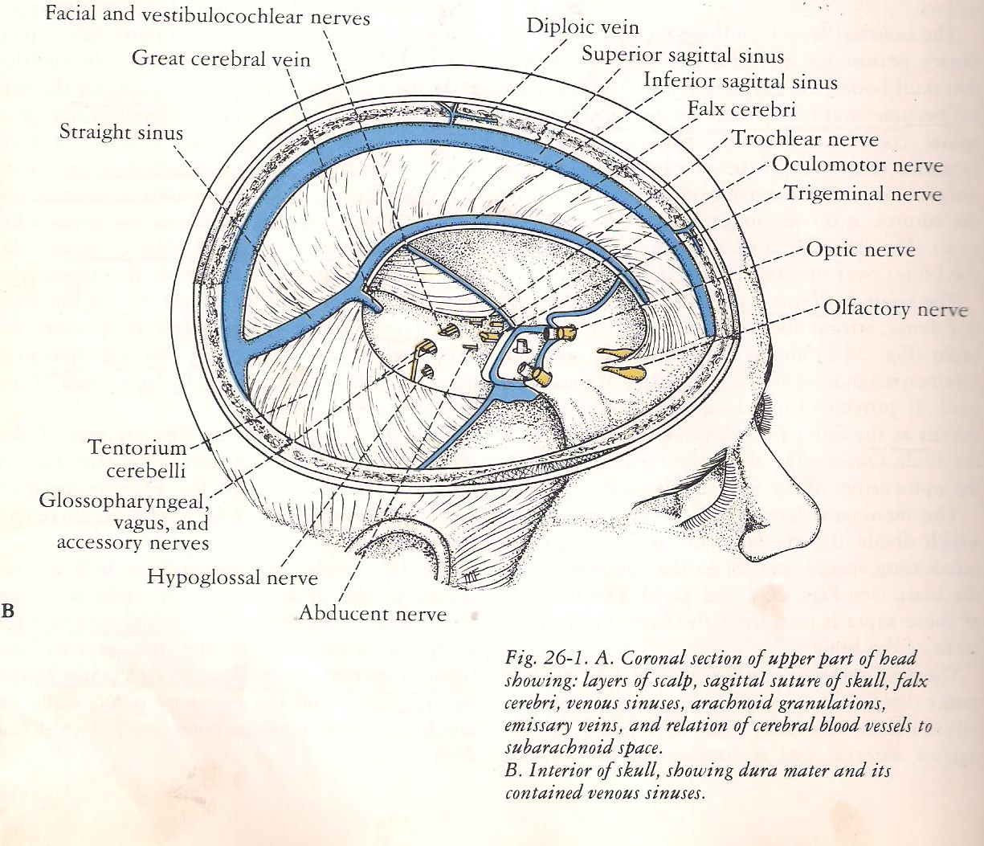

Slide 12
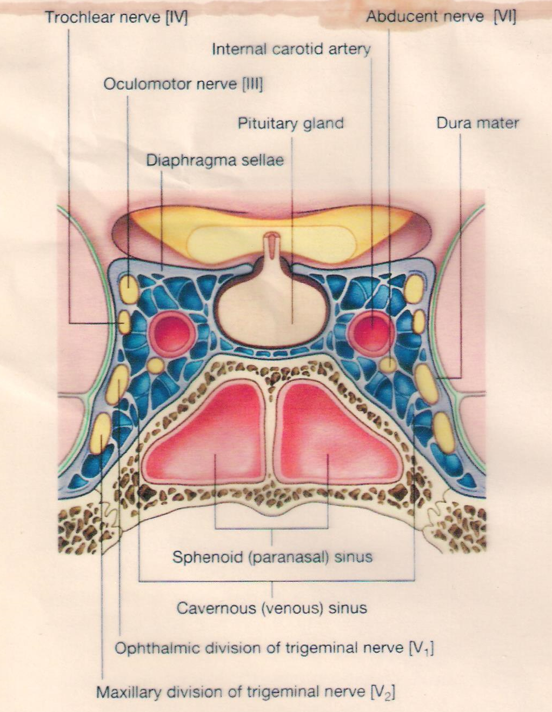

Slide 13
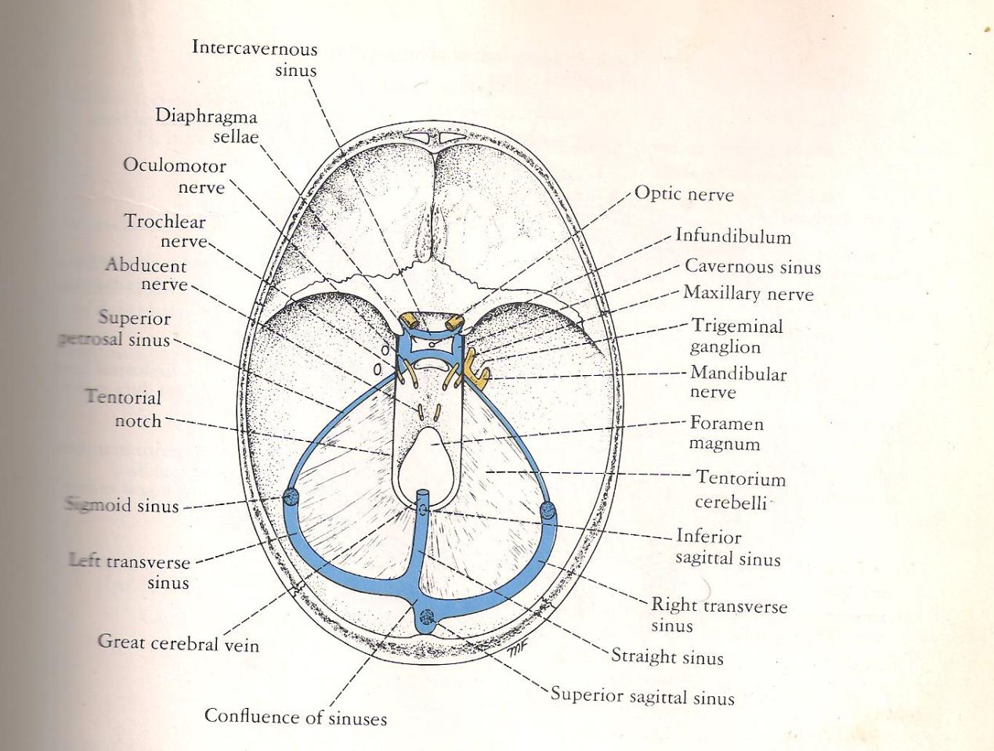

Slide 14
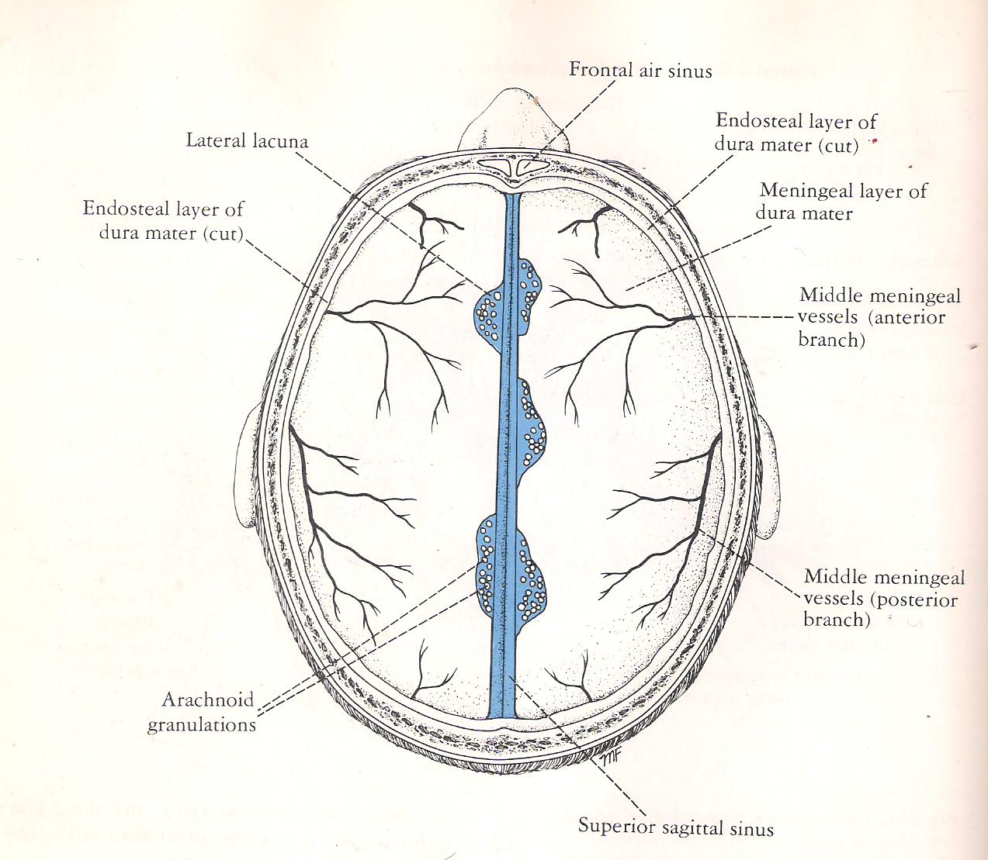

Slide 15
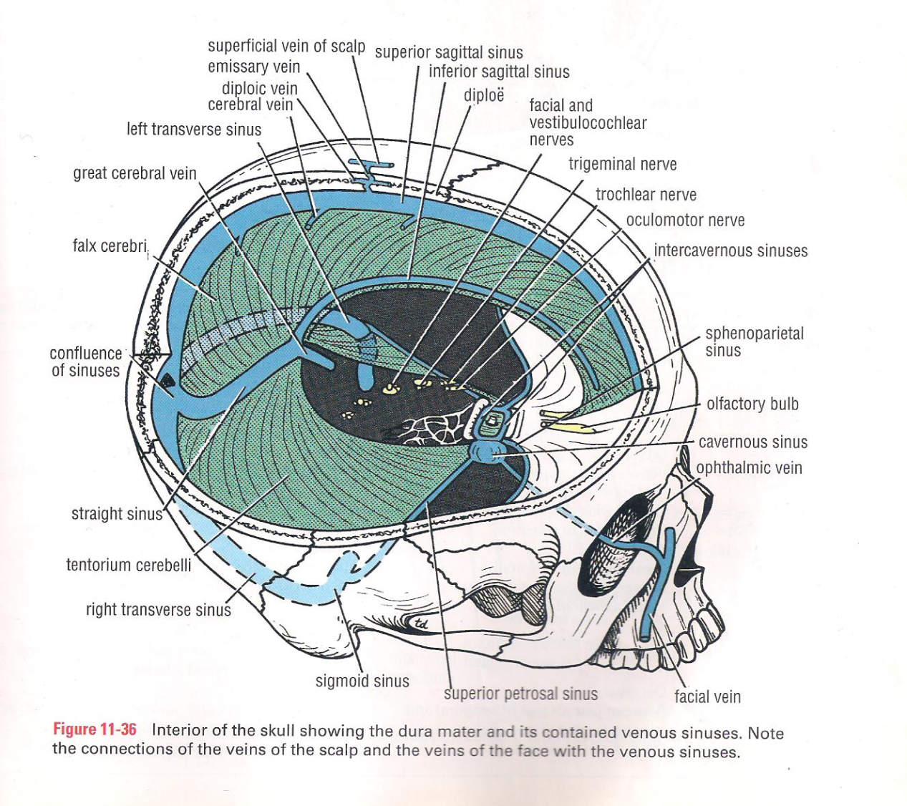

Slide 16
