Slide 1
PARANASAL SINUSES
Ap.Dr.ALI MOHSIN HASAN
DGS FICS CABS MRCS FRCS

Slide 2
OBJECTIVES:
Anatomical location
Connections
Development
Neurovascular supply
Applied anatomy

Slide 3
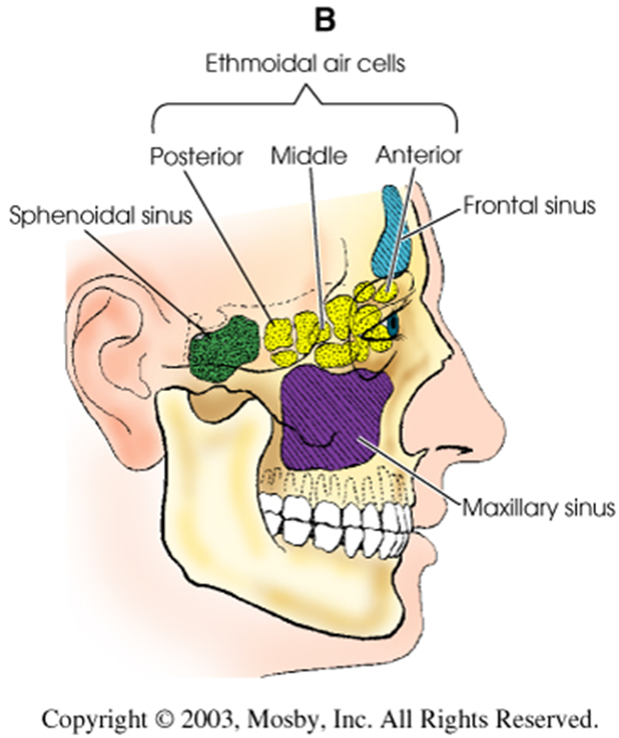
PNS:
Air containing cavities
4 pairs :-
Frontal
Maxillary
Ethmoidal
Sphenoidal

Slide 4
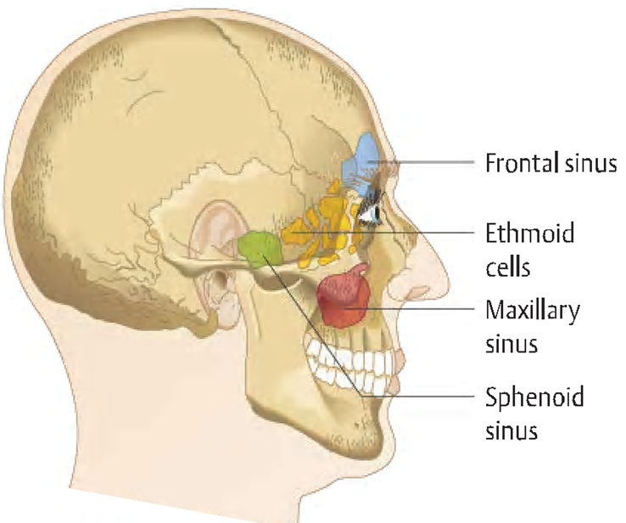
FUNCTION:
To make the skull lighter and add resonance to the voice.
The sinuses are rudimentary or even absent at birth.
Enlarge rapidly during the age 6yr and then afterwards.

Slide 5
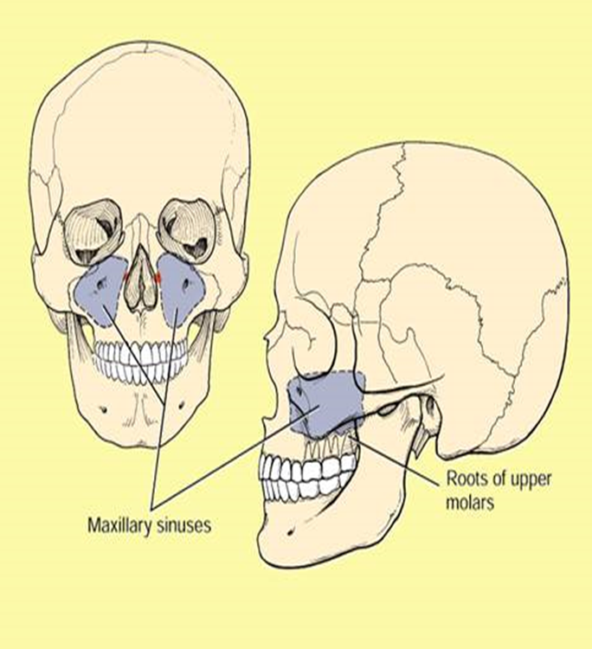
MAXILLARY SINUS:
Largest of all
Pyramidal in shape
Base pointing to lateral wall of nose.
Apex laterally in the zygomatic process of maxilla.

Slide 6
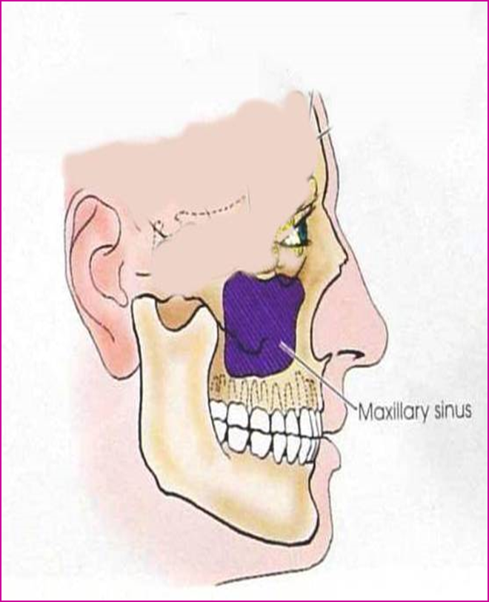
BOUNDARIES:
Anterior:- facial surface of maxilla
Posterior:-infratemporal and pterygopalatine fossa
Medial:- middle and inferior meatus
Floor:- alveolar and palatine processes of maxilla
Roof:-floor of orbit

Slide 7
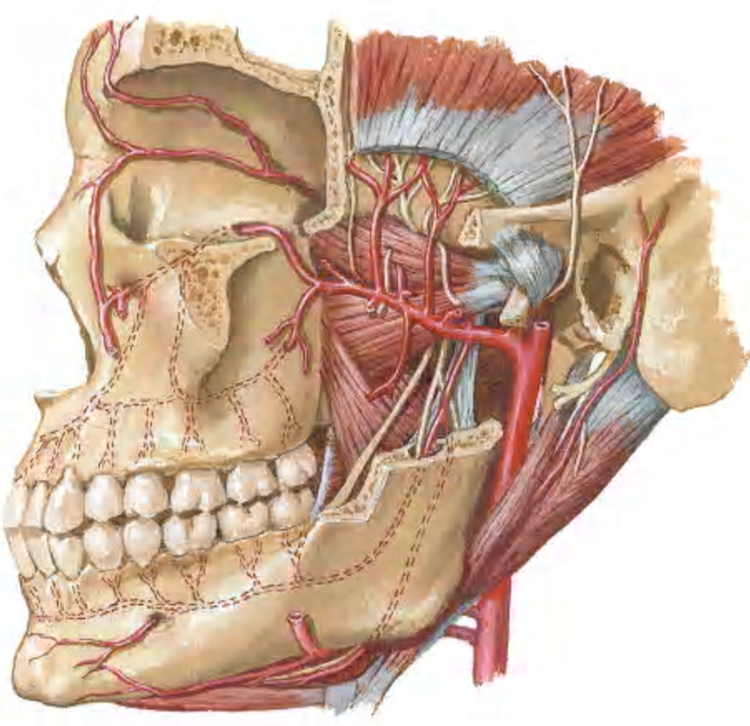
BLOOD SUPPLY:
ARTERIAL:
By facial artery branch of ECA.
By infra orbital & greater palatine arteries branch of max. art which is branch of ECA.
VENOUS:
To anterior facial vein& pterygoid plexus.

Slide 8
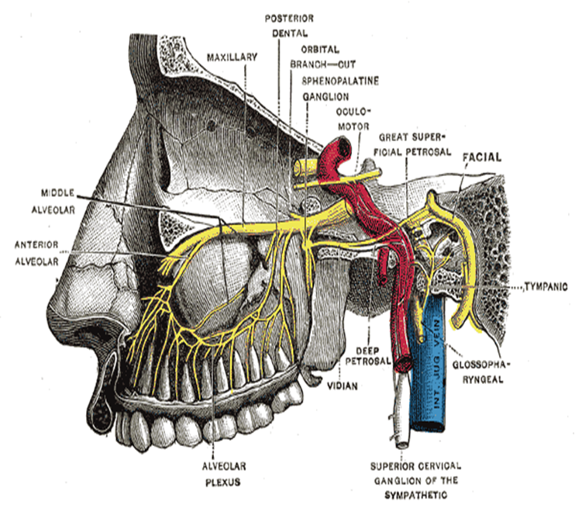
NERVE SUPPLY:
Infraorbital nerve
Anterior superior alveolar nerve
Middle superior alveolar nerve
Posterior superior alveolar nerve

Slide 10
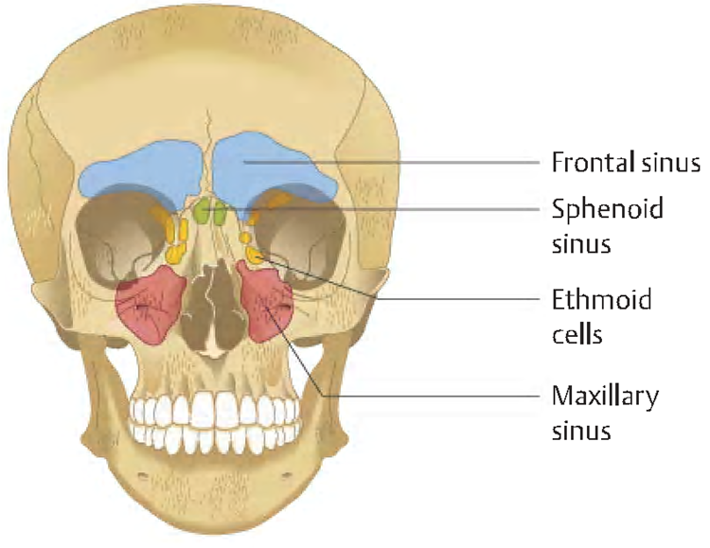
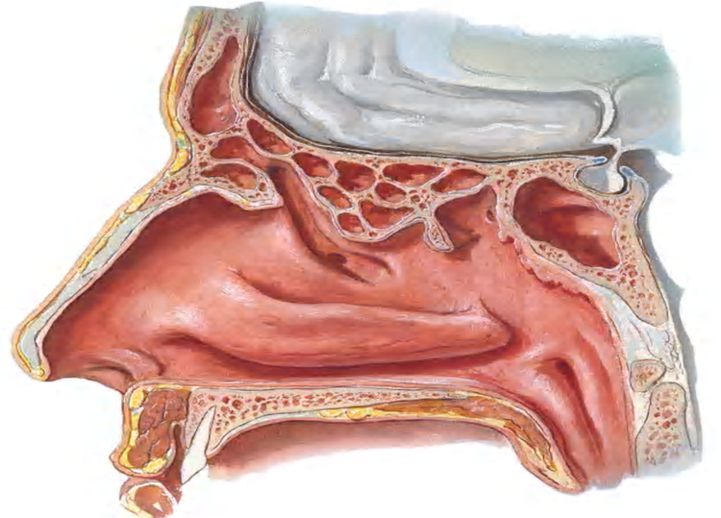
FRONTAL SINUS:
Resides in frontal bone
2nd largest
Asymmetrical
Right n left are usually unequal

Slide 11
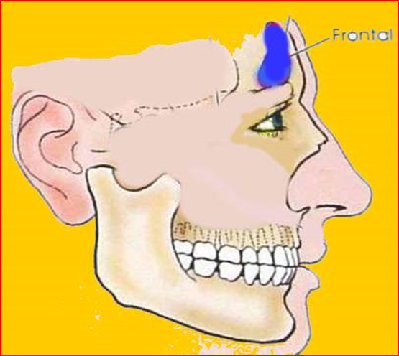
RELATIONS:
Anterior:- skin over the forehead
Inferior:-orbit & its contents
Posterior:- meningeal and frontal lobe of brain

Slide 12
NEUROVASCULAR SUPPLY:
Blood supply - Supra orbital artery
Venous return - Anastomotic veins in supra orbital notch, connecting supra orbital and supra ophthalmic veins.
Lymphatic drainage - Submandibular nodes.
Nerve supply - Supra orbital nerve(ophthalmic nerve)

Slide 14
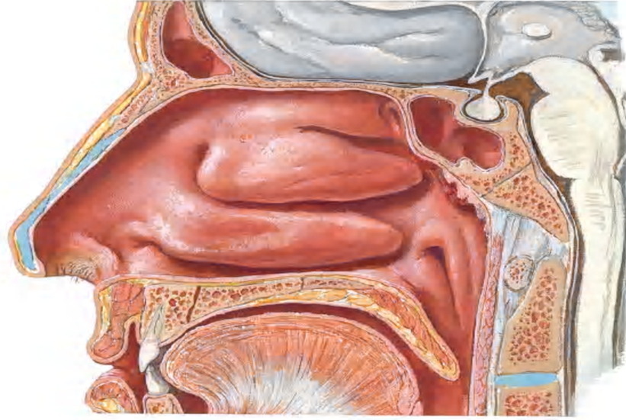
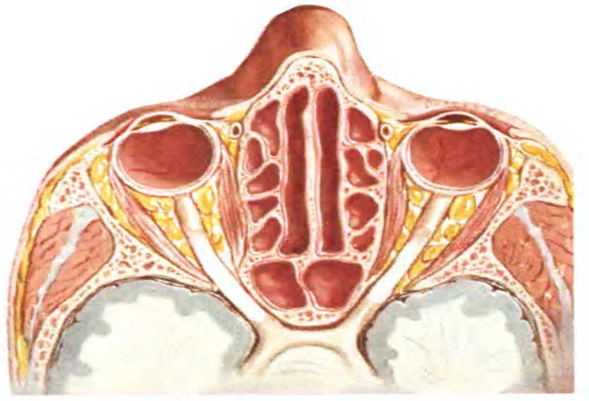
SPHENOIDAL SINUS:
Resides in body of sphenoid
May be single or paired
Asymmetrical
Unequal in size

Slide 15
RELATIONS:
1.Cavernous sinus lies laterally containing the:
IIIrd,
IVth,
Vth (ophthalmic
and maxillary-
divisions) and
VIth cranial nerves,
2.Internal carotid artery

Slide 16
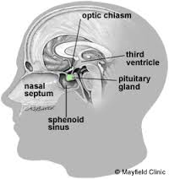
SUPERIORLY
Optic chiasma
Hypophysis cerebri

Slide 17
NEUROVASCULAR SUPPLY:
Blood supply:
Posterior ethmoidal artery
Venous drainage:
Pterygoid plexuses
Nerve supply:
Posterior ethmoidal nerve
Lymphatic drainage: Retropharyngeal nodes

Slide 18
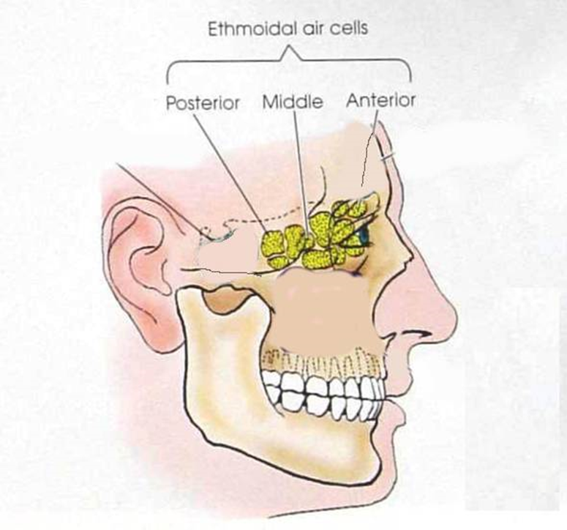
ETHMOIDAL SINUS:
Resides in ethmoid bone
3 groups:-
Anterior
Middle
Posterior
Number varies from 3-18
Present from birth

Slide 19
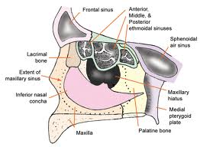
RELATION:
Above:orbital plate of frontal bone
Behind:orbital process of palatine bone
Anteriorly:
lacrimal bone

Slide 20
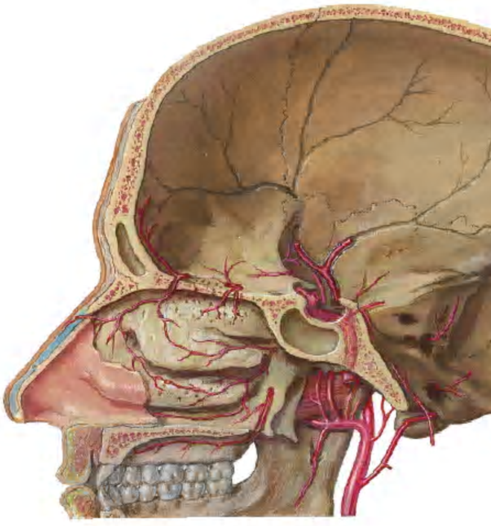
NEUROVASCULAR SUPPLY:
Arterial supply
Anterior ethmoidal artery(ophthalmic artery)
Post. Ethmoidal artery
Sphenoidal artery(maxillary artery)
Venous drainage
Ant. Ethmoidal vein
Post. Ethmoidal vein

Slide 21
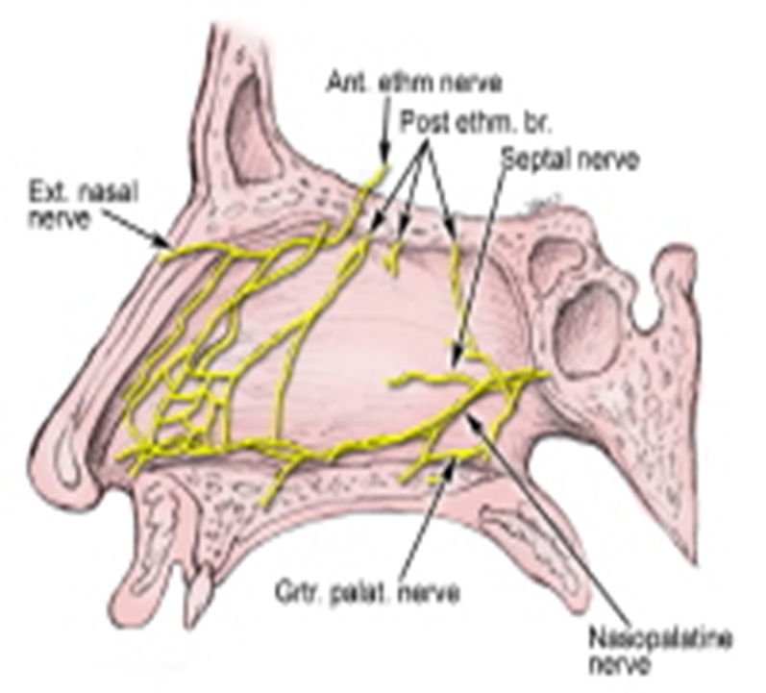
Nerves :
Anterior and posterior ethmoidal nerves. Orbital branches of pterygopalatine ganglion
Lymphatic drainage : Submandibular nodes Retropharyngeal nodes

Slide 22
DEVELOPMENT:
Outpouching from mucus membrane of nose
at birth:-Maxillary and ethmoidal present
At 6-7 yrs:- frontals and sphenoids
At 17-18 :- all fully developed

Slide 23
DRAINAGE:

Slide 24
APPLIED ANATOMY:
SINUSITIS:
Infection of sinus
S/S:
Headache
Thick purulent discharge from nose

Slide 25
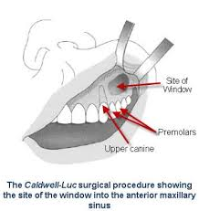
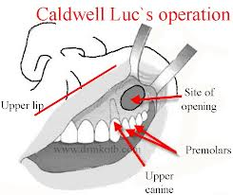
DRAINING MAXILLARY SINUS:

Slide 26
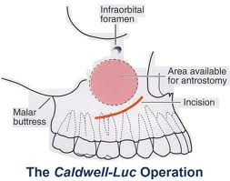
SITE OF INCISION:

Slide 27
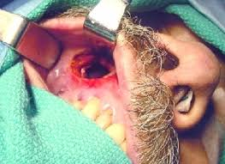
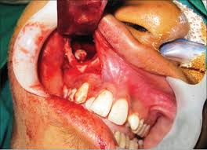
CLINICAL PICTURE:

Slide 28
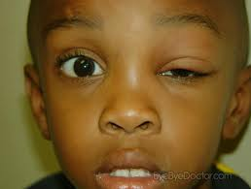
APPLIED:
Frontal sinusitis and ethamoidal sinusitis can cause edema of the lids secondary to infection of the sinuses

Slide 29
RADIOGRAPHIC FINDINGS:

Slide 30
BENIGN NEOPLASMS
Osteomas
Fibrous Dysplasia
Ossifying Fibroma
Ameloblastoma
Inverted Papilloma

Slide 31
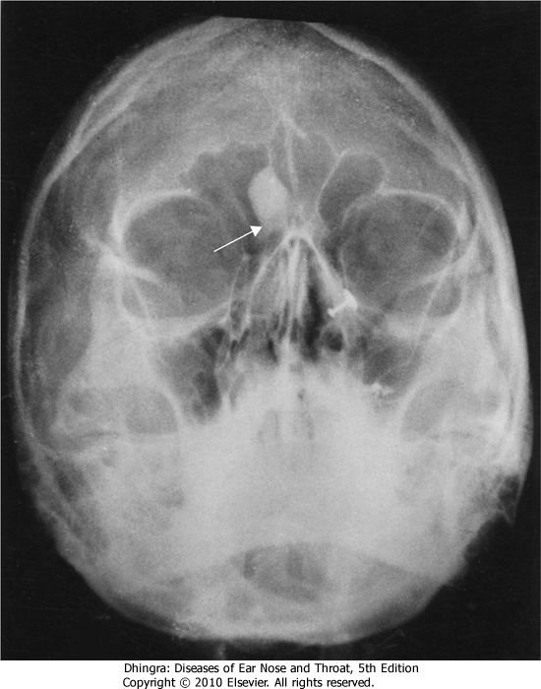
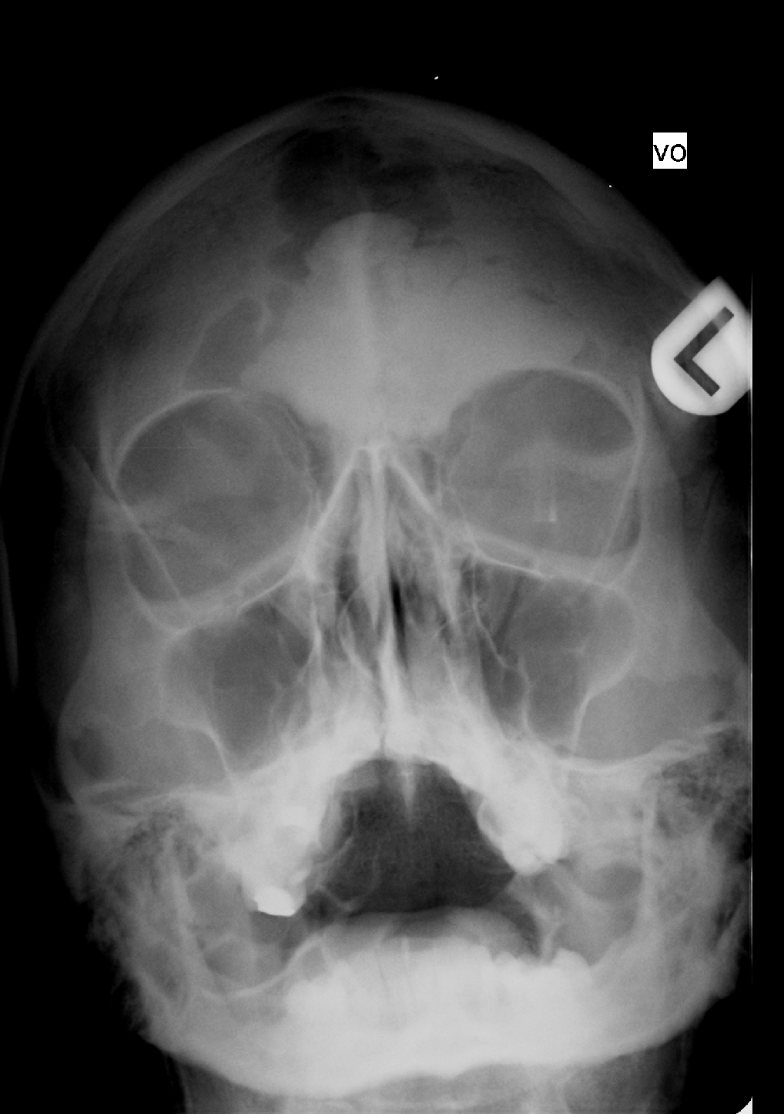
OSTEOMA
15 to 40 years
Frontal > Ethmoid > Maxillary
Slow-growing bone tumour &
often remains asymptomatic.
It can cause
obstruction of ostium
mucocele formation
pressure symptons
Rx :Local excision

Slide 32
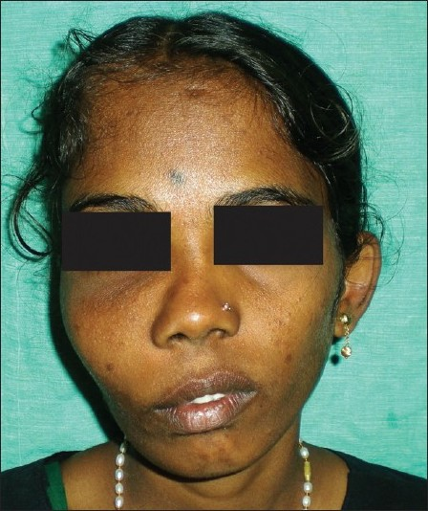
FIBROUS DYSPLASIA
Bone replaced by Fibrous tissue
Maxilla > Ethmoids & Frontal
C/F:
Disfigurement of Face
Nasal Obstruction
Displacement of eyes
Radiology:
Diffuse margins with Ground glass appearance
Rx - Cosmetic restructuring surgery

Slide 33
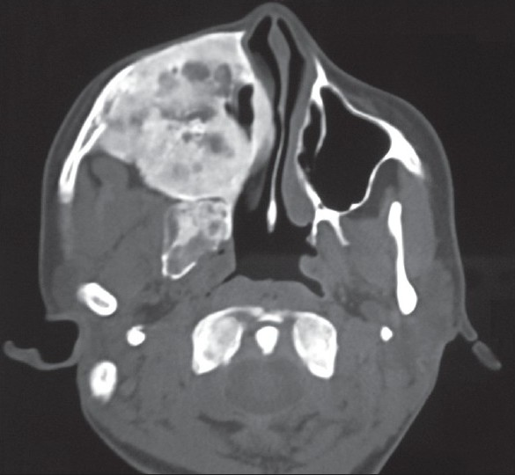
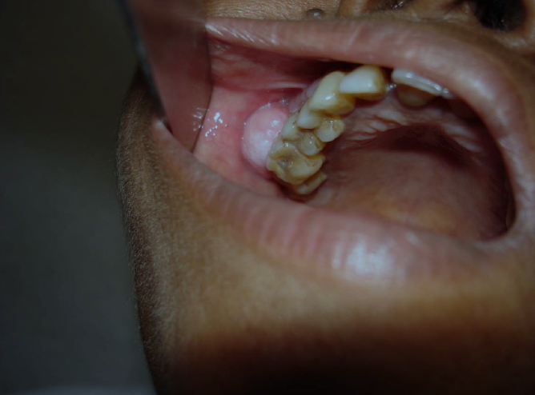
FIBROUS DYSPLASIA
Axial CT shows radiopaque mass oblitearating maxillary sinus and nasalcavity on the right side

Slide 34
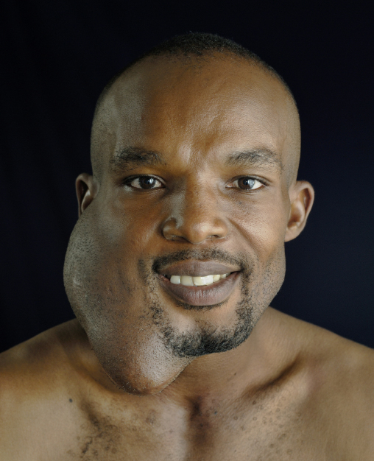
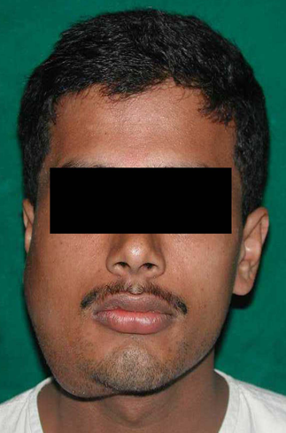
Ameloblastoma(ADAMANTINOMA)
Arises from odontogenic tissue
Locally aggressive
Invades maxillary sinus
Rx :surgical excision

Slide 35
MALIGNANT NEOPLASMS
Ca nose & PNS constitute 0.44% of all malignancies in india
Frequency = Max.s > Ethm.s > Frontal.s > Sphenoid.s
AETIOLOGY
Nickel & Chromium refineries(Sq. Cell Ca & Anaplastic).
Mahogany wood industries (Adeno Ca).
Leather Tanning industries.
Bantus tribes of South Africa –max s Ca due to use of stuff containing Ni & Cr.

Slide 36
Malignant NEOPLASM-lesions
Squamous cell carcinoma-------80%
Adenocarcinoma
Adenoid cystic carcinoma 20%
Melanoma
Sarcomas
etc

Slide 37
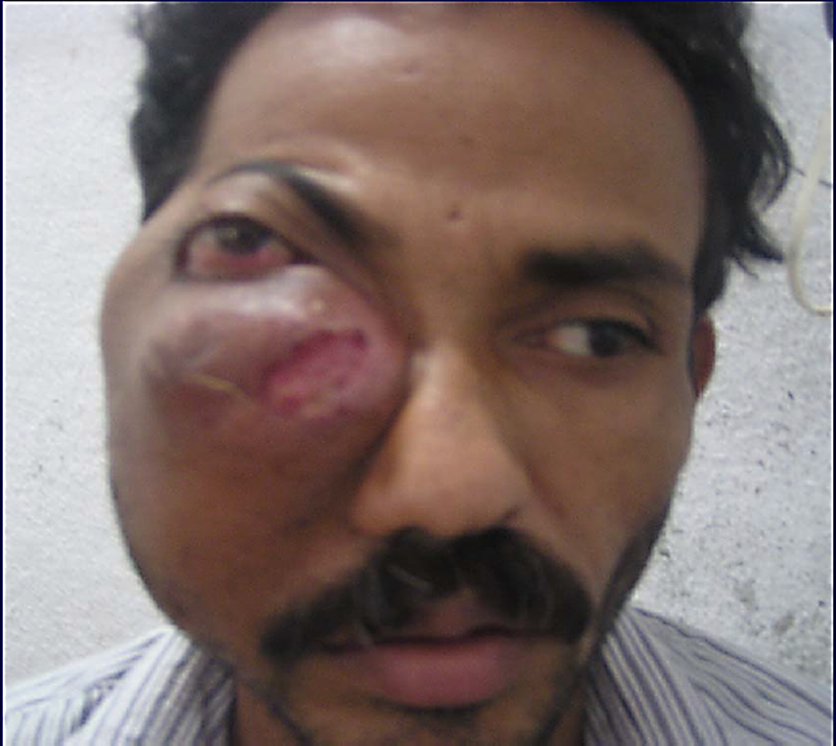
CA MAXILLARY SINUS
Arises from the lining of max sinus.
Middle aged males(40 -60yrs)
Remain silent for a long time or showing only symptons of sinusitis
Late :destroy bony walls & invades in to surrounding structures.

Slide 38
CA MAXILLARY SINUS
Clinical Features
Nasal Stuffiness
Blood stained Nasal discharge
Parasthesia or pain over cheek
Epiphora
These are early C/F.
Often misdiagnosed and treated as sinusitis.

Slide 39
CA MAXILLARY SINUS
Clinical Features based on extention
MEDIAL SPREAD=Nasal obstruction + discharge + epistaxis
Superior spread=Proptosis + diplopia + ocular pain + epiphora
INFERIOR SPREAD=Expansion of alveolus + denatal pain + loosening teeth + poor fitting dentures + ulceration of gingiva + swelling hard palate.
ANTERIOR SPREAD=Swelling of cheek + invasion of facial skin
POSTERIOR spread=Trismus
INTRACRANIAL spread=Via ethmoid , cribriform plate or foramen lacerum
LYMPHATIC SPREAD=Submandibular , Upper jugular nodes and retropharyngeal nodes are enlarged in late stage.
SYSTEMIC SPREAD=in to lungs and occasionally to bones.

Slide 40
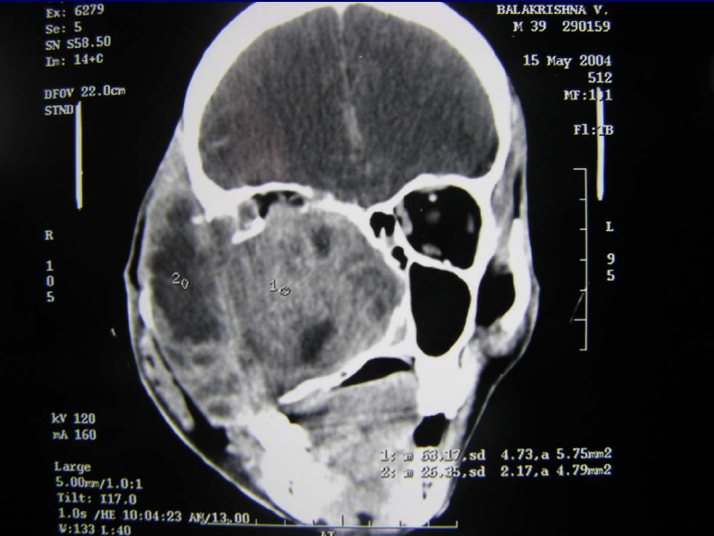
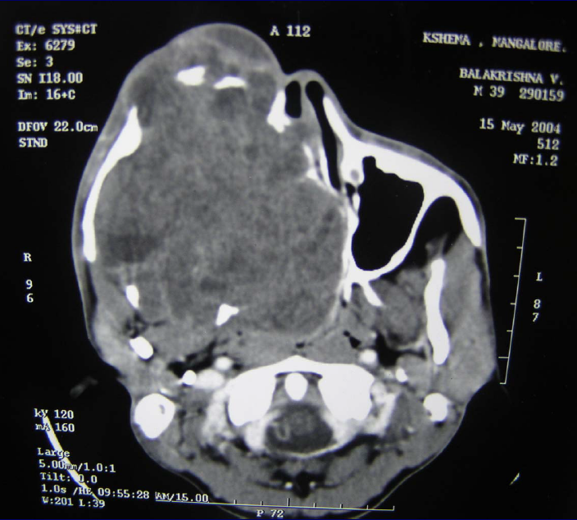
CA MAXILLARY SINUS
DIAGNOSIS:
X-ray PNS.
CT Scan of PNS ( Coronal & Axial).
Biopsy - Nasal Mass / Endoscopic.

Slide 41
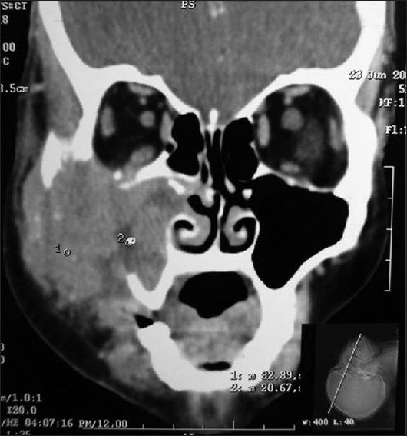
CA MAXILLARY SINUS

Slide 42
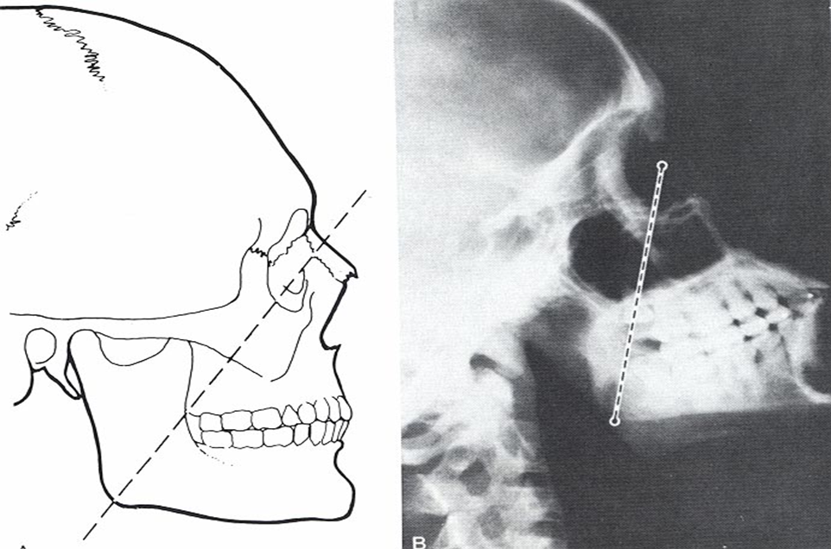
CA MAXILLARY SINUS-classification
OHNGREN’s Classification
Imaginary plane drawn b/w medial canthus of eye & the angle of mandible
Lesion above this : suprastuctural—poor prognosis
Lesion below this : infrastructural

Slide 43
CA MAXILLARY SINUS-classification
AJCC(American Joint Committee on Cancer) Classification
Only for squamous cell Ca
Histopathological
Well differentiated
Moderately differentiated
Poorly differentiated

Slide 44
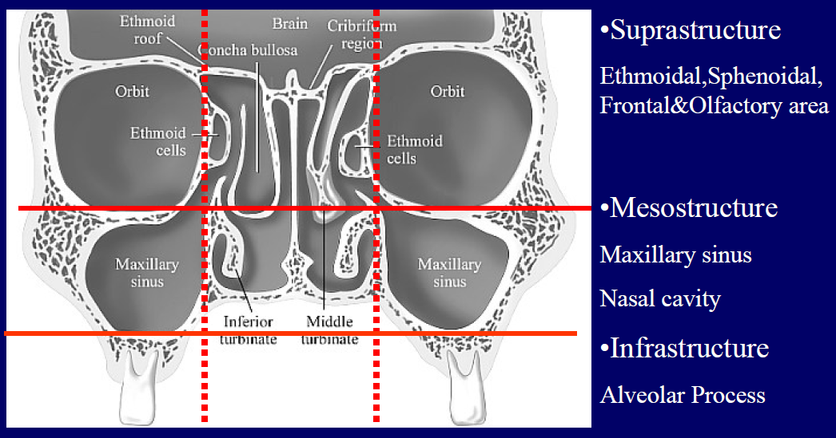
CA MAXILLARY SINUS-classification
Lederman’s Classification

Slide 45
TNM staging of Ca maxillary sinus
Tumour
T1: Limited to antral mucosa without bony erosion.
T2: Erosion or destruction of the infrastructure, including the hard palate and/or middle meatus
T3: Tumor invades: skin of cheek, posterior wall of sinus, inferior or medial wall of orbit, anterior ethmoid sinus
T4: Tumor invades orbital contents and/or: cribriform plate, post ethmoids or sphenoid, nasopharynx, soft palate, pterygopalatine or infratemporal fossa or base of skull

Slide 46
CA MAXILLARY SINUS
TREATMENT
For SCC, combination of radiotherapy and surgery is the choice.
surgery
Total Maxillectomy
Partial Maxillectomy
PROGNOSIS
5yrs survival rate is 30%

Slide 47
ETHMOID SINUS MALIGNANCY
Primary lesion is not common in ethmoid sinus
Occur as an extension from maxillary sinus growth
C/F :
Nasal obstruction
Blood stained nasal discharge
Retro orbital pain
Lateral displacement of eye & diplopia
Intracranial spread can cause meningitis
Rx :Pre operative radiation + Total ethmoidectomy
Prognosis : 5yrs survival rate is 30%

Slide 48
FRONTAL SINUS MALIGNANCY
Uncommon
40-50 yrs age group ; males more
C/F :
Pain & Swelling in frontal region
Growth can go post to ant cranial fossa
Growth can extent through the ethmoids into orbit
Rx : Pre operative radiation + Frontal sinusectomy

Slide 49
THANKS A LOT FOR KIND ATTENDION !!!!!!!

