Slide 1
Acquired mandibular defects
خامس \ صناعة اسنان
د. منية م(10)
2\ 4\ 2017

Slide 2
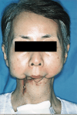
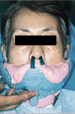
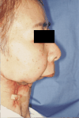
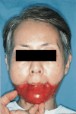
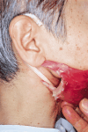
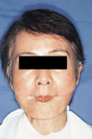
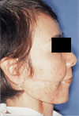

Slide 3
Etiology
Trauma.
Resection of primary tumor.
Resection as a safety margin.

Slide 4
Enhancement of prosthetic prognosis
Maintaining or re-establishing mand. Continuity, by fixation plates.
Sectioning in ramus area.
Sectioning in dentulous portion.
Method of closure .
Resection of mylohyoid + geniohyoid in defect side→ To reduce mand. Deviation.

Slide 5
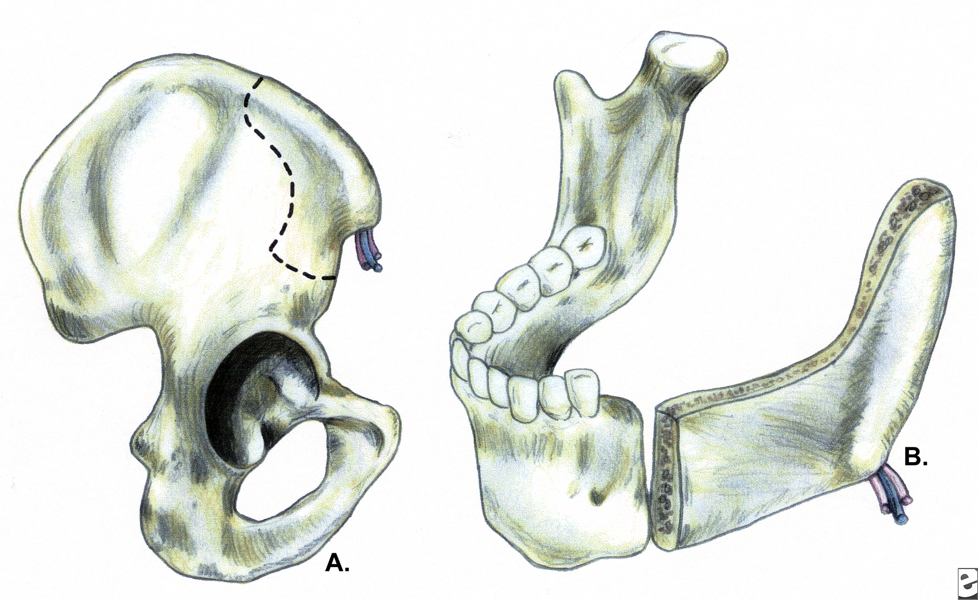

Slide 6
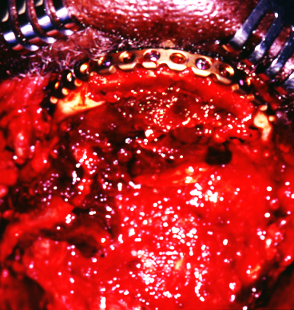
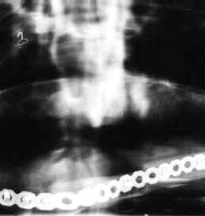
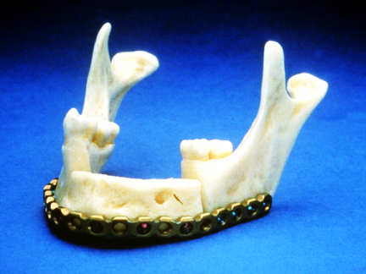

Slide 7
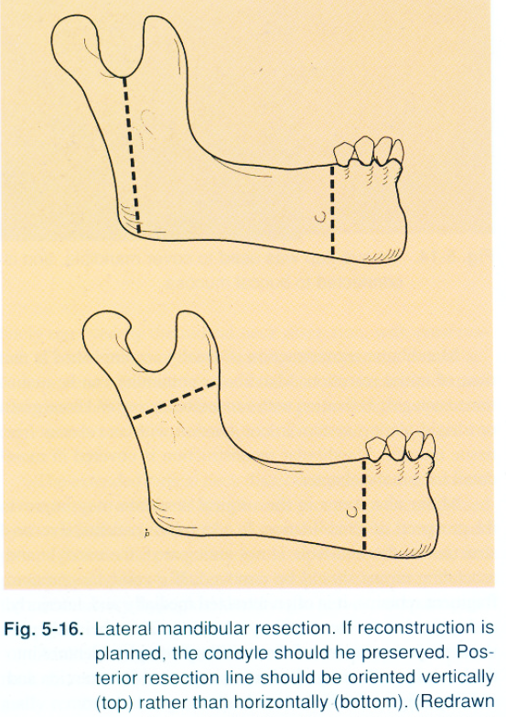

Slide 8
Disabilities associated with the tongue defect
Cosmetic disfigurement.
Speech.
Deglutition.(synergestic squeezing action).
Trismus.
Drooling of saliva.
Mandibular deviation.
Frontal plane rotation.

Slide 9
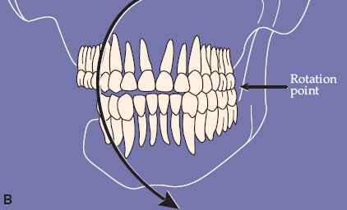
Frontal plane rotation

Slide 10
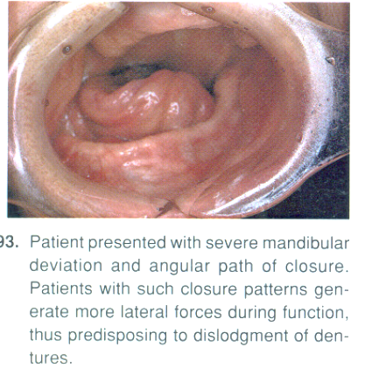

Slide 11
Internal jugular vein resection → local venous congestion + edema → compromise extension of lower complete denture.
Resection marginal of denture mandibular branch of facial nerve → loss of motor innervations of lower lip.
Disabilities associated with radiotherapy
  Sever scarring → trismus.
  Dental caries.
  Impaired mucosal tolerance to prosthesis.
  Changed consistency and volume of saliva.

Slide 12
Disabilities associated with the floor of mouth defects
Sever facial disfigurment:
  Remaining posterior fragments pulled medially and superiorly →difficult construction of complete denture.
  Loss of anterior of mandible → patient looks like losing lower ⅓ of his face.
Tongue retrusion → occlude airway.
Primary closure of wound → ↓mobility of the tongue .
→ loss of anterior vestibule.
Mastication is impossible.
Speech is affected.
Sensory and motor innervations of lower lip is compromised → drooling of saliva.

Slide 13
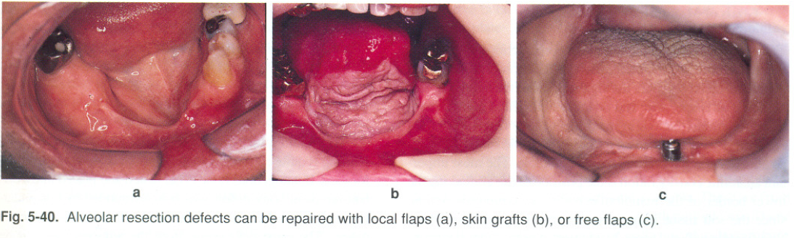

Slide 14
Disabilities associated with tonsillar area defects:
Mandibular resection is more posterior:
  Loss of fewer teeth. Retention of more denture-bearing surface.
Facial disfigurement is not noticeable.
If the lesion external to the tonsillar pillar superiorly:
  Portion of soft palate is resected.
  velopharyngeal incompetence.
  Hypernasal speech.
  Fluid regurgitation.

Slide 15
Cont…
Swallowing is impaired:
  Poor mobility and control of tongue.
  Nasal regurgitation.
Mandibular deviation.
Speech problems.
Control of saliva.
Trismus.
The radiation therapy.

Slide 16
Disabilities associated with defects confined to the mandible
Continuity defects, as in marginal mand. Resection… oblitration of buccal + lingual sulci
Discontinuity defects .. deviation of mand.+tongue.
Function rarely affected

Slide 17
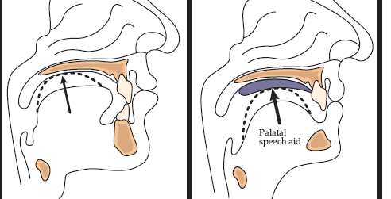
Management of disabilities caused by mandibular defects
Management of mandibular deviation:
  Intermaxilary fixation.
  Physio-therapy.
  Mandibular guidance prosthesis:
    Buccal training flange.
    Palatal ramp.
Occlusal equilibration.

Slide 18
Management of disabilities caused by mandibular defects
Management of mandibular deviation:
  Intermaxilary fixation.
  Physio-therapy.
  Mandibular guidance prosthesis:
    Buccal training flange.
    Palatal ramp.
Occlusal equilibration.

Slide 19
Fixation indication:
Resection confined to mand.+ little soft tissue loss
Min. scar contracture+ enough soft tisssue for closure.
Ms. Imbalance + compromised proprioception

Slide 20
contraindication:
Composite resection ; radical neck dessection ; radiotherapy ;1ry closure.
Profound scar contracture ;worsened man. deviation

Slide 21
Physiotherapy :
2 wks post surgical. How?
Maximum opening of man.
Grasp the chin ….move the man. Away from defect side
why?
reduce scar contracture +tris mus+ ms. Adhesion
Improve maxillary– mand. Relationship.

Slide 22
Man. Guidance therapy:
As early as possible
Presence of the teeth is v. imp.
To get acceptable occ. Relationship + proper proprioceptive mechanism

Slide 23
types of man. Guidance prosthesis:
Buccal training flange (lower)………man. Can be manipulated to proper max..man. Relation + pt. can,t bring man. To occ. b\c lack of motor control
Palatal ramp (upper)…sever deviation b\c more adjustable
Palatal stent……..most of teeth present

Slide 24
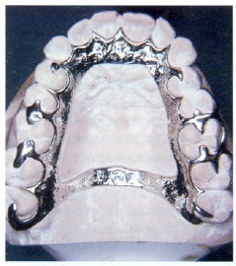
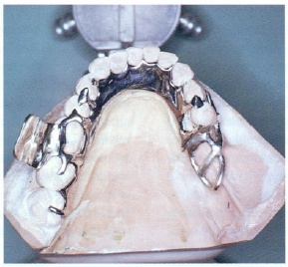
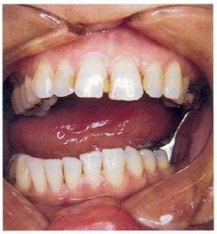
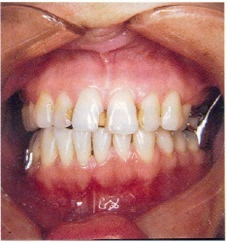

Slide 25
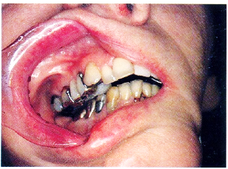
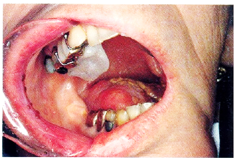
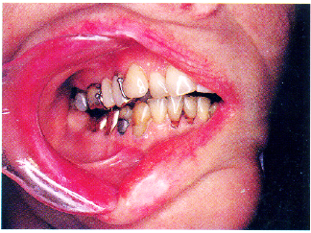

Slide 26
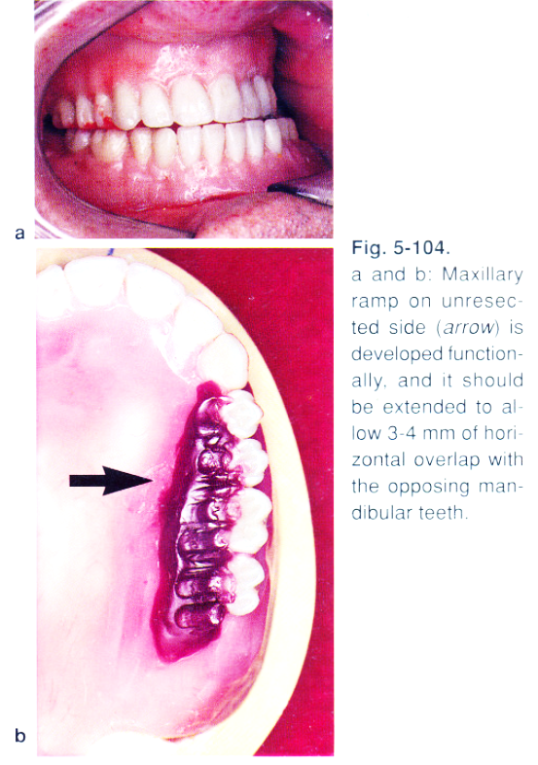

Slide 27
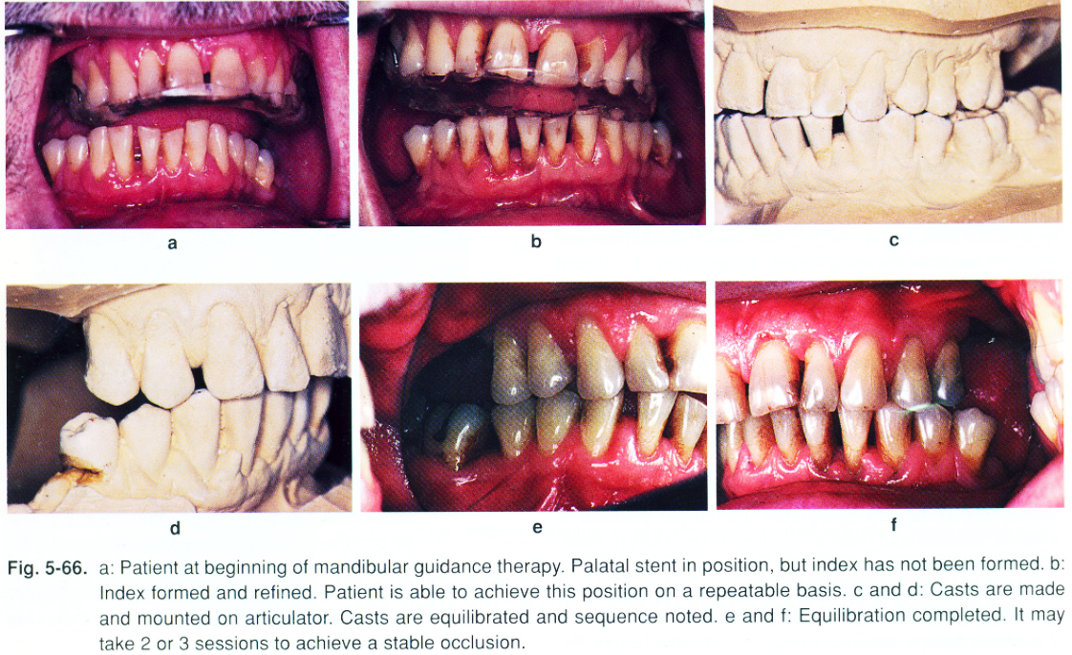

Slide 28
occlusal equilibration
Reduce mand. Deviatio, and frontal plane rotation.
2. Reestablish occlusal stops to reproduce C.R

Slide 29
Prosthetic rehabilitation
Partially edentulous pt.
Completely edentulous pt.

Slide 30
Partially edentulous pt.
Latral discontinuity defects…fulcrum line ,design,steps, altered cast technique (for final imp.), altenative cast technique (pick_up imp.), occ.(proper ICP at C.O ,occ. Ramp lingual to max. teeth
Continuity defects ( latral +anterior)….. conventional RPD or implant_retained

Slide 32
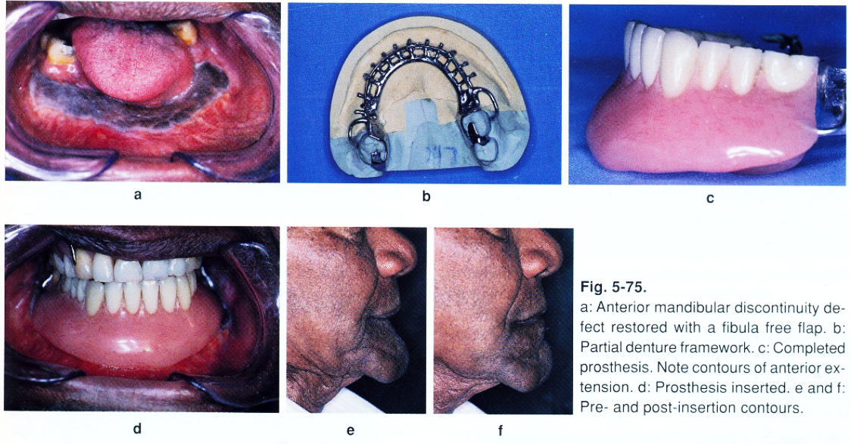

Slide 33
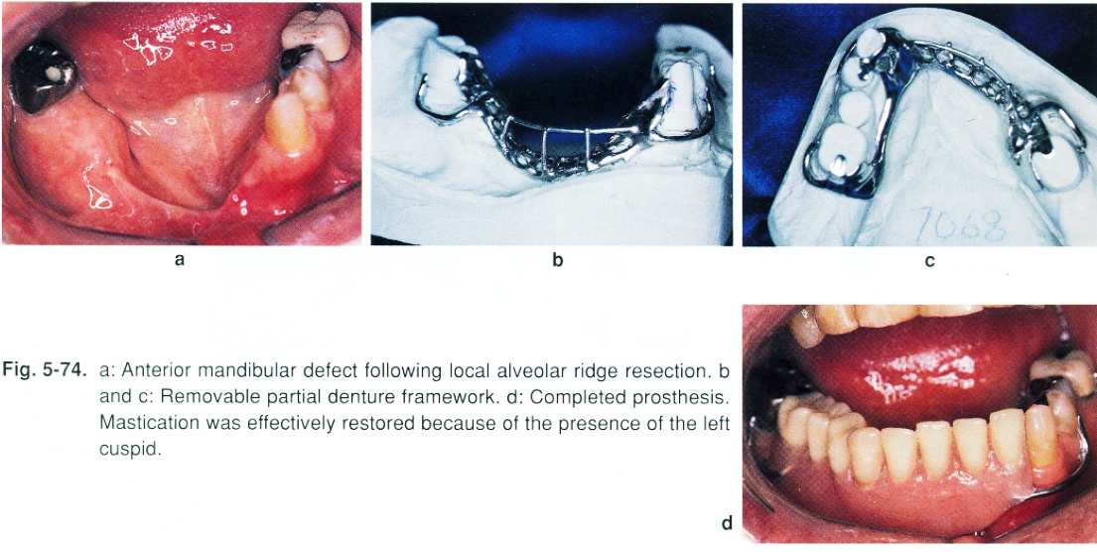

Slide 34
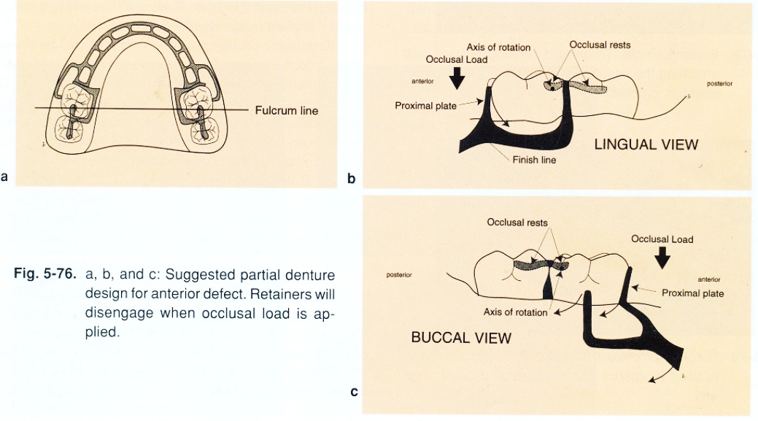

Slide 35
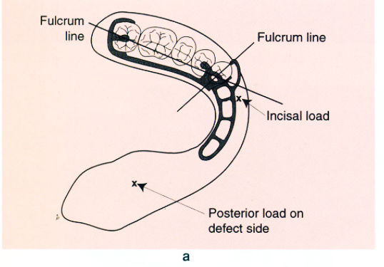
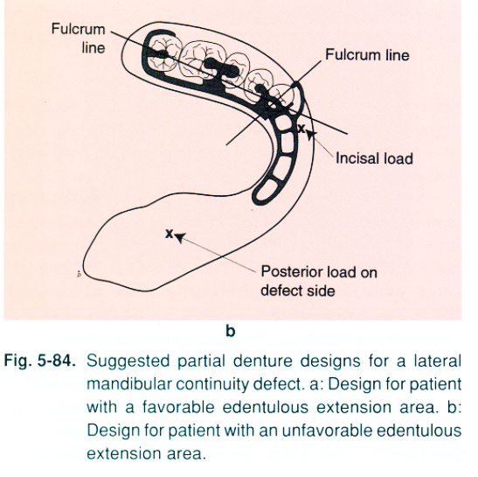

Slide 36
Completely ed. Pt. :
Ant. Discontiuity defects are impossible to restore.
Lateral discontinuity defects
Depend on:

Slide 37
Extent of soft tissue and bony resection
Tongue mobility in directions which stabilize C.D …….tongue immobility is adv. b\c it allows aggressive extention of lingual flange in non_surgical side….increasing the stability.
Man. Dev. Instability of C.D + application of occ. Forces on unresected side reduce ret.
Compromised motor + sensory lip control cause…cheek biting ; salivary drooling ; and lips retracted post. So lingual positioning of C.D teeth.
radiotherapy

Slide 38
Steps
Impression(1ry +2ry)..adaptation;support; stability; proper lip support..
Centric registration..occ. Rim is wide in unresected side b\c man. Dev.and support of upper lip reduced to reduce effect of man. Dev. And retrusion…………..V.D difficult b\c altered proprioception; trismus; man. Dev.; ms. Imbalance; ……..so phonetic methods and swallowing are used instead of neuroms. Methods.
Occ. Schem +latral registration

Slide 39
Non_anatomic post. Teeth used.
Ant. Max. Teeth lingually positioned for esthetic.
Protrusion done by most pt.(incisal guidance not affected).
Lingual inclination of man. On defect side nessacitate thickining of the flange to support lip.

Slide 40
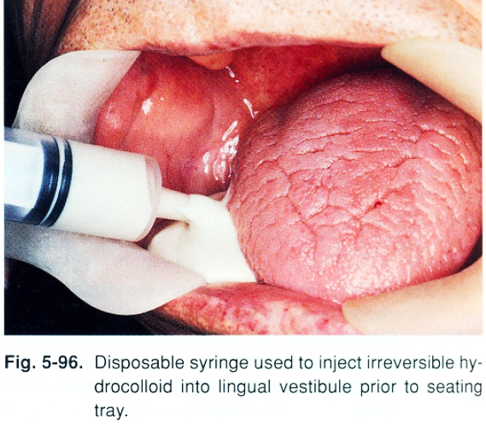

Slide 41
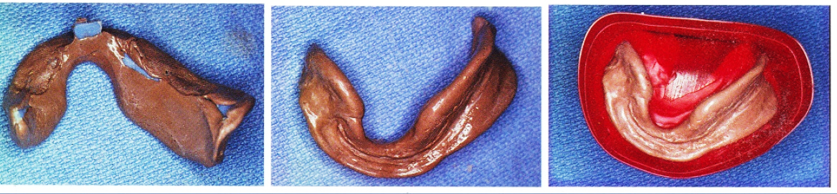
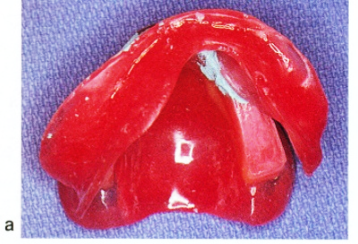

Slide 42
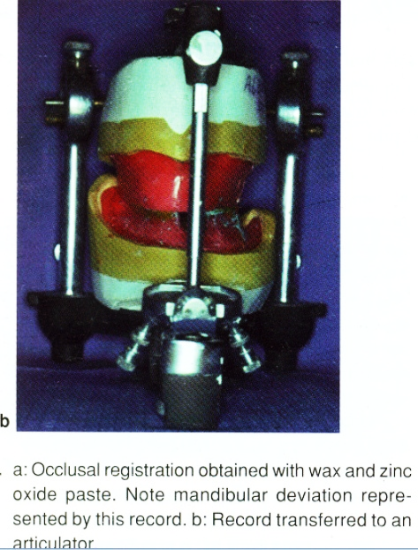

Slide 43
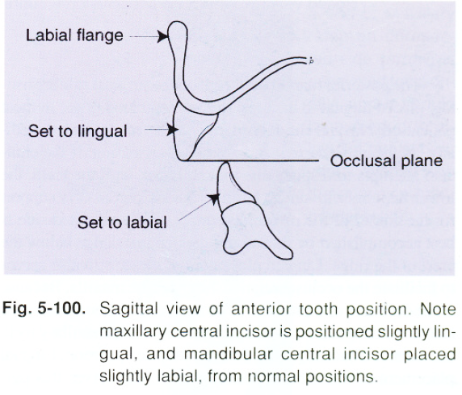

Slide 44
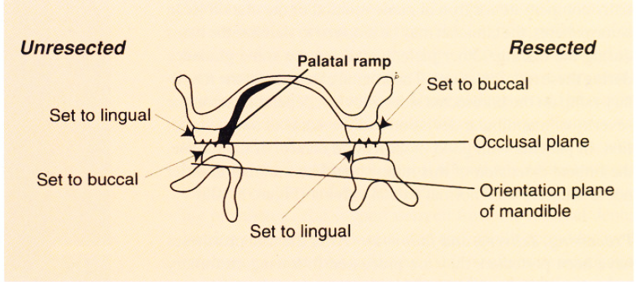

Slide 45
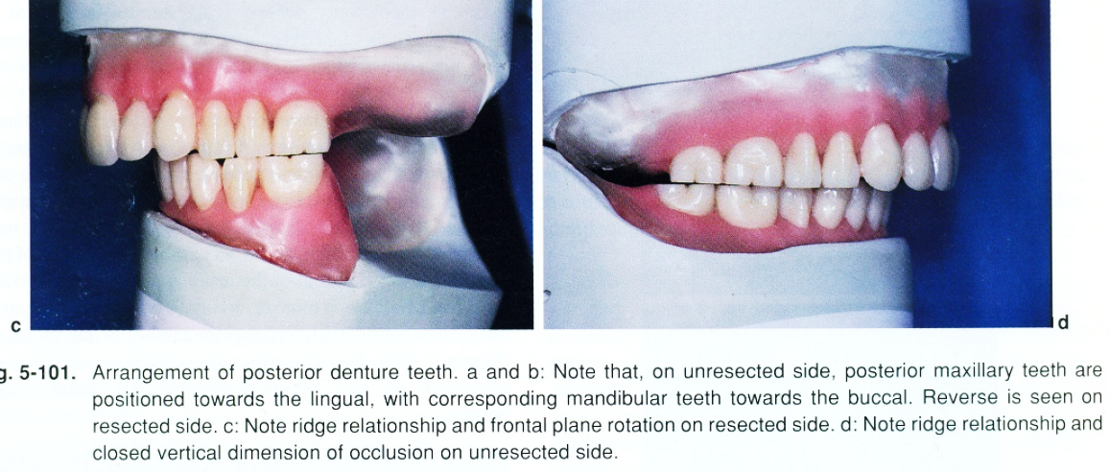

Slide 46
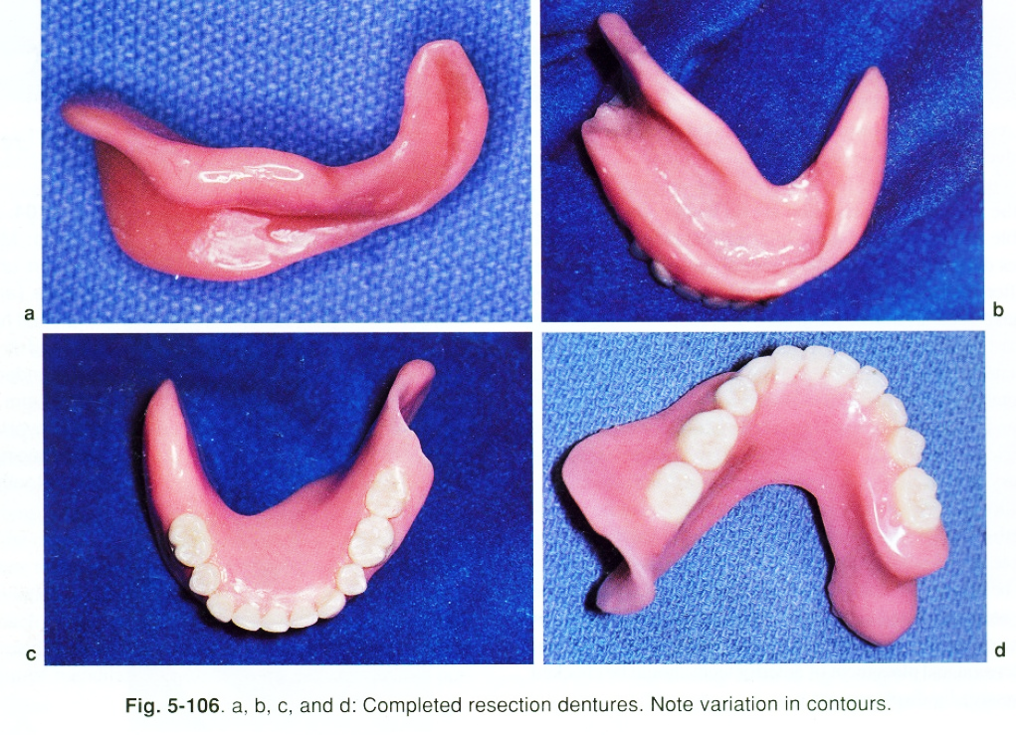

Slide 48
