Slide 1
Lab. 2
Connective Tissue

Slide 2
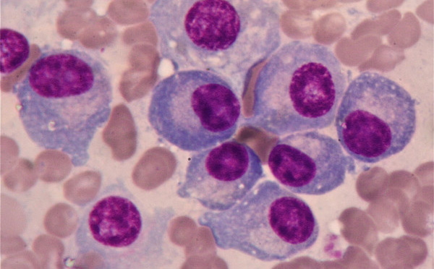
nucleus
Plasma cells
The function of plasma cell is the formation of antibodies

Slide 3
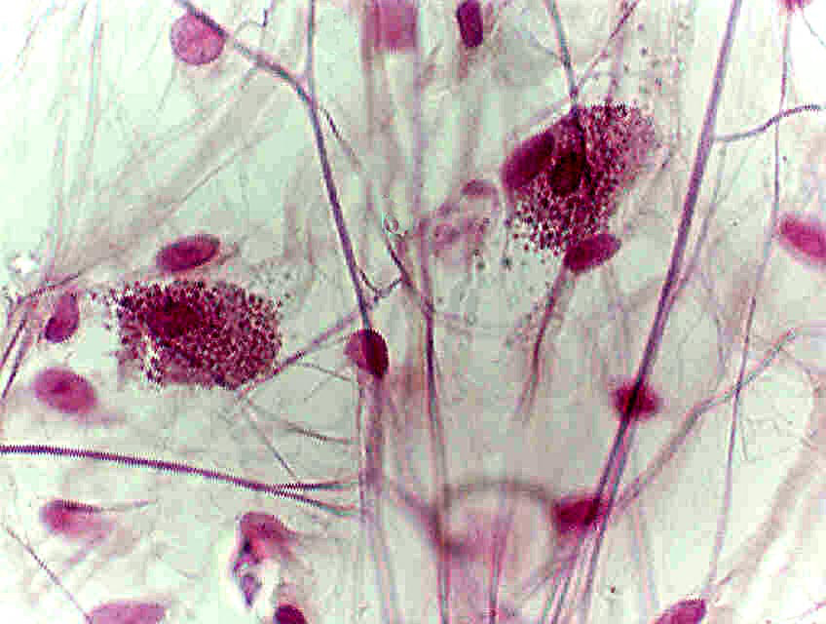
Mast cells
The function is the production of heparin and histamine

Slide 4
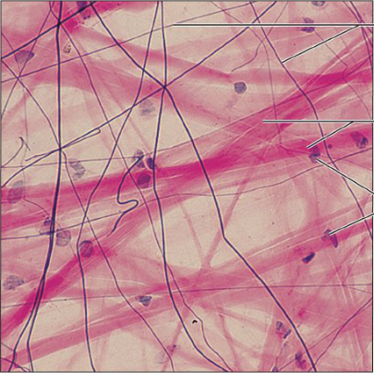
Collagen fibers
Elastic fibers
Connective tissue
cells
Areolar (Loose) Connective Tissue
Location : skin

Slide 5
Lipid droplet
cytoplasm
Location:

Slide 6
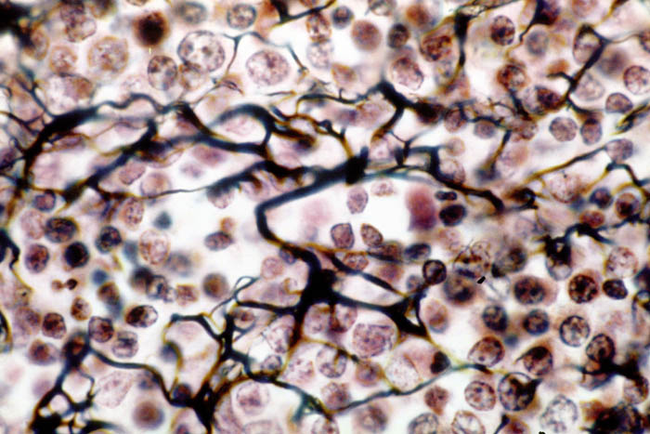
reticular fibers
reticular cells
Reticular tissue
Location : lymph nodes

Slide 7
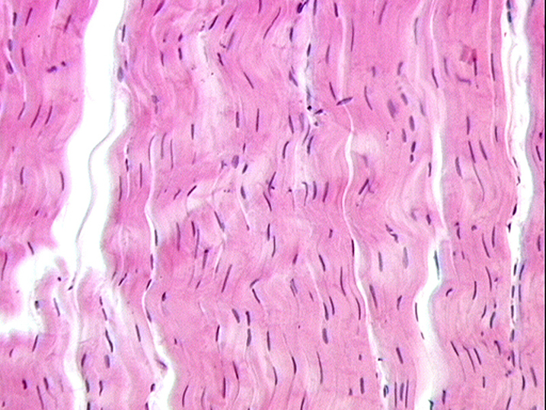
Nucleus of
fibroblast
Dense Regular Connective Tissue
Location : tendons

Slide 8
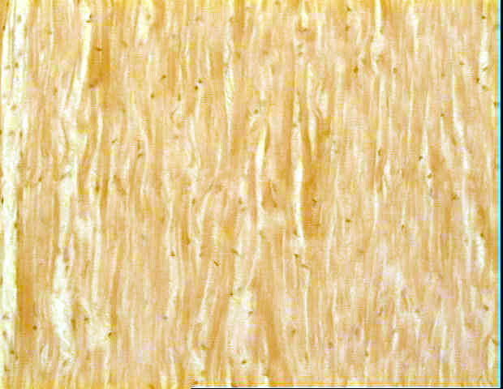
elastic fibers
Nucleus of
fibroblast
Elastic Connective Tissue
Location : ligaments

