Slide 1
Cephalometrics
Dr.Omar .S.M.J.Ali

Slide 2
Introduction
Origin: ‘Cephalo’ means head and ‘Metric’ is measurement
Discovery of X-rays measurement of the head from shadows of bony and soft tissue landmarks on the image

Slide 3
Definitions
“The scientific measurement of the bones of the cranium and face, utilizing a fixed, reproducible position for lateral radiographic exposure of skull and facial bones” -- Moyers
“ A scientific study of the measurements of the head with relation to specific reference points; used for evaluation of facial growth and development, including soft tissue profile” -- Grabers

Slide 4
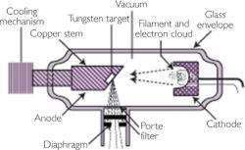
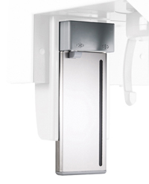
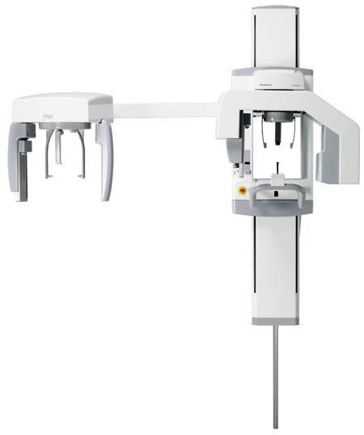
Cephalometric Imaging System
X- ray apparatus
An image receptor
Cephalostat

Slide 5
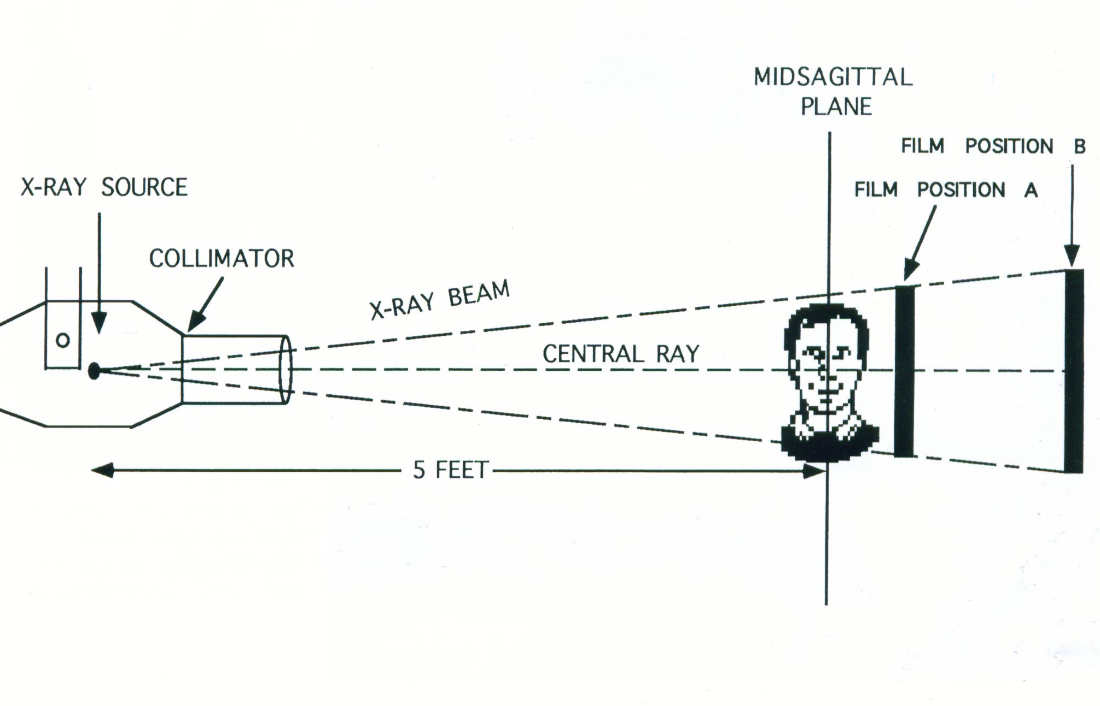
15 cm

Slide 6
Uses of cephalometric
In orthodontic diagnosis & treatment planning
In classification of skeletal & dental abnormalities
In establishing facial types
In evaluation of treatment results
In predicting growth related changes & changes associated with surgical treatment
Valuable aid in research work involving the cranio-dentofacial region
-- Moyers

Slide 7
Principle of Cephalometric analysis
To compare the patient with a normal reference group, so that differences between the patient’s actual dentofacial relationships and those expected for his/her racial or ethnic groups are revealed
-- Jacobson

Slide 8
Goals of Cephalometrics
To evaluate the relationships, both horizontally and vertically, of the five major functional components of the face:
The cranium and the cranial base
The skeletal maxilla
The skeletal mandible
The maxillary dentition and the alveolar process
The mandibular dentition and the alveolar process
-- Jacobson

Slide 9
Types of cephalograms

Slide 10
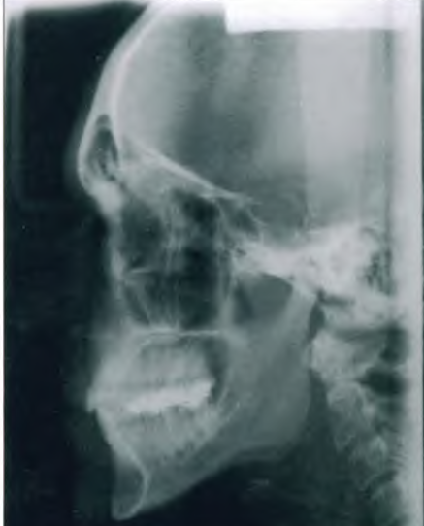
Lateral cephalometric
Taken with head in a standardized reproducible position at a specific distance from X-ray source

Slide 11
Uses :
Important in orthodontic growth analysis
Diagnosis & Treatment planning
Monitoring of therapy
Evaluation of final treatment outcome

Slide 12
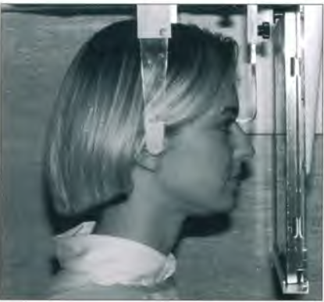
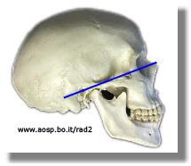
Posteroanterior (p-a) cephalometric radiograph
Image Receptor and Patient Placement:
Image receptor is placed in front of the patient
The patient is placed so that the canthomeatal line is perpendicular to the image receptor

Slide 13
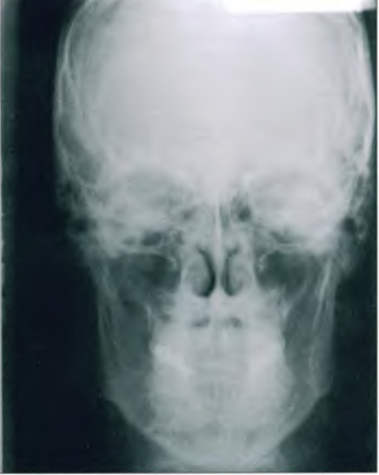
Uses :
Provides information related to skull width
Skull symmetry
Vertical proportions of skull, craniofacial complex & oral structures
For assessing growth abnormalities & trauma

Slide 14
Cephalometric landmarks
A conspicuous point on a cephalogram that serves as a guide for measurement or construction of planes – Jacobson

Slide 15
Requisites for a landmark
Should be easily seen on the x ray film
Be uniform in outline
Easily reproducible
Should permit valid quantitative measurement of lines and angles
Lines and planes should have significant relationship to the vectors of growth

Slide 16
Lateral Cephalometric

Slide 17
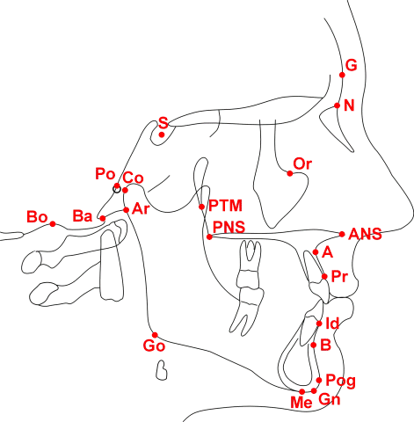
Hard tissue landmarks
Nasion (N)
The frontonasal suture at its most superior point on
the curve at the bridge of the nose.

Slide 18
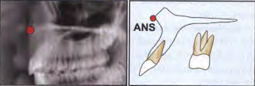
Anterior Nasal Spine (ANS)
The most anterior point on the maxilla at the level of
the palate.

Slide 19
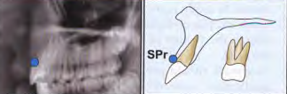
Superior Prosthion (SPr or PR)
Also termed supradentale. The most anterior inferior
point on the maxillary alveolar process.

Slide 20
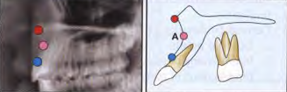
Subspinale ("A" Point)
The most posterior point on the curve between ANS
and PR (SPr). "A" point is usually found 2mm anterior
to the apices of the maxillary central incisor root.

Slide 21
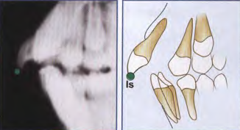
Incision Superius (Is)
The incisal tip of the most anterior maxillary central
incisor.

Slide 22
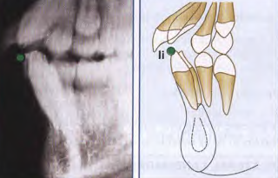
Incision Inferius (Ii)
The incisal tip of the most labial mandibular central
Incisor.

Slide 23
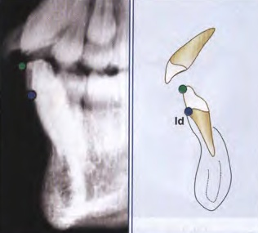
Intradentale (Id)
The most anterosuperior point on the mandibular
alveolar process usually found near the CEJ
of the mandibular central incisor. Also
termed inferior prosthion.

Slide 24
Supramentale (« B » point)
The most posterior point of the bony curvature of the
mandible below infradentale and above Pogonion. "B"
Point is usually found near the apical third of the roots. of the mandibular incisors and may be obscured
during the eruption of these teeth. When the profile
of the chin is not concave, "B" point cannot be
determined.

Slide 25
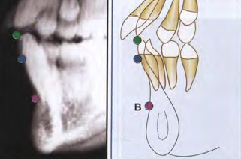

Slide 26
Pogonion (Pog)
Pogonion is the most anterior point on the contour of
the chin. Pogonion usually is located by a tangent
perpendicular to the mandibular line or a tangent
dropped to the chin from nasion.

Slide 27
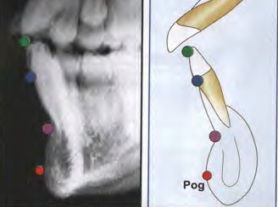

Slide 28
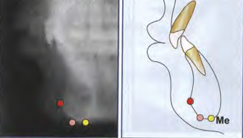
Menton (Me)
Menton is the lowest point on the symphyseal outline
of the chin.

Slide 29
Gnathion (Gn)
The most anteroinferior point on the lateral shadow
of the chin. Gnathion may be approximated by the
midpoint between pogonion and menton on the
contour of the chin

Slide 30
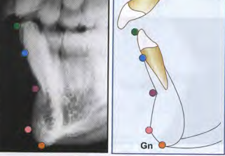

Slide 31
Basion (Ba)
The most inferoposterior point in the sagittal plane
on the anterior rim of the foramen magnum-the tip
of the posterior cranial base.

Slide 32
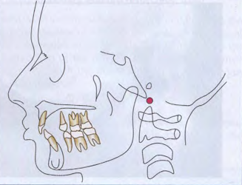

Slide 33
Bolton Point (BO)
The highest point in the upward curvature of the
retrocondylar fossa.

Slide 34
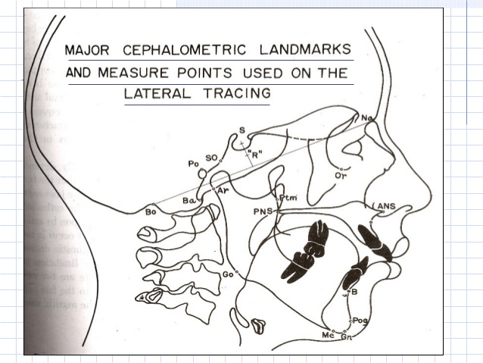

Slide 35
Posterior Nasal Spine (PNS)
The most posterior point on the bony hard plate in
the sagittal plane: usually the meeting point of the
inferior and superior surfaces of the hard plate.

Slide 36
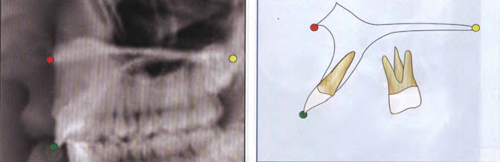

Slide 37
Sella(S)
The center of the hypophyseal fossa (sella turcica). It
is selected by the eye, since that procedure has been
shown to be as reliable as a constructed center.

Slide 38
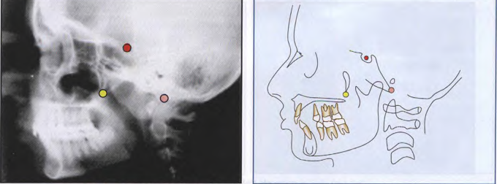

Slide 39
BILATERAL LANDMARKS
Orbitale (Or)
Orbitale has been defined as the lowest point of the
bony orbit. In the PA cephaJogram, each may be
identified but in the lateral cephalograms. the outlines
of the orbital rims overlap. Usually, the lowest point
on the average outline is used to construct the
Frankfort plane.

Slide 40
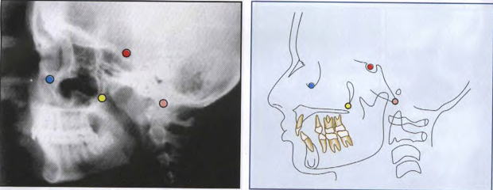

Slide 41
Gonion (Go)
Gonion is the most posteroinferior point at the angle
of the mandible. It may be determined by inspection
or by bisecting the angle formed by the junction of the
ramal and mandibular lines, and extending this
bisector through the mandibular border.

Slide 42
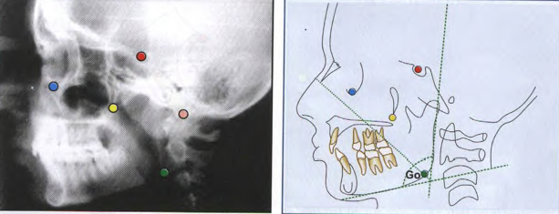

Slide 43
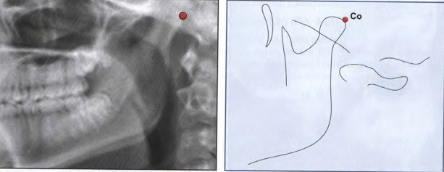
Condylion (Co)
Condylion is the most posterosuperior point on the
condyle of the mandible.

Slide 44
Articulare (Ar)
The intersection of the radiographic shadows:
the inferior surface of the cranial base and the posterior
surfaces of the necks of the condyles of the mandible.
Articulare is systematically used for condylion when
the latter is not reliably discernible. Displacement of
the condyle moves the articulare.

Slide 45
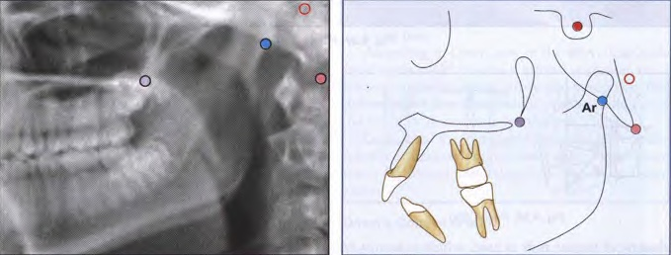

Slide 46
Pterygomaxillary Fissure (Ptm)
A bilateral teardrop-shaped area of radiolucency, the
anterior shadow of which is the posterior surfaces of
the tuberosities of the maxilla.

Slide 47
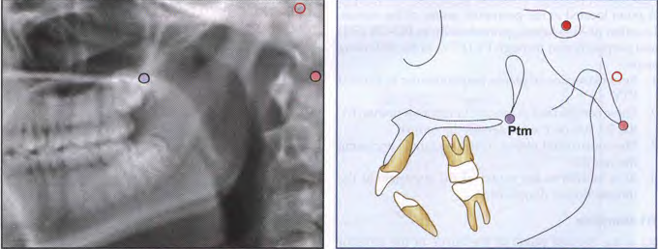

Slide 48
Porion (Po)
The "top" of the external auditory meatus. Sometimes,
because porion is quite unreliable, the "top" of the shadow of the ear rods is used, which is known as
“machine porion".

Slide 49
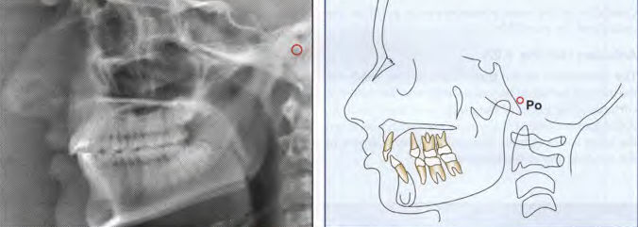

Slide 50
Soft tissue landmarks

Slide 51
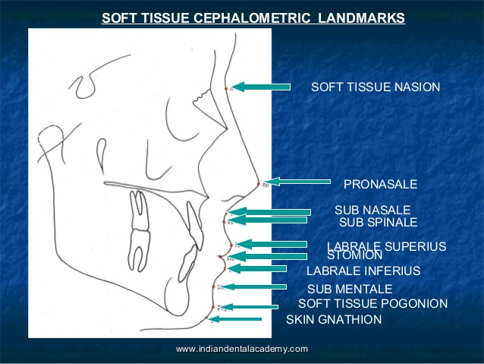

Slide 52

Tracing technique
Tracing supplies & equipments
Lateral ceph, usual dimensions of 8 x 10 inches (patients with facial asymmetry requires antero posterior head film)
Acetate matte tracing paper.
A sharp 3H drawing pencil or a very fine felt-tipped pen

Slide 53
Masking tape
A few sheets of cardboard (preferably black), measuring approximately 6 x 12 inches, and a hollow cardboard tube
A protractor and tooth-symbol tracing template for drawing the teeth (optional)
Dental casts trimmed to maximal intercuspation of the teeth in occlusion
Viewbox (variable rheostat desirable, but not essential)
Pencil sharpener and an eraser

Slide 54
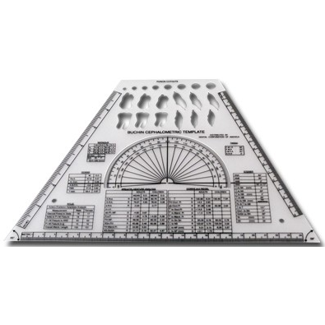

Slide 55
Cephalometric planes
Are derived from at least 2 or 3 landmarks
Used for measurements, separation of anatomic divisions, definition of anatomic structures of relating parts of the face to one another
Classified into horizontal & vertical planes

Slide 56
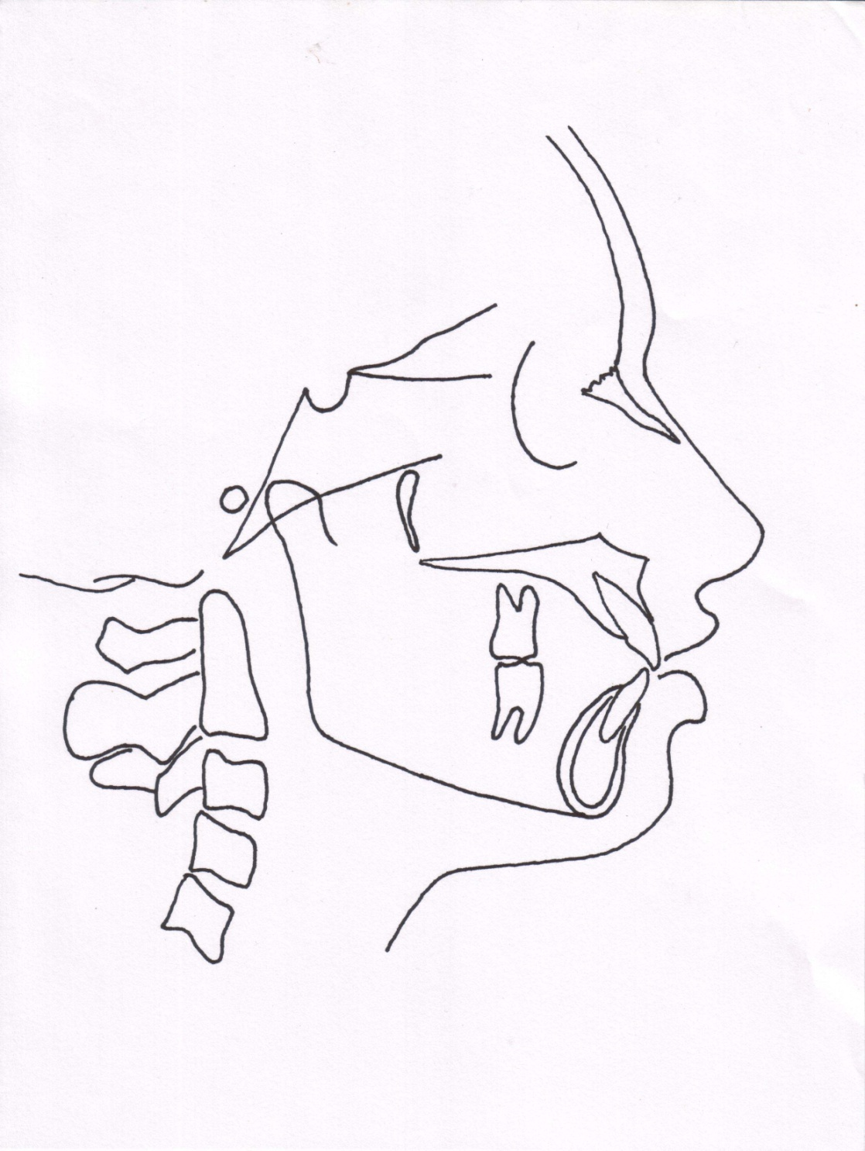
Horizontal planes
Frankfurt Horizontal plane
Porion-orbitale.
P
O

Slide 57
Sella-Nasion plane
S
N

Slide 58
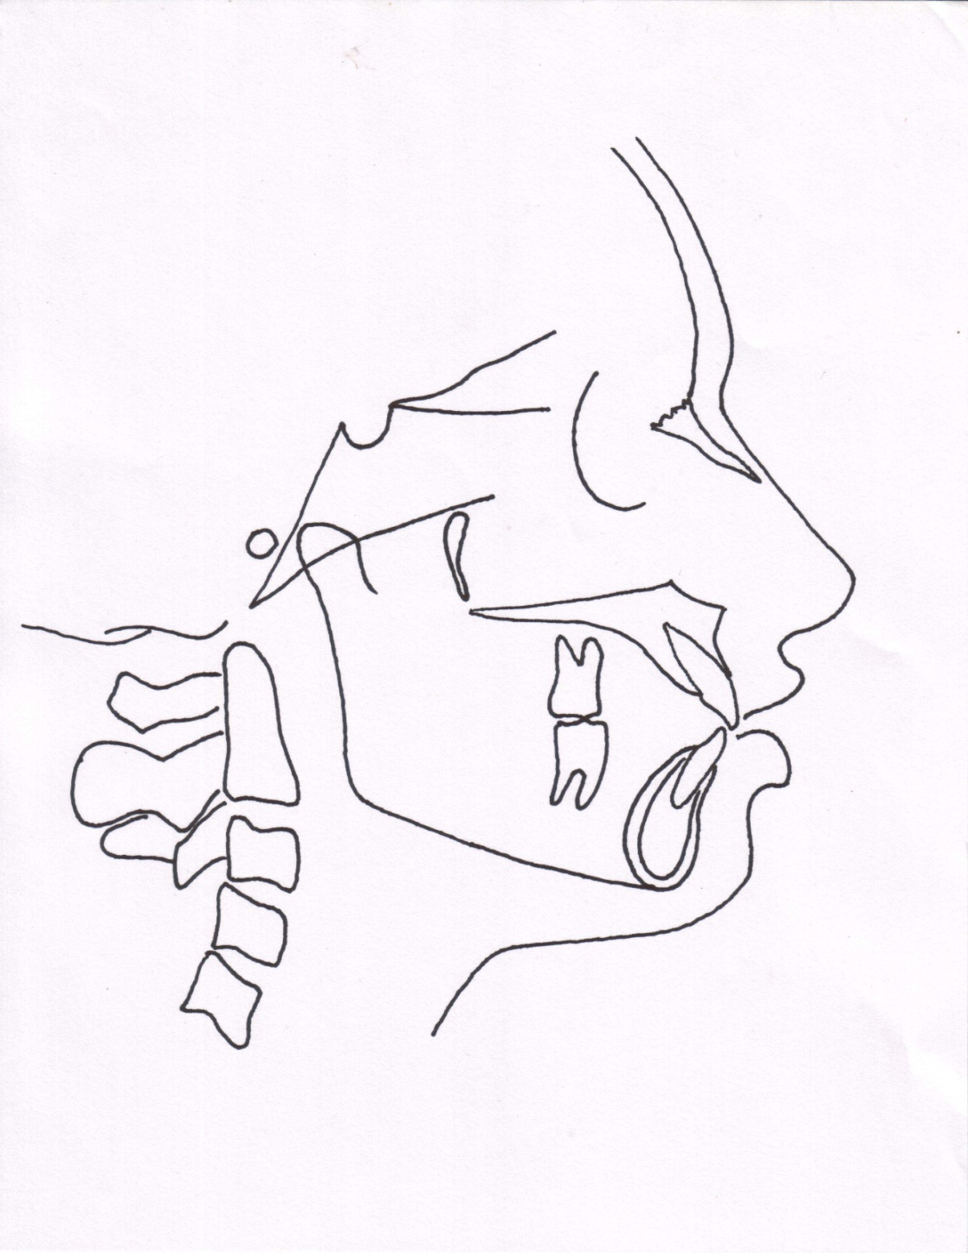
Basion-Nasion plane:
Palatal plane:
Occlusion plane:
N
PNS
ANS
Ba

Slide 59
Mandibular plane: Different definitions are given in different analysis
1. Tweed- Tangent to lower border of the mandible
2. Downs analysis – extends from Go to Me
3. Steiner’s anlysis – extends from Go to Gn
Go
Gn
Me

Slide 60
Vertical planes
Facial plane
A-Pog line
Facial axis
E. plane (Esthetic plane)
N
Ptm
A
E plane
Pog
Gn

Slide 61
Measurement analysis :
Downs analysis
Steiner analysis
Tweed analysis
Wits appraisal
Rickets analysis
Mc Namara analysis
Holdaway soft tissue analysis

Slide 62
MEASUREMENT ANALYSIS
DOWN’S ANALYSIS
Given by WB Downs, 1925
One of the most frequently used cephalometric analysis after St analysis
Based on findings on 20 caucasian individuals of 12-17 yrs age group belonging to both the sexes
Consists of 10 parameters of which 5 are skeletal & 5 are dental

Slide 63

Skeletal parameters :
Facial angle
Average value is 87.8°, Range 82-95°
Gives an indication of anteroposterior positioning of mandible in relation to upper face
Magnitude increases in skeletal class 3 cases, decreases in skeletal class 2 cases
N
FH plane
Pog

Slide 64

Angle of convexity
Reveals convexity or concavity of skeletal profile
Average value 0°, Range = -8.5 to 10°
Positive angle or increased angle – prominent maxillary denture base relative to mandible
Decreased angle , negative angle.prominent of mand.
N
A
Pog

Slide 65
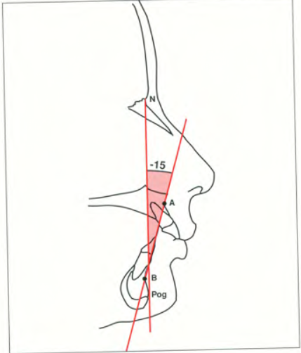
A-B plane angle
Mean value = -4.6°, Range = -9 to 0°
Indicative of maxillary mandibular relationship in relation to facial plane
Positive angle in class 3 malocclusion

Slide 66
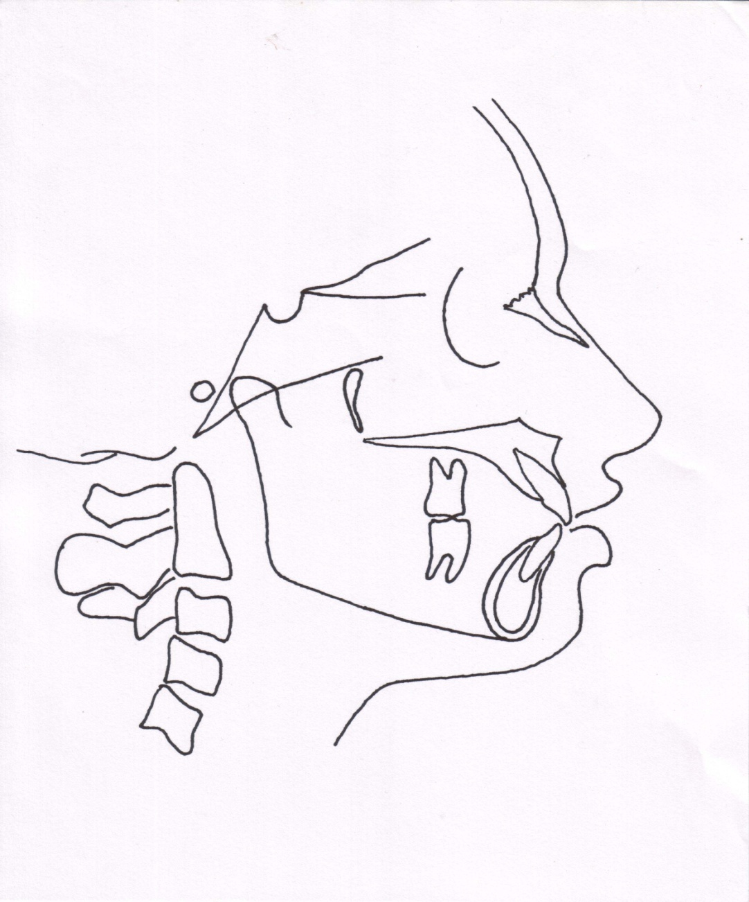
Mandibular plane angle
Mean value = 21.9°, Range = 17 to 28°
Increased mandibular plane angle suggestive of vertical grower with hyperdivergent facial pattern
FHplane
Go
Me

Slide 67

Y- axis (growth axis)
Mean value = 59° , range = 53 to 66°
Angle is larger in class 2 facial patterns than in class 3 patterns
Indicates growth pattern of an individual
Angle greater than normal – vertical growth of mandible
Angle smaller than normal – horizontal growth of mandible
S
FH plane
Gn

Slide 68
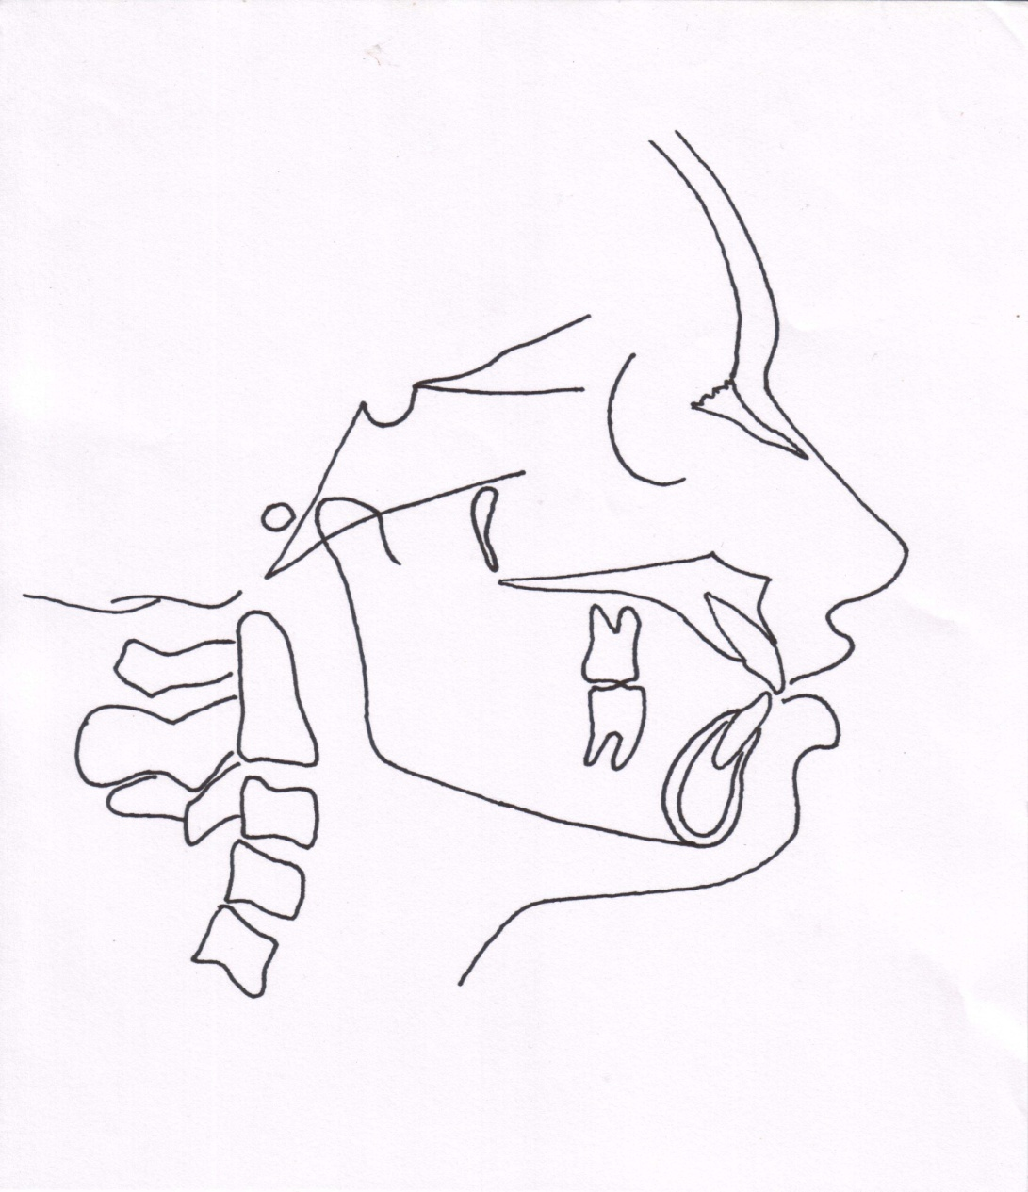
Dental parameters
Cant of occlusal plane
occlusal plane to FH
Mean value = 9.3° , Range = 1.5 to 14°
Gives a measure of slope of occlusal plane relative to FH plane
FH plane

Slide 69

Inter- incisal angle
Average reading = 135.4° ,
Angle decreased in class 1 bimaxillary protrusion & class 2 div 1 malocculsion
Increased in class II div II case

Slide 70
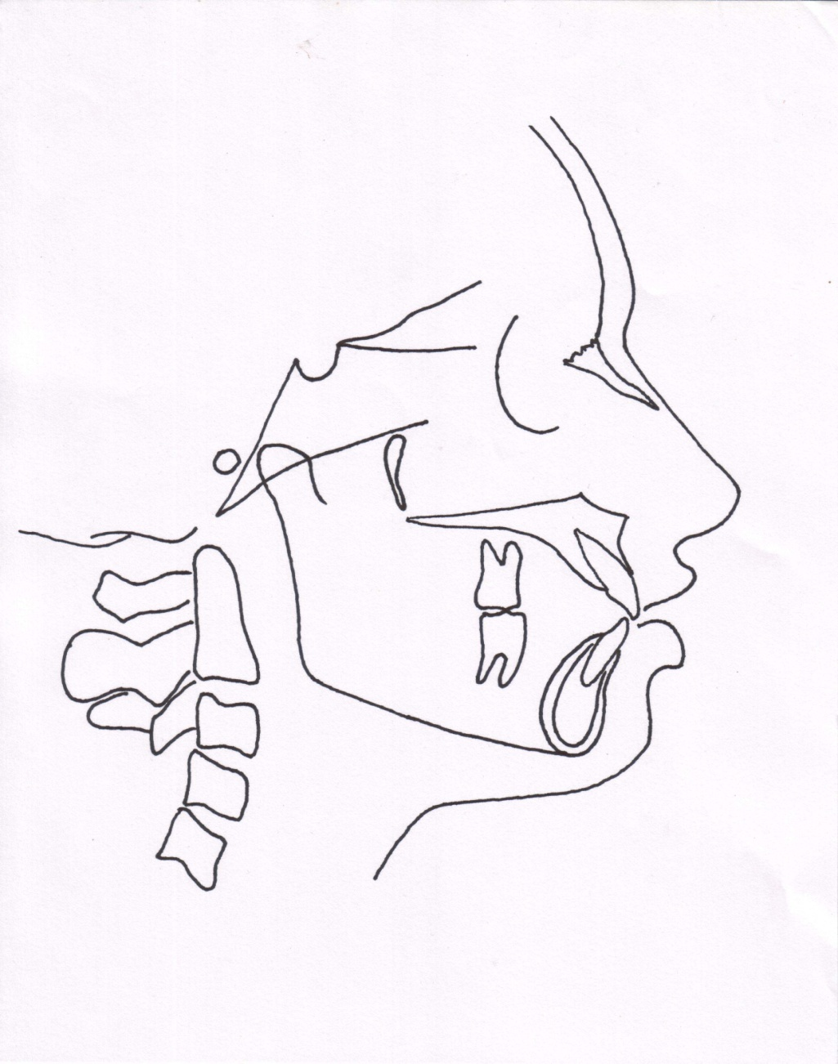
Incisor occlusal plane angle
Average value = 14.5°, range = 3.5 to 20°
Increase in the angle is suggestive of increased lower incisor proclination

Slide 71

Incisor mandibular plane angle
Mean angulation is 1.4, range = -8.5 to 7°
Increase in angle is indicative of lower incisor proclination

Slide 72

Upper incisor to A-Pog line
Average distance is 2.7mm (range -1 to 5 mm)
Measurement is more in patients with upper incisor proclination

Slide 73
Limitations of Downs analysis
Too many landmarks
Too many measurements
Time consuming
-- Jacobson

Slide 74
STEINER ANALYSIS
Developed by Steiner CC in 1930 with an idea of providing maximal information with the least no. of measurements
Divided the analysis into 3 parts
Skeletal
Dental
Soft tissue

Slide 75
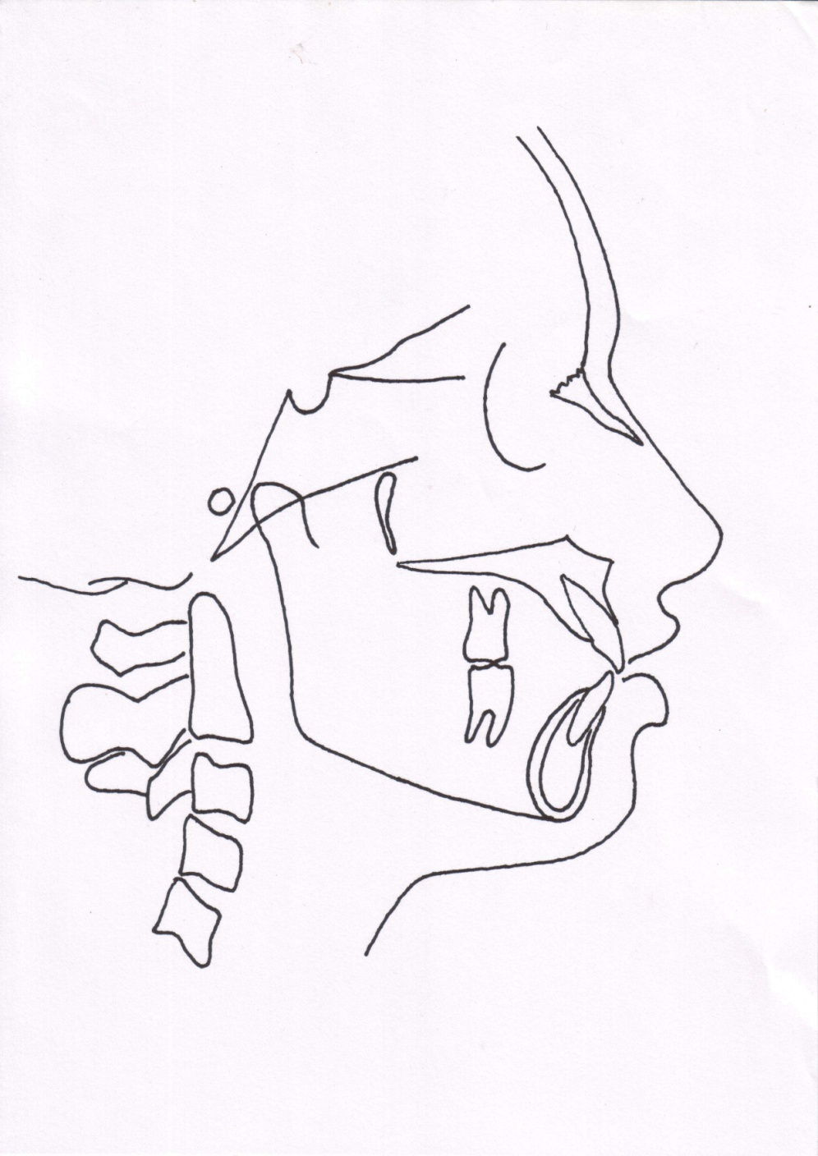
Skeletal analysis
S.N.A angle
Indicates the relative antero-posterior positioning of maxilla in relation to cranial base
>82° -- prognathic maxilla (Class 2)
< 82°– retrognathic maxilla (class 3)
N
S
A
Mean value -- 82°

Slide 76
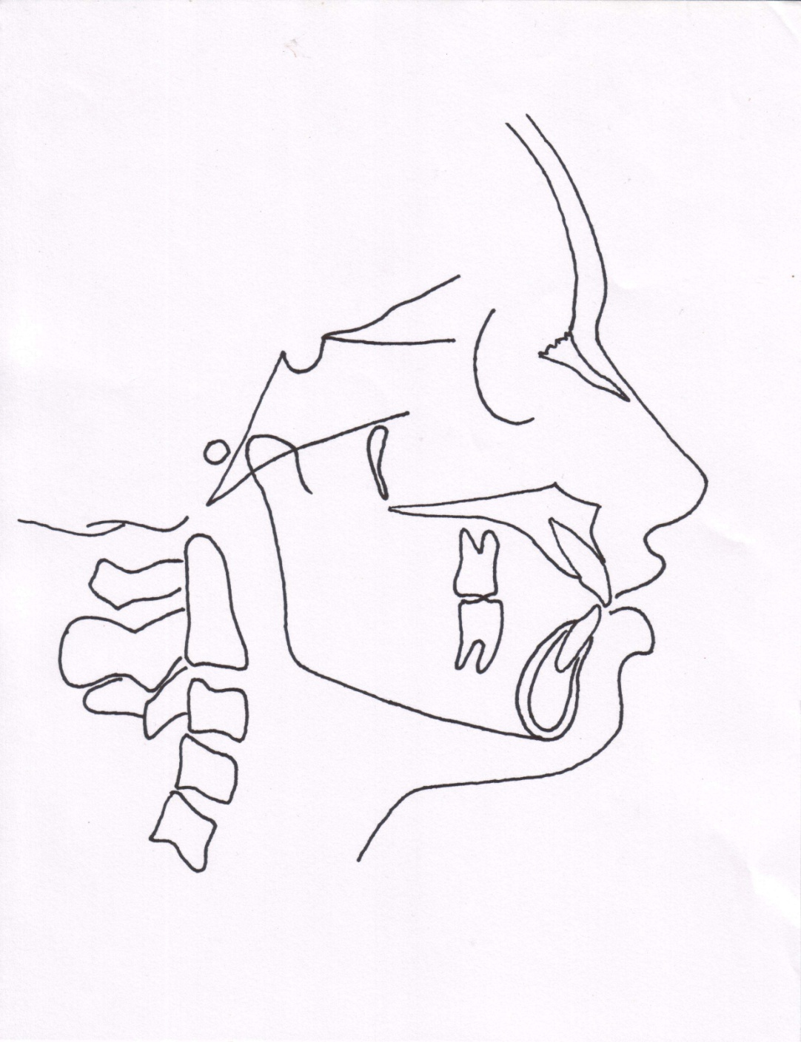
S.N.B angle
Indicates antero-posterior positioning of the mandible in relation to cranial base
> 80°-- prognathic mandible
< 80°-- retrusive mandible
N
S
B
Mean value-- 80°

Slide 77

A.N.B angle
Denotes relative position of maxilla & mandible to each other
> 2° –- class 2 skeletal tendency
< 2°–- skeletal class 3 tendency
N
A
B
Mean value = 2°

Slide 78
Mandibular plane angle
Gives an indication of growth pattern of an individual
< 32° -- horizontal growing face
> 32°– vertical growing individual
N
S
Mean value = 32°

Slide 79
Occlusal plane angle
Mean value = 14.5°
Indicates relation of occlusal plane to the cranium & face
Indicates growth pattern of an individual
N
S

Slide 80
Dental analysis
Upper incisor to N-A(angle)
Normal angle = 22°
Angle indicates relative inclination of upper incisors
Increased angle seen in class 2 div 1 malocclusion
N
A

Slide 81
Upper incisor to N-A ( linear)
Helps in asssessing the upper incisor inclination
Normal value is 4 mm
Increase in measurement – proclined upper incisors
N
A

Slide 82
Inter-incisal angle
< 130 to 131° -- class 2 div 1 malocclusion or a class 1 bimax
> 130 to 131° – class 2 div 2 malocclusion
Mean value = 130 to 131°

Slide 83
Lower incisor to N-B (angle)
Indicates inclination of lower central incisors
>25 °-- proclination of lower incisors
< 25 °– retroclined incisors
Mean value of 25 °
N
B

Slide 84
Lower incisor to N-B (linear)
Helps in assessing lower incisor inclination
Increase in measurement indicates proclined lower incisors
Normal value– 4mm
N
B

Slide 85
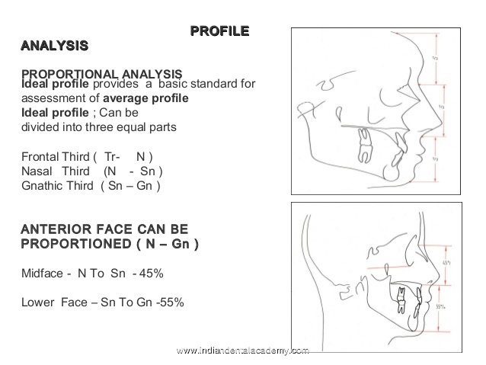

Slide 86
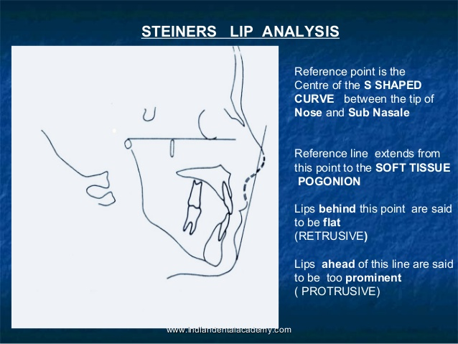

Slide 87
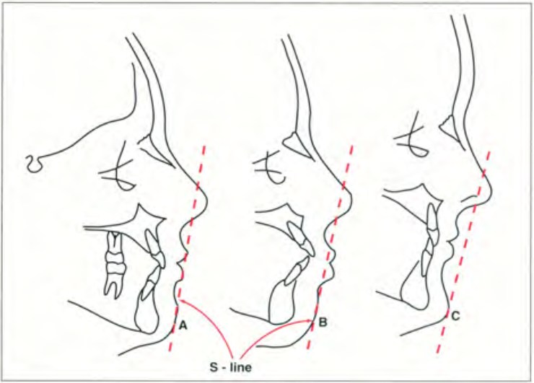
Soft tissue analysis
S line

Slide 88
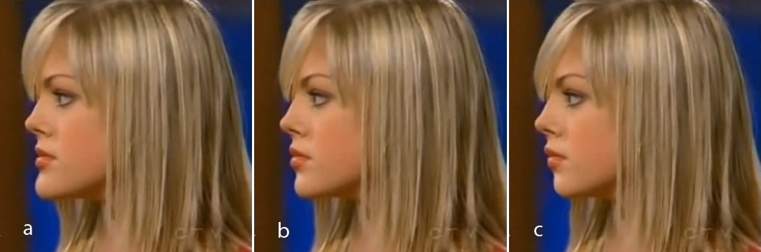

Slide 89
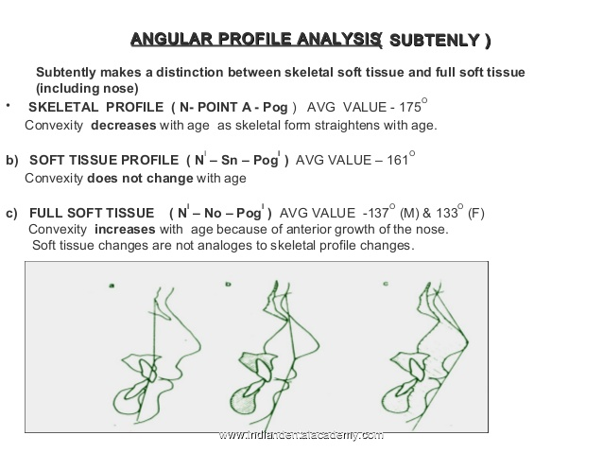

Slide 90
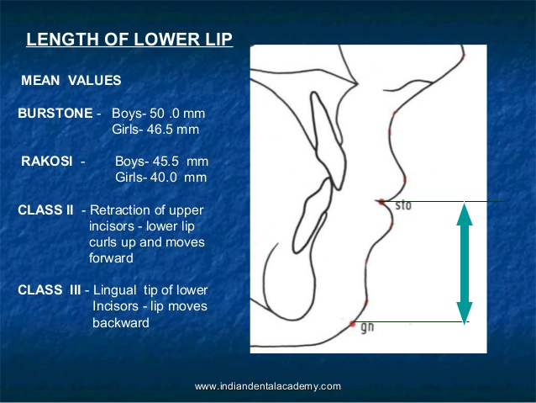

Slide 91
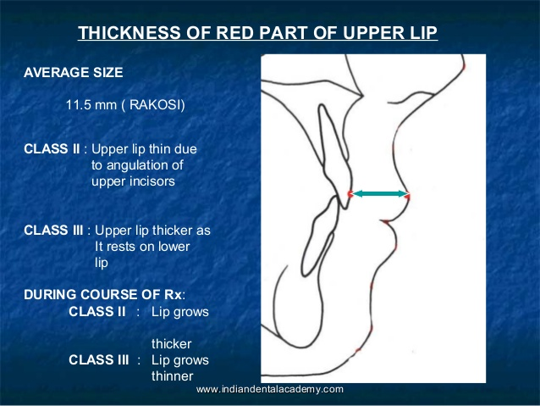

Slide 92
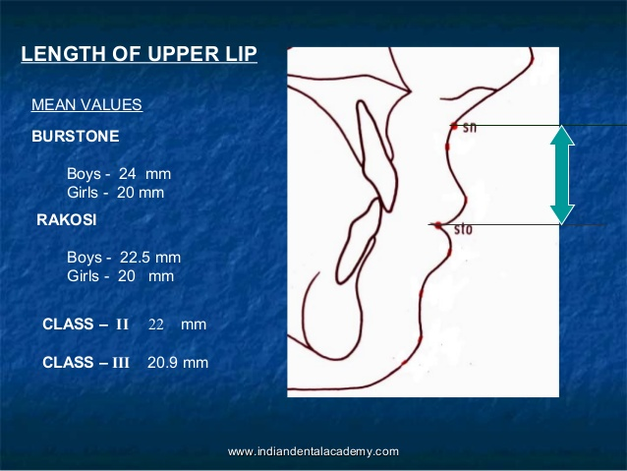

Slide 93
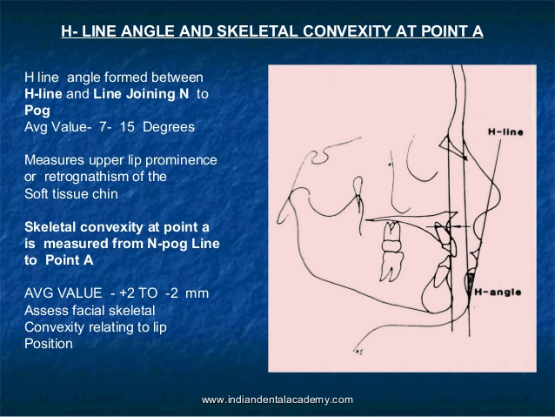

Slide 94
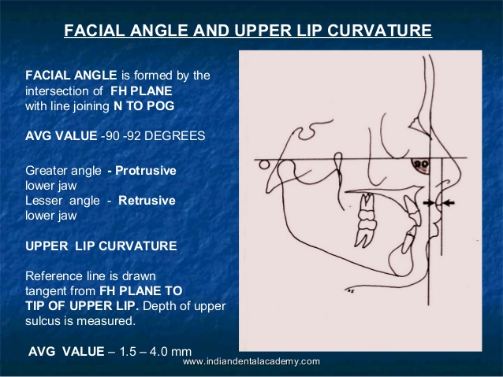

Slide 95
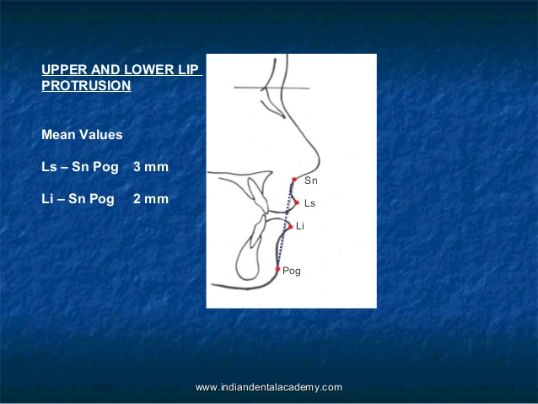

Slide 96


Slide 97


Slide 98


Slide 99


Slide 100


Slide 101


Slide 102
TWEED ANALYSIS
Given by Tweed CH, 1950
Used 3 planes to establish a diagnostic triangle --
Frankfurt horizontal plane
Mandibular plane
Long axis of lower incisor
Determines position of lower incisor

Slide 103
FMPA = 25 °
IMPA = 90 °
FMIA = 65 °
FH plane
Mand plane

Slide 104
WITS APPRAISAL
It is a measure of the extent to which maxilla & mandible are related to each other in antero-posterior or sagittal plane
Used in cases where ANB angle is considered not so reliable due to factors such as position of nasion & rotation of jaws

Slide 105

In males point BO is ahead of AO by 1mm
In females point AO & BO coincide
In skeletal class 2 tendency BO is usually behind AO( positive reading)
In skeletal class 3 tendency BO is located ahead of AO ( negative reading)

Slide 106

  RICKETTS ANALYSIS
Also known as Ricketts’ summary descriptive analysis
Given by RM Ricketts in 1961
The mean measurements given are those of a normal 9 year old child
The growth dependent variables are given a mean change value that is to be expected and adjusted in the analysis.
Dr. RM Ricketts
-- Jacobson

Slide 107
Landmarks
This is a 11 factor summary analysis that employs specific measurements to
Locate the chin in space
Locate the maxilla through the convexity of the face
Locate the denture in the face
Evaluate the profile

Slide 108

This analysis employs somewhat less traditional measurements & reference points
En = nose
DT = soft tissue
Ti = Ti point
Po = Cephalometric
Gn = Gnathion
A6 = upper molar
B6 = Lower molar
Go = gonion
C1 = condyle
DC=articular
CC = Center of cranium
CF = Points from planes at pterygoid

Slide 109
Xi point
A point located at the geometric center of the ramus. Location of Xi is keys of geometrically to Po-Or (FH) and perpendicular through Pt (pterygoid vertical [PtV]; aline perpendicular to FH at the posterior margin of the pterygopalatine fossa) in the following steps:
1. Planes perpendicular to FH and PtV are constructed.
2.The constructed planes are tangent to points R1, R2, R3, and R4 on the borders of the ramus.
3.The constructed planes form rectangular enclosing the ramus.
4. Xi is located in the center of the rectangle at the intersection of the diagonals.

Slide 110


Slide 111


Xi point --
Rl·mand. The deepest point on the curve of the anterior border of the ramus, one half the distance between the inferior and superior curves.
R2- mand. Apoint located on the posterior border of the ramus of the mandible.
R3-mand. Apoint located at the center and most inferior aspect of the sigmoid notch of the ramus of the mandible.
R4-mand. Apoint on the lower border of the mandible, directly inferior to the center of the sigmoid notch of the ramus.

Slide 112


Planes
Frankfurt horizontal -- Extends from porion to orbitale
Facial plane -- Extends from nasion to pogonion
Mandibular plane -- Extends from cephalometric gonion to cephalometric gnathion

Slide 113
Pterygoid vertical -- A vertical line drawn through the distal radiographic outline of the pterygomax fissure & perpendicular to FHP
Ba-Na plane -- Extends from basion to the nasion. Divides the face and cranium.

Slide 114


Occlusal plane -- Represented by line extending through the first molars & the premolars.
A-pog line -- Also known as the dental plane.
E-line -- Extends from soft tissue tip of nose to the soft tissue chin point.

Slide 115
Axis
Ptm
Gn
Facial axis

Slide 116

Condylar axis

Slide 117

Corpus axis

Slide 118


Slide 119
Interpretation
This consists of analyzing:
  Chin in space
  Convexity at point A
  Teeth
  Profile

Slide 120
Chin in Space
This is determined by :
Facial axis angle
Facial (depth) angle
Mandibular plane angle

Slide 121

Facial axis angle
Mean value is 90˚ ± 3˚
Does not changes with growth
Indicates growth pattern of the mandible & also whether the chin is upward & forward or downward & backwards

Slide 122
Facial (depth) angle
Changes with growth
Mean value is 87˚± 3˚ with an increase of 1˚ every 3 years
Indicates the horizontal position of the chin & therefore suggests whether cl.II or cl.III pattern is due to the position of the mandible
Facial (depth) angle

Slide 123
Mandibular plane angle
Mean -- 26˚± 4˚at 9 yrs with 1˚decrease every 3 yrs
High angle -- open bite – vertically growing mandible
Low angle – deep bite – horizontally growing mandible
Also gives an indication about ramus height
Po
O

Slide 124

Convexity at point A
This gives an indication about the skeletal profile
Direct linear measurement from point A to the facial plane
Normal at 9 yrs of age is 2mm & becomes 1mm at 18 yrs of age, since mandible grows more than maxilla
High convexity – Cl II pattern
Negative convexity – Cl III pattern

Slide 125

Teeth
Lower incisor to A-Pog
Referred to as denture plane
Useful reference line to measure position of anterior teeth
Ideally lower incisor should be located 1 mm ahead of A-Pog line
Used to define protrusion of lower arch

Slide 126

Upper molar to PtV
Measurement is the distance between pterygoid vertical to the distal of upper molar
Measurement should equal the age of the patient +3.0mm
Determines whether the malocclusion is due to position of upper or lower molars
Useful in determining whether extractions are necessary

Slide 127
Lower incisor inclinations
Angle between long axis of lower incisors & the A-Pog plane
On average this angle this angle should be 28 degrees
Measurement provides some idea of lower incisor procumbency

Slide 128

Profile
Lower lip to E plane
Distance between lower lip & esthetic plane is an indication of soft tissue balance between lips & profile
Average measurement is -2.0mm at 9 yrs of age
Positive values are those ahead of E- line

Slide 129

Mc NAMARA ANALYSIS
Given By Mc Namara JA, 1984
In an effort to create a clinically useful analysis, the craniofacial skeletal complex is divided into five major sections.
Maxilla to cranial base
Maxilla to mandible
Mandible to cranial base
Dentition
Airway
Dr. Mc Namara JA
-- Jacobson

Slide 130
MAXILLA TO CRANIAL BASE
Soft tissue evaluation
Nasolabial angle
Acute nasolabial angle – dentoalveolar protrusion, but can also occur because of orientataion of base of nose

Slide 131
Cant of upper lip
Line is drawn from nasion perpendicular to upper lip
14 degree in females
8 degree in males

Slide 132


Hard tissue evaluation
Anterior position of point A = +ve value
Posterior position of point A = -ve value
In well-balanced faces, this measurement is 0 mm in the mixed dentition and 1 mm in adult
Maxillary skeletal protrusion
Maxillary skeletal retrusion

Slide 133
Maxilla to mandible
Anteroposterior relationship
Linear relationship exists between effective length of midface & that of mandible

Slide 134
a) Lower Anterior Face Height (LAFH)
LAFH is measured from ANS to Me
In well balanced faces it correlates with the effective length of midface

Slide 135


Vertical relationship
Vertical maxillary excess – downward & backward rotation of mandible, increasing lower anterior facial height
Vertical maxillary deficiency – upward & forward rotation of mandible, decreasing lower anterior facial height

Slide 136

b) Mandibular plane angle
On average, the mandibular plane angle is 22 degrees ± 4 degrees
A higher value → excessive lower facial height
lesser angle→ Lower facial height

Slide 137
c) The facial axis angle
In a balanced face --90 degrees to the basion-nasion line
A negative value → excessive vertical development of the face
Positive values → deficient vertical development of the face

Slide 138
Dentition
a) Maxillary incisor position
The distance from the point A to the facial surface of the maxillary incisors is measured
The ideal distance → 4 to 6 mm

Slide 139
b) Mandibular incisor position
In a well-balanced face, this distance should be 1 to 3 mm

Slide 140

AIRWAY ANALYSIS
Upper Pharynx
Width measured from posterior outline of the soft palate to a point closest on the pharyngeal wall
The average nasopharynx is approximately 15 to 20mm in width.
A width of 2mm or less in this region may indicate airway impairment

Slide 142
Lower Pharynx
Width – point of intersection of posterior border of tongue & inferior border of mandible to closest point on posterior pharyngeal wall
The average measurement is 11 to 14 mm, independent of age
Greater than average lower pharyngeal width-- possible anterior positioning of the tongue

Slide 143

THE HOLDAWAY SOFT TISSUE ANALYSIS
Given by Dr. Reed Holdaway, 1984
Dr. Reed Holdaway in series of two articles outlined the parameter of soft tissue outline
Analysis consists of 11 measurement
Dr. Reed Holdaway
-- Jacobson

Slide 144

Facial Angle (90 degree)
Ideally the angle should be 90 to 92 degrees
>90 degree: mandible too protrusive
<90 degree: recessive lower jaw

Slide 145
2. Upper lip curvature (2.5mm)
Depth of sulcus from a line drawn perpendicular to FH & tangent to tip of upper lip
Lack of upper lip curvature – lip strain
Excessive depths could be caused by jaw overclosure

Slide 146

3. Skeletal convexity at point A (-2to 2mm)
Measured from point A to N’-Pog’ line
Not a soft tissue measurement but a good parameter to assess facial skeletal convexity relating to lip position
Dictates dental relationships needed to produce facial harmony

Slide 147

4. H-Line Angle(7-15 degree)
Formed between H-line & N’-Pog’ line
Measures either degree of upper lip prominence or amount of retrognathism of soft tissue chin
If skeletal convexity & H-line angles donot approximate, facial imbalance may be evident

Slide 148

5. Nose tip to H-line (12mm maximum)
Measurement should not exceed 12mm in individuals 14 yrs of age
6. Upper sulcus depth (5mm)
Short/thin lips -measurement of 3 mm may be adequate
Longer/thicker lips- 7mm may still indicate excellent balance

Slide 149

7.Upper lip thickness (15mm)
Measured horizontally from a point on outer alveolar plate 2mm below point A to outer border of upper lip

Slide 150
8. Upper lip strain
Measured from vermillion border of upper lip to labial surface of maxillary center inc.
Measurement should be approx same as the upper lip thickness (within 1mm)
Measurement less than upper lip thickness – lips are considered to be strained

Slide 151

9. Lower lip to H-line(0mm)
Measured from the most prominent outline of the lower lip
Negative reading – lips are behind the H line
Positive reading – lips are ahead of H line
Range of -1 to +2mm is regarded normal
10. Lower sulcus depth (5mm)

Slide 152
11. Soft tissue-chin thickness (10-12mm)
Measured as distance between bony & soft tissue facial planes
In fleshy chins, lower incisors may be permitted to stay in a more prominent position, allowing for facial harmony

Slide 153


Slide 154


Slide 155


Slide 156


Slide 157


Slide 158


