Slide 1
Nail Diseases

Slide 2
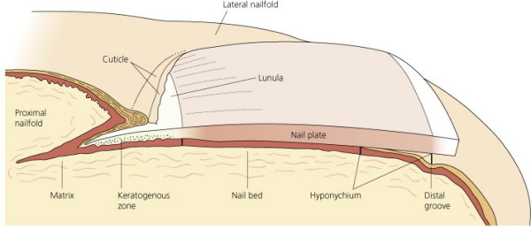
Nail Anatomy
Growth rates …

Slide 3
NAIL DISORDERS ASSOCIATED WITH SKIN DISEASE
Psoriasis
Subungual hyperkerstosis
Onycholysis
Pitting
Oil spot sign
Total dystrophy
Rx: Nail psoriasis is difficult to treat. Relapse is common. Systemic agents such as cyclosporine, methotrexate, acitretin, or biologics may help. Also intralesional triamcinolone acetonide, calcipotriol and tazarotene.
PUSTULAR PSORIASIS OF THE NAIL APPARATUS
Pustular psoriasis of the nail bed, matrix, or surrounding skin is common and may be painful, has a chronic course and poor response to treatment.
Severe cases are treated with systemic retinoids; dovobet and topical calcipotriol are also effective.

Slide 4
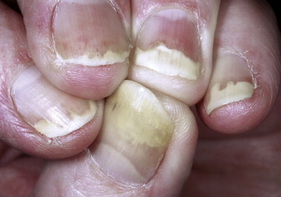

Slide 5
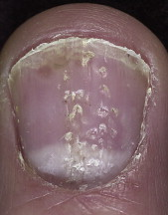
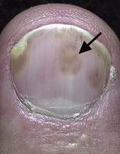

Slide 6
LICHEN PLANUS
Approximately 25% of patients with nail lichen planus (LP) have LP in other sites before or after the onset of nail lesions.
Longitudinal grooving and ridging are the most common findings of LP of the nail.
A pterygium, caused by adhesion of a depressed proximal nail fold to the scarred matrix, may occur after intense matrix inflammation. The nail plate distal to this focus is either absent or thinned out.
In most cases, nail LP is self-limiting or promptly regresses with treatment.
Matrix lesions may respond to intralesional triamcinolone acetonide. Severe cases respond to prednisolone .

Slide 7
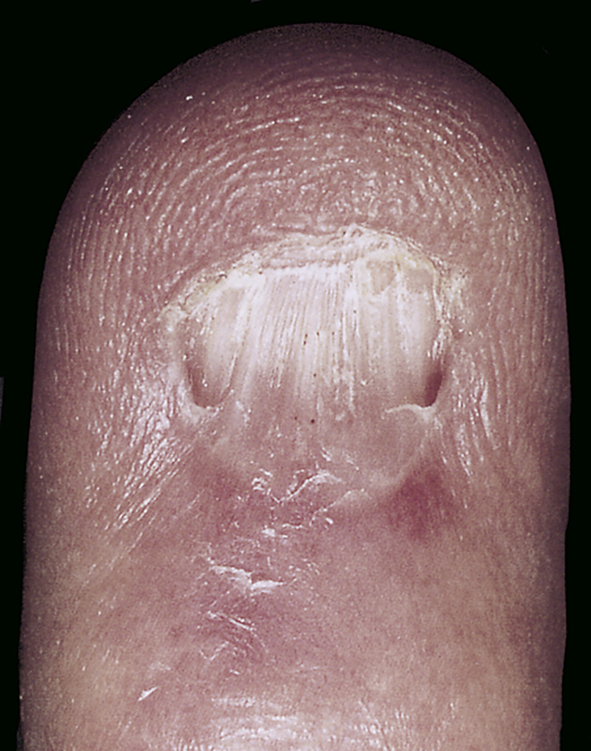

Slide 8
ACQUIRED NAIL DISORDERS
Bacterial and viral infections
ACUTE PARONYCHIA
The rapid onset of painful, bright red swelling of the proximal and lateral nailfold may occur spontaneously or may follow trauma or manipulation.
Infections present with an accumulation of purulent material behind the cuticle .
Rx …
CHRONIC PARONYCHIA {discussed previously}

Slide 9
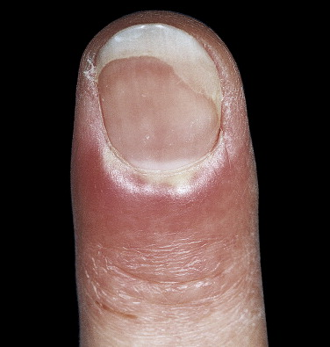

Slide 10
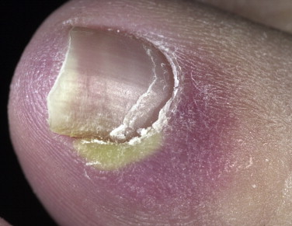
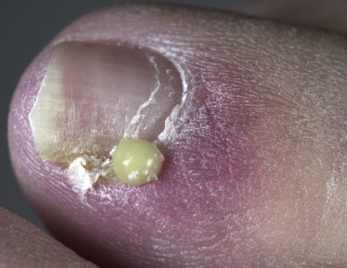

Slide 11
PSEUDOMONAS INFECTION
Repeated exposure to soap and water causes maceration of the hyponychium and softening of the nail plate. Separation of the nail plate (onycholysis) exposes a damp, macerated space between the nail plate and the nail bed, which is a fertile site for the growth of Pseudomonas.
The nail plate assumes a green-black color. There is little discomfort or inflammation.
DDx and Rx …

Slide 12
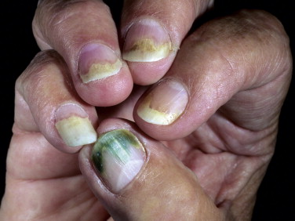

Slide 13
HERPETIC WHITLOW
In the past, dentists and nurses were at risk of acquiring herpes simplex virus (HSV) infection of the fingertip. The risk has greatly diminished with the use of gloves.
Young adults are typically affected by HSV-2. HSV-1 infection of the hand occurs in children as a result of autoinoculation following herpetic gingivostomatitis.
There is extreme pain from the swollen fingertips.
Lymphangitis and lymphadenitis, secondary to HSV infection of the hand, are possible complications, particularly with HSV-2 infection.
Herpetic finger infections in AIDS patients may rapidly progress to the complete destruction of nail structures.

Slide 14
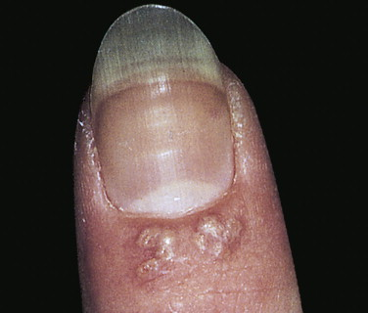

Slide 15
DRUG-INDUCED PARONYCHIA
The protease inhibitors lamivudine and indinavir can cause paronychia and ingrown toenails in about 4% of patients.
Fungal nail infections {Discussed previously}

Slide 16
Trauma
ONYCHOLYSIS
Onycholysis, the painless separation of the nail from the nail bed, is common.
Begins at the distal groove and progresses irregularly and proximally, causing part or most of the plate to become separated.
The nonadherent portion of the nail is opaque with a white, yellow or green tinge.
Causes of onycholysis include psoriasis, trauma, Candida or Pseudomonas infections, internal drugs, PUVA photochemotherapy, contact with chemicals, maceration from prolonged immersion, allergic contact dermatitis, and hyperthyroidism.
Onycholysis is most frequently seen in women with long fingernails. Forcing a stylus between the nail plate and bed while manicuring can cause separation.
Rx: Remove separated nail, promote dryness, avoid manipulation and irritants, miconazole and fluconazole.

Slide 17
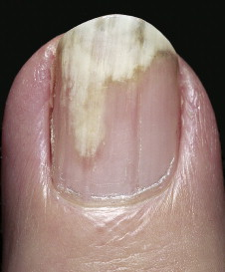
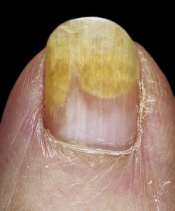

Slide 18
NAIL AND CUTICLE BITING
Nail biting is a nervous habit that usually begins in childhood and lasts for years. One or all nails may be chewed as far as the lunula.
Thin strips of skin on the lateral and proximal nailfold may also be stripped.
Patients are aware of their habit but seem powerless to control it.
Prevention: Mild aversion such as painting the nail plate with a distasteful preparation resulted in significant improvements in nail length.

Slide 19
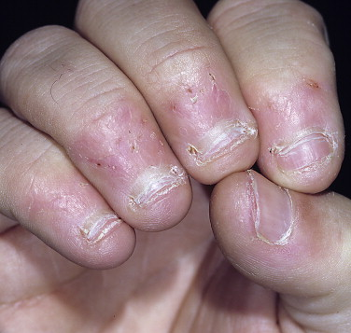

Slide 20
HANGNAIL
Triangular strips of skin may separate from the lateral nailfolds, particularly during the winter months.
Attempts at removal may cause pain and extension of the tear into the dermis.
Rx: Separated skin should be cut before extension occurs. Constant lubrication of the fingertips with skin creams and avoidance of repeated hand immersion in water are beneficial.

Slide 21
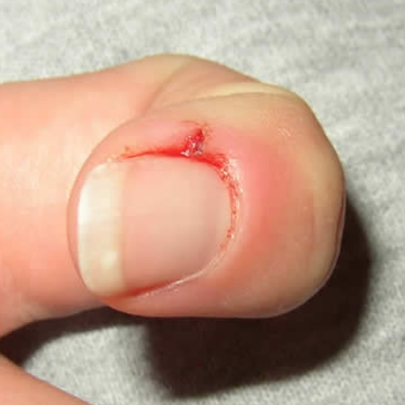
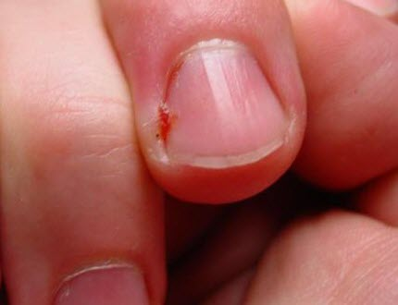

Slide 22
INGROWN TOENAIL
Ingrown fingernails and toenails are common.
The big toe is the most frequently affected.
The nail pierces the lateral nailfold and enters the dermis, where it acts as a foreign body.
The first signs are pain and swelling.
The area of penetration becomes purulent and edematous as exuberant granulation tissue grows alongside the penetrating nail.
Ingrown nails are caused by lateral pressure of poorly fitting shoes, improper or excessive trimming of the lateral nail plate, or trauma.
Prevention and treatment………

Slide 23
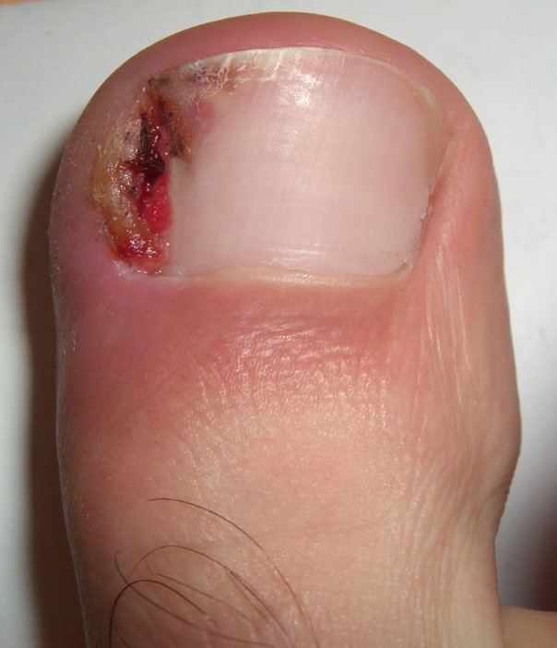

Slide 24
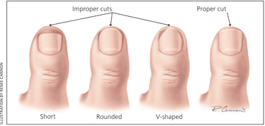

Slide 25
SUBUNGUAL HEMATOMA
Subungual hematoma may be caused by trauma to the nail plate, which causes immediate bleeding and pain.
The quantity of blood may be sufficient to cause separation and loss of the nail plate.
Rx: The traditional method of puncturing the nail with a red-hot paperclip tip remains the quickest and most effective method of draining the blood.
Trauma to the proximal nailfold causes hemorrhage that may not be apparent for days and then grows with the nail.
Young children with subungual hematoma may be victims of child abuse.

Slide 26
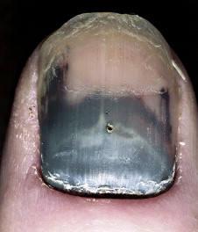

Slide 27
DISTAL PLATE SPLITTING (BRITTLE NAILS)
The splitting into layers or peeling of the distal nail plate may resemble or be analogous to the scaling of dry skin.
This nail change is found in approximately 20% of the adult population.
Repeated water immersion and the frequent use of nail polish removers increase the incidence of brittle nails, particularly in women.
Rx: Protection and moisturization

Slide 28
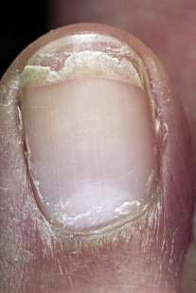

Slide 29
THE NAIL AND INTERNAL DISEASE
BEAU’S LINES
Beau’s lines are transverse depressions of all of the nails that appear at the base of the lunula weeks after a stressful event has temporarily interrupted nail formation.
The lines progress distally with normal nail growth and eventually disappear at the free edge.
They develop in response to many diseases, such as uncontrolled diabetes mellitus, myocarditis, peripheral vascular disease, and zinc deficiency, and to illnesses accompanied by high fevers, such as scarlet fever, measles, mumps, and pneumonia, and to chemotherapeutic agents. They may also occur in chronic paronychia.

Slide 30
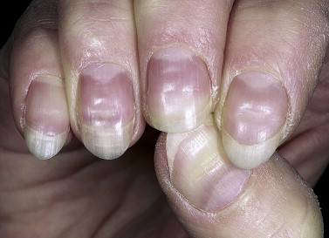

Slide 31
YELLOW NAIL SYNDROME
Yellow nail syndrome is a rare acquired condition defined by the presence of yellow nails.
It is associated with lymphedema and/or chronic respiratory manifestations (pleural effusions, bronchiectasis, chronic sinusitis, and recurrent pneumonias).
Patients note that nail growth slows and appears to stop.
The nail plate may become excessively curved, and it turns dark yellow. The surface remains smooth or acquires transverse ridges. Onycholysis may occur. The cuticles and lunulae are lost, and usually all the nails are involved.
Oral vitamin E in dosages of up to 800 IU/day for up to 18 months may help.
The condition improves in about half of patients, often without specific therapy.

Slide 32
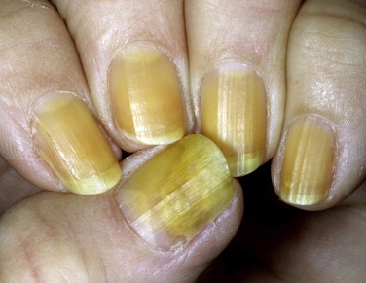

Slide 33
SPOON NAILS
Lateral elevation and central depression of the nail plate cause the nail to be spoon shaped; this is called koilonychia.
Are seen in normal children and may persist a lifetime without any associated abnormalities.
It occurs with iron deficiency anemia and in 50% of patients with idiopathic hemochromatosis.

Slide 34
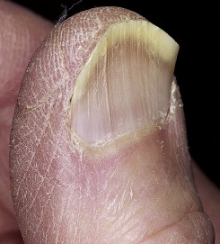

Slide 35
FINGER CLUBBING
Finger clubbing is a distinct feature associated with a number of diseases, but it may occur as a normal variant.
It is painless unless associated with pulmonary hypertrophic osteoarthropathy where there is periarticular pain and swelling in wrists, ankles, knees, and elbows .
The distal phalanges are enlarged to a rounded, bulbous shape. The nail enlarges and becomes curved, hard, and thickened. This process occurs in stages and usually takes years.
Lovibond’s angle?
Vascular endothelial growth factor may play a central role. It is a platelet-derived factor induced by hypoxia and is produced by diverse malignancies.
Etiology: All patients with cyanotic congenital heart disease have clubbing. Clubbing is associated with a variety of lung diseases, cardiovascular disease, cirrhosis, colitis, and thyroid disease. One third of patients with lung cancer have evidence of clubbing. The changes are permanent.

Slide 36
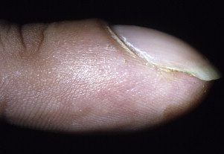

Slide 37
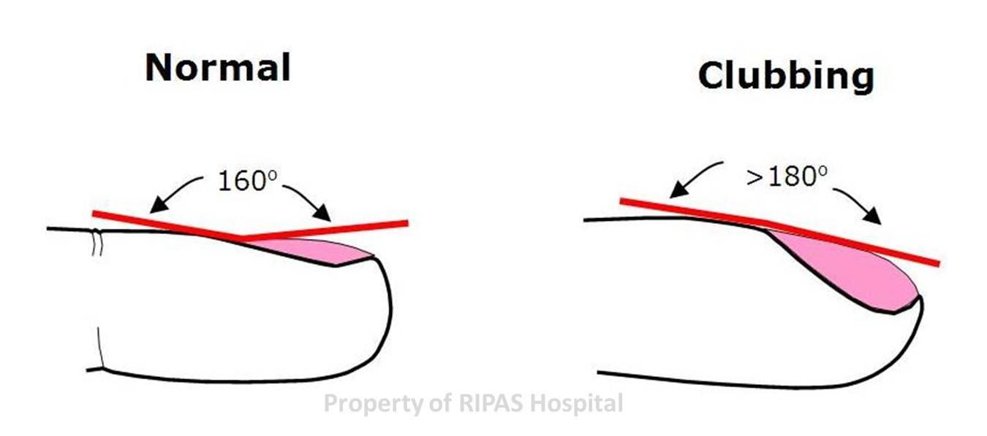

Slide 38
Tumors
WARTS
Is the most common periungual growth.
Warts are most common in children who bite their nails.
Warts on the lateral nailfold and on the fingertip may extend deeply under the nail.
A longitudinal nail groove may result from warts situated over the nail matrix.
Warts are epidermal growths, but, if massive, they can erode the underlying bony matrix by displacement.
Rx: Blunt dissection, imiquimod cream.

Slide 39
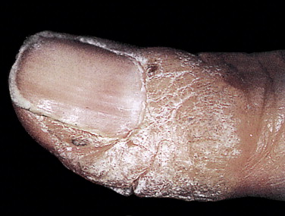
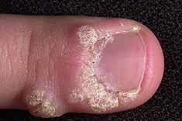

Slide 40
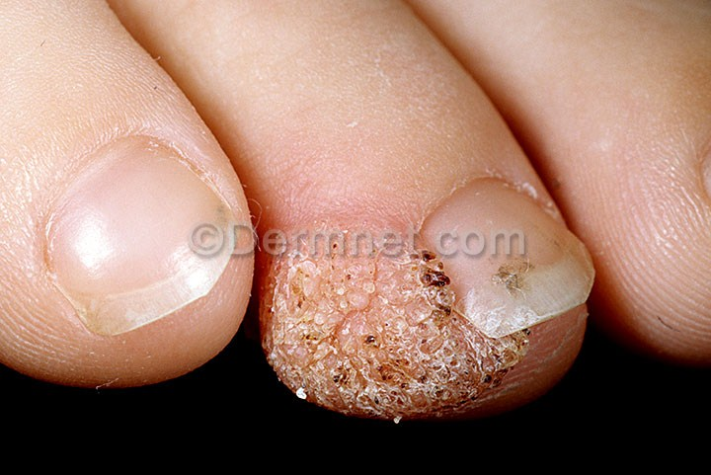

Slide 41
PYOGENIC GRANULOMA
Also called “lobular capillary hemangioma“
May form at the lateral nailfold caused by an ingrown nail.
A ‎pedunculated nodule with a smooth, glistening surface. The surface frequently becomes ‎crusted, eroded, or ulcerated. Minor trauma may produce considerable bleeding.‎ Otherwise it is painless.
This benign mass of vascular tissue is removed with thorough electrodesiccation and curettage.
Recurrences are common if any residual tissue is left.

Slide 42
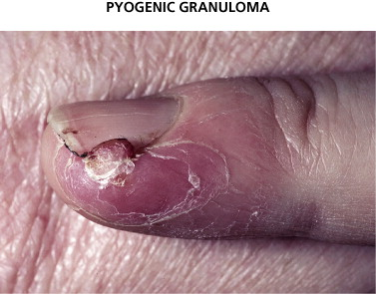

Slide 43
