Slide 1
Occlusal trauma
It is the pathological alterations which developed in periodontium as a result undue force produced by the masticatory muscles

Slide 2
The periodontium attempts to accommodate the forces exerted on the crown. This adaptive capacity varies in different persons and in the same person at different times.

Slide 3
When manitude of occlusal forces is increased The periodontium responds with:
1. widening of the periodontal ligament space.
2. An increase in the number and width of periodontal ligament fibers.
3. Increase in the density of alveolar bone

Slide 4
When occlusal forces exceeds the adaptive and reparative capacity of the periodontal tissues, tissue injury results (trauma from occlusion) .

Slide 5
CLINICAL FEATURES OF TFO
1) Mobility (progressive)
2) Pain on chewing or percussion
4) Occlusal prematurities/discrepancies
5) Tooth migration
6) Chipped or fractured tooth (teeth)
7) Thermal sensitivity

Slide 7
RADIOGRAPHIC FINDINGS OF TFO
• Increased width of periodontal ligament
space.
Thickening of lamina dura.
• Vertical or angular bone loss.
• Radiolucency in furcation areas.
• bone loss.

Slide 9
Types of occlusal trauma
Primary Trauma from occlusion
Secondary Trauma from occlusion

Slide 14
In this case even comparatively small forces may produce traumatic lesions or adaptive changes in the periodontium.

Slide 15
Effect of Trauma from occlusion on periodontium:
On healthy periodontium:
forces when applied to teeth with a healthy periodontium, can not result in pocket formation or in loss of connective tissue attachment. It does, however, result in resorption of alveolar bone leading to an increased tooth mobility

Slide 16
On diseased periodontium
Trauma from occlusion may enhance the rate of progression of the disease, and act as a co-factor in the destructive process. So proper treatment of plaque associated with periodontal disease will arrest the destruction of the periodontal tissues even if the occlusal trauma persists.

Slide 17
Treatment directed towards the trauma alone as occlusal adjustment or splinting, may reduce the mobility of the traumatized teeth and result in some regrowth of bone, but it will not arrest the rate of further breakdown of the supporting apparatus caused by plaque.

Slide 18
TREATMENT
A goal of periodontal therapy in the treatment of occlusal traumatism should be to maintain the periodontium in comfort and function.

Slide 19
In order to achieve this goal a number of treatment considerations must be considered including one or more of the following :
1. Occlusal adjustment.
2. Management of parafunctional habits.
3. Orthodontic tooth movement .
4. Occlusal reconstruction .
5. Extraction of selected teeth.

Slide 20
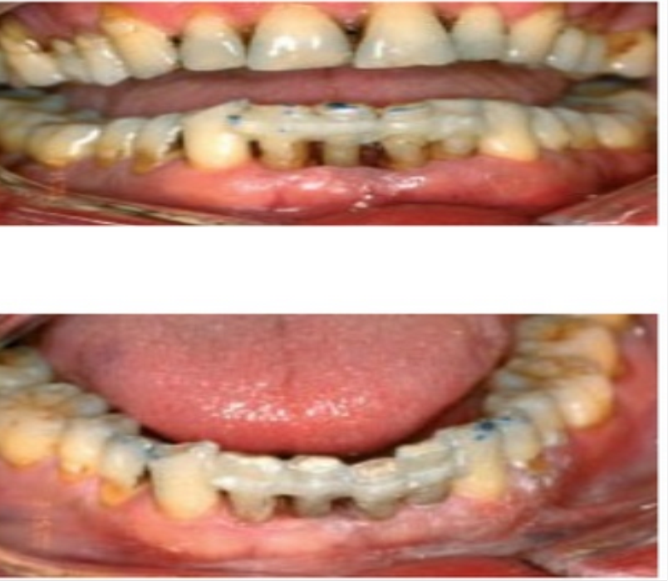
6)Temporary, provisional or long-term stabilization of mobile teeth with removable or fixed appliances.
7)bite plane,night guard,now called [inter-occlusal appliance] a-prevent teeth from fully interdigitating. b-help in preventing or minimizing isomeric contraction of muscles

