Slide 1

Furcation involvement

Slide 2
Furcation involvement
The term furcation involvement refers to the involvement of bifurcation or trifurcation of the multirooted teeth by the periodontal diseases.

Slide 3

Terminology
root complex is the portion of tooth that is located apical to (CEJ).

Slide 4
Terminology

Slide 6

Furcation involvement
Hamp et al. classify the furcation involvement as follow:
Degree I: not exceed one third of the width of the tooth
Degree II: exceed one third of width of the tooth
Degree III: through and through

Slide 7
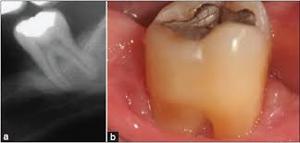
Diagnosis of the furcation involvement
Clinical examination
Careful Probing

Slide 8
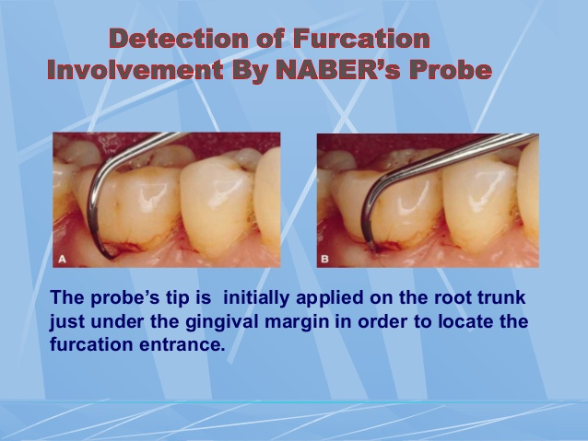

Slide 9
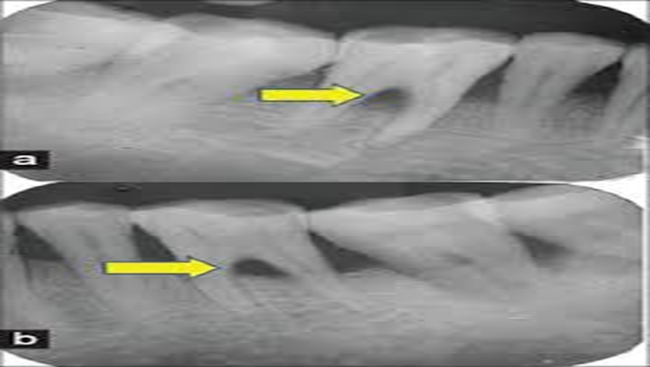
Radiograph
Periapical
Bite-wings

Slide 10
Radiographs must always be obtained to confirm findings made during probing of a furcation-involved tooth.
the location of the interdental bone as well as the bone level within the root complex should be examined
it possible for furcation involvement to be present without detectable radiographic changes.

Slide 11
the localized but extensive attachment loss which may be detected within the root complex of a maxillary molar with the use of a probe will not always appear in the radiograph. This may be due to the superimposition in the radiograph of the palatal root of remaining bone
structure.

Slide 12
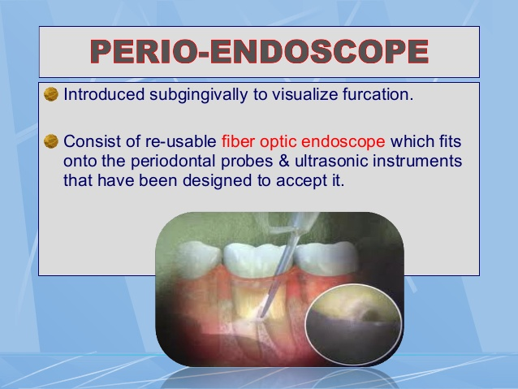

Slide 13
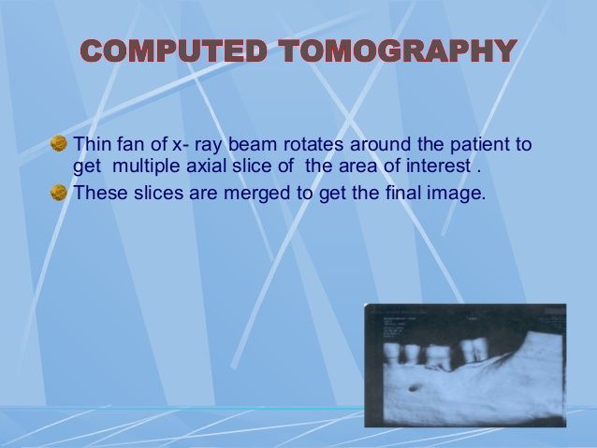

Slide 15
Therapy of furcation involvement
The treatment is intended to meet two objectives:
The elimination of microbial plaque from the exposed surfaces of the root complex.
The establishment of an anatomy of the affected surfaces so that it facilitates proper self performed plaque control.

Slide 16
Therapy of furcation involvement
Examination
Tooth vitality
((( if non vital endodontic treatment precede the periodontal treatment )))
Tooth mobility
((( occlosal adjustment should precede the periodontal treatment )))

Slide 17
Rational therapy of furcation involvement
Degree1 :- scaling and root planning , furcation plasty.
Degree2:-furcation plasty
Tunnel preparation
Root resection
Tooth extraction
GTR
Degree3:-tunnel preparation
Root resection
Tooth extraction

Slide 18
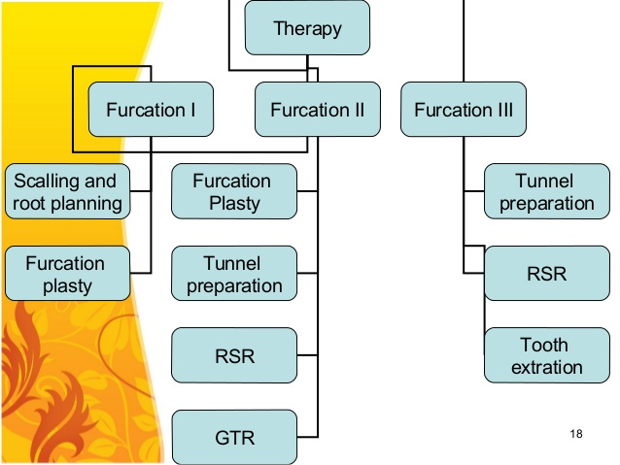

Slide 22
Furcation plasty
Include the following procedures:-
Reflection of mucoperiosteal flap to get better access to the interradicular area.
Removal of soft and hard bacterial deposits and inflammatory soft tissue from furcation area.
Odontoplasty i.e removal of tooth substance in the furcation area in order to widen an arrow entrance of the furcas.
Osteoplasty :i.e recontouring of bony defect in the furcation area.
Repositioning and suturing of the flap

Slide 24
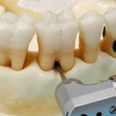

Slide 25
Tunnel preparation
used in degree II ,III(long and divergent roots)
following tissue resection, enough space has been established to be used during self plaque control
The flap apically positioned
The exposed root should be treated by topical chlorhexidine.

Slide 26
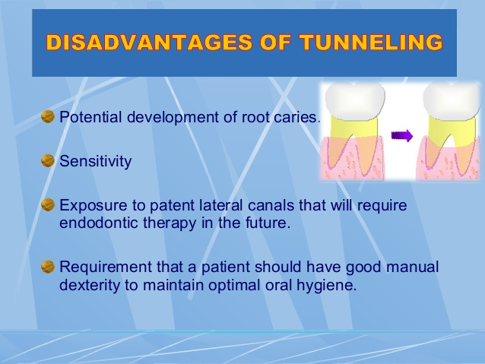

Slide 27
Root separation and resection
Root seperation sectioning of root complex and maintenance of all roots
Root resection sectioning and remove
of one or two roots in multirooted tooth
RSR used in grade II,III

Slide 28
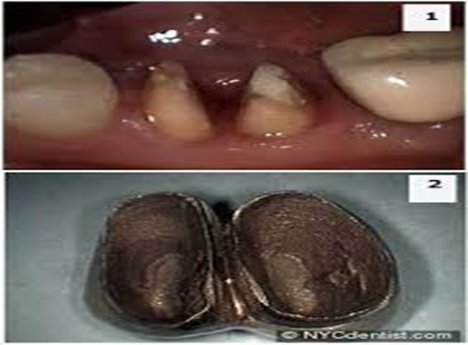
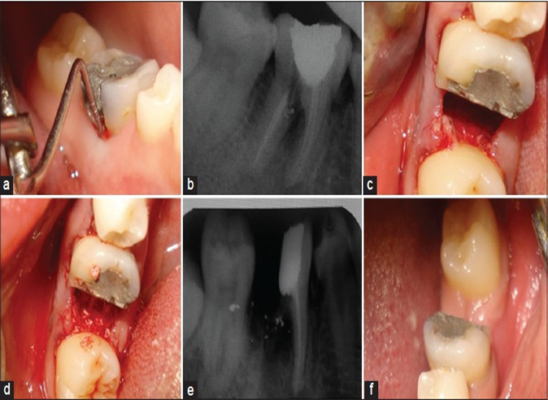
Indications

Slide 30
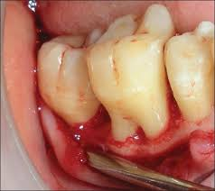
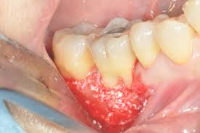
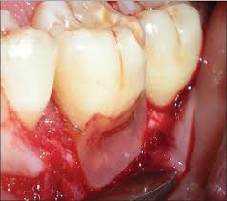
Regeneration of furcation defect

Slide 32
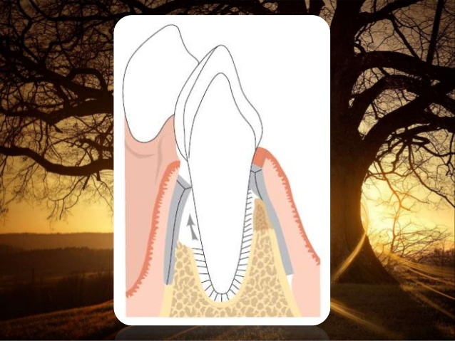

Slide 35
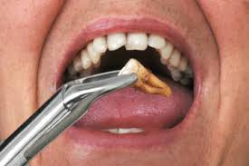
Extraction
When the attachment loss is so extensive.
When the treatment will not result in a tooth/gingival anatomy which allow self plaque-control measures.
When the maintenance or affected tooth will not improve the treatment plan.
When preservation of the affected tooth will represent a risk factor for long term prognosis.

