Slide 1
Like other complex of dentistry, an operator may encounter unwanted or unforeseen circumstances during root canal therapy that can affect the prognosis.
These mishaps are collectively termed procedural accidents or procedural error.

Slide 2
When an accident occurs during root canal treatment, the patient should be informed about,
(1) The incident.
(2) Procedures necessary for correction.
(3)Alternative treatment modalities.
(4) The effect of this accident on prognosis.
Ethical point.

Slide 3
Classification of Procedural Accidents
Accidents During Access Preparation
Accidents During Obturation
Accident During Post Space Preparation
Accidents During Cleaning and Shaping

Slide 4
Classification of
Procedural Accidents
Accidents During Access Preparation
Accidents During Cleaning and Shaping
Ledge formation
Cervical canal perforations
Mi-droot perforations
Apical perforations
Separated instruments and foreign objects
Canal blockage
Perforations During Access Preparation
Causes
Prevention
Recognition and Treatment
Prognosis
Underfilling
Overfilling
Vertical Root Fracture
Accidents During Obturation
Accidents During Post Space Preparation

Slide 5
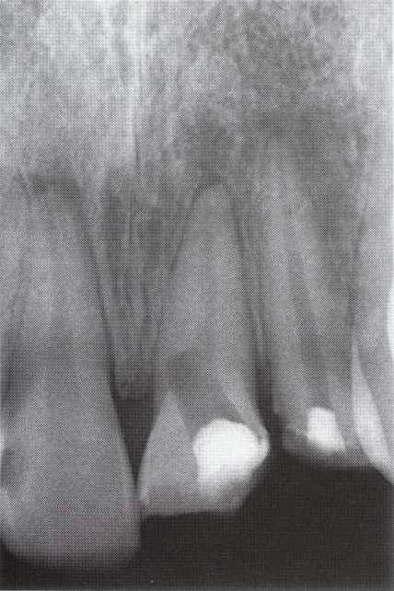
Accidents During Access Preparation

Slide 6
Perforations During Access
Preparation
The prime objective of an access cavity is to provide an unobstructed or straight-line pathway to the apical foramen.
Accidents such as excess removal of tooth structure or perforation may occur during attempts to locate canals.
Perforations must be recognized early to avoid subsequent damage to the periodontal tissues with intracanal instruments and irrigants.

Slide 7
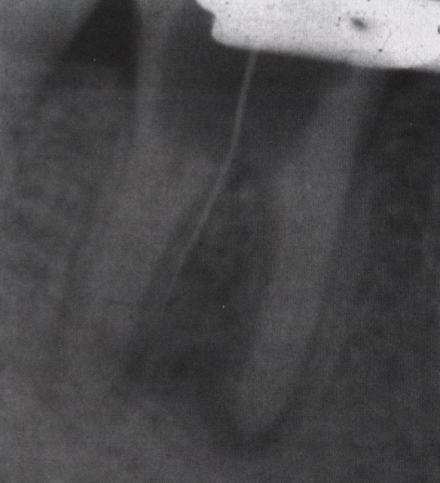
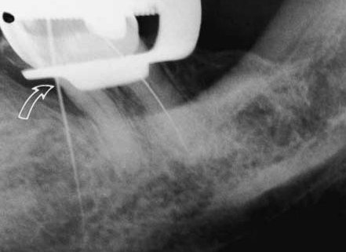
Perforations
There are two types of perforation during access:
1. Lateral root perforation 2. Furcation perforation

Slide 8
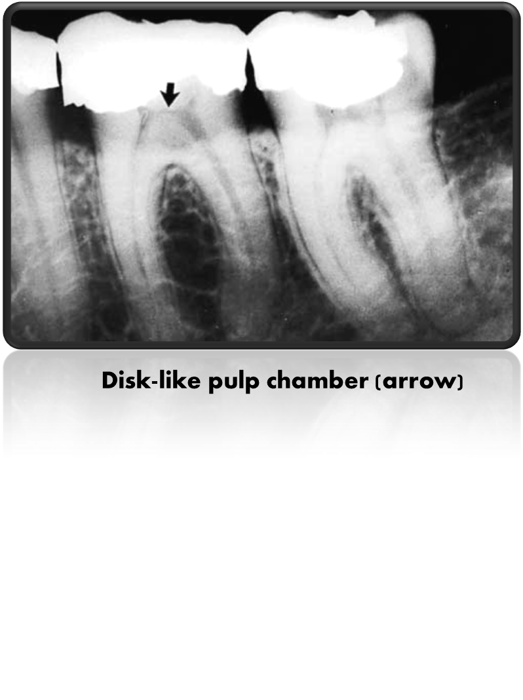
Causes
Failure to direct the bur parallel to the long axis of the tooth.
Searching for canals through an underprepared access cavity.
Access through a small or flattened (disk-like) pulp chamber in a multirooted tooth.
Access through a cast crown often is not aligned in the long axis of the tooth.
Shifted or rotated tooth.

Slide 9
Prevention
Clinical examination
Thorough knowledge of tooth morphology and outlines of the access cavities .
Identification of tooth angulation according to the adjacent teeth.
Proper reading of the preoperative (diagnostic) radiograph to get information about the size and extent of the pulp chamber and internal changes (calcification or resorption).
Radiograph from different angles (shifting technique).

Slide 10
Bur held alongside radiograph to estimate the depth
of penetration

Slide 11
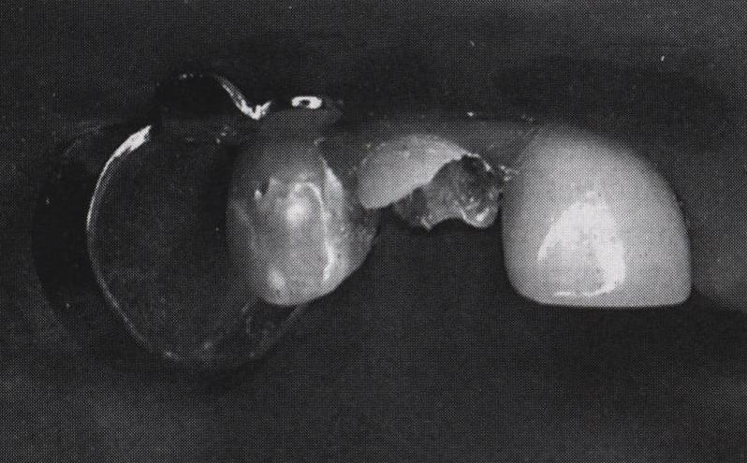
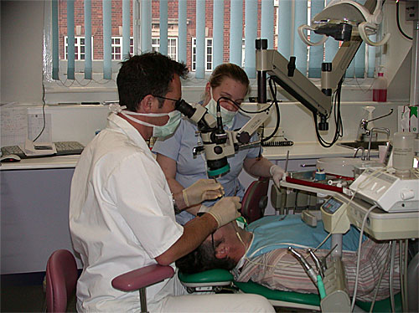
Operative procedures
Access using “split technique” is preferred in specific cases.
2. Use of fiberoptic light and magnifiers
3. Removal of restorations when possible

Slide 12
Recognition
Sudden pain
Sudden hemorrhage
Radiograph
Apex locator
Loss of apical resistance

Slide 13
Types and Treatment
1- Lateral root perforation
A- Perforation at or above the height of crestal bone
Treatment: restorative treatment
Supracrestal perforation repair

Slide 14
B- Perforation below the height of crestal bone in the coronal third of the root
The treatment goal is to position the defect above crestal bone by orthodontic extrusion or crown lengthening .
Internal repair by mineral trioxide aggregate (MTA) is also possible .

Slide 15
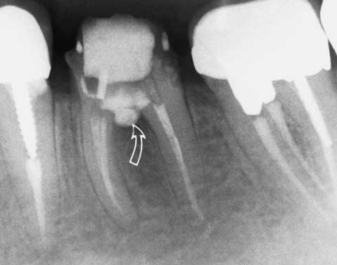
2- Furcation perforation
Treatment: immediate sealing using the suitable restorative material (MTA)
Furcation repair using mineral trioxide aggregate (MTA)

Slide 16
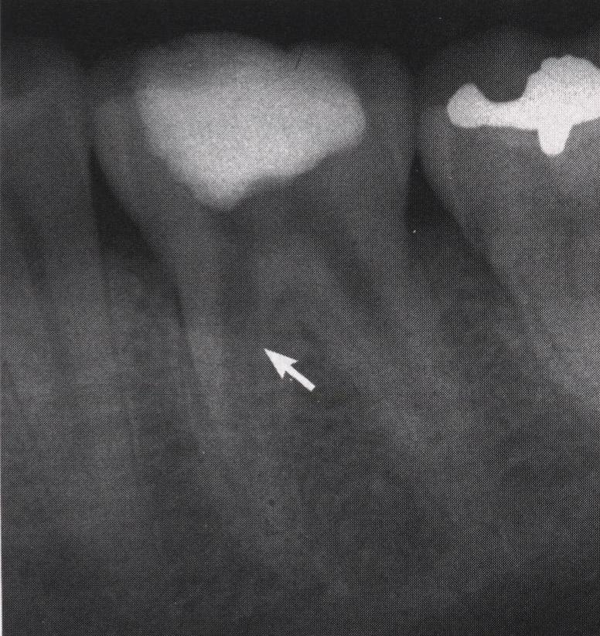
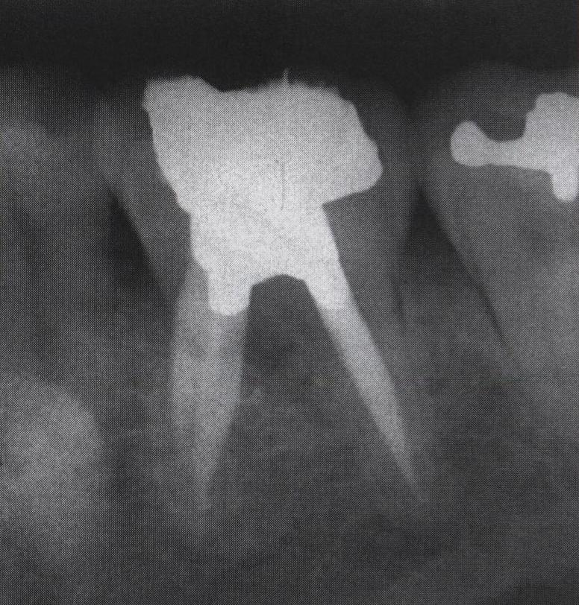
Repair of stripping perforation (arrow)

Slide 17
Nonsurgical Treatment
The site of the perforation must be found.
The floor of the preparation cleansed.
The bleeding stopped.
Mineral trioxide aggregate (MTA) applied to the perforation .
Because it takes MTA more than 3 hours to set, it should be covered with a fast-setting cement.
The other canal orifices should be protected by placing paper points or an instrument in the canals to prevent blockage.

Slide 18
In the event MTA cannot be immediately applied,
  It is best to stop the bleeding,
  Place calcium hydroxide over the “wound,”
  Place a good temporary filling,
  Set an appointment with the patient, the sooner the better.
  The perforation area will be dry at the next appointment;
  MTA can be applied
  Treatment continued.

Slide 19
PROGNOSIS
Factors affecting the long-term prognosis of teeth after perforation repair include:-
The location of the defect in relation to crestal bone.
The accessibility for repair.
The size of the defect.
The presence or absence of a periodontal communication to the defect.
The time between perforation and repair.
The sealing ability of restorative material.
The technical skill of the dentist.
The attitude and oral hygiene of the patient

Slide 20
Treatment of the Wrong Tooth
Treatment of the wrong tooth can be so easily prevented.
One should make sure through testing, examining, and radiography that one has confirmed which tooth requires treatment
Starting (not completing) the access cavity before applying the rubber dam

Slide 21
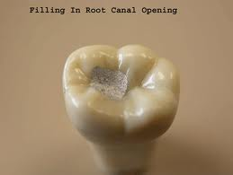
Damage to an Existing Restoration
Porcelain crowns are the most susceptible to chipping and fracture.
Also, do not place a rubber dam clamp on the gingiva of any porcelain or
porcelain-faced crown

Slide 22
Missed Canals
Additional canals in the:
Mesial roots of maxillary molars MB2,3..
The distal roots of mandibular molars.
Second canals in lower incisors,
Second canals in lower premolars,
Third canals in upper premolars are also missed.
One must be prepare adequate occlusal access.

Slide 23


Slide 24
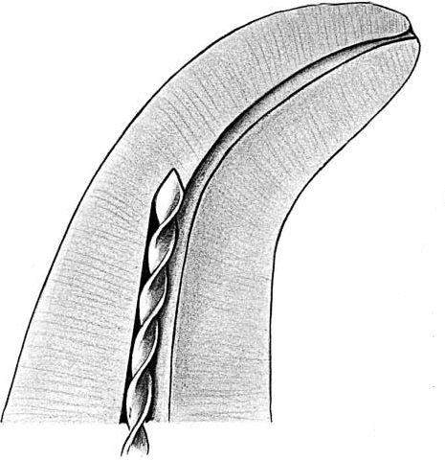
1- Ledge Formation
Accidents During Cleaning and Shapaing
Definition
ledge has been created when the working length can not longer be negotiated and the original patency of the canal is lost.

Slide 25
Causes
inadequate straight-line access into the canal.
inadequate irrigation or lubrication.
excessive enlargement of a curved canal with files.
packing debris in the apical portion of the canal.
Starting with large file size
Jumping to larger file before the smallest one become loose

Slide 26
Prevention
Straight line access.
Accurate working length measurement .
Frequent recapitulation and irrigation.
Use of lubricant like RC-PREP.
Use of flexible Ni-Ti files in curved canals .
Each file must be used until it is loose before a larger size is used .
Avoid application of severe forces during instrumentation .

Slide 27
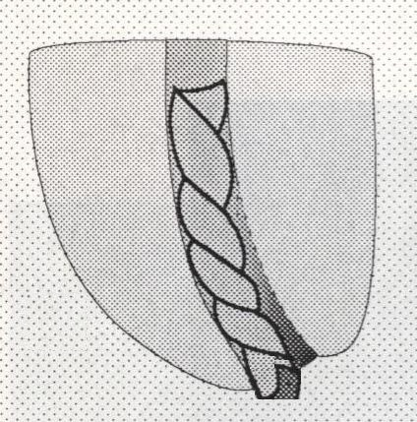
2-Root Perforations
A- Apical perforation
Types
1- Apical perforation through the apical foramen (over instrumentation)
It is caused by instrumentation of the canal beyond the apical constriction (incorrect working length)

Slide 28
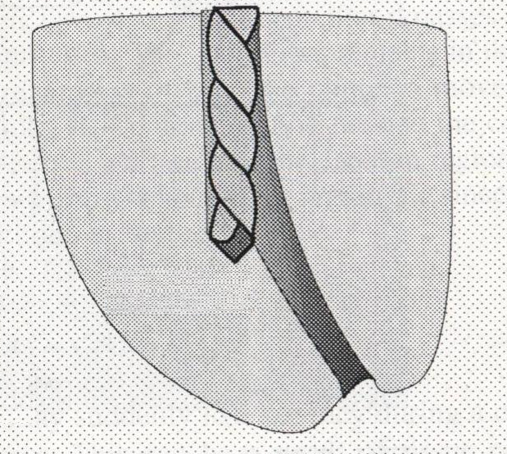
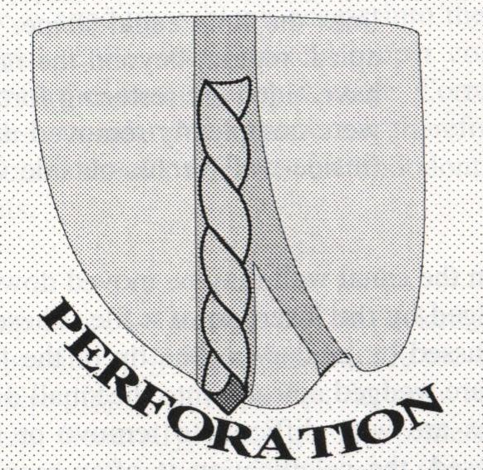
It is caused as a result of operator insistence to manage a ledge in the apical third (especially in curved canals)
2- Apical perforation through the body of the root in the apical third
Ledge apical perforation

Slide 29
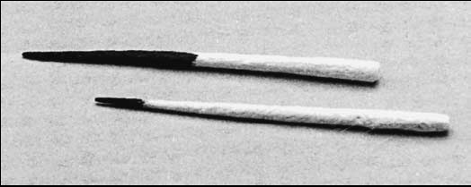
Indicators
Hemorrhage in the canal
Bleeding at the tip of paper point
Sudden pain
Sudden loss of the apical stop
Radiograph
Bleeding at the tip of paper point

Slide 30
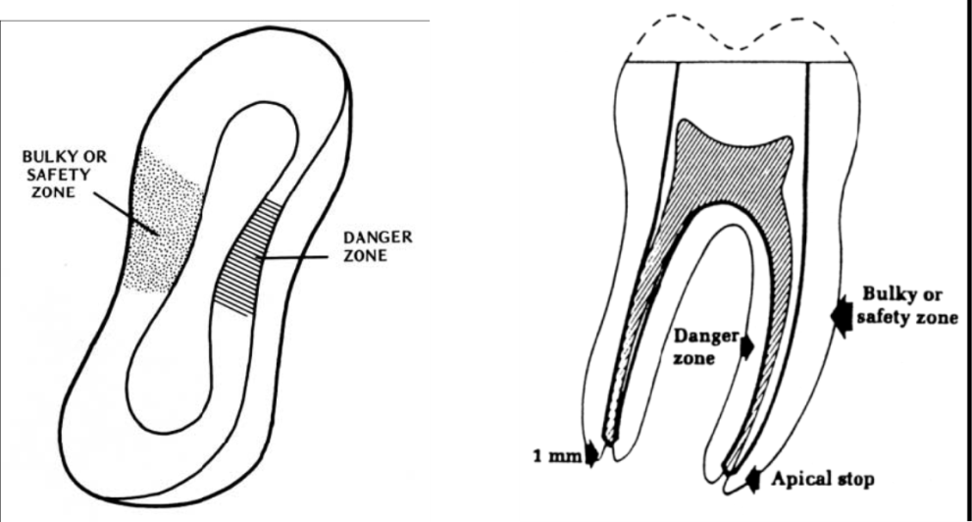
B- Stripping perforation
Usually results from excessive flaring with files or drills.
Over enlargement of canal
Direction of lateral pressure distally (Gates Glidden)
Treatment:
non-surgical treatment by immediate sealing using MTA
surgical treatment: hemi-section, and root amputation

Slide 31
Indicators
They are similar to those of apical perforation
The area of hemorrhage on the point indicates the area where the strip has occurred.

Slide 32
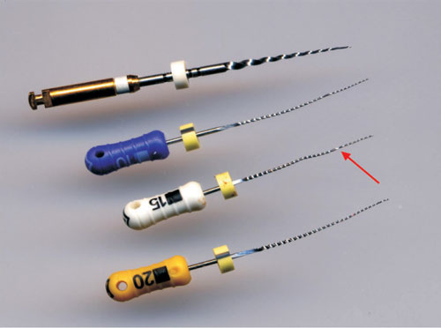
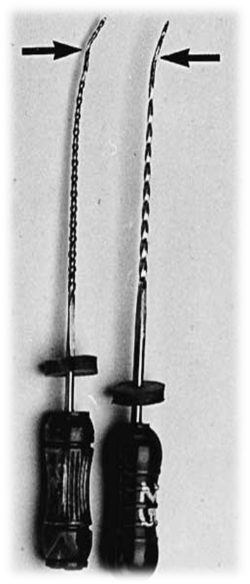
Etiology
Separated Instruments
Limited flexibility
Multiple uses
Excessive force applied to files
Improper use, rotational movement when the apical part is engaged in dentin
Uses of distorted instrument
Notice: any instrument may break either steel, NiTi, hand or rotary

Slide 33
Recognition
Removal of shortened file from the canal
Loss of original working length
Radiograph is essential for confirmation

Slide 34
Prevention
limitations of files is critical.
Continual lubrication with either irrigating solution or lubricants is required EDTA paste.
Each instrument is examined before use ( flutes distortion).
Small files must be replaced often.
To minimize binding, each file size is worked in the canal until it is very loose before the next file size is used.
Nickel-titanium files usually do not show visual signs of fatigue similar they should be discarded according to the how many times were the instruments used.

Slide 35
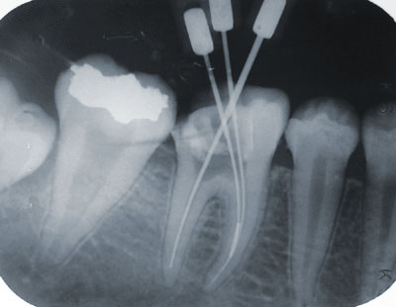
Treatment
There are three approaches:
Attempt to remove the instrument using:
Small file to bypass the instrument
Removal by ultrasonic device
Using especially designed pliers
for removal
Pliers

Slide 36
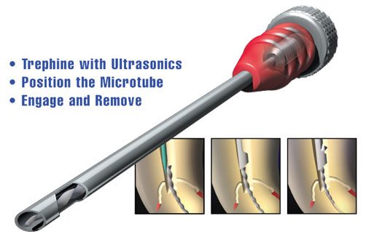
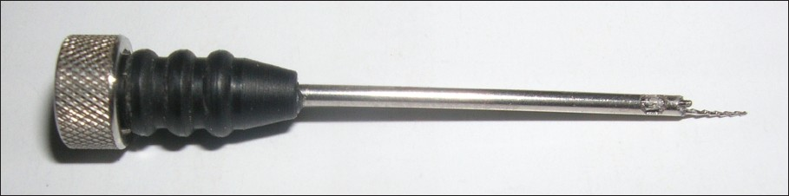

Slide 37
Instrument Aspiration or Ingestion
Prevention
Rubber dam uses
Tighten the clamp and file with dental floss

Slide 38
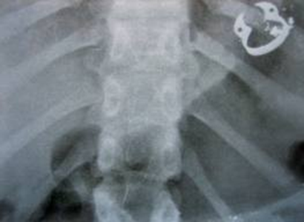

Slide 39
Extrusion of Irrigant
Causes:
Wedging of a needle in the canal or out of a perforation
Prevention
Loose placement of irrigation needles
careful irrigation with light pressure
use of a perforated needle prevent forcing the irrigating solution into the periradicular tissues
Signs and symptoms
Sudden prolonged and sharp pain during irrigation
Rapid diffuse swelling (sodium hypochlorite accident).

Slide 40
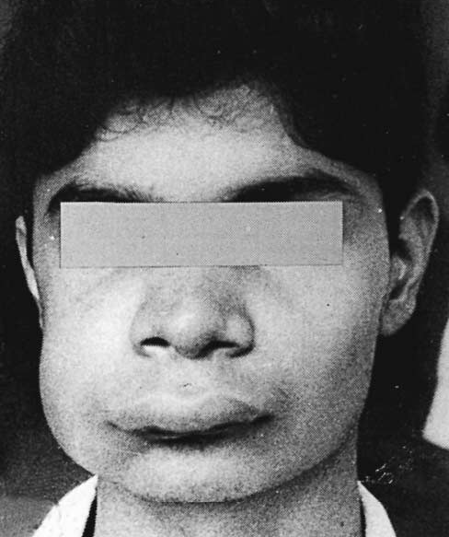
Severe swelling caused by injecting hydrogen peroxide irrigant into tissues.

Slide 41
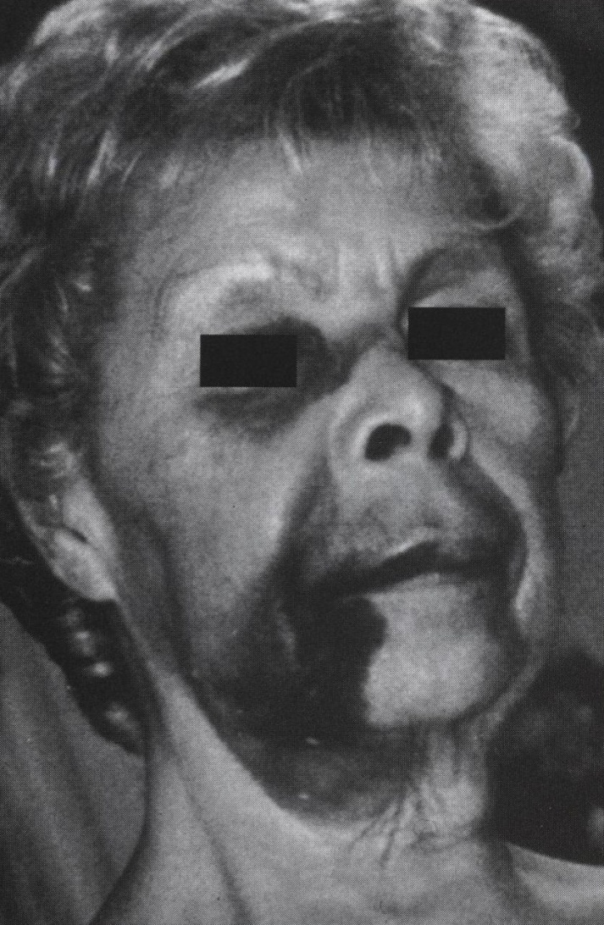
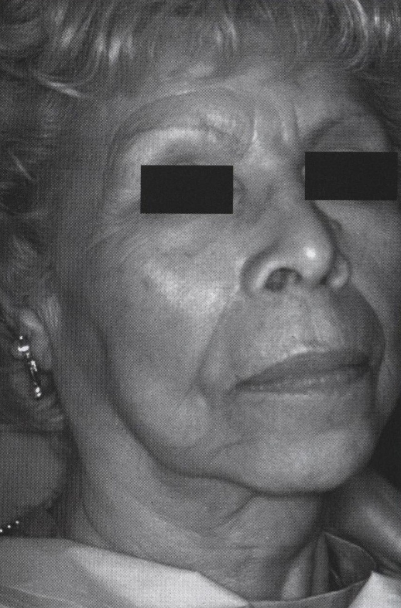
A B
A, Hemorrhagic reaction caused by NaOCl accident
B, Healing within few weeks

Slide 42
Treatment
Antibiotics in addition to analgesics for pain
Antihistamines can also be helpful
Ice packs applied initially to the area, followed by warm saline soaks the following day, should be initiated to reduce the swelling
In more severe cases, hospitalization and surgical intervention with wound debridement, may be necessary
Patient reassurance

Slide 43
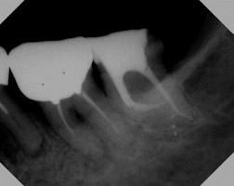
Under filling
Accident during obturation
Causes
Natural barrier (calcification) in the canal.
Ledge.
Insufficient flaring.
Poorly adapted master cone.
Error in W.L determination

Slide 44
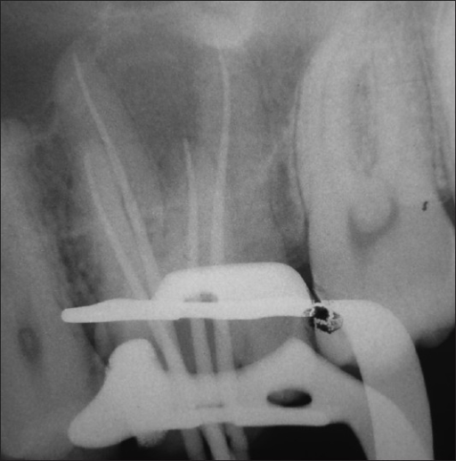
Prevention
Confirmatory of master cone by radiograph
Proper enlargement and fairing of canal
Treatment
Re-treatment

Slide 45
Overfilling
Causes
Over instrumentation
Open apex
Uncontrolled condensation forces

Slide 46
Prevention
Avoid over instrumentation.
Prepare apical matrix (seat).
Confirmatory MAC radiograph.
If displacement of the MAC is suspected, a radiograph is made before excess gutta-percha removal.
In case of wide (open) apex, a solvent customized cone technique is preferred .

