Slide 2
ENURESIS ( Bed-wetting )
Enuresis is defined as the repeated voiding of urine into clothes or bed at least twice a week for at least 3 consecutive months in a child who is at least 5 yr of age (the age when volitional control of micturition is expected).
Enuresis is classified as:
Diurnal (daytime).
Nocturnal (nighttime).
Another useful classification of enuresis is:
Primary (incontinence in a child who has never achieved dryness)
Secondary (incontinence in a child who has been dry for at least 6 months).

Slide 3
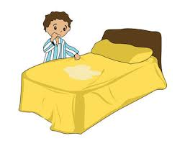
Epidemiology
Approximately 60% of children with nocturnal enuresis are boys.
Nocturnal enuresis has a reported prevalence of:
15% in 5 year olds.
7% in 8 year olds.
1% in 15-year-olds.

Slide 4
Etiology
Multifactorial: Genetic + physiologic + psychologic factors.
PRIMARY ENURESIS:
Often is associated with a family history of delayed acquisition of bladder control.
A genetic etiology has been hypothesized, and familial groups with AD inheritance have been identified.

Slide 5
SECONDARY ENURESIS:
Psychosocial stress.
UTI
Faecal retention severe enough to reduce bladder volume and cause bladder neck dysfunction.
Polyuria from osmotic diuresis, e.g. DM, or renal concentrating disorders, e.g. CRF

Slide 6
Laboratory Test
Urinalysis: pus, protien & cast, glucose & specific gravity. To look for evidence of chronic UTI, renal disease, and diabetes mellitus.
Further testing, such as urine culture, is based on the urinalysis.
Children with complicated enuresis, may need evaluation with a renal sonogram and a voiding cystourethrogram.

Slide 7
Treatment
Non Pharmacologic Therapy:
The best approach to treatment is to reassure the child and parents that the condition is self-limited and to avoid punitive measures that can affect the child’s psychologic development adversely.
Fluid intake should be restricted to 2 oz after 6 or 7 pm.
The parents should be certain that the child voids at bedtime.
Avoiding extraneous sugar and caffeine after 4 pm also is beneficial.
If the child snores and the adenoids are enlarged, referral to an otolaryngologist should be considered, because adenoidectomy can cure the enuresis.

Slide 8
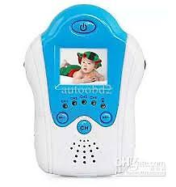
Star chart for dry nights, child earns praise and a star each morning if his bed is dry. The child should not be blamed for wet bed. Waking children a few hours after they go to sleep to have them void often allows them to awaken dry.
Enuresis alarm: effective in most cases.

Slide 11
Pharmacologic Therapy:
Desmopressin : Short-term relief from bedwetting.
Imipramine: the drug may affect heart rhythm & therefore, If there is any history of palpitations, syncope or long QT syndrome in the child, or sudden cardiac death or unstable arrhythmia in the family, the drug should not given.
Anticholinergic therapy as oxybutynin.

